Slide 1
STUDY ON CHEMICAL ACTIVITY OF PIERRE SHALES AND ITS EFFECT ON NEAR WELLBORE PORE PRESSURE DISTRIBUTION
Sabarisha Subramaniyan
July 2014

Slide 2
Objectives
Shale - Chemical nature
Contribution to wellbore instability
Impact on mechanical response
Sensitivity to other properties

Slide 3
Outline
Introduction
Matlab coding structure
Case Study – Results
Code Verification
Conclusions
Limitations

Slide 4
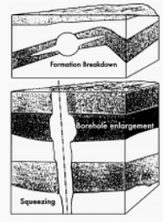
Introduction
Wellbore Instability Problems are
Borehole enlargement
Hole shrinkage
Hole fracture
Hole collapse
Principle of wellbore stability = Equilibrium between rock strength and in-situ stresses
Petrowiki.spe.org

Slide 5
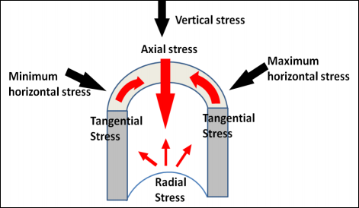
Causes for Wellbore instability
Rock removal
Stress redistribution
Stress state > or < in-situ
stresses = failure
Contributors
Mechanical, chemical, thermal, angular instability
(McLean, 1990)

Slide 6
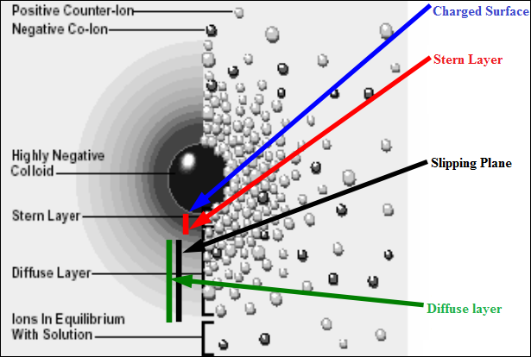
Clay Colloidal Chemistry (Negative charges)
Isomorphic substitution
If pH < or > Zero Point Charge (ZPC)
Clay in electrolyte =
Diffuse double layer
Stern layer – equilibrium
(zeta potential)
Concentration decline
(Colloidal chemistry department, University of Szeged)

Slide 7
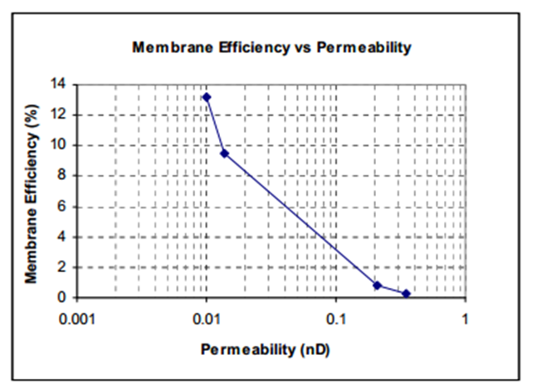
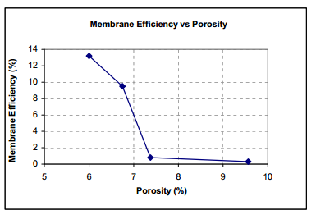

Cation Exchange Capacity (CEC)
Measure of exchangeable ions
CEC ↑ = Reactivity ↑
CEC $∝$ pH
Membrane Efficiency (ME)
Restricting ions (size & charge)
ME $∝$ CEC
ME $∝$ 1/(Φ, k)
(Colline et al., 2008)

Slide 8
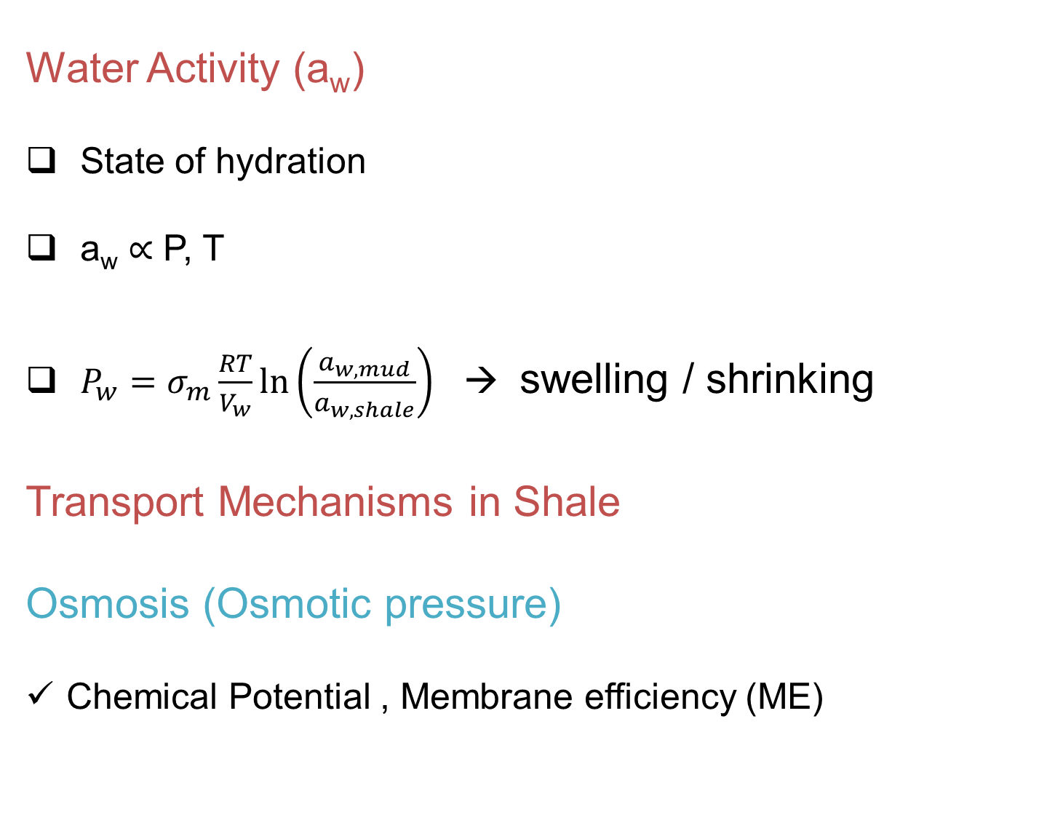
Water Activity (a_{w})
State of hydration
a_{w} $∝$ P, T
$P_{w}=σ_{m}\frac{RT}{V_{w}}\ln\left(\frac{a_{w,mud}}{a_{w,shale}}\right)$ → swelling / shrinking
Transport Mechanisms in Shale
Osmosis (Osmotic pressure)
Chemical Potential , Membrane efficiency (ME)

Slide 9
Osmosis (continued)
Salinity differences in subsurface
Total solute concentration
Longevity of the Osmotic pressure
Diffusion (Fick’s Law)
Opposes Osmosis
Concentration gradient
Effective when ME ↓ and permeability ↑ (drags H₂O)

Slide 10
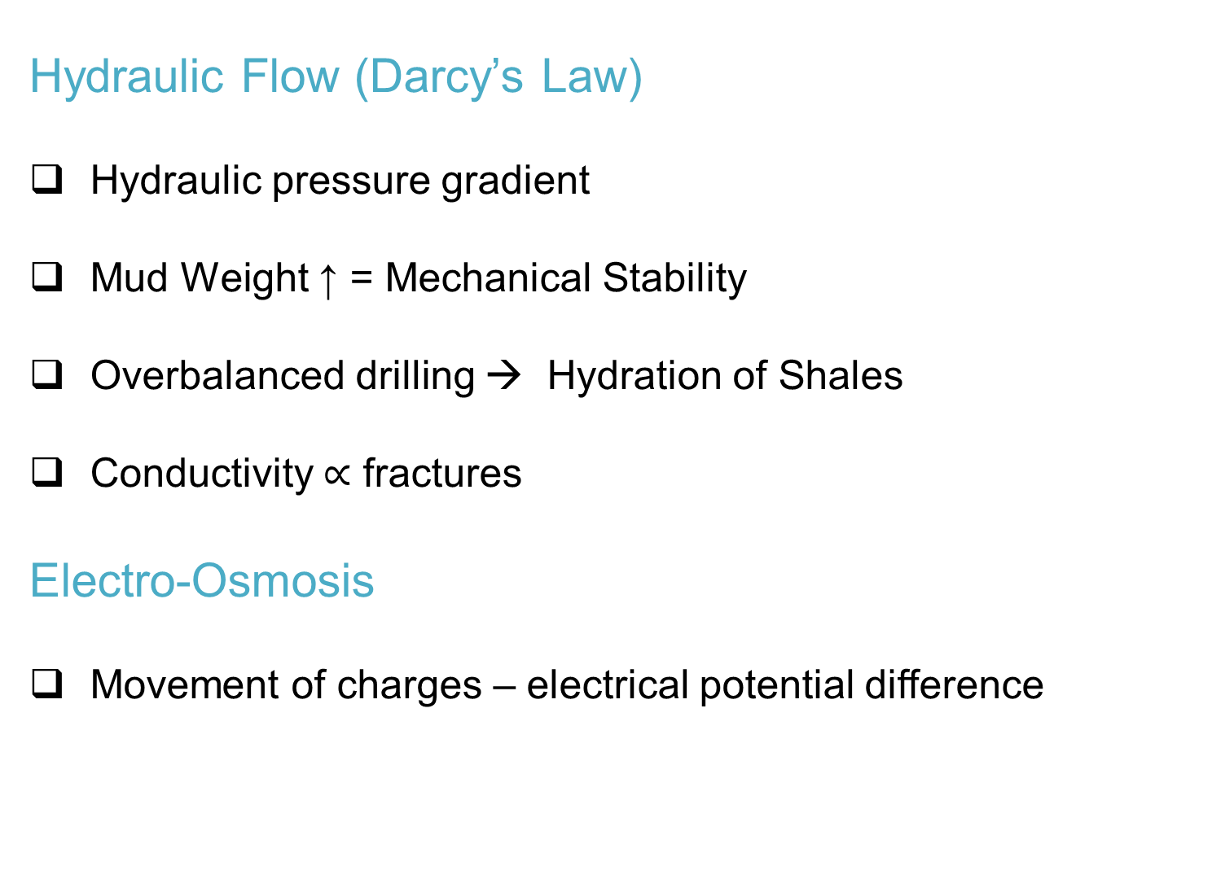
Hydraulic Flow (Darcy’s Law)
Hydraulic pressure gradient
Mud Weight ↑ = Mechanical Stability
Overbalanced drilling → Hydration of Shales
Conductivity $∝$ fractures
Electro-Osmosis
Movement of charges – electrical potential difference

Slide 11
Chronology of Formulations
Year | Process
1908 - Von Reuss | Electro osmosis
1925, 1941 – Terzaghi, Biot | Poroelastic consolidation
1965, 1969 – Young, Olsen | Semi-Permeability of Shales
1967, 1993 – Katchalsky, Yeung | Transport equations
1968 – Esrig | 1D electro kinetic consolidation
2006 - Nguyen & Abousleiman | 3D solution for electrokinetics in Biot’s model
2009, 2013 – Ghassemi, Tran et al., | Thermal model, anisotropic model

Slide 12
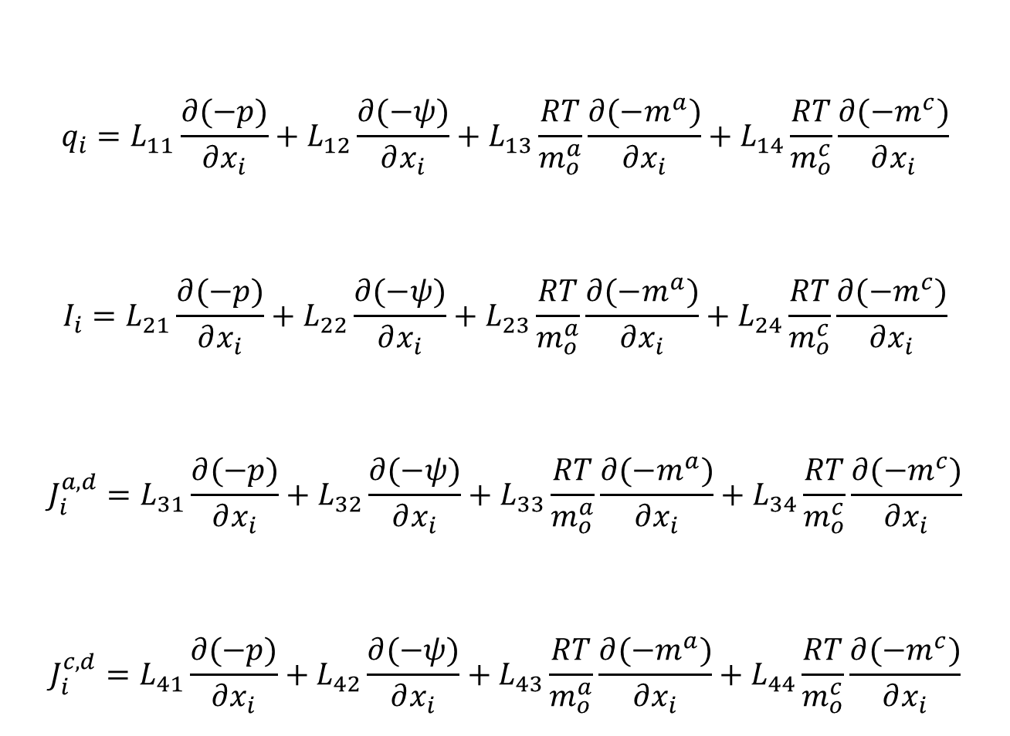
$$q_{i}=L_{11}\frac{∂(−p)}{∂x_{i}}+L_{12}\frac{∂(−ψ)}{∂x_{i}}+L_{13}\frac{RT}{m_{o}^{a}}\frac{∂(−m^{a})}{∂x_{i}}+L_{14}\frac{RT}{m_{o}^{c}}\frac{∂(−m^{c})}{∂x_{i}}$$
$$I_{i}=L_{21}\frac{∂(−p)}{∂x_{i}}+L_{22}\frac{∂(−ψ)}{∂x_{i}}+L_{23}\frac{RT}{m_{o}^{a}}\frac{∂(−m^{a})}{∂x_{i}}+L_{24}\frac{RT}{m_{o}^{c}}\frac{∂(−m^{c})}{∂x_{i}}$$
$$J_{i}^{a,d}=L_{31}\frac{∂(−p)}{∂x_{i}}+L_{32}\frac{∂(−ψ)}{∂x_{i}}+L_{33}\frac{RT}{m_{o}^{a}}\frac{∂(−m^{a})}{∂x_{i}}+L_{34}\frac{RT}{m_{o}^{c}}\frac{∂(−m^{c})}{∂x_{i}}$$
$$J_{i}^{c,d}=L_{41}\frac{∂(−p)}{∂x_{i}}+L_{42}\frac{∂(−ψ)}{∂x_{i}}+L_{43}\frac{RT}{m_{o}^{a}}\frac{∂(−m^{a})}{∂x_{i}}+L_{44}\frac{RT}{m_{o}^{c}}\frac{∂(−m^{c})}{∂x_{i}}$$
Coupled Flow Transport Equations
Yeung & Mitchell (1993)

Slide 13

Constitutive Equations
$dσ_{ij}=2Gdε_{ij}+\frac{2Gν}{1−2ν}dε_{kk}δ_{ij}+αdpδ_{ij}$
$dφ=−αdε_{kk}+\frac{1}{K_{φ}}dp$
$dζ=−αdε_{kk}+\frac{1}{M}dp$
Coussy (2004)

Slide 14

$\frac{∂ρ_{e}}{∂t}=−\frac{∂I_{i}}{∂x_{i}}=0$
Far Field Boundary Conditions
$σ_{xx}=S_{x}$ $σ_{yy}=S_{y}$ $σ_{zz}=S_{z}$
$τ_{xy}=S_{xy}$ $τ_{yz}=S_{yz}$ $τ_{xz}=S_{xz}$
$p=p_{o}$
Governing Equations
Sachs et al., 1987

Slide 15
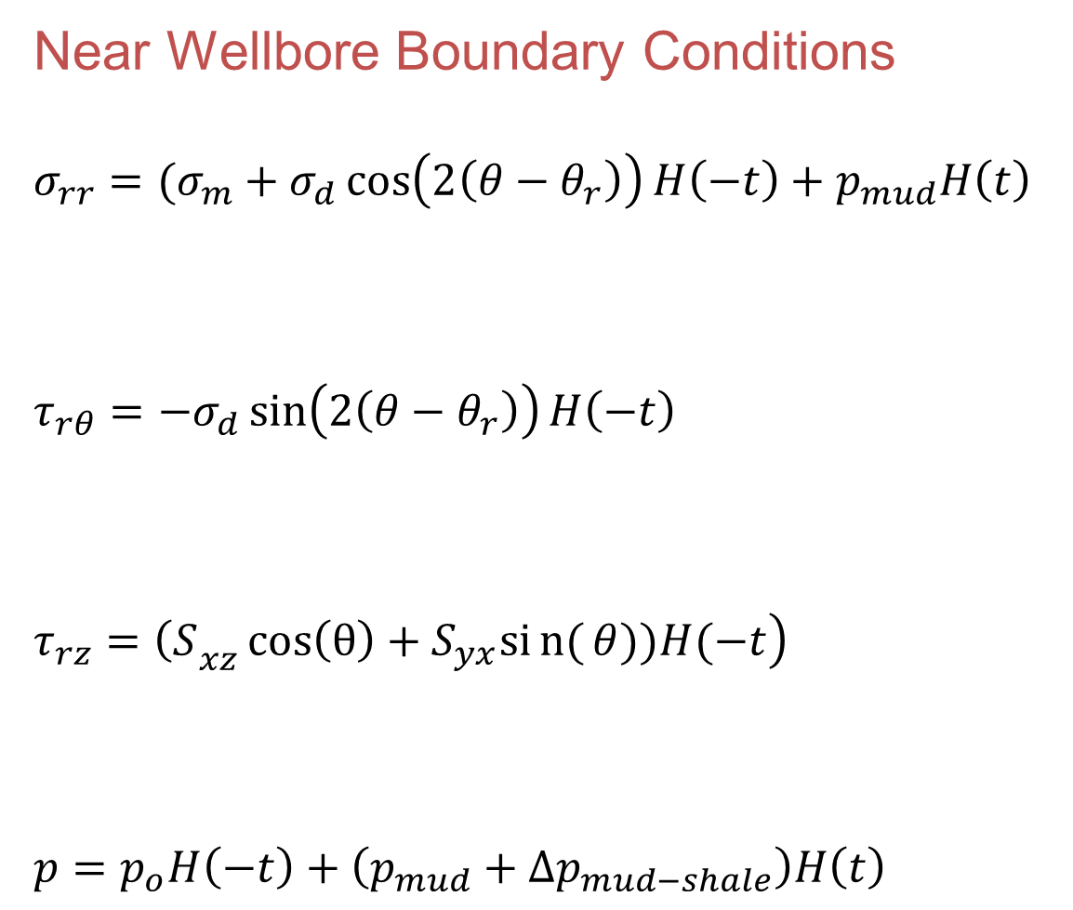
Near Wellbore Boundary Conditions
$σ_{rr}=(σ_{m}+σ_{d}\cos\left(2\left(θ−θ_{r}\right)\right)H\left(−t\right)+p_{mud}H\left(t\right)$
$τ_{rθ}=−σ_{d}\sin\left(2\left(θ−θ_{r}\right)\right)H\left(−t\right)$
$\left.τ_{rz}={\left(S\right.}_{xz}\cos\left(θ\right)+S_{yx}sin{(}θ))H(−t\right)$
$p=p_{o}H\left(−t\right)+\left(p_{mud}+{∆p}_{mud−shale}\right)H\left(t\right)$
Abousleiman et al., (2008)

Slide 16
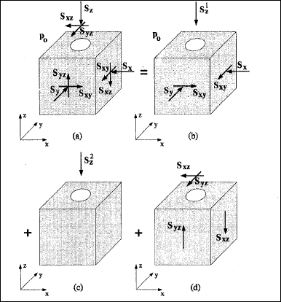
Poroelastic Plane strain problem
1. Elastic radial loading
2. Diffusional loading
3. Deviatoric loading
Elastic Uniaxial stress
Elastic anti plane shear problem
(Cui et al., 1997)

Slide 17
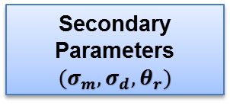
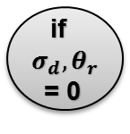
Matlab code structure
Input Parameters
(CEC, a_{w} )
Primary Parameters
(mole fractions)
Secondary Parameters
${(σ}_{m}, σ_{d}, θ_{r})$
Deviatoric stress loading is included
No
Yes
Deviatoric stress loading is ignored
if
$σ_{d}, θ_{r}$ = 0
Sum of Inverse (individual solutions) = Superposed solutions

Slide 18
Case Study
Properties of Pierre Shale considered
Parameters | Values (Salisbury et al.,1991)
Shear (G), Bulk (K) modulus | 600 , 4800 (MPa)
Porosity (φ) | 0.176
Permeability (k) | 6E-21 (m²)
CEC | 36 meq/100 grams dry clay
Pore pressure (p₀) | 21.4 (MPa)
S_{v} , S_{H} , S_{h} | 54, 44, 44 (MPa)
Membrane efficiency | 0.8 (dimensionless)
Temperature | 82° C
Depth | 2200 (meters)
m^{fc} ,mª , m^{c} | 0.0719, 0.0052, 0.0771

Slide 19
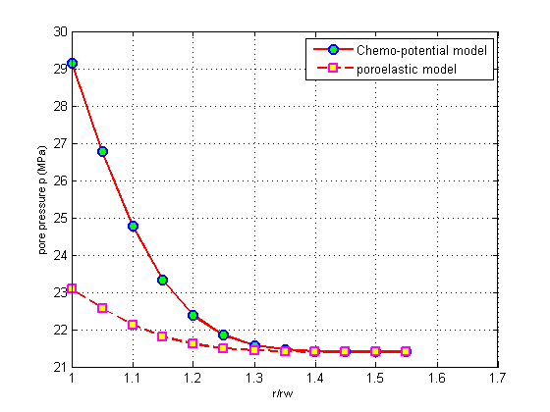
Case 1: When mud activity > pore fluid activity
Pore Pressure (in MPa) Vs Distance Ratio
Water moves from mud → shale (hydration)

Slide 20
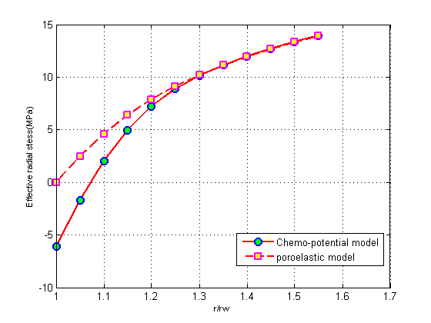
Effective Radial Stress (in MPa) Vs Distance Ratio
Tensile Stress > Compressive Stress ( Spalling Failure)

Slide 21
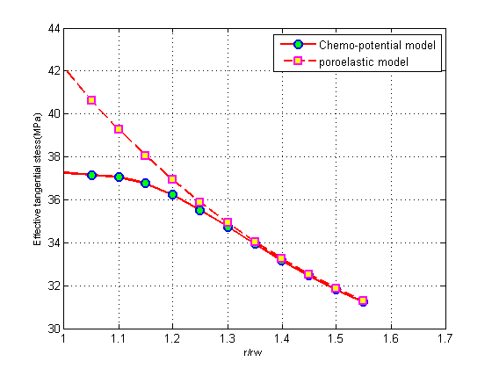
Effective Tangential Stress (in MPa) Vs Distance Ratio
Tensile Stress > Compressive Stress ( Spalling Failure)

Slide 22
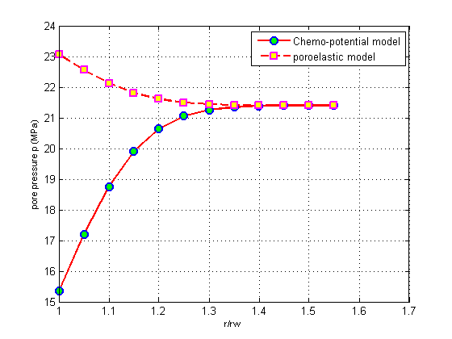
Case 2: When mud activity < pore fluid activity
Pore Pressure (in MPa) Vs Distance Ratio
Water moves from shale → mud (Stability ↑ )

Slide 23
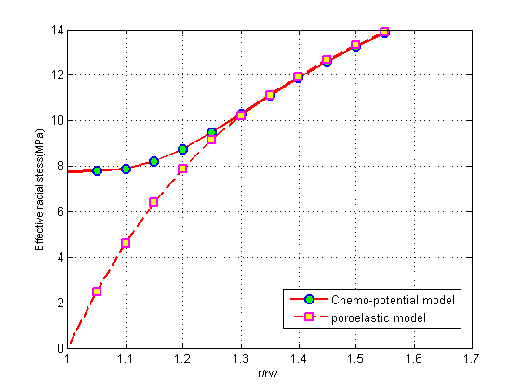
Effective Radial Stress (in MPa) Vs Distance Ratio
More Compressive than Poroelastic medium (Stability ↑ )

Slide 24
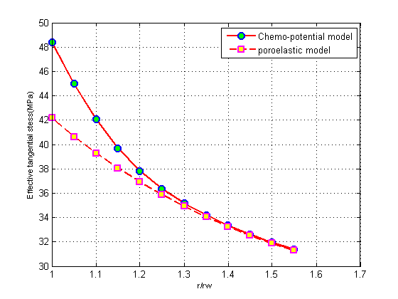
Effective Tangential Stress (in MPa) Vs Distance Ratio
More Compressive than Poroelastic medium (Stability ↑ )

Slide 25
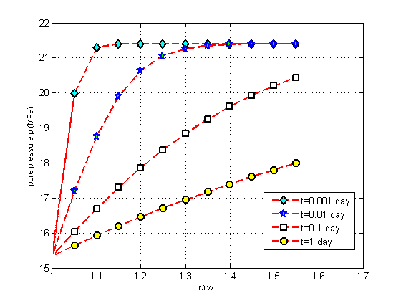
Case 3: Time Propagation of the pore pressures generated (when mud activity < Pore fluid activity)
Saturation of Shale ↓ with increase in time (stability ↑)

Slide 26
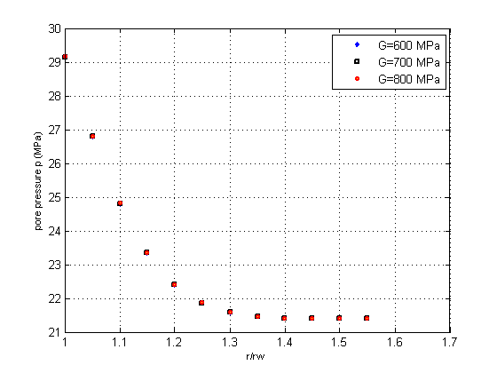
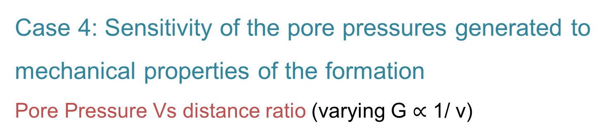
Case 4: Sensitivity of the pore pressures generated to mechanical properties of the formation
Pore Pressure Vs distance ratio (varying G $∝$ 1/ ν)

Slide 27
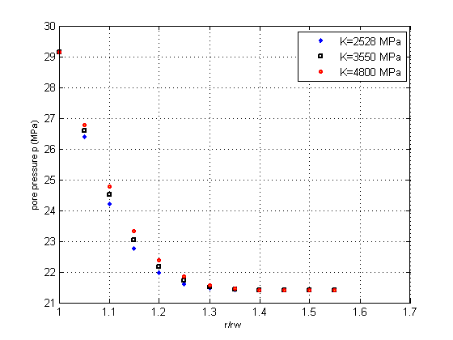
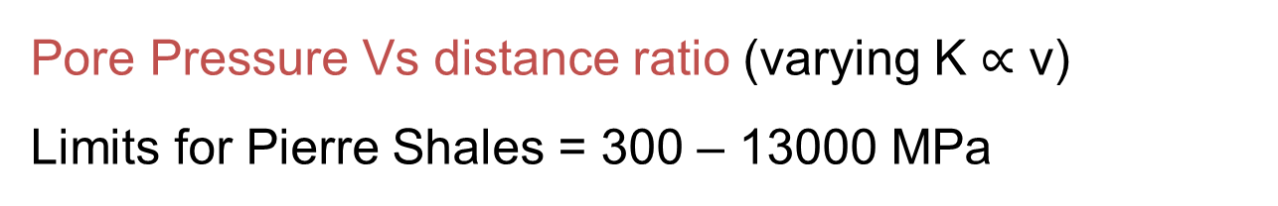
Pore Pressure Vs distance ratio (varying K $∝$ ν)
Limits for Pierre Shales = 300 – 13000 MPa

Slide 28
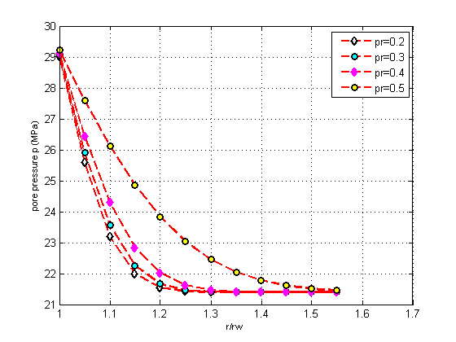
Pore Pressure Vs Distance ratio (varying Poisson’s ratio)
The phenomena is sensitive only to differential volumetric ratio

Slide 29
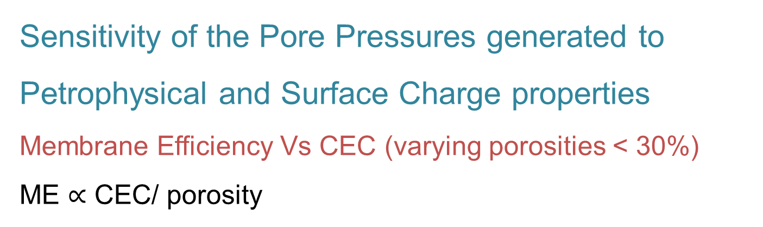
Sensitivity of the Pore Pressures generated to Petrophysical and Surface Charge properties
Membrane Efficiency Vs CEC (varying porosities < 30%)
ME $∝$ CEC/ porosity

Slide 30
Membrane Efficiency Vs CEC (varying porosities > 30%)
Changes in ME is more sensitive for higher porosities
Higher porosities affect ME even if CEC is high

Slide 31
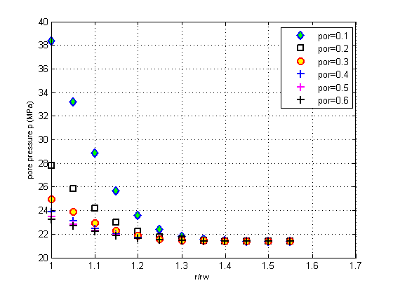
Pore pressure Vs distance ratio (varying porosities)
Osmosis is counter checked by Diffusion at higher porosities
30% porosity - threshold value for Pierre Shales

Slide 32
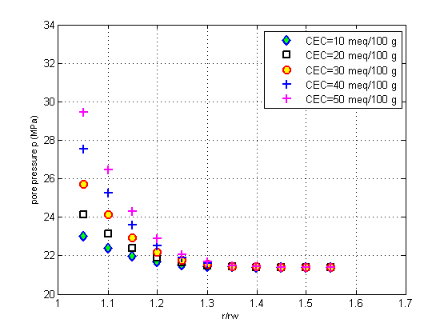
Pore pressure Vs distance ratio (varying Cation Exchange Capacity)
Osmosis is counter checked by Diffusion at lower CEC

Slide 33
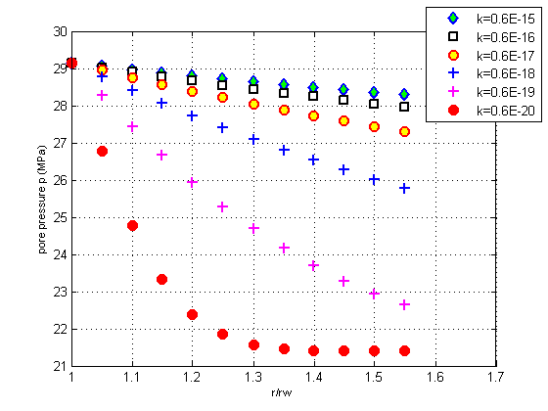
Pore pressure Vs distance ratio (varying Permeability)
Low permeable formations least affected if mud activity > shale activity as pore pressure propagation is slower

Slide 34
Code Verification
Type 1: Comparing the analytical solutions with results of Nguyen et al., (2008)
Pore pressure Vs Distance Ratio (Poroelastic & Porochemoelastic models)
The matching between the
results is excellent

Slide 35
Comparison of the effective radial stresses obtained in Matlab and by Abousleiman et al.,(2008)
Comparison of the effective tangential stresses obtained in Matlab and by Abousleiman et al.,(2008)

Slide 36
Type 2: Verifying the results of sensitivity analysis based on Jaeger’s analytical solutions for 1-D Poroelastic consolidation
Berea Sand - draining starts around t = 1000 (dimensionless)

Slide 37
Displacement at top of the column Vs Dimensionless time
Shale - draining starts around t = 10¹¹ (dimensionless)
due to low Permeability

Slide 38
Displacement Vs Dimensionless time (varying permeability)
Low permeable formations need more time to initiate draining

Slide 39
Displacement Vs Dimensionless time (varying Porosities)
Pore fluid drainage is rapid in less compacted formations
Drainage initiation is quicker in consolidated shales - P_{c}

Slide 40
Displacement Vs Dimensionless time (varying Bulk Modulus)
Draining = function (volumetric changes)
Shales with higher bulk modulus drains less

Slide 41
Displacement Vs Dimensionless time (varying Shear Modulus)
Shales with higher shear modulus drains more
Poisson’s ratio – Deciding factor

Slide 42
Conclusions
Mud activity < pore fluid activity (favorable condition)
Diffusion > osmosis (salt concentration ↑ )
Sensitivity to CEC, porosity and membrane efficiency
Compressibility of the medium is important (ν >> K, G)
Effect of permeability

Slide 43
Limitations
Valid only for isotropic
Thermal effects neglected
Elasticity of shales

Slide 44
Acknowledgement:
Dr. Ahmad Jamili – Advisor
Dr. Deepak Devegowda
Dr. Ben Shiau

Slide 45
THANKS
QUESTIONS?

Slide 46
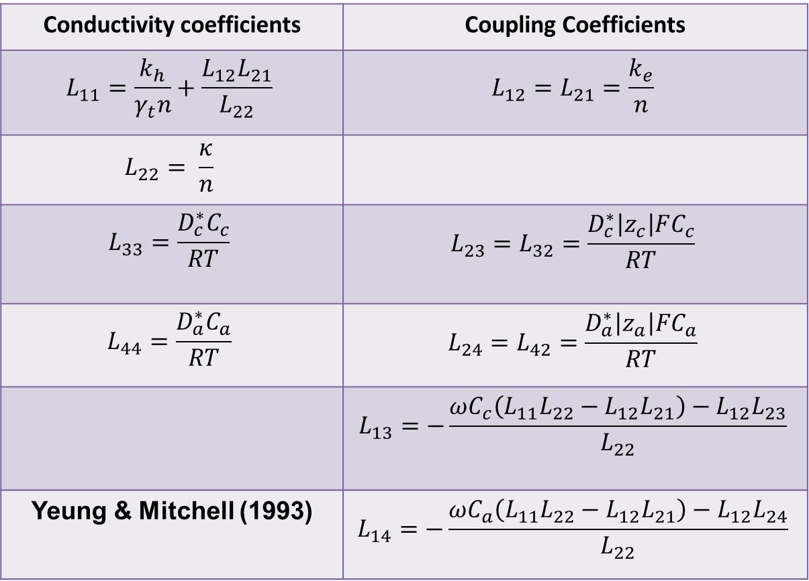

Supporting Slides
Conductivity coefficients | Coupling Coefficients
$$L_{11}=\frac{k_{h}}{γ_{t}n}+\frac{L_{12}L_{21}}{L_{22}}$$ | $$L_{12}=L_{21}=\frac{k_{e}}{n}$$
$$L_{22}= \frac{κ}{n}$$
$$L_{33}=\frac{D_{c}^{∗}C_{c}}{RT}$$ | $$L_{23}=L_{32}=\frac{D_{c}^{∗}\left|z_{c}\right|FC_{c}}{RT}$$
$$L_{44}=\frac{D_{a}^{∗}C_{a}}{RT}$$ | $$L_{24}=L_{42}=\frac{D_{a}^{∗}\left|z_{a}\right|FC_{a}}{RT}$$
 | $$L_{13}=−\frac{ωC_{c}\left(L_{11}L_{22}−L_{12}L_{21}\right)−L_{12}L_{23}}{L_{22}}$$
Yeung & Mitchell (1993) | $$L_{14}=−\frac{ωC_{a}\left(L_{11}L_{22}−L_{12}L_{21}\right)−L_{12}L_{24}}{L_{22}}$$
$$L_{34}=L_{43}=0$$

Slide 47
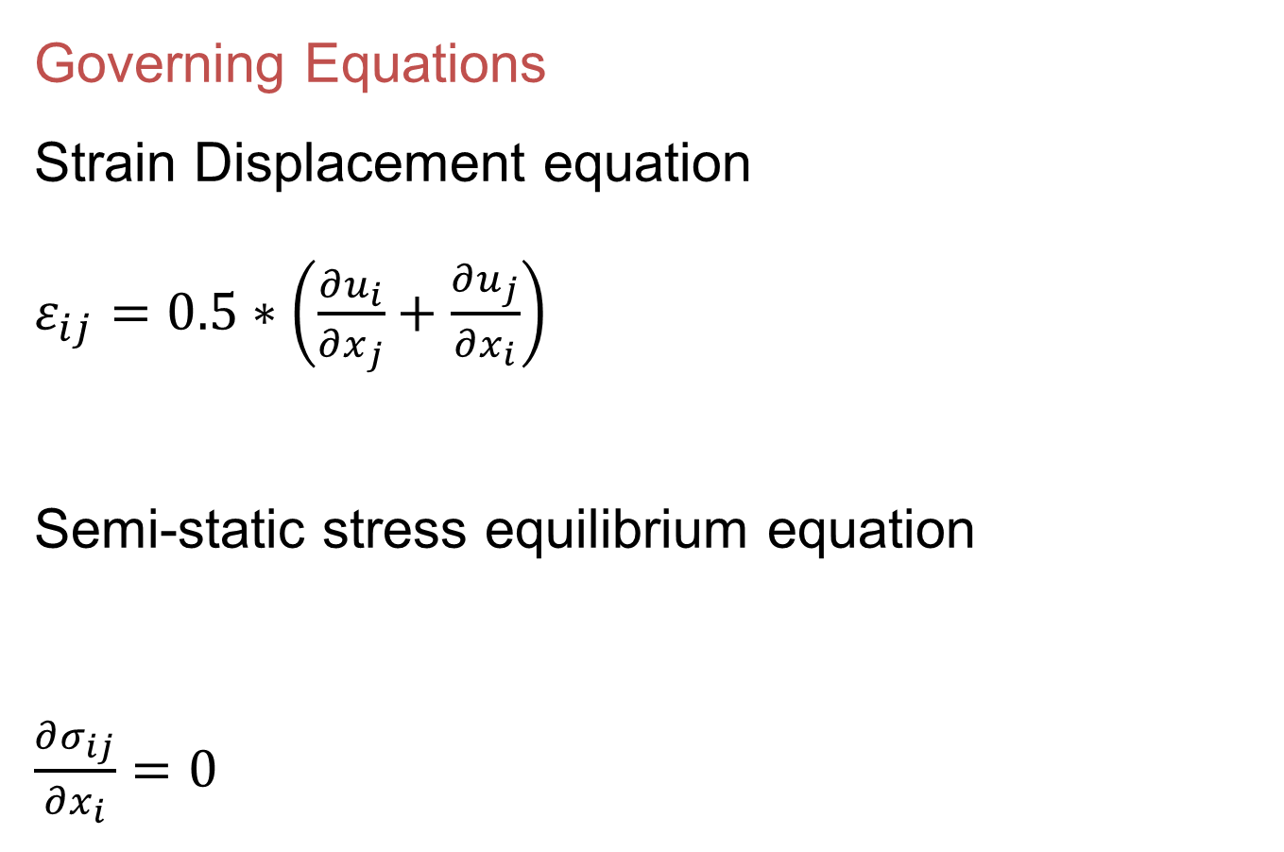
Governing Equations
Strain Displacement equation
$ε_{ij}=0.5∗\left(\frac{∂u_{i}}{∂x_{j}}+\frac{∂u_{j}}{∂x_{i}}\right)$
Semi-static stress equilibrium equation
$\frac{∂σ_{ij}}{∂x_{i}}=0$
Katchalsky & Curran (1967)

Slide 48
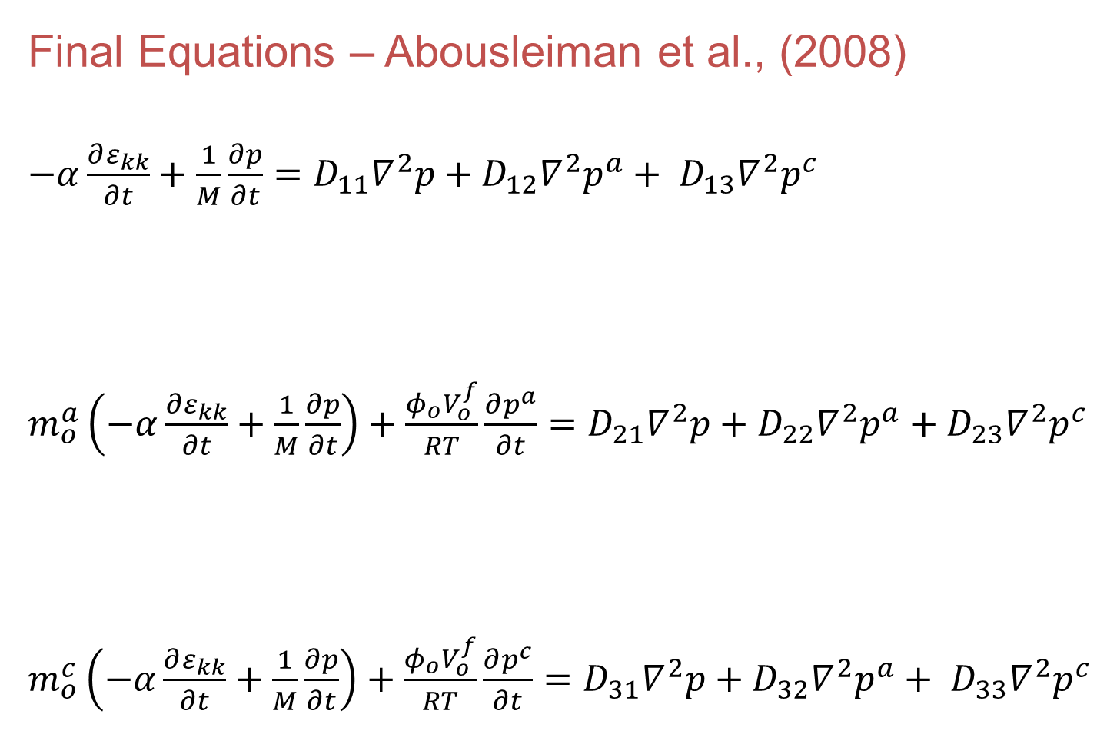
Final Equations – Abousleiman et al., (2008)
$−α\frac{∂ε_{kk}}{∂t}+\frac{1}{M}\frac{∂p}{∂t}=D_{11}∇^{2}p+D_{12}∇^{2}p^{a}+ D_{13}∇^{2}p^{c}$
$m_{o}^{a}\left(−α\frac{∂ε_{kk}}{∂t}+\frac{1}{M}\frac{∂p}{∂t}\right)+\frac{φ_{o}V_{o}^{f}}{RT}\frac{∂p^{a}}{∂t}=D_{21}∇^{2}p+D_{22}∇^{2}p^{a}+D_{23}∇^{2}p^{c}$
$m_{o}^{c}\left(−α\frac{∂ε_{kk}}{∂t}+\frac{1}{M}\frac{∂p}{∂t}\right)+\frac{φ_{o}V_{o}^{f}}{RT}\frac{∂p^{c}}{∂t}=D_{31}∇^{2}p+D_{32}∇^{2}p^{a}+ D_{33}∇^{2}p^{c}$

Slide 49
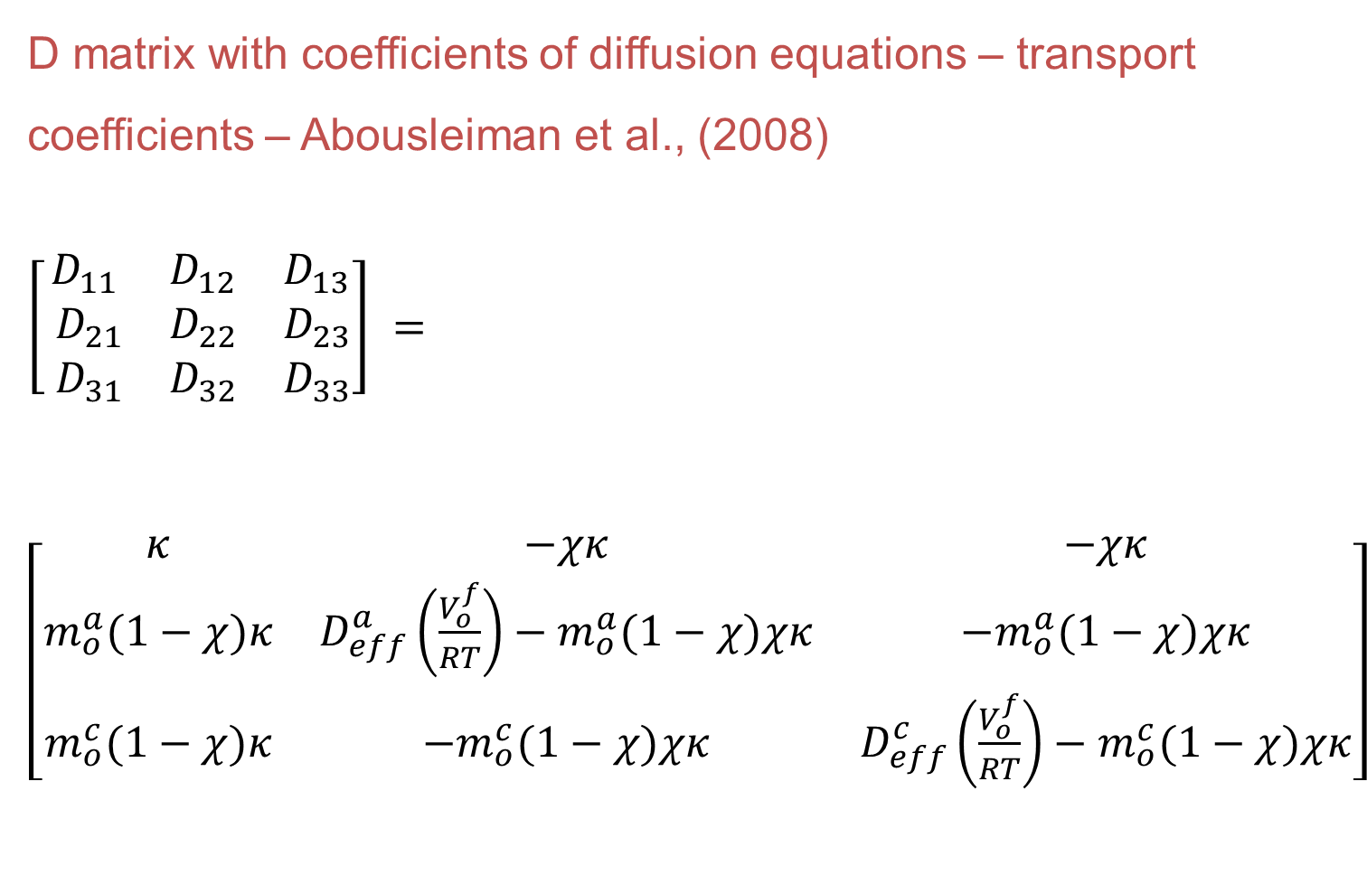
D matrix with coefficients of diffusion equations – transport coefficients – Abousleiman et al., (2008)
$\left[\begin{matrix}D_{11} & D_{12} & D_{13} \\ { D}_{21} & D_{22} & D_{23} \\ { D}_{31} & D_{32} & D_{33}\end{matrix}\right] =\left[\begin{matrix}κ & −χκ & −χκ \\ m_{o}^{a}(1−χ)κ & D_{eff}^{a}\left(\frac{V_{o}^{f}}{RT}\right)−m_{o}^{a}(1−χ)χκ & −m_{o}^{a}(1−χ)χκ \\ m_{o}^{c}(1−χ)κ & {−m}_{o}^{c}(1−χ)χκ & D_{eff}^{c}\left(\frac{V_{o}^{f}}{RT}\right)−m_{o}^{c}(1−χ)χκ\end{matrix}\right]$

Slide 50
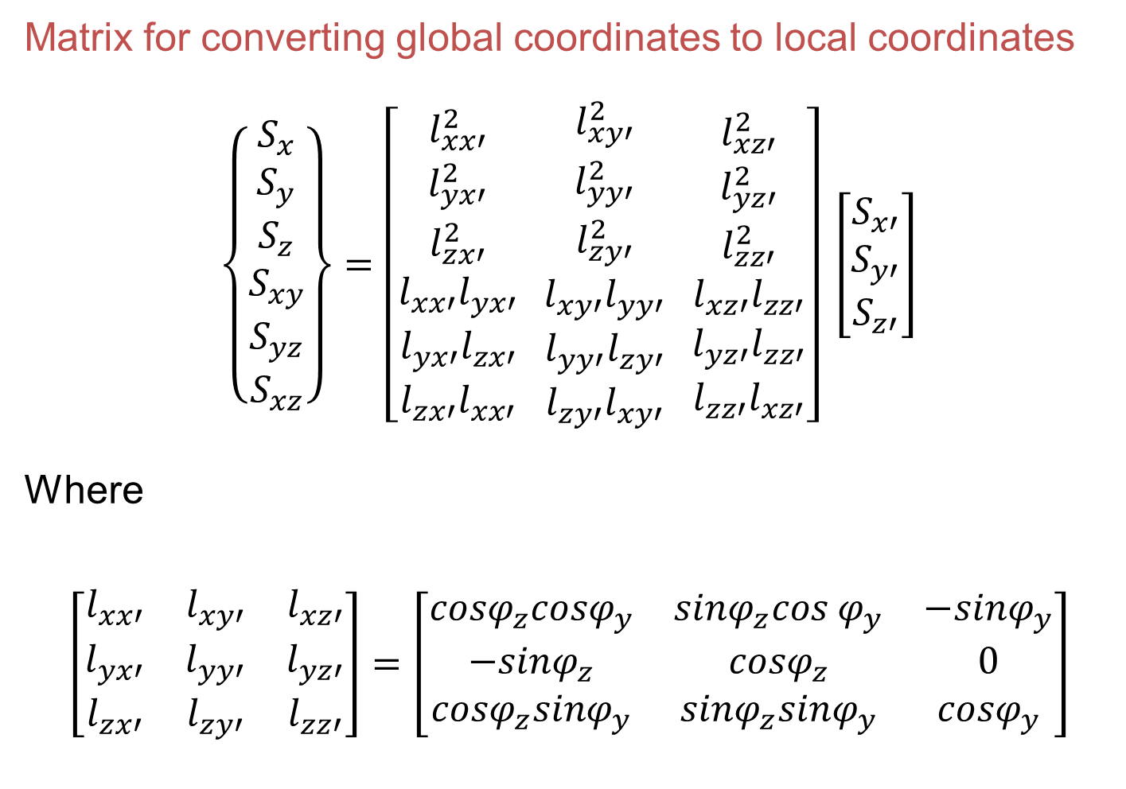
Matrix for converting global coordinates to local coordinates
$$\left\{\begin{aligned}S_{x} \\ S_{y} \\ S_{z} \\ S_{xy} \\ S_{yz} \\ S_{xz}\end{aligned}\right\}=\left[\begin{aligned}l_{xx′}^{2} \\ l_{yx′}^{2} \\ l_{zx′}^{2} \\ l_{xx′}l_{yx′} \\ l_{yx′}l_{zx′} \\ l_{zx′}l_{xx′}\end{aligned} \begin{aligned}l_{xy′}^{2} \\ l_{yy′}^{2} \\ l_{zy′}^{2} \\ l_{xy′}l_{yy′} \\ l_{yy′}l_{zy′} \\ l_{zy′}l_{xy′}\end{aligned} \begin{aligned}l_{xz′}^{2} \\ l_{yz′}^{2} \\ l_{zz′}^{2} \\ l_{xz′}l_{zz′} \\ l_{yz′}l_{zz′} \\ l_{zz′}l_{xz′}\end{aligned}\right] \left[\begin{aligned}S_{x′} \\ S_{y′} \\ S_{z′}\end{aligned}\right]$$
Where
$$\left[\begin{matrix}l_{xx′} & l_{xy′} & l_{xz′} \\ l_{yx′} & l_{yy′} & l_{yz′} \\ l_{zx′} & l_{zy′} & l_{zz′}\end{matrix}\right]=\left[\begin{matrix}{cosφ}_{z}{cosφ}_{y} & {sinφ}_{z}{cos φ}_{y} & {−sinφ}_{y} \\ {−sinφ}_{z} & {cosφ}_{z} & 0 \\ {cosφ}_{z}{sinφ}_{y} & {sinφ}_{z}{sinφ}_{y} & {cosφ}_{y}\end{matrix}\right]$$
Fjaer (2000)

Slide 51
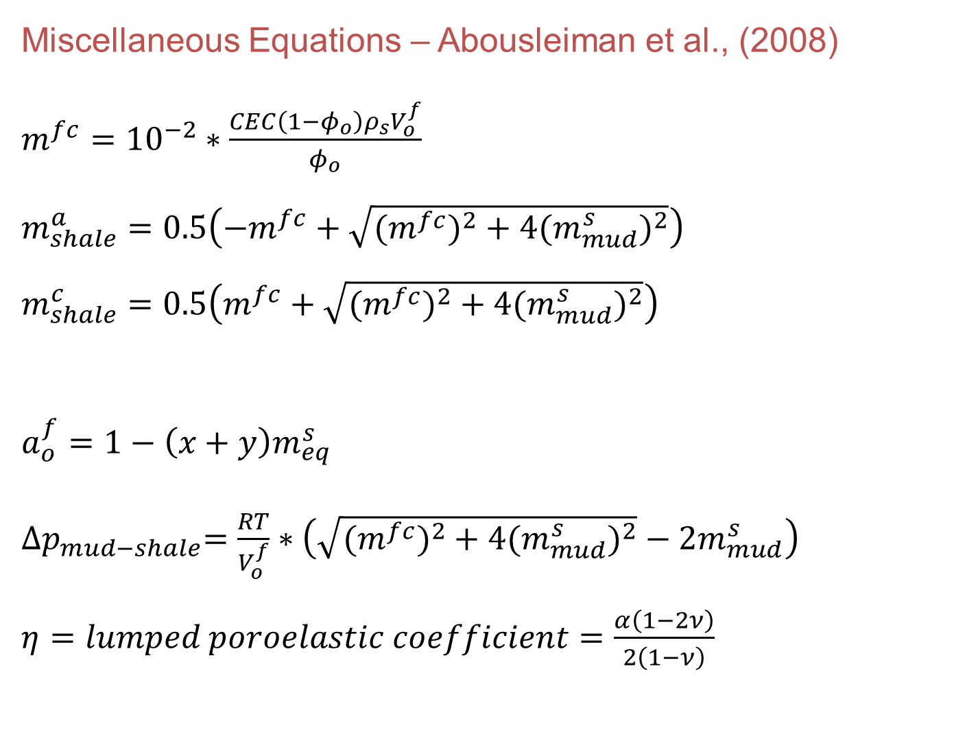
Miscellaneous Equations – Abousleiman et al., (2008)
$m^{fc}={10}^{−2}∗\frac{CEC\left(1−φ_{o}\right)ρ_{s}V_{o}^{f}}{φ_{o}}$
$m_{shale}^{a}=0.5\left(−m^{fc}+\sqrt{{{(m}^{fc})}^{2}+4({m_{mud}^{s})}^{2}}\right)$
$m_{shale}^{c}=0.5\left(m^{fc}+\sqrt{{{(m}^{fc})}^{2}+4({m_{mud}^{s})}^{2}}\right)$
$a_{o}^{f}=1−\left(x+y\right)m_{eq}^{s}$
${∆p}_{mud−shale}=\frac{RT}{V_{o}^{f}}∗\left(\sqrt{{{(m}^{fc})}^{2}+4({m_{mud}^{s})}^{2}}−2m_{mud}^{s}\right)$
$η=lumped poroelastic coefficient=\frac{α\left(1−2ν\right)}{2\left(1−ν\right)}$

Slide 52

Continued…
$σ_{m}=\frac{S_{x}+S_{y}}{2}$
$σ_{d}=0.5\sqrt{{(S_{x}−S_{y})}^{2}+4S_{xy}^{2}}$
$θ_{r}=0.5\tan^{−1}\left(\frac{2S_{xy}}{S_{x}−S_{y}}\right)$
${∆m}_{mud−shale}^{a}=m_{shale}^{a}−m_{mud}^{s}$
${∆m}_{mud−shale}^{c}=m_{shale}^{c}−m_{mud}^{s}$

Slide 53
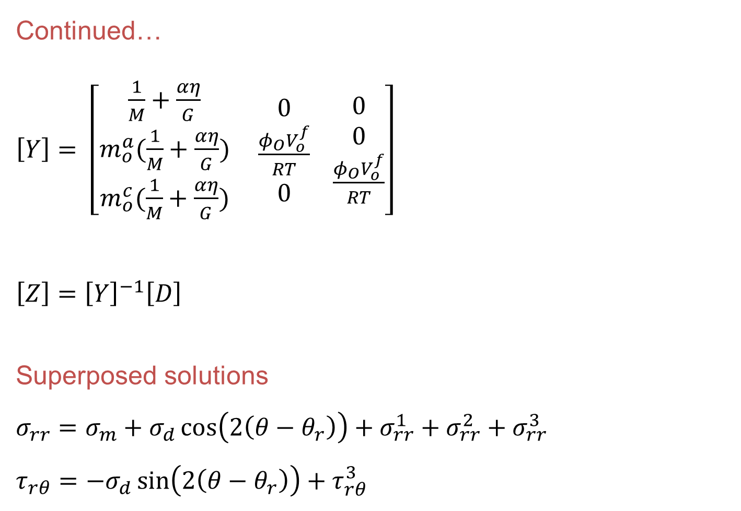
Continued…
$\left[Y\right]= \left[\begin{aligned}\frac{1}{M}+\frac{αη}{G} \\ m_{o}^{a}(\frac{1}{M}+\frac{αη}{G}) \\ m_{o}^{c}(\frac{1}{M}+\frac{αη}{G})\end{aligned} \begin{aligned}0 \\ \frac{φ_{O}V_{o}^{f}}{RT} \\ 0\end{aligned} \begin{aligned}0 \\ 0 \\ \frac{φ_{O}V_{o}^{f}}{RT}\end{aligned}\right]$
$\left[Z\right]={\left[Y\right]}^{−1}\left[D\right]$
Superposed solutions
$σ_{rr}=σ_{m}+σ_{d}\cos\left(2\left(θ−θ_{r}\right)\right)+σ_{rr}^{1}+σ_{rr}^{2}+σ_{rr}^{3}$
$τ_{rθ}=−σ_{d}\sin\left(2\left(θ−θ_{r}\right)\right)+τ_{rθ}^{3}$

Slide 54

Continued…
$p=p_{o}+p^{2}+p^{3}$
$σ_{rr}^{1}=−\left(σ_{m}−p_{mud}\right)\left(\frac{R_{w}^{2}}{r^{2}}\right)$
$σ_{θθ}^{1}=\left(σ_{m}−p_{mud}\right)\left(\frac{R_{w}^{2}}{r^{2}}\right)$
$σ_{zz}=S_{z}−2νσ_{m}−α\left(1−2ν\right)p_{o}$
$τ_{rz}=\left(S_{xz}cosθ+S_{yz}sinθ\right)\left(1−\left(\frac{R_{w}^{2}}{r^{2}}\right)\right)$
$τ_{θz}=−\left(S_{xz}sinθ−S_{yz}cosθ\right)\left(1+\left(\frac{R_{w}^{2}}{r^{2}}\right)\right)$

Slide 55
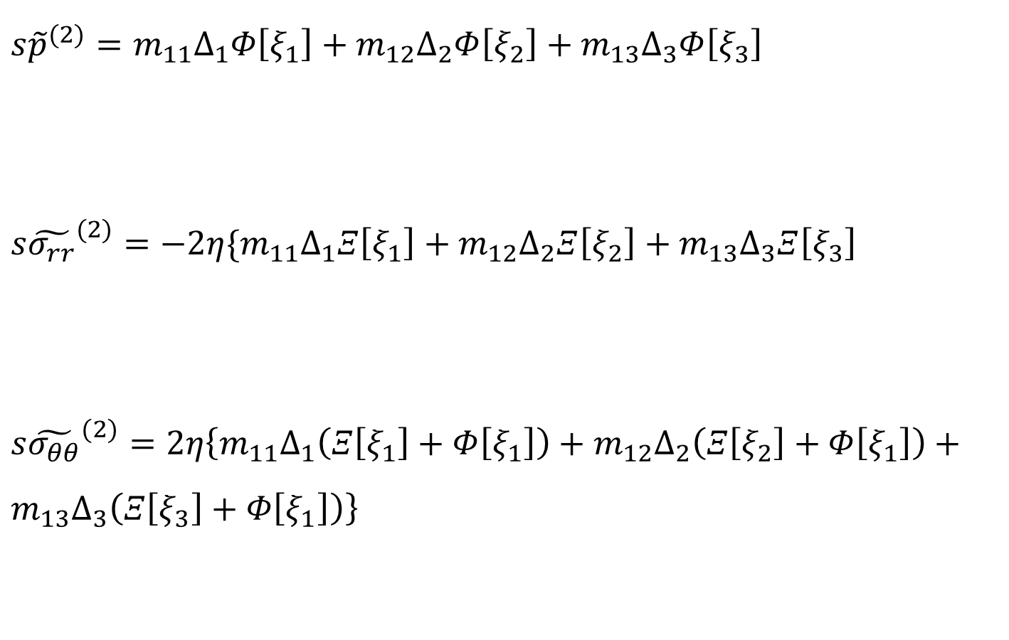
Continued…
Mode 2: Diffusional loading - Detourney et al.,(1988)
$s{\tilde{p}}^{(2)}=m_{11}∆_{1}Φ\left[ξ_{1}\right]+m_{12}∆_{2}Φ\left[ξ_{2}\right]+m_{13}∆_{3}Φ\left[ξ_{3}\right]$
$s{\tilde{σ_{rr}}}^{(2)}=−2η\{m_{11}∆_{1}Ξ\left[ξ_{1}\right]+m_{12}∆_{2}Ξ\left[ξ_{2}\right]+m_{13}∆_{3}Ξ\left[ξ_{3}\right]$
$s{\tilde{σ_{θθ}}}^{(2)}=2η\left\{m_{11}∆_{1}\left(Ξ\left[ξ_{1}\right]+Φ\left[ξ_{1}\right]\right)+m_{12}∆_{2}\left(Ξ\left[ξ_{2}\right]+Φ\left[ξ_{1}\right]\right)+m_{13}∆_{3}\left(Ξ\left[ξ_{3}\right]+Φ\left[ξ_{1}\right]\right)\right\}$

Slide 56

Continued…
Mode 3: Deviatoric loading – Detourney et al., (1988)
$s{\tilde{p}}^{(3)}=σ_{d}\left\{m_{11}D_{1}K_{2}\left[ξ_{1}r\right]+m_{12}D_{2}K_{2}\left[ξ_{2}r\right]+m_{13}D_{3}K_{2}\left[ξ_{3}r\right]+D_{4}f_{1}\left(\frac{R_{w}^{2}}{r^{2}}\right)\right\}cos\left[2\left(θ−θ_{r}\right)\right]$
${s\tilde{σ_{rr}}}^{\left(3\right)}=−σ_{d}\left\{\begin{aligned}2η\left(m_{11}D_{1}Θ\left[ξ_{1}\right]+m_{12}D_{2}Θ\left[ξ_{2}\right]+m_{13}D_{3}Θ\left[ξ_{3}\right]\right)−2G\left(h+\frac{α}{η}\right)D_{4}\left(\frac{R_{w}^{2}}{r^{2}}\right) \\ −D_{5}\left(\frac{R_{w}^{4}}{r^{4}}\right)\end{aligned}\right\}cos\left[2\left(θ−θ_{r}\right)\right]$

Slide 57
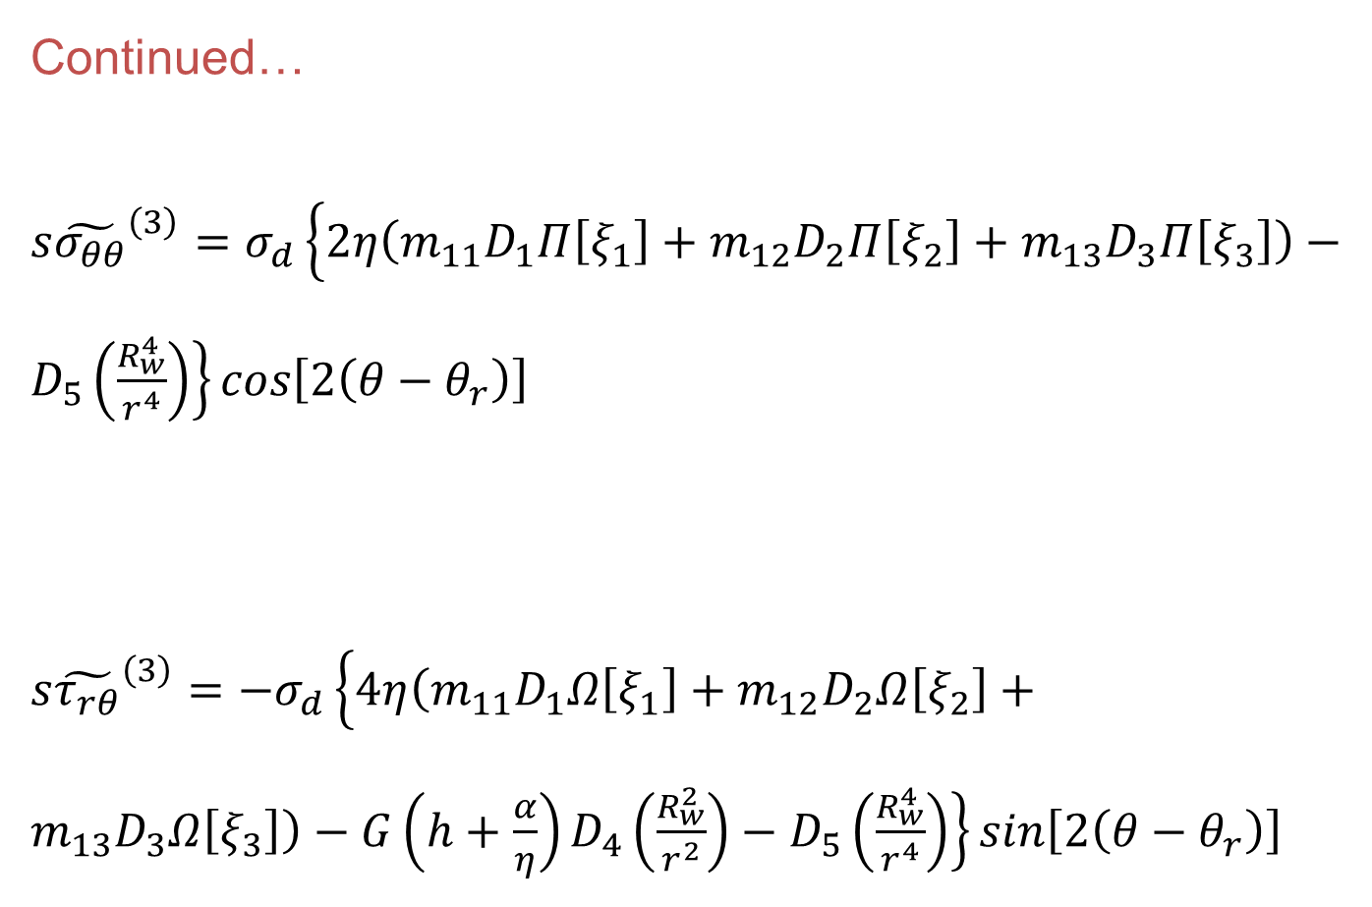
Continued…
${s\tilde{σ_{θθ}}}^{\left(3\right)}=σ_{d}\left\{2η\left(m_{11}D_{1}Π\left[ξ_{1}\right]+m_{12}D_{2}Π\left[ξ_{2}\right]+m_{13}D_{3}Π\left[ξ_{3}\right]\right)−D_{5}\left(\frac{R_{w}^{4}}{r^{4}}\right)\right\}cos\left[2\left(θ−θ_{r}\right)\right]$
${s\tilde{τ_{rθ}}}^{\left(3\right)}=−σ_{d}\left\{4η\left(m_{11}D_{1}Ω\left[ξ_{1}\right]+m_{12}D_{2}Ω\left[ξ_{2}\right]+m_{13}D_{3}Ω\left[ξ_{3}\right]\right)−G\left(h+\frac{α}{η}\right)D_{4}\left(\frac{R_{w}^{2}}{r^{2}}\right)−D_{5}\left(\frac{R_{w}^{4}}{r^{4}}\right)\right\}sin\left[2\left(θ−θ_{r}\right)\right]$

Slide 58
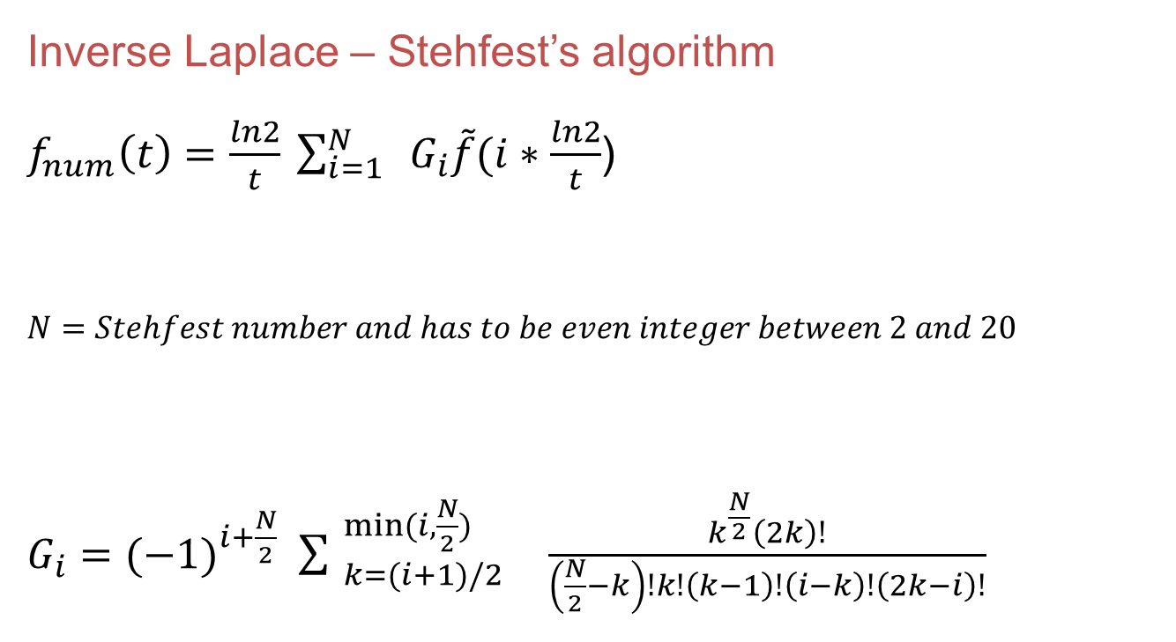
Inverse Laplace – Stehfest’s algorithm
$f_{num}\left(t\right)=\frac{ln2}{t} \sum_{i=1}^{N}{{ G}_{i}\tilde{f}(i∗\frac{ln2}{t}}$)
$N=Stehfest number and has to be even integer between 2 and 20$
$G_{i}={(−1)}^{i+\frac{N}{2}} \sum_{ k=(i+1)/2}^{ min(i, \frac{N}{2})}{ \frac{k^{\frac{N}{2}}\left(2k\right)!}{\left(\frac{N}{2}−k\right)!k!\left(k−1\right)!\left(i−k\right)!\left(2k−i\right)!}}$

