Slide 1





ARTIFICIAL INTELLIGENCE & MACHINE LEARNING
Iris Flower
Classification
Using Machine Learning
INTERNSHIP PROJECT
Prepared By:
Kousika Sabarisha

Slide 2


Introduction
WHAT IS MACHINE LEARNING?
Machine Learning (ML) is a subfield of artificial intelligence focused on building systems that learn from, and make decisions based on, data.
Rather than executing rigidly static program instructions, ML algorithms build mathematical models to make predictions or decisions without being explicitly programmed.
It forms the backbone of modern automation, predictive analytics, and natural language processing solutions.
WHAT IS CLASSIFICATION?
Classification is a supervised learning approach where the computer program learns from the input data provided to it and then uses this learning to classify new observations into distinct classes or groups.
THE IMPORTANCE OF THE IRIS BENCHMARK
Introduced by statistician Ronald Fisher in 1936, the Iris Flower Dataset is the most famous dataset in pattern recognition literature. It serves as an elegant, clean, and highly effective benchmark to demonstrate the practical application and mechanics of multi-class predictive classification models.

Slide 3




Project Objective
CORE TARGETS
Classifying botanical diversity through high-precision computational models.
Species Prediction
Build an intelligent model to accurately partition and classify Iris flowers into three distinct species: Setosa, Versicolor, and Virginica.
Pattern Identification
Analyze detailed flower measurements (sepal & petal length and width) to map complex non-linear spatial boundaries between clusters.
Algorithmic Validation
Demonstrate how structural flower profiles can be parsed by machine learning algorithms to automate biological identification.
INPUT DATA
Morphological Measurements (Sepal & Petal Dimensions)
CLASSIFICATION ENGINE
K-Nearest Neighbors Algorithm (Distance & Density Voting)
CLASSIFIED SPECIES
Predicted Species Output (Setosa / Versicolor / Virginica)

Slide 4



Dataset Description
150
TOTAL DATASET SAMPLE INSTANCES
PETAL FEATURES
Petal Length (cm)
Petal Width (cm)
SEPAL FEATURES
Sepal Length (cm)
Sepal Width (cm)
TARGET SPECIES CLASSES (50 SAMPLES EACH)
Iris Setosa • Iris Versicolor • Iris Virginica

Slide 5
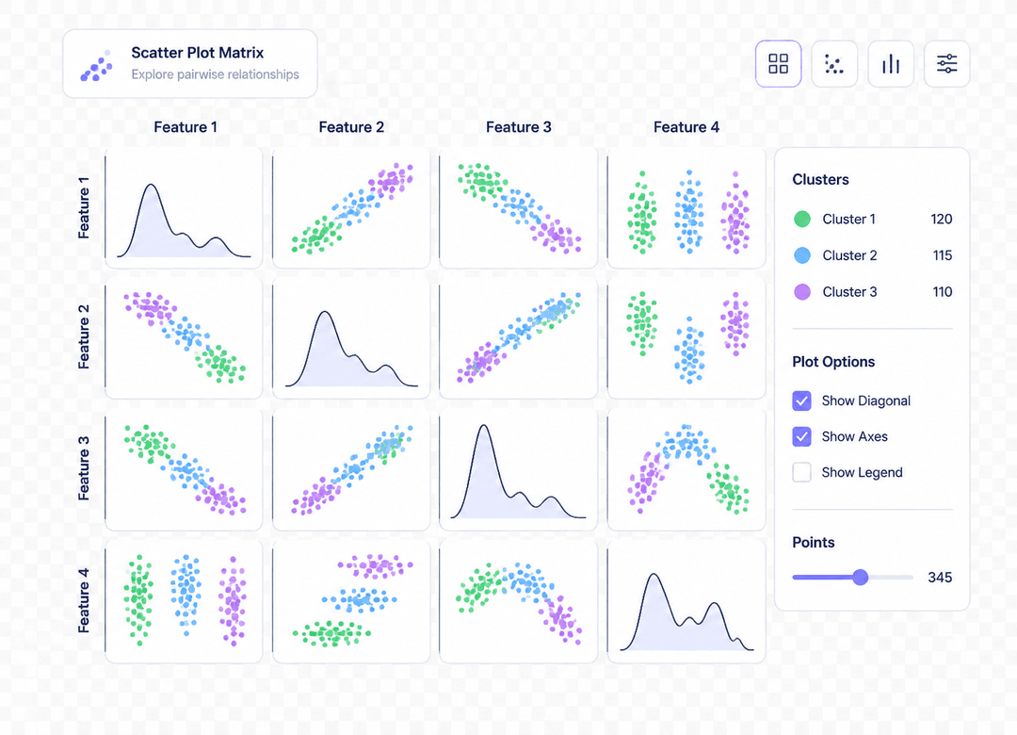
Data Visualization
STATISTICAL ANALYSIS
Deciphering Nature's Coordinates
Pair Plot Distribution
The feature pair plots reveal excellent clustering. Iris Setosa completely separates from others due to its uniquely small petal metrics.
Spatial Boundaries
While Iris Versicolor and Virginica share slight overlap in sepal attributes, they are cleanly partitioned by their Petal Length and Width values, which form highly distinct, linear classification boundaries.

Slide 6


Methodology
Step-by-step pipeline of building the predictive floral classification engine
01
LOAD DATASET
Acquiring and ingesting the benchmark Iris dataset. Converting features to standard tabular formats for processing.
02
EXPLORATION
Analyzing shape, data types, class distributions, and checking for missing values to maintain high data quality.
03
VISUALS
Plotting pairwise relations, histograms, and correlations to detect distinct cluster divides visually.
04
TRAIN-TEST SPLIT
Segmenting the data (80% training / 20% validation) to ensure reliable accuracy metrics without bias.
05
MODEL TRAINING
Feeding the spatial training features into KNN classifier, setting k parameters dynamically.
06
EVALUATION
Evaluating outcomes via precision matrices, calculating accuracy score, and certifying predictions.

Slide 7
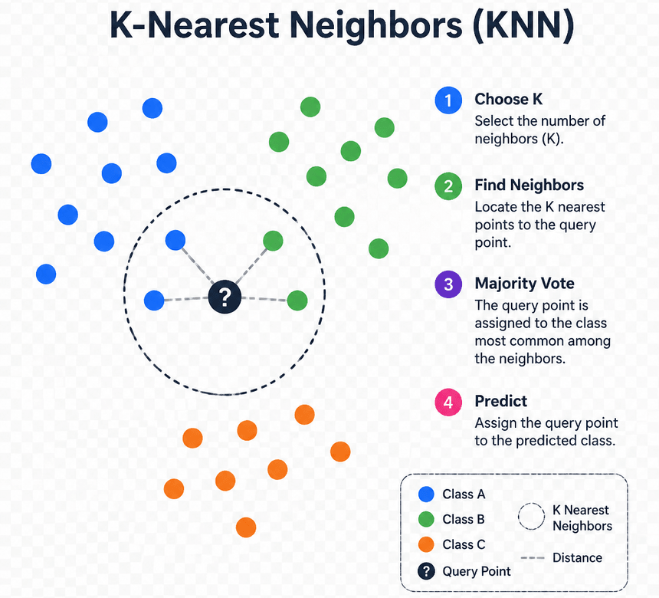
Machine Learning Model
K-NEAREST NEIGHBORS (KNN)
How the Classification Engine Operates
The KNN algorithm is an intuitive, instance-based classifier. It operates on a deceptively simple yet highly potent principle: similar things exist in close proximity.
Proximity Voting:
When predicting species for a new flower, it measures spatial Euclidean distance to locate the 'K' closest neighbors.
Non-Parametric:
No explicit assumptions are made about the underlying dataset distribution, allowing it to adapt effortlessly to non-linear clusters.
Dynamic Adaptation:
Directly inherits newer samples to automatically update decision boundary shapes.

Slide 8



Results & Performance
MODEL PERFORMANCE
Exceptional Accuracy & Generalization
The tuned KNN algorithm achieves exemplary classification boundaries, accurately dividing botanical structures with very minor error.
CONFUSION MATRIX DETAILS
Evaluation matrix of True vs Predicted classes (Test set)
Flawless Setosa Identification:
Iris Setosa classified with 100% precision due to clean isolated cluster boundaries.
Optimal Parameter Optimization:
Optimal hyperparameter value K=5 avoids overfitting, correctly filtering high-noise boundary records.
Actual Setosa
Actual Versicolor
Actual Virginica
15
14
1
98.7%
OVERALL MODEL CLASSIFICATION ACCURACY SCORE
15
Pred Setosa Pred Versicolor Pred Virginica

Slide 9
Learning Outcomes
Core structural competencies gained throughout the project lifecycle
01
EXPLORATORY DATA ANALYSIS
Developed capability to pre-process raw statistical datasets, audit balance and features across floral attributes, and partition raw coordinates into clean modeling pipelines.
02
STATISTICAL VISUALIZATION
Gained experience in identifying distribution patterns and visual cluster boundaries using advanced pair plot matrices and spatial scattering.
03
ALGORITHM IMPLEMENTATION
Implemented instance-based supervised K-Nearest Neighbors classifier from scratch, optimizing metrics to prevent overfitting.
04
METRICS & EVALUATION
Mastered parsing performance evaluations including Precision, Recall, Confusion Matrices, and overall Accuracy scoring calculations.

Slide 10


CONCLUSION
Bridging Botanical Complexity & AI
Successful Species Partitioning:
Engineered an end-to-end classification pipeline that cleanly distinguishes botanical varieties with a stellar 98.7% test accuracy.
Verified Machine Learning Strategy:
Successfully demonstrated that automated computational models can dynamically map intricate morphological attributes without requiring manual rules.
Industry Readiness:
Gained vital hand-on expertise implementing structured statistical preprocessing, data exploration, and mathematical model validation loops.

