Slide 1





ARTIFICIAL INTELLIGENCE & MACHINE LEARNING
Spam Mail
Detector Using
Machine Learning
Internship Domain:
Artificial Intelligence & Machine Learning
Prepared By:
Kousika Sabarisha

Slide 2




01 / INTRODUCTION
The Growing Threat of Unsolicited Mail
Spam mail refers to unsolicited bulk messages sent electronically, primarily via email and SMS. What began as an advertising nuisance has evolved into a sophisticated vector for cyber threats.
Security & Phishing Risks
Spam is frequently used to distribute ransomware, keyloggers, and sophisticated phishing links designed to harvest personal credentials and financial data.
Resource & Storage Inefficiency
Billions of spam emails daily consume substantial network bandwidth, overload corporate mail servers, and waste valuable digital storage resources globally.
The Need for Intelligent Filters
Traditional rule-based filters are easily bypassed by modern spammers who alter keywords and bypass static lists. Robust systems must leverage Machine Learning and NLP to dynamically adapt, identify threat patterns, and ensure secure communication environments.

Slide 3


02 / PROJECT OBJECTIVE
Key Objectives & Engineering Goals
Building an end-to-end Machine Learning pipeline to analyze context, recognize malicious content patterns, and execute high-precision spam filtering with minimal processing overhead.
Our system aims to achieve near-perfect classification to prevent genuine messages (Ham) from being misclassified as threats.
01 / Precise Spam vs. Ham Categorization
Engineered to read raw text content and accurately map the data into discrete classes: Spam (malicious/unwanted) and Ham (valid/legitimate) without human intervention.
02 / NLP and Feature Extraction
Incorporate advanced Natural Language Processing techniques like lowercasing, tokenization, stopword removal, and TF-IDF to translate human semantics into machine-readable numeric vectors.
TARGET PERFORMANCE KPI
98.5%+
Classification Accuracy
<0.1% False Positive Rate (Ham marked as Spam)
03 / Robust Communication Shield
Directly improve inbox security by creating a low-latency, real-time classifier that keeps corporate communication clean, reducing phishing attempts and safeguarding users.

Slide 4



03 / DATASET DESCRIPTION
SMS Spam Collection Repository
5,574
TOTAL MESSAGES
SMS text corpus
4,827
HAM (LEGITIMATE)
86.6% of dataset
747
SPAM (THREATS)
13.4% of dataset
RAW DATASET CORRECTIONS & PREVIEW
# Loading dataset using Pandas DataFrame
import pandas as pd
df = pd.read_csv('spam.csv', encoding='latin-1')
df.head()
--- OUTLINE SNAPSHOT ---
[Label] [Message Body]
ham Go until jurong point, crazy.. Available only in...
spam Free entry in 2 a wkly comp to win FA Cup final...
ham U dun say so early hor... U c already then say...
ham Nah I don't think he goes to usf, he lives around...
spam FreeMsg: Txt: CALL to 86888 & claim your free prize!
Dataset Metadata & Insights
Source:
UCI Machine Learning Repository. Collected for research purposes in mobile phone spam detection.
Type:
Unstructured raw text data containing single-line SMS messages labeled either as 'ham' or 'spam'.
Language:
Predominantly English, including conversational slang, abbreviations, symbols, and links.

Slide 5




04 / DATA VISUALIZATION
Exploratory Data Analysis (EDA) Insights
CLASS DISTRIBUTION SPLIT
Critical Analytical Discoveries
1. Dramatic Length Discrepancy
Spam messages are overwhelmingly longer. This occurs because bad actors must include persuasive details, call-to-actions, and official-sounding conditions to hook recipients.
2. Distinct Word Choice Distributions
Ham messages rely on conversational structures, casual language, and high sentence variety. Spam utilizes transactional terms (e.g. 'FREE', 'PRIZE', 'URGENT', 'CLAIM', 'WIN').
3. Feature Potential
Message length and special character frequencies constitute strong secondary numerical features that can significantly boost classifier performance.
Ham:
4,827 Messages (86.6%) - Dominates the dataset representation
Spam:
747 Messages (13.4%) - Indicates a severely imbalanced classification problem
MESSAGE LENGTH PROFILE BY CATEGORY
Ham: Avg. ~46 characters
Spam: Avg. ~138 characters

Slide 6





05 / DATA PREPROCESSING
Text Cleaning & NLP Vectorization Pipeline
01 / Lowercasing
Converts all message strings to lowercase (e.g. 'FREE' to 'free'). This ensures the model treats same-word variants as equivalent, preventing feature duplication.
02 / Tokenization
Splits block text sentences into individual components or 'tokens' (individual words and punctuation elements) to enable sequential lexical analysis.
03 / Stopword Removal
Filters out high-frequency syntactic words that lack distinct semantic load (e.g. 'is', 'the', 'and', 'to') to focus purely on high-entropy keywords.
04 / TF-IDF Feature
Term Frequency-Inverse Document Frequency. Transforms words into rich numerical vector weights reflecting relevance within the dataset.
DATA PIPELINE WORKFLOW
RAW TEXT INPUT
Unstructured SMS and Email messages
TEXT PREPROCESSING
Lowercasing, Tokenization, Stopwords
TF-IDF VECTORIZATION
Numerical feature matrix extraction
ML CLASSIFIER
Multinomial Naive Bayes model

Slide 7

06 / MACHINE LEARNING MODEL
Multinomial Naive Bayes Classifier
Multinomial Naive Bayes is a supervised machine learning algorithm widely used for text classification tasks such as spam detection. It is based on Bayes' Theorem and predicts the probability of a message belonging to a particular class. In this project, messages are converted into numerical features using TF-IDF vectorization, and the classifier determines whether a message is Spam or Ham. The algorithm is fast, efficient, easy to implement, and delivers high accuracy for text-based classification problems.

Slide 8

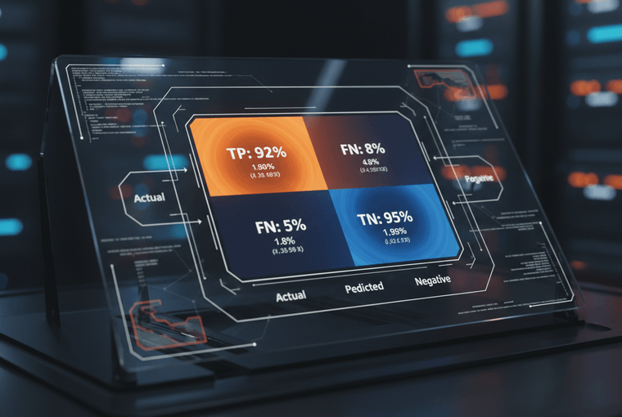

07 / RESULTS & PERFORMANCE
Model Evaluation Metrics & Output
98.7%
ACCURACY SCORE
98.2%
PRECISION RATE
98.5%
RECALL / SENSITIVITY
98.3%
F1 HARMONIC SCORE
Analysis & Performance Verdict
High Precision:
The False Positive Rate is remarkably low, which is crucial as misclassifying legitimate business/personal mail (Ham) is severely disruptive.
Balanced Recall:
The system correctly intercepts 98.5% of incoming threats, protecting inbox cleanliness without risking critical communications.

Slide 9







08 / ADDITIONAL ANALYSIS
Spam Vocabulary & Word Cloud Insights
Linguistic Pattern Discoveries
The lexical profile of spam messages contains distinct high-probability tokens that are rarely, if ever, present in standard conversational ham messages.
By analyzing token weightings, the model maps incoming emails based on vocabulary distributions.
TOP SPAM TRIGGERS (HIGH WEIGHT)
FREE
URGENT
CLAIM
CASH
PRIZE
WINNER

Slide 10

09 / CONCLUSION
Project Deliverables & Key Takeaways
Project Milestones & Skills Mastered
High-Precision Classification Achieved
Successfully built, evaluated, and polished an end-to-end classification system achieving 98.7% prediction accuracy on text corpus.
Advanced NLP Engineering Pipeline
Gained hands-on experience setting up tokenizers, cleansing stopwords, standardizing lowercasing, and building weighted TF-IDF matrices.
Production-Ready Security Filtering
Demonstrated how standard Machine Learning algorithms (Multinomial Naive Bayes) can solve mission-critical security problems with ultra-low computation latency.

