Slide 1

Databricks AI/BI Genie

Slide 2
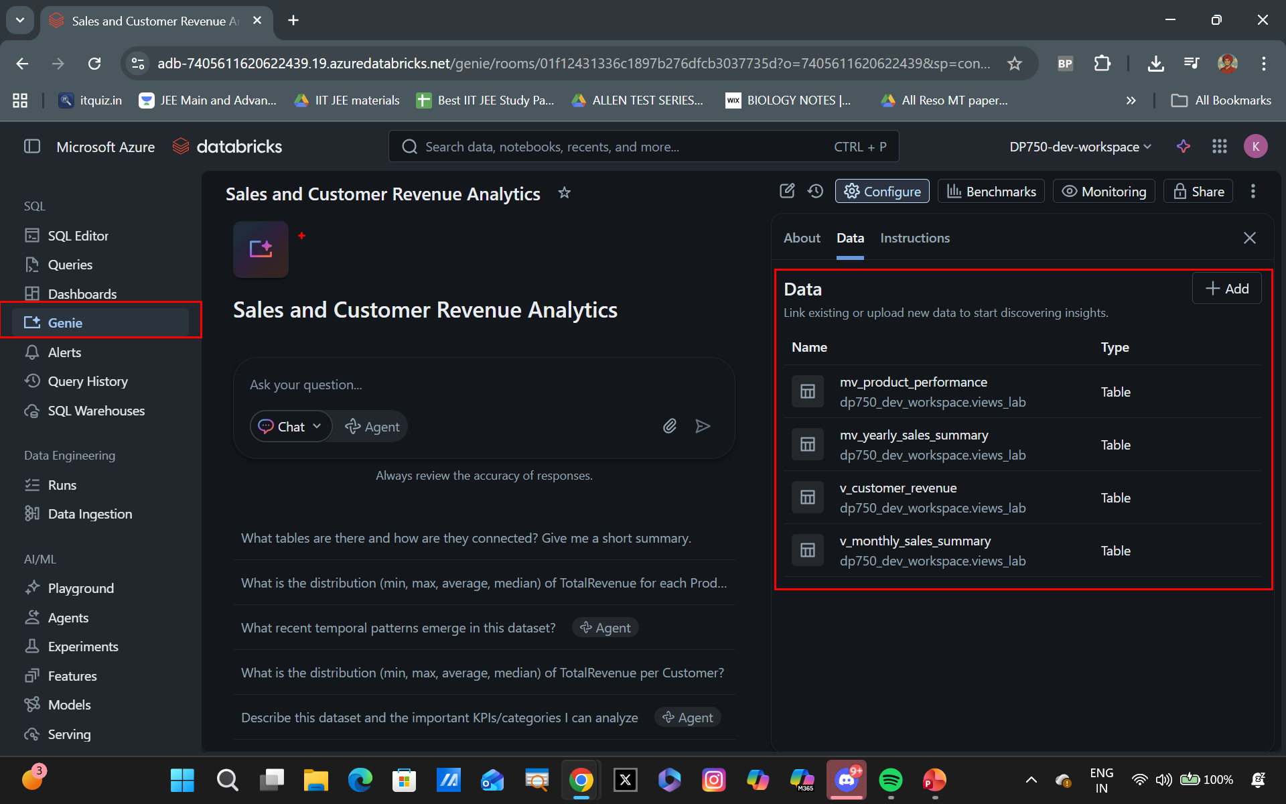
AI/BI Genie for Data Insight Generation
Natural language to SQL: Converts user questions into SQL queries automatically
Powered by Unity Catalog data: Uses governed and trusted datasets for accurate insights
Context-aware insights: Leverages metadata, relationships, and business context
No SQL expertise required: Enables non-technical users to explore data easily
Interactive data exploration: Allows users to refine queries and drill deeper
Faster decision-making: Reduces time from question to insight

Slide 3
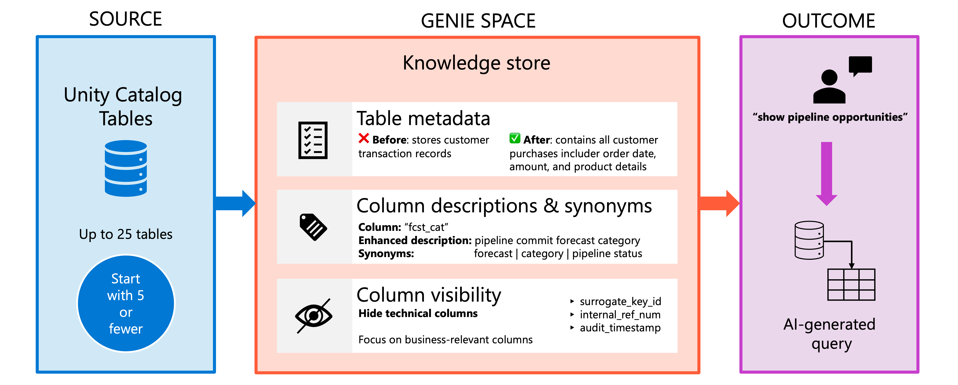
Some Best Practices
The better your data context and metadata, the more accurate and meaningful Genie’s insights become.

