Slide 1
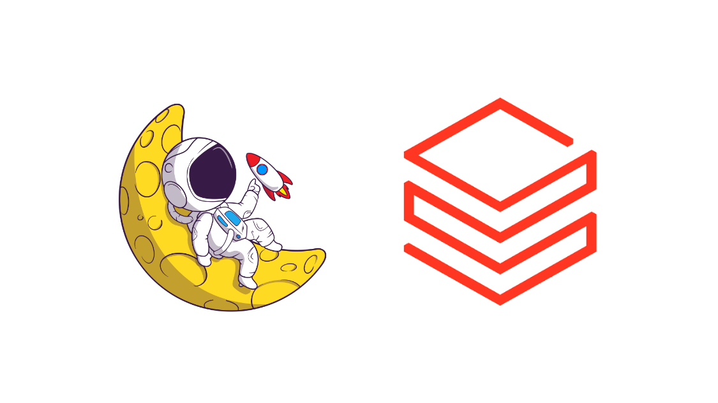
Databricks Managed and Self-Hosted Agent Memory

Slide 2
The Problem Statement(s)
A context window in a large language model is the maximum amount of text—measured in tokens—that the model can process and "remember" during a single interaction.
Everything in the request counts toward the context window: the system prompt, every message in messages (including tool results, images, and documents), and your tool definitions.

Slide 3
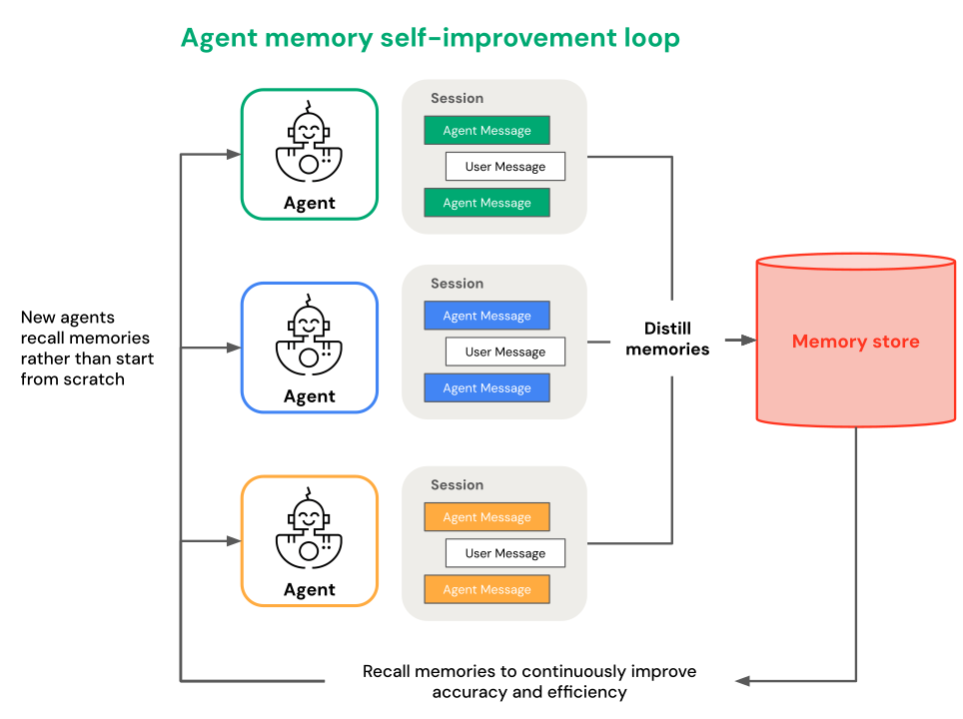
Agent Memory – Retrieval as-and-when Required
Memory lets agents remember information from earlier in a conversation or from previous conversations. With memory, agents provide context-aware responses and build personalized experiences over time.

Slide 4
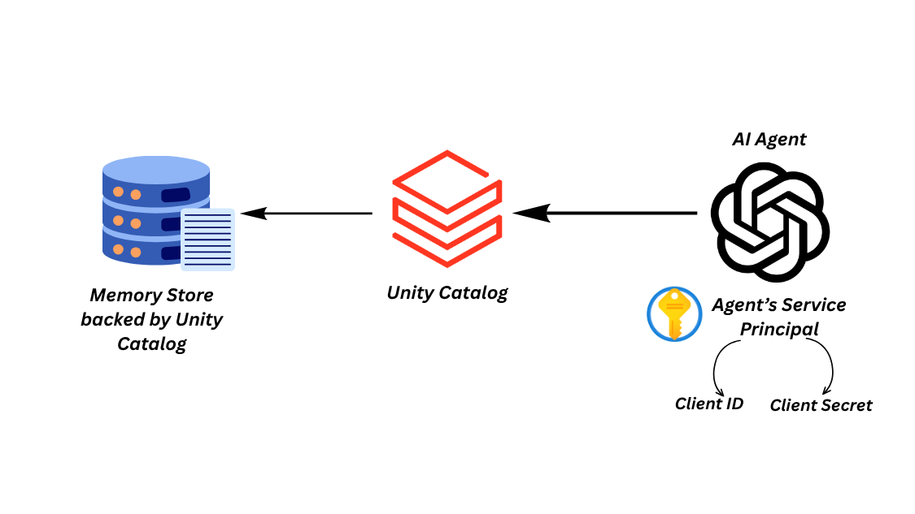
Managed Agent Memory
Managed agent memory gives your agents long-term memory across conversations. Azure Databricks runs the infrastructure and isolates each scope's memories, so you don't have to manage storage or partitioning yourself.
Managed memory has two levels:
1) A memory store is a Unity Catalog securable that acts as a container for memory entries. A memory store inherits the same governance, access control, and lineage as any other Unity Catalog asset.
2) A memory entry is an individual piece of content stored inside a memory store. Each entry is identified by a scope and a path. The scope determines whose memories an entry belongs to, and the path organizes entries within a scope, similar to a file path (for example, /memories/preferences.md).

Slide 5
Defining Scopes for our Memory Store
Scope is how you make a memory private to one user or shared across a group
1) Private memory for each user: Set the scope to the verified end-user identity. Each user gets their own partition and only sees their own entries. The value user_client resolves the end-user's ID for you.
Example: A support agent remembers one user's communication preferences and past tickets.
2) Shared memory for a group: Set the scope to a fixed key you choose, such as an organization, team, or project ID. Every user reads and writes the same memories.
Example: A team agent remembers a shared glossary of company terms and internal policies.
3) Memory split by something else: Build the scope from your own values, such as a tenant ID or a user_id:project composite.
Example: A multi-tenant app keeps each customer's memory separate, or a single user's memory is isolated per project.

Slide 6
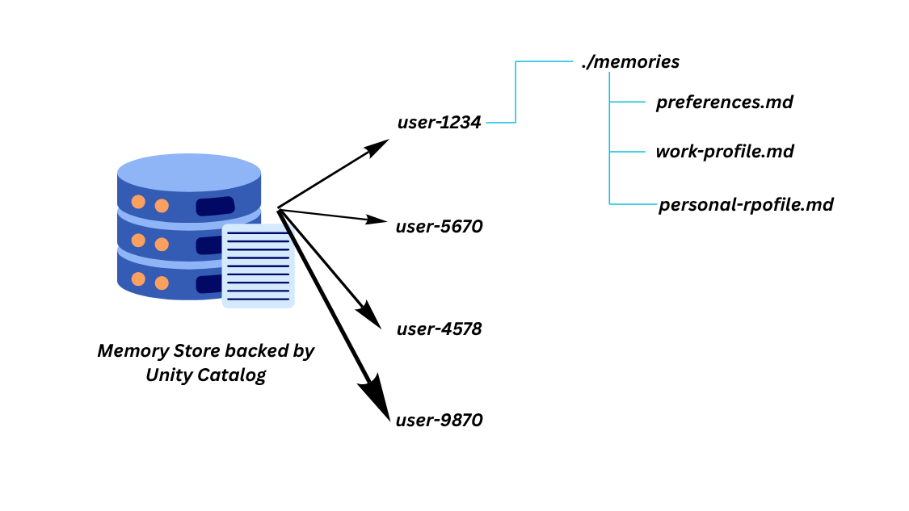
Structure of an Agent Memory Store

Slide 7
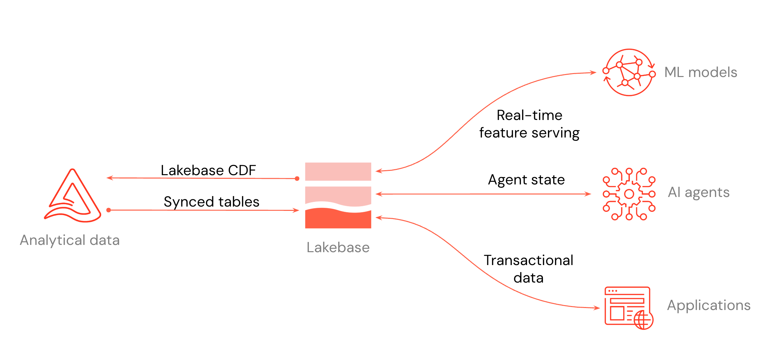
Self-Managed Agent Memory (Lakebase)
Lakebase is a fully managed Postgres database integrated into the Databricks platform. Build real-time transactional applications alongside your lakehouse data, with automatic scaling, instant branching, and native Unity Catalog integration.

Slide 8
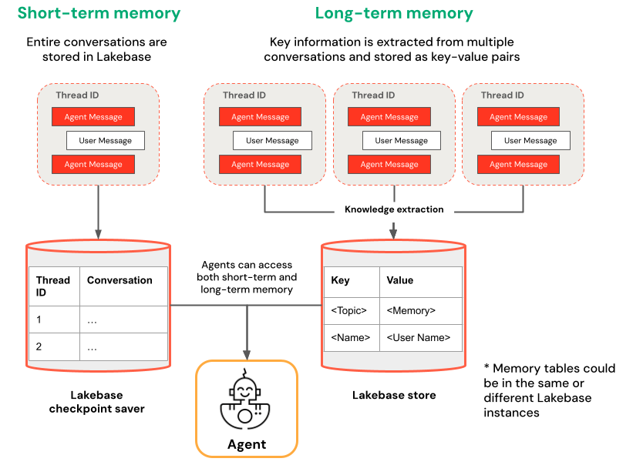
Short-term and Long-term Memories with Lakebase
Short-term memory captures context in a single conversation session using thread IDs and checkpointing. It maintains context for follow-up questions within a session.
Long-term memory extracts and stores key information across multiple conversations. It personalizes interactions based on past preferences and builds a knowledge base about users that improves responses over time.

