Slide 1
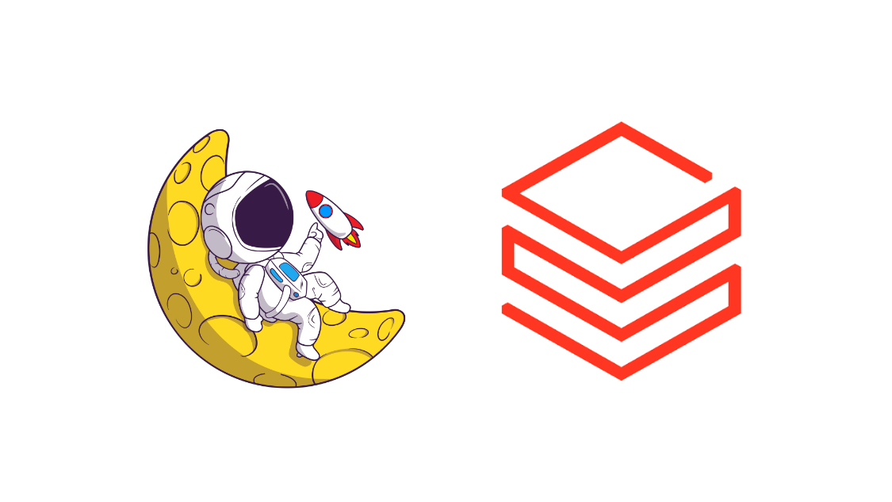
Databricks Apps

Slide 2
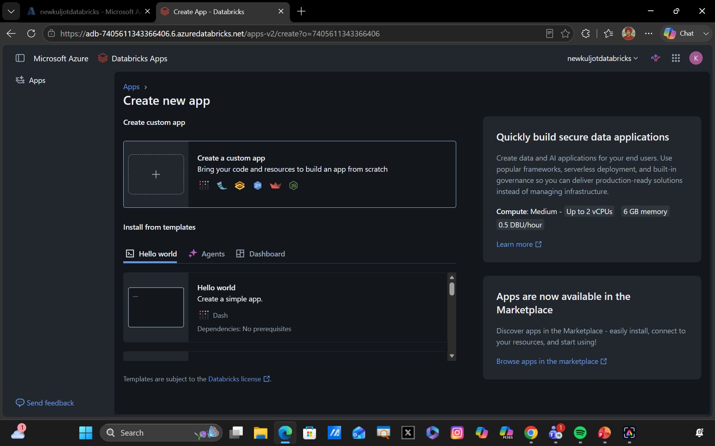
What are Databricks Apps?
Databricks Apps let you build and deploy secure data and AI applications directly on the Databricks platform.
Supports popular frameworks such as Streamlit, Dash, Gradio, Flask, and React/Node.js.
Provides built-in authentication and authorization, reducing the need to build separate security infrastructure.
Applications run on serverless infrastructure managed by Databricks, simplifying deployment and scaling.
Developers can build GenAI applications, agents, dashboards, and interactive data applications close to their governed enterprise data.
Key Idea: Build and securely deploy production data and GenAI applications without managing the underlying infrastructure.

Slide 3
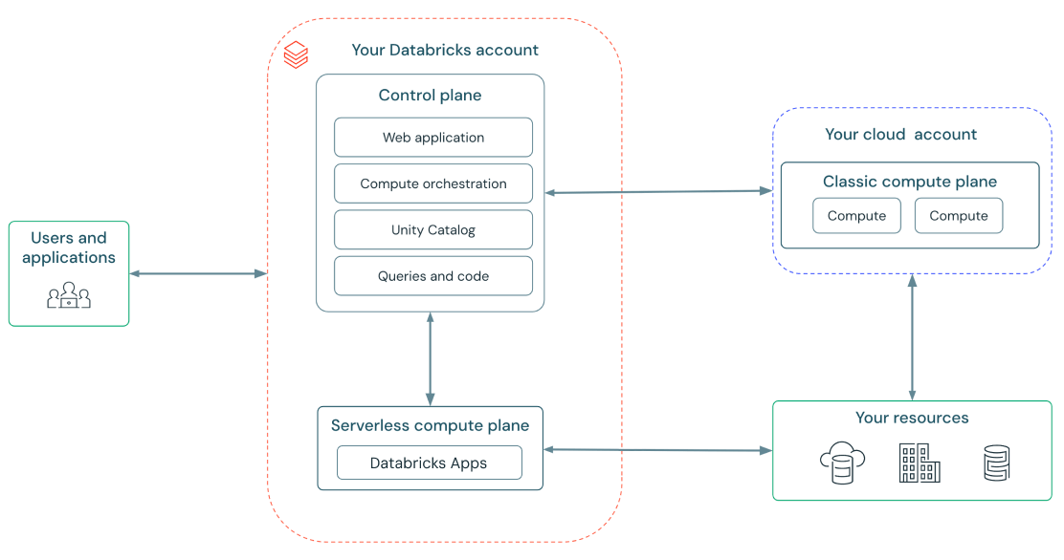
Built-in Governance with Databricks Apps
You can also govern which users can use and manage Databricks Apps with built-in governance and administration.
Service Principal for Authentication. Each Service Principal has a Client ID and Client Secret and can request Oauth tokens for accessing other protected databricks resources.

Slide 4
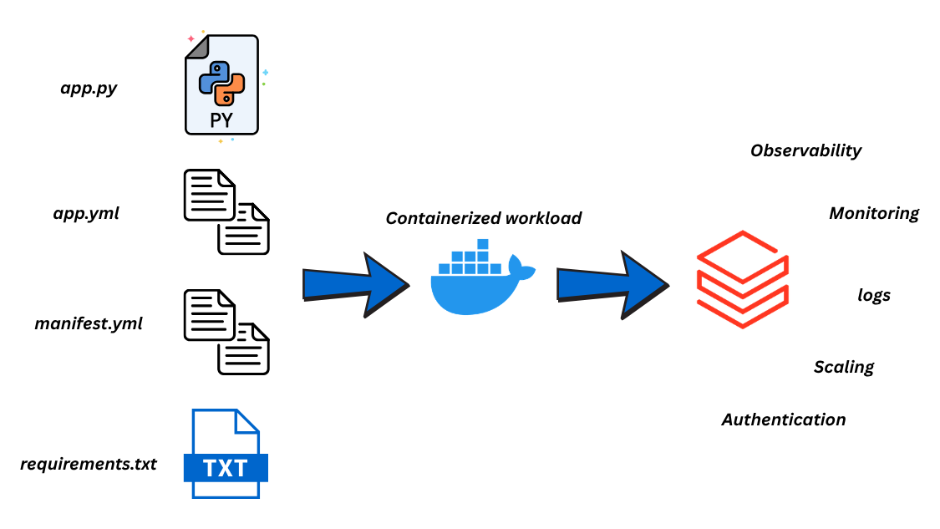
How Does all this Work?

