Slide 1
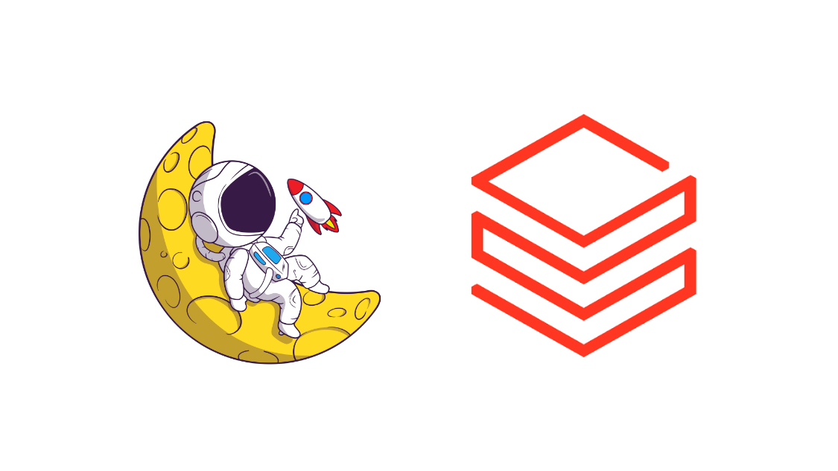
Intro to MCP Servers

Slide 2
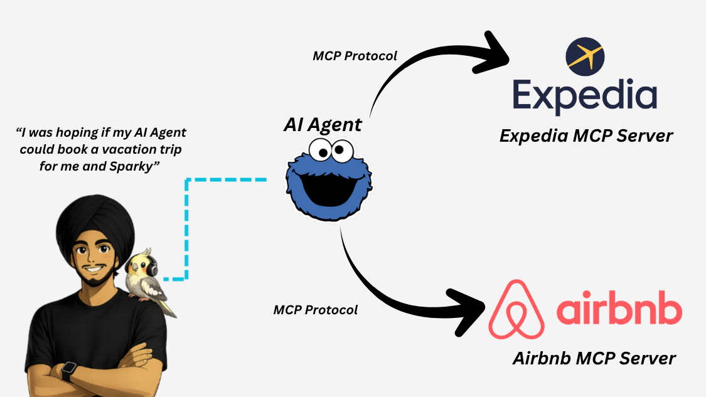
Imagine This…..
The MCP layer standardizes the communication between your AI Agent and the APIs that expose certain business logic

Slide 3
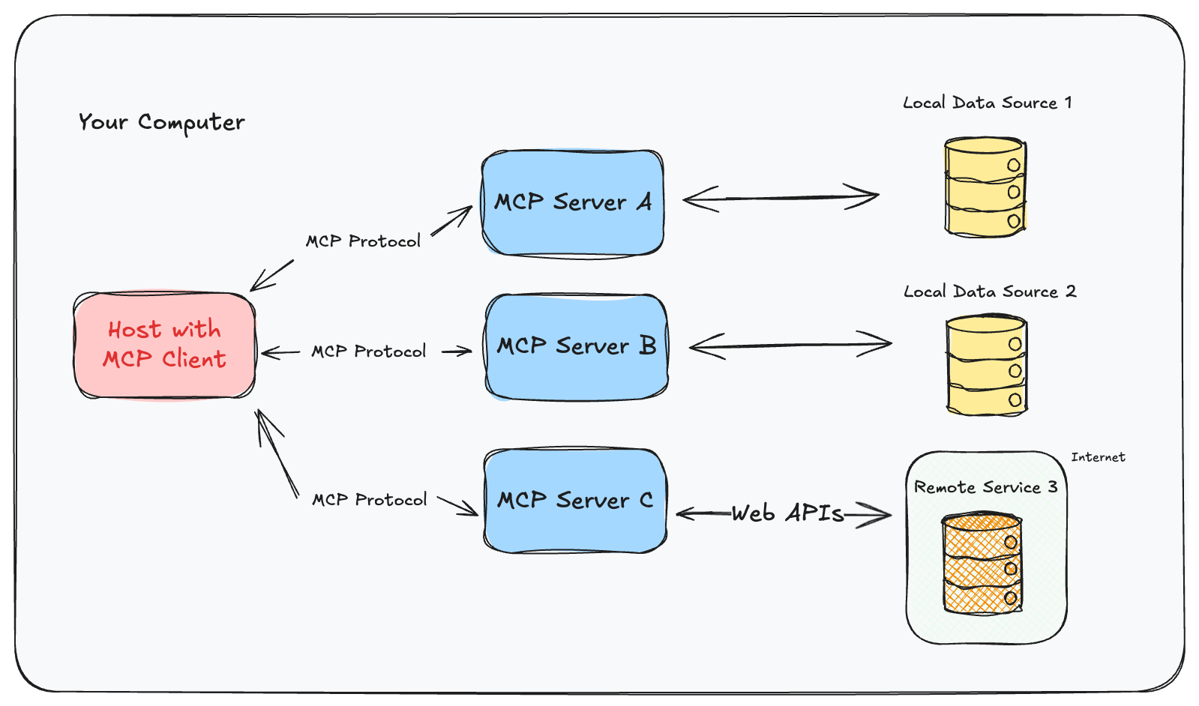
What are MCP Servers?
MCP (Model Context Protocol) is an open standard for connecting AI agents to external tools and knowledge
An MCP Server exposes capabilities (tools, APIs, documents, actions) in a model-friendly way
Think of it as a “universal adapter” between agents and external systems
Removes hard-coded integrations inside the agent

