Slide 1
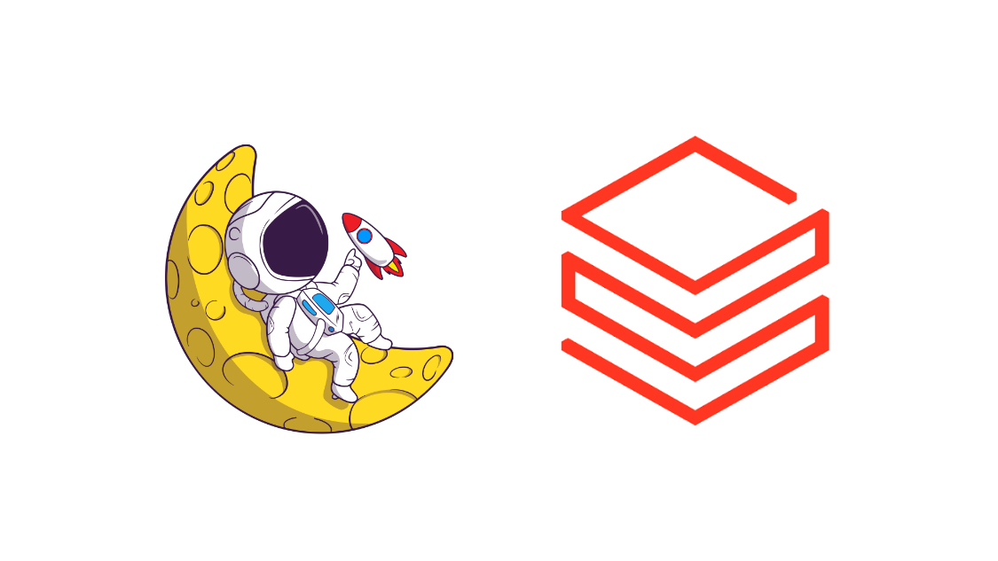
Databricks Unity AI Gateway

Slide 2
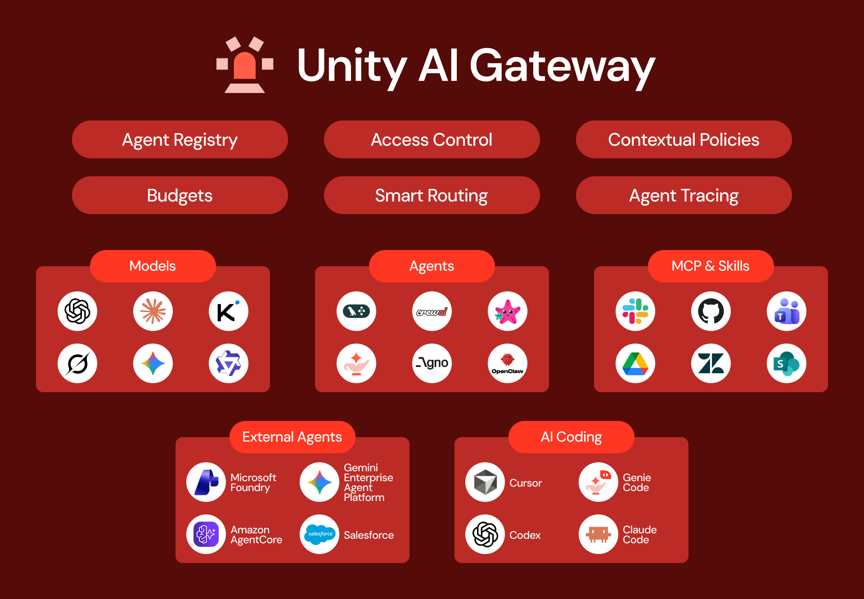
What is the Unity AI Gateway?
What is the Unity AI Gateway?
Unity AI Gateway provides a centralized governance and control layer for AI assets across the Databricks Data Intelligence Platform.
Provides unified access control for models, agents, MCP servers, tools, and other AI resources.
Supports usage tracking and budgets to monitor and control AI consumption and costs.
Provides smart routing to dynamically route requests across models and AI endpoints.
Enables agent tracing and observability to monitor agent behavior and interactions.

Slide 3
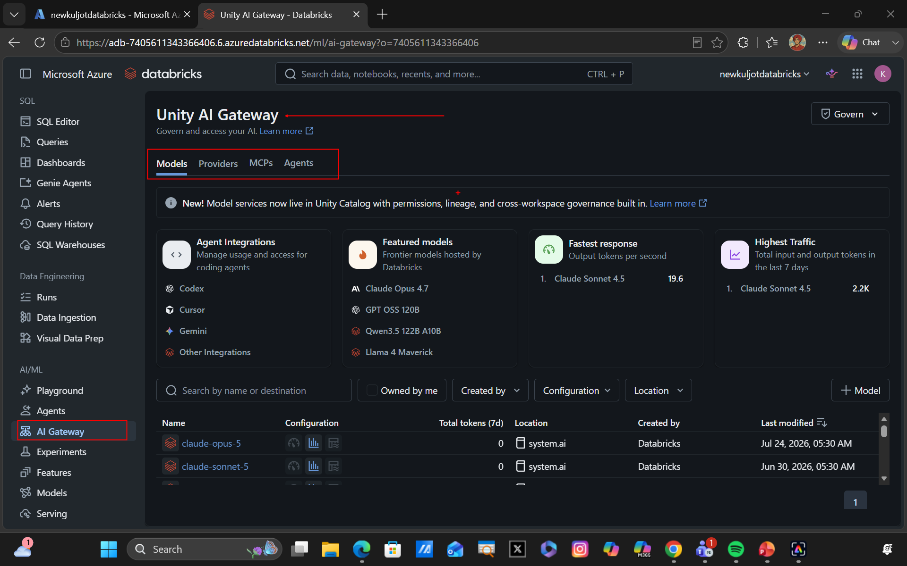

Slide 4
