Slide 1

The Databricks Agent Bricks Ecosystem

Slide 2
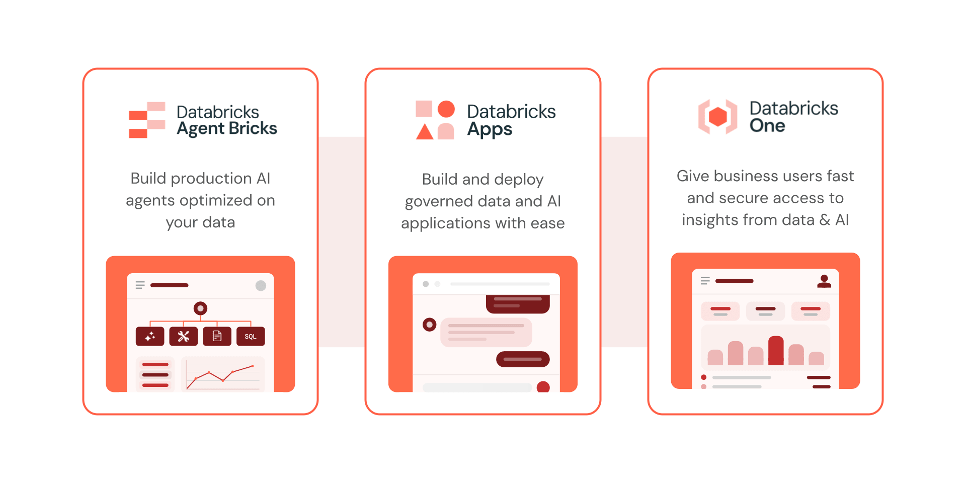
Databricks Agent Bricks
Agent Bricks streamlines building, evaluating, and optimizing production‑grade AI agents on your enterprise data. Just define your task and connect your data, and Agent Bricks handles the heavy lifting, including built-in evaluation and unified Unity Catalog governance.

Slide 3
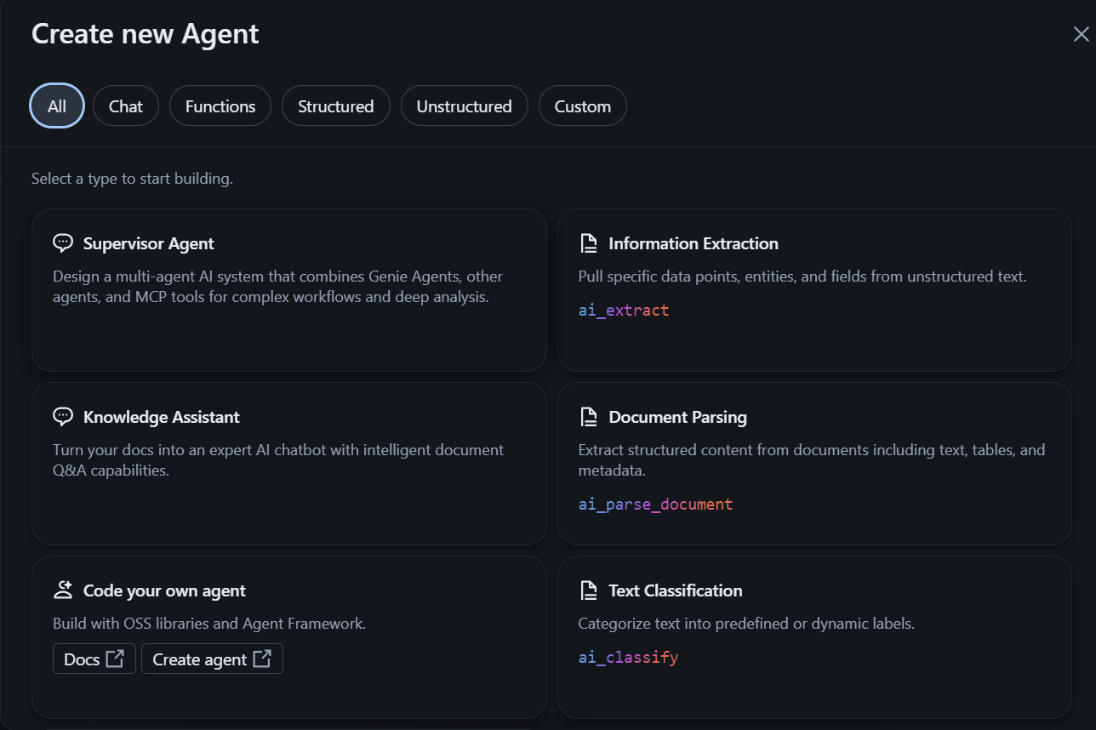
Agent Bricks = Prebuilt and customizable building blocks for creating enterprise AI agents and common GenAI workflows on Databricks.

Slide 4
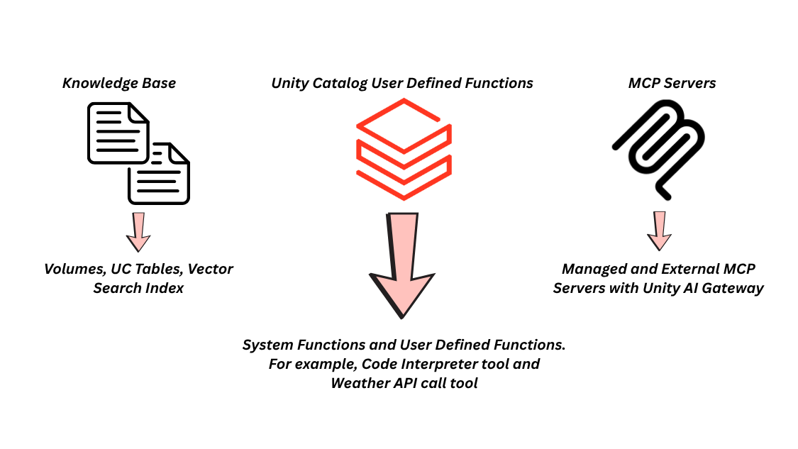
Tools in the Agent Bricks Ecosystem

Slide 5
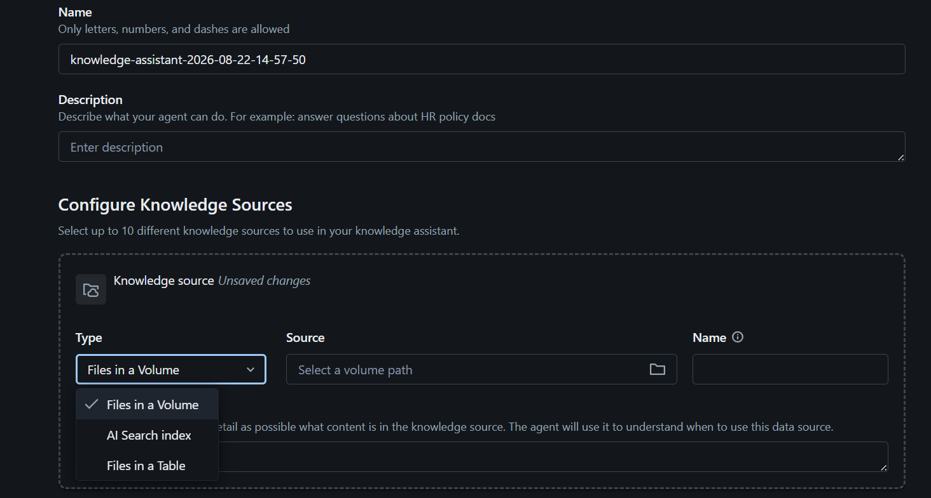
Knowledge Assistant with Agent Bricks
Knowledge can be grounded using multiple source types, including Files in a Volume, AI Search indexes, and Files in a Table.
Databricks handles much of the underlying retrieval and agent optimization, simplifying development of high-quality knowledge agents.

Slide 6
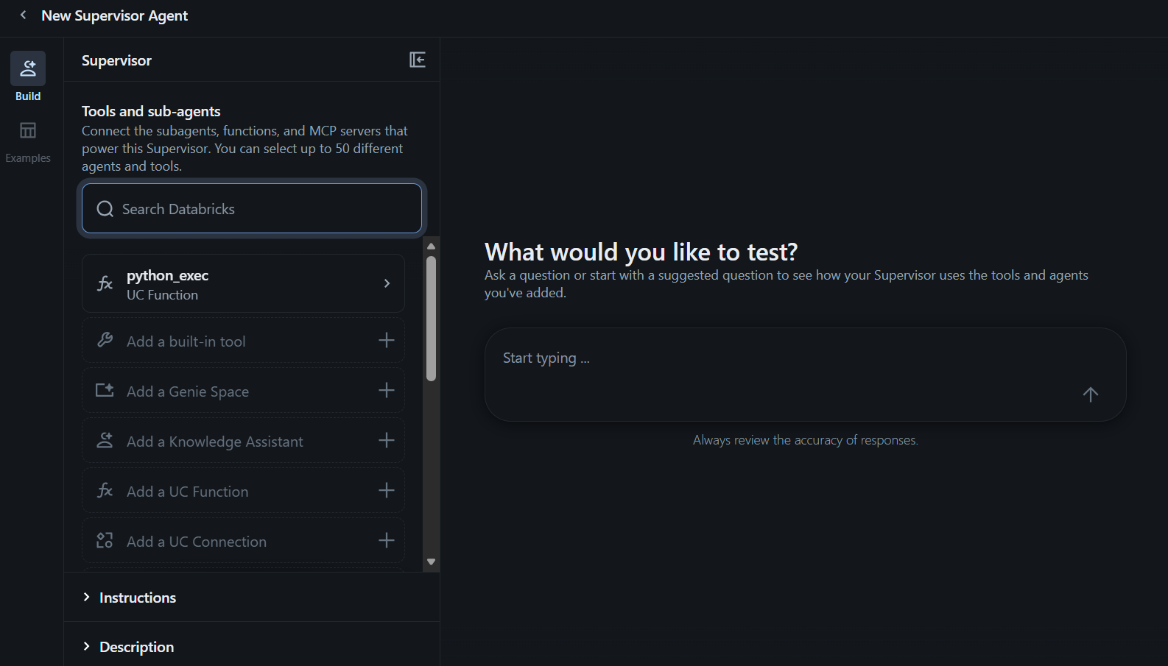
Supervisor Agent
Supervisor Agent orchestrates multiple specialized agents and tools to handle complex, multi-step user requests.
Enables developers to build sophisticated multi-agent systems without manually implementing all orchestration logic.

Slide 7
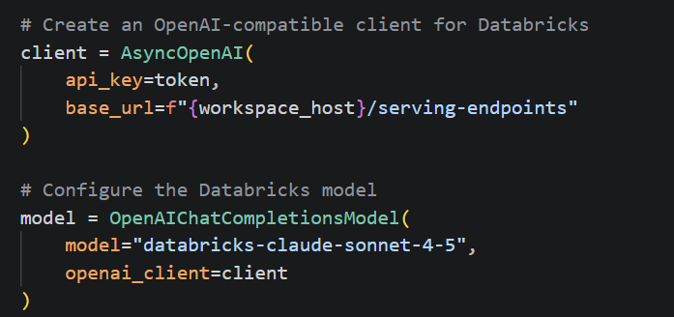
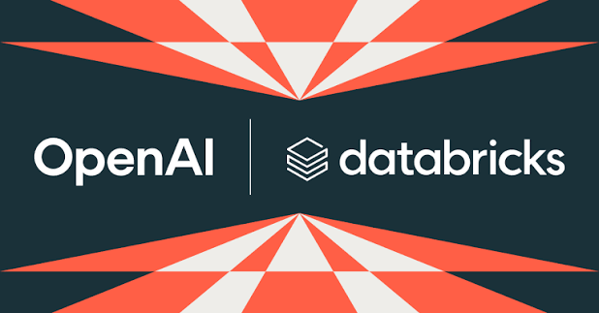
Custom Agents with OpenAI Agents SDK
For building custom agents with the OpenAI Agents SDK, you must implement the Agent loop yourself.
This involves a significant amount of code writing practices but provides a higher level of implementation flexibility.

