Slide 1
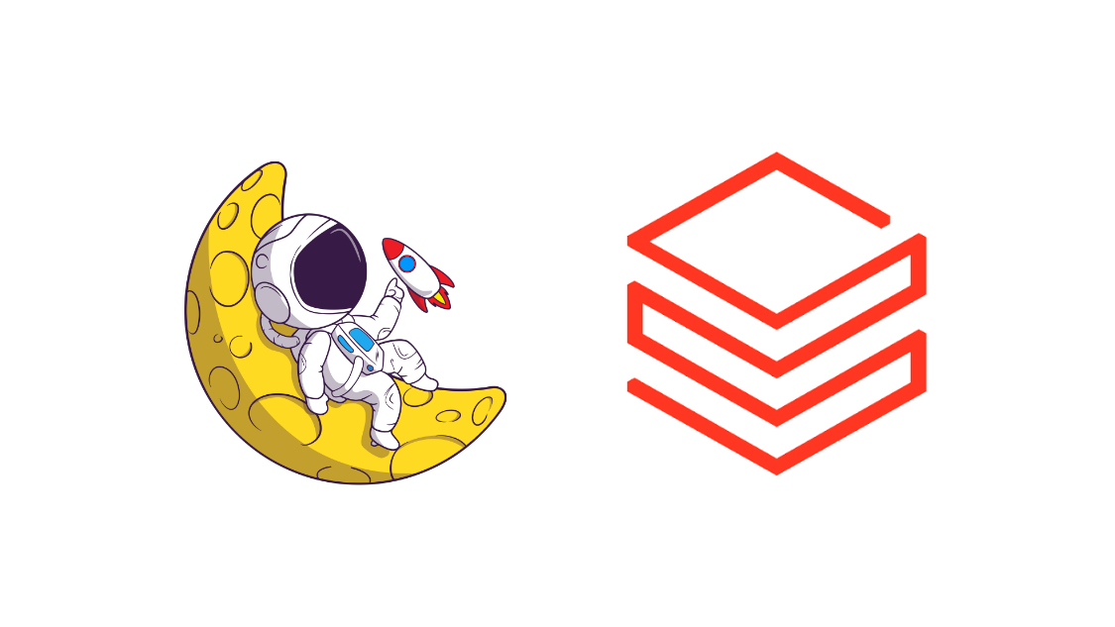
MCP Server Architecture Deep-Dive

Slide 2
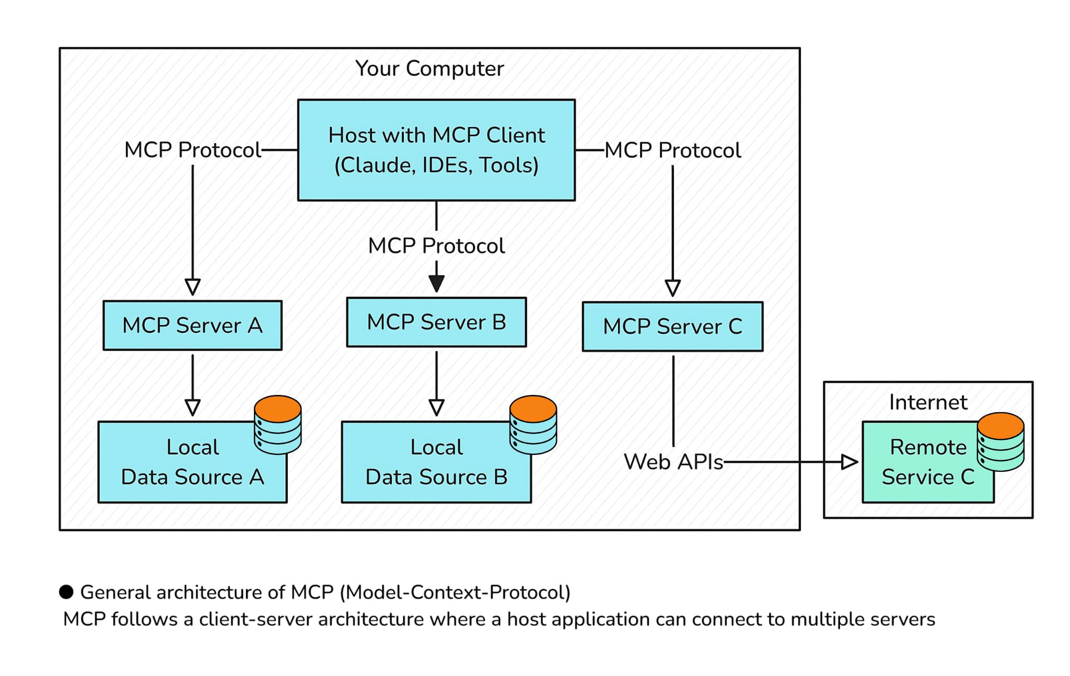
MCP – General Architecture
1) MCP Hosts: Programs like Claude Desktop, IDEs, or AI tools that want to access data through MCP
2)MCP Clients: Protocol clients that maintain 1:1 connections with servers
MCP Servers: Lightweight programs that each expose specific capabilities through the standardized Model Context Protocol
3) Local Data Sources: Your computer’s files, databases, and services that MCP servers can securely access
4) Remote Services: External systems available over the internet (e.g., through APIs) that MCP servers can connect to
At its core, MCP follows a client-server architecture where a host application can connect to multiple servers

Slide 3
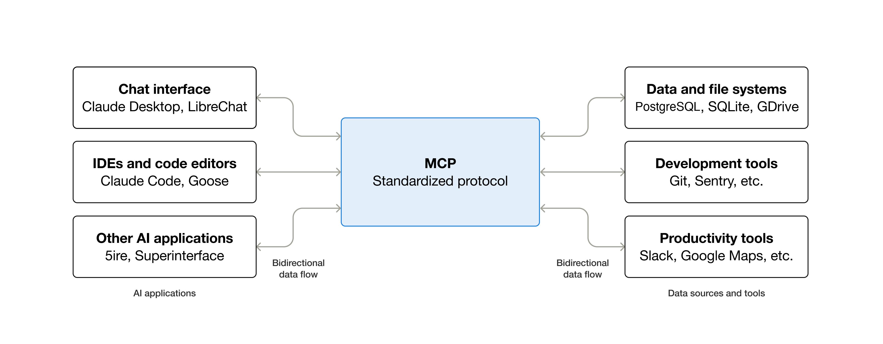
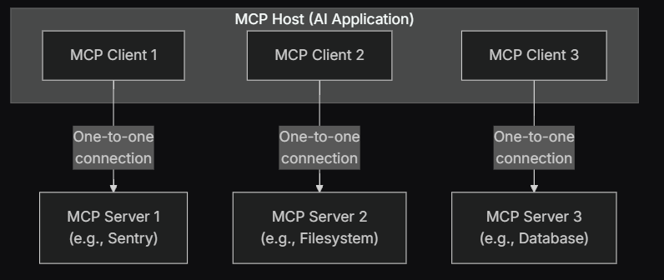
Visual Studio Code acts as an MCP host.
When Visual Studio Code establishes a connection to an MCP server, such as the Sentry MCP server, the Visual Studio Code runtime instantiates an MCP client object that maintains the connection to the Sentry MCP server.

Slide 4
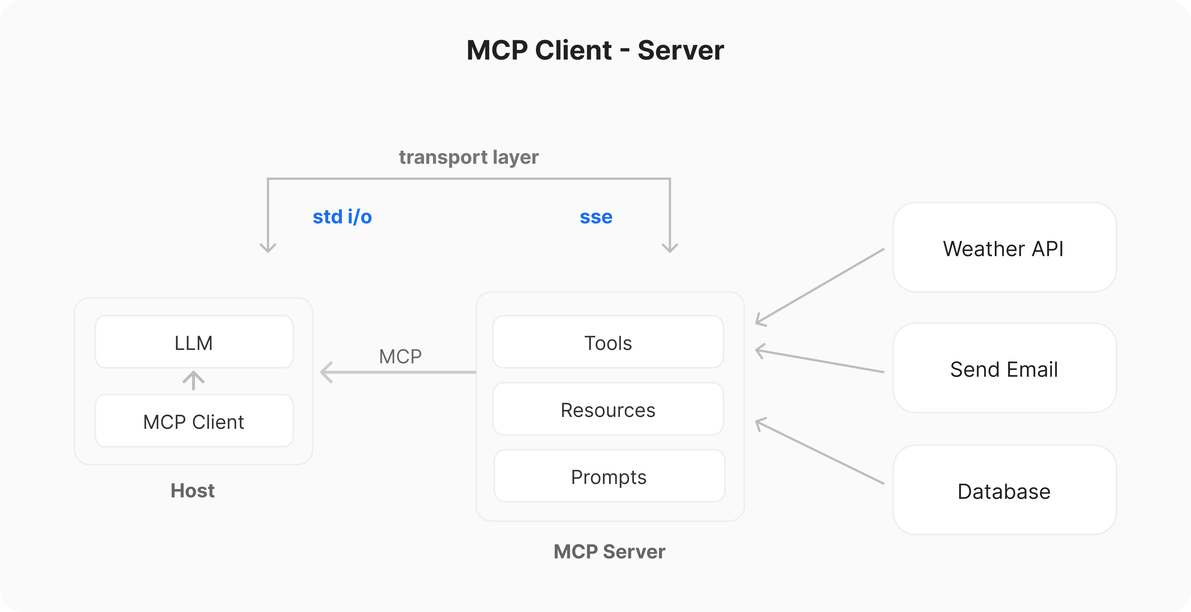
MCP Data and Transport Layer
Replaced by Streamable HTTP
Data Layer
JSON-RPC 2.0
The Data Layer Defines how the Queries should be structured for data retrieval and the Transport Layer defines how the Queries are transported over network calls

Slide 5
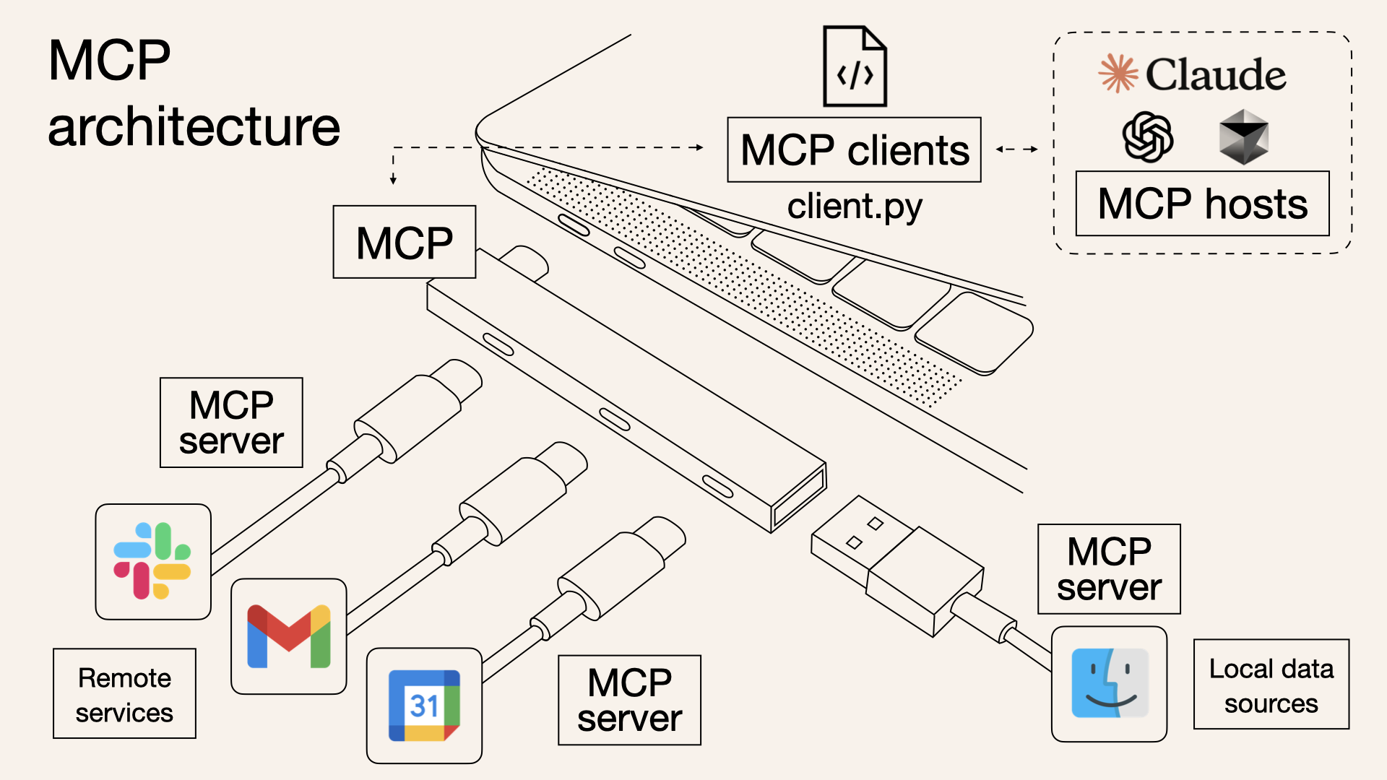
And then it looks something like……
This is EASY!
This is TOUGH!
You would focus on consuming the MCP server information if you are acting as the customer for those enterprises.
MCP Server – this is something you would develop if you are in the Gmail team, Slack Team or even part of a team that sells its API services

