Slide 1
Module 7:
EVALUATION TECHNIQUES
Goals and types of Evaluation, Evaluation through Expert analysis, Evaluation through user Participation, Choosing an evaluation method.

Slide 2
Understand evaluation techniques for evaluating interactive system.
.1 Explain the main goal of evaluation
.2 Evaluate the design by expert analysis
a. Cognitive walkthrough
b. Heuristic evaluation
c. Review-based evaluation
d. Model-based evaluation
3 Evaluate the design by user participation
a. Laboratory studies
b. Field studies
c. Observational techniques
d. Query techniques
e. Empirical design : Experimental evaluation
4. Choosing an evaluation method

Slide 3
we have discussed a design process to support the design of usable interactive systems. However, even if such a process is used, we still need to assess our designs and test our systems to ensure that they actually behave as we expect and meet user requirements. This is the role of evaluation.
Ideally, evaluation should occur throughout the design life cycle, with the results of the evaluation feeding back into modifications to the design. Clearly, it is not usually possible to perform extensive experimental testing continuously throughout the design, but analytic and informal techniques can and should be used.

Slide 4
3.1.1 Main goal of evaluation
Evaluation has three main goals:
To assess the extent and accessibility of the system’s functionality.
To assess user’s experience of the interaction.
To identify any specific problems with the system.

Slide 5
3.1.2 Evaluate the design
The first evaluation of a system should ideally be performed before any implementation work has started.
If the design itself can be evaluated, expensive mistakes can be avoided, since the design can be altered prior to any major resource commitments.
Consider four approaches to expert analysis:
a) Cognitive walkthrough.
b) Heuristic evaluation.
c) Review-based evaluation.
d) Model-based evaluation.

Slide 6
a) Cognitive walkthrough
The origin of this method is the code walkthrough familiar in software engineering.
Require a detailed review of a sequence of actions.
Sequence of actions refers to the steps that an interface will require a user to perform in order to accomplish some known task.
Evaluators then ‘step through’ that action sequence to check it for potential usability problems.
Main focus of the cognitive walkthrough is to establish how easy a system is to learn.

Slide 7
a) Cognitive walkthrough
Focus is on learning through exploration.
Experience shows that many users prefer to learn how to use a system by exploring its functionality hands on, and not after sufficient training or examination of a user’s manual.
Evaluators go through each step in the task and provide a ‘story’ about why that step is good or not good for a new user.

Slide 8
How to do it
Prior to doing a walkthrough, you need four things:
You need a description of a prototype of the interface. It doesn't have to be complete, but it should be fairly detailed. Things like exactly what words are in a menu can make a big difference.
You need a task description (for a representative task).
You need a complete, written list of the actions needed to complete the task.
You need an idea of who the users will be and what kind of experience they'll bring to the job.

Slide 9
Four question for each step in the action sequence
Is the effect of the action the same as the users goal at that point?
Will user see that the action is available?
Once user have found the correct action will they know it is the one they need?
After the action is taken, will users understand the feedback they get?

Slide 10
b) Heuristic Evaluation
Proposed by Nielsen and Molich.
Usability criteria (heuristics) are identified
Design examined by experts to see if these are violated
Example heuristics
  system behaviour is predictable
  system behaviour is consistent
  feedback is provided
Heuristic evaluation `debugs' design.

Slide 11

b) Heuristic Evaluation
1: Visibility of system status
2: Match between system & real world
3: User control & freedom
4: Consistency & standards
5: Error prevention
6: Recognition rather than recall
7: Flexibility and efficiency of use
8: Aesthetic and minimalist design
9: Help users recognize, diagnose, and recover from errors
10: Help and documentation

Slide 12

1: Visibility of system status
Keep users informed about what is going on.
  example: pay attention to response time
    0.1 sec : no special indicators needed, why?
    1.0 sec : user tends to lose track of data
    10 sec : max. duration if user to stay focused on action
    for longer delays, use percent-done progress bars
searching database for matches

Slide 13
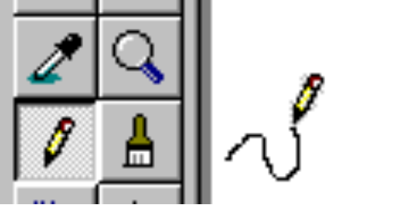
1: Visibility of system status
  Appropriate visible feedback
What mode am I in now?
What did I select?
How is the system interpreting my actions?

Slide 14

2: Match between system & real world
speak the users’ language
follow real world conventions
(bad) example: Mac desktop
  Dragging disk to trash
    should delete it, not eject it!

Slide 15
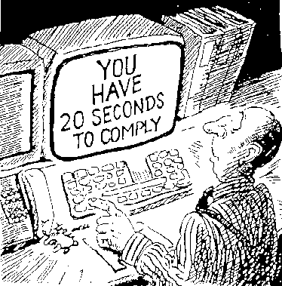
3: User control & freedom
“exits” for mistaken choices, undo, redo
don’t force down fixed paths
Strategies:
  Cancel button (for dialogs waiting for user input)
  Universal Undo (can get back to previous state)
  Interrupt (especially for lengthy operations)
  Quit (for leaving the program at any time)
  Defaults (for restoring a property sheet)
How do I get out of this?

Slide 16
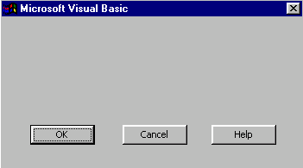
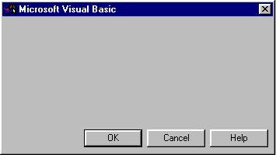
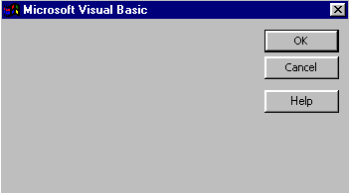
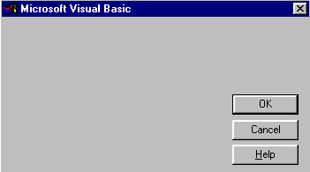
4: Consistency & standards
Consistency of effects
  same words, commands, actions will always have the same effect in equivalent situations
    predictability
Consistency of language and graphics
  same info/controls in same location on all screens/dialog boxes
  forms follow boiler plate
  same visual appearance across the system (e.g. widgets)
    e.g. different scroll bars in a single window system!
Consistency of input
  consistent syntax across complete system

Slide 17
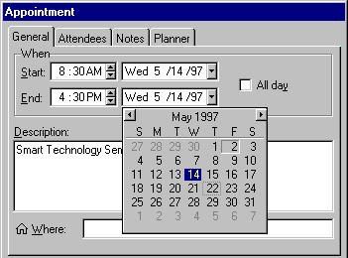
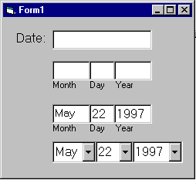
5: Error prevention
Try to make errors impossible
Modern widgets: only “legal commands” selected, or “legal data” entered
Provide reasonableness checks on input data
  on entering order for office supplies
    5000 pencils is an unusually large order. Do you really want to order that many?

Slide 18
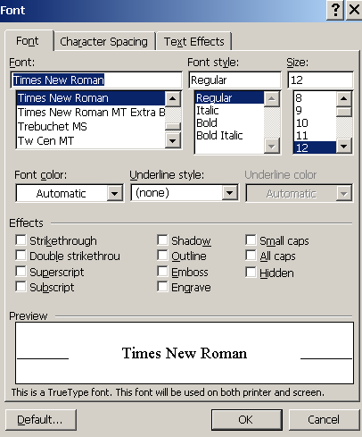
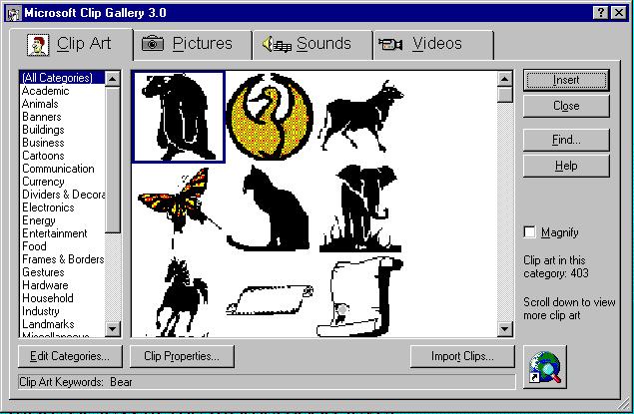
6: Recognition rather than recall
Computers good at remembering things, people aren’t!
Promote recognition over recall
  menus, icons, choice dialog boxes vs command lines, field formats
  relies on visibility of objects to the user (but less is more!)

Slide 19
7: Flexibility and efficiency of use
Experienced users should be able to perform frequently used operations quickly
Strategies:
  keyboard and mouse accelerators
    abbreviations
    command completion
    menu shortcuts
    function keys
    double clicking vs menu selection
  type-ahead (entering input before the system is ready for it)
  navigation jumps
    e.g., going to window/location directly, and avoiding intermediate nodes
  history systems
    WWW: ~60% of pages are revisits

Slide 20
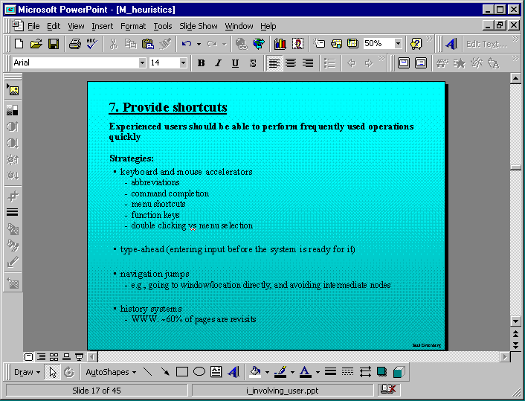
Keyboard accelerators for menus
Customizable toolbars and
palettes for frequent actions
Split menu, with recently used fonts on top
Double-click raises toolbar dialog box
Double-click raises object-specific menu
Scrolling controls for page-sized increments

Slide 21
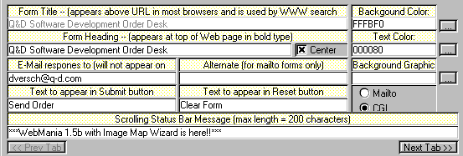
8: Aesthetic and minimalist design
No irrelevant information in dialogues
Bad example:

Slide 22
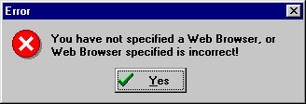
9: Help users recognize, diagnose, and recover from errors
error messages in plain language
precisely indicate the problem
constructively suggest a solution

Slide 23
10: Help and documentation
Help is not a replacement for bad design!
Simple systems:
  walk up and use; minimal instructions
Most other systems:
  feature rich
  some users will want to become “experts” rather than “casual” users
  intermediate users need reminding, plus a learning path
Many users do not read manuals
  prefer to spend their time pursuing their task
Usually used when users are in some kind of panic, need immediate help
  indicates need for online documentation, good search/lookup tools
  online help can be specific to current context
  paper manuals unavailable in many businesses!
    e.g. single copy locked away in system administrator’s office
Sometimes used for quick reference
  syntax of actions, possibilities...
  list of shortcuts ...

Slide 24
Types of help
Tutorial and/or getting started manuals
  short guides that people are likely to read when first obtaining their systems
    encourages exploration and getting to know the system
    tries to get conceptual material across and essential syntax
  on-line “tours”, exercises, and demos
    demonstrates very basic principles through working examples
Reference manuals
  used mostly for detailed lookup by experts
    rarely introduces concepts
    thematically arranged
  on-line hypertext
    search / find
    table of contents
    index
    cross-index

Slide 25
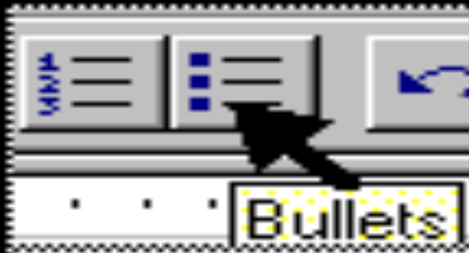
Types of help (cont.)
Reminders
  short reference cards
    expert user who just wants to check facts
    novice who wants to get overview of system’s capabilities
  keyboard templates
    shortcuts/syntactic meanings of keys; recognition vs. recall; capabilities
  tooltips
    text over graphical items indicates their meaning or purpose

Slide 26
3 stages for doing heuristic evaluation
Briefing session to tell experts what to do.
Evaluation period of 1-2 hours in which:
  Each expert works separately;
  Take one pass to get a feel for the product;
  Take a second pass to focus on specific features.
Debriefing session in which experts work together to prioritize problems.

Slide 27
Advantages and problems
Few ethical & practical issues to consider because users not involved.
Can be difficult & expensive to find experts.
Best experts have knowledge of application domain & users.
Biggest problems:
  Important problems may get missed;
  Many trivial problems are often identified;
  Experts have biases.

Slide 28
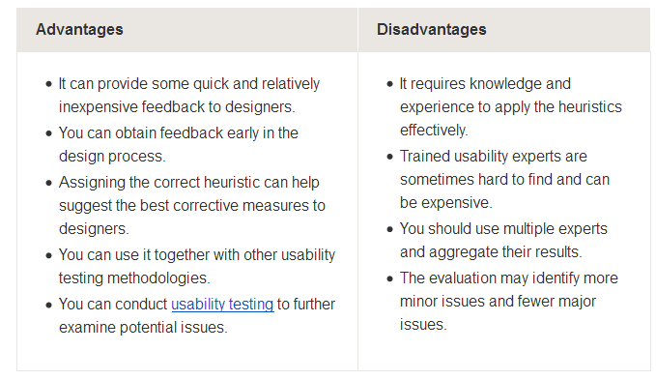
Advantages and Disadvantages of Heuristics

Slide 29
Comparison
Cognitive Walkthrough | Heuristic Evaluation
Informed by cognitive psychology | Informed by design practices
Done by one person (the researcher) | Done by appointed experts
More formal | Less formal
Better for highly structured tasks | Better for less structured tasks

Slide 30
c) Review-based Evaluation
Experimental psychology and human–computer interaction between them possess a wealth of experimental results and empirical evidence.
Examples of such issues are the usability of different menu types, the recall of command names, and the choice of icons.
A final approach to expert evaluation exploits this inheritance, using previous results as evidence to support or refuse aspects of the design.

Slide 31
c) Review-based Evaluation
It is expensive to repeat experiments continually and an expert review of relevant literature can avoid the need to do so.
The reviewer must therefore select evidence carefully, noting the experimental design chosen, the population of participants used, the analyses performed and the assumptions made.
Expertise in the area is required to ensure that correct assumptions are made.

Slide 32
d) Model-based Evaluation
A third expert-based approach.
Certain cognitive and design models provide a means of combining design specification and evaluation into the same framework.
For example, GOMS (Goals, Operators, Methods and Selection).
GOMS is the model that predicts user performance with a particular interface and can be used to filter particular design options.

Slide 33
d) Model-based Evaluation
GOMS: Goals, Operators, Methods, and Selection rules are the elements of a model that describes purposeful HCI.
  Goals specify what the user wants and intends to achieve.
  Operators are the building blocks for describing human-computer interaction at the concrete level.
  Methods are programs built with operators that are designed to accomplish goals.
  Selection rules predict which method will be used. For example, “If the mouse is working, select ‘point to an item on screen’, if not select ‘choose OPEN option in file menu’”.

Slide 34
Usability analysis methods HCI
In Human-Computer Interaction (HCI), usability analysis methods aim to assess how easy and enjoyable it is for users to achieve their goals using a product or system.
Usability Testing
Heuristic Evaluation
Cognitive Walkthrough
Contextual Inquiry
Scenario-Based Testing

Slide 35
Usability Testing
Observing real users as they interact with a product or system to identify usability problems and areas for improvement.
Types:
Moderated: A facilitator guides the user through tasks and observes their behavior.
Unmoderated: Users complete tasks independently, often with automated data collection.
In-person: Users and researchers are in the same physical location.
Remote: Users complete tasks from a distance, often using video conferencing or screen sharing.

Slide 36
Goals:
Determine whether users can complete tasks successfully and independently.
Assess user performance and mental state.
Identify usability problems and their severity.
Find solutions to usability problems.
Example:
A researcher might ask users to navigate a website to find a specific product, observing their actions and listening to their feedback.

Slide 37
Heuristic Evaluation
Experts evaluate a product or system against a set of usability principles (heuristics)
Process:
Experts independently review the interface and identify potential usability problems.
Example:
Nielsen's 10 Usability Heuristics (visibility of system status, match between system and the real world, user control and freedom, consistency and standards, error prevention, recognition rather than recall, flexibility and efficiency of use, aesthetic and minimalist design, help users recognize, diagnose, and recover from errors, help and documentation)

Slide 38
Cognitive Walkthrough
Experts simulate how users would interact with a system, focusing on the cognitive processes involved.
Process:
Experts walk through the user interface, considering the user's goals, knowledge, and potential difficulties.
Example:
A cognitive walkthrough might focus on how a user would understand and use a specific feature of a software application

Slide 39
Contextual Inquiry
Observing users in their natural environment to understand their needs and behaviors.
Process:
Researchers visit users at their workplace or home, observing how they use the product or system in context.
Example:
A researcher might observe how doctors use a medical software application in a hospital setting

Slide 40
Scenario-Based Testing
Users are given specific scenarios and tasks to complete, allowing researchers to observe their interactions and identify usability issues.
Process:
Researchers create realistic scenarios that reflect how users might use the product or system.
Example:
A user might be asked to navigate a website to book a flight, with the researcher observing their actions and listening to their feedback

Slide 41
Evaluate the design by user participation

Slide 42
a) Laboratories Studies
Users are taken out of their normal work environment to take part in controlled tests, often in a specialist usability laboratory.
This approach has a number of benefits and disadvantages.
A well-equipped usability laboratory may contain sophisticated audio/visual recording and analysis facilities, two-way mirrors, instrumented computers and the like.
In addition, the participant operates in an interruption-free environment.

Slide 43
a) Laboratories Studies
It is especially difficult to observe several people cooperating on a task in a laboratory situation.
Also some very constrained single-user tasks may be adequately performed in a laboratory.
We may deliberately want to manipulate the context in order to uncover problems or observe less used procedures, or we may want to compare alternative designs within a controlled context.

Slide 44
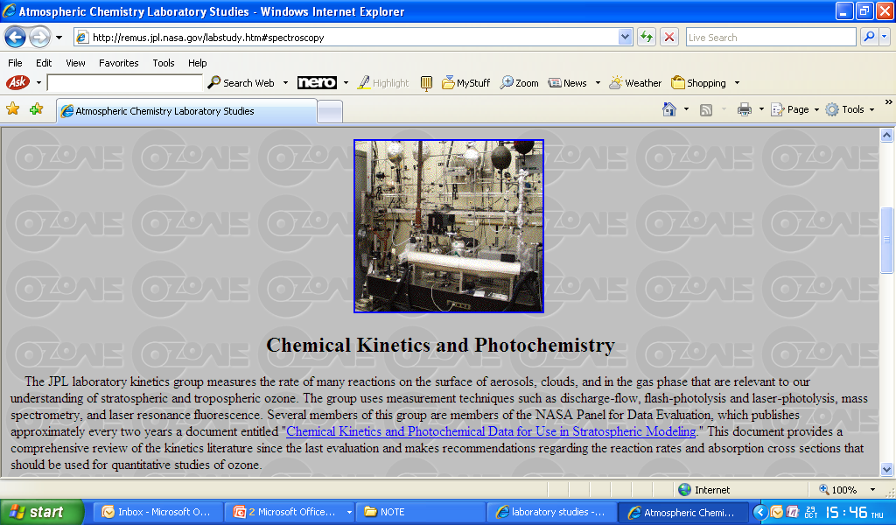
Example of Laboratory Studies

Slide 45
a) Laboratories Studies
Advantages:
  specialist equipment available
  uninterrupted environment
Disadvantages:
  lack of context
  difficult to observe several users cooperating
Appropriate
  if system location is dangerous or impractical for constrained single user systems to allow controlled manipulation of use

Slide 46
b) Field Studies
This method takes the designer or evaluator out into the user’s work environment in order to observe the system in action.
High levels of ambient noise, greater levels of movement and constant interruptions make field observation difficult.
The context is retained and we are seeing the user in his ‘natural environment’.

Slide 47
b) Field Studies
Controlled experiments can be useful for evaluation of specific interface features, and must normally be conducted under laboratory conditions.
From an economic angle, we need to weigh the costs of establishing recording equipment in the field, and possibly disrupting the actual work situation, with the costs of taking one or more participants away from their jobs into the laboratory.

Slide 48
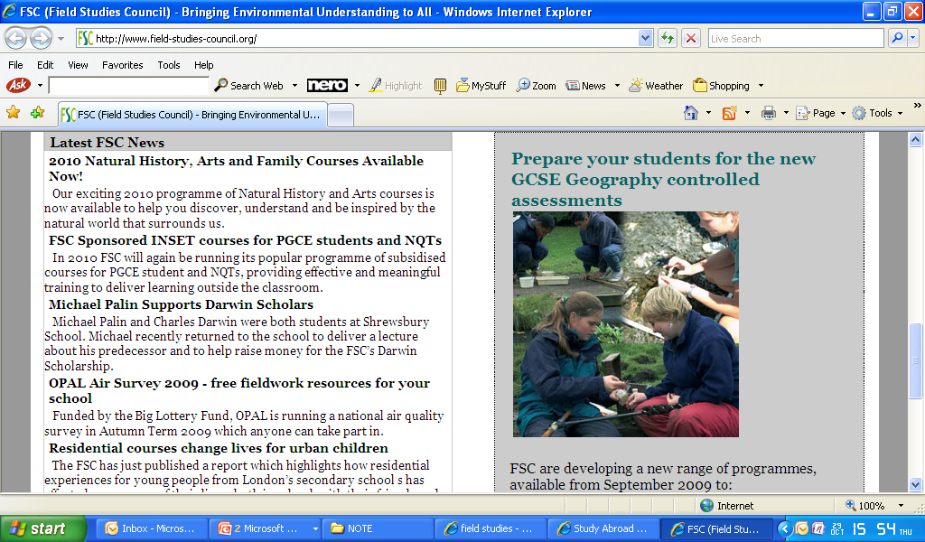
Example of Field Studies

Slide 49
b) Field Studies
Advantages:
  natural environment
  context retained (though observation may alter it)
  longitudinal studies possible
Disadvantages:
  distractions
  noise
Appropriate
  where context is crucial for longitudinal studies

Slide 50
c) Empirical method
Most powerful methods of evaluating a design or an aspect of a design is to use a controlled experiment.
Provides empirical evidence to support a particular claim or hypothesis.
Can be used to study a wide range of different issues at different levels of detail.
Evaluator chooses a hypothesis to test, which can be determined by measuring some attribute of participant behavior.

Slide 51
c) Empirical method
Any experiment has the same basic form.
Within this basic form there are a number of factors that are important to the overall reliability of the experiment.
These include the participants chosen, the variables tested and manipulated, and the hypothesis tested.

Slide 52
d) Observational Methods
Think Aloud
Cooperative evaluation
Protocol analysis
Automated analysis
Post-task walkthroughs

Slide 53
Think Aloud
user observed performing task
user asked to describe what he is doing and why, what he thinks is happening etc.
Advantages
  simplicity - requires little expertise
  can provide useful insight
  can show how system is actually use
Disadvantages
  subjective
  selective
  act of describing may alter task performance

Slide 54
Cooperative evaluation
variation on think aloud
user collaborates in evaluation
both user and evaluator can ask each other questions throughout
Additional advantages
  less constrained and easier to use
  user is encouraged to criticize system
  clarification possible

Slide 55
Protocol analysis
paper and pencil – cheap, limited to writing speed
audio – good for think aloud, difficult to match with other protocols
video – accurate and realistic, needs special equipment, obtrusive
computer logging – automatic and unobtrusive, large amounts of data difficult to analyze
user notebooks – coarse and subjective, useful insights, good for longitudinal studies
Mixed use in practice.
audio/video transcription difficult and requires skill.
Some automatic support tools available

Slide 56
automated analysis – EVA
Workplace project
Post task walkthrough
  user reacts on action after the event
  used to fill in intention
Advantages
  analyst has time to focus on relevant incidents
  avoid excessive interruption of task
Disadvantages
  lack of freshness
  may be post-hoc interpretation of events

Slide 57
post-task walkthroughs
transcript played back to participant for comment
  immediately → fresh in mind
  delayed → evaluator has time to identify questions
useful to identify reasons for actions and alternatives considered
necessary in cases where think aloud is not possible

Slide 58
e) Query Techniques
Interviews
Questionnaires

Slide 59
Interviews
analyst questions user on one-to -one basis
usually based on prepared questions
informal, subjective and relatively cheap
Advantages
  can be varied to suit context
  issues can be explored more fully
  can elicit user views and identify unanticipated problems
Disadvantages
  very subjective
  time consuming

Slide 60
Questionnaires
Set of fixed questions given to users
Advantages
  quick and reaches large user group
  can be analyzed more rigorously
Disadvantages
  less flexible
  less probing

Slide 61
Questionnaires (ctd)
Need careful design
  what information is required?
  how are answers to be analyzed?
Styles of question
  general
  open-ended
  scalar
  multi-choice
  ranked

Slide 62
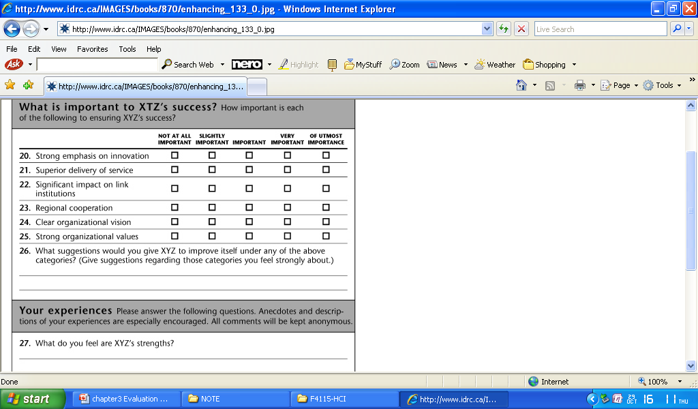

Slide 63
3.2.4 Factors considered in experimental design
  Participants
  Variables
  Hypothesis
  Experimental design
  Statistical measures

Slide 64
A - Participants
The choice of participants is vital for success.
Participants should be chosen to match the expected user population as closely as possible.
If participants are not actual users, they should be chosen to be of a similar age and level of education as the intended user group.
A second issue relating to the participant set is the sample size chosen.
The sample size must be large enough to be considered to be representative of the population.

Slide 65
B - Variables
Experiments manipulate and measure variables under controlled conditions, in order to test the hypothesis.
2 main types of variable:
1. Those that are manipulated or changed
(known as the independent variables)
2. Those that are measured
(the dependent variables).

Slide 66
B - Variables
Independent variables are those elements of the experiment that are manipulated to produce different conditions for comparison.
E.g : interface style, level of help, number of menu items and icon design.
Each of these variables can be given a number of different values.
Each value that is used in an experiment is known as a level of the variable.
More complex experiments may have more than one independent variable.

Slide 67
B - Variables
Dependent variables are the variables that can be measured in the experiment, their value is depend on the changes made to the independent variable.
Must be measurable in some way, it must be affected by the independent variable, and, as far as possible, unaffected by other factors.
Common choices of dependent variable in evaluation experiments are the time taken to complete a task, the number of errors made, user preference and the quality of the user’s performance

Slide 68
C - Hypothesis
Prediction of the outcome of an experiment.
Framed in terms of the independent and dependent variables.
Stating that a variation in the independent variable will cause a difference in the dependent variable.
Aim of the experiment is to show that this prediction is correct.

Slide 69
D – Experimental Design
In order to produce reliable and generalizable results, an experiment must be carefully designed.
There are two main methods: between-subjects and within-subjects.
In a between-subjects design, each participant is assigned to a different condition.
There are at least two conditions: the experimental condition (in which the variable has been manipulated) and the control (which is identical to the experimental condition except for this manipulation).

Slide 70
D – Experimental Design
The second experimental design is within-subjects.
Each user performs under each different condition.
Within-subjects is less costly than between-subjects, since fewer users are required, and it can be particularly effective where learning is involved.
There is also less chance of effects from variation between participants.
Choice of experimental method depend on resources available, how far learning transfer is likely or can be controlled, and how representative the participant group is considered to be.

Slide 71
E – Statistical Measures
2 rules of statistical analysis are to look at the data and to save the data.
Easy to carry out statistical tests blindly when a glance at a graph, histogram or table of results would be more instructive.
In particular, looking at the data can expose outliers, single data items that are very different from the rest.
Saving the data is important, as we may later want to try a different analysis method.

Slide 72
E – Statistical Measures
Choice of statistical analysis depends on the type of data and the questions that want to answer.
Variables can be classified as either discrete variables or continuous variables.
A discrete variable can only take a finite number of values or levels; for example, a screen color that can be red, green or blue.
A continuous variable can take any value (although it may have an upper or lower limit); for example a person’s height or the time taken to complete a task.

Slide 73
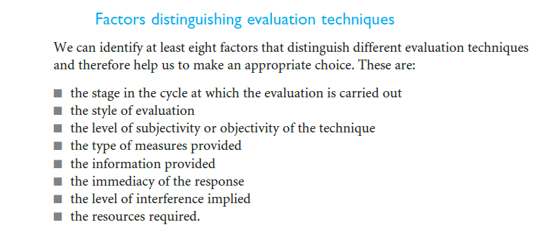
Choosing an evaluation method

Slide 74
Choosing an Evaluation Method
when in process: design vs. implementation
style of evaluation: laboratory vs. field
how objective: subjective vs. objective
type of measures: qualitative vs. quantitative
level of information: high level vs. low level
level of interference: obtrusive vs. unobtrusive
resources available: time, subjects,
equipment, expertise

Slide 75
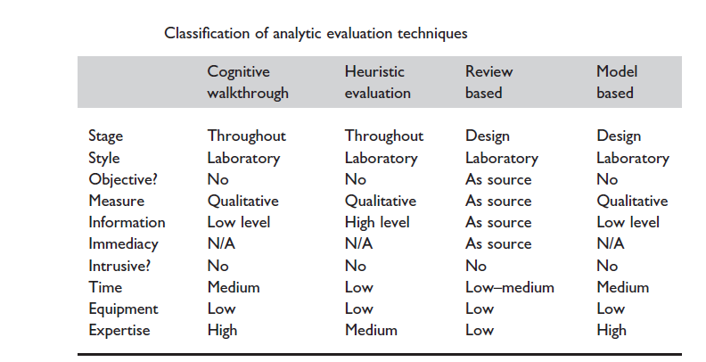
classification of evaluation techniques

Slide 76
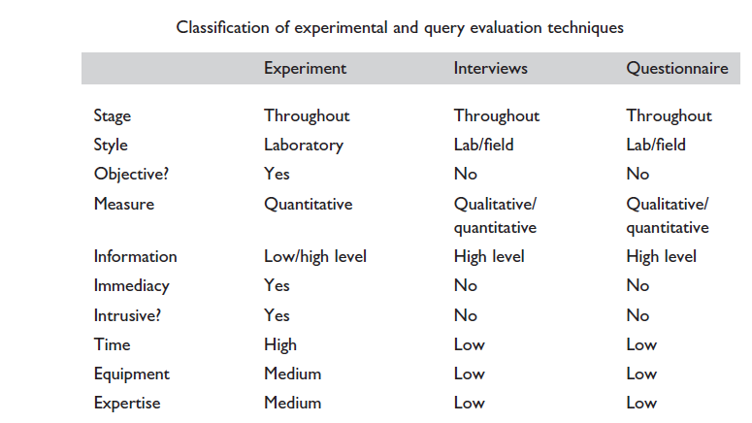

Slide 77
