Slide 1
Interactive system development Frame work
A development framework refers to a modular approach for interactive program development where the core computational and interface parts are developed in a modularized fashion and combined in a flexible manner.
Such a development framework is often based on the UI toolkit, which provides the abstraction for the interface parts. For one, the framework allows the concept of plugging in different interfaces for the same model computation and easier maintenance of the overall program.
In addition, such a practice also promotes the productivity as well as easier and less costly pos tmaintenance. MVC (model, view, and controller) is one such major framework.

Slide 2
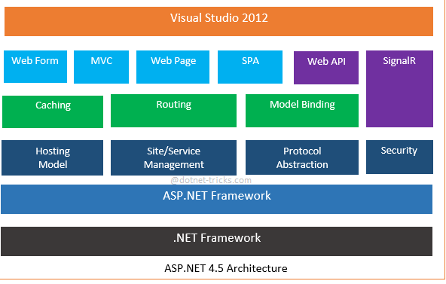

Slide 3
Introduction
Model View Controller or MVC as it is popularly called, is a software design pattern for developing web applications.
MVC is one of three ASP.NET programming models.
Model–view–controller (MVC) is a software architecture pattern which separates the representation of information from the user's interaction with it .

Slide 4
History of MVC
Presented by Trygve Reenskaug in 1979
First used in the Smalltalk-80 framework
  Used in making Apple interfaces (Lisa and Macintosh

Slide 5
MVC uses
Smalltalk’s MVC implementation inspired many other GUI frameworks such as:
The NEXTSTEP and OPENSTEP development environments encourage the use of MVC.
Cocoa and GNUstep, based on these technologies, also use MVC.
Microsoft Foundation Classes (MFC) (also called Document/View architecture)
Java Swing
The Qt Toolkit (since Qt4 Release).

Slide 6
Parts of MVC
A Model View Controller pattern is made up of the following three parts:
Model
View
Controller

Slide 7
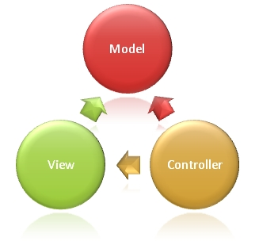
The MVC model defines web
applications with 3 logic layers:
The business layer (Model logic)
The display layer (View logic)
The input control (Controller logic)

Slide 8
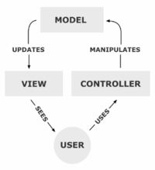

Slide 9
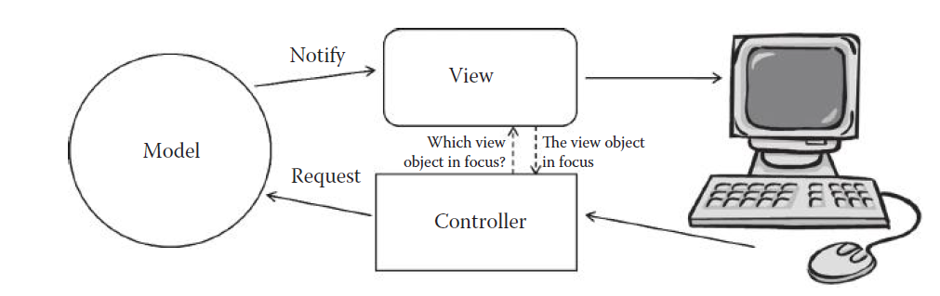

Slide 10
Model
The model is responsible for managing the data of the application.
It responds to the request from the view and it also responds to instructions from the controller to update itself
It is the lowest level of the pattern which is responsible for maintaining data.
The Model represents the application core (for instance a list of database records).
It is also called the domain layer

Slide 11
View
The View displays the data (the database records).
A view requests information from the model, that it needs to generate an output representation.
It presents data in a particular format like JSP, ASP, PHP.
MVC is often seen in web applications, where the view is the HTML page.

Slide 12
Controller
The Controller is the part of the application that handles user interaction.
Typically controllers read data from a view, control user input, and send input data to the model.
It handles the input, typically user actions and may invoke changes on the model and view.

Slide 13
View/Controller
In many application architectures, the view and controller may be merged into one module or object because they are so tightly related to each other
UI button object will be defined by attribute parameters such as its size, label, and color as well as the event handler that invokes the methods on the model for change or manipulation
large-scale systems, to quickly explore
and implement and modify various user interfaces (view/controller) for the same core functional model. This is based on a famous software engineering principle: the separation of concern

Slide 14
Workflow in MVC
Though MVC comes in diﬀerent ﬂavours, the control ﬂow generally works as follows:
1. The user interacts with the user interface in some way (e.g., user presses a button)
2. A controller handles the input event from the user interface, often via a registered handler or callback.
3. The controller accesses the model, possibly updating it in a way appropriate to the user’s
action (e.g., controller updates user’s shopping cart).

Slide 15
4. A view uses the model to generate an appropriate user interface (e.g., view produces a screen listing the shopping cart contents).
The view gets its own data from the model. The model has no direct knowledge of the view.
5. The user interface waits for further user interactions, which begins the cycle anew.

Slide 16
Dependence hierarchy
There is usually a kind of hierarchy in the MVC pattern.
The Model knows only about itself.
That is, the source code of the Model has no references to either the View or Controller.

Slide 17
The View however, knows about the Model. It will poll the Model about the state, to know what to display.
That way, the View can display something that is based on what the Model has done.
But the View knows nothing about the Controller.

Slide 18
The Controller knows about both the Model and the View.
Take an example from a game: If you click on the "fire" button on the mouse, the Controller knows what fire function in the Model to call.
If you press the button for switching between first and third person, the Controller knows what function in the View to call to request the display change.

Slide 19
Why dependence hierarchy is used?
The reason to keep it this way is to minimize dependencies.
No matter how the View class is modified, the Model will still work.
Even if the system is moved from a desktop operating system to a smart phone, the Model can be moved with no changes.
But the View probably needs to be updated, as will the Controller.

Slide 20
Use in web applications
Although originally developed for personal computing, Model View Controller has been widely adapted as an architecture for World Wide Web applications in all major programming languages.
Several commercial and noncommercial application frameworks have been created that enforce the pattern.
These frameworks vary in their interpretations, mainly in the way that the MVC responsibilities are divided between the client and server

Slide 21
Early web MVC frameworks took a thin client approach that placed almost the entire model, view and controller logic on the server.
In this approach, the client sends either hyperlink requests or form input to the controller and then receives a complete and updated web page from the view; the model exists entirely on the server.
As client technologies have matured, frameworks such as JavaScript MVC and Backbone have been created that allow the MVC components to execute partly on the client

Slide 22
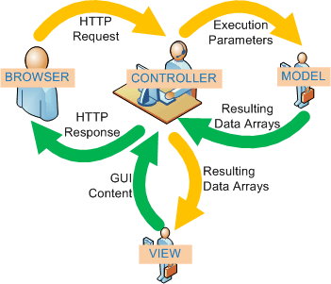
Working of MVC in web application

Slide 23
Web forms vs. MVC
The MVC programming model is a lighter alternative to traditional ASP.NET (Web Forms).
It is a lightweight, highly testable framework, integrated with all existing ASP.NET features, such as Master Pages, Security, and Authentication.

Slide 24
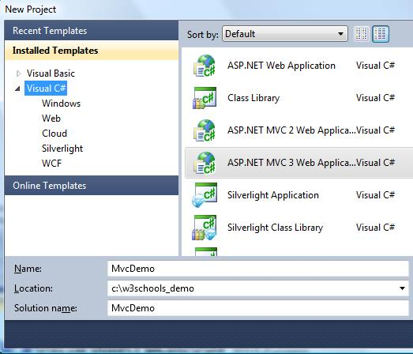
Creating the Web Application
If you have Visual Web Developer installed, start Visual Web Developer and select New Project.

Slide 25
Steps
In the New Project dialog box:
Open the Visual C# templates
Select the template ASP.NET MVC 3 Web Application
Set the project name to MvcDemo
Set the disk location to something like c:\example_demo
Click OK
When the New Project Dialog Box opens:
Select the Internet Application template
Select the Razor Engine
Select HTML5 Markup
Click OK

Slide 26
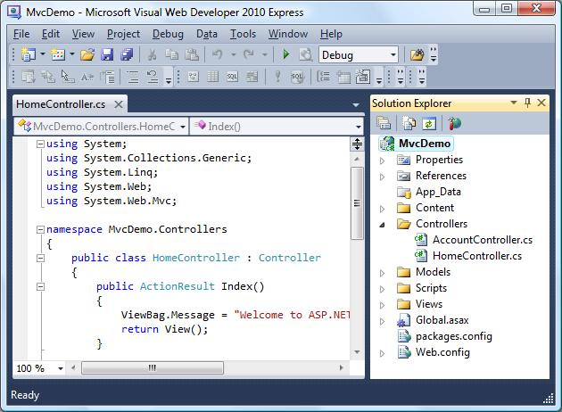
Visual Studio Express will create a project much like this:

Slide 27
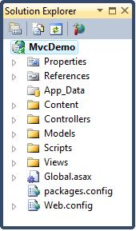
MVC Folders
Application information
Properties
References
Application folders
App_Data Folder
Content Folder
Controllers Folder
Models Folder
Scripts Folder
Views Folder
Configuration files
Global.asax
packages.config
Web.config

Slide 28
Advantages
Clear separation between presentation logic and business logic.
Each object in mvc have distinct responsibilities.
parallel development
easy to maintain and future enhancements
All objects and classes are independent of each other.

Slide 29
Disadvantages
Increased complexity
Inefficiency of data access in view
Difficulty of using MVC with modern user interface too.
For parallel development there is a needed multiple programmers.
Knowledge on multiple technologies is required.

Slide 30
Example
The Observer pattern allows the BankAccount class to notify multiple views without minimal information.
Observers can register themselves with their Subjects. No strings attached!

Slide 31
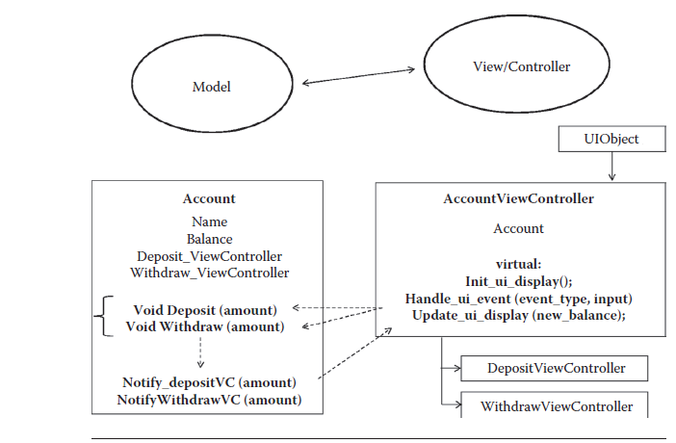
Example of MVC Implementation 1: Simple Bank Application

Slide 32
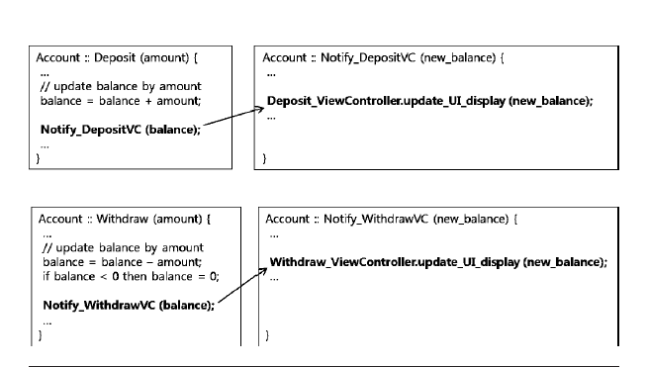

Slide 33
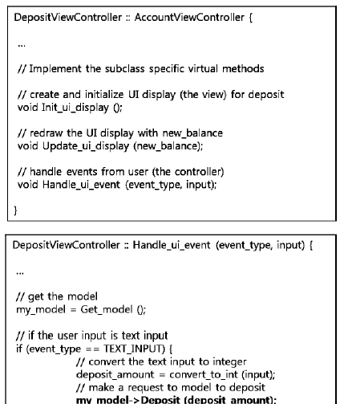

Slide 34
Observer Class Diagram
Observable
Observer
+addObserver(Observer)
+deleteObserver(Observer)
+notifyObservers(Object)
#hasChanged() : boolean
#setChanged()
+update(Observable,
Object)
AccountView
+update(Observable,
Object)
BankAccount
+widthdraw(double) : long
+deposit(double) : long
+getBalance() : double
SummaryView
+update(Observable,
Object)

Slide 35
Transactions Happen!
Controller
BankAccount
AccountView
SummaryView
deposit()
setChanged()
notifyObservers()
update()
getBalance()
update()
getBalance()

Slide 36
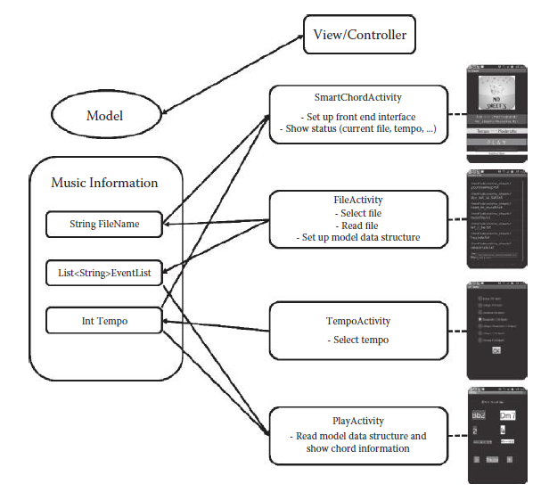
No sheet

