Slide 1

ERGONOMICS

Slide 2
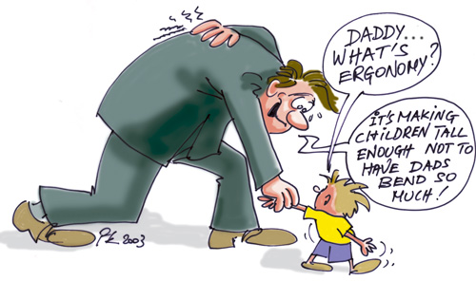
WHAT DOES IT MEAN…..?
Derived from two Greek words:
“Nomoi” meaning natural laws
“Ergon” meaning work
Hence, ergonomists study human
capabilities in relationship to work
demand.
Ergonomics is the science and the art of fitting the job and the workplace to workers’ needs.
It is the study of work
It is a way to make jobs/tasks
fit the employees better
It is a way to make work easier

Slide 3


WHY ERGONOMICS EMERGED…?
As early as 18th century doctors noted that workers who required to maintain body positions for long periods of time developed musculoskeletal problems.
Within last 20 years research has clearly established connections between certain job tasks and RSI or MSD.

Slide 4
3 MAIN ERGONOMIC PRINCIPLES:
Work activities should permit worker to adopt several different healthy and safe postures.
Muscle forces should be done by the largest appropriate muscle groups available
Work activities s/b performed with joints at about mid-point of their ROM (esp. head,trunk,UE)

Slide 5
TYPES OF ERGONOMICS
Physical ergonomics is the human body’s responses to physical and physiological work loads. Repetitive strain injuries from repetition, vibration, force, and posture fall into this category.
Cognitive ergonomics deals with the mental processes and capacities of humans when at work. Mental strain from workload, decision making, human error, and training fall into this category.
Organizational ergonomics deals with the organizational structures, policies and processes in the work environment, such as shift work, scheduling, job satisfaction, motivation, supervision, teamwork, telecommuting, and ethics.

Slide 6
ROLE IN FSP
As a facilities and services planner one should provide safety and work in the work station.
The study of ergonomics enables a person to know how to provide safety for a worker and his environment.

Slide 7
OBJECTIVES
The objective is to improve the efficiency of operation by taking into account a typical person's size, strength, speed, visual acuity, and physiological stresses, such as fatigue, speed of decision making, and demands on memory and perception.
To maximize productivity while lowering the risk of Musculoskeletal Disorders (MSDs). MSDs develop as a result of long term exposure to a combination of ergonomic risk factors such as repetition, high forces and awkward postures. Examples of MSDs include carpal tunnel syndrome, tendonitis and back disorders.

Slide 8
EFFECTS OF ERGONOMICS
Two classifications of ergonomic injuries
  Cumulative Trauma Disorders (CTD’s) – exposure driven
  Strains/Sprains – instantaneous (event driven)
Cumulative Trauma Disorders (CTD’s)
  Injury to soft tissue caused by prolonged exposure to multiple ergonomic risk factors
  Typically develop in small body segments (i.e. fingers, wrists, elbows, and neck)

Slide 9


Examples of CTD’s
  Tendon disorders:
    Inflammation of tendon and/or tendon sheathing caused by repeated rubbing against ligaments, bone, etc.
    Lateral epicondylitis (tennis elbow)
  Nerve disorders:
    Compression of nerves from repeated or sustained exposure to sharp edges, bones, ligaments, and/or tendons
    Carpal tunnel syndrome
  Neurovascular disorders:
    Compression of blood vessels and/or nerves from repeated exposure to vibration or cold temperatures
    Raynaud’s phenomenon (white finger syndrome)

Slide 10

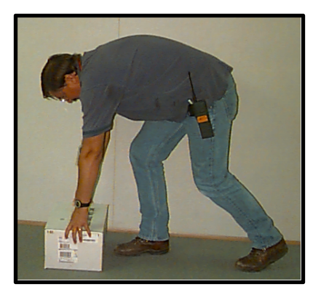
Strains & Sprains
  Injury to connective tissue caused by single forceful event: lifting heavy objects in awkward position
  Common to large body segments (i.e. back, legs, and shoulders)
  Risk of injury increases with the presence of multiple risk factors

Slide 11
ERGONOMIC RISK FACTORS
Static Loading
Repetition
Contact Stress
Force
Awkward
Posture
Vibration
Risk of injury increases with:
Prolonged exposure to any of these ergonomic risk factors
Presence of multiple risk factors within a single job task

Slide 12
WHAT TO DO…..?
PREVENT,PREVENT,PREVENT
Warm up & stretch before activities that are repetitive, static or prolonged
Take frequent breaks from ANY sustained posture every 20-30 minutes
Respect pain- positions or stop painful activity
Recognize early signs of inflammatory process, & tx early
Be aware of workstation environment.

Slide 13
HOW TO REDUCE MSD
Post your group’s BODY MAP on the wall.
Compare the BODY MAPS.
What seems to be the same about the BODY MAPS?
What do the BODY MAPS tell us about construction work?
Notes:
COHP Hardhat Ergonomics 2-Hour TRAINER'S NOTES
COHP/ER2h-HHE v1.1 1-2002
Activity -- Body Mapping (continued)
(6) Tape maps on wall when they are done.
(7) Tell groups to look at all the maps.
(8) Ask: “ What seems to be the same about the body maps?”
Co-Trainer writes answers on flip-chart
(9) Ask: “What do the body maps tell us about construction work?”
Co-Trainer writes answers on flip-chart
* Extra Information:
Symptoms of MSDs include pain, cramping, swelling, stiffness, weakness, numbness, tingling.
Symptoms and signs of MSDs are listed in Pocket Reference on page ____

Slide 14


MAINTAIN NEUTRAL POSTURE
Maintain erect position of back
& neck w/ shoulders relaxed
Position equipment & work directly in front of and close to your major tasks
Keep upper arms close to the body, elbows 90-100 degrees
Keep feet flat on floor, upper body weight resting on “sits bones”
Wrists as neutral as possible; safe zone for wrist movement is 15 degrees in all directions

Slide 15
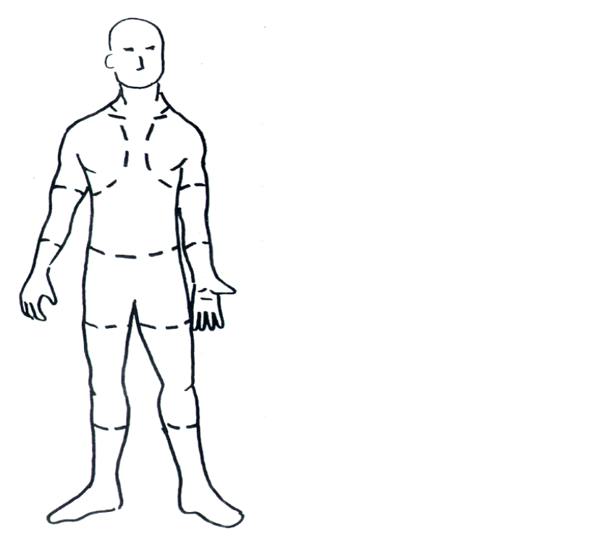
MSDs (Musculoskeletal Disorders)
A study done by the University of Iowa has shown that construction workers hurt!
70% report pain in their
lower back
46% report pain in their
knees
43% report pain in their
wrists and hands
42% report pain in their
shoulders and necks
(The University of Iowa Construction Survey, 1996)
Hardhat Ergonomics-PowerPoint Presentation 1.2 (November 2000) Slide <number>
Notes:
COHP Hardhat Ergonomics 2-Hour TRAINER'S NOTES
COHP/ER2h-HHE v1.1 1-2002
Informational Slide -- Iowa Study data
* Read/Review Iowa Study Data
Iowa Survey data shows us that most construction workers suffer from the same types of pains that you identified on your body maps.
This data is in the Pocket Reference on page ____.
* Extra Information
This study is very special because few ergonomic studies look at
construction work--most focus on assembly line work or computer users.
This is because it is hard to study construction work--it is very complex work.

Slide 16
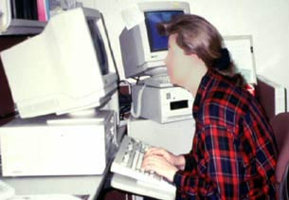

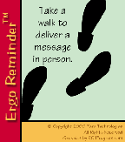
Avoid bending neck forward for prolonged periods of time (*remember quadruple the force); use a copy holder
Avoid static positions for prolonged time; muscles fatigue---MOVE to circulation!

Slide 17


MODIFY TASKS:
Alternate activities frequently; rotate heavy &/or repetitive tasks w/ lighter less repetitive ones.
If sx become worse REASSESS task setup & look for alternative methods
Avoid repetitive or prolonged grip activities
Avoid pinching w/ wrist in flexion or wrist deviation (bending to side)
Take frequent breaks to stretch & rest hands

Slide 18
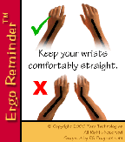
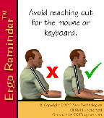
ERGO REMINDERS

Slide 19
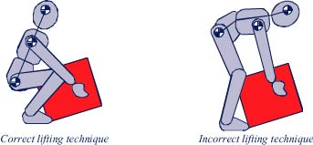
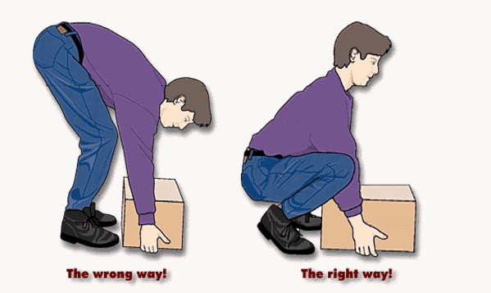
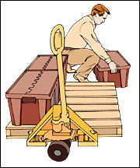
CORRECT & INCORRECT TECHNIQUES

Slide 20



Practice Wellness at Work and Home !
Exercise
Relaxation
Nutrition
Spirit
Mind
Body

Slide 21

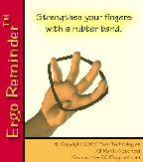

MOVE
STRETCH
BRE
AT
HE

Slide 22
ADVANTAGES
A successful ergonomics program utilizes the skills of many disciplines, including engineering, psychology, medical, safety, management and the employees or associates
Applications range from the design of work areas (including office furniture, automobile interiors, and aircraft cockpits) to the disposition of switches and gauges on the control panels of machinery to determining the size, shape, and layout of keys on computer terminals and character height, color, and clarity on video displays.

Slide 23
ADVANTAGES
The benefits of applying ergonomic principles:
- Maximize productivity, efficiency and quality;
- Reduce MSD risk by eliminating or minimizing ergonomic risk factors;
- Improve employee morale; and
- Cost savings associated with injury-related absenteeism, treatment, new hire training and WCB claims.
It can help you do work safely
It can make you more comfortable
It can prevent injuries

Slide 24
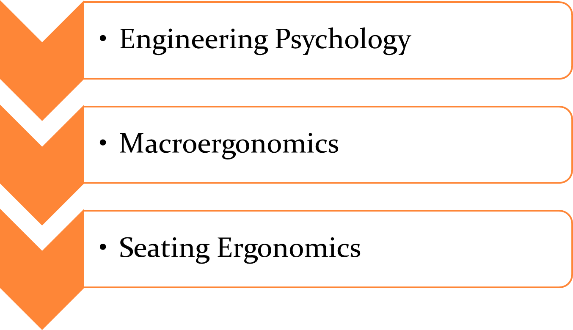
FIELDS OF ERGONOMICS

Slide 25
ENGINEERING PSYCHOLOGY
Engineering Psychology works on the relationship between human and machines and makes a continuous effort to improve the relation. This might include changing the location of the workplace, modifying the ways of using machine or redesigning of the equipment. In short, the main work of engineering psychology is to make the machines 'user-friendly' for the workers.

Slide 26
MACRO-ERGONOMICS
Macro-ergonomics works on a wider aspect and emphasizes more on the organizational environment, history, goal, culture and design. It concentrates more on the physical design and the surrounding environment. Its aim is to set an efficient work system and consequently improve the employee satisfaction, safety, health and productivity in the organization or workplace.

Slide 27
SEATING ERGONOMICS
Seating ergonomics can be defined as a comfortable working posture with a natural alignment of all your joints from head to toes. Before discussing on how to set your computer workstation, let’s have a look at the concept of ergonomic seating (neutral body positioning).This method of Ergonomic Seating helps you reduce the stress and strain on the muscles, tendons, and skeletal system thus reducing the risks of developing ergonomic problems.

Slide 28
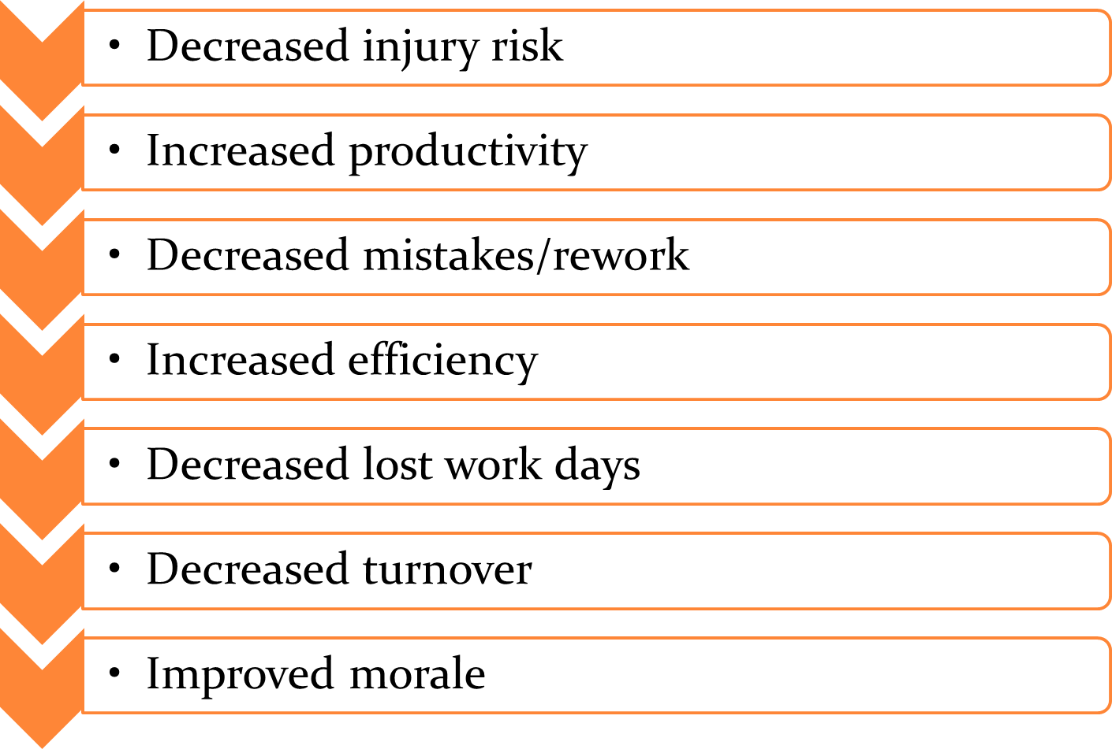
BENEFITS OF ERGONOMICS

Slide 29
APPLICATIONS OF ERGONOMICS
More than twenty technical subgroups within the Human Factors and Ergonomics Society(HFES) indicate the range of applications for ergonomics. Human factors engineering continues to be successfully applied in the fields of aerospace, aging, health care, product design, transportation, training, nuclear and virtual environments, among others.

Slide 30
APPLICATIONS OF ERGONOMICS (2)
Physical ergonomics is important in the medical field, particularly to those diagnosed with physiological ailments or disorders such as arthritis (both chronic and temporary) or carpal tunnel syndrome. Pressure that is insignificant or imperceptible to those unaffected by these disorders may be very painful, or render a device unusable, for those who are. Many ergonomically designed products are also used or recommended to treat or prevent such disorders, and to treat pressure-related chronic pain. Human factors issues arise in simple systems and consumer products as well.

Slide 31
APPLICATIONS OF ERGONOMICS (3)
Some examples include cellular telephones and other hand held devices that continue to shrink yet grow more complex (a phenomenon referred to as "creeping featurism"), millions of VCRs blinking "12:00" across the world because very few people can figure out how to program them, or alarm clocks that allow sleepy users to inadvertently turn off the alarm when they mean to hit 'snooze'. A user-centered design (UCD), also known as a systems approach or the usability engineering life cycle aims to improve the user-system.

Slide 32
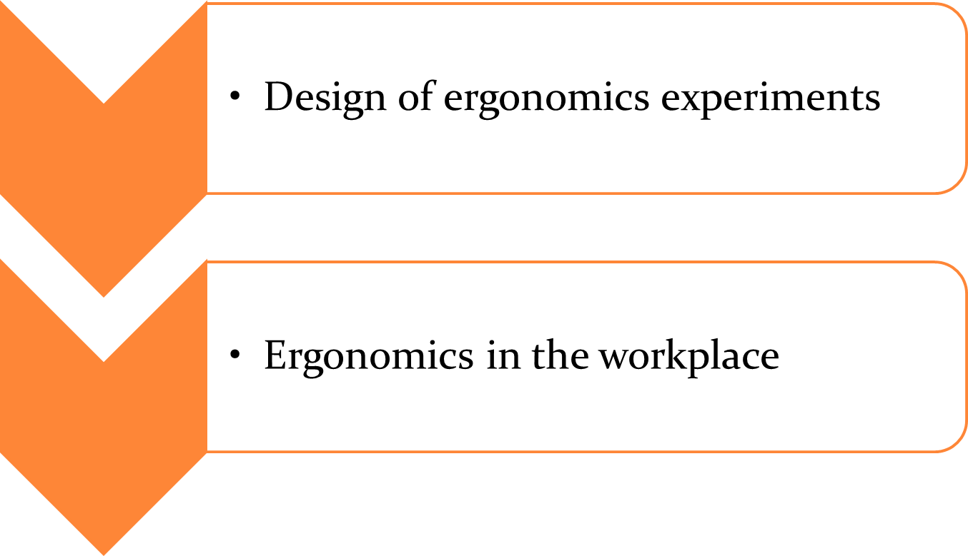
APPLICATIONS OF ERGONOMICS

Slide 33
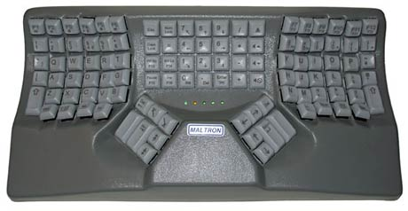
ERGONOMICS IN THE WORKPLACE
Outside of the discipline itself, the term 'ergonomics' is generally used to refer to physical ergonomics as it relates to the workplace (as in for example ergonomic chairs and keyboards).

Slide 34
ERGONOMICS IN THE WORKPLACE (2)
Ergonomics in the workplace has to do largely with the safety of employees, both long and short-term. Ergonomics can help reduce costs by improving safety. This would decrease the money paid out in workers’ compensation. For example, over five million workers sustain overextension injuries per year.

Slide 35
ERGONOMICS IN THE WORKPLACE (3)
Workplaces may either take the reactive or proactive approach when applying ergonomics practices.
Reactive ergonomics is when something needs to be fixed, and corrective action is taken.
Proactive ergonomics is the process of seeking areas that could be improved and fixing the issues before they become a large problem.

Slide 36
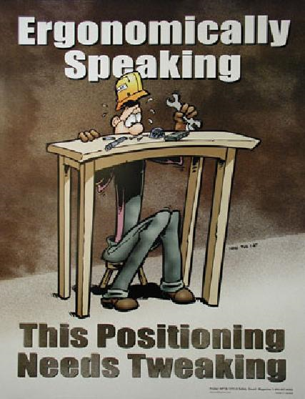
OFFICE ERGONOMICS
Components of office ergonomics:
  Computers
  Chairs
  Telephones

Slide 37
RISKS AND HAZARDS ASSOCIATED WITH IMPROPER COMPUTER SETUP
Backrest:
  Poor back support and inappropriate postures may result from inadequate backrest size, material, positioning, or use. Working in these postures may lead to back pain and fatigue.
Seat:
  Using a chair with a seat that is too high may force you to work with your feet unsupported or encourage you to move forward in the chair to a point where your back is unsupported making it more difficult to maintain the S-shape of the spine. These awkward postures can lead to fatigue, restricted circulation, swelling, numbness, and pain.
Armrest:
  Armrests that are not adjustable, or those that have not been properly adjusted, may expose you to awkward postures or fail to provide adequate support.
Base:
  Chairs with four or fewer legs may provide inadequate support and are prone to tipping.

Slide 38
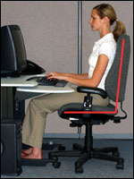
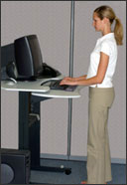
PROPER COMPUTER SETUP
Hands, wrists, and forearms must be straight, in-line and roughly parallel to the floor.
Head is level, or bent slightly forward, forward facing, and balanced. Generally it is in-line with the torso.
Shoulders are relaxed and upper arms hang normally at the side of the body.
Elbows stay in close to the body and are bent between 90 and 120 degrees.
Feet are fully supported by floor or footrest.
Back is fully supported with appropriate lumbar support when sitting vertical or leaning back slightly.
Thighs and hips are supported by a well-padded seat and generally parallel to the floor.
Knees are about the same height as the hips with the feet slightly forward.

Slide 39
TIPS FOR USING A MICROSCOPE
Use a chair that provides good back support.
Sit close to your work surface.
Remove false fronts and supplies from under the bench work area.
Avoid leaning on hard edges.
Pad forearms and edges.
Keep elbows close by your sides.
Work with wrists in straight, neutral positions.
Adjust your chair, workbench, or microscope as needed to maintain an upright head position.
Elevate, tilt or move the microsocpe close to the edge of the counter to avoid bending your neck.
Use adjustable eye-pieces or mount your microscope on a 30° angle stand for easier viewing.
Keep scopes repaired and clean.
Spread microsope work throughout the day and between several people, if possible.
Take breaks. Every 15 minutes, close your eyes or focus on something in the distance. Every 30-60 minutes, get up to stretch and move.

Slide 40
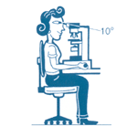
PROPER MICROSCOPE USE

Slide 41
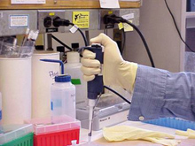
TIPS FOR USING PIPETTE
Sit supported against the backrest of your chair.
Sit or stand close to your work at bench cut outs.
Elevate your chair rather than reaching up to pipette.
Hold the pipetter with a relaxed grip.
Use minimal pressure while pipetting.
Take a 1 to 2 minute break after every 20 minutes of pipetting.

Slide 42
Human Body Ergonomics (Motor Capabilities)
human motor capabilities that are used to make input interaction
Fitts’s law is a model of human movement that predicts the time required to rapidly move to a target area as a function of the distance to and the size of the target.
The movement task’s Index of Difficulty (ID) can be quantified in terms of the required information amount, i.e., in the number of bits. .

Slide 43
the actual time to complete the movement task is predicted using a simple linear equation, where movement time, MT, is a linear function of ID.
MT = a + b * ID and ID = log(A/W + 1)
where A and B are coefficients specific to a given task.
Thus, to reiterate, ID represents an abstract notion of difficulty of the task, while MT is an actual prediction value for a particular task. The values for coefficients a and b are obtained by taking sample
of the performance and mathematically deriving them by regression

Slide 44
the original Fitts’s law was created for interaction with everyday objects (in the context of operation in factory assembly lines) rather than for computer interfaces., the task of “dragging an icon into a trashcan icon” using a mouse can be assessed using Fitts’s law

Slide 45
Motor Control

