Slide 1
ARTIFICIAL INTELLIGENCE

Slide 2

Artificial Intelligence
Intelligence
Artificial
Artificial Intelligence
“A field of Computer Science that is associated with the concept of machines “thinking like humans” to perform tasks such as learning, problem solving, planning ,reasoning and identifying patterns”

Slide 3
INTELLIGENT AGENTS

Slide 4
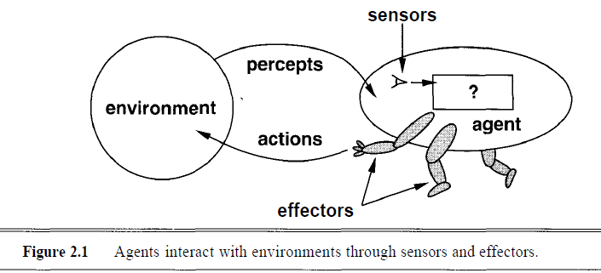

Agents and Environments
Agents
Perceives the environment through Sensors and act on the environment through Actuators

Slide 5
Agents and Environments
Agents
Percept
Percept Sequence
Action
Agent Function
maps from percept to actions:
[f: P* → A]
Agent Program
Runs on the physical architecture to produce f
Agent
Architecture +Program

Slide 6
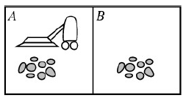
Agents and Environments
Vacuum Cleaner World
Percepts
Location + Contents (Dirt)
Actions
Left, Right, Suck, NOP

Slide 7
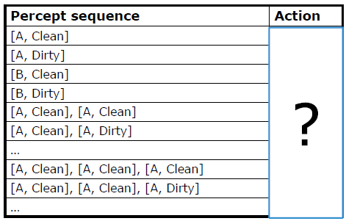
Agents and Environments
Simple Agent Function

Slide 8
Agents and Environments
Rational Agent
To do the right thing based on its percepts and actions
Performance Measure
Success of an agents’ behaviour
Measure what is desired rather than how the agent should behave
RA
“For each possible percept sequence, a rational agent should select an action that is expected to maximize its performance measure, given the evidence provided by the percept sequence and whatever built-in knowledge the agent has”

Slide 9
Agents and Environments
Omniscience, Learning & Autonomy
Distinction between rationality and omniscience
Expected performance vs. actual performance
Agents can perform actions in order to modify future percepts so as to obtain useful information (information gathering, exploration)
An agent can also learn from what it perceives
An agent is autonomous if its behaviour is determined by its own experience
Ability to learn and adapt

Slide 10
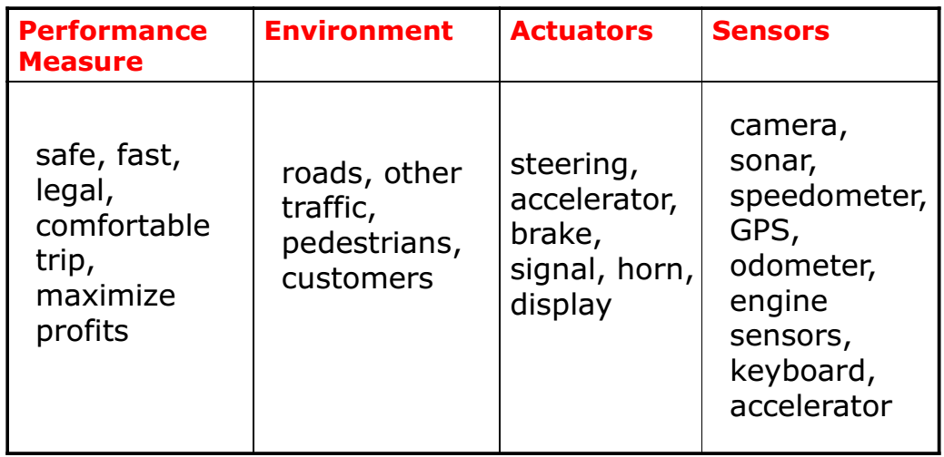
Agents and Environments
PEAS
Performance, Environment, Actuators, Sensors
Eg. Taxi Driver

Slide 11
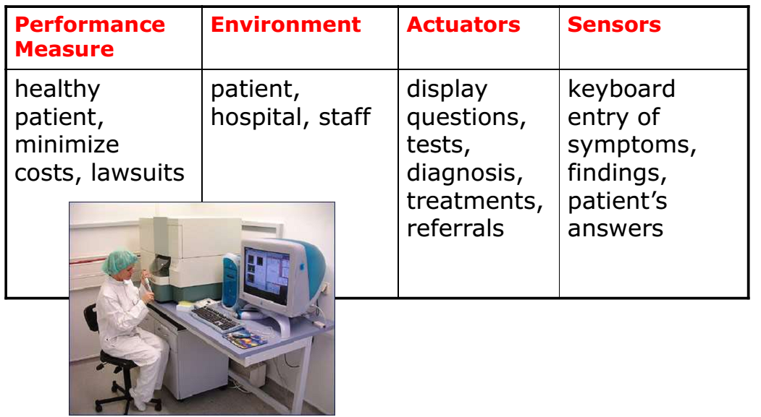
Agents and Environments
PEAS
Eg. Medical Diagnosis System

Slide 12
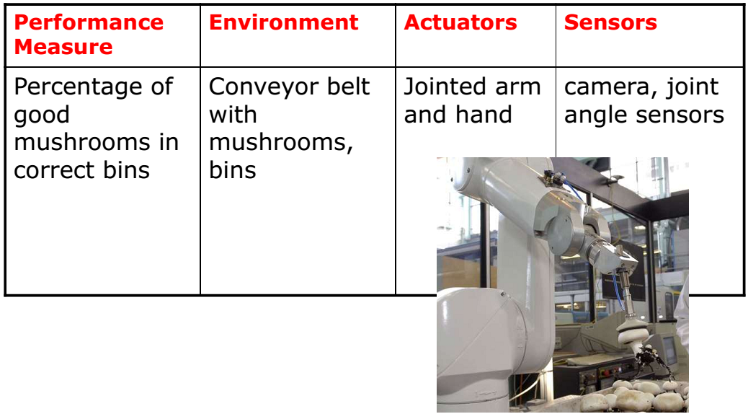
Agents and Environments
PEAS
Eg. Mushroom Picking Robot

Slide 13
Agents and Environments

Slide 14
Agents and Environments
Properties of Task Environments
Fully observable vs. Partially observable
An agent's sensors give it access to the complete state of the environment at each point in time
Deterministic vs. Stochastic
Next state of the env. determined by current state and the agent’s action -determimistic
If the environment is deterministic except for the actions of other agents, then the environment is strategic.
uncertain, nondeterministic
Episodic vs. Sequential
Agent's experience is divided into atomic "episodes“
Choice of action in each episode depends only on the episode itself

Slide 15
Agents and Environments
Properties of Task Environments
Static vs. Dynamic
Agent deliberation: Unchanged environment
Semidynamic if the environment itself doesn’t change with time but the agent's performance score does
Discrete vs. Continuous
Limited number of distinct, clearly defined percepts and actions
Single Agent vs. Multi Agent
Agent operating by itself
Competitive vs Cooperative

Slide 16
Agents and Environments
Task Environments & its Characteristics

Slide 17
Structure of Agents
Agent Program
Agent Function : f: P* → A
Architecture
Computing device + Sensors + Actuators
Agent
Architecture + Agent Program

Slide 18
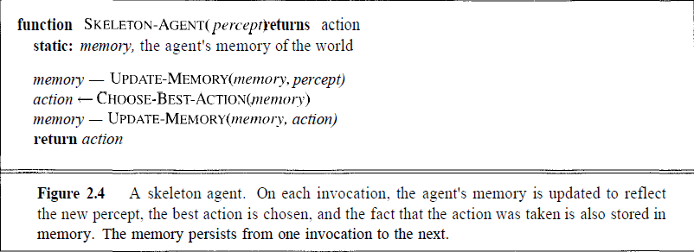
Structure of Agents
Skeleton of an Agent Program

Slide 19
Types of Agents
Category of Agents
Simple reflex Agents
Model based reflex Agents
Goal based Agents
Utility based Agents

Slide 20
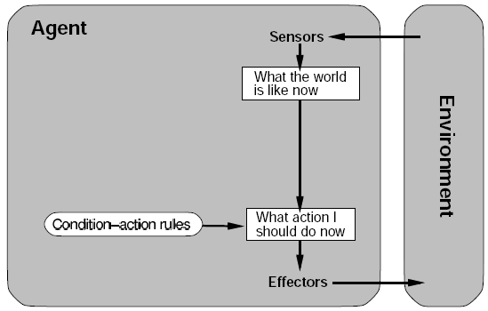
Types of Agents
Simple reflex Agents
Current Percept only
Automated response or Reflex action
Only one possible action

Slide 21
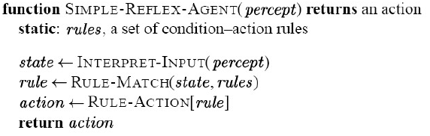
Types of Agents
Simple reflex Agents
Human Reflex: If hand is in fire then pull hand
Condition-Action Rule
Suitability: Fully Observable Environment

Slide 22
Types of Agents
Simple reflex Agents
Infinite loops are often unavoidable for simple reflex agent operating in partially observable environments
Randomization will help
A randomized simple reflex agent might outperform a deterministic simple reflex agent
Better way
Maintain internal states
To keep track of the unobservable environment

Slide 23
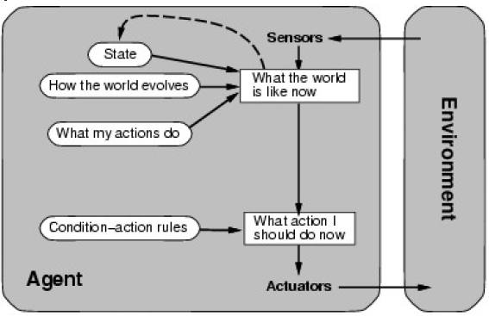
Types of Agents
Model Based Reflex Agents
Partial Observability
Maintains Internal State

Slide 24
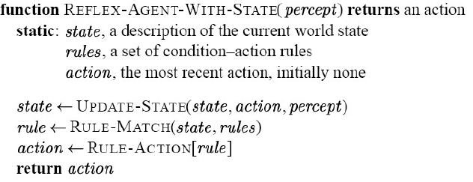
Types of Agents
Model Based Reflex Agents
Internal model
Determines the percept history and effect of actions

Slide 25
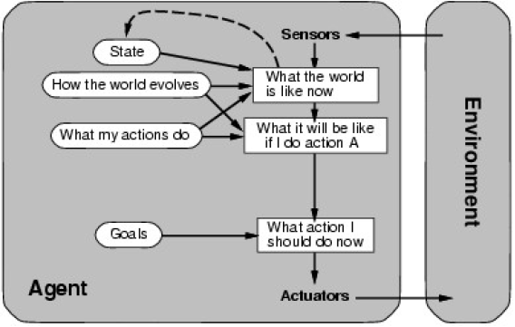
Types of Agents
Goal Based Agents
A goal is a description of a desirable situation
Use goal information to achieve desirable capabilities ; Model based

Slide 26
Types of Agents
Goal Based Agents
Choose actions so as to achieve a (given or computed) goal
Keeping track of the current state is often not enough
Need to add goals to decide which situations are good
Deliberative(Planned) instead of reactive.
Consider long sequences of possible actions before deciding if goal is achieved
”what will happen if I do...?”

Slide 27
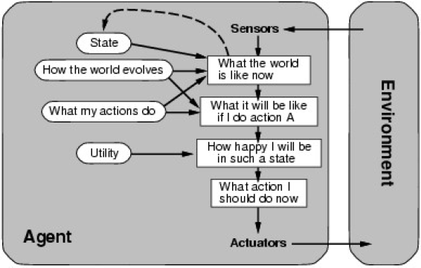
Types of Agents
Utility Based Agents
Agents make choices based on Utility
Utility measurement: Degree of Happiness

Slide 28
Types of Agents
Utility Based Agents
Utility function
U: State → Real Numbers
Represents measure of success or happiness when at a given state
Uncertainty
Choice between conflicting goals
Choice between likelihood of success and importance of goal
Rational agent
Chooses action that optimizes the expected utility of the outcome

Slide 29
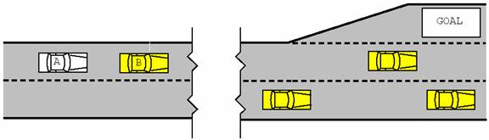
Types of Agents
Example for Goal Based, Utility Based Agents
Cameras: Used to gain positions of car, the edges of lanes and the position of the goals.
Car can speed up, slow down, change lanes, turn, park, pull away
Car A : Multiple tasks possible but the highest outputs of the utility function are, change lanes or stay behind car B.

Slide 30
Learning Agents
Learning Agents
Agents with the capability of learning from their previous experience
Components of LA
Learning element: Enables learning agents to learn from previous experiences
Critic: Provides feedback on how the agent is doing
The performance element: Decides on the external action that needs to be taken
The problem generator: Acts as a feedback agent that performs certain tasks such as making suggestions (new) and keeping history.

Slide 31
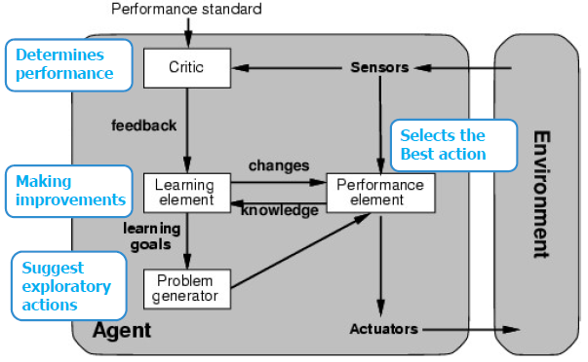
Learning Agents
Components of LA
https://www.doc.ic.ac.uk/project/examples/2005/163/g0516334/app.html

Slide 32
Learning Agents
Example of Learning Reflex Agents
ALICE: Chatbot
Pre-determined response
If no proper action, bot probes
Larger set of Condition-Action rules

Slide 33
Thank you

