Slide 1
KNOWLEDGE REPRESENTATION

Slide 2
KNOWLEDGE
From Webster Dictionary
A (1): the fact or condition of knowing something with familiarity gained through experience or association
(2):acquaintance with or understanding of a science, art, or technique
B(1): the fact or condition of being aware of something
(2): the range of one's information or understanding
c: the circumstance or condition of apprehending truth or fact through reasoning: Cognition
d: the fact or condition of having information or of being learned
In AI
Large amount of knowledge
Appropriate mechanism to represent and manipulate the knowledge
Example
X has umbrella
It is raining
Umbrella prevents you from getting wet when it rains
Umbrella prevents you from getting wet only if used properly
Umbrella prevents you from scorching heat during hot summer
Umbrellas are not useful if its windy

Slide 3
TYPES OF KNOWLEDGE
A priori knowledge
Knowledge independent of all experiences
considered to be universally true
A posteriori knowledge
Knowledge verifiable through the senses
may not always be reliable
Procedural knowledge
knowing how to do something
Declarative knowledge
knowing that something is true or false
Tacit knowledge
knowledge not easily expressed by language

Slide 4

KNOWLEDGE BASED SYSTEM (KBS)
KBS are not useful without the ability to represent knowledge
Different knowledge representation schemes may be appropriate
Based on tasks and circumstances
Knowledge representation schemes and reasoning methods must be coordinated
KBS
Knowledge Base
Inference Engine
Knowledge Base
Set of sentences that describe the world in some formal (representational) language (Eg. First order logic)
Inference Engine
Set of procedures that work upon representational language and infer new facts or answer KB queries

Slide 5
KNOWLEDGE REPRESENTATION (KR)
Knowledge Representation
Express knowledge in the format which a computer understands
Helps AI agent to perform well
KR Language
Syntax
Defines which configurations of the components of the language constitute valid sentences
Which symbols can we use and how do we combine those symbols
Semantics
Defines which facts in the world the sentences refer to
How do we interpret?
Assigns a meaning to each sentence

Slide 6
KNOWLEDGE REPRESENTATION (KR)
KR Requirements
Representational Adequacy
Ability to represent different kinds of knowledge required in the specified domain
Inferential Adequacy
Ability to manipulate the representational structures to derive new structures from existing structures
Inferential Efficiency
Ability to incorporate additional information into the knowledge structure
Acquisitional Efficiency
Ability to acquire new information
Agent should be capable of controlling its knowledge acquisition
Feasibility?

Slide 7
AUTOMATED REASONING SYSTEMS
Theorem Provers
Prove sentences in the first order logic
Use inference rules, resolution rule and resolution refutation
Rule Based System
Deductive System
Systems based on rules (Horn form)
Prove theorems and infer new assertions
Reactive System
Systems based on rules with actions
Semantic Networks
Graphical representation of the world
Objects are nodes and relations are links
Frames
OO representation
Procedural control of inference

Slide 8
RULE BASED SYSTEM
Knowledge Base
Rule Base
Represents knowledge structure / relations
Working Memory(Fact)
Rule interpreter
Rule Set Example
R1. IF Raining Ù Outside(x) Ù HasUmbrella(x)
THEN UseUmbrella(x)
R2. IF Raining Ù Outside(x) Ù ØHasUmbrella(x)
THEN GetWet(x)
R3. IF GetsWet(x) THEN CatchCold(x)
R4. IF Sunny Ù Outside(x) THEN GetSunBurnt(x)

Slide 9
Basic structure of a rule-based expert system

Slide 10
The knowledge base contains the domain knowledge useful for problem solving. In a rule-based expert system, the knowledge is represented as a set of rules. Each rule specifies a relation, recommendation, directive, strategy or heuristic and has the IF (condition) THEN (action) structure. When the condition part of a rule is satisfied, the rule is said to fire and the action part is executed.
The database includes a set of facts used to match against the IF (condition) parts of rules stored in the knowledge base.

Slide 11
The inference engine carries out the reasoning whereby the expert system reaches a solution. It links the rules given in the knowledge base with the facts provided in the database.
The explanation facilities enable the user to ask the expert system how a particular conclusion is reached and why a specific fact is needed. An expert system must be able to explain its reasoning and justify its advice, analysis or conclusion.
The user interface is the means of communication between a user seeking a solution to the problem and an expert system.

Slide 12
RULE BASED SYSTEM
LHS ➔RHS
If → Then
Antecedents ➔ Consequents
Triggered Rules vs Fired Rules
Conflict Resolution Strategy

Slide 13
Two broad kinds of rule system
forward chaining systems, and backward chaining systems.
In a forward chaining system you start with the initial facts, and keep using the rules to draw new conclusions (or take certain actions) given those facts
In a backward chaining system you start with some hypothesis (or goal) you are trying to prove, and keep looking for rules that would allow you to conclude that hypothesis, perhaps setting new subgoals to prove as you go.

Slide 14
Data or Goal Driven?
Forward chaining systems are primarily data-driven
backward chaining systems are goal-driven
Recognise-Act Cycle
A Rule Interpreter can be described as a recognise-act cycle
Match the premise patterns of rules against elements in the working memory
If there is more than one rule that can be applied (i.e. that can be "fired"), choose one to apply in the conflict resolution. If no rule applicable, stop.
Apply the chosen rule, perhaps by adding a new item to the working memory or deleting an old one. If termination condition fulfilled stop, else go to step 1.
The termination condition is either defined by a goal state or by a cycle condition (e.g. maximally 100 steps)

Slide 15
A number of conflict resolution strategies are typically used to decide which rule to fire
Don't fire a rule twice on the same data.
Fire rules on more recent working memory elements before older ones. This allows the system to follow through a single chain of reasoning, rather than keeping on drawing new conclusions from old data.
Fire rules with more specific preconditions before ones with more general preconditions. This allows us to deal with non-standard cases. If, for example, we have a rule ``IF (bird X) THEN ADD (flies X)'' and another rule ``IF (bird X) AND (penguin X) THEN ADD (swims X)'' and a penguin called tweety, then we would fire the second rule first and start to draw conclusions from the fact that tweety swims.

Slide 16
Forward Chaining Systems
facts in the system are represented in a working memory which is continually updated.
Rules in the system represent possible actions to take when specified conditions hold on items in the working memory
they are sometimes called condition-action rules
The conditions are usually patterns that must match items in the working memory

Slide 17
Forward Chaining Systems
actions usually involve adding or deleting items from the working memory.
interpreter controls the application of the rules, given the working memory, thus controlling the system's activity.
It is based on a cycle of activity sometimes known as a recognize-act cycle
The system first checks to find all the rules whose conditions hold
selects one and performs the actions in the action part of the rule

Slide 18
Forward Chaining Systems
The actions will result in a new working memory, and the cycle begins again.
This cycle will be repeated until either no rules fire, or some specified goal state is satisfied.

Slide 19
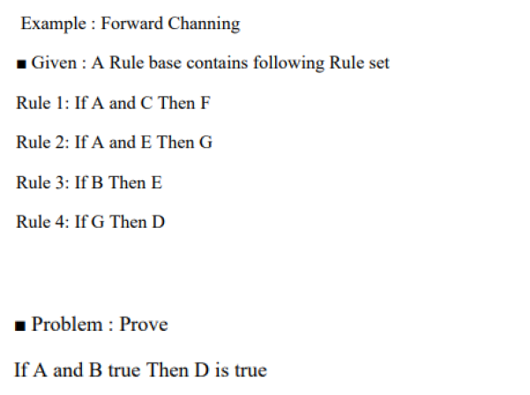

Slide 20
Backward Chaining Systems
Given a goal state to try and prove the system will first check to see if the goal matches the initial facts given
If it does, then that goal succeeds
If it doesn't the system will look for rules whose conclusions (previously referred to as actions) match the goal
One such rule will be chosen, and the system will then try to prove any facts in the preconditions of the rule using the same procedure, setting these as new goals to prove

Slide 21
Backward chaining system
Note that a backward chaining system does NOT need to update a working memory
Instead it needs to keep track of what goals it needs to prove its main hypothesis.

Slide 22
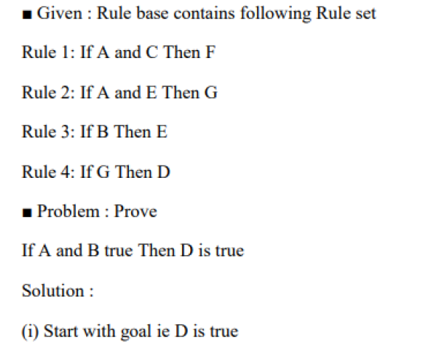
Example- Backward chaining

Slide 23
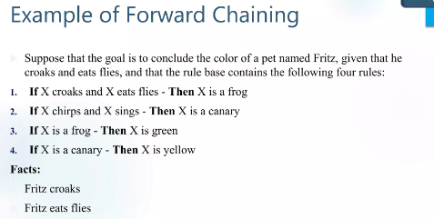

Slide 24
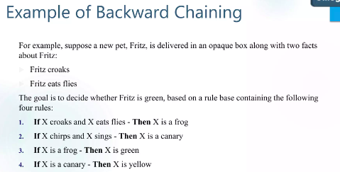

Slide 25
RULE BASED – DEDUCTION SYSTEM
Animal Identification Example
R1: IF ?X Has hair
THEN ?X is a mammal
R2: IF ?X gives milk
THEN ?X is a mammal
R3: IF ?X Has feathers
THEN ?X is a bird
R4: IF ?X flies
?X lays eggs
THEN ?X is a bird

Slide 26
RULE BASED – DEDUCTION SYSTEM
R5 : IF ?X is a mammal
?X eats meat
THEN ?X is a carnivore
R6 : IF ?X is a mammal
?X has pointed teeth
?X has claws
?X Has forward pointing eyes
THEN ?X is a carnivore
R7 : IF ?X is a mammal
?X has hoogs
THEN ?X is an ungulate

Slide 27
RULE BASED – DEDUCTION SYSTEM
R8 : IF ?X is a mammal
?X chew cud
THEN ?X is an ungulate
R9 : IF ?X is a carnivore
?X has tawny color
?X has dark spots
THEN ?X is a cheetah
R10 : IF ?X is a carnivore
?X has tawny color
?X has black strips
THEN ?X is a tiger

Slide 28
RULE BASED – DEDUCTION SYSTEM
Animal Identification Example
R11 : IF ?X is an ungulate
?X has long legs
?X has long neck
?X has tawny color
?X has dark spots
THEN ?X is a giraffe
R12 : IF ?X is an ungulate
?X has white color
?X has black stripes
THEN ?X is a zebra

Slide 29
RULE BASED – DEDUCTION SYSTEM
Animal Identification Example
R13 : IF ?X is a bird
?X does not fly
?X has long legs
?X has long neck
?X is black and white
?X has dark spots
THEN ?X is an ostrich
R14 : IF ?X is a bird
?X does not fly
?X swims
?X is black and white
THEN ?X is a penguin

Slide 30
Forward chaining
Animal Identification Example
To identify animal
In Working Memory
has hair
chews cud
has long legs
has long neck
has tawny color
has dark spots

Slide 31
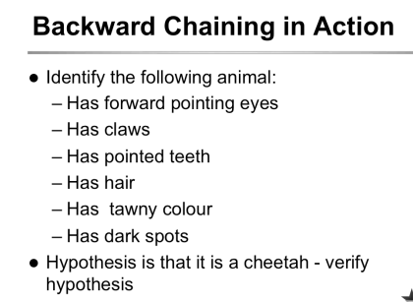
Backward chaining

Slide 32
SEMANTIC NETS
Semantic Networks
AI Knowledge representation technique for propositional information
Also known as Association Nets / Semantic Nets
Semantic Nets
Is a labelled directed graph
Nodes → Object
Objects represent Physical objects, concepts , Events
Link / Edges → Relationship

Slide 33
SEMANTIC NETS

Slide 34
SEMANTIC NETS
Structure of Semantic Networks
Lexical part
Nodes – denoting objects
Links – denoting relations between objects
Labels – denoting particular objects and relations
Structural part
Links and nodes form directed graphs
Labels are placed on the links and nodes
Semantic part
Meanings are associated with the link and node labels (the details will depend on the application domain)
Procedural part
Constructors allow creation of new links and nodes
Destructors allow the deletion of links and nodes
Writers allow the creation and alteration of labels
Readers can extract answers to questions

Slide 35
SEMANTIC NETS
Relationships in Semantic Networks
IS-A
Member of a class
Class→ Group of objects with common attributes
Eg: Tom IS-A Dog

Slide 36
SEMANTIC NETS
Relationships in Semantic Networks
A-KIND-OF
Relates one class to another class.
Eg: Balloons are A-KIND-OF Aircraft
Dogs are A-KIND-OF Mammals
HAS-A
Relates attributes to Objects
Eg: Dog HAS-A Tail
Aircraft HAS-A Wings

Slide 37
SEMANTIC NETS
Relationships in Semantic Networks
IS-PART
Relates attributes to Objects
Eg: Dog HAS-A Tail

Slide 38
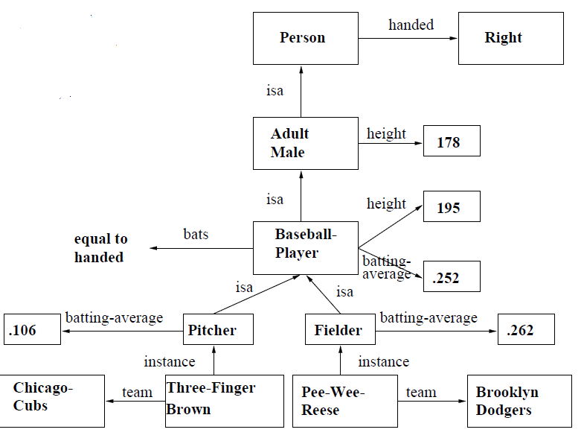
SEMANTIC NETS
A typical Semantic Network
Mixed Type

Slide 39
SEMANTIC NETS
Relationships
Subset
Relationship b/w classes
Member
Instance of a class
R-relation
Relationship b/w individuals

Slide 40
SEMANTIC NETS
Reasoning in Semantic Networks
Inheritance
Properties of Super class inherited by sub class
Exceptions
Default Values
Over-riding
Generic Values

Slide 41
SEMANTIC NETS
Reasoning in Semantic Networks
Multiple Inheritance
Conflicts may occur
Over-ride
Resolve conflicts
Additional Info.

Slide 42
SEMANTIC NETS
Tangled Hierarchy
Inheritance Conflicts
Solution
Look for specific knowledge
How?
Inferential Distance

Slide 43
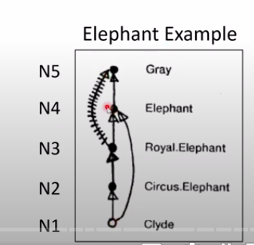
SEMANTIC NETS
Inferential Distance
Simple Distance
Shorter path
Inferential distance
Node 1 is closer to Node2 than Node3 iff Node1 has an inference path through node2 to node3
Longest inference path.
In elephant example, to find colour of the elephant. “clyde” is gray and not gray- conflict conclusions. The dashed line represents Royal elephant is not gray.
shorter path yields clyde is gray, but incorrect.
Travel from N1,N2,N3,N5. We can get clyde is not gray
Partial Ordering – only involves common nodes

Slide 44
SEMANTIC NETS
Inferential Distance
Partial Ordering – only involves common nodes
Will not work
No relationship between Quaker and Republican- No common node

Slide 45
SEMANTIC NETS
Intersection Search
Find Relationship between objects
By spreading activation
Identify objects where the spreading meets.
Common object between Three finger brown and Pee wee reese is baseball player.

Slide 46
SEMANTIC NETS
Pros
Visualization is easy
Knowledge interpretation and its meaning has clarity
Objects represented only once
Flexibility for KE in representation
Cons
Larger Problems
Complex representation schemes
No Clarity in syntax and semantics eads to problem
No standards
Multiple inheritance and inference problems

Slide 47
Example
Othello’s Story
Othello was a General married to Desdemona. Iago was a captain married to Emilia and he hated Othello. Iago told lies about Desdemona. Othello killed Desdemona with a pillow. He felt remorse and ended his life with a dagger.
KR: Construct a Semantic network for the above story.
Inference: What do the pillow and dagger have in common?

Slide 48
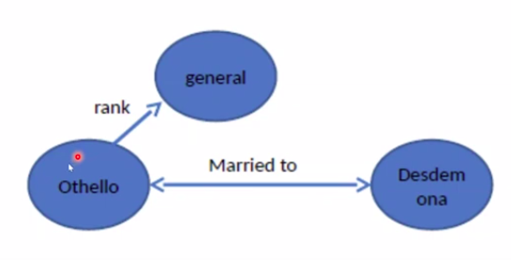
contd..

Slide 49
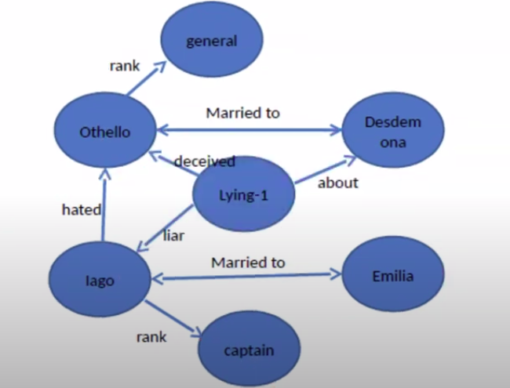

Slide 50
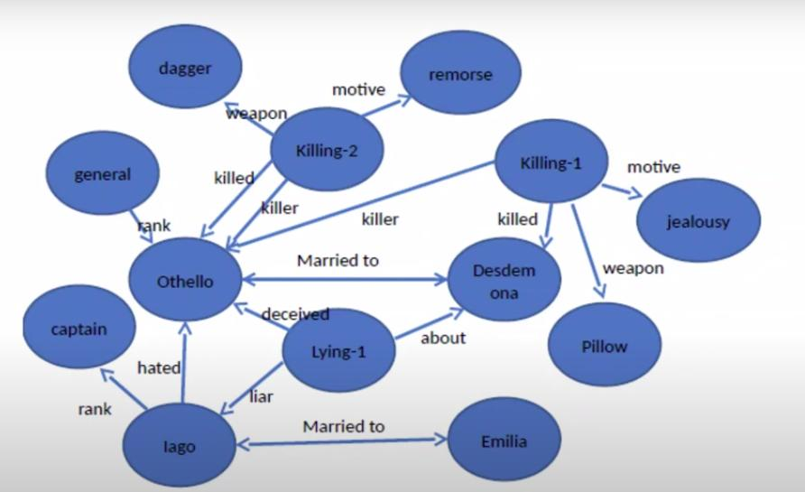

Slide 51
Frames
Frames – semantic net with properties
A frame represents an entity as a set of slots (attributes) and associated values
A frame can represent a specific entry, or a general concept
Frames are implicitly associated with one another because the value of a slot can be another frame
Book Frame
Slot (attributes)→ Filler(values)
Title → AI. A modern Approach Author → Russell & Norvig Year → 2003
3 components of a frame
frame name
attributes (slots)
values (fillers: list of values, range, string, etc.)

Slide 52
Features of Frame Representation
More natural support of values than semantic nets (each slots has constraints describing legal values that a slot can take)
Can be easily implemented using object-oriented programming techniques
Inheritance is easily controlled
Lower level frames can inherit information from upper level frames in network.
Nodes are connected using links viz.,
– ako / subclass (links two class frames, one of which is subclass of other e.g., science_faculty class is ako of faculty class),
– is_a / instance ( connects a particular instance of a class frame e.g., Linni is_a science_faculty)
– a_part_of (connects two class frames one of which is contained in other e.g., faculty class is_part_of department class).

Slide 53
Property link of semantic net is replaced by SLOT fields.
A frame may have any number of slots needed for describing object.
e.g., faculty frame may have name, age, address, qualification etc as slot names.
Each frame includes two basic elements : slots(attributes) and facets.
– Each slot may contain one or more facets (called fillers) which may take many forms such as:
value (value of the slot),
default (default value of the slot),
range (indicates the range of integer or enumerated values,
a slot can have),
Pointers to other frames - Inheritance

Slide 54
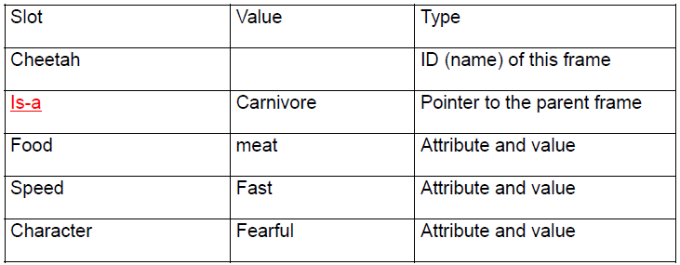
FRAMES

Slide 55
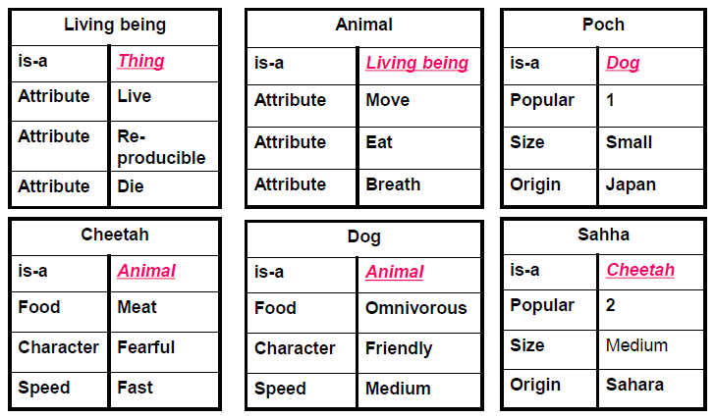
FRAMES

Slide 56
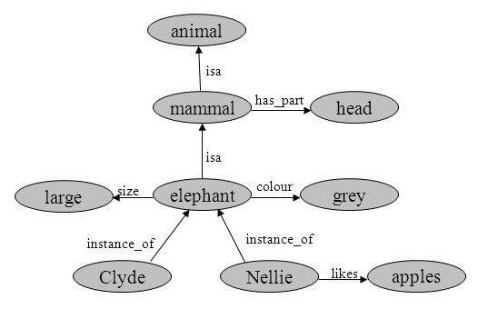
TYPES OF FRAMES
Class Frame
IS-A
Instance Frame
Instance

Slide 57
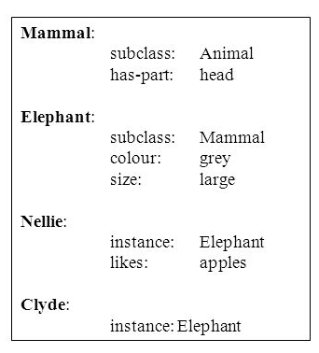
SLOTS

Slide 58
Inheritance
Similar to Object-Oriented programming paradigm
Hotel Chair
what → chair height →20-40cm legs → 4
Hotel Room
what → room where →hotel contains→ hotel chair hotel phone hotel bed
Hotel Phone
what → phone billing → guest
Hotel Bed
what → bed size →king part → mattress
Mattress
price → 100$

Slide 59
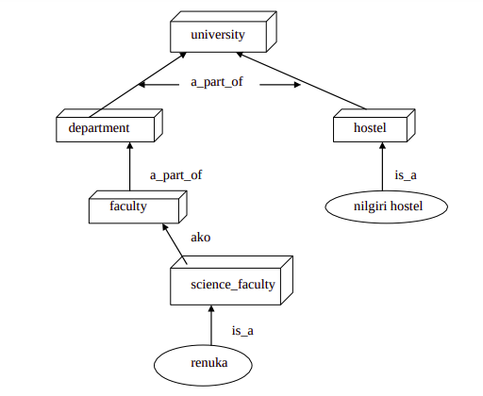
Frames - Example

Slide 60
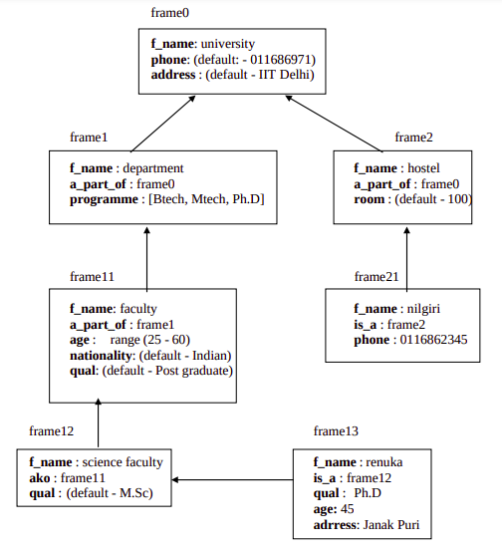

Slide 61
Benefits of Frames
Makes programming easier by grouping related knowledge
Easily understood by non-developers
Expressive power
Easy to set up slots for new properties and relations
Easy to include default information and detect missing values

Slide 62
Drawbacks of Frames
No standards (slot-filler values)
More of a general methodology than a specific representation:
Frame for a class-room will be different for a professor and for a maintenance worker
No associated reasoning/inference mechanisms

