Slide 1
Wi-Fi Signal Strength Heatmap Using Numerical Methods
EEE3400: Numerical Techniques Labratory

Slide 2
Presented By:
Name | Id
Md. Mosaddik Habib | 0212330071
Hasan Rayhan Rabbe | 0212410026
Sabbir Ahmed | 0212410034
Course Instructor: Nure-Alam-Dipu

Slide 3
Problem Statement and Motivation:
Nowadays, Wi-Fi signal strength can vary from one location to another.
For important activities such as online classes, video conferencing, and data transfer, it is important to know where the Wi-Fi signal is strong or weak.
Therefore, we need a reliable way to analyze and visualize Wi-Fi signal strength at different locations.
Our project focuses on this problem by measuring Wi-Fi signal strength and generating a Wi-Fi signal strength heatmap to identify strong and weak signal areas.
Project Objectives :
To analyze Wi-Fi signal strength (RSSI) and generate a Wi-Fi signal strength heatmap.
To apply numerical techniques to solve a real-life engineering problem.
To implement and visualize theoretical equations and concepts learned from previous courses.
To analyze real-time Wi-Fi data and compare the practical results with theoretical analysis.
To identify the strong and weak signal regions based on the measured RSSI values.

Slide 4
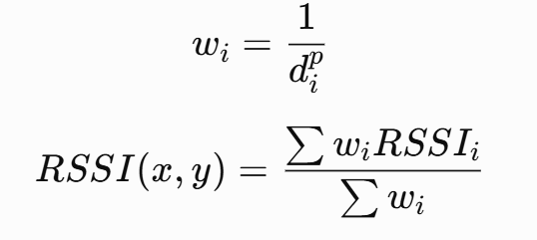
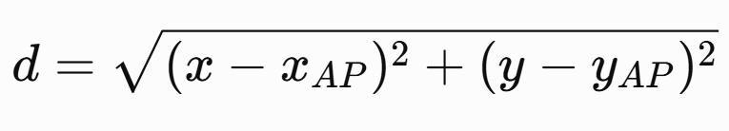
Mathematical Formulation:
IDW Interpolation:
Distant measurement:
Physical Meaning:
Nearby data points have a greater influence on the estimated value than distant points.
In other words, the closer the point, the higher its weight; the farther the point, the lower its weight
Physical Meaning:
Distance represents the physical separation between the Wi-Fi access point and the measurement location.

Slide 5

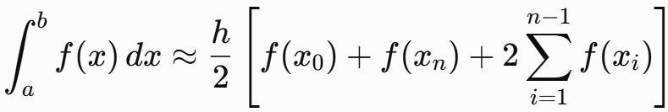
Mathematical Formulation:
RSSI Values in dB:
Composite Trapizoid Integration:
Physical Meaning:
RSSI represents the strength of the Wi-Fi signal received by the ESP32 at a particular location
Physical Meaning:
The integration represents the accumulated RSSI related quantity over a specific distance range.

Slide 6
Numerical Methods used:
Interpolation Method: Inverse Distance Weighting (IDW)
Used to estimate RSSI values at locations where direct measurements are not available and generate the Wi-Fi heatmap.
Root-Finding Methods:
Bisection Method
False Position Method
Newton-Raphson Method
Secant Method
Used to numerically determine the distance corresponding to a specified RSSI value based on the signal propagation model.
Numerical Integration Method: Composite Trapezoidal Rule
Used to numerically calculate the accumulated/average behavior of the RSSI-related function over a specified distance range.

Slide 7
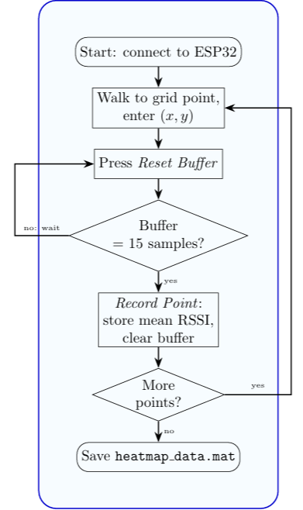
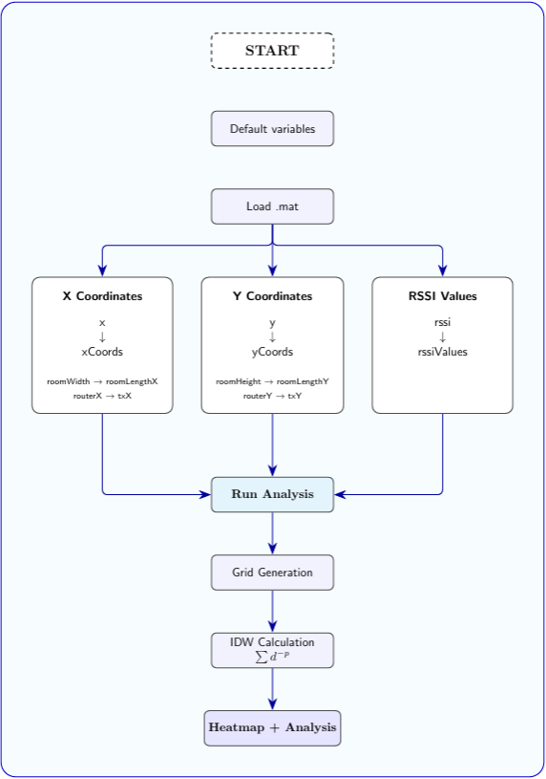
Implementation (Project Workflow):
Collector
Analyzer

Slide 8
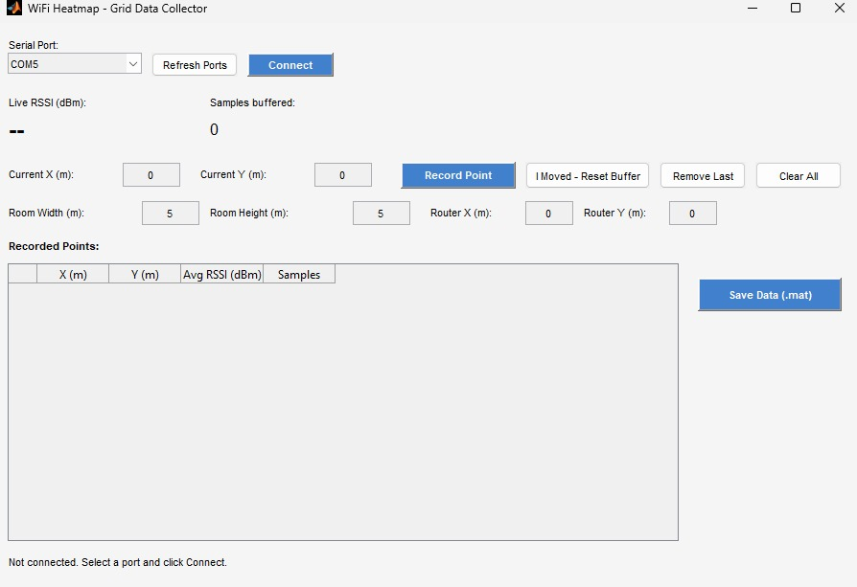
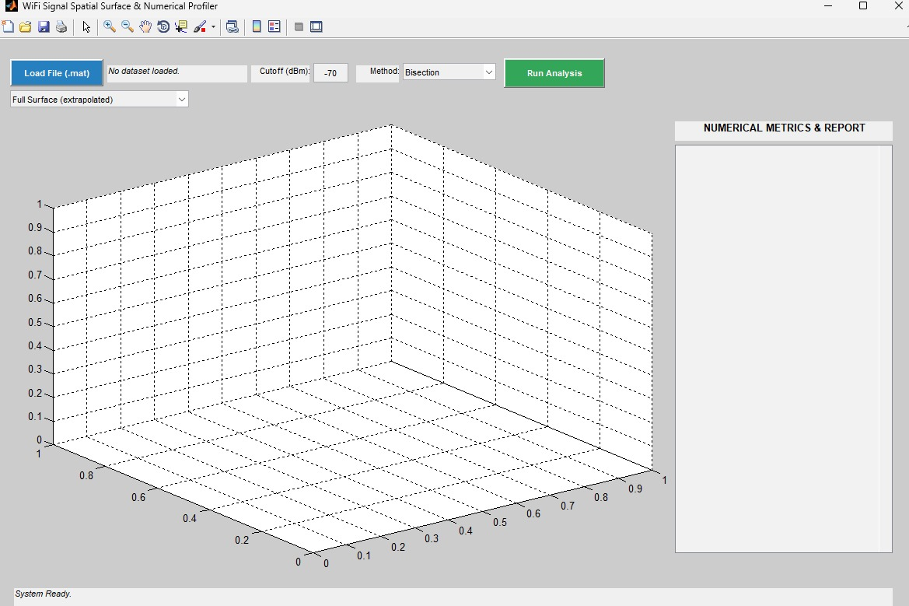
Implementation (GUI):
Fig 1: Data Collector
Fig 2: Data Analyzer

Slide 9
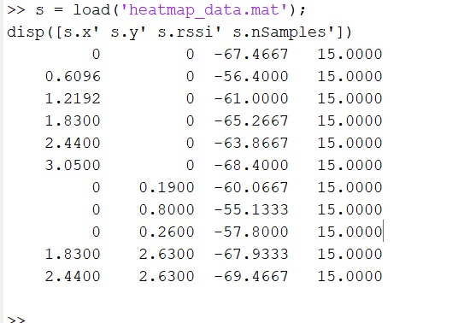
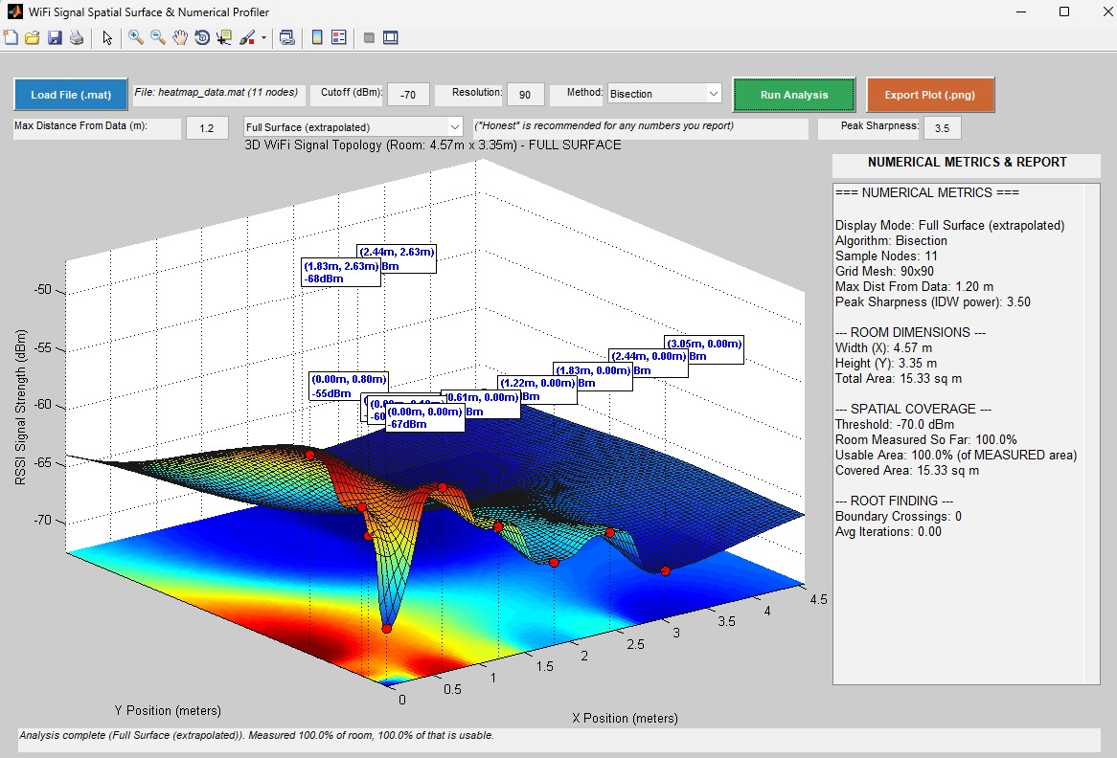
. Results and Analysis:
(Based on real-time data)
Fig 1: Data Taken from UIU building 5th floor
Fig 2: 3D Data plotting in 2D plane using MATLAB

Slide 10
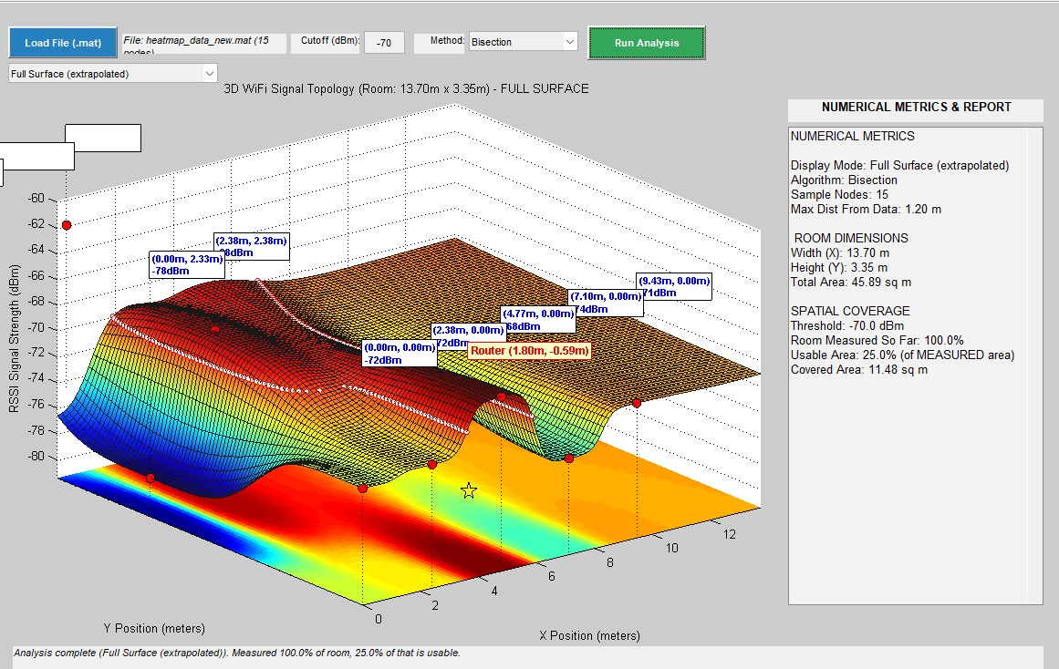
Result & Analysis:
(Based on real-time data)
Fig 3: Another plotted data

Slide 11
Error and Performance Analysis
Method | Convergence | Iteration | Performance
Bisection | Guaranteed* | Relatively high | Stable
False-position | Good | Moderate | Stable
Newton-Raphson | Very fast* | Low | Fast
Secant | Fast* | Low–Moderate | Efficient

Slide 12
Conclusion:
The project successfully analyzed Wi-Fi signal strength (RSSI) at different locations and represented the results using a Wi-Fi heatmap.
Numerical methods such as IDW interpolation, root-finding, and numerical integration were applied to a real-life engineering problem.
The project allowed us to compare theoretical models with real-time measured data.
The generated heatmap can help identify strong and weak Wi-Fi coverage areas.
Recommendations:
Multiple data taking over a wide range improves the estimation quality.
Considering environmental factors such as walls, obstacles, and interference for better prediction.

Slide 13
References :
Numerical Methods Lab Sheets
Numerical Methods Lab Course Materials
MATLAB Documentation
ESP32 Documentation
Team Contributions:
Mosaddik Habib: Data Collection , Presentation Slide Preparation & project Implementation
Hasan Rayhan Rabbe: Data Analysis , Data Collection & project Implementation
Sabbir Ahmed: Project Idea Development , ESP32 Module Calibration & project Implementation

Slide 14
Thank You...
Turning Wi-Fi Signal Data into Meaningful Insights
Questions & Discussion

