Slide 1

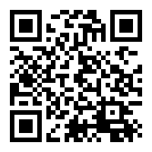
BookNerd
Final Progress
GROUP
Sabbir Mollah - 1712490642 Nazmul Hossain - 1631141042
Abdullah Al Rafi - 1731371642
GITHUB LINK

Slide 2
Introduction

Slide 3
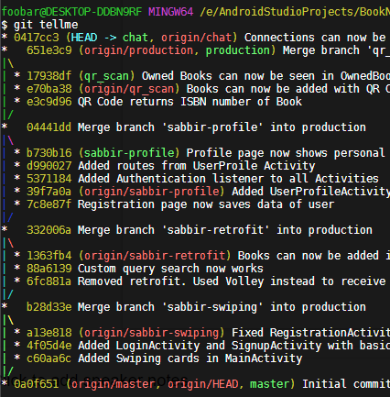
The Story of
BookNerd
What
Why
How
Results

Slide 4






Finding Books
Finding People
BookNerd

Slide 5
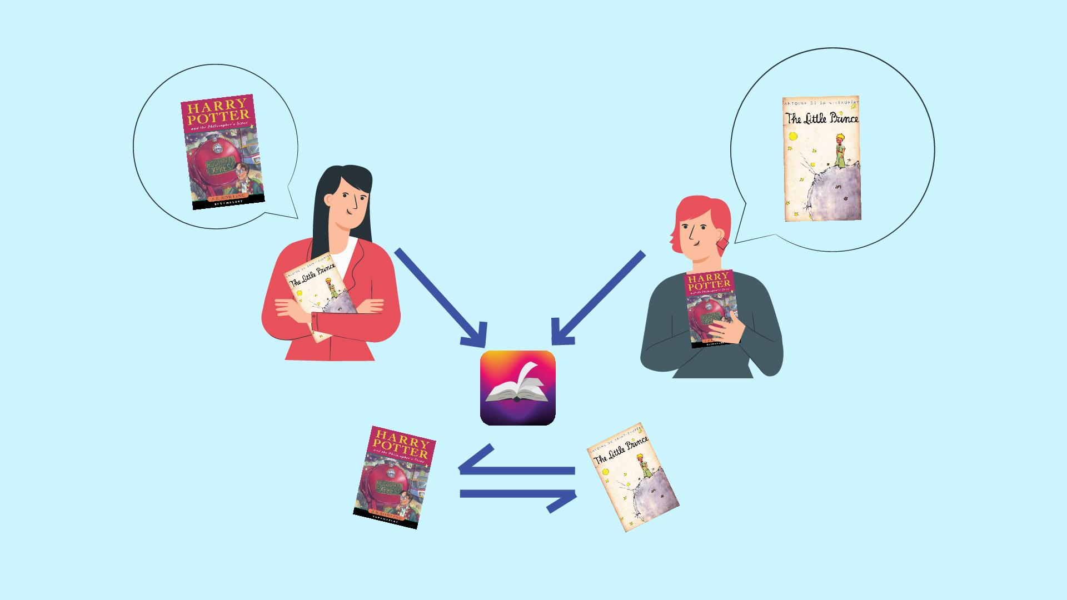

Slide 6
Timeline
Authentication ✔
Basic Features
Profile Creations ✔
CHAT ✔
API Integration ✔
Connections ✔
Improve Recommendation
Algorithm ❌
TODAY

Slide 7




Tools and Workflow
Android Studio
Firebase
Git & Github
Trello

Slide 8
Methodology

Slide 9
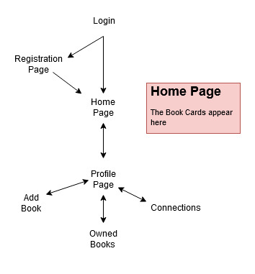
Activity Flow

Slide 10
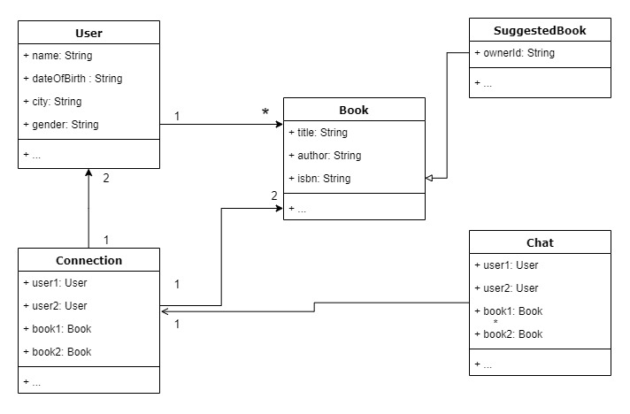
UML of the base models
P.S: getters() and setters() are not shown to save slide space

Slide 11
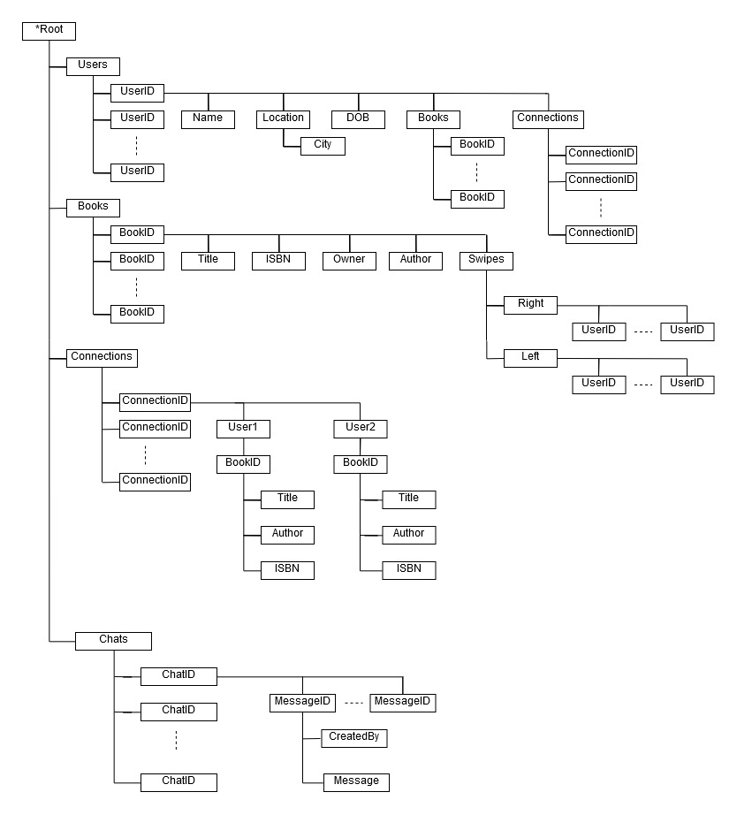
Firebase Realtime Database
Root
.
.
.
New this Week:

Slide 12
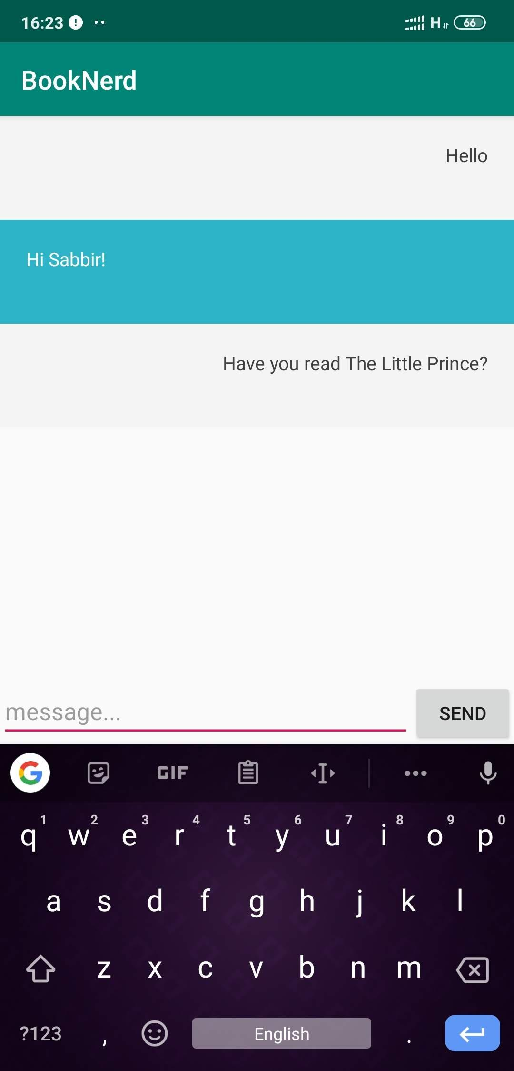
Chat View

Slide 13
Making Connections
swipeLeft(){
skip();
}
swiperight(){
checkConnection();
}

Slide 14
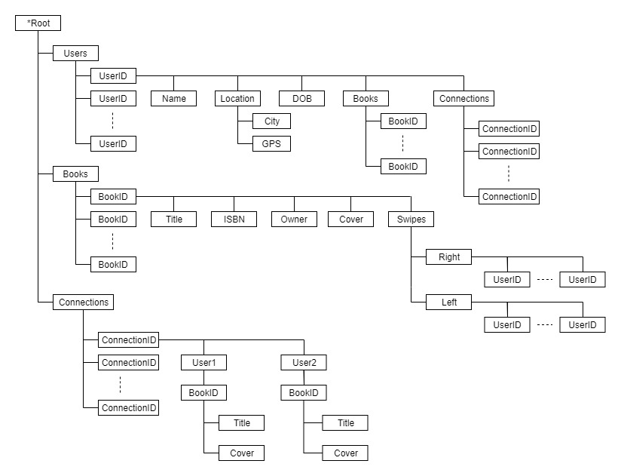
Our Connection function
Our Connection function
OwnerID

Slide 15
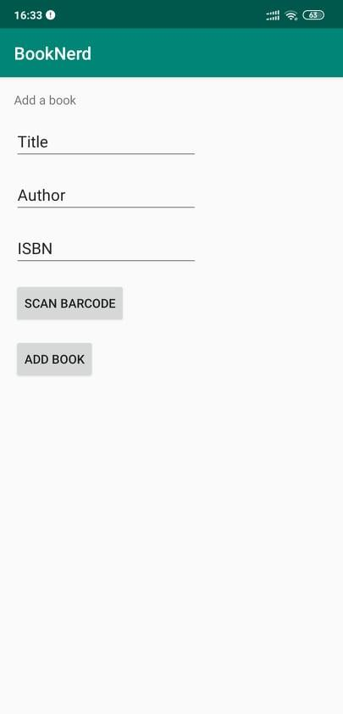
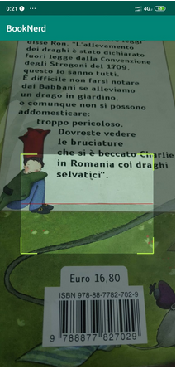
Add Book

Slide 16
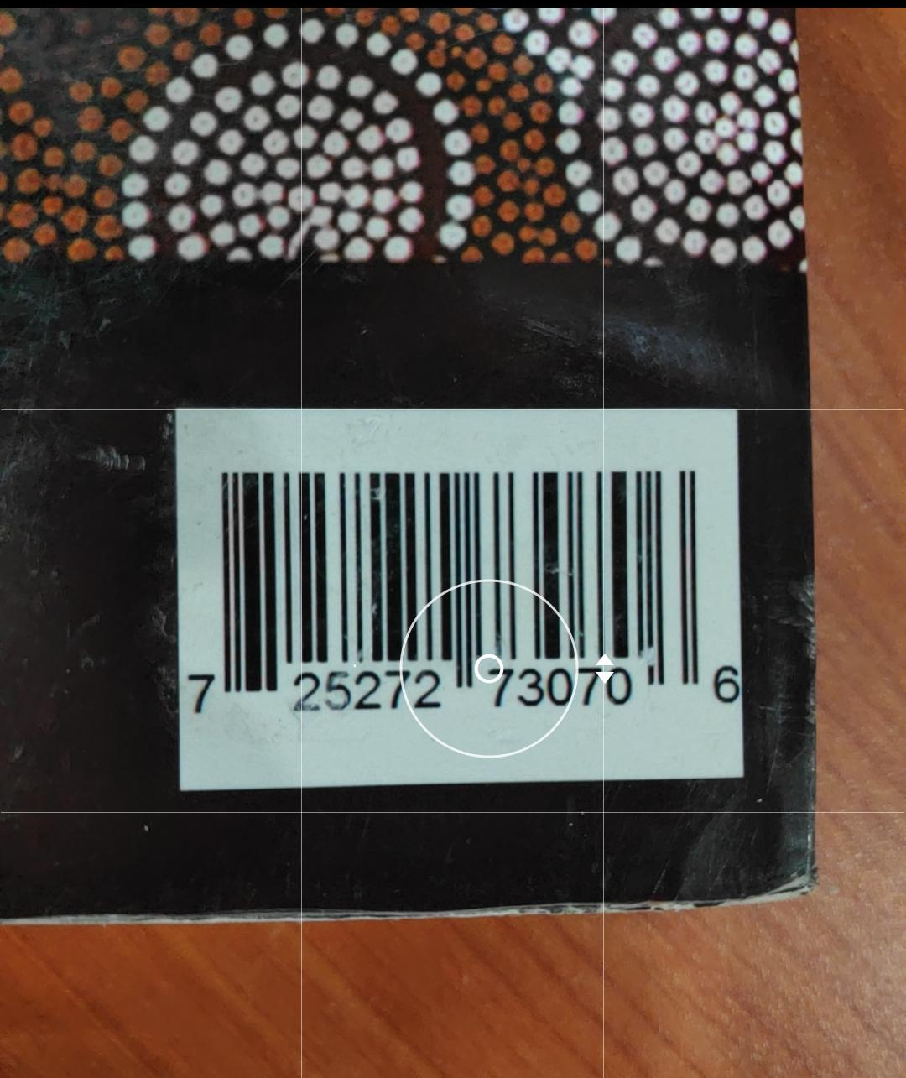
Google Play API format
REQUEST:
https://www.googleapis.com/books/v1/volumes?q=
isbn:9781781100219

Slide 17
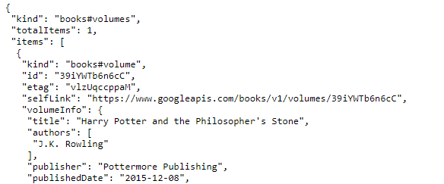
Book data as a
JSON object

Slide 18
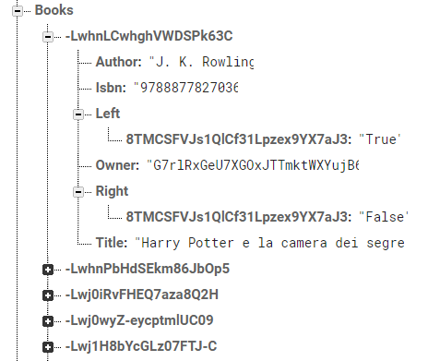


Slide 19
Wrapping Up

Slide 20
Future Goals
Optimizing Recommendation System Using Machine Learning
Filter books by Geo-Location and other factors
HCI Research to improve UI
Research correlation between people’s book preference and social connections

Slide 21
Thank You.
Questions?

