Slide 1
Accounting Principles
Thirteenth Edition
Weygandt ● Kimmel ● Kieso
Chapter 1
Accounting in Action
This slide deck contains animations. Please disable animations if they cause issues with your device.

Slide 2
Chapter Outline
Learning Objectives
L O 1 Identify the activities and users associated with accounting.
L O 2 Explain the building blocks of accounting: ethics, principles, and assumptions.
L O 3 State the accounting equation, and define its components.
L O 4 Analyze the effects of business transactions on the accounting equation.
L O 5 Describe the four financial statements and how they are prepared.

Slide 3
Accounting Activities and Users
Accounting consists of three activities
Identification – Identify economic events (relevant to its business)
Recording - Record, classify, and summarize
Communication
Prepare accounting reports
Analyze and interpret the reported information

Slide 4
Who Uses Accounting Data (1 of 2)
Internal Users
Finance - Is cash sufficient to pay dividends to Microsoft stockholders?
Marketing – What price should Apple charge for an iPad to maximize net income?
Human Resources – Can General Motors afford to give its employees pay raises this year?
Management - Which PepsiCo product line is the most profitable? Should any product lines be eliminated?

Slide 5
Who Uses Accounting Data (2 of 2)
External Users
Investors
Is General Electric earning satisfactory income?
How does Disney compare in size and profitability with Time Warner?
Creditors – Will United Airlines be able to pay its debts as they come due?

Slide 6
Do It! 1: Basic Concepts (1 of 2)
Indicate whether each of the statements is true or false.
The three steps in the accounting process are identification, recording, and communication.
Bookkeeping encompasses all steps in the accounting process.
Accountants prepare, but do not interpret, financial reports.
The two most common types of external users are investors and company officers.
Managerial accounting focuses on reports for internal users.
Solution:
1.
2.
3.
4.
5.

Slide 7
Do It! 1: Basic Concepts (2 of 2)
Indicate whether each of the statements is true or false.
The three steps in the accounting process are identification, recording, and communication.
Bookkeeping encompasses all steps in the accounting process.
Accountants prepare, but do not interpret, financial reports.
The two most common types of external users are investors and company officers.
Managerial accounting focuses on reports for internal users.
Solution:
1. True
2. False
3. False
4. False
5. True

Slide 8
The Building Blocks of Accounting
Ethics in Financial Reporting
Financial scandals include: Enron, WorldCom, HealthSouth, A I G.
Regulators and lawmakers were concerned that economy would suffer if investors lost confidence in corporate accounting
Congress passed Sarbanes-Oxley Act (S O X)
Effective financial reporting depends on sound ethical behavior

Slide 9
Ethics in Financial Reporting (1 of 2)
Ethics are the standards of conduct by which actions are judged as:
a. right or wrong
b. honest or dishonest
c. fair or not fair
d. all of these options

Slide 10
Ethics in Financial Reporting (2 of 2)
Ethics are the standards of conduct by which actions are judged as:
a. right or wrong
b. honest or dishonest
c. fair or not fair
d. Answer: all of these options

Slide 11
Generally Accepted Accounting Principles
Standards that are generally accepted and universally practiced. These standards indicate how to report economic events.
Standard-setting bodies:
Financial Accounting Standards Board (F A S B)
Securities and Exchange Commission (S E C)
International Accounting Standards Board (I A S B)

Slide 12
Measurement Principles
Historical Cost Principle (or cost principle)
Record assets at their cost.
Fair Value Principle
Assets and liabilities should be reported at fair value (the price received to sell an asset or settle a liability)
Selection of which principle to follow generally relates to trade-offs between relevance and faithful representation.

Slide 13
Assumptions (1 of 5)
Monetary Unit Assumption
Include in accounting records only transaction data that can be expressed in terms of money
Economic Entity Assumption
Activities of entity be kept separate and distinct from activities of its owner and all other economic entities
Forms of Business Ownership
Proprietorship
Partnership
Corporation

Slide 14
Forms of Business Ownership
Proprietorship
Owned by one person
Owner is often manager/operator
Owner receives any profits, suffers any losses, and is personally liable for all debts
Partnership
Owned by two or more persons
Often retail and service-type businesses
Generally unlimited personal liability
Partnership agreement
Corporation
Ownership divided into transferable shares of stock
Separate legal entity organized under state corporation law
Limited liability

Slide 15
Assumptions (2 of 5)
Combining the activities of Kellogg and General Mills would violate the
a. cost principle
b. economic entity assumption
c. monetary unit assumption
d. ethics principle.

Slide 16
Assumptions (3 of 5)
Combining the activities of Kellogg and General Mills would violate the
a. cost principle
b. Answer: economic entity assumption
c. monetary unit assumption
d. ethics principle.

Slide 17
Assumptions (4 of 5)
A business organized as a separate legal entity under state law having ownership divided into shares of stock is a
a. proprietorship
b. partnership
c. corporation
d. sole proprietorship

Slide 18
Assumptions (5 of 5)
A business organized as a separate legal entity under state law having ownership divided into shares of stock is a
a. proprietorship
b. partnership
c. Answer: corporation
d. sole proprietorship

Slide 19
Do It! 2: Building Blocks of Accounting (1 of 4)
Indicate whether each of the five statements presented below is true or false. If false, indicate how to correct the statement.
Congress passed the Sarbanes-Oxley Act to reduce unethical behavior and decrease the likelihood of future corporate scandals.
The primary accounting standard-setting body in the United States is the Financial Accounting Standards Board (F A S B).
The historical cost principle dictates that companies record assets at their cost. In later periods, however, the fair value of the asset must be used if fair value is higher than its cost.
Solution:
1.
2.
3.

Slide 20
Do It! 2: Building Blocks of Accounting (2 of 4)
Indicate whether each of the five statements presented below is true or false. If false, indicate how to correct the statement.
Congress passed the Sarbanes-Oxley Act to reduce unethical behavior and decrease the likelihood of future corporate scandals.
The primary accounting standard-setting body in the United States is the Financial Accounting Standards Board (F A S B).
The historical cost principle dictates that companies record assets at their cost. In later periods, however, the fair value of the asset must be used if fair value is higher than its cost.
Solution:
1. True
2. True
3. False. The historical cost principle dictates that companies record assets at their cost. Under the historical cost principle, the company must also use cost in later periods.

Slide 21
Do It! 2: Building Blocks of Accounting (3 of 4)
Indicate whether each of the five statements presented below is true or false. If false, indicate how to correct the statement.
Relevance means that financial information matches what really happened; the information is factual.
A business owner’s personal expenses must be separated from expenses of the business to comply with accounting’s economic entity assumption.
Solution:
1. True
2. True
3. False
4.
5.

Slide 22
Do It! 2: Building Blocks of Accounting (4 of 4)
Indicate whether each of the five statements presented below is true or false. If false, indicate how to correct the statement.
Relevance means that financial information matches what really happened; the information is factual.
A business owner’s personal expenses must be separated from expenses of the business to comply with accounting’s economic entity assumption.
Solution:
1. True
2. True
3. False
4. False. Faithful representation, not relevance, means that financial information matches what really happened; the information is factual.
5. True

Slide 23

The Accounting Equation (1 of 6)
Basic Accounting Equation
Provides underlying framework for recording and summarizing economic events
Assets are claimed by either creditors or owners
If a business is liquidated, claims of creditors must be paid before ownership claims

Slide 24
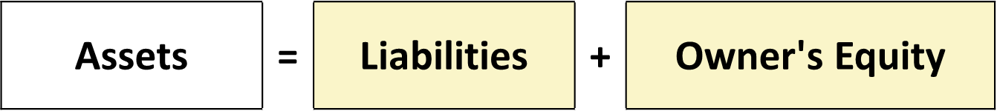
The Accounting Equation (2 of 6)
Assets
Resources a business owns
Provide future services or benefits
Cash, Supplies, Equipment, etc.

Slide 25

The Accounting Equation (3 of 6)
Liabilities
Claims against assets (debts and obligations)
Creditors (party to whom money is owed)
Accounts Payable, Notes Payable, Salaries and Wages Payable, etc.

Slide 26

The Accounting Equation (4 of 6)
Owner’s Equity
Ownership claim on total assets
Referred to as residual equity
Investment by owners and revenues increases owner's equity
Drawings and expenses decreases owner's equity

Slide 27
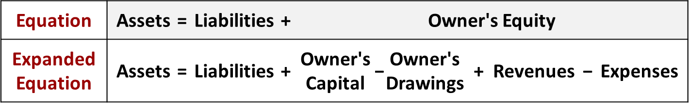
The Accounting Equation (5 of 6)
Increase in Owner’s Equity
Investment by Owner. Assets the owner puts into the business
Revenues. Increases in assets or decreases in liabilities resulting from sale of goods or performance of services in normal course of business

Slide 28
The Accounting Equation (6 of 6)
Decrease in Owner’s Equity
Drawings. A withdraw of cash or other assets for personal use
Expenses. Cost of assets consumed or services used in the process of earning revenue

Slide 29
Do It! 3: Owner’s Equity Effects
Classify the following items as investment by owner (I), owner’s drawings (D), revenues (R), or expenses (E). Then indicate whether each item increases or decreases owner’s equity.
 | Classification | Effect on Equity
Rent Expense | Expense | Decrease
Service Revenue | Revenue | Increase
Drawings | Owner’s Drawings | Decrease
Salaries and Wages Expense | Expense | Decrease

Slide 30
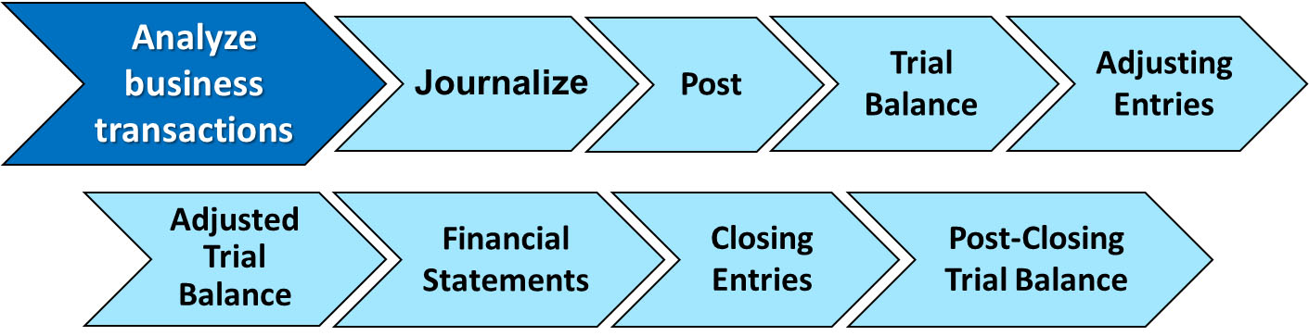
Analyzing Business Transactions (1 of 2)
Transactions are a business’s economic events recorded by accountants.
May be external or internal
Not all activities represent transactions
Have a dual effect on the accounting equation

Slide 31
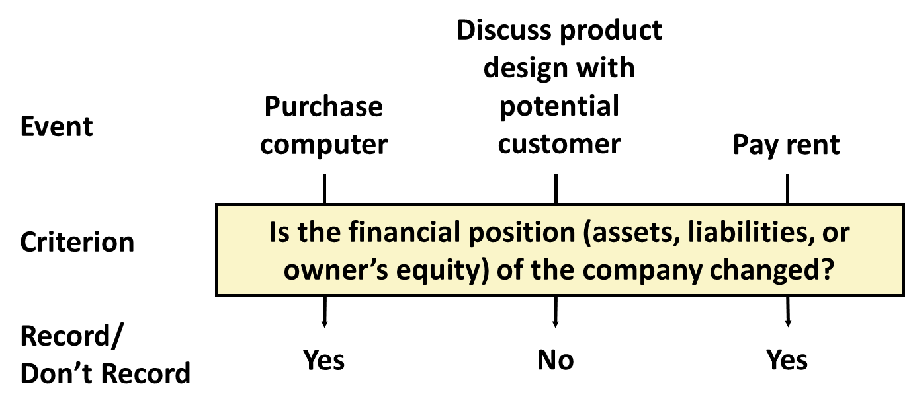
Analyzing Business Transactions (2 of 2)
Illustration: Are the following events recorded in the accounting records?

Slide 32
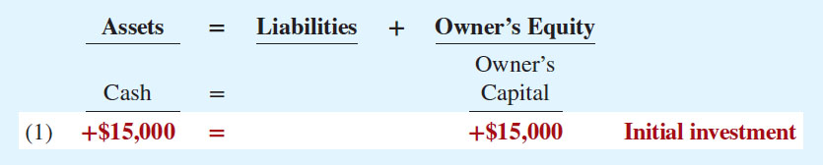
Transaction Analysis (1 of 10)
Transaction 1. Ray Neal decides to start a smartphone app development company which he names Softbyte. On September 1, 2020, he invests $15,000 cash in the business. This transaction results in an equal increase in assets and owner’s equity.

Slide 33
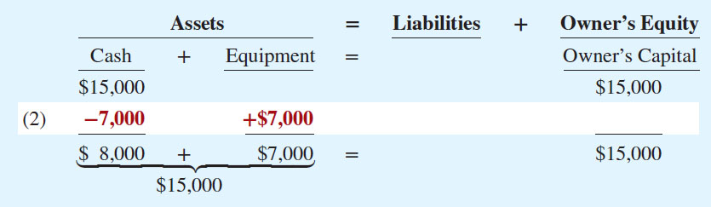
Transaction Analysis (2 of 10)
Transaction 2. Softbyte purchases computer equipment for $7,000 cash.

Slide 34
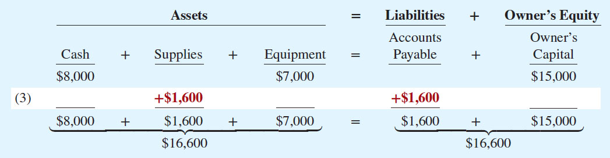
Transaction Analysis (3 of 10)
Transaction 3. Softbyte Inc. purchases for $1,600 headsets and other computer accessories expected to last several months. The supplier allows Softbyte to pay this bill in October.

Slide 35
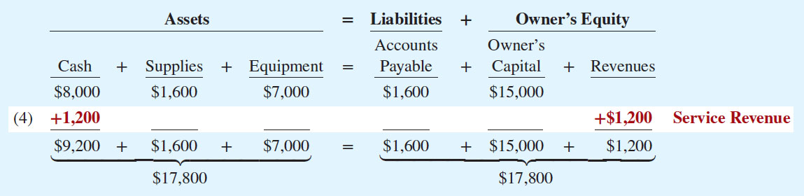
Transaction Analysis (4 of 10)
Transaction 4. Softbyte receives $1,200 cash from customers for app development services it has performed.

Slide 36
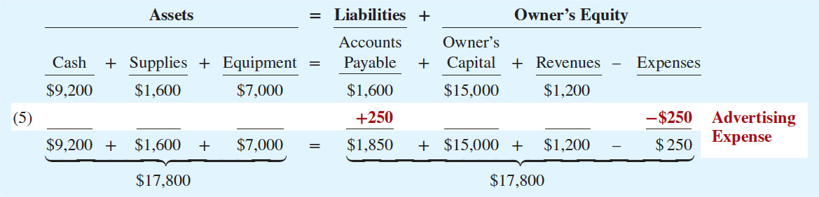
Transaction Analysis (5 of 10)
Transaction 5. Softbyte Inc. receives a bill for $250 from the Daily News for advertising on its online website but postpones payment until a later date.

Slide 37
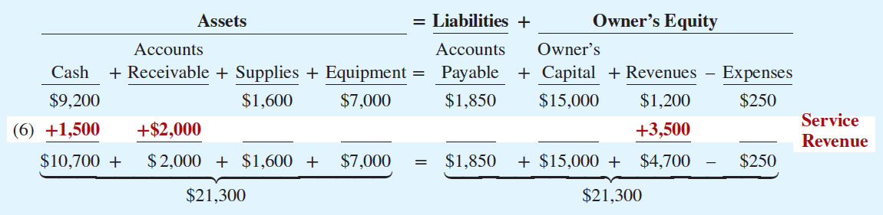
Transaction Analysis (6 of 10)
Transaction 6. Softbyte performs $3,500 of app development services for customers. The company receives cash of $1,500 from customers, and it bills the balance of $2,000 on account.

Slide 38
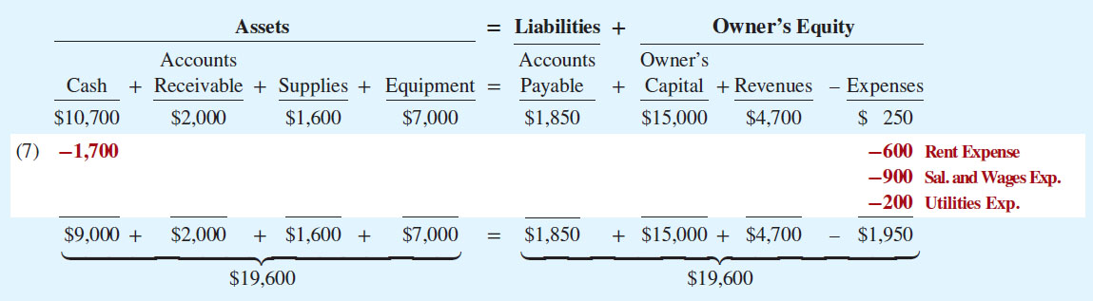
Transaction Analysis (7 of 10)
Transaction 7. Softbyte pays the following expenses in cash for September: office rent $600, salaries and wages of employees $900, and utilities $200.

Slide 39
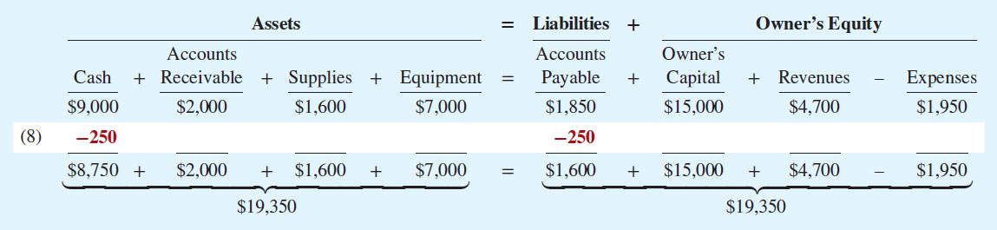
Transaction Analysis (8 of 10)
Transaction 8. Softbyte pays its $250 Daily News bill in cash. The company previously (in Transaction 5) recorded the bill as an increase in Accounts Payable and a decrease in owner’s equity.

Slide 40
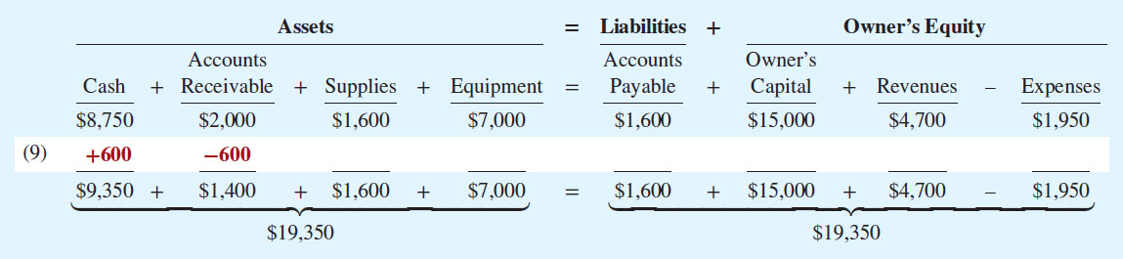
Transaction Analysis (9 of 10)
Transaction 9. Softbyte receives $600 in cash from customers who had been billed for services (in Transaction 6).

Slide 41
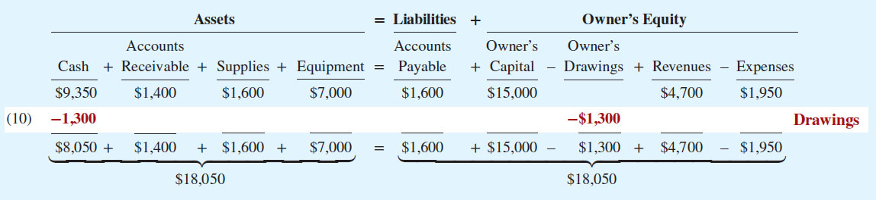
Transaction Analysis (10 of 10)
Transaction 10. Ray Neal withdraws $1,300 in cash from the business for his personal use.

Slide 42
Summary of Transactions
Each transaction analyzed in terms of effect on:
a. Three components of basic accounting equation
Assets
Liabilities
Owner’s equity
b. Specific types of items, such as Cash
Two sides of equation must always be equal
The Owner’s Capital, Owner’s Drawings, Revenues, and Expenses columns indicate the cause of each change in the owner’s claim on assets.

Slide 43
Do It! 4: Tabular Analysis (1 of 6)
Transactions made by Virmari & Co., a public accounting firm, for the month of August are shown below. Prepare a tabular analysis which shows the effects of these transactions on the expanded accounting equation, similar to that shown in Illustration 1.8.
The owner invested $25,000 cash in the business.
The company purchased $7,000 of office equipment on credit.
The company received $8,000 cash in exchange for services performed.
The company paid $850 for this month’s rent.
The owner withdrew $1,000 cash for personal use.

Slide 44
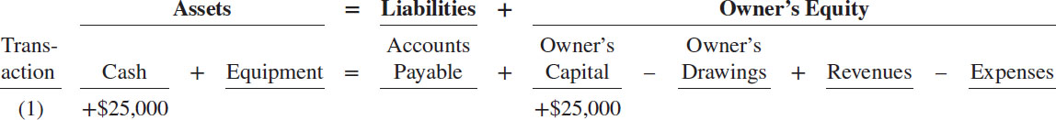
Do It! 4: Tabular Analysis (2 of 6)
Transaction 1. The owner invested $25,000 cash in the business.

Slide 45
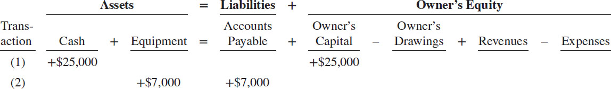
Do It! 4: Tabular Analysis (3 of 6)
Transaction 2. The company purchased $7,000 of office equipment on credit.

Slide 46
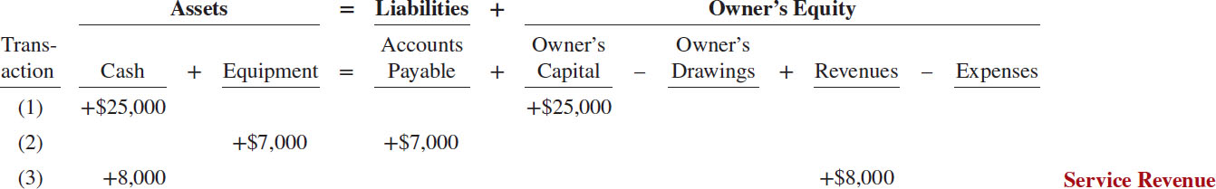
Do It! 4: Tabular Analysis (4 of 6)
Transaction 3. The company received $8,000 cash in exchange for services performed.

Slide 47
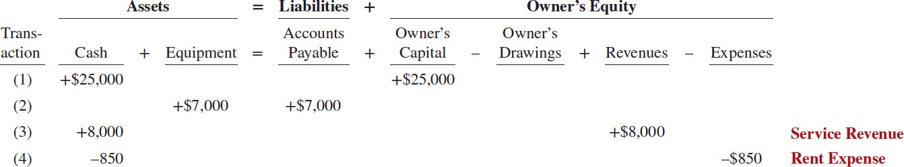
Do It! 4: Tabular Analysis (5 of 6)
Transaction 4. The company paid $850 for this month’s rent.

Slide 48
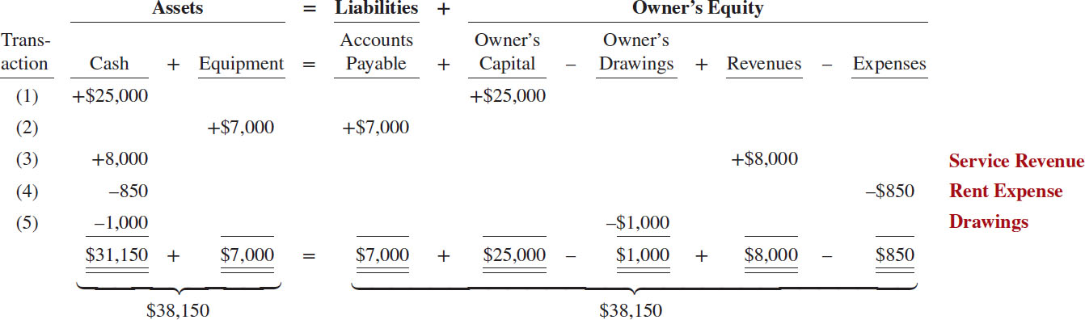
Do It! 4: Tabular Analysis (6 of 6)
Transaction 5. The owner withdrew $1,000 cash for personal use.

Slide 49
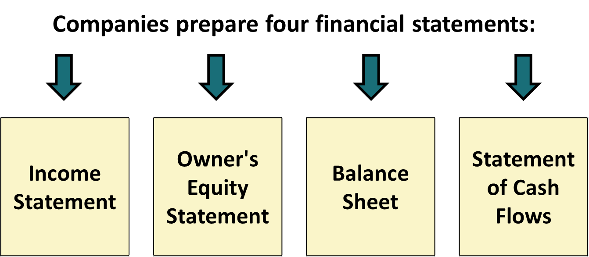
The Four Financial Statements

Slide 50
Financial Statements (1 of 7)
Net income will result during a time period when:
a. assets exceed liabilities
b. assets exceed revenues
c. expenses exceed revenues
d. revenues exceed expenses

Slide 51
Financial Statements (2 of 7)
Net income will result during a time period when:
a. assets exceed liabilities
b. assets exceed revenues
c. expenses exceed revenues
d. Answer: revenues exceed expenses

Slide 52
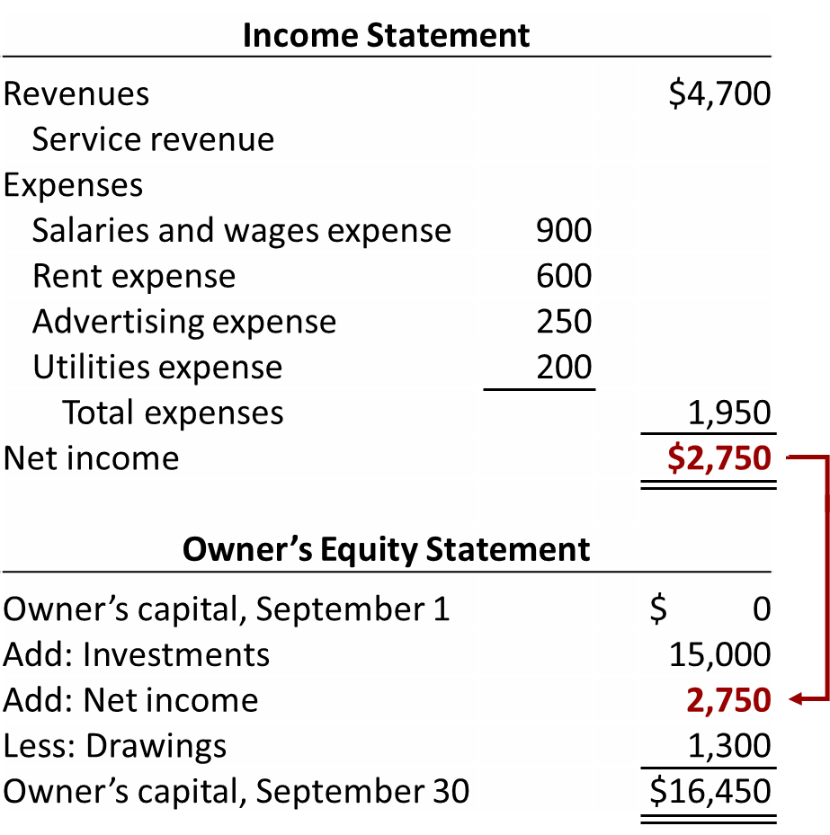
Financial Statements (3 of 7)
Softbyte statements for the Month Ended September 30, 2020

Slide 53
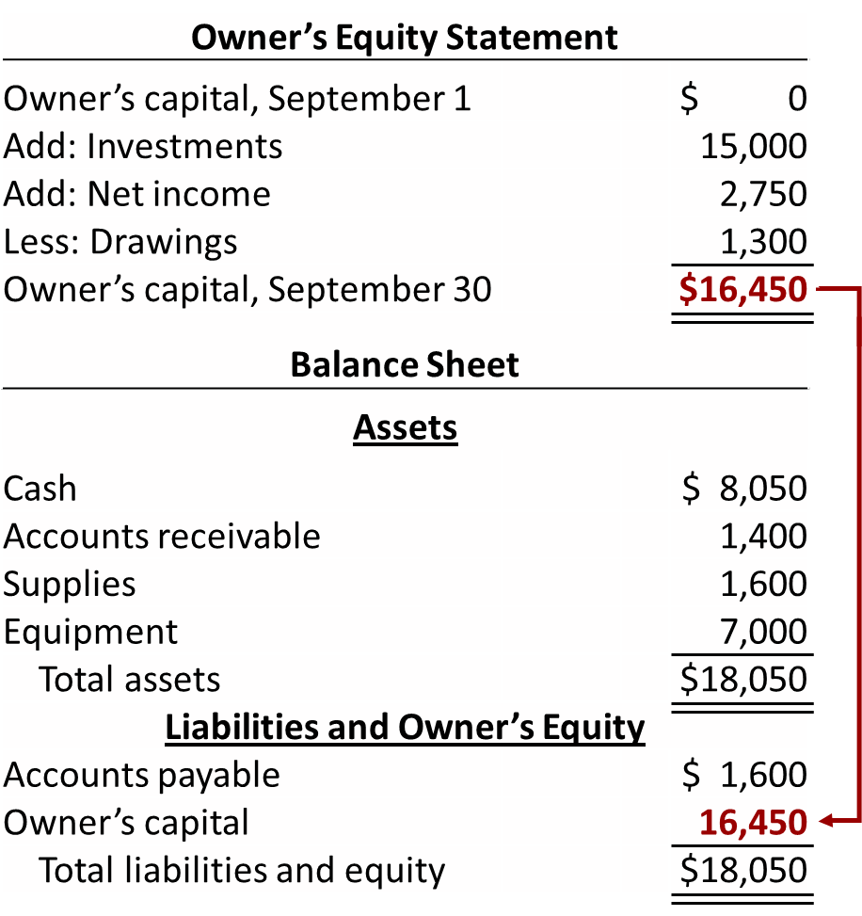
Financial Statements (4 of 7)
Softbyte statements for the Month Ended September 30, 2020

Slide 54
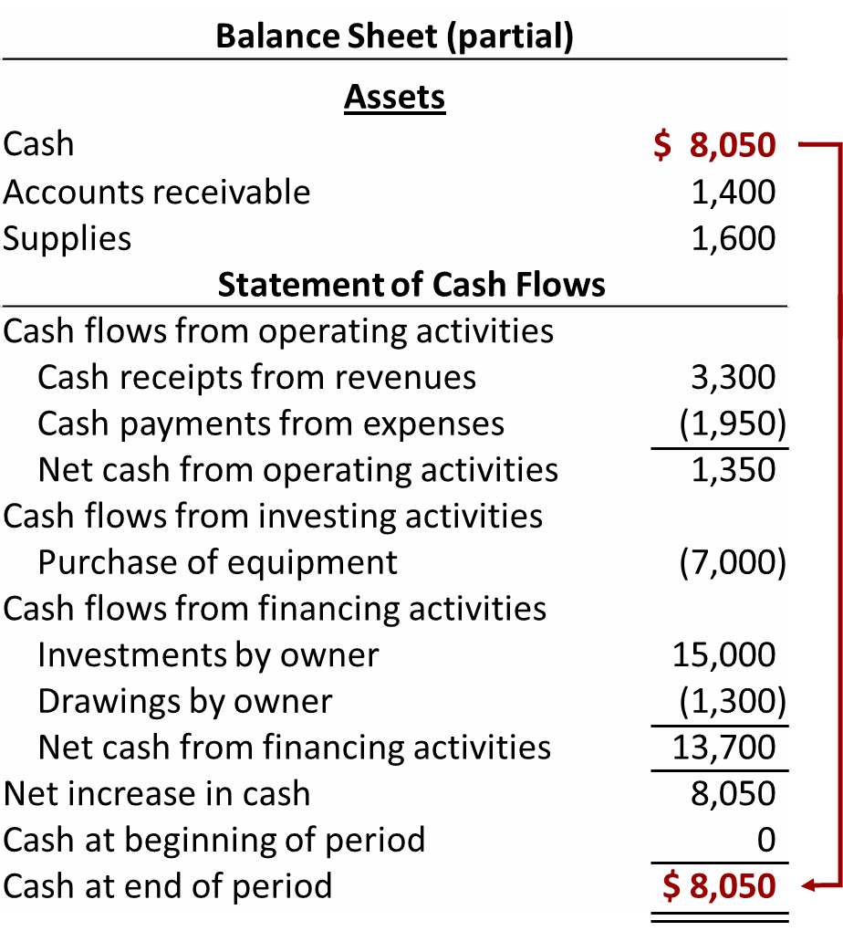
Financial Statements (5 of 7)
Softbyte statements for the Month Ended September 30, 2020

Slide 55
Income Statement
Reports revenues and expenses for a specific period of time
Lists revenues first, followed by expenses
Shows net income (or net loss)
Does not include investment and withdrawal transactions between owner and business in measuring net income

Slide 56
Owner’s Equity Statement
Reports changes in owner’s equity for a specific period of time
Time period is the same as that covered by the income statement

Slide 57
Balance Sheet
Reports assets, liabilities, and owner’s equity at a specific date
Lists assets at top, followed by liabilities and owner’s equity
Total assets must equal total liabilities and owner's equity
Snapshot of company’s financial condition at a specific moment in time (usually month-end or year-end)

Slide 58
Statement of Cash Flows
Provides information on cash receipts and payments for a specific period of time
Answers the following:
Where did cash come from during the period?
What was cash used for during the period?
What was the change in the cash balance during the period?

Slide 59
Usefulness of the Statement of Cash Flows
Provides information to help assess:
Entity’s ability to generate future cash flows.
Entity’s ability to pay dividends and meet obligations.
Reasons for difference between net income and net cash provided (used) by operating activities.
Cash investing and financing transactions during the period.

Slide 60
Financial Statements (6 of 7)
Which of the following financial statements is prepared as of a specific date?
a. Balance sheet
b. Income statement
c. Owner’s equity statement
d. Statement of cash flows

Slide 61
Financial Statements (7 of 7)
Which of the following financial statements is prepared as of a specific date?
a. Answer: Balance sheet
b. Income statement
c. Owner’s equity statement
d. Statement of cash flows

Slide 62
Do It! 5: Financial Statement Items (1 of 4)
Presented below is selected information related to Flanagan Company at December 31, 2020. Flanagan reports financial information monthly.
Equipment | 10,000 | Utilities Expense | 4,000
Cash | 8,000 | Accounts Receivable | 9,000
Service Revenue | 36,000 | Salaries and Wages Expense | 7,000
Rent Expense | 11,000 | Notes Payable | 16,500
Accounts Payable | 2,000 | Owner’s Drawings | 5,000
a. Determine the total assets of Flanagan Company at December 31, 2020.
b. Determine the net income that Flanagan Company reported for December 2020.
c. Determine the owner’s equity of Flanagan Company at December 31, 2020.

Slide 63
Do It! 5: Financial Statement Items (2 of 4)
Presented below is selected information related to Flanagan Company at December 31, 2020. Flanagan reports financial information monthly.
Equipment | 10,000 | Utilities Expense | 4,000
Cash | 8,000 | Accounts Receivable | 9,000
Service Revenue | 36,000 | Salaries and Wages Expense | 7,000
Rent Expense | 11,000 | Notes Payable | 16,500
Accounts Payable | 2,000 | Owner’s Drawings | 5,000
a. Determine the total assets of Flanagan Company at December 31, 2020.
Cash
$ 8,000
Accounts receivable
9,000
Equipment
10,000
Total assets

Slide 64
Do It! 5: Financial Statement Items (3 of 4)
Presented below is selected information related to Flanagan Company at December 31, 2020. Flanagan reports financial information monthly.
Equipment | 10,000 | Utilities Expense | 4,000
Cash | 8,000 | Accounts Receivable | 9,000
Service Revenue | 36,000 | Salaries and Wages Expense | 7,000
Rent Expense | 11,000 | Notes Payable | 16,500
Accounts Payable | 2,000 | Owner’s Drawings | 5,000
b. Determine the net income that Flanagan Company reported for December 2020.
Service revenue
$36,000
Rent expense
11,000
Salaries and wages expense
7,000
Utilities expense
4,000
Net income

Slide 65
Do It! 5: Financial Statement Items (4 of 4)
Presented below is selected information related to Flanagan Company at December 31, 2020. Flanagan reports financial information monthly.
Equipment | 10,000 | Utilities Expense | 4,000
Cash | 8,000 | Accounts Receivable | 9,000
Service Revenue | 36,000 | Salaries and Wages Expense | 7,000
Rent Expense | 11,000 | Notes Payable | 16,500
Accounts Payable | 2,000 | Owner’s Drawings | 5,000
c. Determine the owner’s equity of Flanagan Company at December 31, 2020.
Total assets
$27,000
Less: Notes payable expense
16,500
Less: Accounts payable
2,000
Owner’s equity

Slide 66
Appendix 1A: Career Opportunities in Accounting
Public Accounting Careers in auditing, taxation, and management consulting serving the general public.
Private Accounting Careers in industry working in cost accounting, budgeting, accounting information systems, and tax planning and preparation.
Governmental Accounting Careers with the I R S, F B I, the S E C, public colleges and universities, and in state and local governments.
Forensic Accounting Uses accounting, auditing, and investigative skills to conduct investigations into theft and fraud.

Slide 67
Copyright
Copyright © 2018 John Wiley & Sons, Inc.
All rights reserved. Reproduction or translation of this work beyond that permitted in Section 117 of the 1976 United States Act without the express written permission of the copyright owner is unlawful. Request for further information should be addressed to the Permissions Department, John Wiley & Sons, Inc. The purchaser may make back-up copies for his/her own use only and not for distribution or resale. The Publisher assumes no responsibility for errors, omissions, or damages, caused by the use of these programs or from the use of the information contained herein.

