Slide 1
Accounting Principles
Thirteenth Edition
Weygandt ● Kimmel ● Kieso
Chapter 5
Accounting for Merchandising Operations
This slide deck contains animations. Please disable animations if they cause issues with your device.

Slide 2
Chapter Outline
Learning Objectives
L O 1 Describe merchandising operations and inventory systems.
L O 2 Record purchases under a perpetual inventory system.
L O 3 Record sales under a perpetual inventory system.
L O 4 Apply the steps in the accounting cycle to a merchandising company.
L O 5 Prepare a multiple-step income statement and a comprehensive income statement.

Slide 3
Merchandising Operations and Inventory Systems
Merchandising companies that sell directly to consumers are called retailers.
Merchandising companies that sell to retailers are known as wholesalers.
The primary source of revenues is referred to as sales revenue or sales.

Slide 4
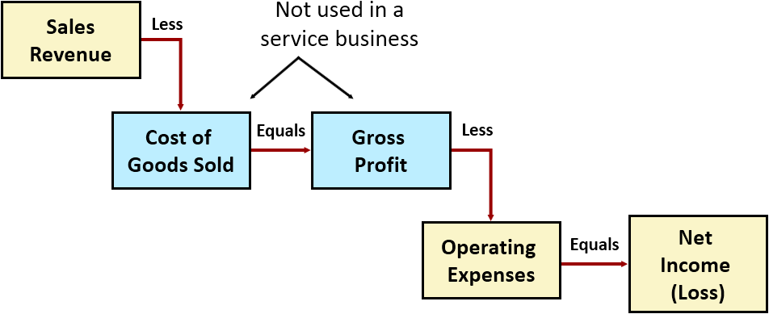
Merchandising Operations
Income Measurement
Cost of goods sold is the total cost of merchandise sold during the period.

Slide 5
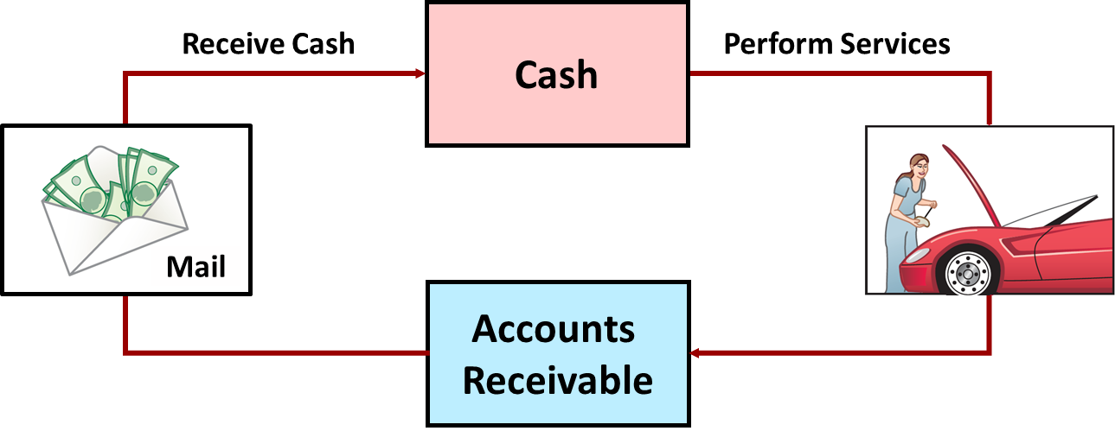
Operating Cycles (1 of 2)
Service Company

Slide 6
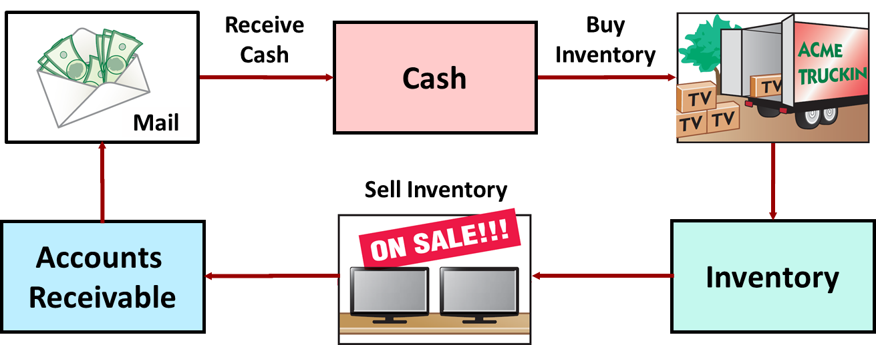
Operating Cycles (2 of 2)
Merchandising Company
Ordinarily is longer than that of a service company.

Slide 7
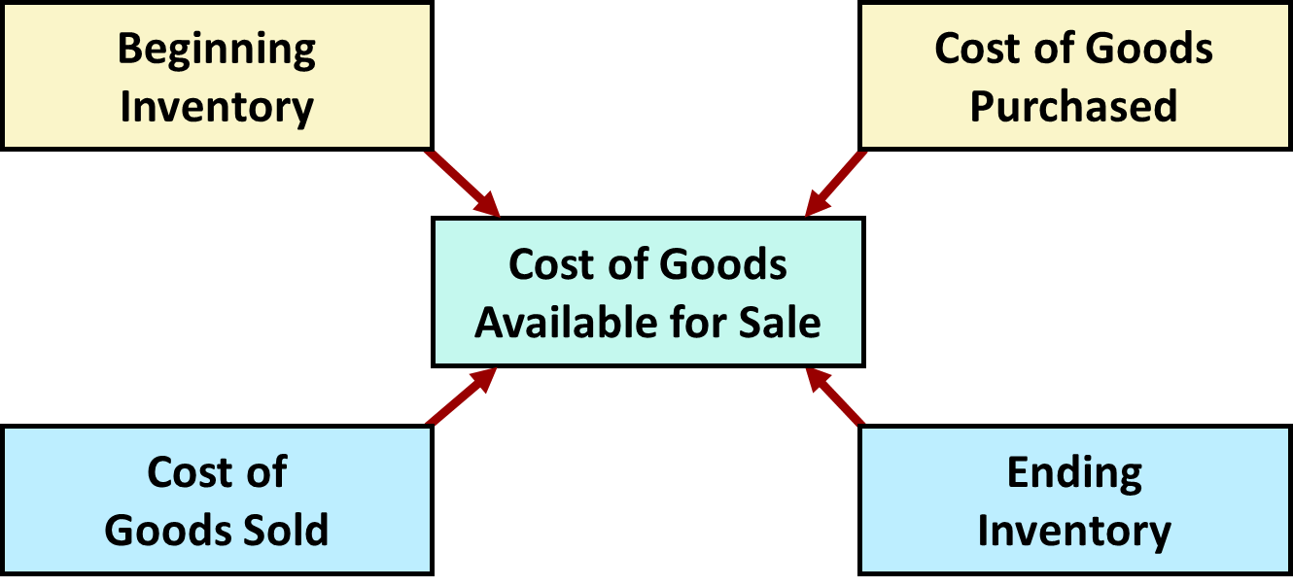
Flow of Costs (1 of 4)
Companies use a perpetual or a periodic inventory system.

Slide 8
Flow of Costs (2 of 4)
Perpetual System
Maintain detailed records of cost of each inventory purchase and sale
Records continuously show inventory that should be on hand for every item
Company determines cost of goods sold each time a sale occurs

Slide 9
Flow of Costs (3 of 4)
Periodic System
Do not keep detailed records of the goods on hand
Cost of goods sold determined by count at the end of the accounting period
Calculation of Cost of Goods Sold:
Beginning inventory | $ 100,000
Add: Purchases, net | 800,000
Goods available for sale | 900,000
Less: Ending inventory | 125,000
Cost of goods sold | $ 775,000

Slide 10
Flow of Costs (4 of 4)
Advantages of the Perpetual System
Traditionally used for merchandise with high unit values
Shows quantity and cost of inventory that should be on hand at any time
Provides better control over inventories than a periodic system

Slide 11
Do It! 1: Merchandising Operations and Inventory Systems (1 of 2)
Indicate whether the following statements are true or false. If false, indicate how to correct the statement.
The primary source of revenue for a merchandising company results from performing services for customers.
The operating cycle of a service company is usually shorter than that of a merchandising company.
Sales revenue less cost of goods sold equals gross profit.
Ending inventory plus the cost of goods purchased equals cost of goods available for sale.
Solution:
1.
3.
4.
2.

Slide 12
Do It! 1: Merchandising Operations and Inventory Systems (2 of 2)
Indicate whether the following statements are true or false. If false, indicate how to correct the statement.
The primary source of revenue for a merchandising company results from performing services for customers.
The operating cycle of a service company is usually shorter than that of a merchandising company.
Sales revenue less cost of goods sold equals gross profit.
Ending inventory plus the cost of goods purchased equals cost of goods available for sale.
Solution:
1. False. The primary source for a service company results from performing services for customers.
3. True
4. False. Beginning inventory plus the cost of goods purchased equals cost of goods available for sale.
2. True

Slide 13
Recording Purchases Perpetual System (1 of 3)
Made using cash or credit (on account)
Normally record when goods are received from seller
Purchase invoice should support each credit purchase

Slide 14
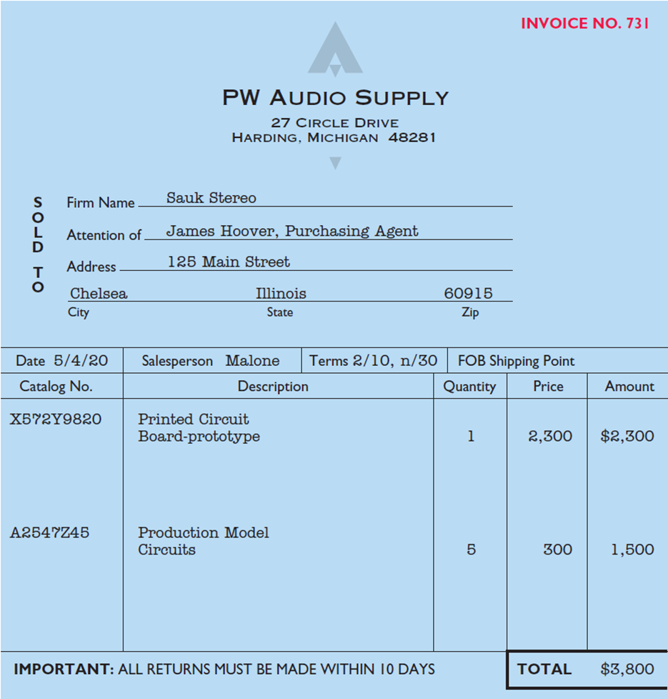
Recording Purchases Perpetual System (2 of 3)
Purchase invoice should support each credit purchase

Slide 15
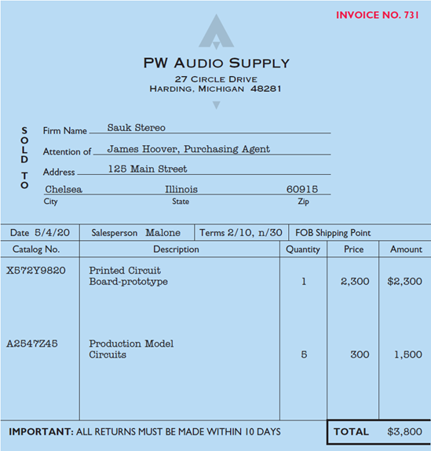
Recording Purchases Perpetual System (3 of 3)
Illustration: Sauk Stereo (the buyer) uses as a purchase invoice the sales invoice prepared by PW Audio Supply (the seller). Prepare the journal entry for Sauk Stereo for the invoice from PW Audio Supply.
May 4
Inventory
3,800
Accounts Payable
(To record goods purchased on account from P W Audio Supply)
3,800

Slide 16
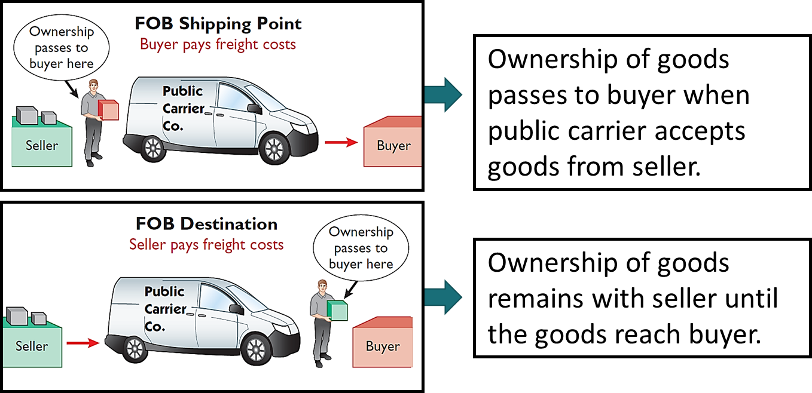
Freight Costs (1 of 2)
Freight costs incurred by the seller are an operating expense.

Slide 17
Freight Costs (2 of 2)
Illustration: If Sauk Stereo (the buyer) pays Public Carrier Co. $150 for freight charges on May 6, the entry on Sauk Stereo’s books is:
May 6
Inventory
150
Cash
150
If the freight terms on the invoice in Illustration 5.6 had required PW Audio Supply (the seller) to pay the freight charges, the entry by PW Audio Supply would be:
May 4
Freight-Out (Delivery Expense)
150
Cash
150

Slide 18
Purchase Returns and Allowances (1 of 4)
Purchaser may be dissatisfied because goods are damaged or defective, of inferior quality, or do not meet purchaser’s specifications.
Purchase Return
Purchaser may return goods to seller for credit if sale was made on credit, or for a cash refund if purchase was for cash.
Purchase Allowance
Purchaser may choose to keep merchandise if seller will grant an allowance (deduction) from purchase price.

Slide 19
Purchase Returns and Allowances (2 of 4)
Illustration: Assume that Sauk Stereo returned goods costing $300 to PW Audio Supply on May 8.
May 8
Accounts Payable
300
Inventory
(To record return of goods purchased from P W Audio Supply)
300

Slide 20
Purchase Returns and Allowances (3 of 4)
In a perpetual inventory system, a return of defective merchandise by a purchaser is recorded by crediting:
a. purchases
b. purchase returns
c. purchase allowance
d. inventory

Slide 21
Purchase Returns and Allowances (4 of 4)
In a perpetual inventory system, a return of defective merchandise by a purchaser is recorded by crediting:
a. purchases
b. purchase returns
c. purchase allowance
d. Answer: inventory

Slide 22
Purchase Discounts (1 of 5)
Credit terms may permit buyer to claim a cash discount for prompt payment. Example: Credit terms 2/10, n/30.
Advantages:
Purchaser saves money, and
Seller shortens operating cycle by converting accounts receivable into cash earlier

Slide 23
Purchase Discounts (2 of 5)
2/10, n/30
2% discount if paid within 10 days, otherwise net amount due within 30 days.
1/10 EOM
1% discount if paid within first 10 days of next month
n/10 E O M
Net amount due within the first 10 days of the next month

Slide 24
Purchase Discounts (3 of 5)
Illustration: Assume Sauk Stereo pays the balance due of $3,500 (gross invoice price of $3,800 less purchase returns and allowances of $300) on May 14, the last day of the discount period. Prepare the journal entry Sauk Stereo makes on May 14 to record the payment.
May 14
Accounts Payable
3,500
Cash
3,430
Inventory
70
(Discount = $3,500 × 2% = $70)
(To record payment within discount period)

Slide 25
Purchase Discounts (4 of 5)
Illustration: If Sauk Stereo failed to take the discount, and instead made full payment of $3,500 on June 3, the journal entry would be:
June 3
Accounts Payable
3,500
Cash
3,500

Slide 26
Purchase Discounts (5 of 5)
Should discounts be taken when offered?
Discount of 2% on $3,500 | $70.00
$3,500 loan at 10% for 20 days | 19.18
Savings by taking the discount | $50.82
Example: 2% for the use of $3,500 for 20 days = Annual rate of 36.5% (2% × 365/20)

Slide 27
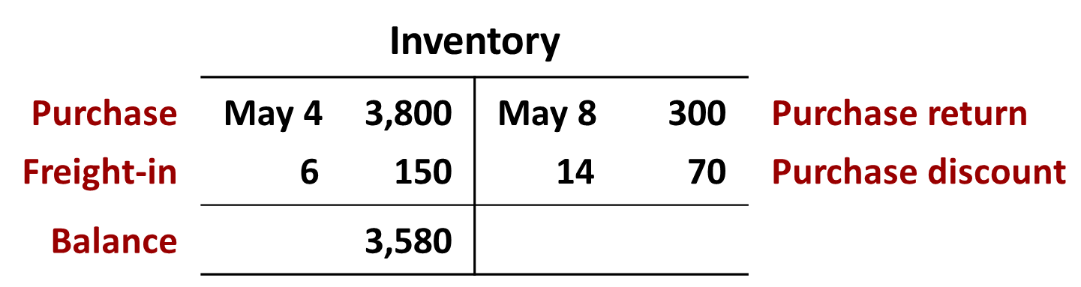
Summary of Purchasing Transactions

Slide 28
Do It! 2: Purchase Transactions
On September 5, De La Hoya Company buys merchandise on account from Junot Diaz Company. The purchase price of the goods paid by De La Hoya is $1,500, and the cost to Diaz Company was $800. On September 8, De La Hoya returns defective goods with a selling price of $200. Record the transactions on the books of De La Hoya Company.
Sept. 5
Inventory
1,500
Accounts Payable
(To record goods purchased on account)
1,500
8
Accounts Payable
200
Inventory
(To record return of defective goods)
200

Slide 29
Recording Sales Perpetual System (1 of 3)
Made using cash or credit (on account)
Sales revenue, like service revenue, is recorded when performance obligation is satisfied
Performance obligation is satisfied when goods are transferred from seller to buyer
Sales invoice should support each credit sale

Slide 30
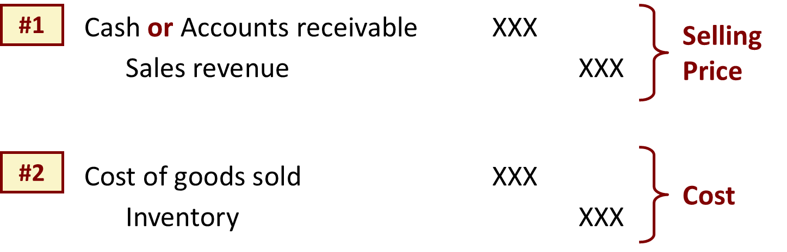
Recording Sales Perpetual System (2 of 3)
Journal Entries to Record a Sale

Slide 31
Recording Sales Perpetual System (3 of 3)
Illustration: PW Audio Supply records its May 4 sale of $3,800 to Sauk Stereo (Illustration 5.6) as follows (assume merchandise cost PW Audio Supply $2,400).
May 4
Accounts Receivable
3,800
Sales Revenue
(To record credit sale to Sauk Stereo per invoice #731)
3,800
4
Cost of Goods Sold
2,400
Inventory
(To record cost of merchandise sold on invoice #731 to Sauk Stereo)
2,400

Slide 32
Sales Returns and Allowances (1 of 5)
“Flip side” of purchase returns and allowances
Contra-revenue account to Sales Revenue (debit)
Sales not reduced (debited) because:
Would obscure importance of sales returns and allowances as a percentage of sales
Could distort comparisons between total sales in different accounting periods.

Slide 33
Sales Returns and Allowances (2 of 5)
Illustration: Prepare the entry PW Audio Supply would make to record the credit for returned goods that had a $300 selling price (assume a $140 cost). Assume the goods were not defective.
May 8
Sales Returns and Allowances
300
Accounts Receivable
(To record credit granted to Sauk Stereo for returned goods)
300
8
Inventory
140
Cost of Goods Sold
(To record cost of goods returned)
140

Slide 34
Sales Returns and Allowances (3 of 5)
Illustration: Assume the returned goods were defective and had a scrap value of $50, P W Audio would make the following entries.
May 8
Sales Returns and Allowances
300
Accounts Receivable
(To record credit granted to Sauk Stereo for returned goods)
300
8
Inventory
50
Cost of Goods Sold
(To record fair value of goods returned)
50

Slide 35
Sales Returns and Allowances (4 of 5)
The cost of goods sold is determined and recorded each time a sale occurs in:
a. periodic inventory system only.
b. a perpetual inventory system only.
c. both a periodic and perpetual inventory system.
d. neither a periodic nor perpetual inventory system.

Slide 36
Sales Returns and Allowances (5 of 5)
The cost of goods sold is determined and recorded each time a sale occurs in:
a. periodic inventory system only.
b. Answer: a perpetual inventory system only.
c. both a periodic and perpetual inventory system.
d. neither a periodic nor perpetual inventory system.

Slide 37
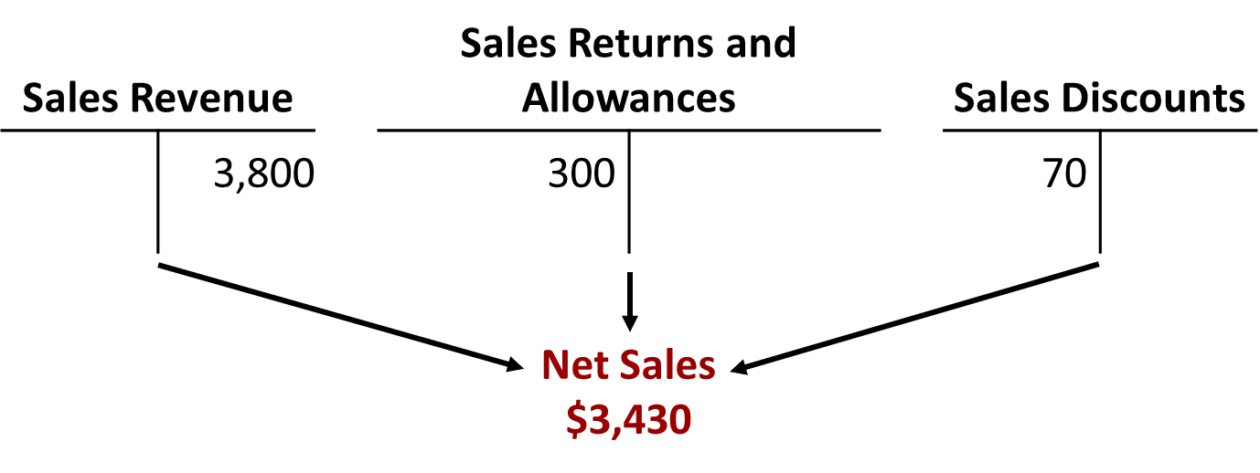
Sales Discounts (1 of 2)
Offered to customers to promote prompt payment of balance due
Contra-revenue account (debit) to Sales Revenue

Slide 38
Sales Discounts (2 of 2)
Illustration: Assume Sauk Stereo pays the balance due of $3,500 (gross invoice price of $3,800 less purchase returns and allowances of $300) on May 14, the last day of the discount period. Prepare the journal entry PW Audio Supply makes to record the receipt on May 14.
Cash
3,430
Sales Discounts
70
Accounts Receivable
(To record collection within 2/10, n/30 discount period from Sauk Stereo)
3,500
[($3,800 − $300) × 2%]

Slide 39
Do It! 3: Sales Transactions (1 of 2)
On September 5, De La Hoya Company buys merchandise on account from Junot Diaz Company. The selling price of the goods is $1,500, and the cost to Diaz Company was $800. On September 8, De La Hoya returns defective goods with a selling price of $200 and a fair value of $30. Record the transactions on the books of Junot Diaz Company.
Sept. 5
Accounts Receivable
1,500
Sales Revenue
(To record credit sale)
1,500
5
Cost of Goods Sold
800
Inventory
(To record cost of goods sold on account)
800

Slide 40
Do It! 3: Sales Transactions (2 of 2)
On September 5, De La Hoya Company buys merchandise on account from Junot Diaz Company. The selling price of the goods is $1,500, and the cost to Diaz Company was $800. On September 8, De La Hoya returns defective goods with a selling price of $200 and a fair value of $30. Record the transactions on the books of Junot Diaz Company.
Sept. 8
Sales Returns and Allowances
200
Accounts Receivable
(To record credit granted for receipt of returned goods)
200
8
Inventory
30
Cost of Goods Sold
(To record fair value of goods returned)
30

Slide 41
The Accounting Cycle for a Merchandising Company
Adjusting Entries
Generally same as a service company
One additional adjustment to make records agree with actual inventory on hand
Involves adjusting Inventory and Cost of Goods Sold

Slide 42
Adjusting Entries
Illustration: Suppose that PW Audio Supply has an unadjusted balance of $40,500 in Inventory. Through a physical count, PW Audio Supply determines that its actual merchandise inventory at December 31 is $40,000. The company would make an adjusting entry as follows.
Cost of Goods Sold
500
Inventory ($40,500 − $40,000)
(To adjust inventory to physical count)
500

Slide 43
Closing Entries (1 of 3)
Closing entries include:
Closing income statement accounts with credit balances
Closing income statement accounts with debit balances
Closing net income or net loss to capital
Closing drawings to capital

Slide 44
Closing Entries (2 of 3)
Dec. 31 | Service Revenue | 480,000
 | Income Summary |  | 480,000
 | (To close income statement accounts with credit balances)
31 | Income Summary | 450,000
 | Sales Returns and Allowances |  | 12,000
 | Sales Discounts |  | 8,000
 | Cost of Goods Sold |  | 316,000
 | Salaries and Wages Expense |  | 64,000
 | Freight-Out |  | 7,000
 | Advertising Expense |  | 16,000
 | Utilities Expense |  | 17,000
 | Depreciation Expense |  | 8,000
 | Insurance Expense |  | 2,000
 | (To close income statement accounts with debit balances)

Slide 45
Closing Entries (3 of 3)
Dec. 31 | Income Summary | 30,000
 | Owner’s Capital |  | 30,000
 | (To close net income to capital)
31 | Owner’s Capital | 15,000
 | Owner’s Drawings |  | 15,000
 | (To close drawings to capital)

Slide 46
Do It! 4: Sales Transactions (1 of 2)
The trial balance of Celine’s Sports Wear Shop at December 31 shows Inventory $25,000, Sales Revenue $162,400, Sales Returns and Allowances $4,800, Sales Discounts $3,600, Cost of Goods Sold $110,000, Rent Revenue $6,000, Freight-Out $1,800, Rent Expense $8,800, and Salaries and Wages Expense $22,000. Prepare the closing entries for the above accounts.
Dec. 31
Sales Revenue
162,400
Rent Revenue
6,000
Income Summary
(To close accounts with credit balances)
168,400

Slide 47
Do It! 4: Sales Transactions (2 of 2)
The trial balance at December 31 shows Inventory $25,000, Sales Revenue $162,400, Sales Returns and Allowances $4,800, Sales Discounts $3,600, Cost of Goods Sold $110,000, Rent Revenue $6,000, Freight-Out $1,800, Rent Expense $8,800, and Salaries and Wages Expense $22,000. Prepare the closing entries for the above accounts.
Dec. 31
Income Summary
151,000
Cost of Goods Sold
110,000
Sales Returns and Allowances
4,800
Sales Discounts
3,600
Freight-Out
1,800
Rent Expense
8,800
Salaries and Wages Expense
(To close accounts with debit balances)
22,000

Slide 48
Multiple-Step and Comprehensive Income Statements
Shows several steps in determining net income
Two steps relate to principal operating activities
Distinguishes between operating and non-operating activities
Highlights intermediate components of income and shows subgroupings of expenses.

Slide 49
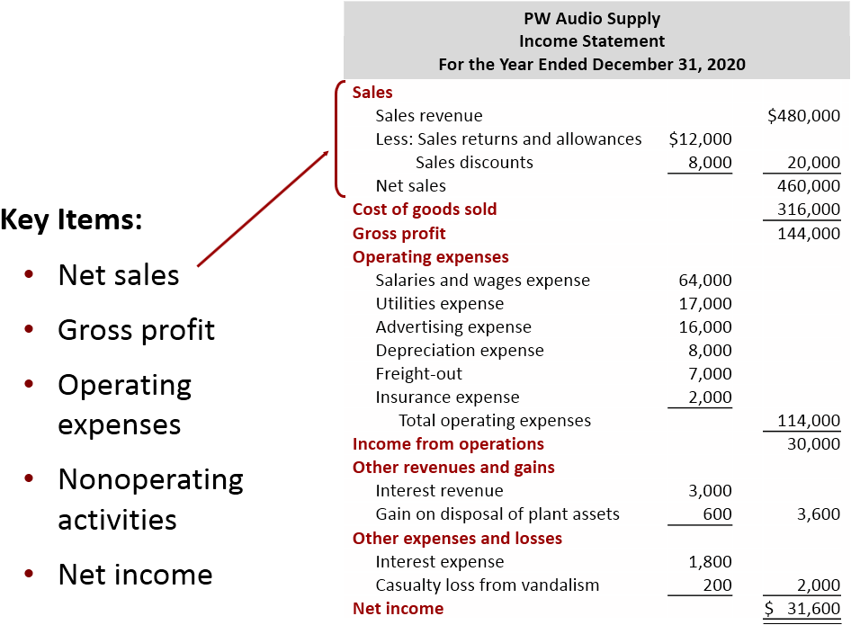
Multiple-Step (1 of 2)

Slide 50
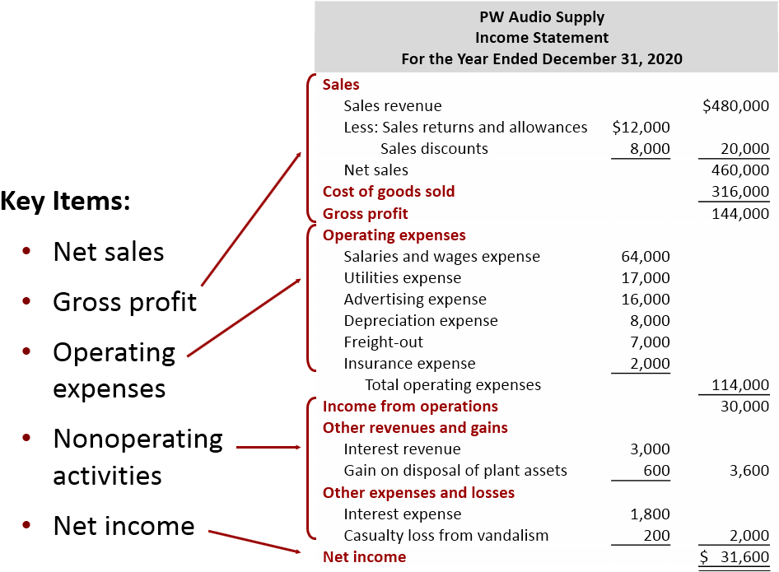
Multiple-Step (2 of 2)

Slide 51
Nonoperating Activities
Various revenues and expenses and gains and losses that are unrelated to company’s main line of operations.
Other Revenues and Gains
Interest revenue from notes receivable and marketable securities.
Dividend revenue from investments in common stock.
Rent revenue from subleasing a portion of the store.
Gain from the sale of property, plant, and equipment.
Other Expenses and Losses
Interest expense on notes and loans payable.
Casualty losses from recurring causes, such as vandalism and accidents.
Loss from the sale or abandonment of property, plant, and equipment.
Loss from strikes by employees and suppliers.

Slide 52
Multiple-Step Income Statement (1 of 2)
The multiple-step income statement for a merchandiser shows each of the following features except:
a. gross profit.
b. cost of goods sold.
c. a sales revenue section.
d. investing activities section.

Slide 53
Multiple-Step Income Statement (2 of 2)
The multiple-step income statement for a merchandiser shows each of the following features except:
a. gross profit.
b. cost of goods sold.
c. a sales revenue section.
d. Answer: investing activities section.

Slide 54
Single-Step Income Statement
Subtract total expenses from total revenues in one step
Two reasons for using single-step format:
Company does not realize any profit until total revenues exceed total expenses
Format is simpler and easier to read

Slide 55
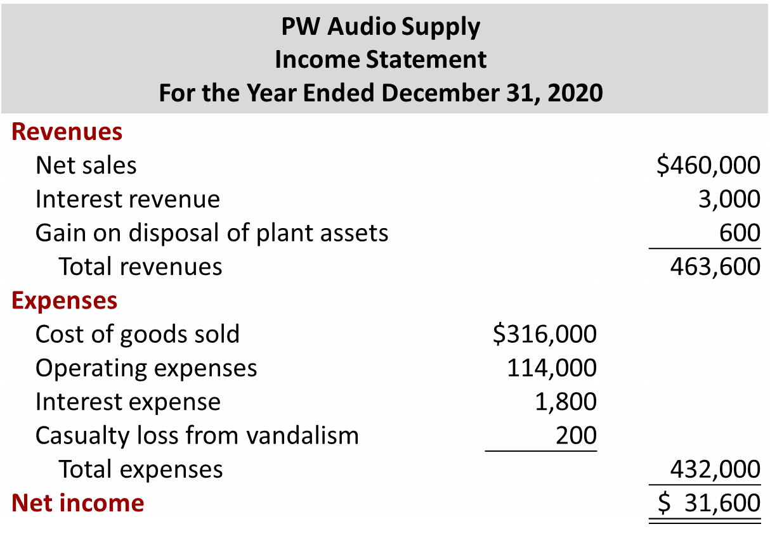
Single-Step

Slide 56
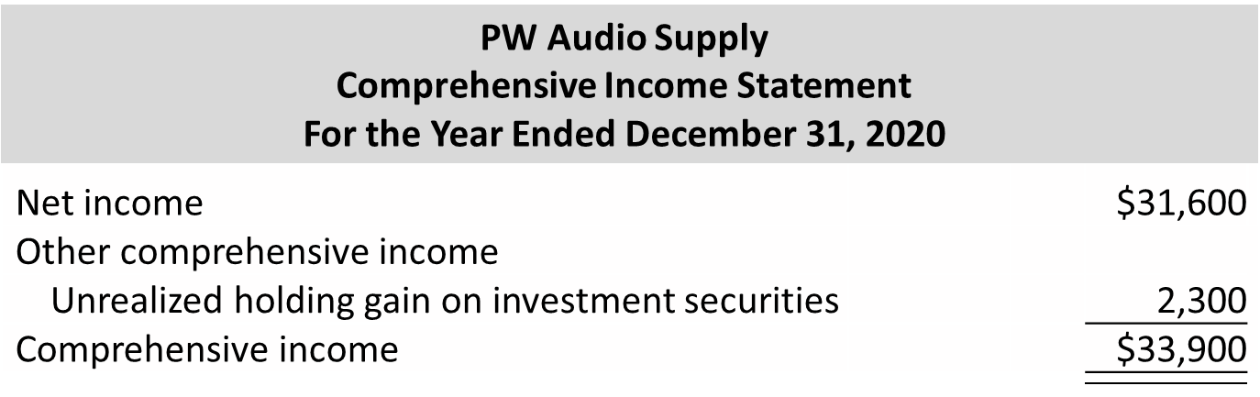
Comprehensive Income Statement
Items excluded from net income but included in comprehensive income are either reported in either:
Combined statement of net income and comprehensive income
Separate comprehensive income statement

Slide 57
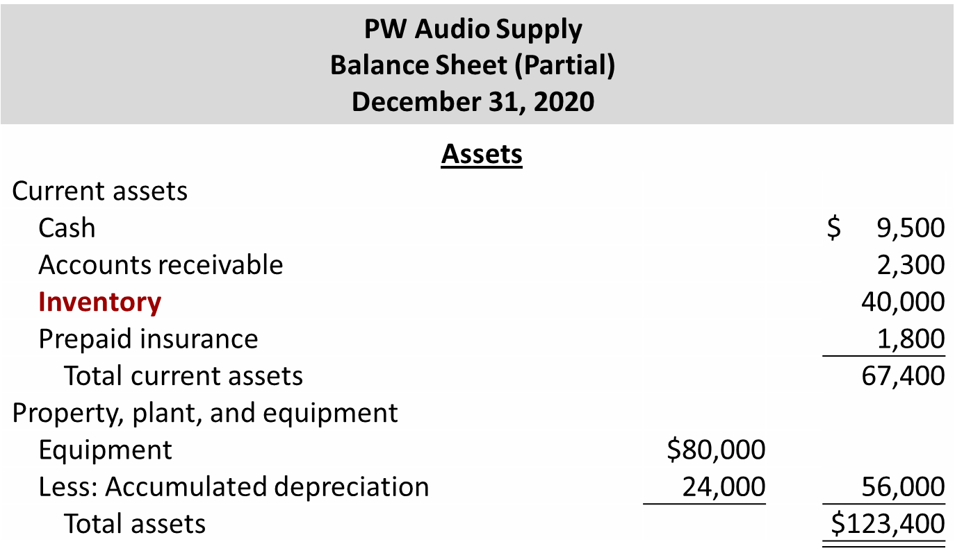
Classified Balance Sheet

Slide 58
Do It! 5: Multiple-Step Income Statement (1 of 3)
The following information is available for Art Center for the year ended December 31, 2020.
Other revenues and gains | $ 8,000 | Sales revenue | $462,000
Other expenses and losses | 3,000 | Operating expenses | 187,000
Cost of goods sold | 147,000 | Sales discounts | 20,000
Other comprehensive loss | 10,000
Prepare a multiple-step income statement and comprehensive income statement for Art Center.

Slide 59
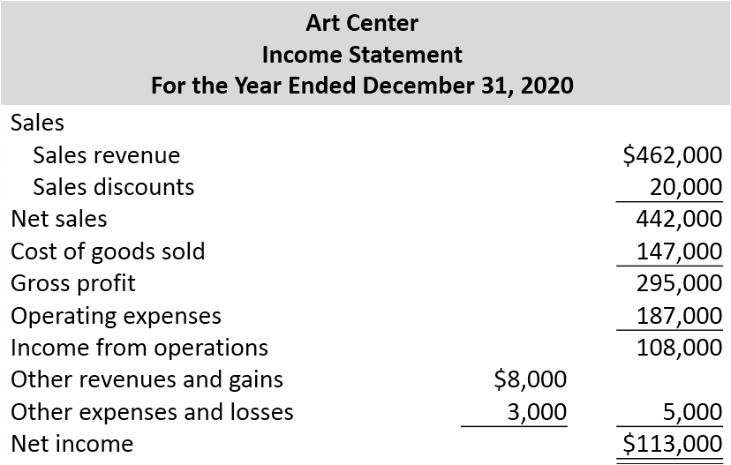
Do It! 5: Multiple-Step Income Statement (2 of 3)

Slide 60
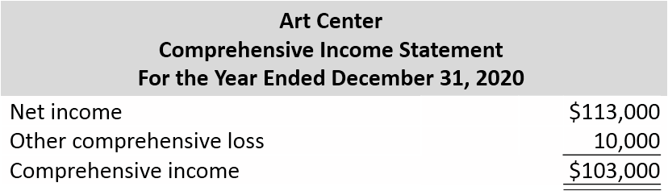
Do It! 5: Multiple-Step Income Statement (3 of 3)

Slide 61
Appendix 5A: Worksheet for a Merchandising Company (1 of 2)
As indicated in Chapter 4, a worksheet enables companies to prepare financial statements before they journalize and post adjusting entries. The steps in preparing a worksheet for a merchandising company are the same as for a service company. Illustration 5A.1 shows the worksheet for PW Audio Supply (excluding nonoperating items). The unique accounts for a merchandiser using a perpetual inventory system are in red.

Slide 62
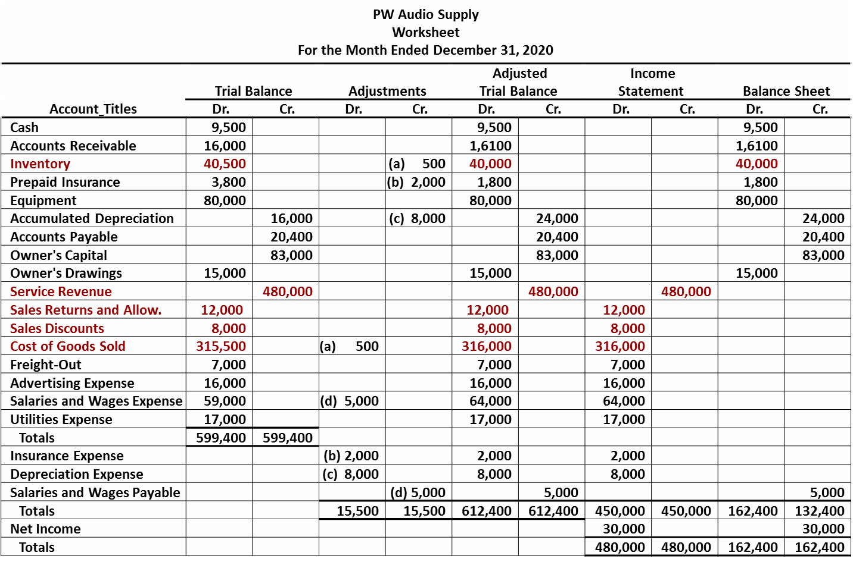
Appendix 5A: Worksheet for a Merchandising Company (2 of 2)

Slide 63
Appendix 5B: Periodic Inventory System (1 of 2)
Determining Cost of Goods Sold Under a Periodic System
No running account of changes in inventory
Ending inventory determined by physical count
Cost of goods sold not determined until end of period
Different accounts used for purchases, freight costs, returns, and discounts

Slide 64
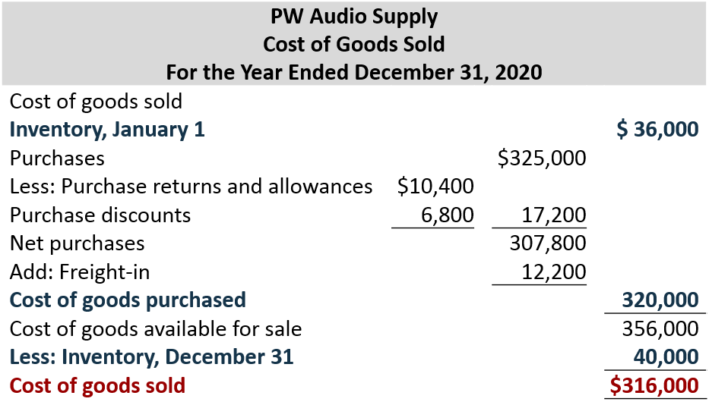
Appendix 5B: Periodic Inventory System (2 of 2)

Slide 65
Recording Merchandise Transactions
Record revenues when sales are made
Cost of merchandise sold not recorded on date of sale
Physical inventory count at end of period determines:
cost of merchandise on hand and
cost of merchandise sold during the period
Purchases recorded in Purchases account
Purchase returns and allowances, Purchase discounts, and Freight costs are recorded in separate accounts

Slide 66
Recording Purchases of Merchandise (1 of 4)
Illustration: On the basis of the sales invoice (Illustration 5.6) and receipt of the merchandise ordered from P W Audio Supply, Sauk Stereo records the $3,800 purchase as follows.
May 4
Purchases
3,800
Accounts Payable
(To record goods purchased on account from P W Audio Supply)
3,800

Slide 67
Recording Purchases of Merchandise (2 of 4)
Freight Costs
Illustration: If Sauk Stereo pays Public Carrier Co. $150 for freight charges on its purchase from P W Audio Supply on May 6, the entry on Sauk Stereo’s books is:
May 6
Freight-In (Transportation-In)
150
Cash
(To record payment of freight on goods purchased)
150

Slide 68
Recording Purchases of Merchandise (3 of 4)
Purchase Returns and Allowances
Illustration: Sauk Stereo returns goods costing $300 to P W Audio Supply and prepares the following entry to recognize the return.
May 8
Accounts Payable
300
Purchase Returns and Allowances
(To record return of goods purchased from P W Audio Supply)
300

Slide 69
Recording Purchases of Merchandise (4 of 4)
Purchase Discounts
Illustration: On May 14, Sauk Stereo pays the balance due on account to PW Audio Supply, taking the 2% cash discount allowed by PW Audio Supply for payment within 10 days. Sauk Stereo records the payment and discount as follows.
May 14
Accounts Payable ($3,800 − $300)
3,500
Purchase Discounts ($3,500 × .02)
70
Cash
(To record payment within the discount period)
3,430

Slide 70
Recording Sales of Merchandise (1 of 3)
Illustration: The seller, PW Audio Supply, records the sale of $3,800 of merchandise to Sauk Stereo on May 4 (sales invoice No. 731, Illustration 5.6) as follows.
May 4
Accounts Receivable
3,800
Sales Revenue
(To record credit sales per invoice #731 to Sauk Stereo)
3,800
No entry is recorded for cost of goods sold at time of sale under a periodic system.

Slide 71
Recording Sales of Merchandise (2 of 3)
Sales Returns and Allowances
Illustration: To record the returned goods received from Sauk Stereo on May 8, PW Audio Supply records the $300 sales return as follows.
May 8
Sales Returns and Allowance
300
Accounts Receivable
(To record credit granted to Sauk Stereo for returned goods)
300

Slide 72
Recording Sales of Merchandise (3 of 3)
Sales Discounts
Illustration: On May 14, PW Audio Supply receives payment of $3,430 on account from Sauk Stereo. PW Audio Supply honors the 2% cash discount and records the payment of Sauk Stereo’s account receivable in full as follows.
May 14
Cash
3,430
Sales Discounts ($3,500 × .02)
70
Accounts Receivable ($3,800 − $300)
(To record collection within 2/10, n/30 discount period from Sauk Stereo)
3,500

Slide 73
Closing Entries (1 of 2)
All accounts that affect the determination of net income are closed to Income Summary
In journalizing, all debit column amounts are credited, and all credit columns amounts are debited
To close the merchandise inventory in a periodic inventory system:
Beginning inventory balance is debited to Income Summary and credited to Inventory
Ending inventory balance is debited to Inventory and credited to Income Summary

Slide 74
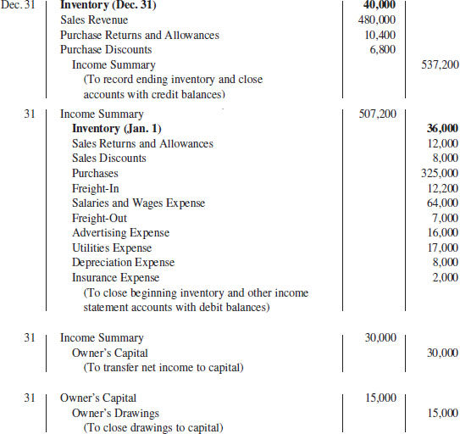
Closing Entries (2 of 2)

Slide 75
A Look at I F R S (1 of 4)
Key Points
Similarities
Under both G A A P and I F R S, a company can choose to use either a perpetual or periodic inventory systems.
The definition of inventories is basically the same under G A A P and I F R S.
As indicated above, the basic accounting entries for merchandising are the same under both G A A P and I F R S.
Both G A A P and I F R S require that income statement information be presented for multiple years. For example, I F R S requires that 2 years of income statement information be presented, whereas G A A P requires 3 years.

Slide 76
A Look at I F R S (2 of 4)
Key Points
Differences
Under G A A P companies generally classify income statement items by function. Classification by function leads to descriptions like administration, distribution (selling), and manufacturing. Under I F R S, companies must classify expenses either by nature or by function. Classification by nature leads to descriptions such as the following: salaries, depreciation expense, and utilities expense. If a company uses the functional-expense method on the income statement, disclosure by nature is required in the notes to the financial statements.

Slide 77
A Look at I F R S (3 of 4)
Key Points
Differences
Presentation of the income statement under G A A P follows either a single-step or multiple-step format. I F R S does not mention a single-step or multiple-step approach.
Under I F R S revaluation of land, buildings, and intangible assets is permitted. The initial gains and losses resulting from this revaluation are reported as adjustments to equity, often referred to as other comprehensive income. The effect of this difference is that the use of I F R S results in more transactions affecting equity (other comprehensive income) but not net income.

Slide 78
A Look at I F R S (4 of 4)
Looking to the Future
The I A S B and F A S B are working on a project that will rework the structure of financial statements. Specifically this project will address the issue of how to classify various items in the income statement. A main goal of this new approach is to provide information that better represents how businesses are run. In addition, this approach draws attention away from just one number—net income. It will adopt major groupings similar to those currently used by the statement of cash flows (operating, investing, and financing), so that numbers can be more readily traced across statements. For example, the amount of income that is generated by operations would be traceable to the assets and liabilities used to generate the income. Finally, this approach would also provide detail, beyond that currently seen in most statements (either G A A P or I F R S), by requiring that line items be presented both by function and by nature. The new financial statement format was heavily influenced by suggestions from financial statement analysts.

Slide 79
Copyright
Copyright © 2018 John Wiley & Sons, Inc.
All rights reserved. Reproduction or translation of this work beyond that permitted in Section 117 of the 19 76 United States Act without the express written permission of the copyright owner is unlawful. Request for further information should be addressed to the Permissions Department, John Wiley & Sons, Inc. The purchaser may make back-up copies for his/her own use only and not for distribution or resale. The Publisher assumes no responsibility for errors, omissions, or damages, caused by the use of these programs or from the use of the information contained herein.

