Slide 1
Accounting Principles
Thirteenth Edition
Weygandt ● Kimmel ● Kieso
Chapter 10
Plant Assets, Natural Resources, and Intangible Assets
This slide deck contains animations. Please disable animations if they cause issues with your device.

Slide 2
Chapter Outline
Learning Objectives
L O 1 Explain the accounting for plant asset expenditures.
L O 2 Apply depreciation methods to plant assets.
L O 3 Explain how to account for the disposal of plant assets.
L O 4 Describe how to account for natural resources and intangible assets.
L O 5 Discuss how plant assets, natural resources, and intangible assets are reported and analyzed.

Slide 3
Plant Asset Expenditures (1 of 3)
Plant assets are resources that have
physical substance (a definite size and shape)
are used in the operations of a business
are not intended for sale to customers
are expected to be of use to the company for a number of years
Referred to as property, plant, and equipment; plant and equipment; and fixed assets.

Slide 4
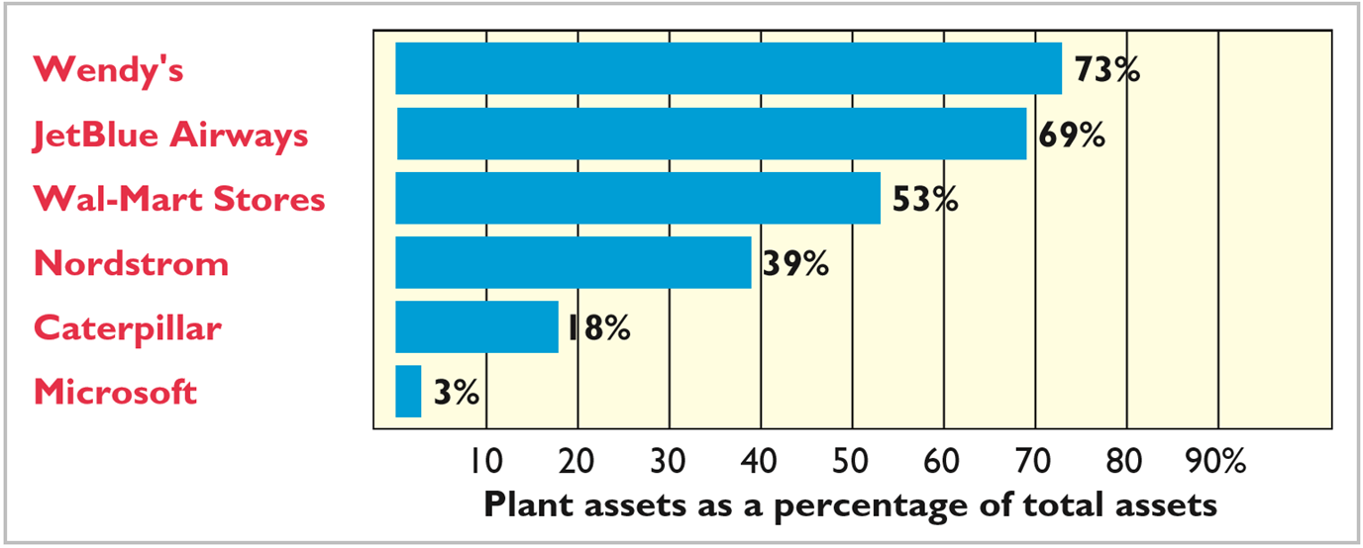
Plant Asset Expenditures (2 of 3)
Plant assets are critical to a company’s success.

Slide 5
Plant Asset Expenditures (3 of 3)
Determining the Cost of Plant Assets
Historical Cost Principle requires that companies record plant assets at cost.
Cost consists of all expenditures necessary to acquire an asset and make it ready for its intended use.

Slide 6
Determining the Cost of Plant Assets (1 of 11)
Land
All necessary costs incurred in making the land ready for its intended use increase (debit) the Land account.
Costs typically include:
cash purchase price,
closing costs such as title and attorney’s fees,
real estate brokers’ commissions, and
accrued property taxes and other liens on land assumed by purchaser.

Slide 7
Determining the Cost of Plant Assets (2 of 11)
Illustration: Hayes Company acquires real estate at a cash cost of $100,000. The property contains an old warehouse that is razed at a net cost of $6,000 ($7,500 in costs less $1,500 proceeds from salvaged materials). Additional expenditures are the attorney’s fee, $1,000, and the real estate broker’s commission, $8,000. Determine the amount to be reported as the cost of the land.

Slide 8
Determining the Cost of Plant Assets (3 of 11)
Illustration: Determine the amount to be reported as the cost of the land.
 | Land
Cash price of property | $100,000
Net removal cost of warehouse ($7,500 − $1,500) | 6,000
Attorney’s fee | 1,000
Real estate broker’s commission | 8,000
Cost of land | $115,000
Hayes makes the following entry:
Land
115,000
Cash
115,000
(To record purchase of land)

Slide 9
Determining the Cost of Plant Assets (4 of 11)
Land Improvements
Structural additions with limited life made to land. Cost includes all expenditures necessary to make the improvements ready for their intended use.
Examples: driveways, parking lots, fences, landscaping, and underground sprinklers
Limited useful lives
Expense (depreciate) cost of land improvements over their useful lives

Slide 10
Determining the Cost of Plant Assets (5 of 11)
Buildings
Includes all necessary expenditures related directly to purchase or construction.
Purchase costs:
Purchase price, closing costs (attorney’s fees, title insurance, etc.) and real estate broker’s commission
Remodeling and replacing or repairing the roof, floors, electrical wiring, and plumbing

Slide 11
Determining the Cost of Plant Assets (6 of 11)
Buildings
Includes all necessary expenditures related directly to purchase or construction.
Construction costs:
Contract price
Payments for architects’ fees
Building permits
Excavation costs

Slide 12
Determining the Cost of Plant Assets (7 of 11)
Equipment
Includes all costs incurred in acquiring the equipment and preparing it for use.
Costs typically include:
Cash purchase price
Sales taxes
Freight charges
Insurance during transit paid by purchaser
Assembling, installing, and testing

Slide 13
Determining the Cost of Plant Assets (8 of 11)
Illustration: Lenard Company purchases a delivery truck at a cash price of $22,000. Related expenditures are sales taxes $1,320, painting and lettering $500, motor vehicle license $80, and a three-year accident insurance policy $1,600. Compute the cost of the delivery truck.
 | Delivery Truck
Cash price | $22,000
Sales taxes | 1,320
Painting and lettering | 500
Cost of delivery truck | $23,820

Slide 14
Determining the Cost of Plant Assets (9 of 11)
Illustration: Lenard Company purchases a delivery truck at a cash price of $22,000. Related expenditures are sales taxes $1,320, painting and lettering $500, motor vehicle license $80, and a three-year accident insurance policy $1,600. Prepare the journal entry to record these costs.
Equipment
23,820
License Expense
80
Prepaid Insurance
1,600
Cash
25,500
(To record purchase of delivery truck and related expenditures)

Slide 15
Determining the Cost of Plant Assets (10 of 11)
Ordinary Repairs are expenditures to maintain the operating efficiency and productive life of the unit.
Debit to Maintenance and Repairs Expense
Referred to as revenue expenditures
Additions and Improvements are costs incurred to increase the operating efficiency, productive capacity, or useful life of a plant asset.
Debit plant asset affected
Referred to as capital expenditures

Slide 16
Determining the Cost of Plant Assets (11 of 11)
Anatomy of a Fraud
Bernie Ebers was the founder and C E O of the phone company WorldCom. The company engaged in a series of increasingly large, debt-financed acquisitions of other companies. These acquisitions made the company grow quickly, which made the stock price increase dramatically. However, because the acquired companies all had different accounting systems, WorldCom’s financial records were a mess. When WorldCom’s performance started to flatten out, Bernie coerced WorldCom’s accountants to engage in a number of fraudulent activities to make net income look better than it really was and thus prop up the stock price. One of these frauds involved treating $7 billion of line costs as capital expenditures. The line costs, which were rental fees paid to other phone companies to use their phone lines, had always been properly expensed in previous years. Capitalization delayed expense recognition to future periods and thus boosted current-period profits.
Total take: $7 billion
The Missing Controls
Documentation procedures. The company’s accounting system was a disorganized collection of non-integrated systems, which resulted from a series of corporate acquisitions. Top management took advantage of this disorganization to conceal its fraudulent activities.
Independent internal verification. The fraud should have been detected by a comparison of actual physical assets with the list of physical assets shown in the accounting records.

Slide 17
Do It! 1: Cost of Plant Assets
Assume that Drummond Heating and Cooling Co. purchases a delivery truck for $15,000 cash, plus sales taxes of $900 and delivery costs of $500. The buyer also pays $200 for painting and lettering, $600 for an annual insurance policy, and $80 for a motor vehicle license. Explain how each of these costs would be accounted for.
Solution
The first four payments ($15,000, $900, $500, and $200) are expenditures necessary to make the truck ready for its intended use and, therefore, are included in the cost of the truck ($16,600).
The payments for insurance and the license are operating costs incurred annually and therefore are expensed.

Slide 18
Depreciation Methods (1 of 3)
Depreciation
Process of allocating to expense the cost of a plant asset over its useful (service) life in a rational and systematic manner.
Process of cost allocation, not asset valuation
Applies to land improvements, buildings, and equipment, not land
Depreciable because the revenue-producing ability of asset will decline over the asset’s useful life

Slide 19
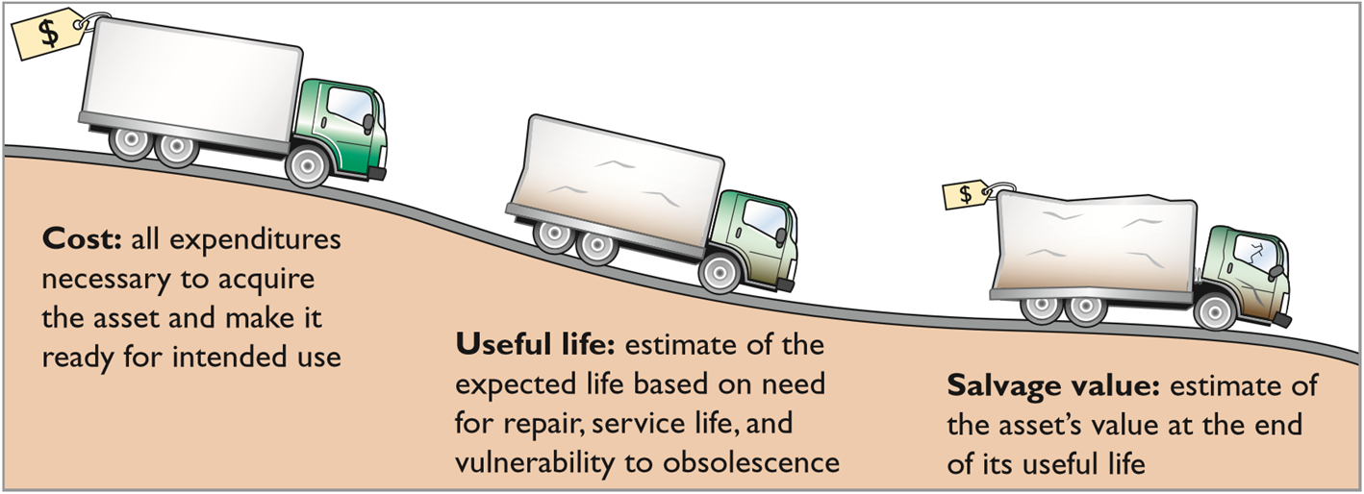
Factors in Computing Depreciation
Alternative Terminology
Another term sometimes used for salvage value is residual value.
Helpful Hint
Depreciation expense is reported on the income statement. Accumulated depreciation is reported on the balance sheet as a deduction from plant assets.

Slide 20
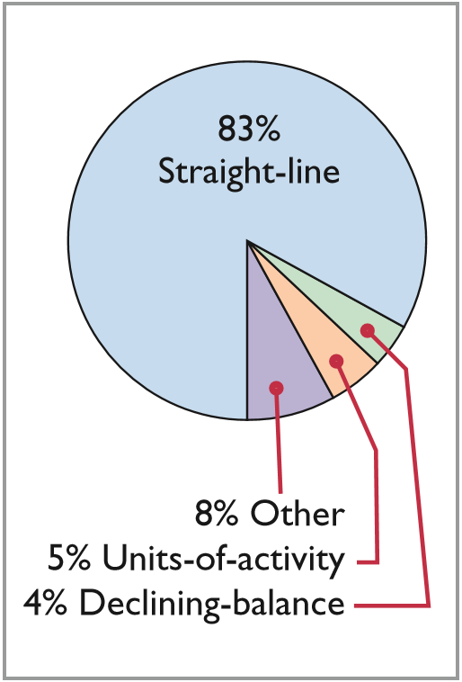
Depreciation Methods (2 of 3)
Management selects the method it believes best measures an asset’s contribution to revenue over its useful life.
Examples include:
Straight-line method
Units-of-activity method
Declining-balance method

Slide 21
Depreciation Methods (3 of 3)
Illustration: Barb’s Florists purchased a small delivery truck on January 1, 2020.
Cost | $13,000
Expected salvage value | $ 1,000
Estimated useful life in years | 5
Estimated useful life in miles | 100,000
Required: Compute depreciation using the following.
(a) Straight-Line (b) Units-of-Activity (c) Declining Balance

Slide 22
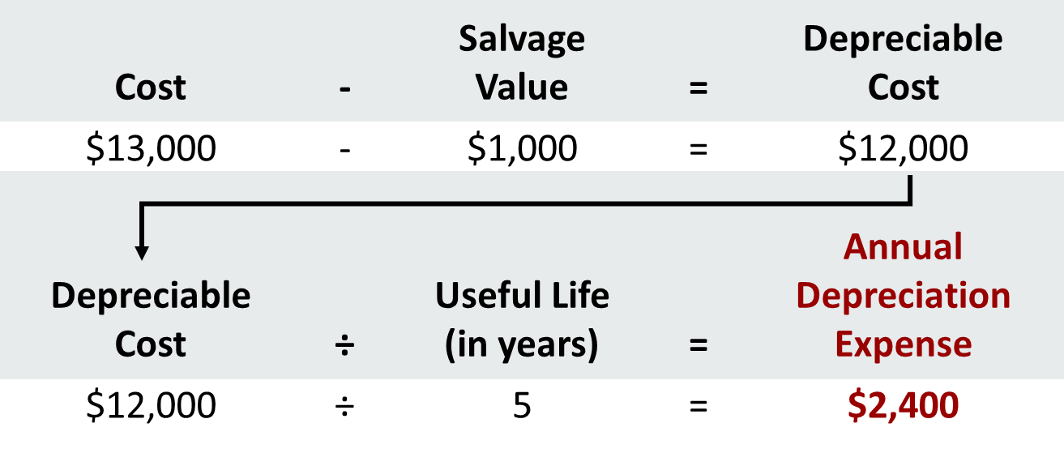
Straight-Line Method (1 of 3)
Expense is same amount for each year
Depreciable cost = Cost less salvage value

Slide 23
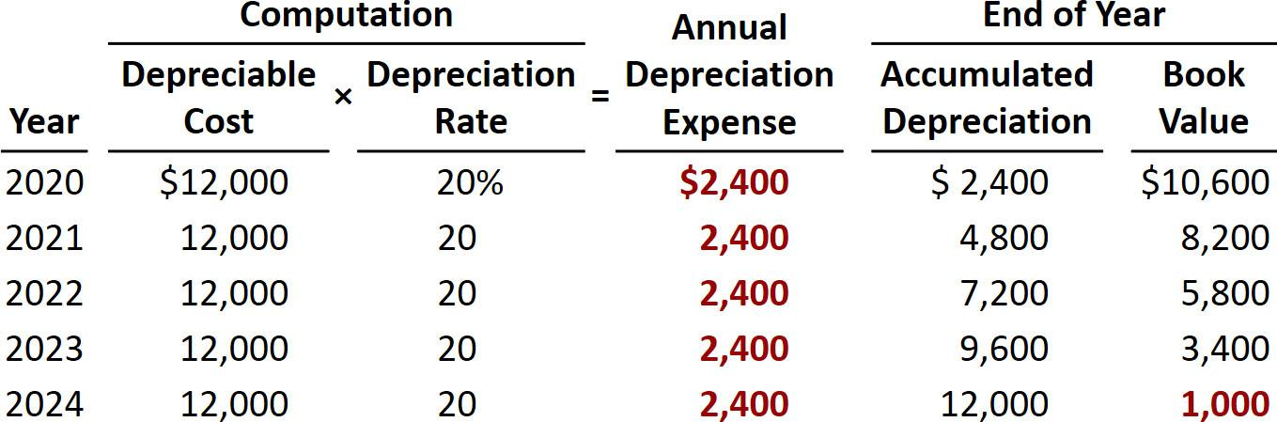
Straight-Line Method (2 of 3)
Barb’s Florist
2020 Journal Entry
Depreciation Expense
2,400
Accumulated Depreciation
2,400

Slide 24
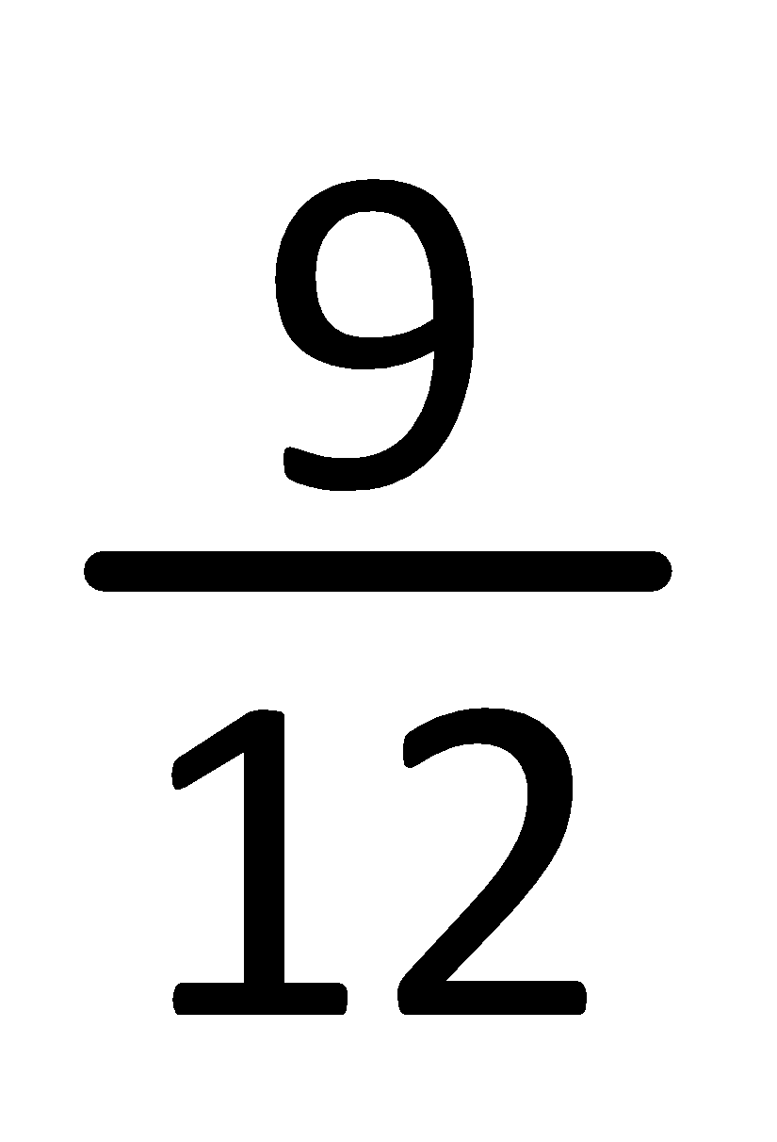
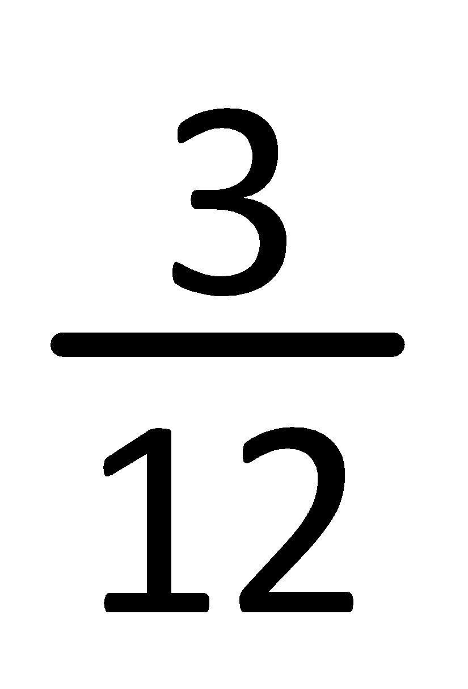
Straight-Line Method (3 of 3)
Partial Year
Assume the delivery truck was purchased on April 1, 2020.
Year | . | Depreciable Cost | × | Rate | = | Annual Depreciation Expense | × | Partial Year | = | Current Year Expense | . | Accumulated Depreciation
2020 |  | $12,000 | × | 20% | = | $2,400 | × |  | = | $ 1,800 |  | $ 1,800
2021 |  | 12,000 |  | 20 |  | 2,400 |  |  |  | 2,400 |  | 4,200
2022 |  | 12,000 |  | 20 |  | 2,400 |  |  |  | 2,400 |  | 6,600
2023 |  | 12,000 |  | 20 |  | 2,400 |  |  |  | 2,400 |  | 9,000
2024 |  | 12,000 |  | 20 |  | 2,400 |  |  |  | 2,400 |  | 11,400
2025 |  | 12,000 | × | 20 | = | 2,400 | × |  | = | 600 |  | 12,000
 |  |  |  |  |  |  |  |  |  | $12,000

Slide 25
Do It! 2a: Straight-Line Depreciation
On January 1, 2020, Iron Mountain Ski Corporation purchased a new snow-grooming machine for $50,000. The machine is estimated to have a 10-year life with a $2,000 salvage value. What journal entry would Iron Mountain Ski Corporation make at December 31, 2020, if it uses the straight-line method of depreciation?
Solution
($50,000 − $2,000) ÷ 10 = $4,800
Depreciation Expense
4,800
Accumulated Depreciation
4,800
(To record annual depreciation on snow-grooming machine)

Slide 26
Units-of-Activity Method (1 of 3)
Companies estimate total units of activity to calculate depreciation cost per unit
Expense varies based on units of activity
Depreciable cost is cost less salvage value
Often referred to as units-of-production method

Slide 27
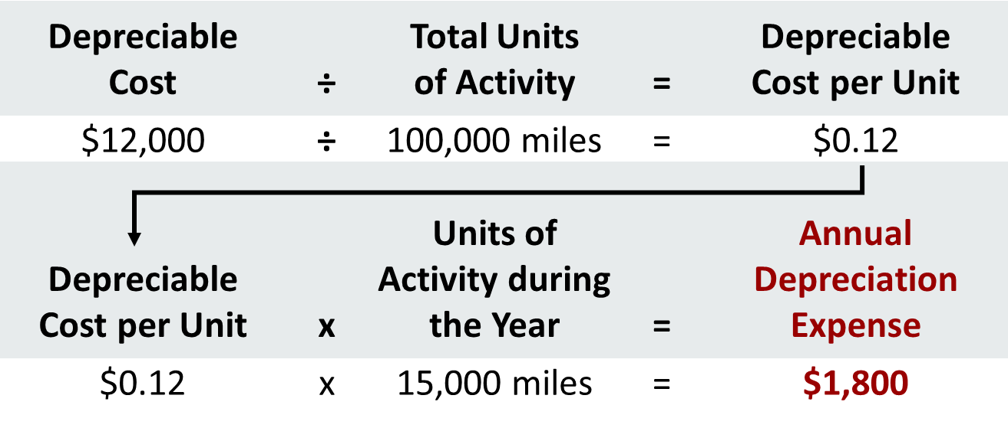
Units-of-Activity Method (2 of 3)

Slide 28
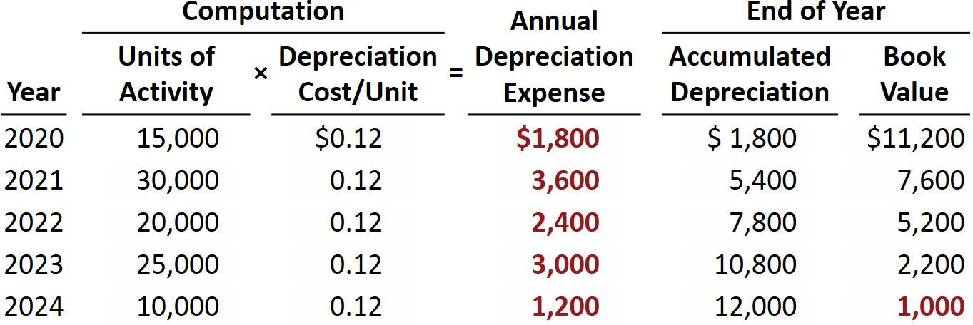
Units-of-Activity Method (3 of 3)
Barb’s Florists

Slide 29
Declining-Balance Method (1 of 3)
Accelerated method
Decreasing annual depreciation expense over asset’s useful life
Twice straight-line rate with Double-Declining-Balance
Applied to declining book value
Depreciation rate remains constant from year to year
Book Value at Beginning of Year | × | Declining-Balance Rate | = | Annual Depreciation Expense
$13,000 | × | 40% | = | $5,200

Slide 30
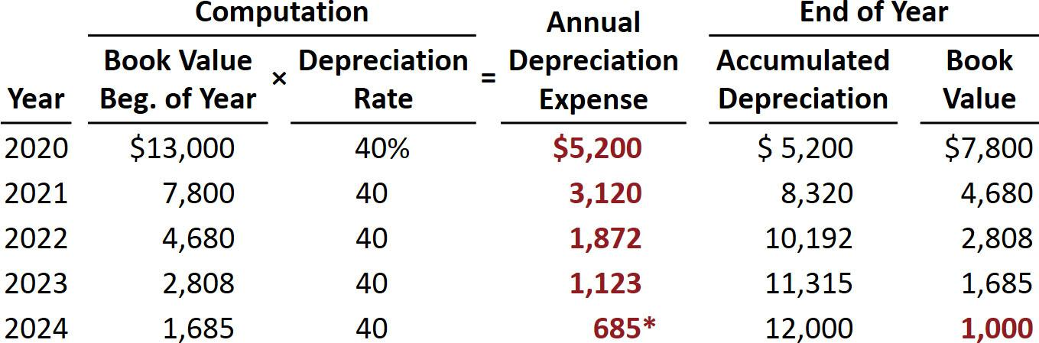
Declining-Balance Method (2 of 3)
Barb’s Florists
* Computation of $674 ($1,685 × 40%) is adjusted to $685 in order for book value to equal salvage value.

Slide 31
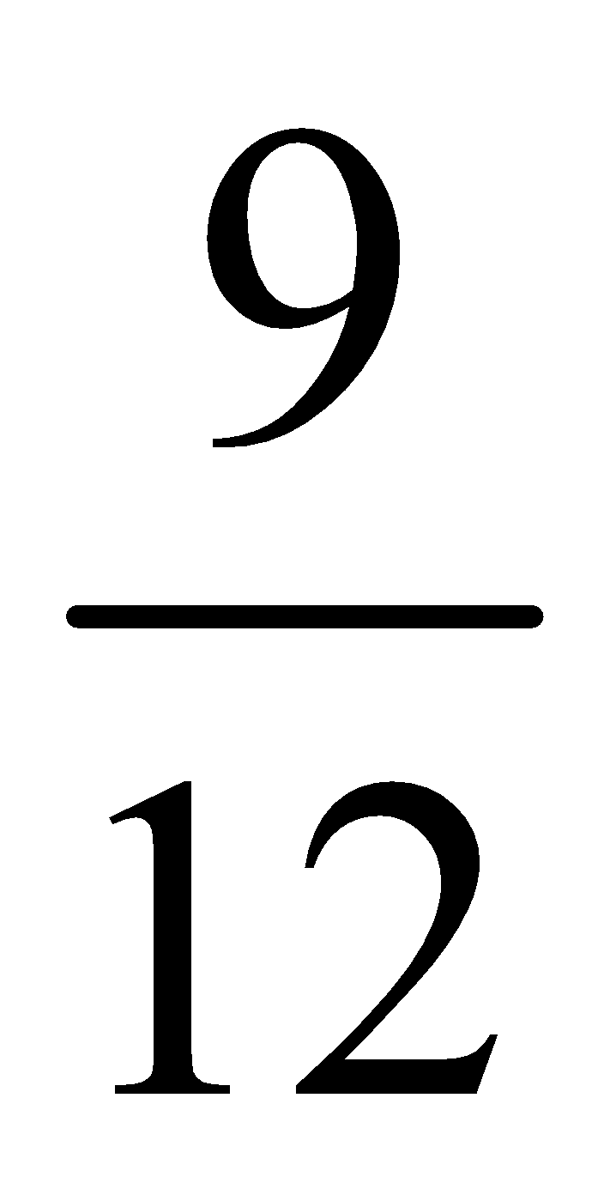
Declining-Balance Method (3 of 3)
Partial Year
Assume the delivery truck was purchased on April 1, 2020.
Year | Book Value Beg. of Year | × | Rate | = | Annual Depreciation Expense | × | Partial Year | = | Current Year Expense | Accumulated Depreciation
2020 | $13,000 | × | 40% | = | $5,200 | × | 9 over 12 | = | $ 3,900 | $ 3,900
2021 | 9,100 |  | 40 |  | 3,640 |  |  |  | 3,640 | 7,540
2022 | 5,460 |  | 40 |  | 2,184 |  |  |  | 2,184 | 9,724
2023 | 3,276 |  | 40 |  | 1,310 |  |  |  | 1,310 | 11,034
2024 | 1,966 |  | 40 |  | 786 |  |  |  | 786 | 11,820
2025 | 1,180 | × | 40 | = | 472 |  | Plug |  | 180 | 12,000
 |  |  |  |  |  |  |  |  | $12,000

Slide 32
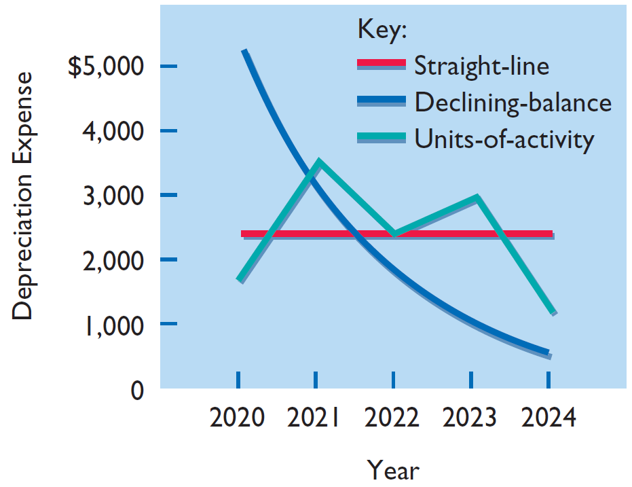
Comparison of Depreciation Methods
Year | . | Straight-Line | . | Units-of-Activity | . | Declining- Balance
2020 |  | $ 2,400 |  | $ 1,800 |  | $ 5,200
2021 |  | 2,400 |  | 3,600 |  | 3,120
2022 |  | 2,400 |  | 2,400 |  | 1,872
2023 |  | 2,400 |  | 3,000 |  | 1,123
2024 |  | 2,400 |  | 1,200 |  | 685
 |  | $12,000 |  | $12,000 |  | $12,000
Helpful Hint
Under any method, depreciation stops when the asset’s book value equals expected salvage value.

Slide 33
Depreciation and Income Taxes
I R S does not require taxpayer to use the same depreciation method on the tax return that is used in preparing financial statements.
Taxpayers must use the straight-line method or a special accelerated-depreciation method called the Modified Accelerated Cost Recovery System (M A C R S).
M A C R S is NOT acceptable under G A A P.

Slide 34
Revising Periodic Depreciation (1 of 3)
Accounted for in period of change and future periods (Change in Estimate)
No change in depreciation reported for prior years
Not considered an error
Use a step-by-step approach:
determine new depreciable cost
divide by remaining useful life

Slide 35
Revising Periodic Depreciation (2 of 3)
Barb’s Florists decides on January 1, 2023, to extend the useful life of the truck one year (a total life of six years) and increase its salvage value to $2,200. The company has used the straight-line method to depreciate the asset to date. Accumulated depreciation after three years (2020–2022) is $7,200, and book value is $5,800.
What entry is necessary to correct prior year's deprecation?
Calculate the depreciation expense for 2023 and future years?

Slide 36
Revising Periodic Depreciation (3 of 3)
Book value, 1/1/23 | $ 5,800
Less: Salvage value | 2,200
Depreciable cost | $ 3,600
Remaining useful life | 3 years (2023−2025)
Revised annual depreciation ($3,600 ÷ 3) | $ 1,200
Barb’s Florists makes no entry for the change in estimate.

Slide 37
DO IT! 2b Revised Depreciation (1 of 2)
Chambers Corporation purchased a piece of equipment for $36,000. It estimated a 6-year life and $6,000 salvage value. Thus, straight-line depreciation was $5,000 per year [($36,000 − $6,000) ÷ 6]. At the end of year three (before the depreciation adjustment), it estimated the new total life to be 10 years and the new salvage value to be $2,000. Compute the revised depreciation.
Solution
Original depreciation expense = [($36,000 − $6,000) ÷ 6] = $5,000
Accumulated depreciation after 2 years = 2 × $5,000 = $10,000
Book value = $36,000 − $10,000 = $26,000

Slide 38
DO IT! 2b Revised Depreciation (2 of 2)
Book value after 2 years of depreciation | $26,000
Less: New salvage value | 2,000
Depreciable cost | $24,000
Remaining useful life | 8 years
Revised annual depreciation ($24,000 ÷ 8) | $ 3,000

Slide 39
Plant Asset Disposals
Companies dispose of plant assets in three ways —
Retirement: Equipment is scrapped or discarded
Sale: Equipment is sold to another party
Exchange: Equipment is traded for new equipment
Record depreciation up to the date of disposal.
Eliminate asset by (1) debiting Accumulated Depreciation, and (2) crediting the asset account.

Slide 40
Retirement of Plant Asset (1 of 3)
No cash is received
Decrease (credit) asset account for original cost in asset
Decrease (debit) Accumulated Depreciation for full amount of depreciation taken over life of asset

Slide 41
Retirement of Plant Asset (2 of 3)
Illustration: Hobart Enterprises retires its computer printers, which cost $32,000. The accumulated depreciation on these printers is $32,000. Prepare the entry to record this retirement.
Accumulated Depreciation—Equipment
32,000
Equipment
32,000
(To record retirement of fully-depreciated equipment)
Question: What happens if a fully depreciated plant asset is still useful to the company?
Answer: The asset and its accumulated depreciation continue to be reported on the balance sheet, without further depreciation adjustment, until the company retires the asset.

Slide 42
Retirement of Plant Asset (3 of 3)
Illustration: Sunset Company discards delivery equipment that cost $18,000 and has accumulated depreciation of $14,000. The journal entry is?
Accumulated Depreciation—Equipment
14,000
Loss on Disposal of Plant Assets
4,000
Equipment
18,000
(To record retirement of delivery equipment at a loss)
Companies report a loss on disposal in the “Other expenses and losses” section of the income statement.

Slide 43
Sale of Plant Asset (1 of 2)
Compare the book value of the asset with the proceeds received from the sale
If proceeds exceed the book value, a gain on disposal occurs
If proceeds are less than the book value, a loss on disposal occurs

Slide 44
Sale of Plant Asset (2 of 2)
Gain on Sale
Illustration: On July 1, 2020, Wright Company sells office furniture for $16,000 cash. The office furniture originally cost $60,000. As of January 1, 2020, it had accumulated depreciation of $41,000. Depreciation for the first six months of 2020 is $8,000. Prepare the journal entry to record depreciation expense up to the date of sale.
Jul. 1
Depreciation Expense
8,000
Accumulated Depreciation—Equipment
8,000
(To record depreciation expense for the first 6 months of 2020)

Slide 45
Gain on Sale
Cost of office furniture | $60,000
Less: Accumulated depreciation ($41,000 + $8,000) | 49,000
Book value at date of disposal | 11,000
Proceeds from sale | 16,000
Gain on disposal of plant asset | $ 5,000
Wright records the sale as follows.
Jul. 1
Cash
16,000
Accumulated Depreciation—Equipment
49,000
Equipment
60,000
Gain on Disposal of Plant Assets
5,000
(To record sale of office furniture at a gain)

Slide 46
Loss on Sale
Cost of office furniture | $60,000
Less: Accumulated depreciation ($41,000 + $8,000) | 49,000
Book value at date of disposal | 11,000
Proceeds from sale | 9,000
Loss on disposal of plant asset | $ 2,000
Wright records the sale as follows.
Cash
9,000
Accumulated Depreciation—Equipment
49,000
Loss on Disposal of Plant Assets
2,000
Equipment
60,000
(To record sale of office furniture at a loss)

Slide 47
Do It! 3: Plant Asset Disposal (1 of 2)
Overland Trucking has decided to sell an old truck that cost $30,000 and which has accumulated depreciation of $16,000. (a) What entry would Overland Trucking make to record the sale of the truck for $17,000 cash?
Cash
17,000
Accumulated Depreciation—Equipment
16,000
Equipment
30,000
Gain on Disposal of Plant Assets
3,000
[$17,000 − ($30,000 − $16,000)]
(To record sale of truck at a gain)

Slide 48
Do It! 3: Plant Asset Disposal (2 of 2)
Overland Trucking has decided to sell an old truck that cost $30,000 and which has accumulated depreciation of $16,000. (b) What entry would Overland Trucking make to record the sale of the truck for $10,000 cash?
Cash
10,000
Accumulated Depreciation—Equipment
16,000
Loss on Disposal of Plant Assets
[$10,000 − ($30,000 − $16,000)]
4,000
Equipment
30,000
(To record sale of truck at a loss)

Slide 49
Determining Natural Resources and Intangible Assets
Natural resources consist of standing timber and underground deposits of oil, gas, and minerals.
Distinguishing characteristics:
Physically extracted in operations
Replaceable only by an act of nature
Cost is the price needed to acquire the resource and prepare it for its intended use.

Slide 50
Depletion (1 of 3)
The allocation of the cost of natural resources to expense in a rational and systematic manner over the resource’s useful life.
Companies generally use units-of-activity method
Depletion generally is a function of the units extracted

Slide 51
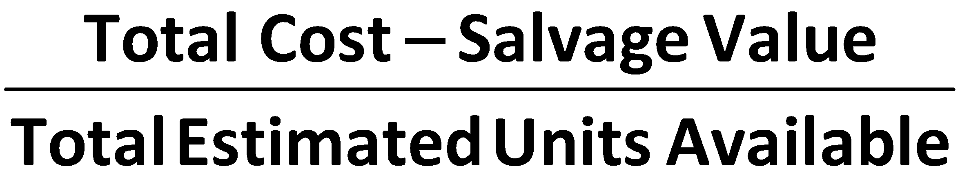
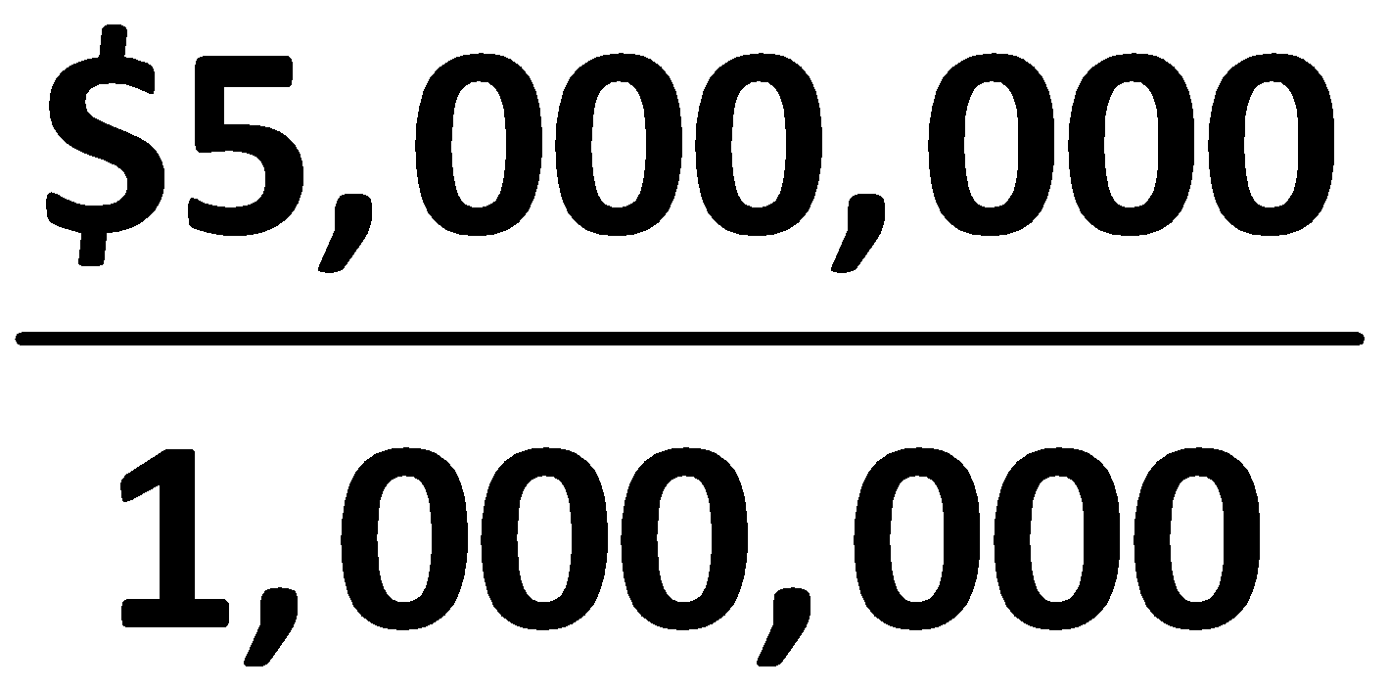
Depletion (2 of 3)
Illustration: Lane Coal Company invests $5 million in a mine estimated to have 1 million tons of coal and no salvage value. Compute the depletion cost per unit.
 | = | Depletion Cost per Unit
. | = | $5.00 per ton

Slide 52
Depletion (3 of 3)
Illustration: Lane Coal Company invests $5 million in a mine estimated to have 1 million tons of coal and no salvage value. In the first year, Lane extracts and sells 250,000 tons of coal. Lane computes the depletion as follows:
$5,000,000 ÷ 1,000,000 = $5.00 depletion cost per ton
$5.00 × 250,000 = $1,250,000 annual depletion
Journal entry:
Inventory (coal)
1,250,000
Accumulated Depletion
1,250,000
(To record depletion of coal mine)

Slide 53
Intangible Assets
Rights, privileges, and competitive advantages that result from ownership of long-lived assets that do not possess physical substance.
Limited life or indefinite life.
Common types of intangibles:
Patents
Copyrights
Goodwill
Trademarks and Trade Names
Franchises

Slide 54
Accounting for Intangible Assets (1 of 7)
Limited-Life intangibles:
Amortize to expense
Credit specific intangible asset account
Helpful Hint
Amortization is to intangibles what depreciation is to plant assets and depletion is to natural resources.
Indefinite-Life intangibles:
No foreseeable limit on time the asset is expected to provide cash flows
No amortization

Slide 55
Accounting for Intangible Assets (2 of 7)
Patents
Amortize to expense
Exclusive right to manufacture, sell, or otherwise control an invention for 20 years from date of grant
Capitalize costs of purchasing a patent and amortize over 20-year life or its useful life, whichever is shorter
Expense any R&D costs in developing a patent
Legal fees incurred successfully defending a patent are capitalized to Patent account

Slide 56
Patent (3 of 7)
Illustration: Assume that National Labs purchases a patent at a cost of $60,000. National estimates the useful life of the patent to be eight years. National calculates the annual amortization expense as follows.
$60,000 cost ÷ 8 years = $7,500
National records the annual amortization as follows.
Dec. 31
Amortization Expense
7,500
Patents
7,500
(To record patent amortization)

Slide 57
Accounting for Intangible Assets (4 of 7)
Copyrights
Gives owner exclusive right to reproduce and sell an artistic or published work
Extend for life of creator plus 70 years
Cost of copyright is cost of acquiring and defending it
Amortized to expense over useful life

Slide 58
Accounting for Intangible Assets (5 of 7)
Trademarks and Trade Names
Word, phrase, jingle, or symbol that identifies a particular enterprise or product
Wheaties, Monopoly, Kleenex, Coca-Cola, Big Mac, and Jeep
Legal protection for indefinite number of 20 year renewal periods
Capitalize acquisition costs
No amortization

Slide 59
Accounting for Intangible Assets (6 of 7)
Franchises
Contractual arrangement between a franchisor and a franchisee
Shell, Subway, and Rent-A-Wreck are franchises
Franchise (or license) with a limited life should be amortized to expense over its useful life
If life is indefinite, cost is not amortized

Slide 60
Accounting for Intangible Assets (7 of 7)
Goodwill
Includes exceptional management, desirable location, good customer relations, skilled employees, high-quality products, etc.
Only recorded when an entire business is purchased
Goodwill is recorded as excess of purchase price over fair value of net assets acquired
Not amortized

Slide 61
Research and Development Costs
Expenditures that may lead to
patents
copyrights
new processes
new products
All R & D costs are expensed when incurred whether successful or not.

Slide 62
Do It! 4: Classification Concepts (1 of 4)
Identify the term most directly associated with each statement.
The allocation of the cost of a natural resource to expense in a rational and systematic manner.
Rights, privileges, and competitive advantages that result from the ownership of long-lived assets that do not possess physical substance.
An exclusive right granted by the federal government to reproduce and sell an artistic or published work.
1.
2.
3.

Slide 63
Do It! 4: Classification Concepts (2 of 4)
Identify the term most directly associated with each statement.
The allocation of the cost of a natural resource to expense in a rational and systematic manner.
Rights, privileges, and competitive advantages that result from the ownership of long-lived assets that do not possess physical substance.
An exclusive right granted by the federal government to reproduce and sell an artistic or published work.
1. Depletion
2. Intangible assets
3. Copyrights

Slide 64
Do It! 4: Classification Concepts (3 of 4)
Identify the term most directly associated with each statement.
A right to sell certain products or services or to use certain trademarks or trade names within a designated geographic area.
Costs incurred by a company that often lead to patents or new products. These costs must be expensed as incurred.
4.
5.

Slide 65
Do It! 4: Classification Concepts (4 of 4)
Identify the term most directly associated with each statement.
A right to sell certain products or services or to use certain trademarks or trade names within a designated geographic area.
Costs incurred by a company that often lead to patents or new products. These costs must be expensed as incurred.
4. Franchises
5. Research and development costs

Slide 66
Statement Presentation and Analysis (1 of 2)
Presentation
Usually, companies combine plant assets and natural resources under “Property, plant, and equipment” in the balance sheet
Intangible assets are shown separately

Slide 67
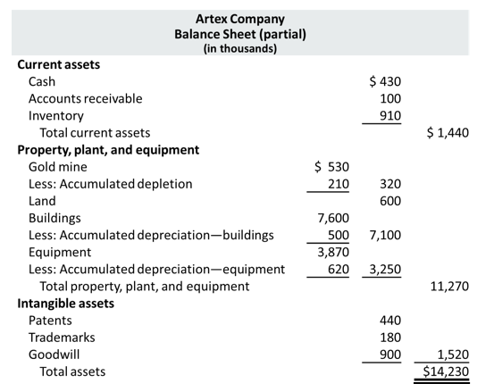
Statement Presentation and Analysis (2 of 2)

Slide 68
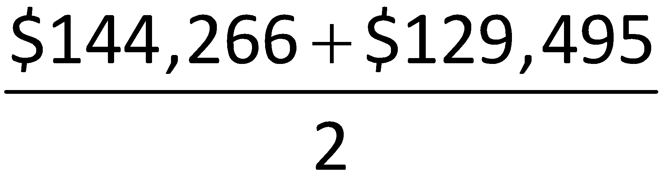
Analysis
Illustration: P&G’s net sales for 2015 were $76,279 million. Its total ending assets were $129,495 million, and beginning assets were $144,266 million.
Net Sales | ÷ | Average Total Assets | = | Asset Turnover
$76,279 | ÷ |  | = | .56 Times
Each dollar invested in assets produced $0.56 in sales. If a company is using its assets efficiently, each dollar of assets will create a high amount of sales.

Slide 69
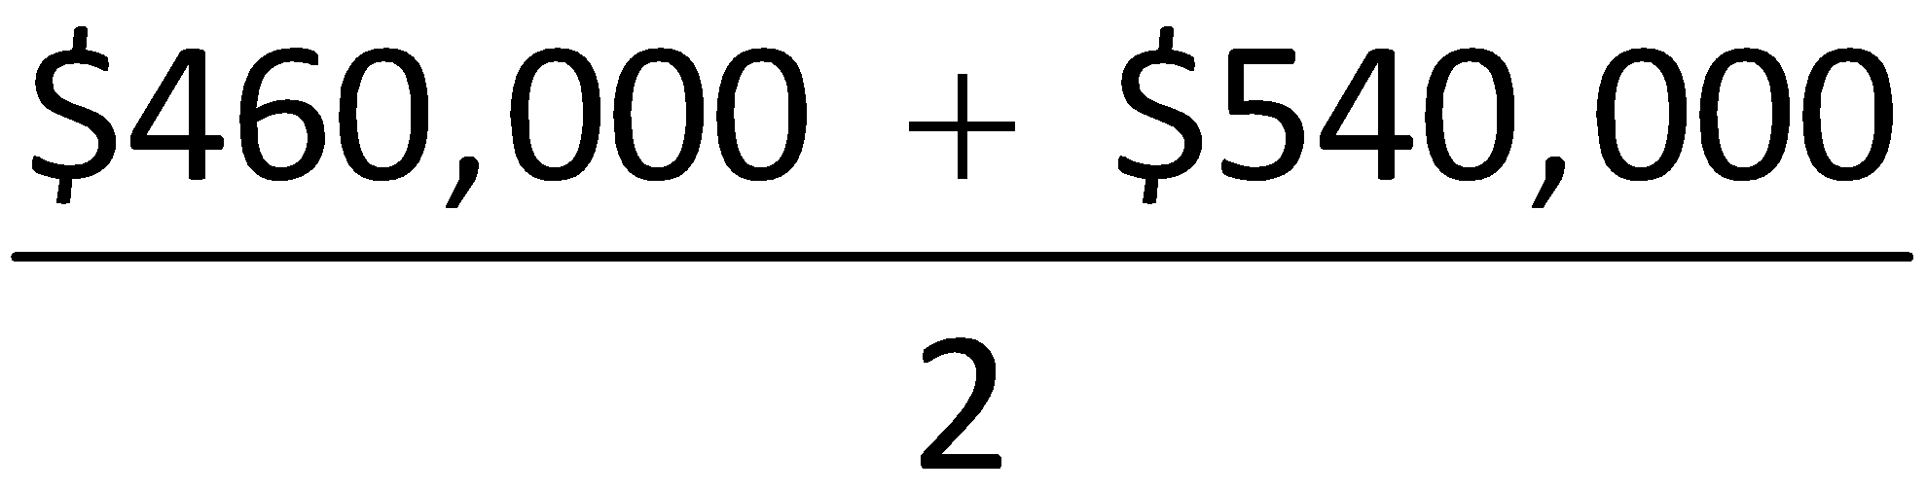
Do It! 5: Asset Turnover
Paramour Company reported net income of $180,000, net sales of $420,000, and had total assets of $460,000 on January 1, 2020, and total assets on December 31, 2020, of $540,000 billion. Determine Paramour’s asset turnover for 2020.
Solution
Net Sales | ÷ | Average Total Assets | = | Asset Turnover
$420,000 | ÷ |  | = | .84 Times

Slide 70
Appendix 10A: Exchange of Plant Assets
Ordinarily, companies record a gain or loss on exchange of plant assets
Most exchanges have commercial substance
Commercial substance exists if future cash flows change as a result of exchange

Slide 71
Loss Treatment (1 of 2)
Illustration: Roland Co. exchanged old trucks (cost $64,000 less $22,000 accumulated depreciation) plus cash of $17,000 for a new semi-truck. The old trucks had a fair market value of $26,000.
Cost of used trucks | $64,000
Less: Accumulated depreciation | 22,000
Book value | 42,000
Fair market value of used trucks | 26,000
Loss on disposal of plant assets | $16,000
Fair market value of used trucks | $26,000
Cash paid | 17,000
Cost of new truck | $43,000

Slide 72
Loss Treatment (2 of 2)
Illustration: Roland Co. exchanged old trucks (cost $64,000 less $22,000 accumulated depreciation) plus cash of $17,000 for a new semi-truck. The old trucks had a fair market value of $26,000. Prepare the entry to record the exchange of assets by Roland Co.
Equipment (new)
43,000
Accumulated Depreciation—Equipment
22,000
Loss on Disposal of Plant Assets
16,000
Equipment (old)
64,000
Cash
17,000
(To record exchange of used truck for semi-truck)

Slide 73
Gain Treatment (1 of 2)
Illustration: Mark Express Delivery trades its old delivery equipment (cost $40,000 less $28,000 accumulated depreciation) for new delivery equipment. The old equipment had a fair market value of $19,000. Mark also paid $3,000.
Cost of old equipment | $40,000
Less: Accumulated depreciation | 28,000
Book value | 12,000
Fair market value of old equipment | 19,000
Gain on disposal of plant assets | $ 7,000
Fair market value of old equipment | $19,000
Cash paid | 3,000
Cost of new equipment | $22,000

Slide 74
Gain Treatment (2 of 2)
Illustration: Mark Express Delivery trades its old delivery equipment (cost $40,000 less $28,000 accumulated depreciation) for new delivery equipment. The old equipment had a fair market value of $19,000. Mark also paid $3,000.
Equipment (new)
22,000
Accumulated Depreciation—Equipment
28,000
Equipment (old)
40,000
Gain on Disposal of Plant Assets
7,000
Cash
3,000
(To record exchange of old delivery equipment for new delivery equipment)

Slide 75
A Look at I F R S (1 of 6)
Key Points
Similarities
The definition for plant assets for both I F R S and G A A P is essentially the same.
Both I F R S and G A A P follow the historical cost principle when accounting for property, plant, and equipment at date of acquisition. Cost consists of all expenditures necessary to acquire the asset and make it ready for its intended use.
Under both I F R S and G A A P, interest costs incurred during construction are capitalized. Recently, I F R S converged to G A A P requirements in this area.

Slide 76
A Look at I F R S (2 of 6)
Key Points
Similarities
I F R S also views depreciation as an allocation of cost over an asset’s useful life. I F R S permits the same depreciation methods (e.g., straight-line, accelerated, and units-of-activity) as G A A P.
Under both G A A P and I F R S, changes in the depreciation method used and changes in useful life are handled in current and future periods. Prior periods are not affected. G A A P recently conformed to international standards in the accounting for changes in depreciation methods.
The accounting for subsequent expenditures (such as ordinary repairs and additions) are essentially the same under I F R S and G A A P.

Slide 77
A Look at I F R S (3 of 6)
Key Points
Similarities
The accounting for plant asset disposals is essentially the same under I F R S and G A A P.
Initial costs to acquire natural resources are essentially the same under I F R S and G A A P.
The definition of intangible assets is essentially the same under I F R S and G A A P.
The accounting for exchanges of nonmonetary assets has recently converged between I F R S and G A A P. G A A P now requires that gains on exchanges of nonmonetary assets be recognized if the exchange has commercial substance. This is the same framework used in I F R S.

Slide 78
A Look at I F R S (4 of 6)
Key Points
Differences
I F R S uses the term residual value rather than salvage value to refer to an owner’s estimate of an asset’s value at the end of its useful life for that owner.
I F R S allows companies to revalue plant assets to fair value at the reporting date. Companies that choose to use the revaluation framework must follow revaluation procedures. If revaluation is used, it must be applied to all assets in a class of assets. Assets that are experiencing rapid price changes must be revalued on an annual basis, otherwise less frequent revaluation is acceptable.

Slide 79
A Look at I F R S (5 of 6)
Key Points
Differences
I F R S requires component depreciation. Component depreciation specifies that any significant parts of a depreciable asset that have different estimated useful lives should be separately depreciated. Component depreciation is allowed under G A A P but is seldom used.
As in G A A P, under I F R S the costs associated with research and development are segregated into the two components. Costs in the research phase are always expensed under both I F R S and G A A P. Under I F R S, however, costs in the development phase are capitalized as Development Costs once technological feasibility is achieved.
I F R S permits revaluation of intangible assets (except for goodwill). G A A P prohibits revaluation of intangible assets.

Slide 80
A Look at I F R S (6 of 6)
Looking to the Future
The I A S B and F A S B have identified a project that would consider expanded recognition of internally generated intangible assets. I F R S permits more recognition of intangibles compared to G A A P.

Slide 81
Copyright
Copyright © 2018 John Wiley & Sons, Inc.
All rights reserved. Reproduction or translation of this work beyond that permitted in Section 117 of the 1976 United States Act without the express written permission of the copyright owner is unlawful. Request for further information should be addressed to the Permissions Department, John Wiley & Sons, Inc. The purchaser may make back-up copies for his/her own use only and not for distribution or resale. The Publisher assumes no responsibility for errors, omissions, or damages, caused by the use of these programs or from the use of the information contained herein.

