Slide 1
BOOSTING ALGORITHM

Slide 2
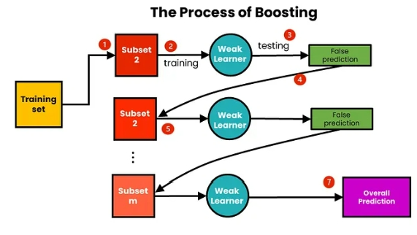

Slide 3
BOOSTING ALGORITHMS
Ada Boost
XG Boosting
LG Boosting

Slide 4
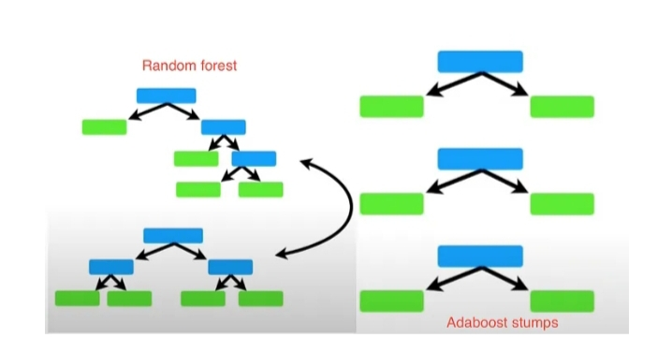
Ada Boosting
Initialization
Iterative Training
Weight update
Classifier Combination

Slide 5
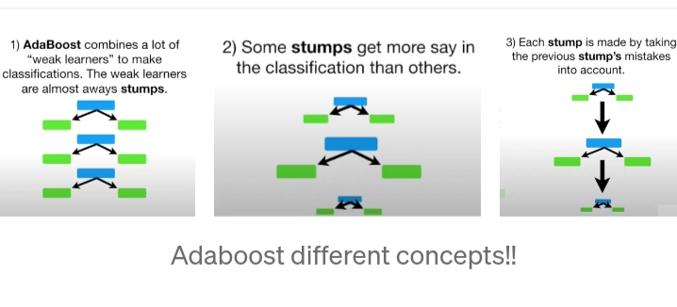

Slide 6
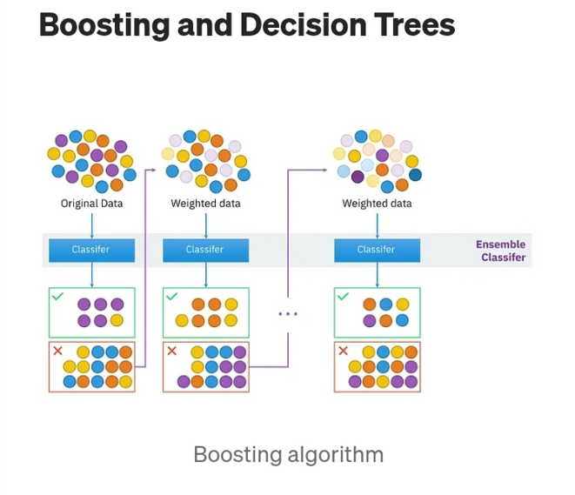
X G Boosting
Speed and Performance
Regularization(prevents overfitting)
Handling Missing Valueses
Tree Pruning
Flexibility

Slide 7
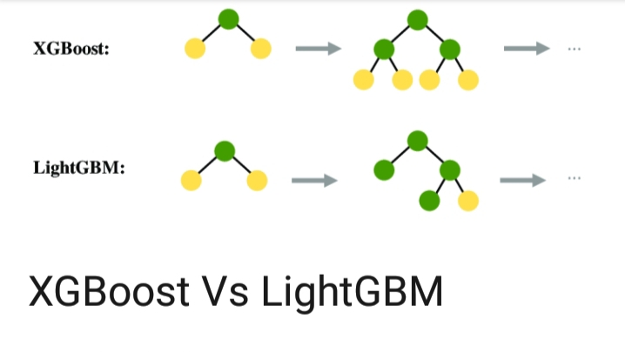
LG Boosting
Speed and Efficiency
Histogram-Based Learning
Leaf-Wise Growth
Categorical Feature Support
Parallel and GPU Learning

