Slide 1
BOOSTING ALGORITHM

Slide 2
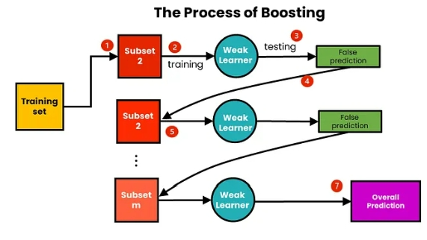

Slide 3
BOOSTING ALGORITHMS
Ada Boost
XG Boosting
LG Boosting

Slide 4
Ada Boosting Algorithm
AdaBoost, (or) Adaptive Boosting, is a machine learning algorithm that improves the performance of weak classifiers (models that do slightly better than random guessing) by combining them into a single strong classifier.
Working Principle:
Start with a Weak Classifier: Begin with a simple model that can make predictions.
Focus on Mistakes: After making predictions, identify the examples the model got wrong.
Adjust Weights: Increase the importance (weights) of the misclassified examples, so the next model pays more attention to them.
Train a New Classifier: Train another weak classifier on the updated data with adjusted weights.
Repeat: Continue this process for a set number of iterations, each time focusing on the errors of the previous classifiers.
Combine Models: Finally, combine all the classifiers into one strong model by weighting their predictions based on their accuracy.
.

Slide 5
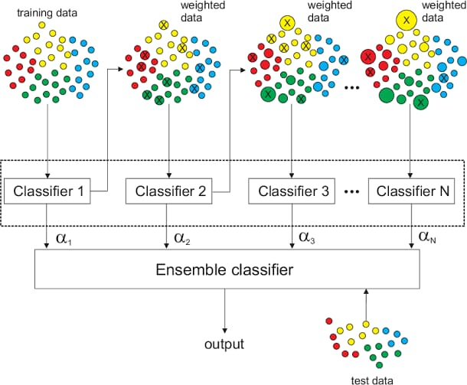
ADA BOOSTING ALGORITHM

Slide 6
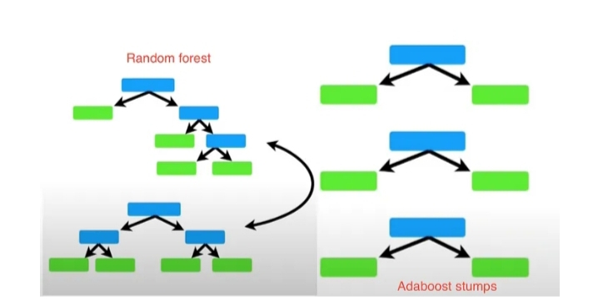
Ada Boosting
Initialization
Iterative Training
Weight update
Classifier Combination

Slide 7
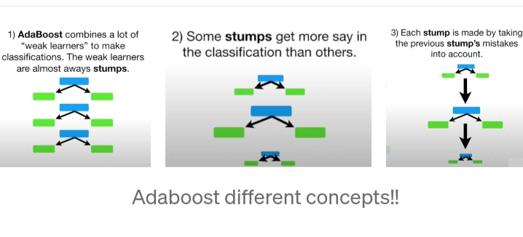

Slide 8
Ada Boosting Pros and Cons
Pros:
Improves Accuracy: Boosts the performance of weak learners, leading to better prediction accuracy.
Flexibility: Can be used with various types of weak learners (e.g., decision trees).
Reduces Overfitting: Often less prone to overfitting compared to other algorithms when tuned properly.
Handles Noise: Can manage noisy data well by focusing on misclassified instances.
Cons:
Sensitive to Noisy Data: Can be affected by outliers and noise, as it tries to correct misclassifications.
Computationally Intensive: Can be slower to train, especially with a large number of weak learners.
Requires Careful Tuning: Performance can heavily depend on hyperparameter settings.
Less Interpretability: The resulting model can be harder to interpret compared to simpler models.

Slide 9
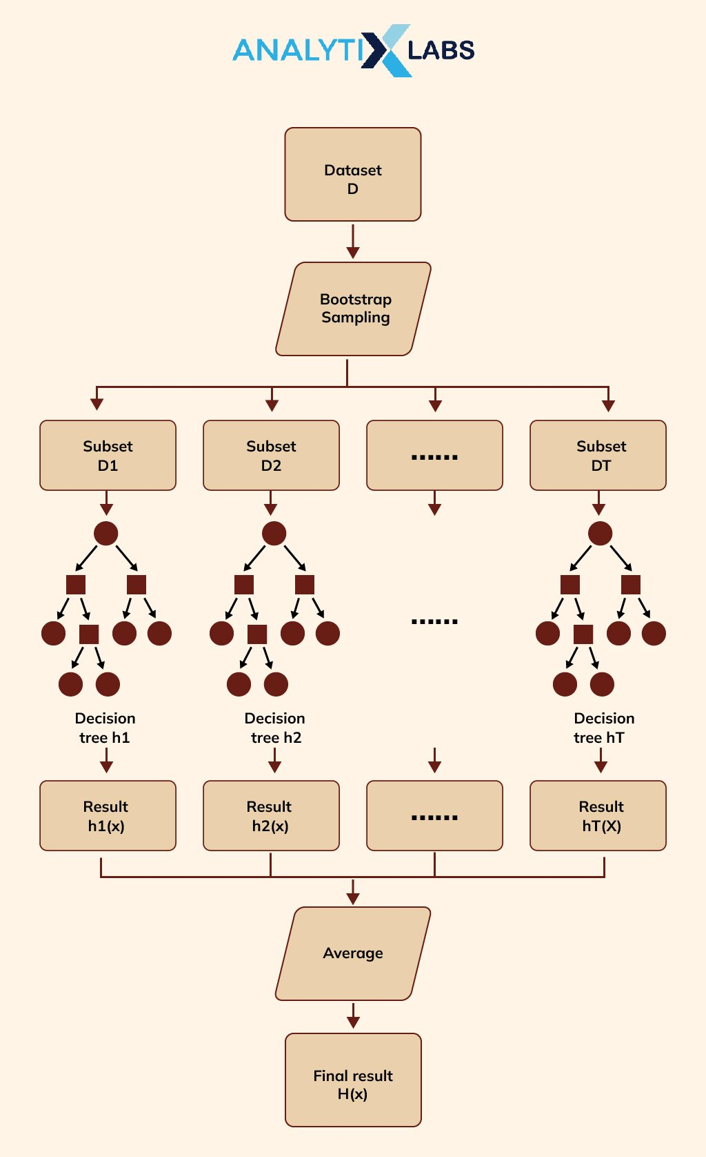
XG BOOSTING
XGBoost (Extreme Gradient Boosting) is a highly efficient and scalable machine learning algorithm that uses gradient boosting techniques for supervised learning tasks. It optimizes performance through regularization, parallel processing, and effective handling of missing data.

Slide 10
Working Principle:
Initialization: Start with an initial prediction (often the mean of the target values).
Iteration:
Calculate Residuals: Compute the difference between the actual target values and the current predictions. These differences are called residuals.
Build a Decision Tree: Create a new decision tree that predicts these residuals.
Update Predictions: Adjust the model’s predictions by adding the new tree’s predictions, scaled by a learning rate (to control how much to update the predictions).
Regularization: XGBoost includes regularization terms to prevent overfitting, making it more robust compared to traditional boosting methods.
Repeat: Repeat the iteration process for a specified number of trees or until the performance stops improving.
Final Prediction: The final model is a weighted sum of all the individual trees, leading to improved accuracy.

Slide 11
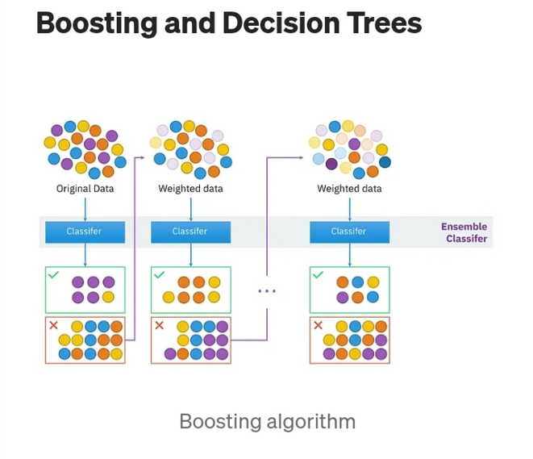
X G Boosting Pros
Speed and Performance
Regularization(prevents overfitting)
Parallel Processing
Handling Missing Valueses
Tree Pruning
Flexibility
Features Importance

Slide 12
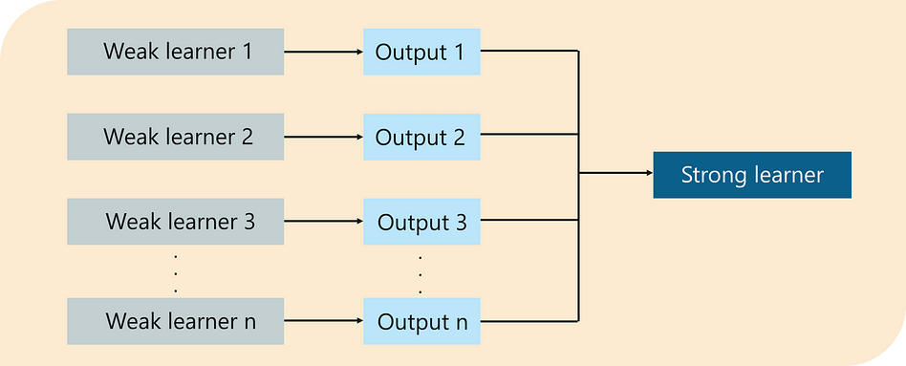
XG Boosting Cons
Complexity
Memory Consumption
Overfitting Risk
Interpretability
Long Training Time on Large Datasets
Sensitive to Noisy Data

Slide 13
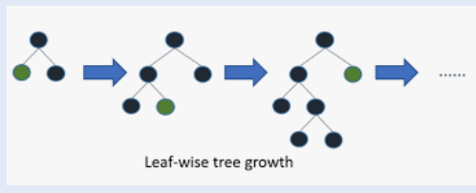
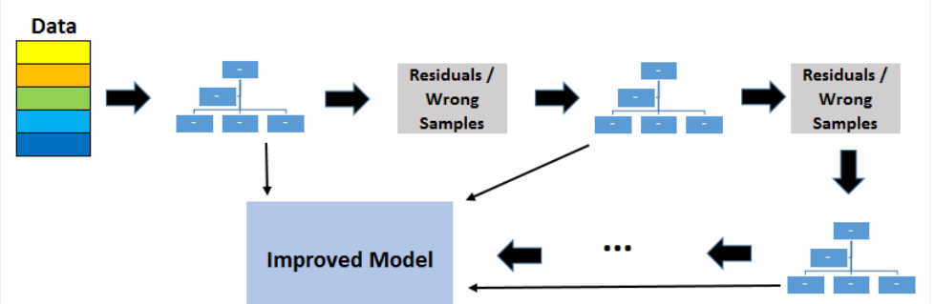
LG BOOSTING
LightGBM (Light Gradient Boosting Machine) is a fast, distributed, high-performance implementation of gradient boosting designed for large datasets.

Slide 14
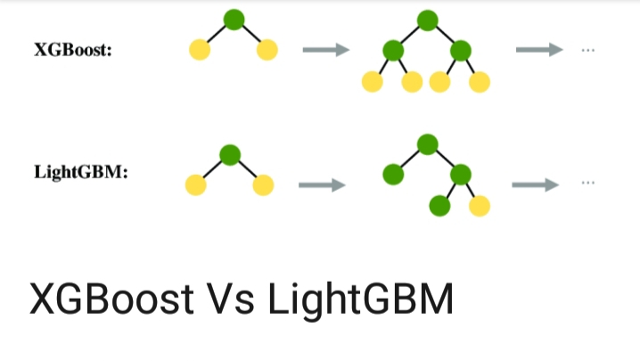
LG Boosting
Speed and Efficiency
Histogram-Based Learning
Leaf-Wise Growth
Categorical Feature Support
Parallel and GPU Learning

Slide 15
Advantages of LightGBM
Fast Training Speed: LightGBM is optimized for speed, allowing it to train models quickly, especially on large datasets.
Low Memory Usage: The histogram-based approach reduces memory consumption, making it efficient for big data.
Handling Categorical Features: It can directly work with categorical features without the need for one-hot encoding, simplifying preprocessing.
High Accuracy: The leaf-wise tree growth strategy can lead to more accurate models by capturing complex patterns in the data.
Scalability: Supports parallel and distributed learning, enabling it to efficiently handle large-scale data.
Disadvantages of LightGBM
Complex Parameter Tuning: The abundance of hyperparameters can make tuning the model more challenging for beginners.
Overfitting Risk: It can be prone to overfitting, especially if not properly tuned or if the dataset is small.
Less Intuitive: The model's complexity may be less approachable for those new to machine learning compared to simpler models.
Prediction Speed: While training is fast, making predictions with very large models can be slower than some other algorithms.
Limited Objective Function Support: It may not support as wide a range of specific tasks compared to some other gradient boosting frameworks.

Slide 16
THANK YOU

