Slide 1
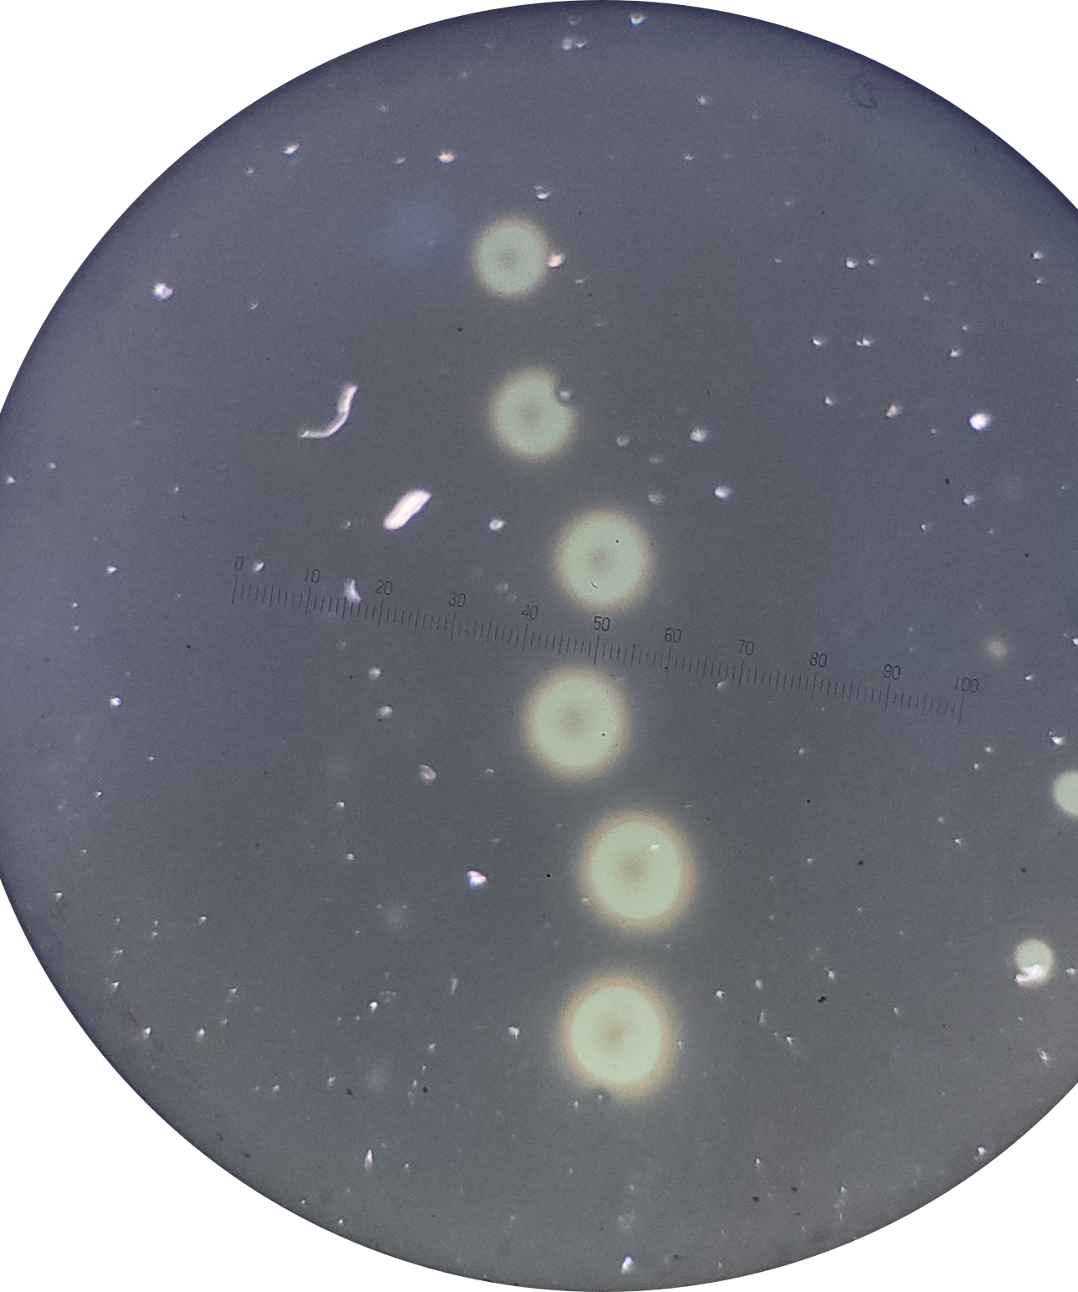
Optical Analysis of GRIN Lenses using TMM Calculation
Soeke Sabelus

Slide 2
Overview
Influence of laser power and pulse duration on lenses
  Size and color dependence of lenses
  Experimental transmission spectra
Fitting with transfer matrix method (TMM)
  Genetic Algorithm
  Spectral calibration
  Fitting schemes & material mixing

Slide 3
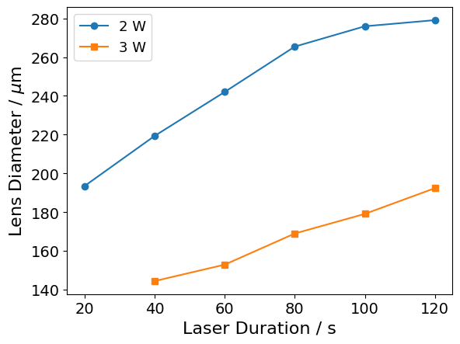
Effect of Pulse Duration on Lenses
Size increases with pulse length
Color difference at longer illuminations in the center of lens
3W:

Slide 4
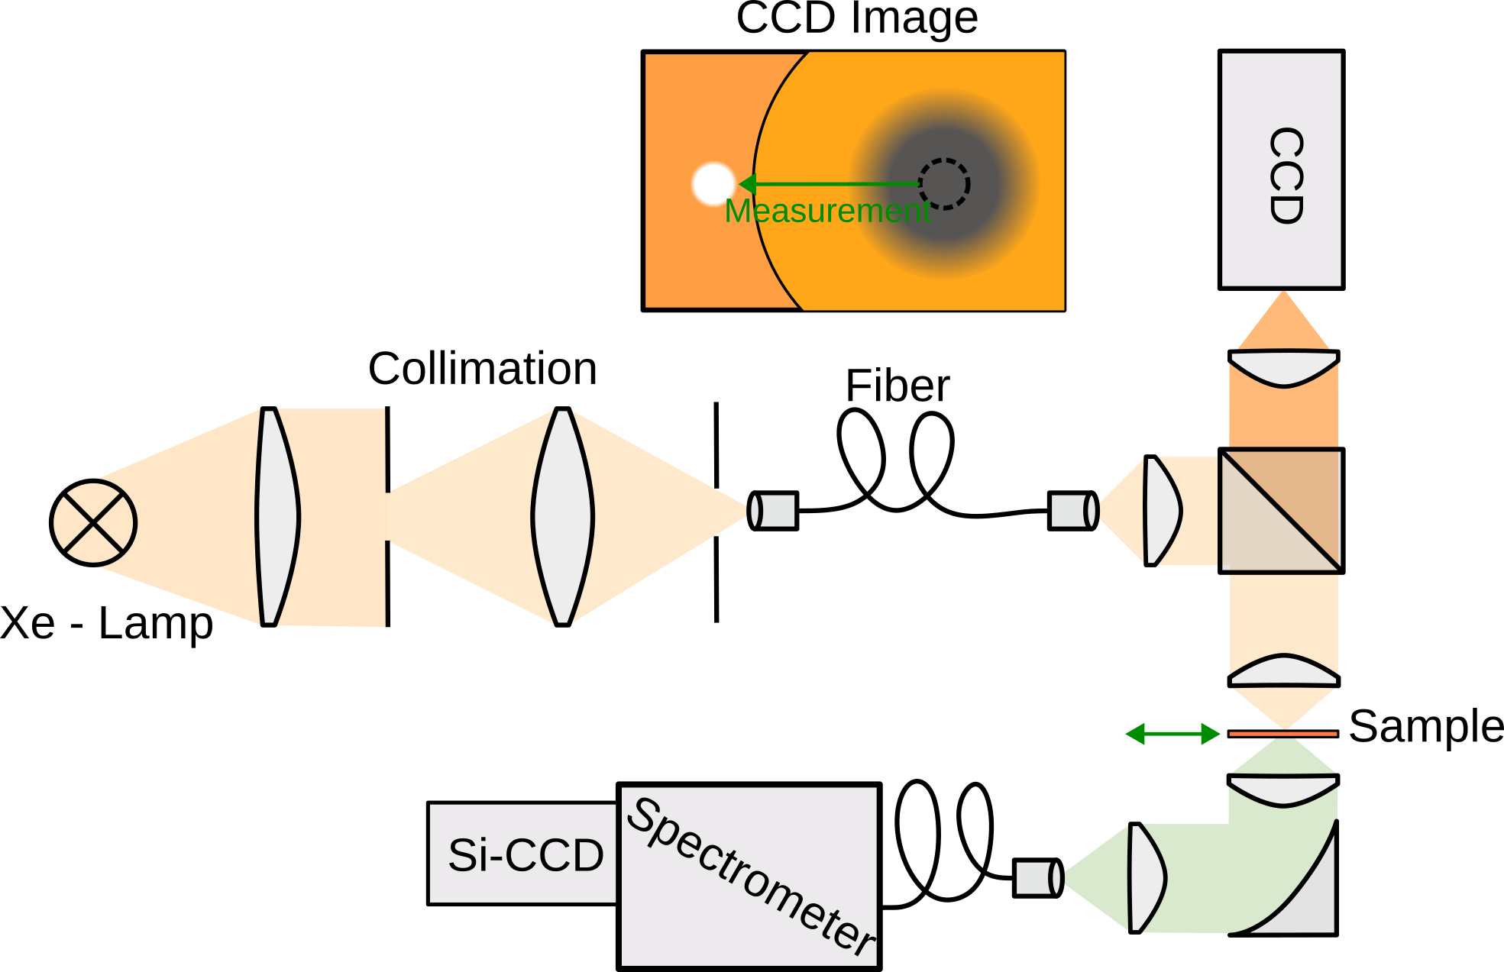
Transmission Spectrum Measurement Setup
Hier WiTec Foto einfügen
(aus Labor)

Slide 5
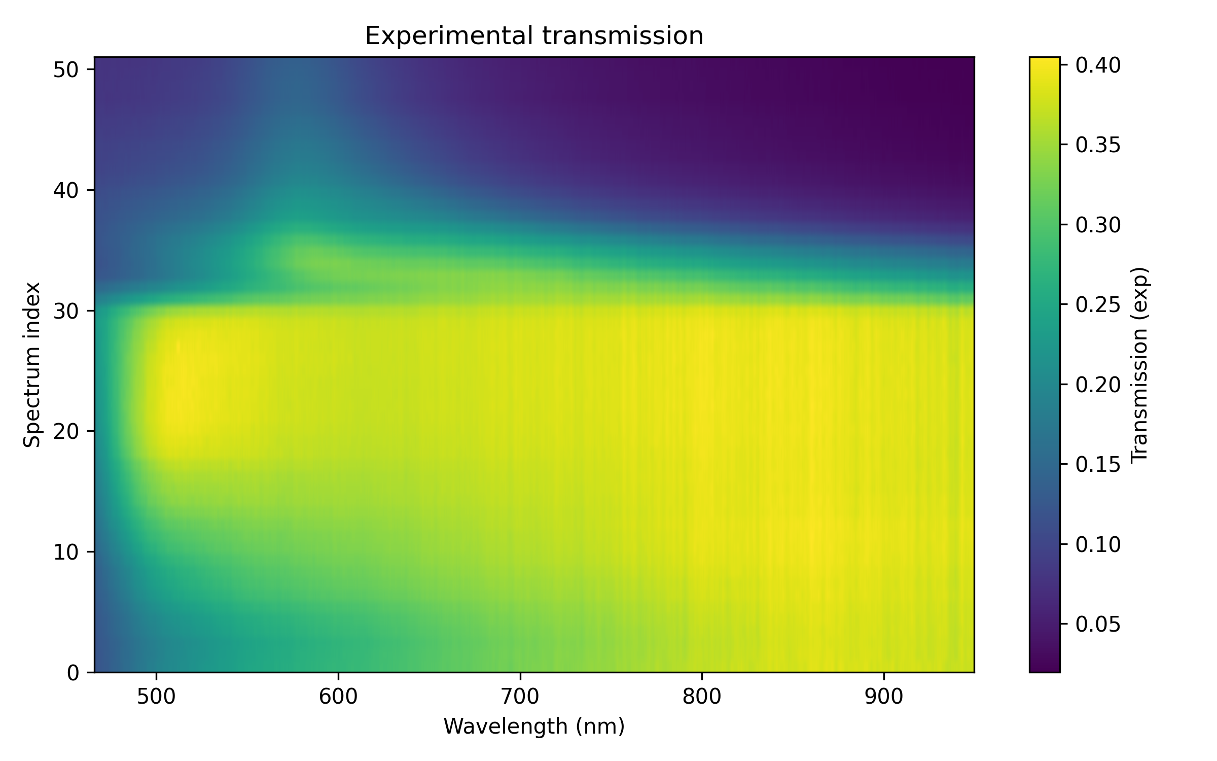

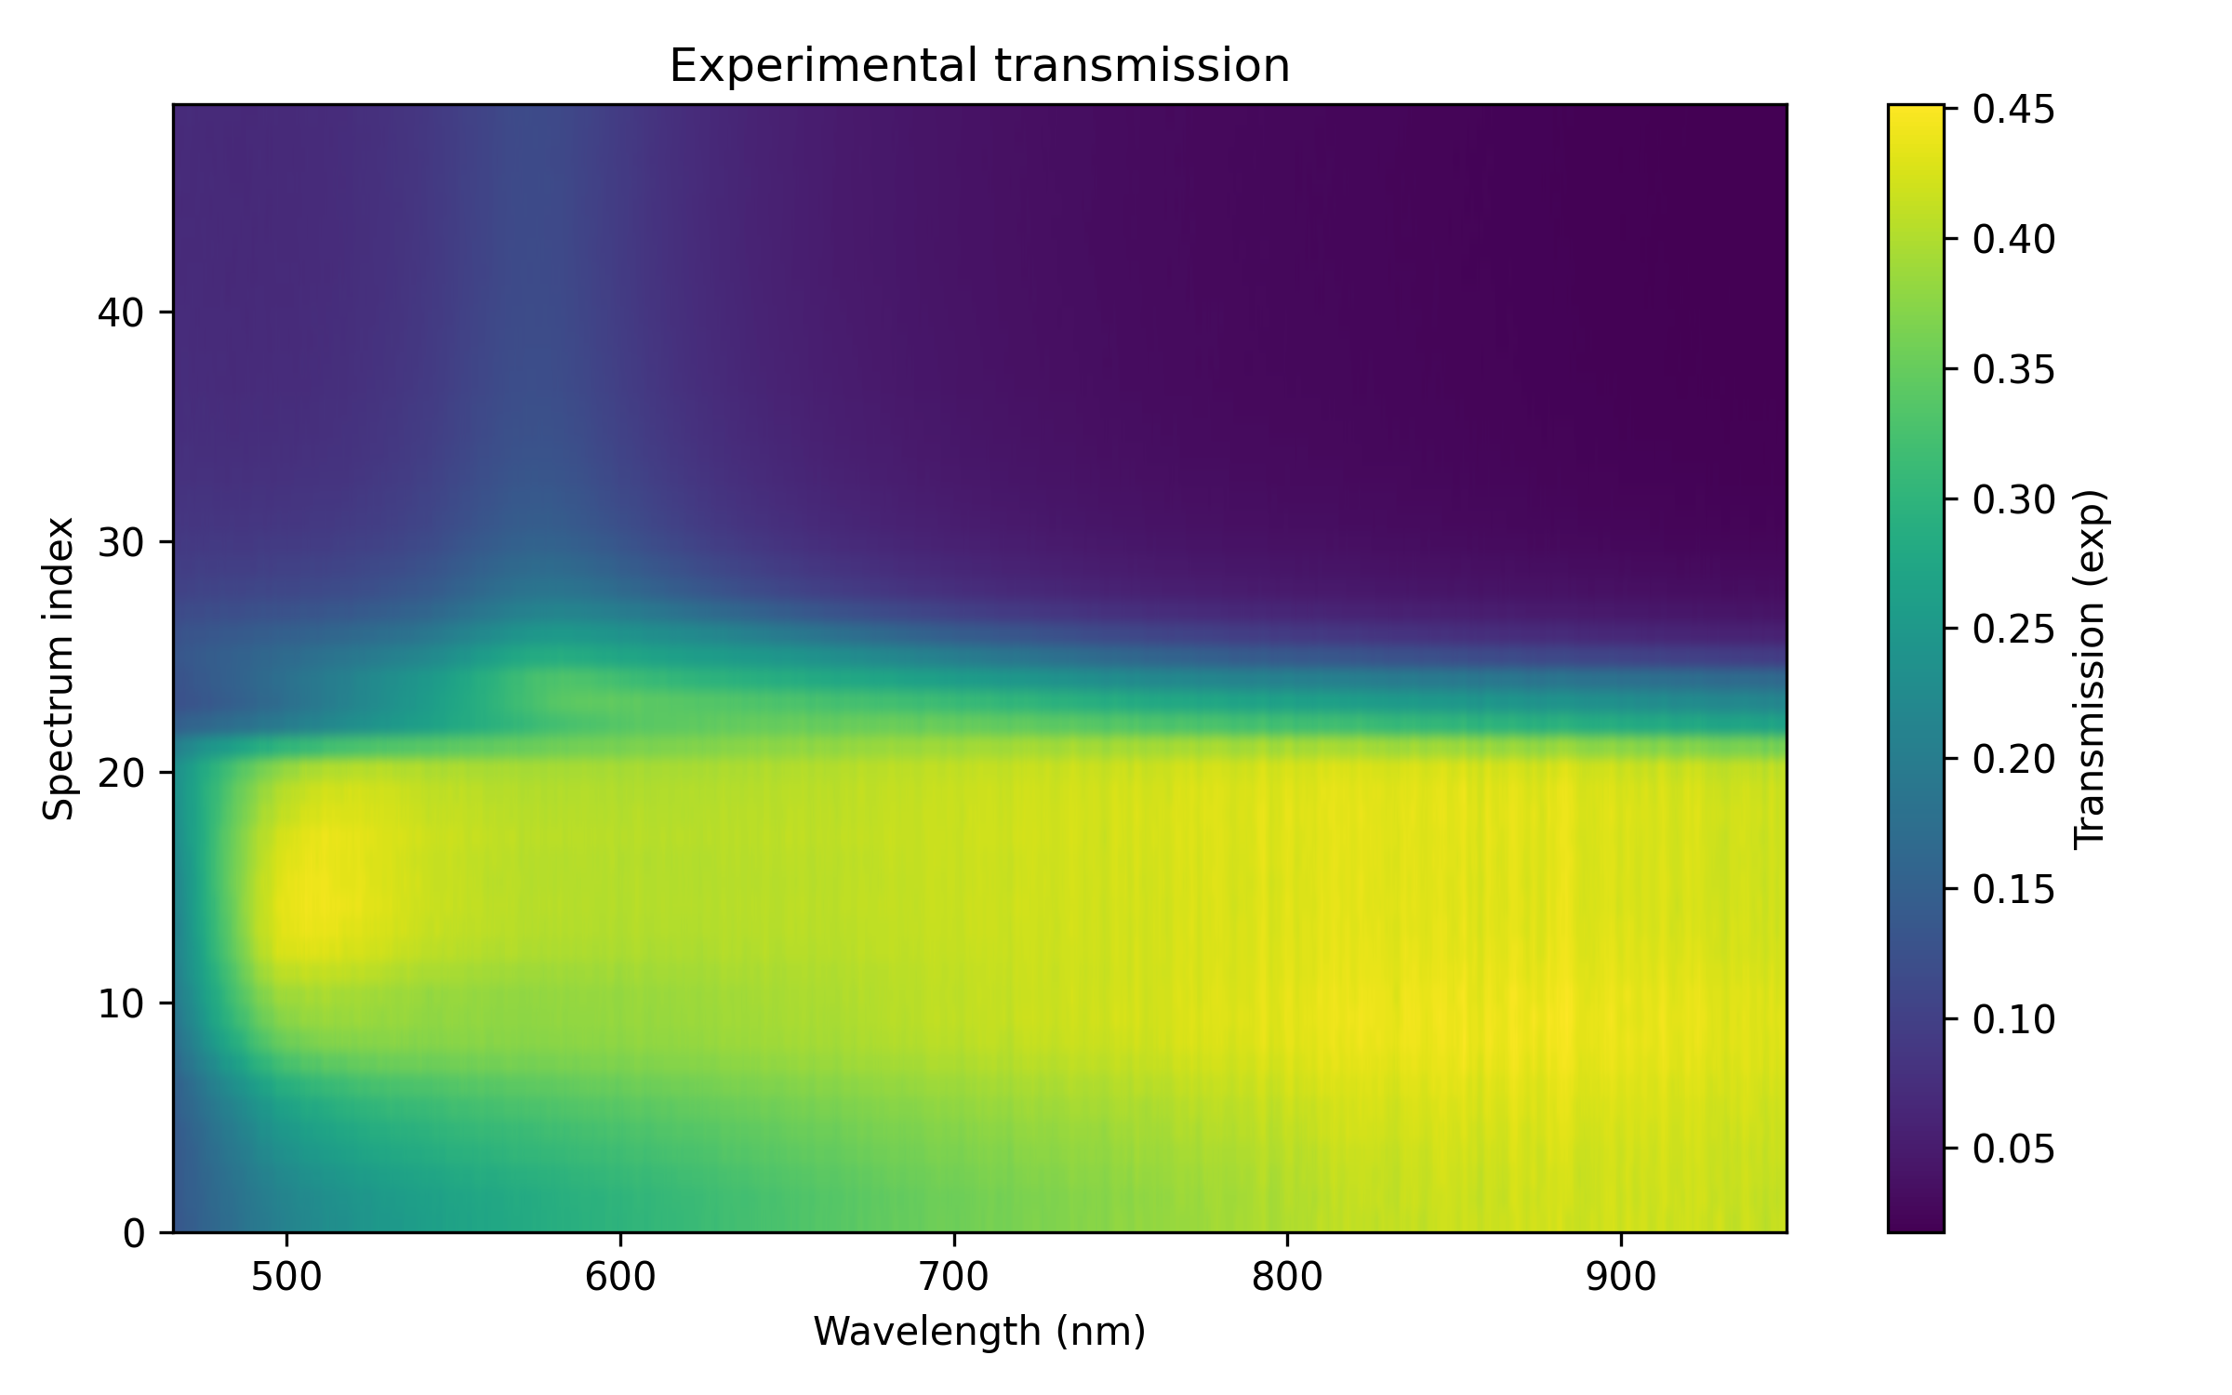
Transmission Spectra (Pulse Duration Varied)
2W, 120s
2W, 60s
2W, 40s
No difference in size and spectra
Smaller in size

Slide 6
Lenses Treated in this Study
Lens 1: 2W laser power, 40s pulse duration, 50mbar O2
Lens 2: 2W laser power, 60s pulse duration, 50mbar O2
Lens 3: 3W laser power, 120s pulse duration, 50mbar O2
Hier Bilder von allen drei
Linsen einfügen

Slide 7
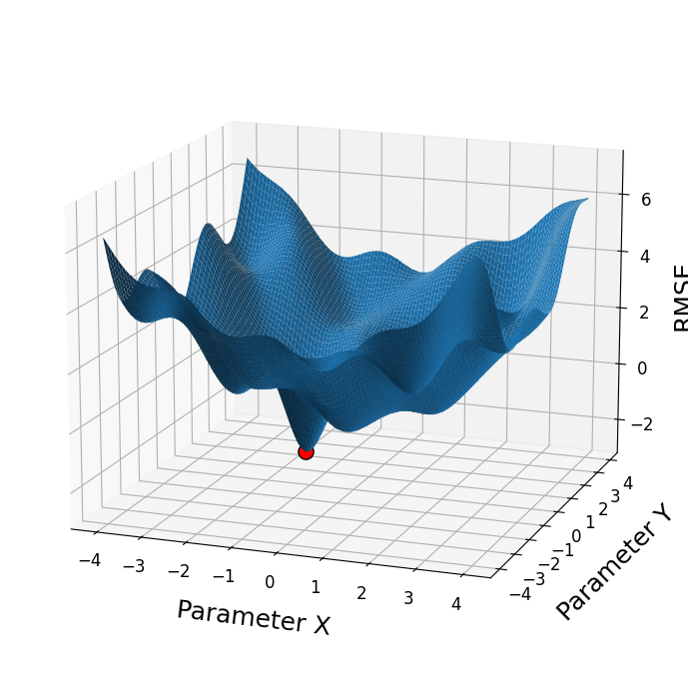
Fitting with Transfer Matarix Method (TMM)
Challanges:
- Many free parameters
- Local Minima

Slide 8
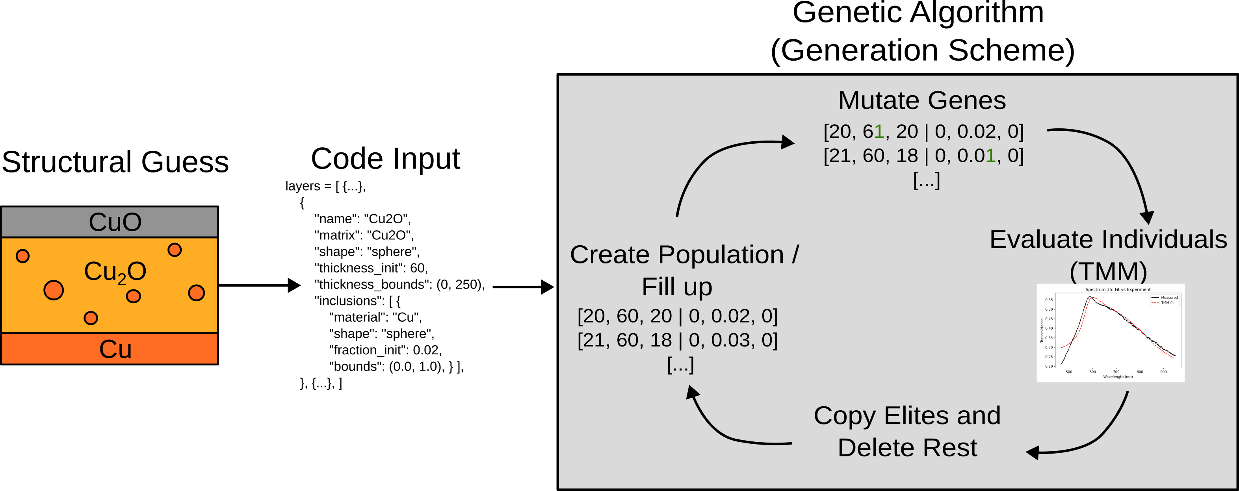
Fitting with Transfer Matarix Method (TMM)

Slide 9
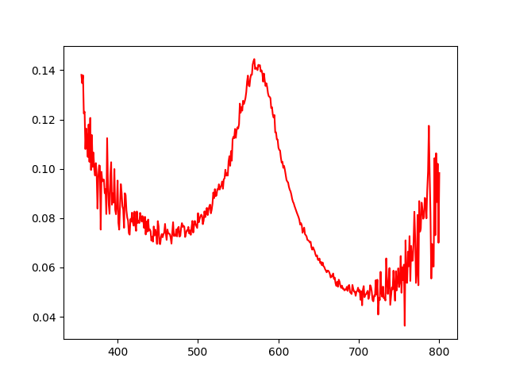
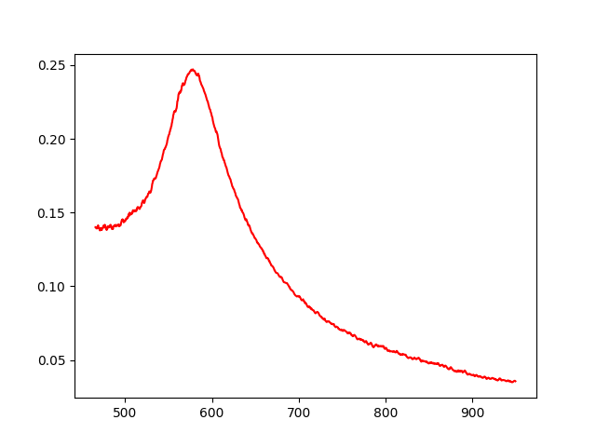
Spectral Calibration
Measurement of calibrated spectrometer (left) and transmission from WiTec Setup (right)
Problem: Amplitudes do not match!
Transmission
Transmission
Wavelenght / nm
Wavelenght / nm

Slide 10
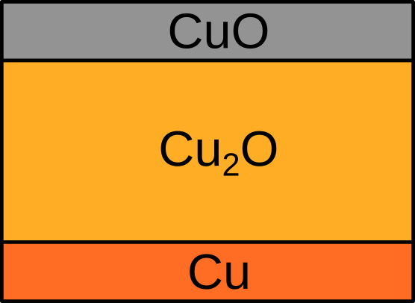
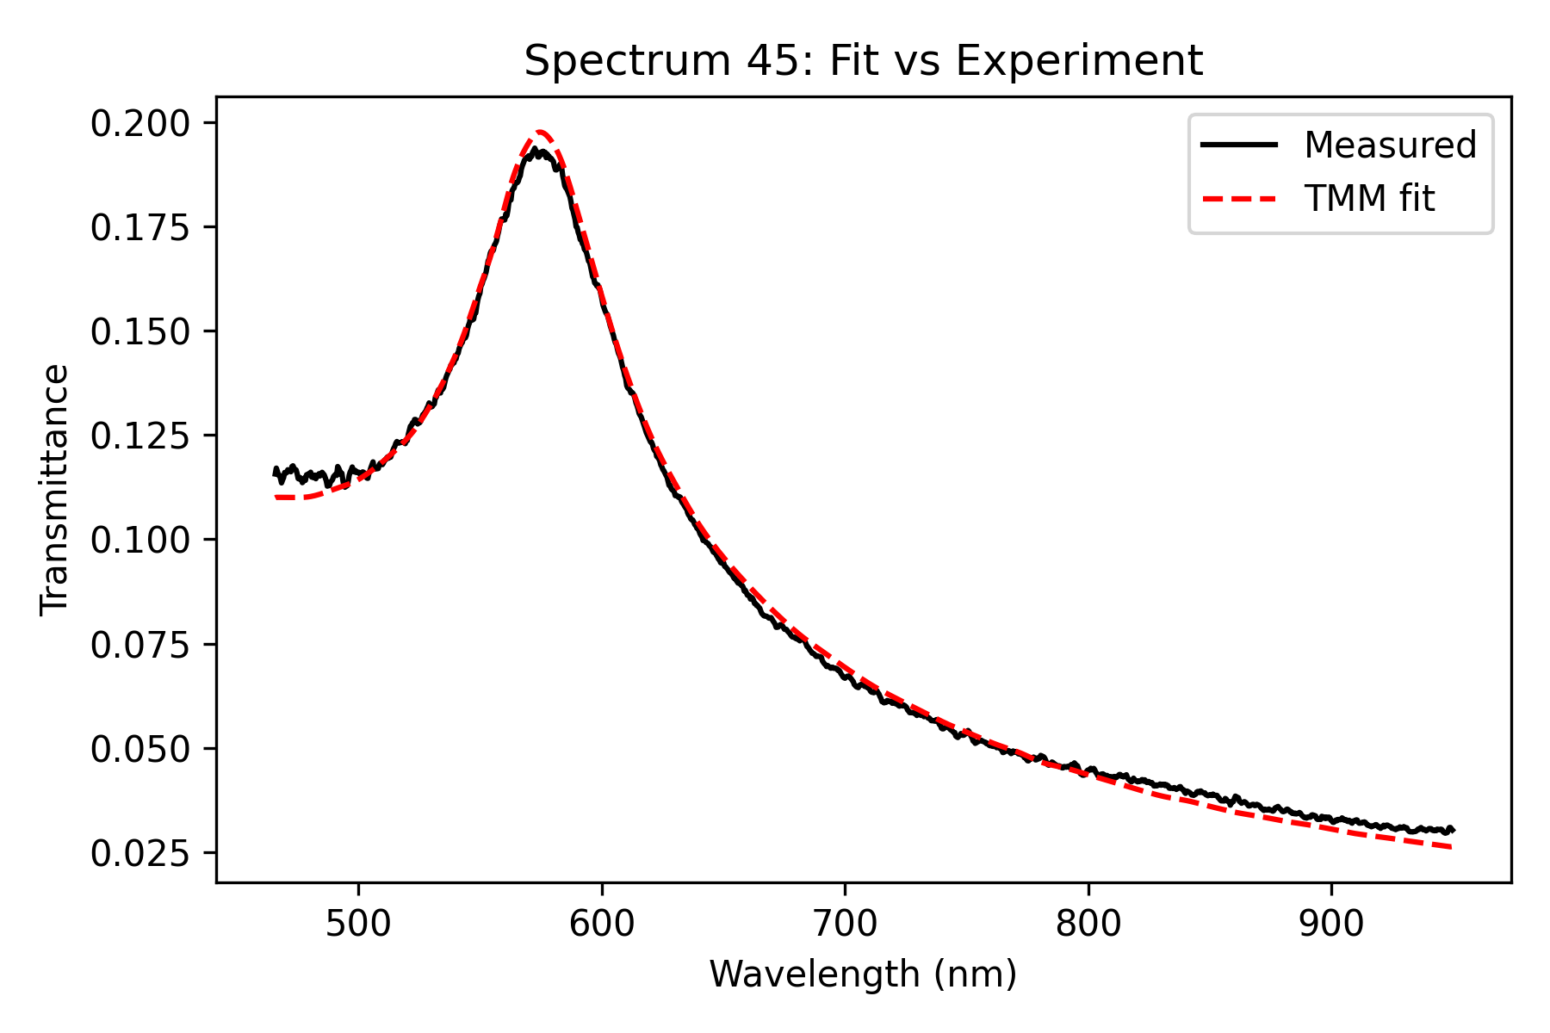
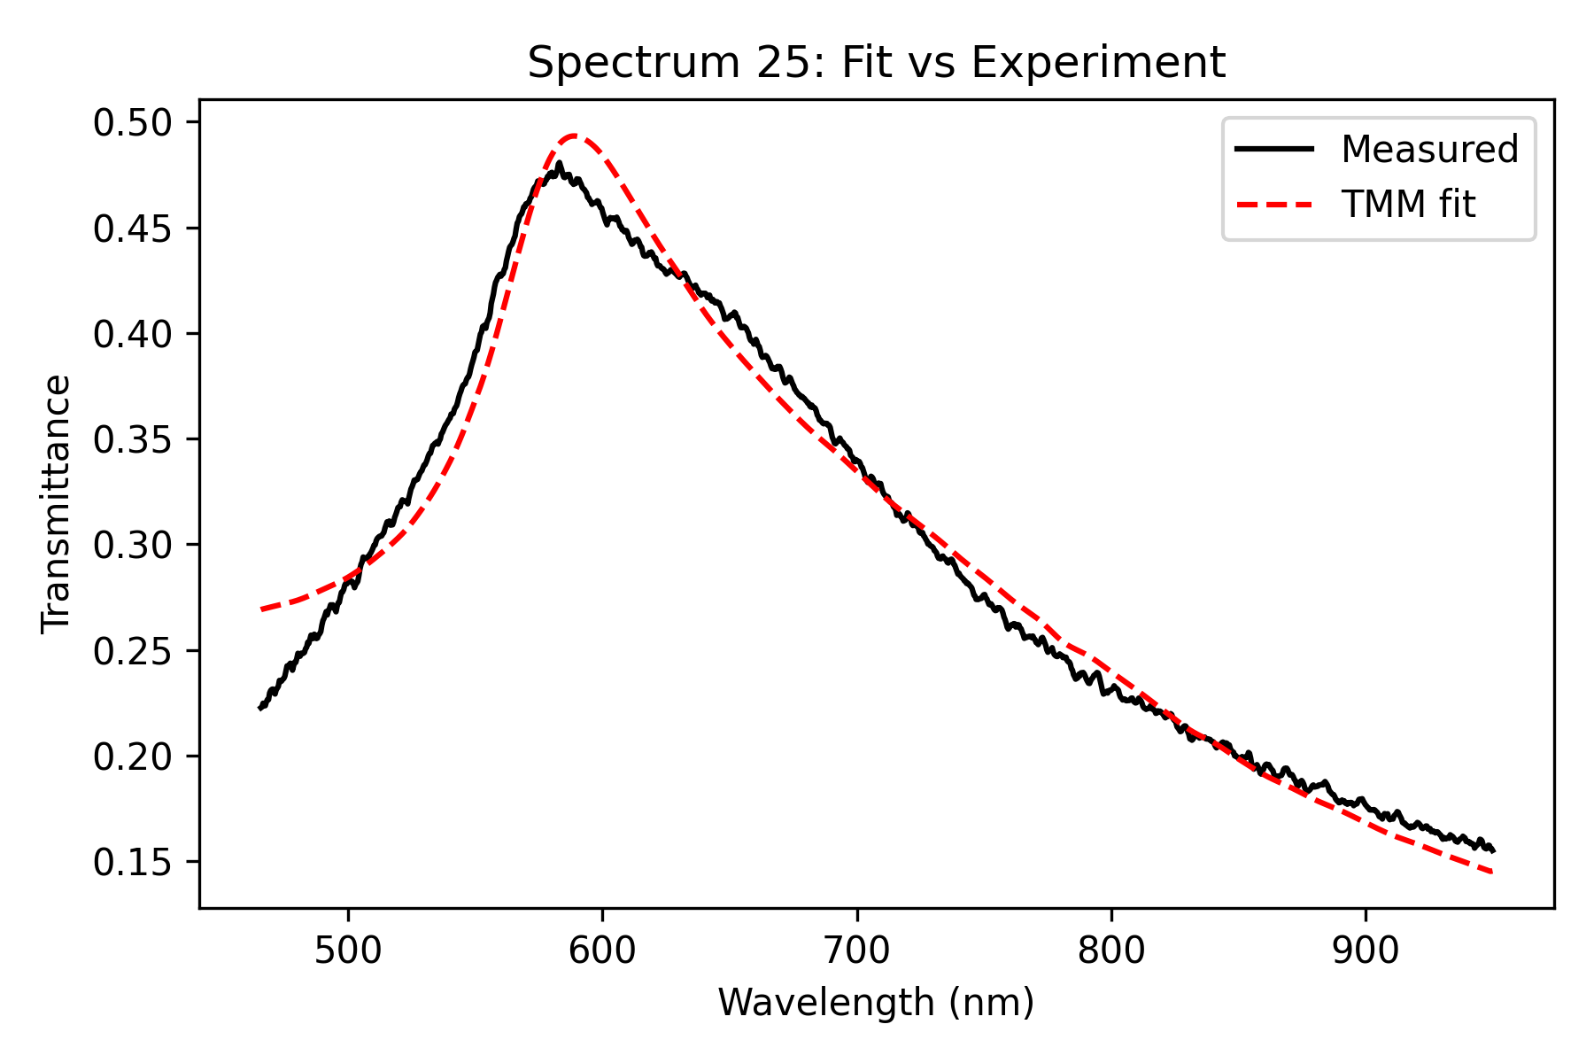
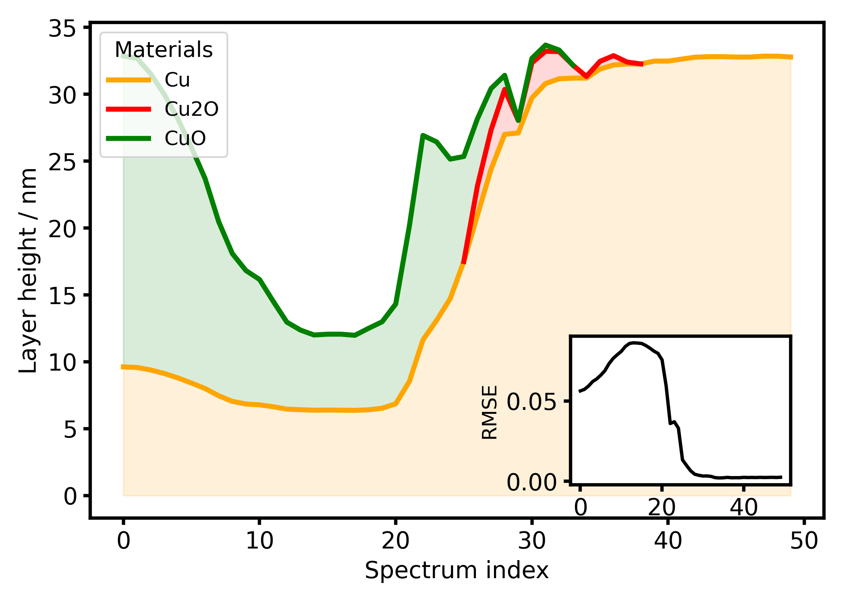
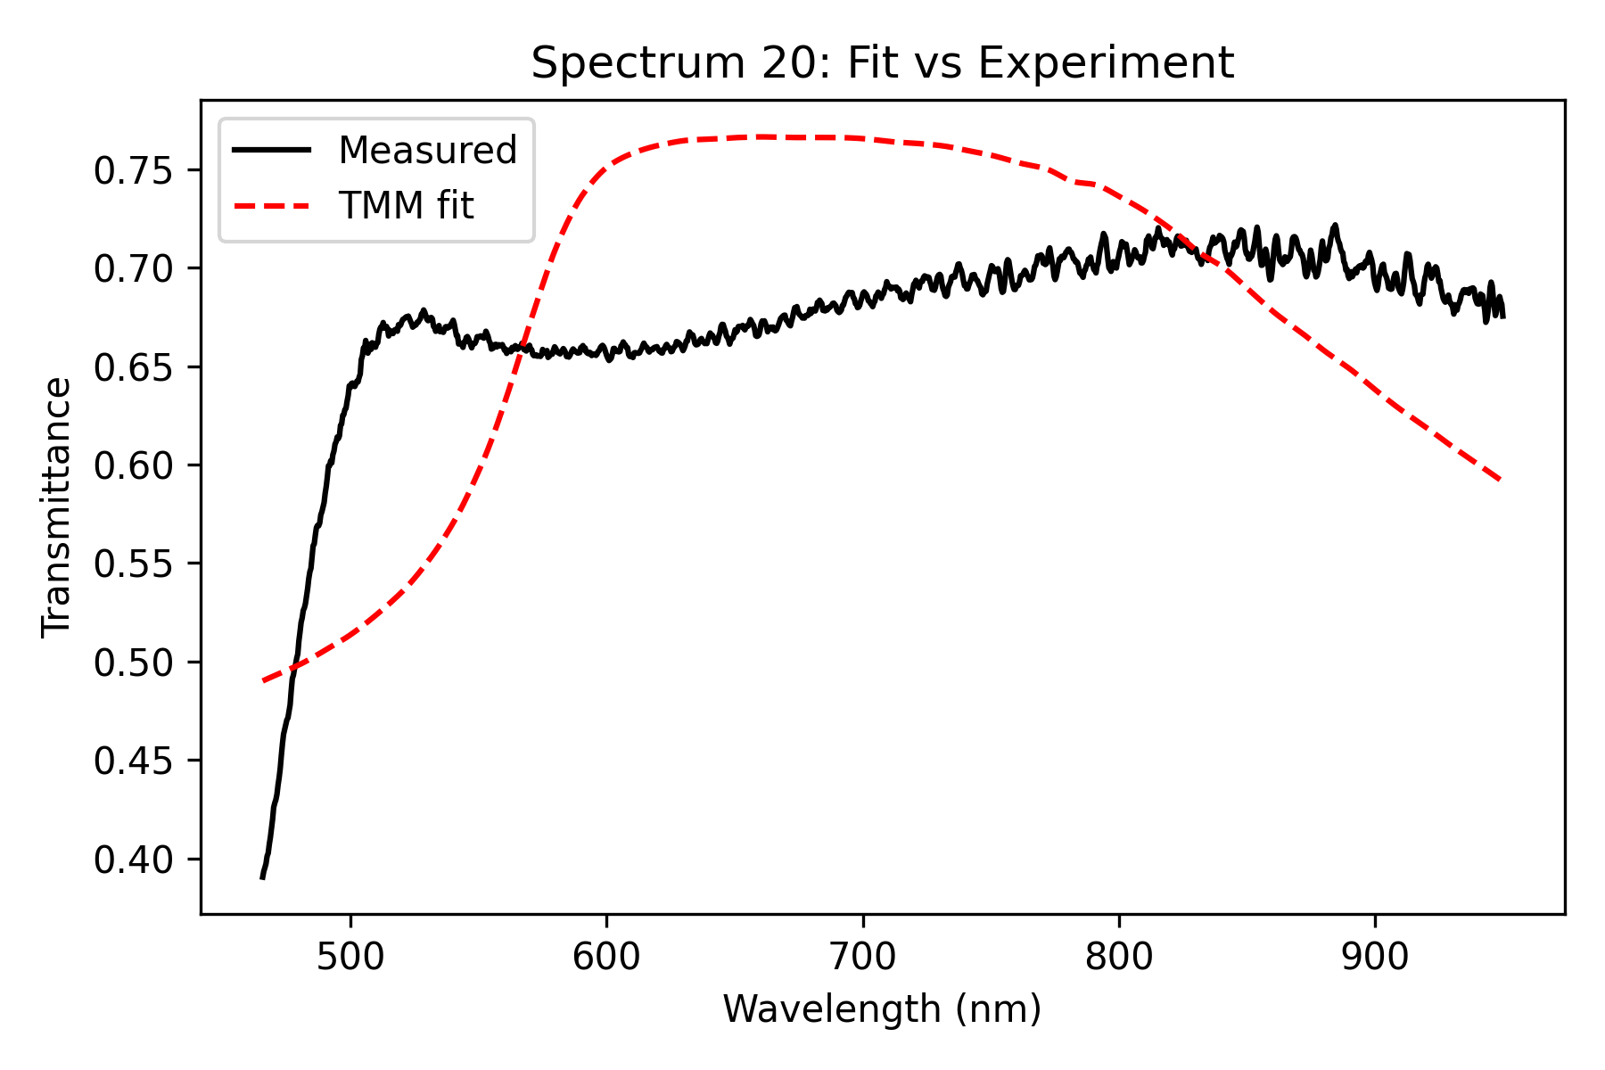
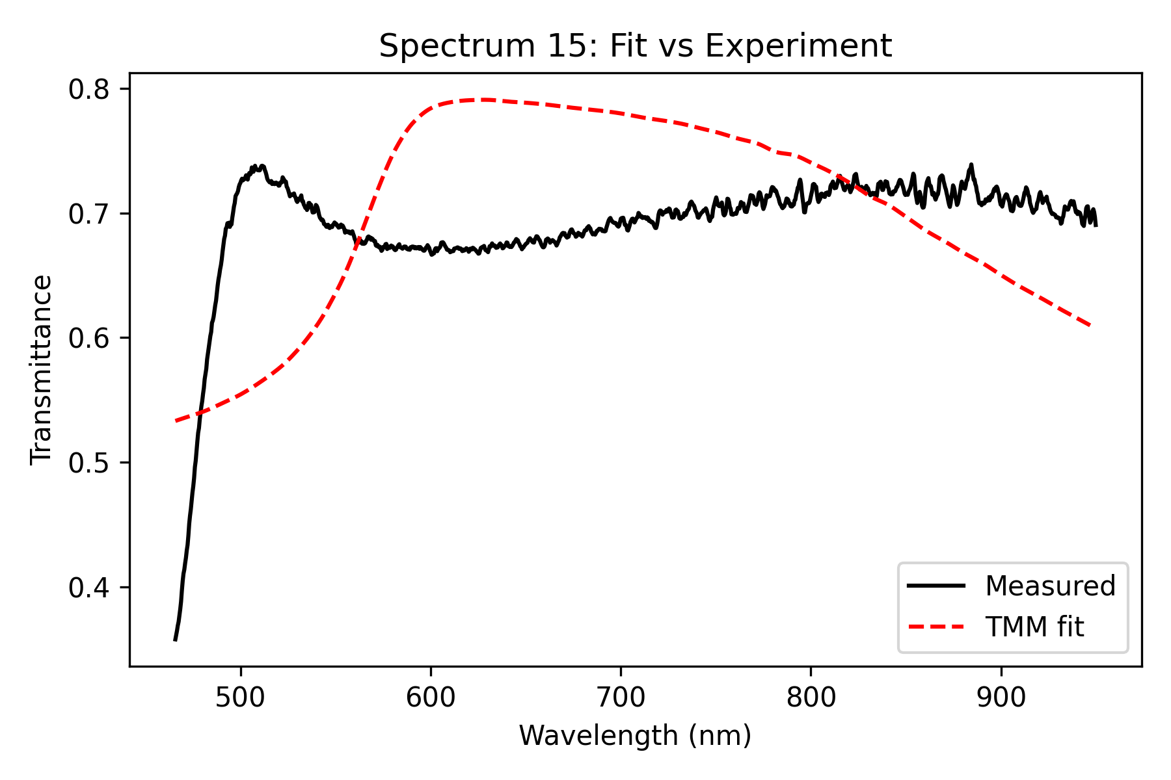
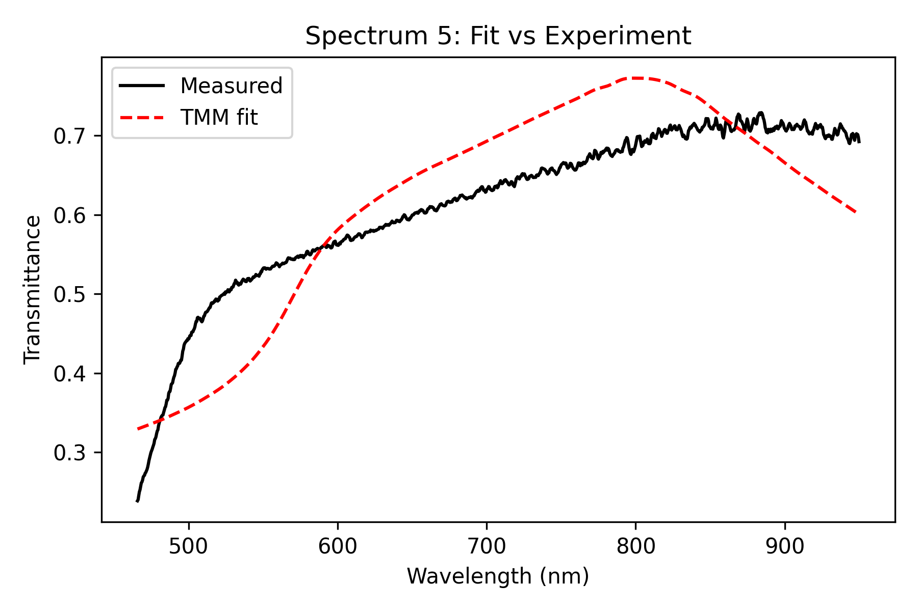
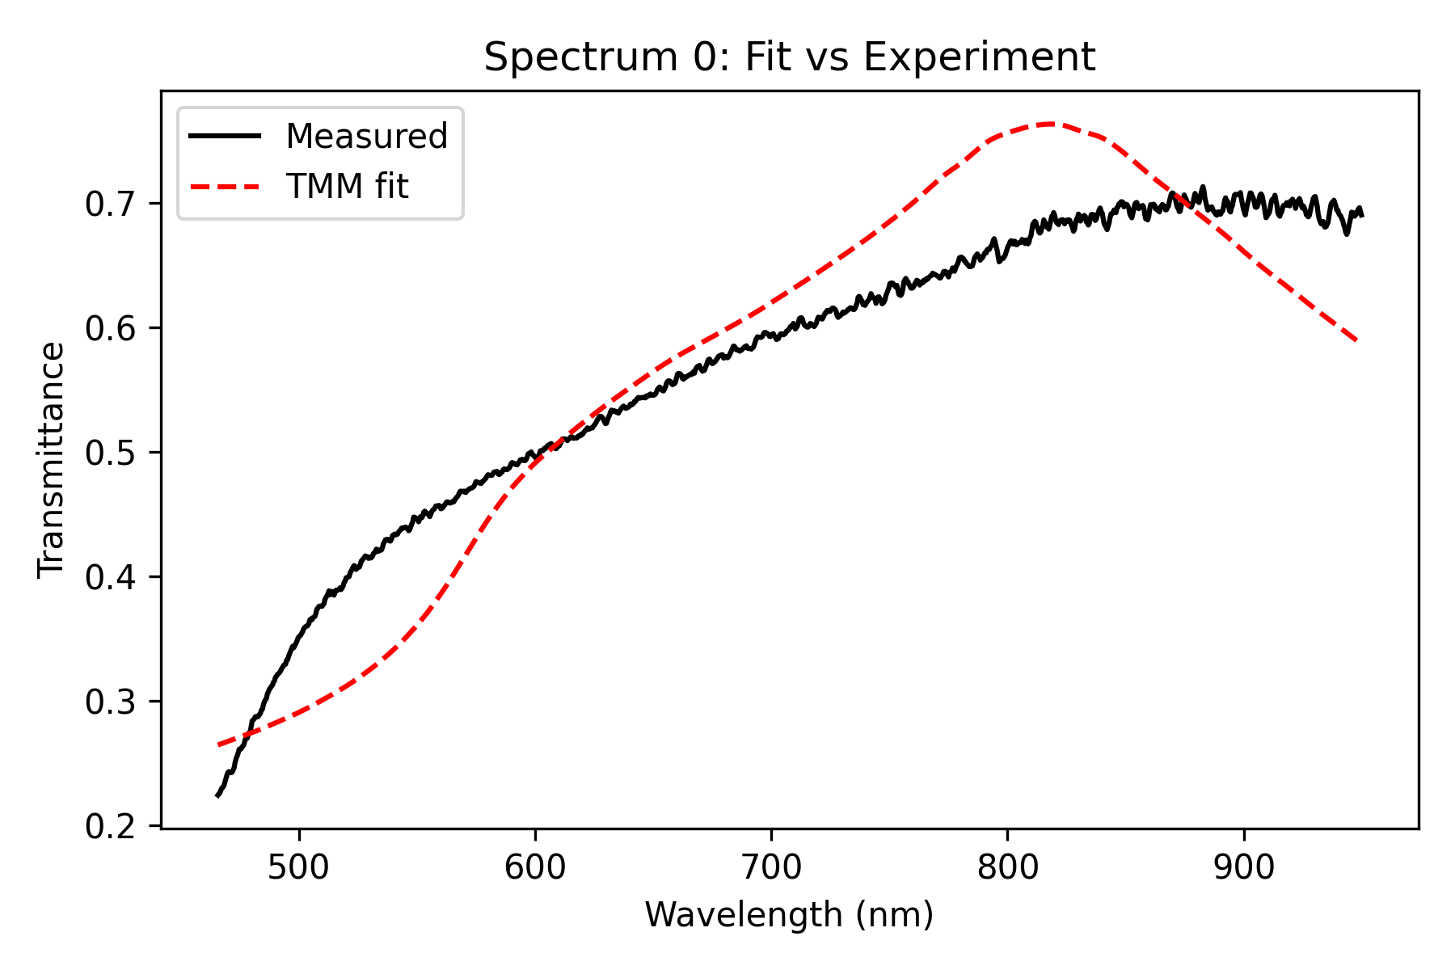
Influence of scaling Parameter on Fit (Lens 2W, 40s)
Unchanged scaling:

Slide 11
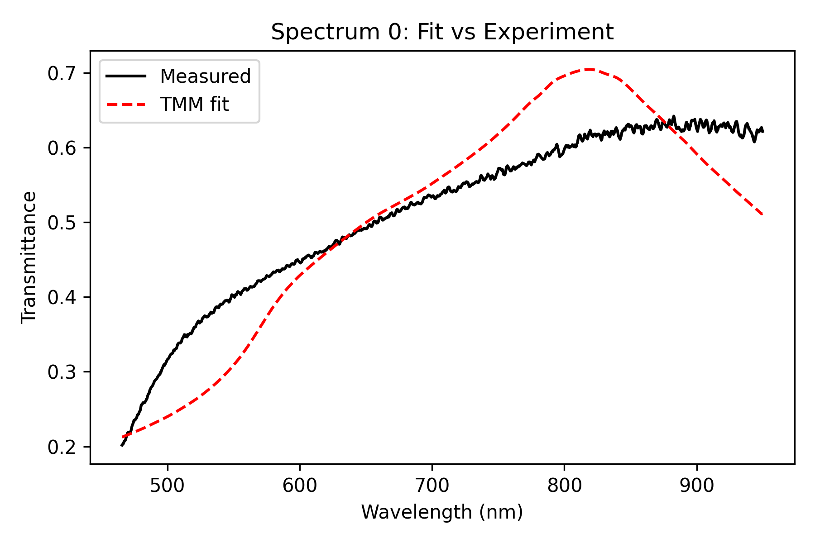
Influence of scaling Parameter on Fit (Lens 2W, 40s)
0.9x scaling:

Slide 12
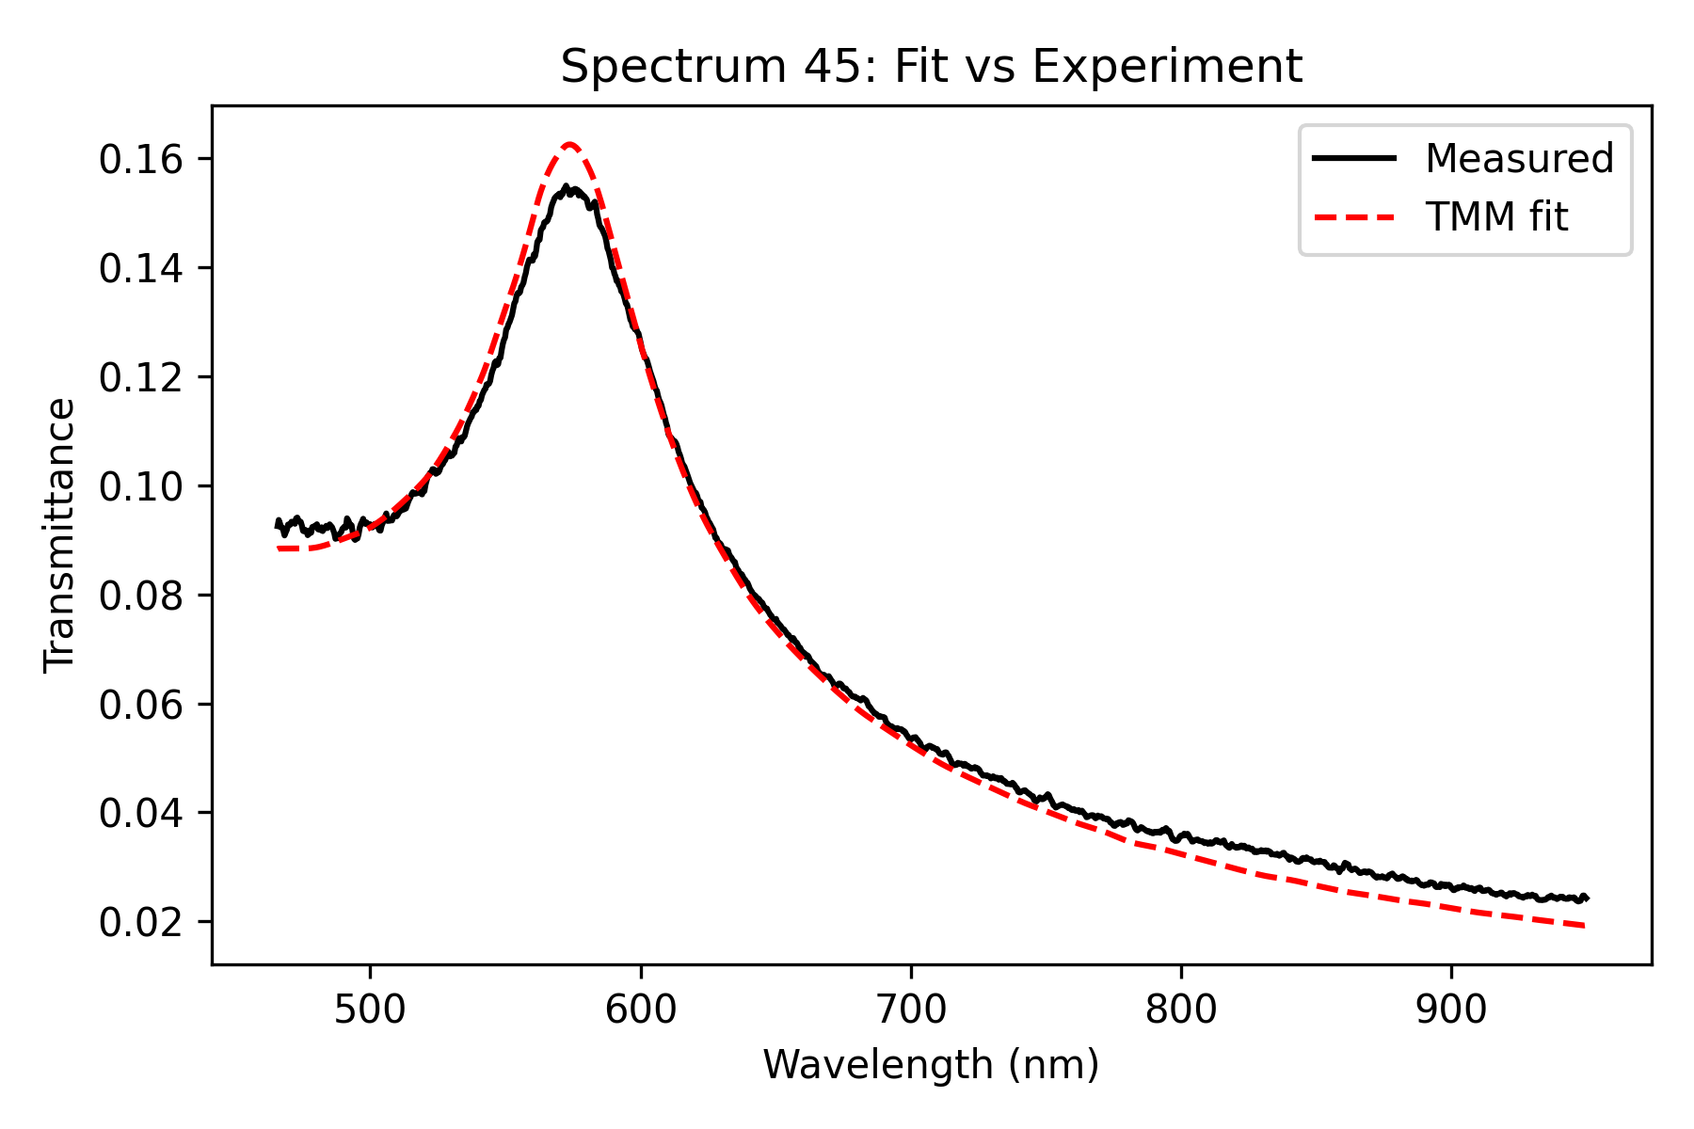
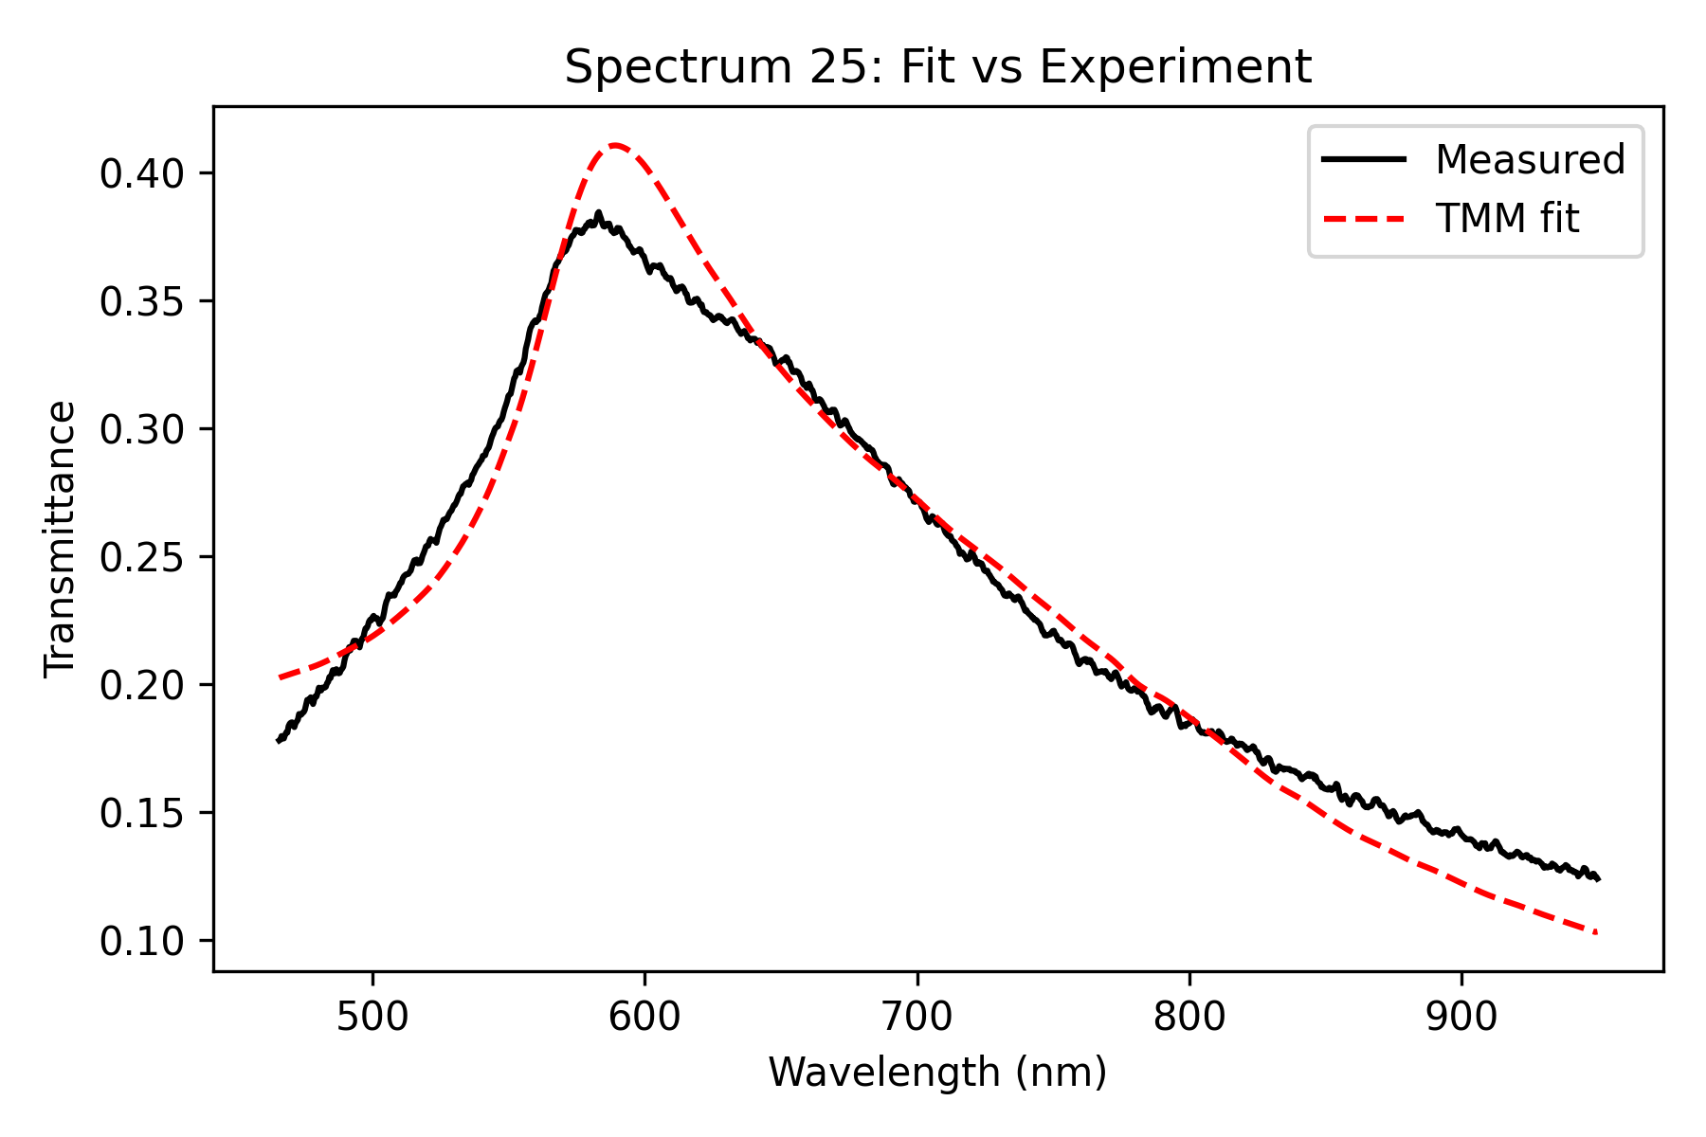
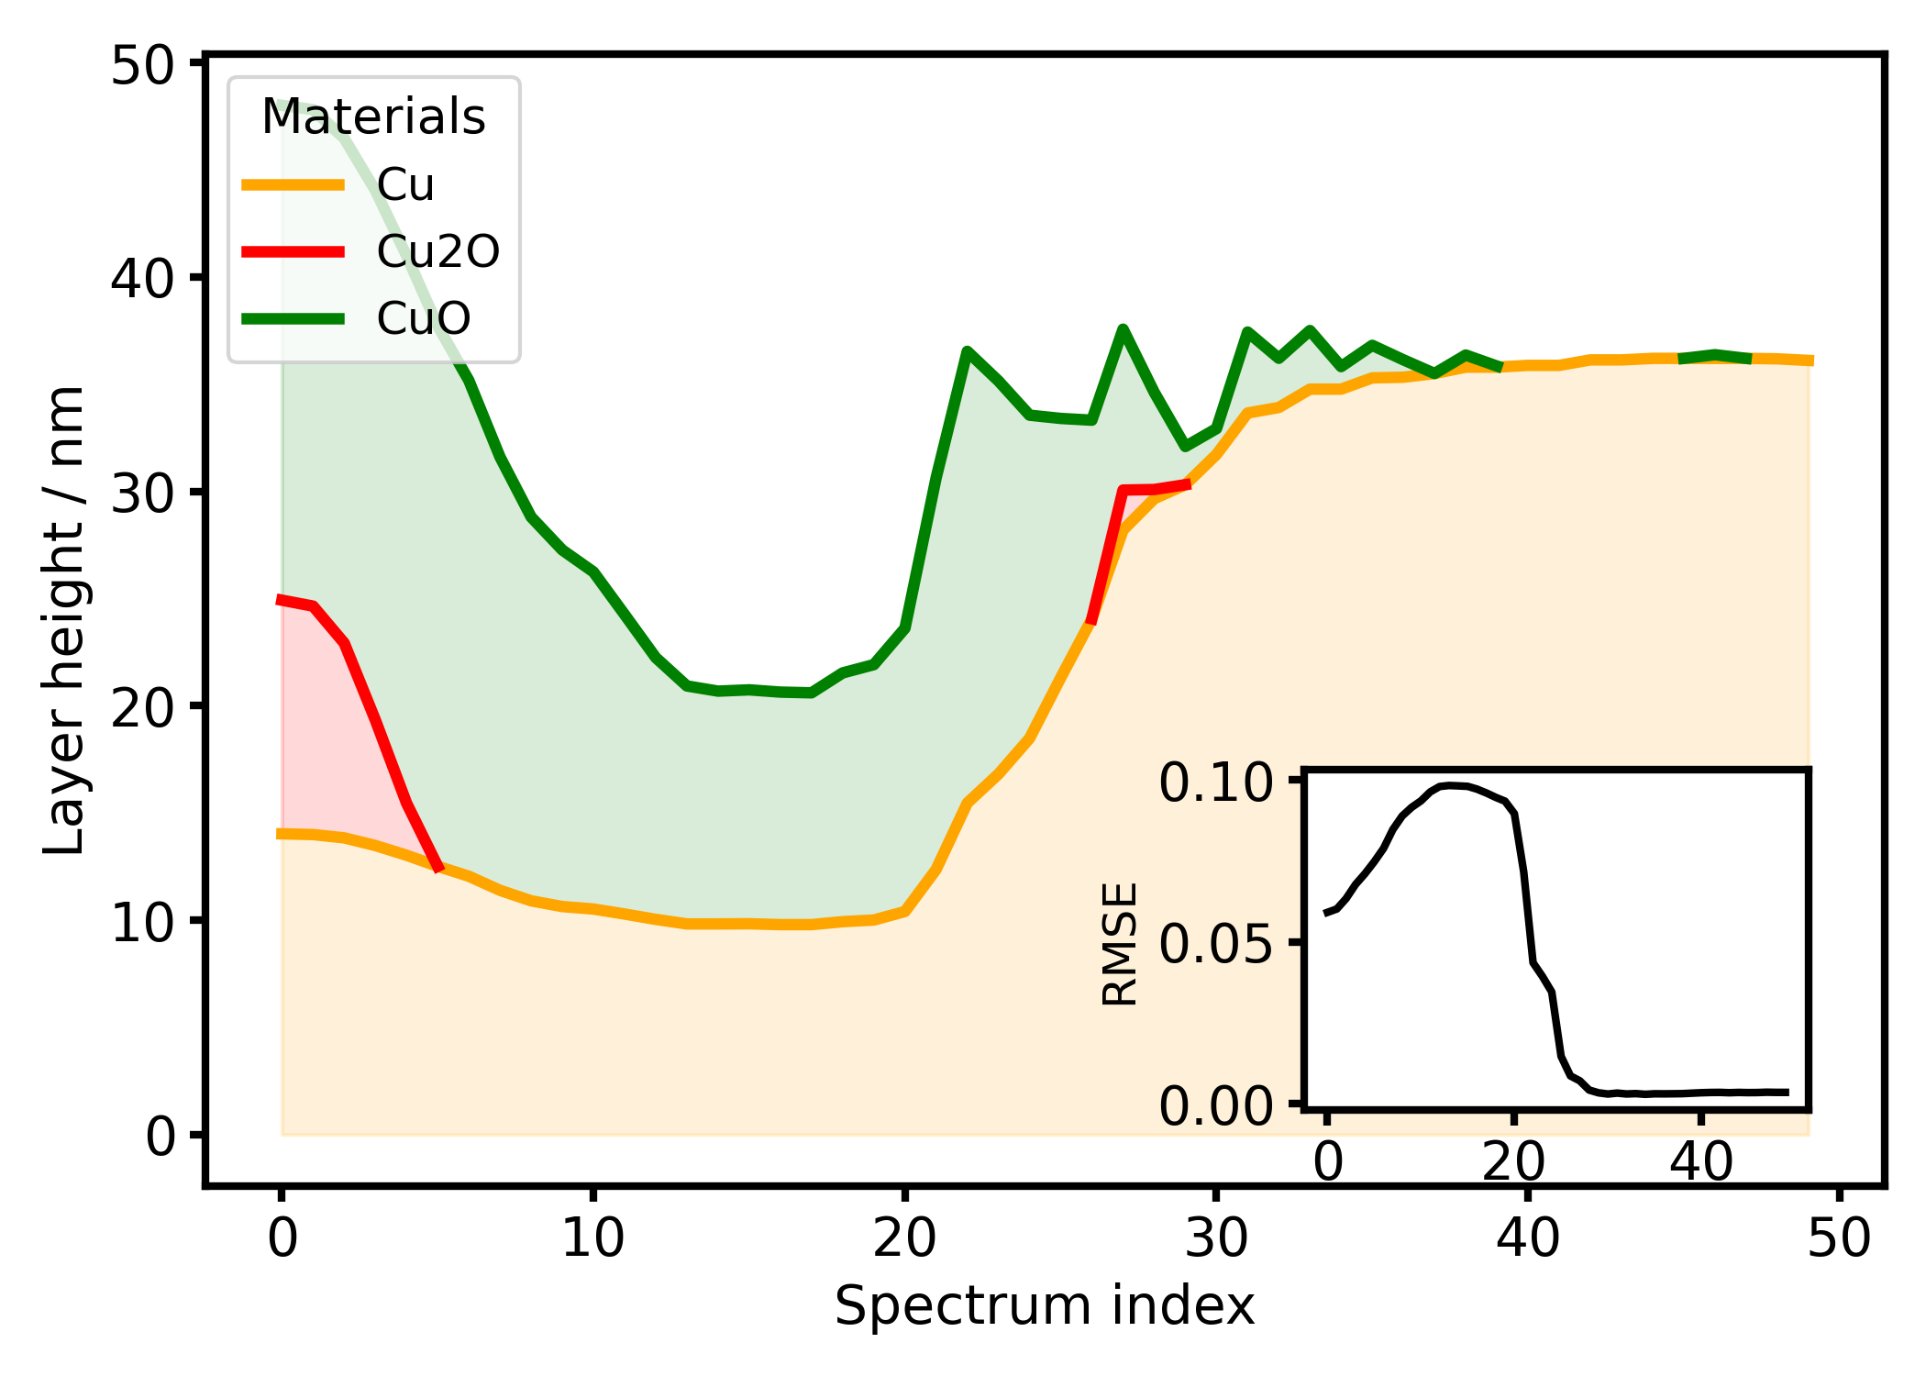
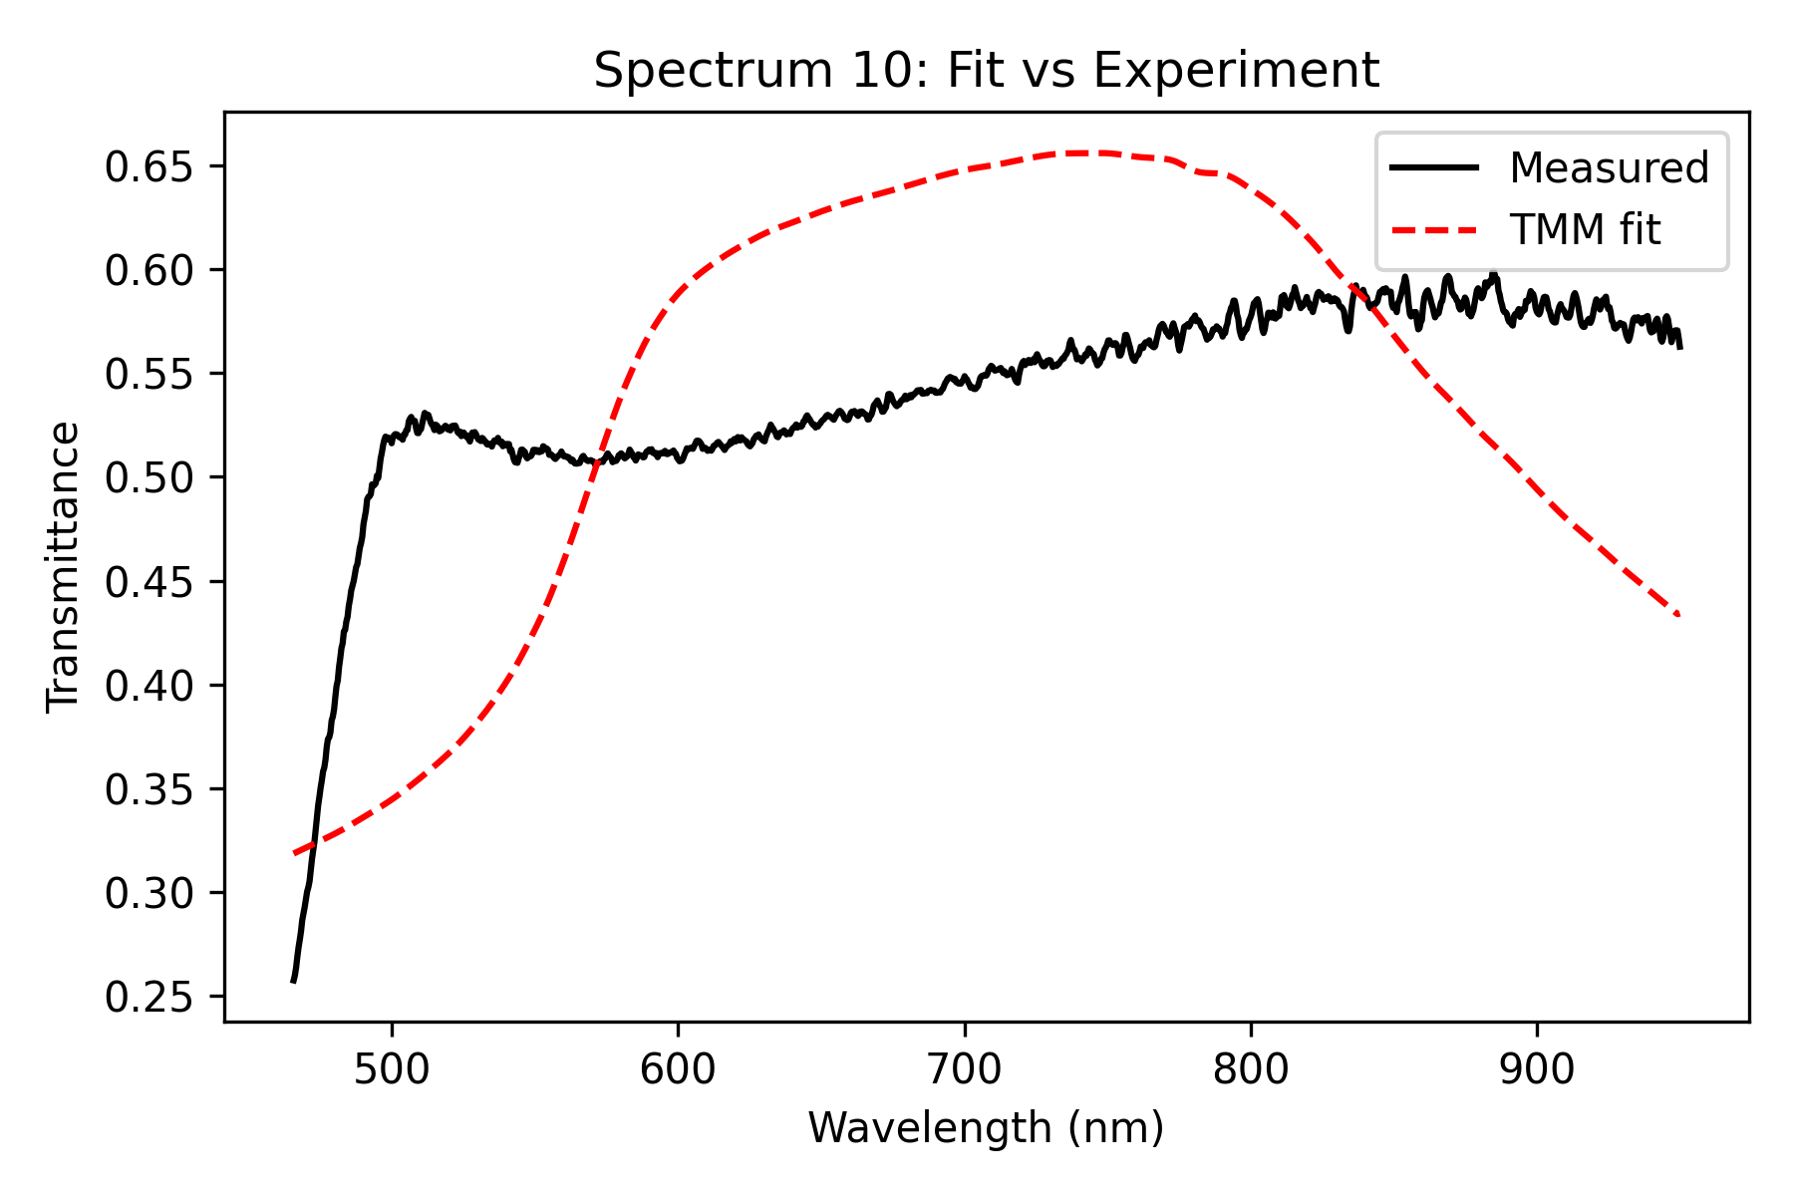
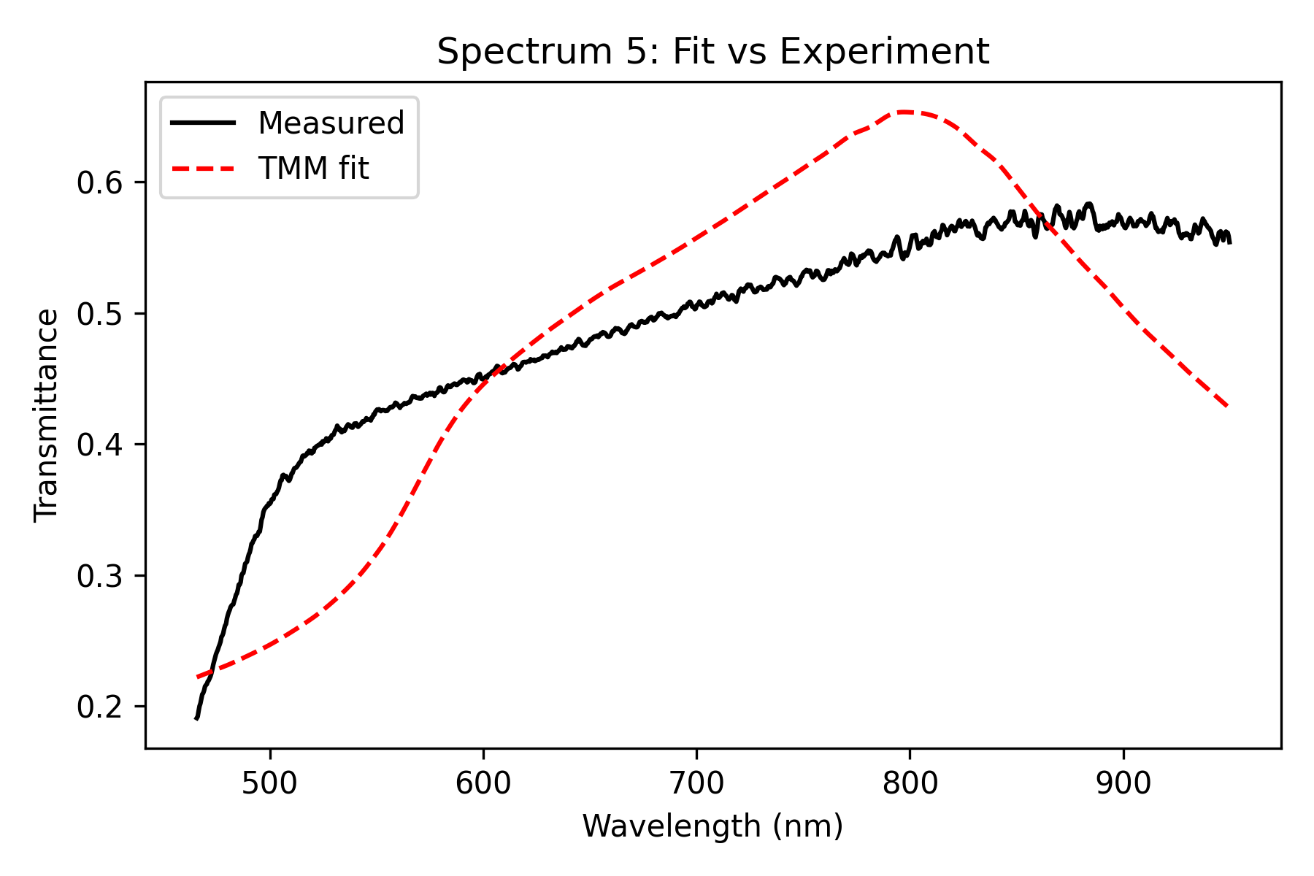
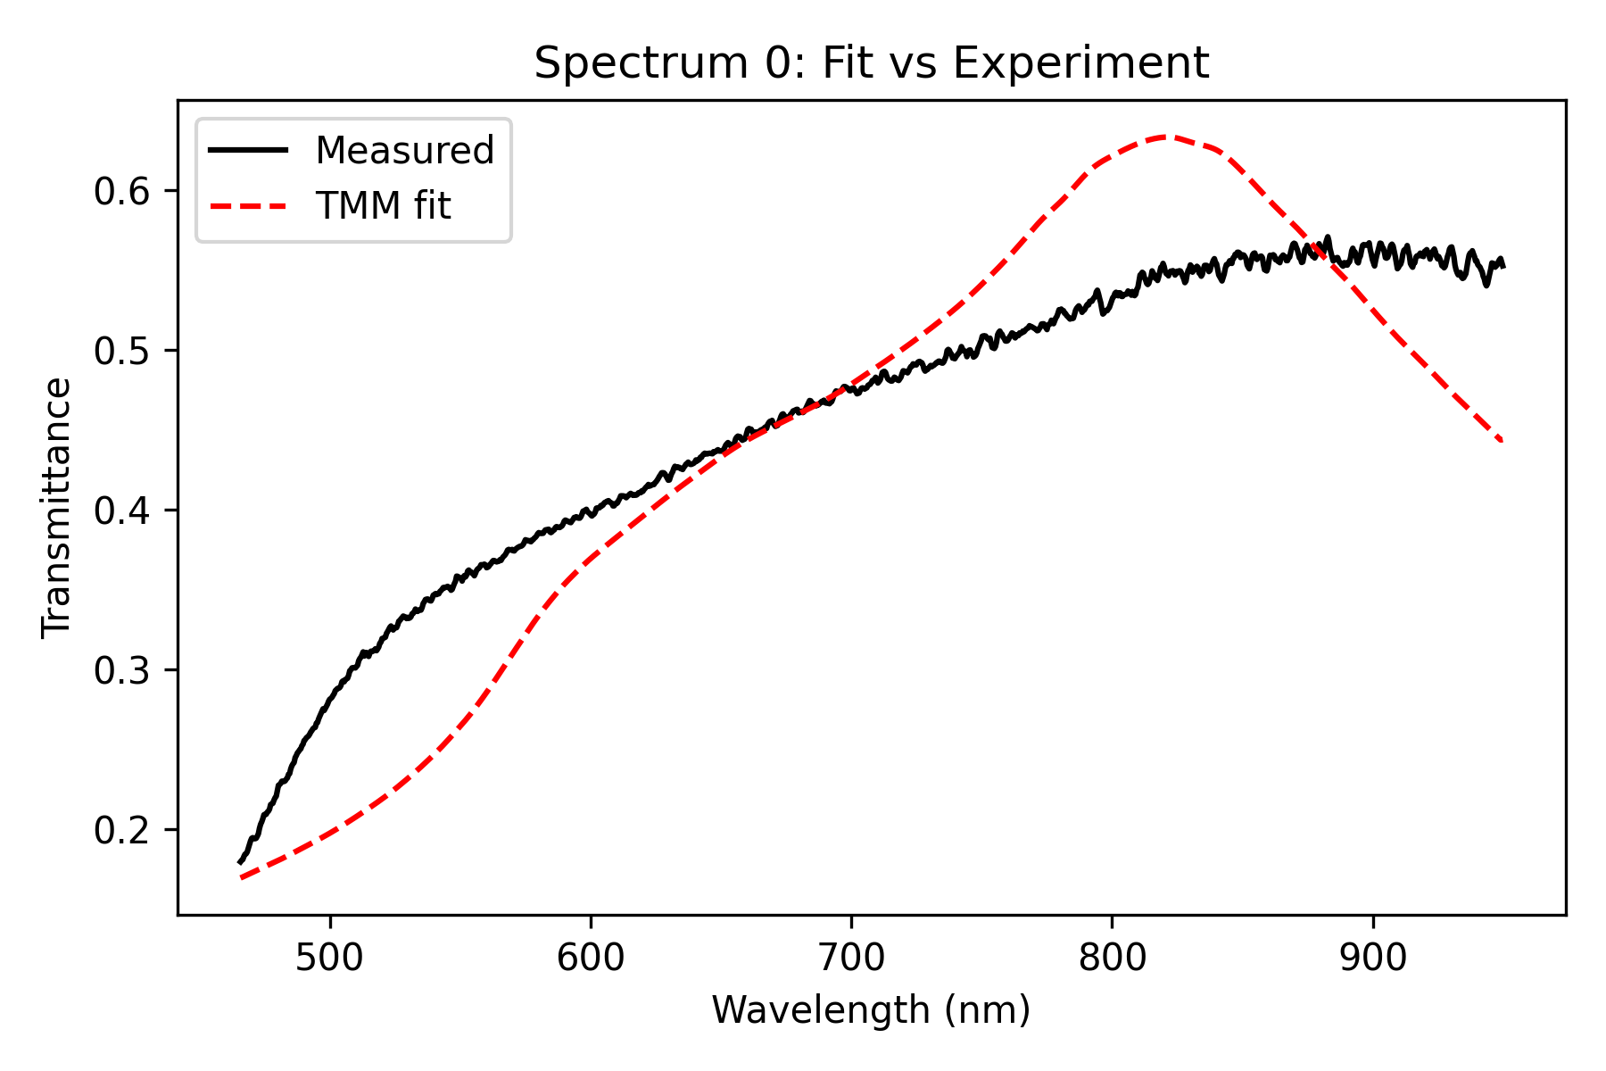
Influence of scaling Parameter on Fit (Lens 2W, 40s)
0.8x scaling:

Slide 13
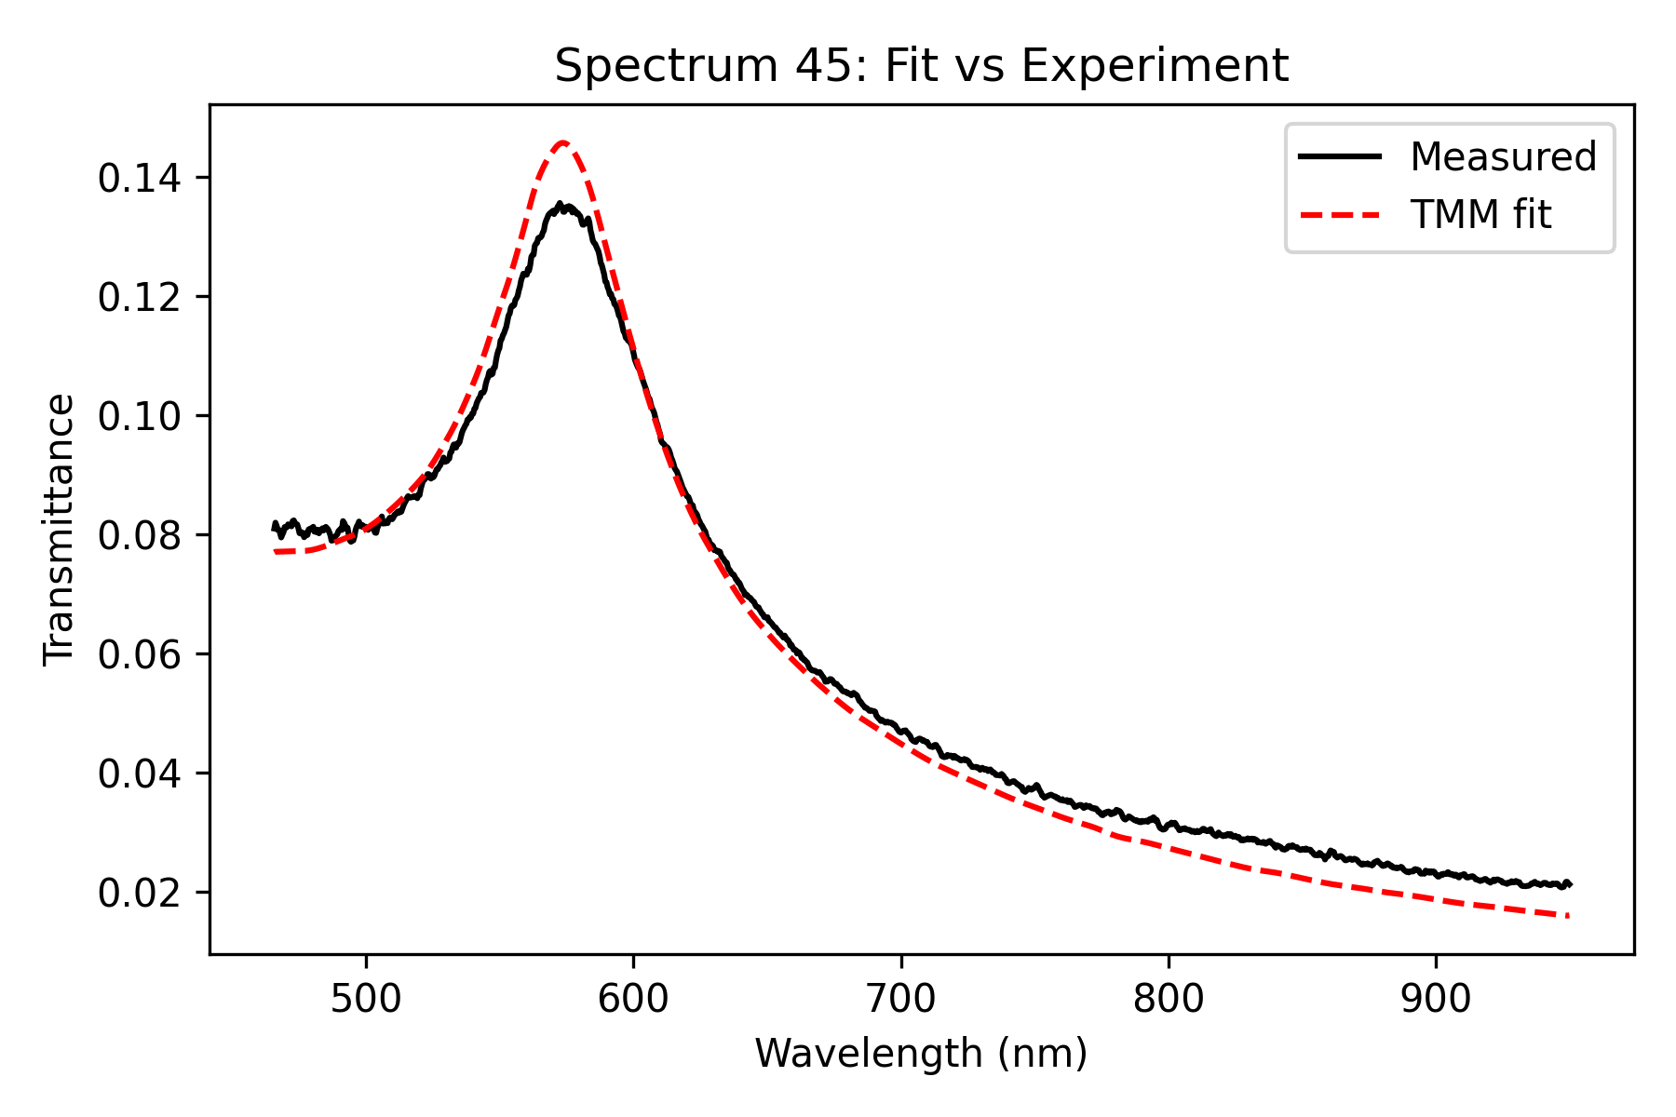
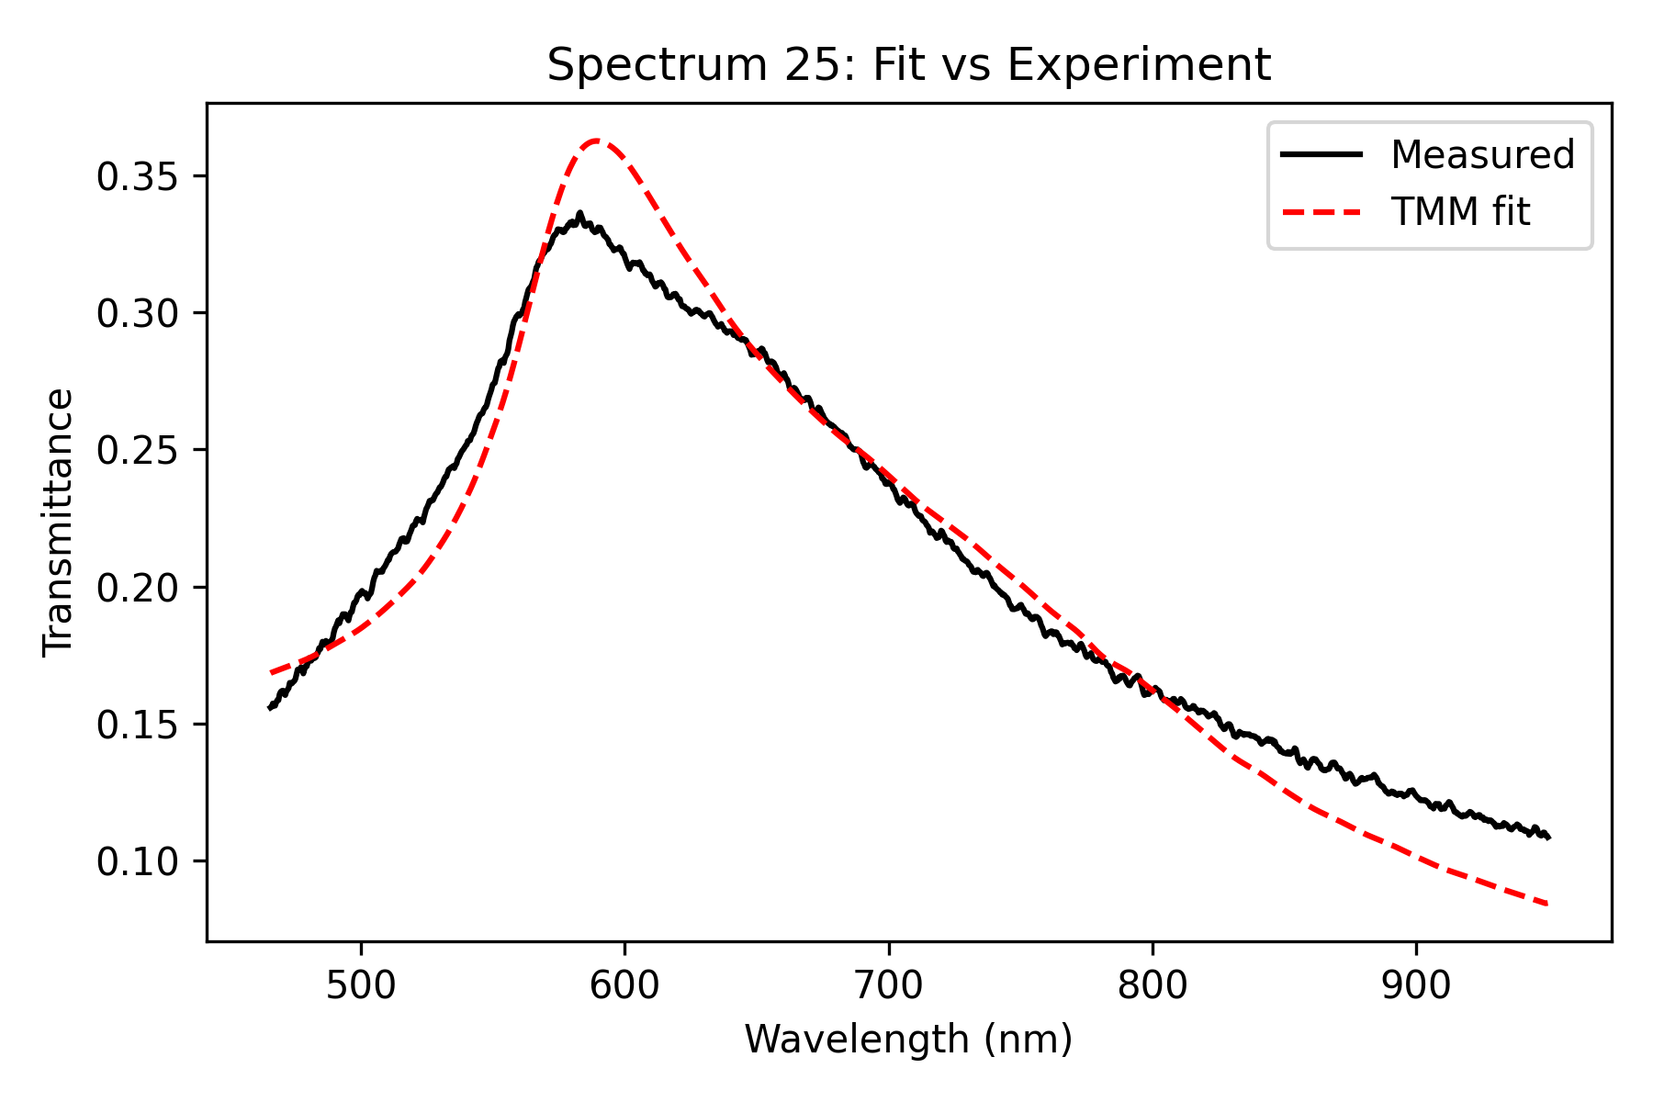
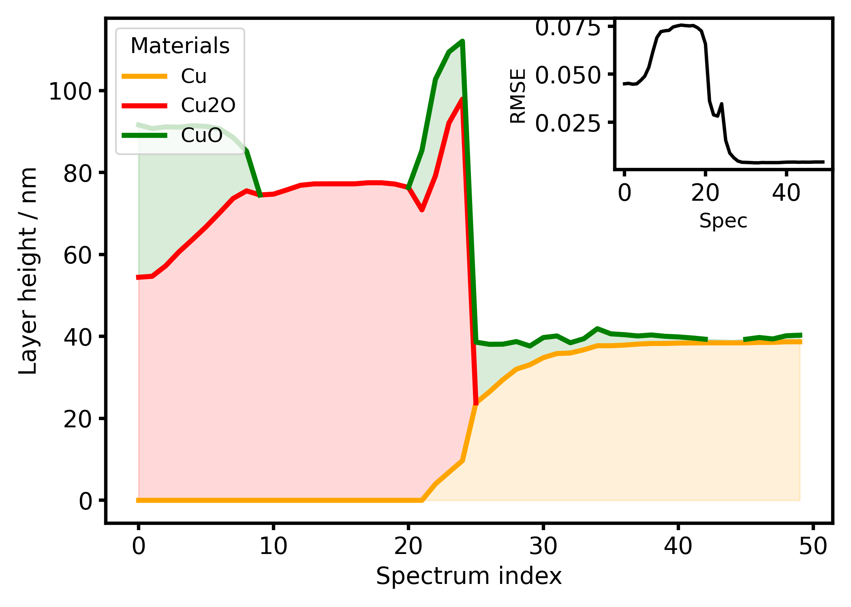
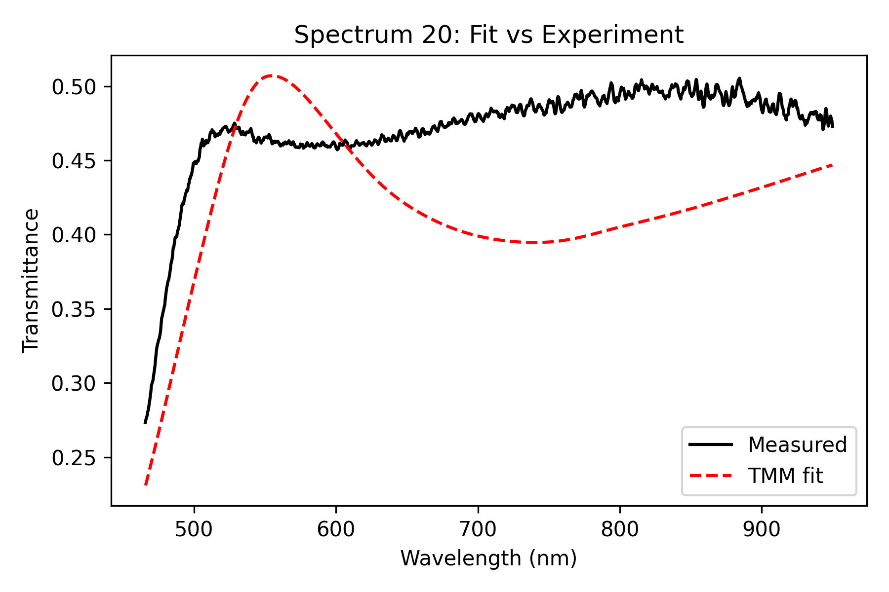
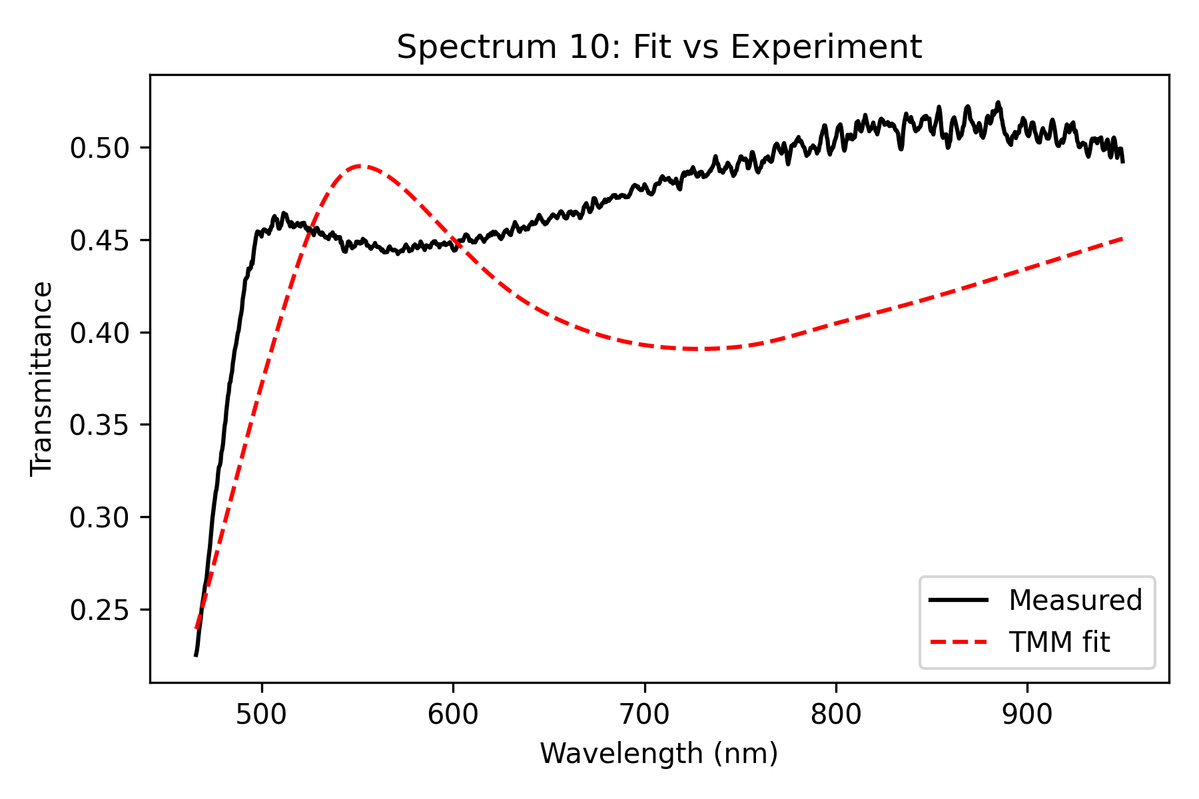
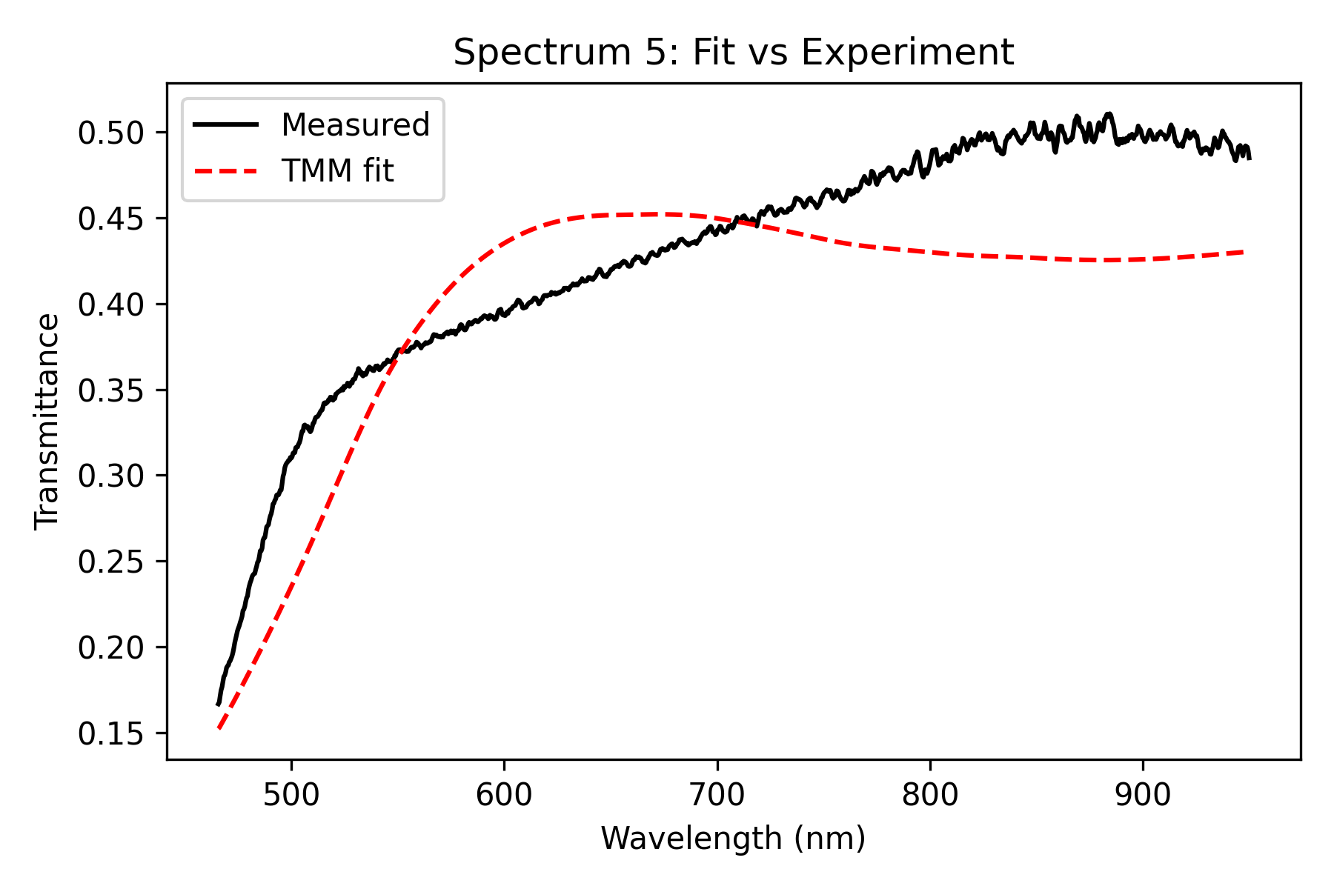
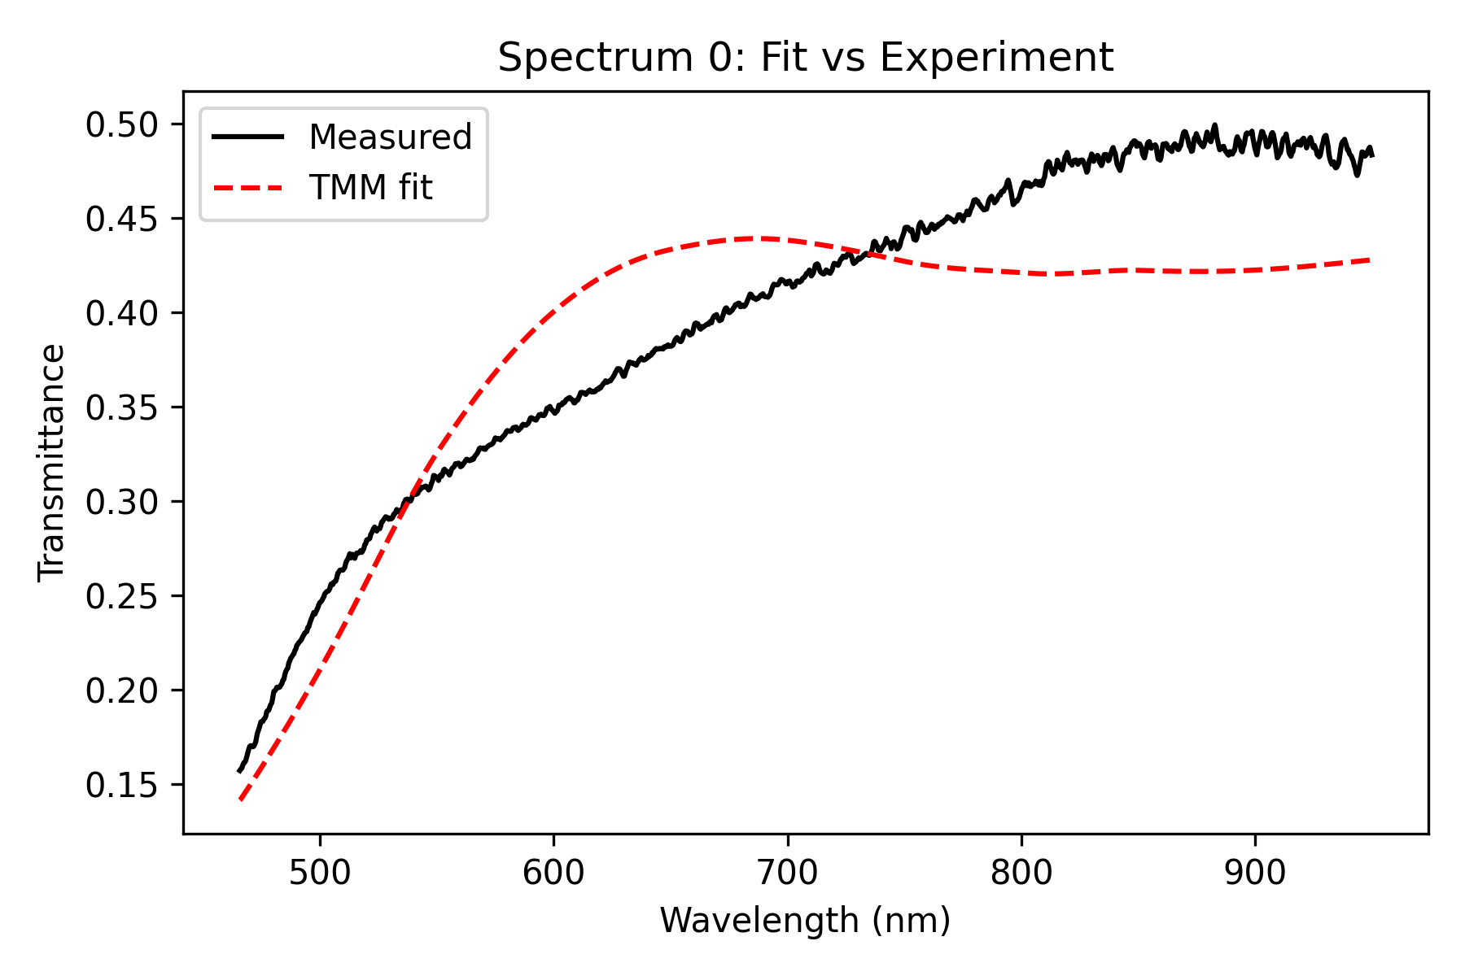
Influence of scaling Parameter on Fit (Lens 2W, 40s)
0.7x scaling:

Slide 14
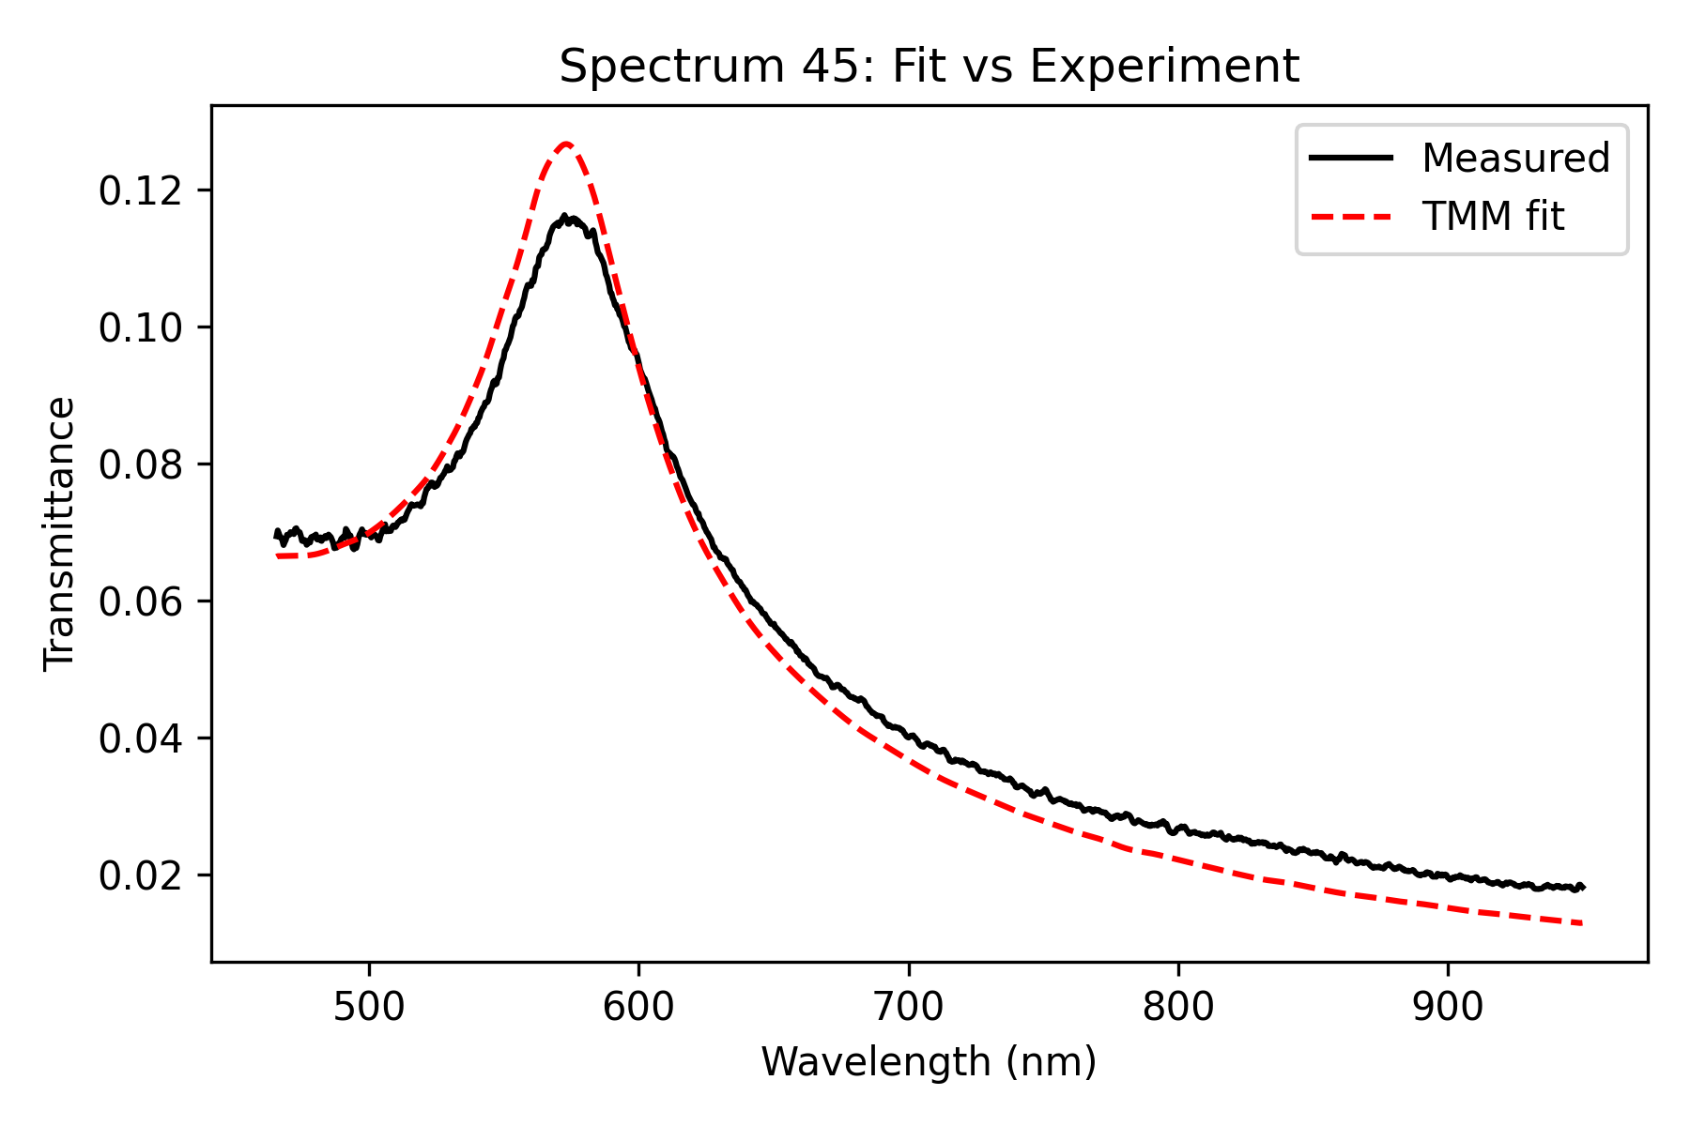

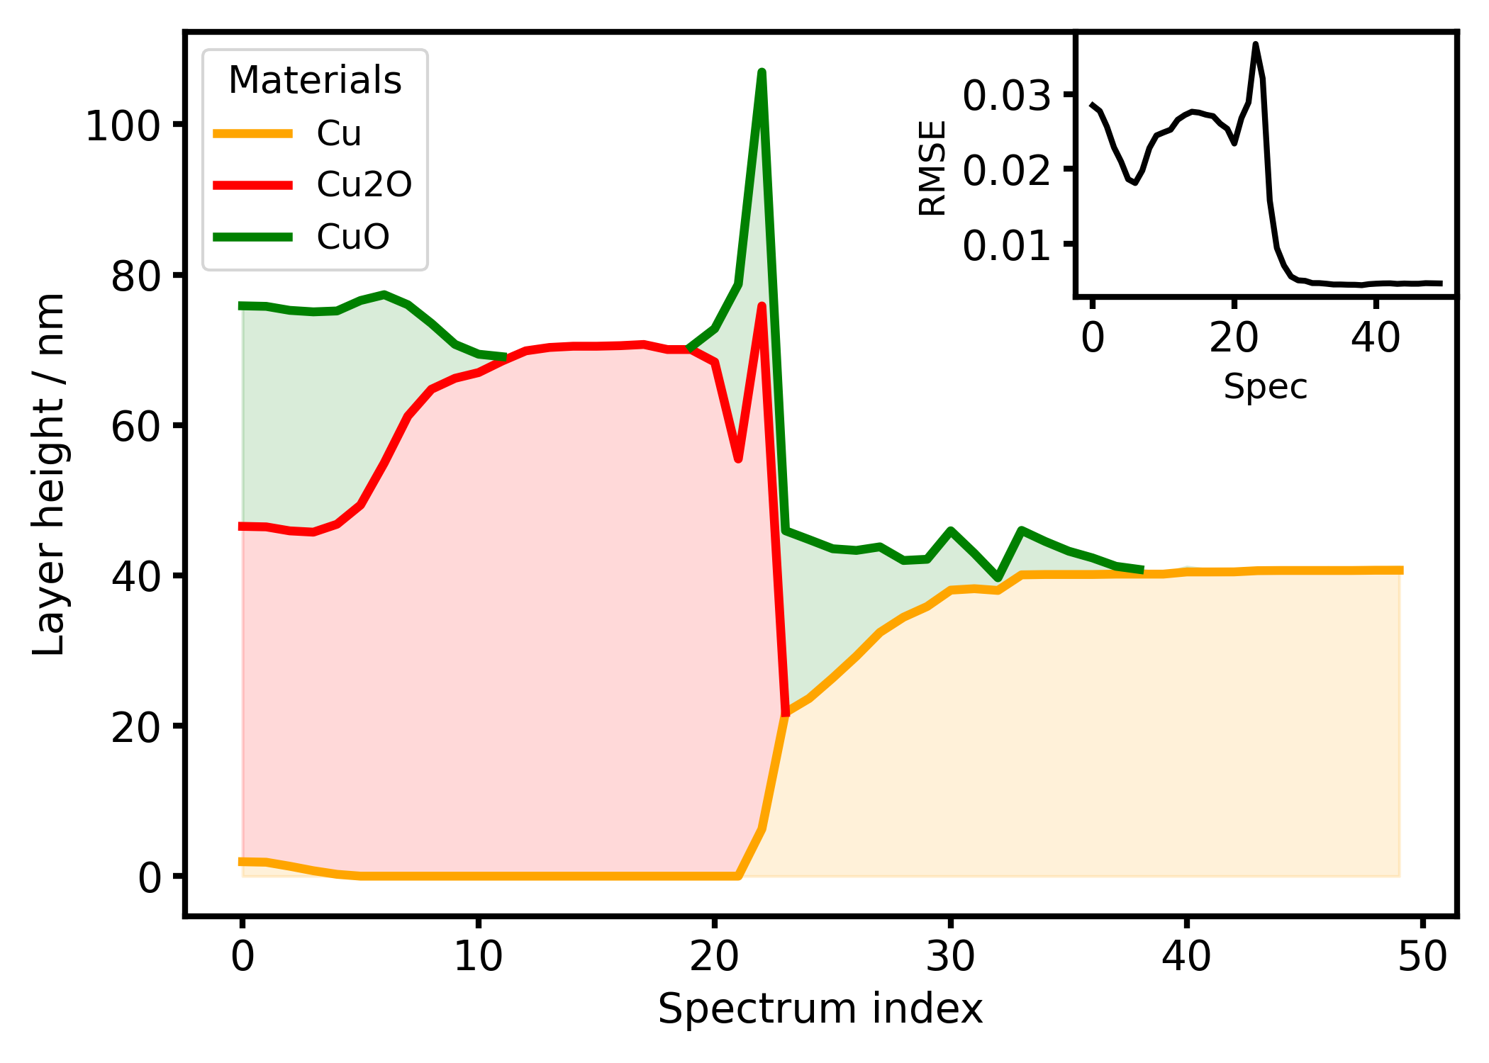
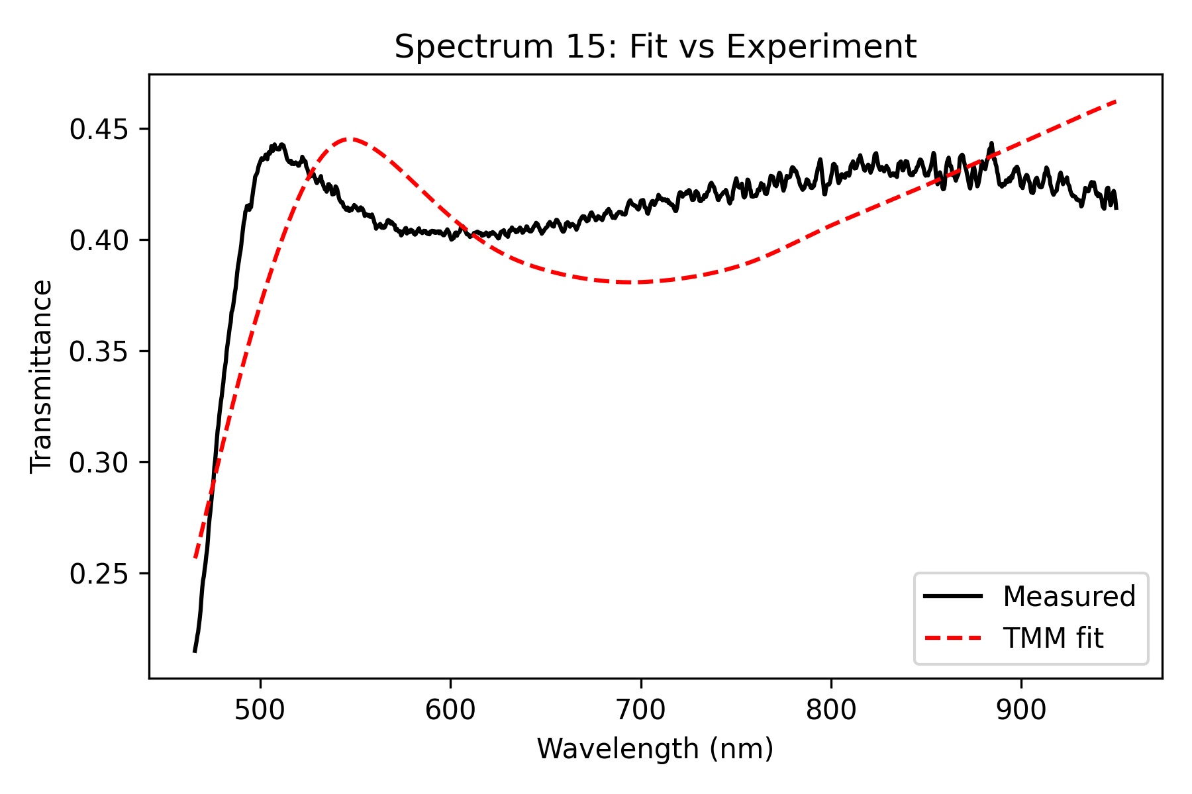
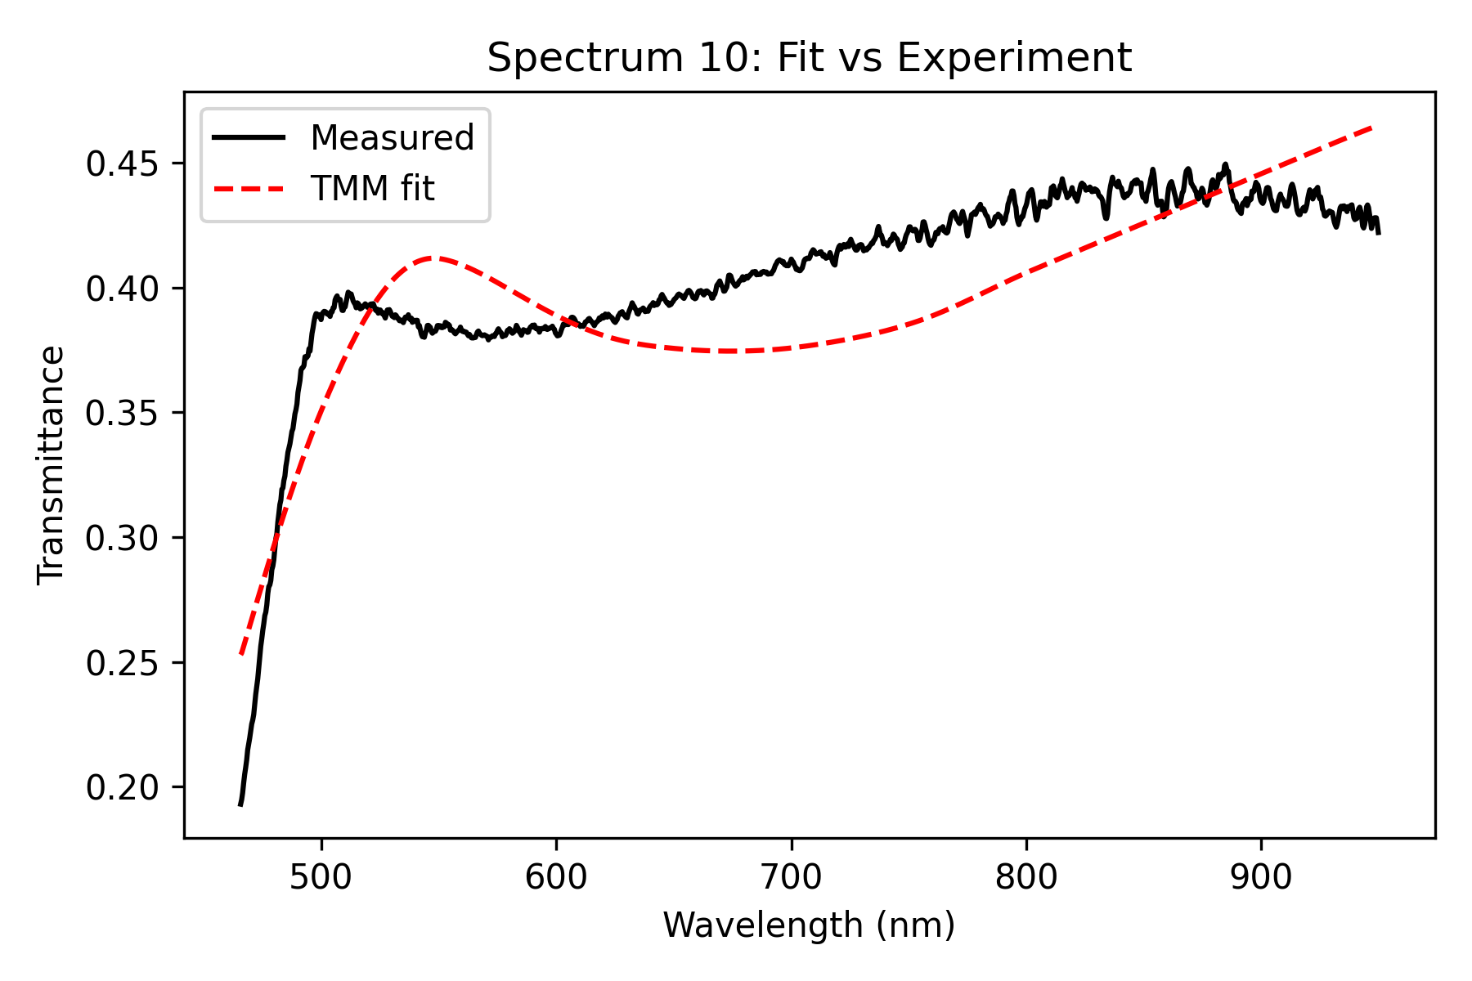
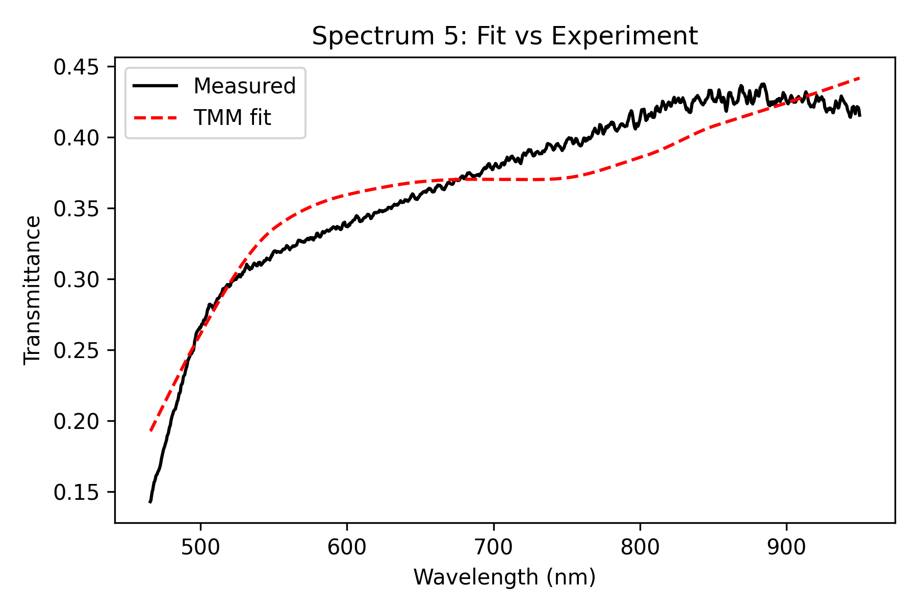
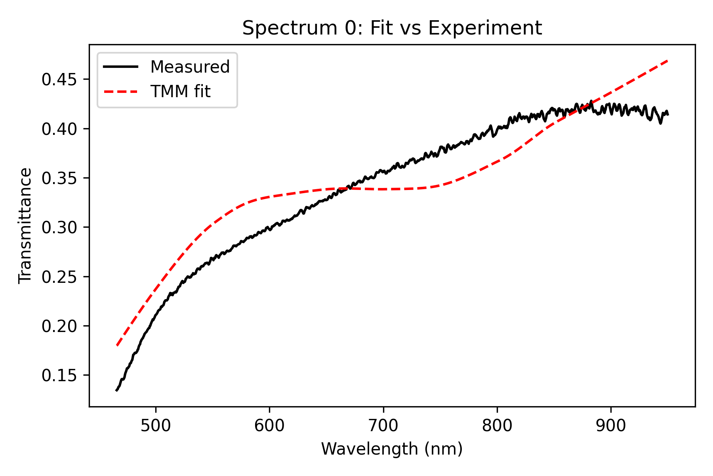
Influence of scaling Parameter on Fit (Lens 2W, 40s)
0.6x scaling:

Slide 15

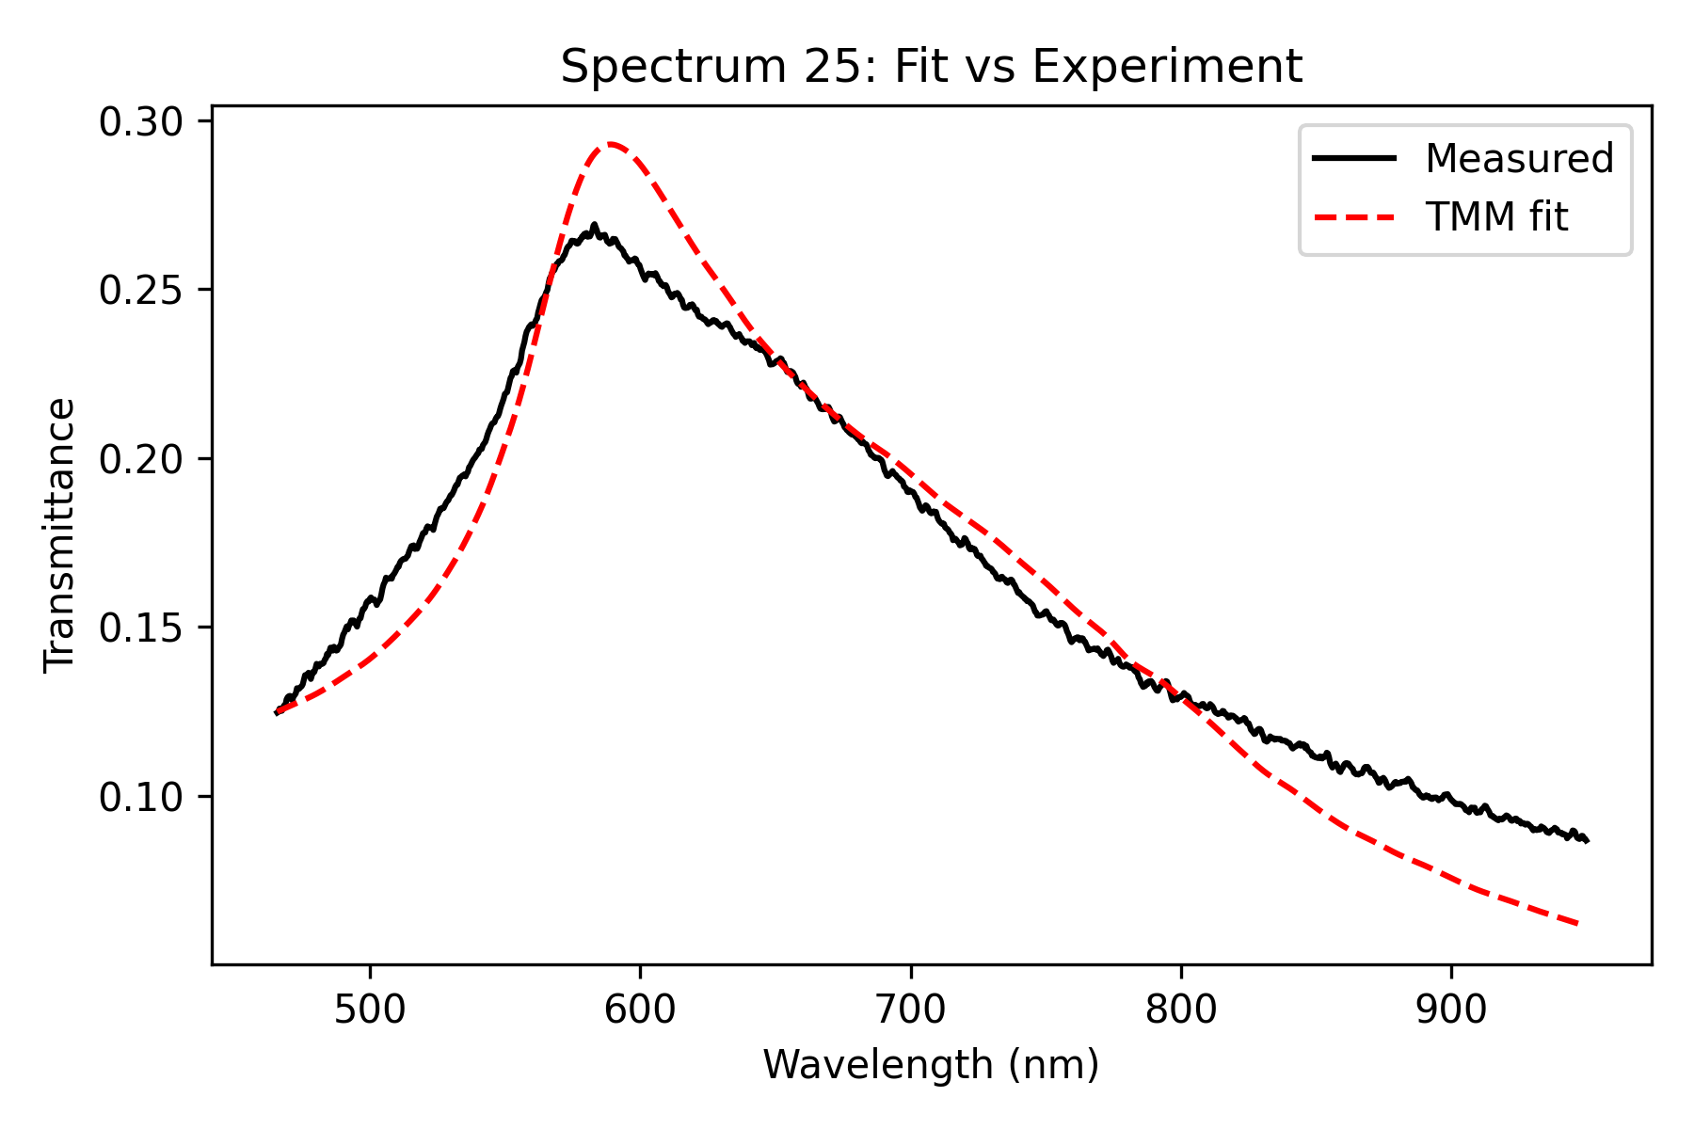
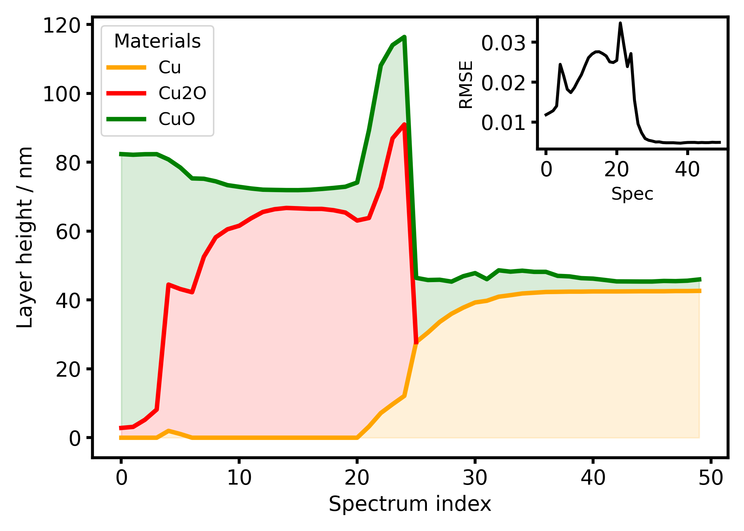
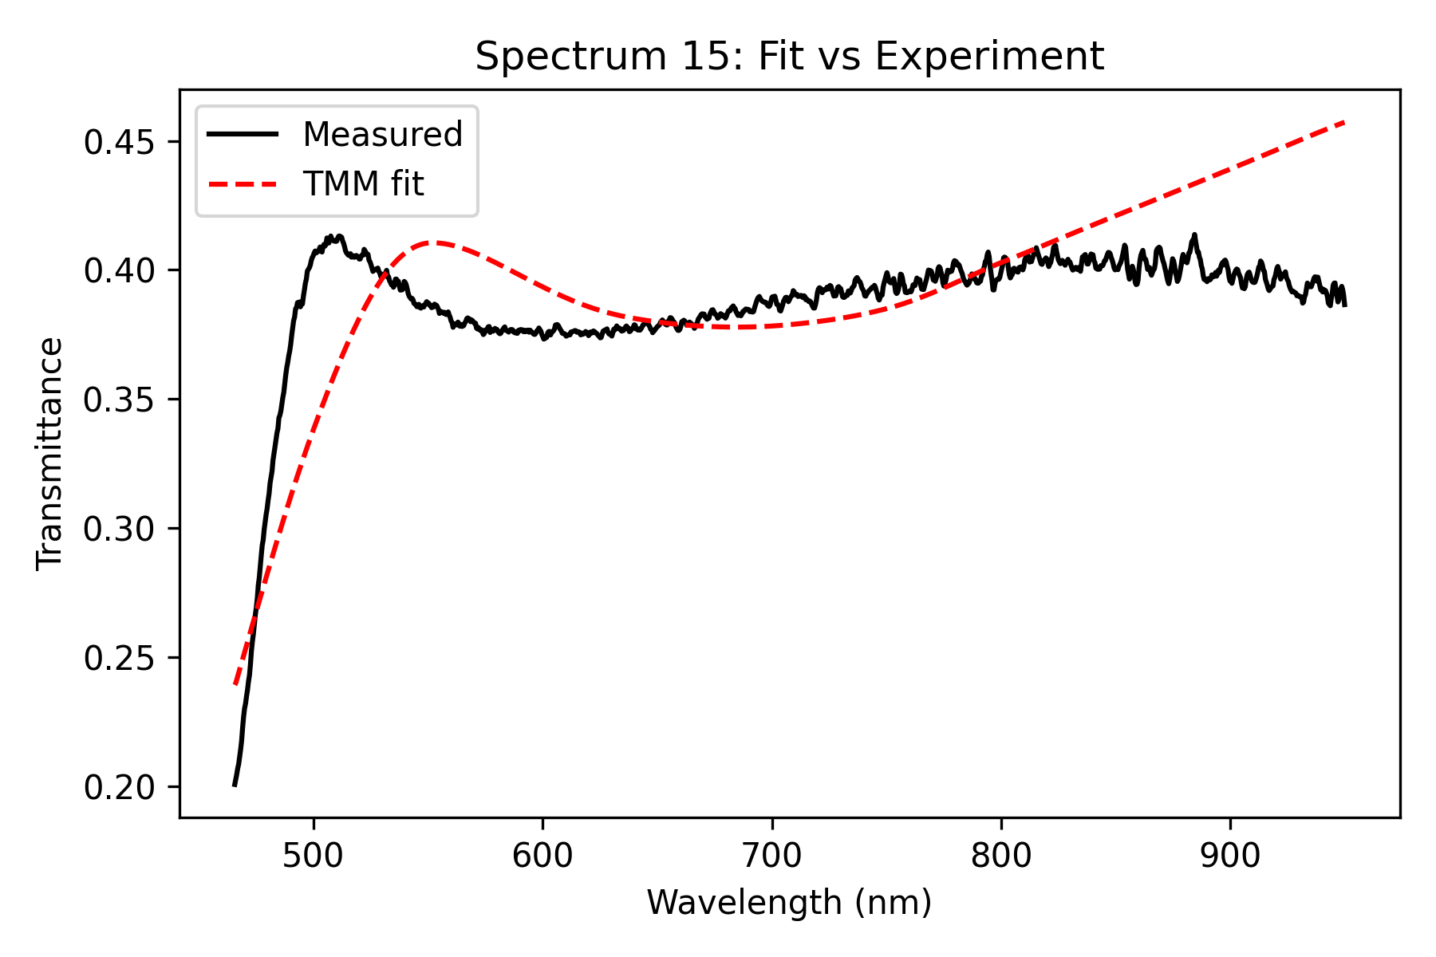
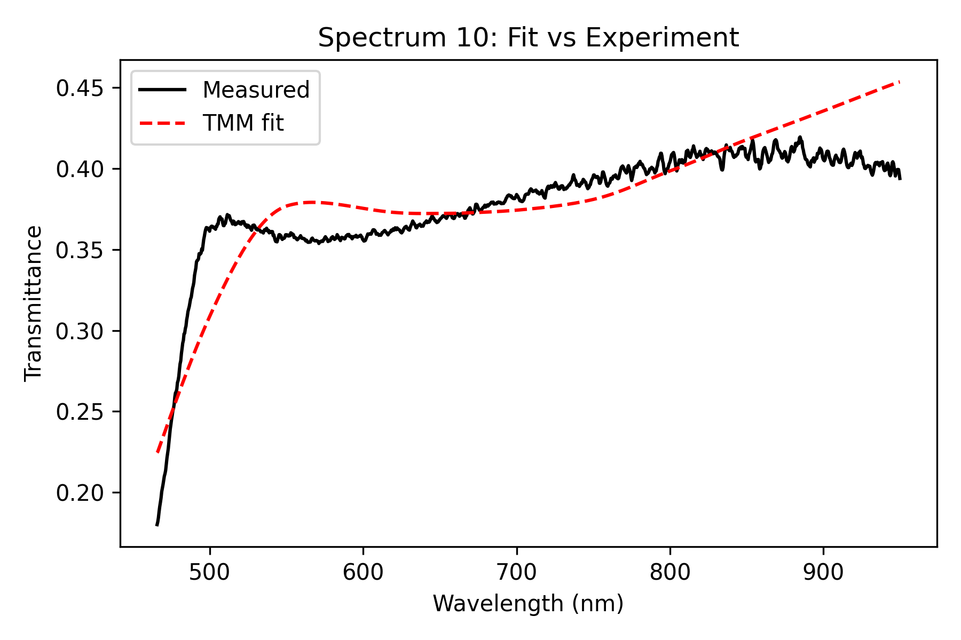
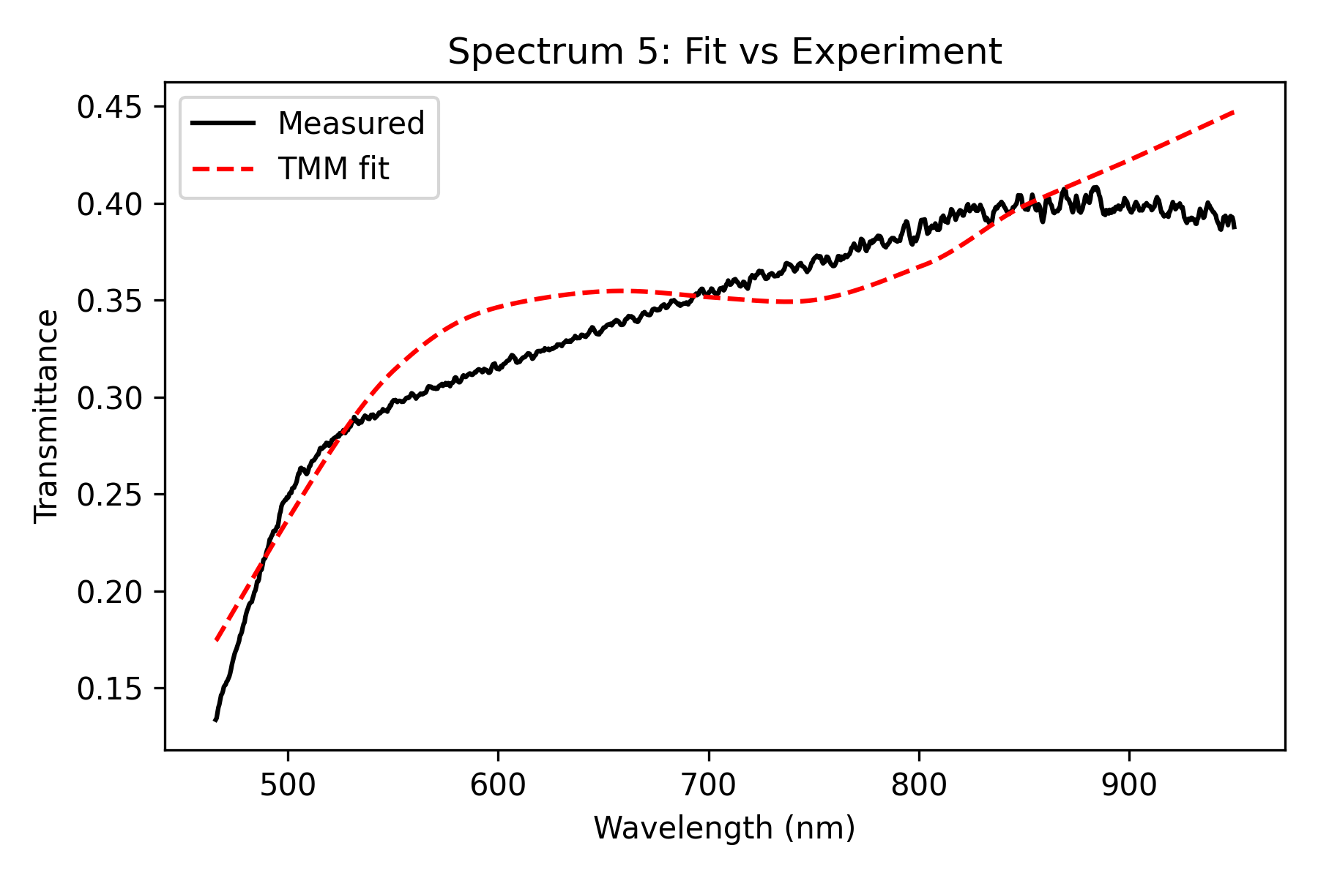
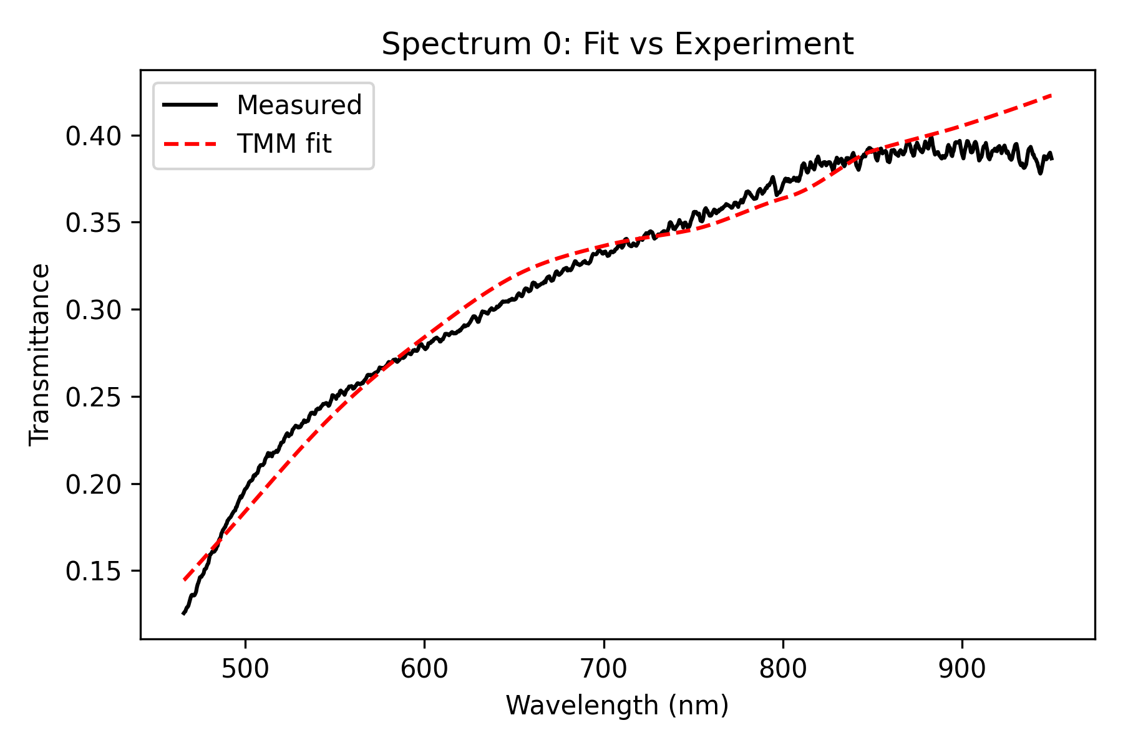
Influence of scaling Parameter on Fit (Lens 2W, 40s)
0.56x scaling:

Slide 16
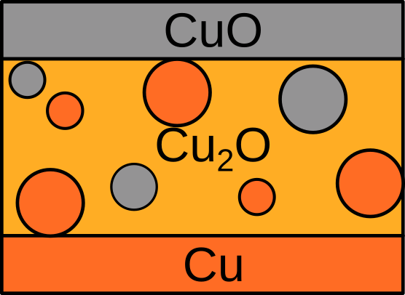
Optimizing the Fitting
Brüggemann Mixing, Smart Mutation Scaling, Clamping Layer Height Bounds

Slide 17
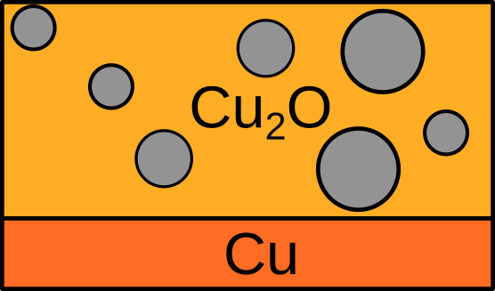
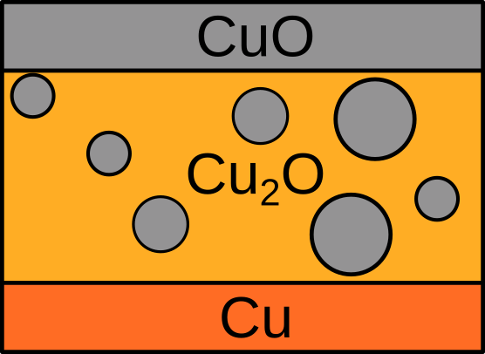
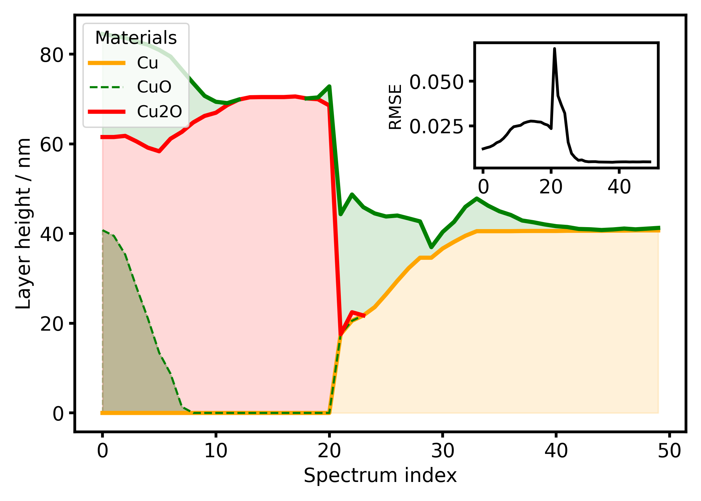
Results of different Fitting Schemes: (Lens 2W, 40s)
No improvements over no-mixing scheme!

Slide 18
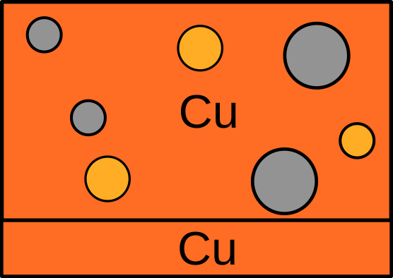
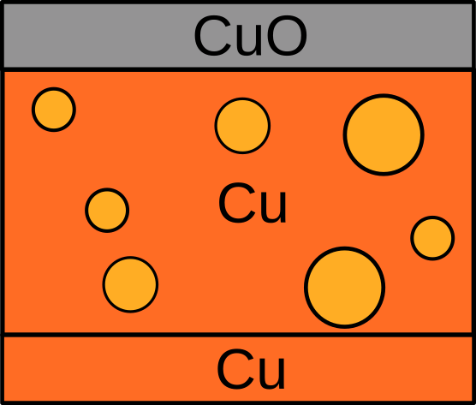
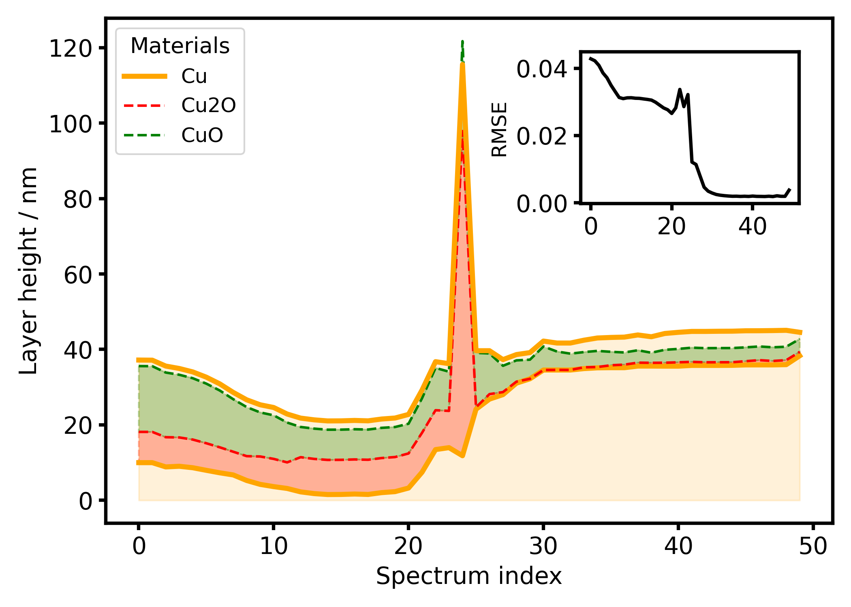
Results of different Fitting Schemes: (Lens 2W, 40s)
Spike from local minimum
Better RMSE, but different
height profile!

Slide 19
Best Results for other lenses

Slide 20

Lens 3W, 120s Fitting Results

Slide 21
Lens 2W, 60s Fitting Results

Slide 22
Lens: 50 mBar O2; 2W; 60s
Hier Bild von Linse einfügen
Platzhalter-Logo
Für mehr als drei Logos (oder wenn der Platz unten rechts nicht ausreicht)
Platzhalter-Logo
Platzhalter-Logo
Platzhalter-Logo

Slide 23
Fitting: Cu – Cu2O – CuO

Slide 24


Fitting: Cu – Cu2O – CuO

Slide 25

Fitting: Cu – Cu2O + CuO (sphere)
- No difference to individual layer model!

Slide 26




Cu – Cu2O + CuO (sphere)

Slide 27

Cu – Cu2O + CuO (sphere) – CuO

Slide 28






Cu – Cu2O + CuO (sphere) – CuO

Slide 29
Cu – Cu2O + Vacuum (sphere) – CuO + Vacuum (sphere)

Slide 30




Cu – Cu2O + Vacuum (sphere) – CuO + Vacuum (sphere)

Slide 31
Cu – Cu + Cu2O (sphere) + Vacuum (sphere) – CuO

Slide 32



Cu – Cu + Cu2O (sphere) + Vacuum (sphere) – CuO

Slide 33
Cu + Cu2O (sphere) + CuO (sphere)

Slide 34





Cu – Cu2O + Vacuum (sphere) + CuO (sphere)

Slide 35
Cu - Cu + Cu2O (sphere) - CuO

Slide 36
Cu - Cu + Cu2O (sphere) - CuO

Slide 37
Cu - Cu + Cu2O (chains) - CuO

Slide 38
Cu - Cu + Cu2O (chains) - CuO

