Slide 1
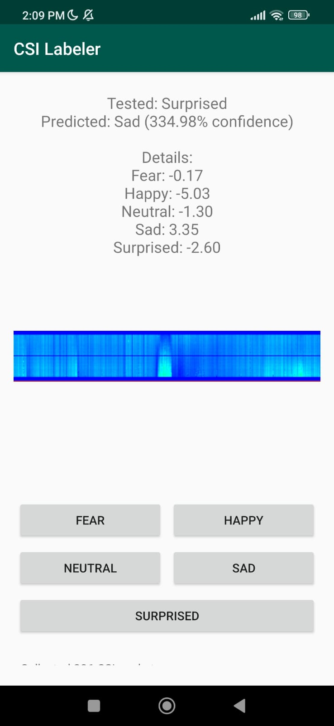
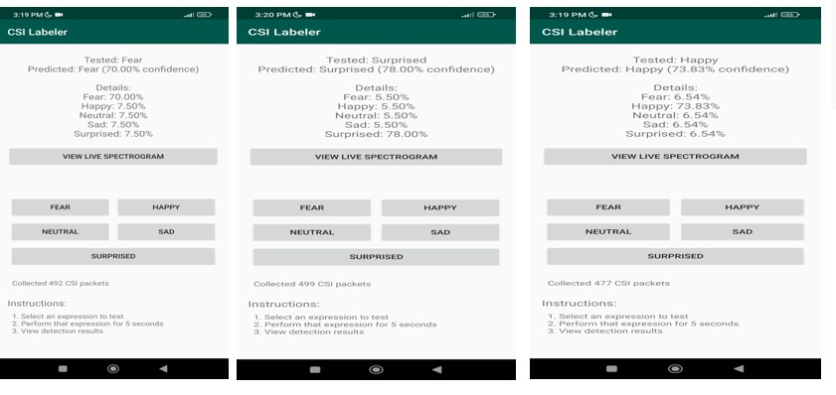
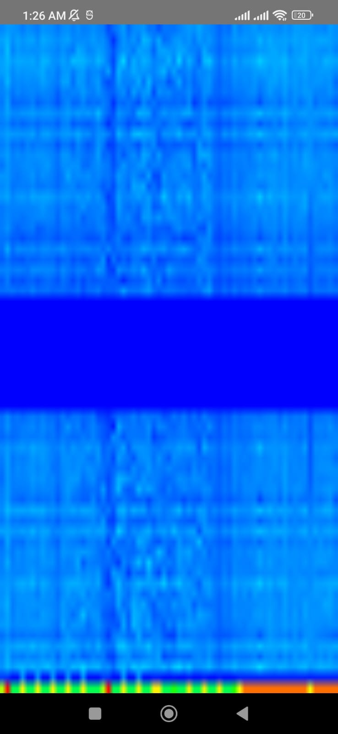
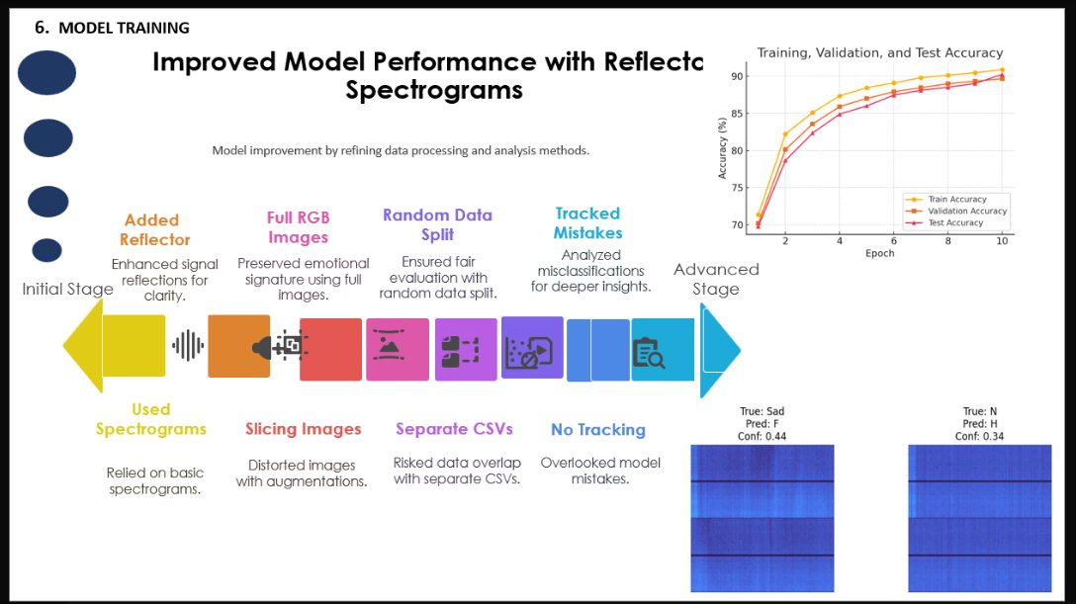
EmotiFi
WI-FI SENSING
EDGE AI
REAL-TIME
PRIVACY-SAFE
Sabir Jan | COMSATS
Privacy-Preserving Contactless Emotion Recognition
REAL-TIME ANDROID APP
THE PIPELINE
RESULTS
CSI → Amplitude → Filter → Window → Normalize → Spectrogram → CNN → Inference
Capture → Extract → Denoise → Segment → Scale → Encode → Classify → Predict
90%+
Test Accuracy Achieved
SYSTEM ARCHITECTURE
Model: EfficientNetV2B0 + PyTorch Lite
Technique: Reflector spectrograms | Dataset: 1,540 samples
ESP32
Transmitter
ESP32
Receiver
Android
USB Serial
Preprocess
Filter + Norm
PROBLEM & SOLUTION
Spectrogram
FFT-based
CNN Model
EfficientNetV2B0
Emotion Output
Happy · Sad · Fear · Neutral · Surprised
THE PROBLEM
Cameras → Privacy violations, intrusive
Wearables → Uncomfortable, impractical
Lab Sensors → Expensive, not scalable
THE SOLUTION
Wi-Fi CSI via ESP32 — no camera, no wearable
Detects subtle body disturbances from emotions
5 emotions: Happy, Sad, Fear, Neutral, Surprised
Real-Time · Contactless · Privacy-Safe · Edge AI · No Cloud
MODEL TRAINING JOURNEY
IMPACT
LIVE SPECTROGRAM
EXP 1
ResNet18
49%
EXP 2
EffNetV2
34%
EXP 3
Abs Diff
44%
FINAL
90%+
🏥 Healthcare — Mental wellness monitoring
🏠 Smart Homes — Emotion-aware environments
💻 HCI — Adaptive gaming interfaces
🔒 Security — Zero-privacy-footprint sensing
Breakthrough: Reflector spectrograms + Full RGB images + Person-wise data splitting eliminated data leakage and boosted signal clarity
On-Device Inference
PyTorch Mobile Lite + ONNX Runtime
USB serial CSI streaming from ESP32
Live spectrogram + emotion prediction
Tested: Fear 70% | Surprised 78% | Happy 74%
KEY ACHIEVEMENTS
✓ Real-time CSI streaming ✓ Android spectrogram rendering ✓ PyTorch Lite mobile deployment
✓ Custom dataset (1,540 samples) ✓ USB serial integration ✓ 90%+ test accuracy
Wi-Fi CSI → Amplitude Extraction → Filtering → Spectrogram → CNN → Emotion → Mobile Inference
Sabir Jan | BS Computer Engineering | COMSATS University Islamabad | github.com/Saber7Jan/EmotiFi
Final Year Project | Contactless Emotion Recognition using Wi-Fi CSI and Deep Learning

