Slide 1
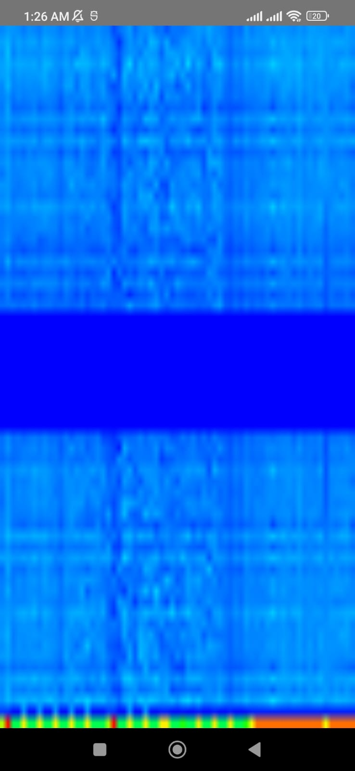
EmotiFi
Privacy-Preserving Contactless
Emotion Recognition
using Wi-Fi CSI & Deep Learning
Edge AI
Wi-Fi Sensing
On-Device Inference
Privacy-Safe
Sabir Jan
BS Computer Engineering — COMSATS University Islamabad
Final Year Project
Live CSI Spectrogram

Slide 2
Problem Statement
📷 Cameras
We Need A System That Is...
Privacy violations, poor low-light performance, intrusive surveillance
✅ Contactless
⌚ Wearables
✅ Privacy-Preserving
Uncomfortable, require consent, impractical for passive monitoring
✅ Real-Time
✅ Low-Cost
🧪 Lab Sensors
Expensive, require specialist setup, not scalable
✅ Camera-Free
"Works in darkness. Through walls. Without a camera."

Slide 3
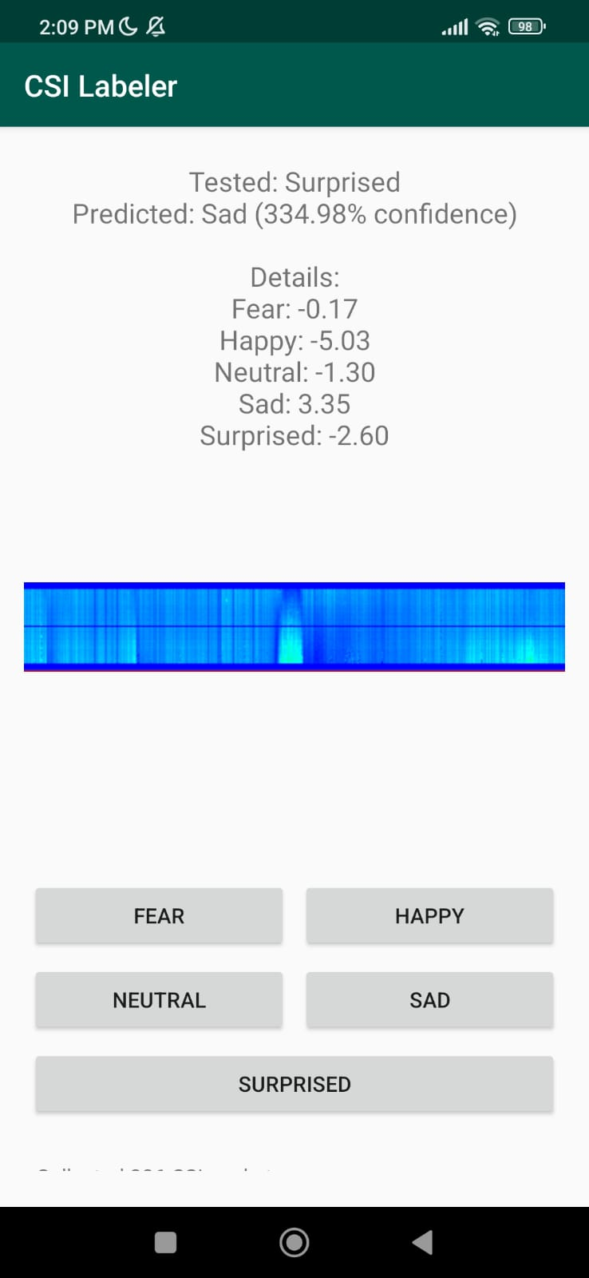
Proposed Solution
EmotiFi uses Wi-Fi Channel State Information (CSI) captured via ESP32 to detect subtle body disturbances caused by human emotions — no camera, no wearable.
1
Capture CSI signals via ESP32
2
Convert to spectrograms
3
Apply CNN inference (ResNet18 / EfficientNetV2B0)
4
Predict emotion in real-time on Android
😄 Happy
😢 Sad
😨 Fear
😐 Neutral
😲 Surprised
Real-time prediction on Android

Slide 4
Methodology / Approach
📡 Data Acquisition
⚙️ Signal Processing
▸ ESP32 TX sends Wi-Fi packets
▸ ESP32 RX captures CSI values
▸ USB Serial to Android
▸ Amplitude extraction
▸ Noise filtering
▸ Log normalization
▸ Spectrogram generation
🧠 AI Pipeline
📱 Output
▸ Spectrograms → CNN
▸ ResNet18 / EfficientNetV2B0
▸ PyTorch Mobile Lite
▸ Real-time prediction
▸ Live spectrogram view
▸ CSV dataset logging
Wi-Fi CSI → Amplitude Extraction → Filtering → Spectrogram → CNN → Emotion

Slide 5
Current Development Stage
✓
ESP32 TX/RX communication established
✓
CSV dataset generation pipeline ready
✓
Real-time CSI capture working
✓
PyTorch Lite model integrated
✓
Android USB Serial integration completed
✓
Real-time mobile inference pipeline under testing
✓
Live spectrogram rendering implemented
✓
Live dashboard / web communication prototype available

Slide 6
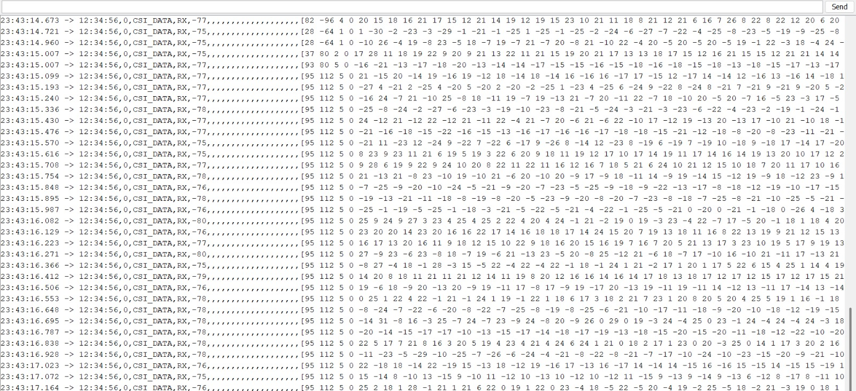
System Architecture
ESP32
Transmitter
ESP32
Receiver
Android
App
Signal
Preprocessing
Spectrogram
Generator
CNN Model
(ResNet18)
Emotion
Prediction
Wi-Fi TX
CSI Capture
USB Serial
Filtering
FFT-based
PyTorch Lite
Real-time
Real-time
Contactless
Privacy-safe
Edge AI
No Cloud
Live CSI data stream from ESP32 receiver

Slide 7
Tools & Technologies
🔧 Hardware
💻 Software
🧠 AI / ML
📊 Signal Processing
▸ ESP32 (TX & RX)
▸ Android Studio
▸ ResNet18
▸ FFT Spectrograms
▸ USB OTG Cable
▸ Java
▸ EfficientNetV2B0
▸ CSI Amplitude
▸ Android Phone
▸ Python
▸ PyTorch Mobile Lite
▸ Log Normalization
▸ 802.11n Wi-Fi
▸ Node.js
▸ ONNX Runtime
▸ Custom CSI Dataset
▸ React

Slide 8
Dataset & CSI Parameters
CSI Configuration
Collected Dataset Summary
Wi-Fi Channel
6
Class
Per Person
No Reflect.
With Reflect.
Channel Bandwidth
20 MHz
Neutral
2
60
188
CSI Sampling Rate
100 pps
Happy
2
60
188
Number of Subcarriers
64
Sad
2
60
188
Center Frequency
2.4 GHz
Fear
2
60
188
Sampling Time Window
5 sec
Surprise
2
60
188
Sampling Frequency
100 Hz
Total
10
600
940
Transmitter Power
20 dBm
Without Reflectors
With Reflectors
Emotion Classes
5
600 total samples
Baseline setup
940 total samples
Enhanced signal clarity
Two-approach dataset: reflectors boosted signal quality and increased class-separability in spectrograms.

Slide 9
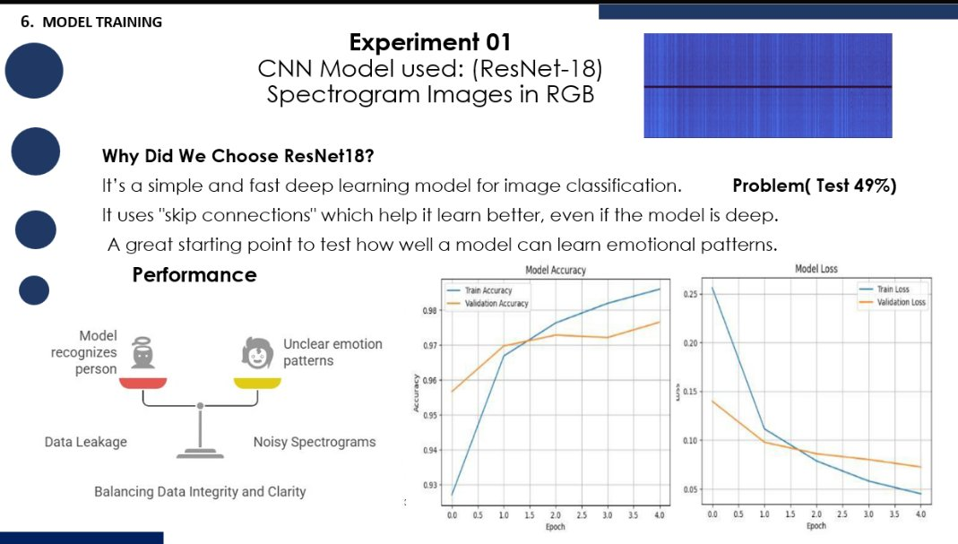
Model Training
Experiment 1 — ResNet18 on RGB Spectrograms
Why ResNet18?
▸ Fast, efficient deep learning model for image classification
▸ Skip connections help learn better even in deep networks
▸ Good starting point for learning emotional signal patterns
▸ Lightweight enough for PyTorch Mobile deployment
⚠ Problem: Test Accuracy Only 49%
Model overfit on training data — poor generalization to new subjects.
Root Causes Identified
▸ Data leakage — subject identity leaked across train/test splits
▸ Noisy spectrograms with overlapping emotional signals
▸ Unclear emotion patterns in raw CSI data
Training accuracy ~98% vs Test 49% — classic overfitting

Slide 10
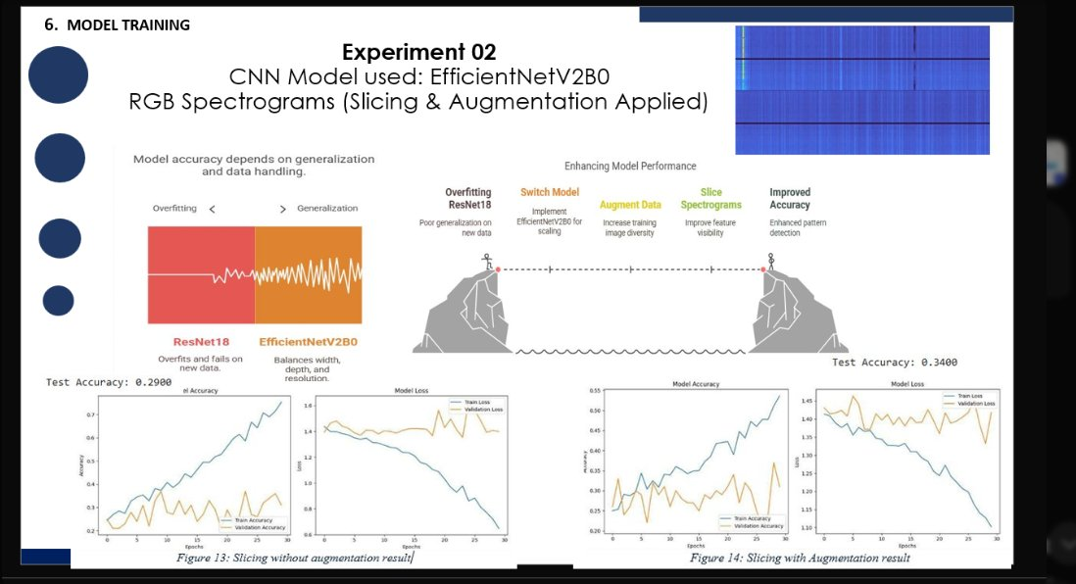
Model Training
Experiment 2 — EfficientNetV2B0 + Slicing & Augmentation
Why Switch to EfficientNetV2B0?
ResNet18 overfit and failed on new data. EfficientNetV2B0 balances width, depth, and resolution — better generalization with same compute budget.
Improvements Applied
▸ Spectrogram slicing — improve feature visibility
▸ Data augmentation — increase training diversity
▸ Without augmentation: Test Acc = 29%
▸ With augmentation: Test Acc = 34%
Still insufficient — gap between train & test accuracy remains large.
Left: slicing only (29%). Right: slicing + augmentation (34%)

Slide 11
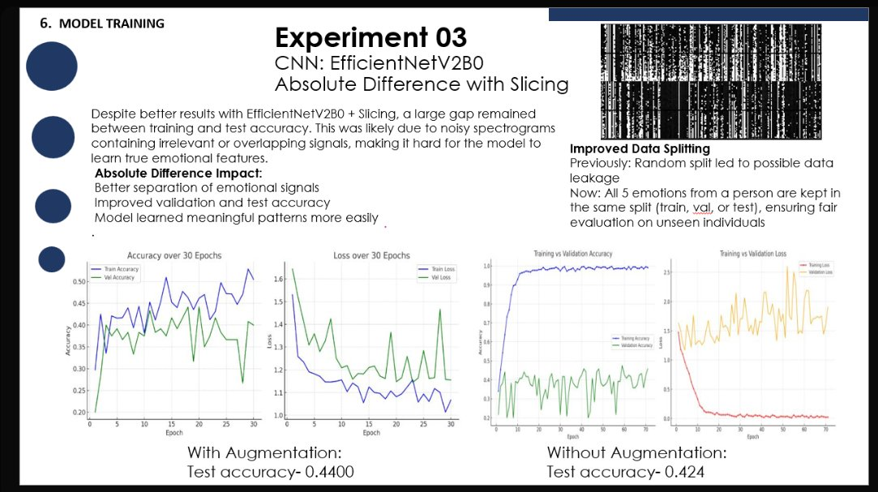
Model Training
Experiment 3 — Absolute Difference Spectrograms + Fair Data Splitting
What Changed in Exp. 3?
▸ Absolute Difference spectrograms — isolate emotional signal changes more clearly
▸ Improved data split — all 5 emotions per person kept in same split to prevent data leakage
▸ Result: better separation of emotional signals, model learns meaningful patterns
With Augmentation
Without Augmentation
Test Acc: 44.0%
Test Acc: 42.4%
Key Fix: Data Leakage Prevention
Before: Random split → same person's samples in both train & test
Now: All 5 emotions per person stay in ONE split — fair evaluation on truly unseen subjects
Exp 3 training curves — improved generalization with absolute difference input

Slide 12
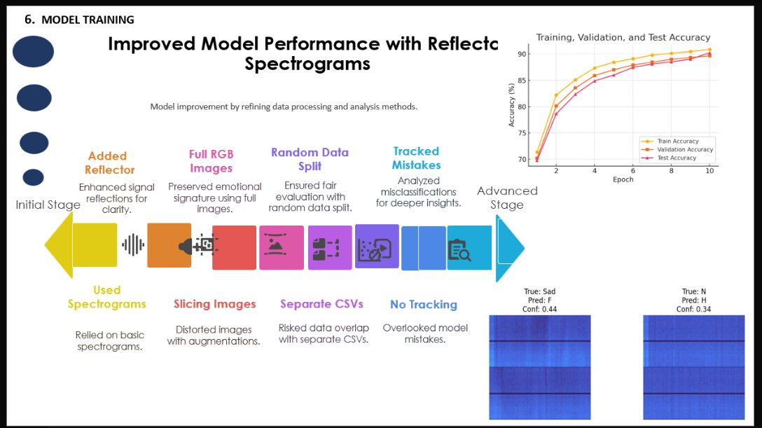
Model Training
Breakthrough — Reflector Spectrograms Push Accuracy to 90%+
❌
📡
🎨
🏆 Best Result
🔀
🔍
→
→
→
Test Accuracy: 90%+
Used Spectrograms
Added Reflectors
Full RGB Images
Random Data Split
→
Tracked Mistakes
Basic approach
Better signal clarity
Preserved emotion signatures
Reflectors + Full RGB + Person-wise splits
Fair evaluation
Deeper insights
Misclassification analysis → further insights
What Changed
Before
After
Problem Fixed
Sliced Images
Full RGB Images
Distorted augmentations
Separate CSVs
Unified Dataset
Risked data overlap
No Error Tracking
Tracked Mistakes
Overlooked model errors
Random Splits
Person-wise Splits
Caused data leakage
Train/Val/Test accuracy reaching 90%+ with reflector spectrograms

Slide 13
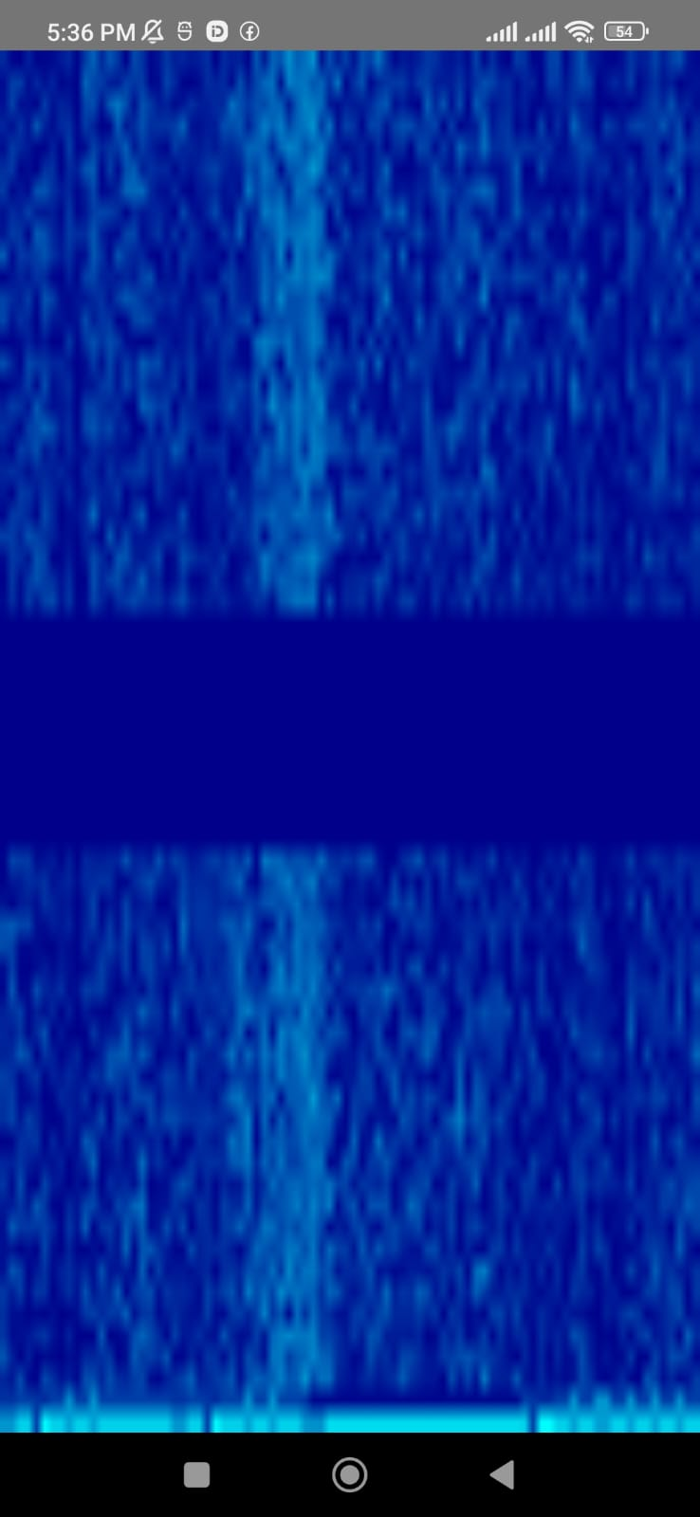
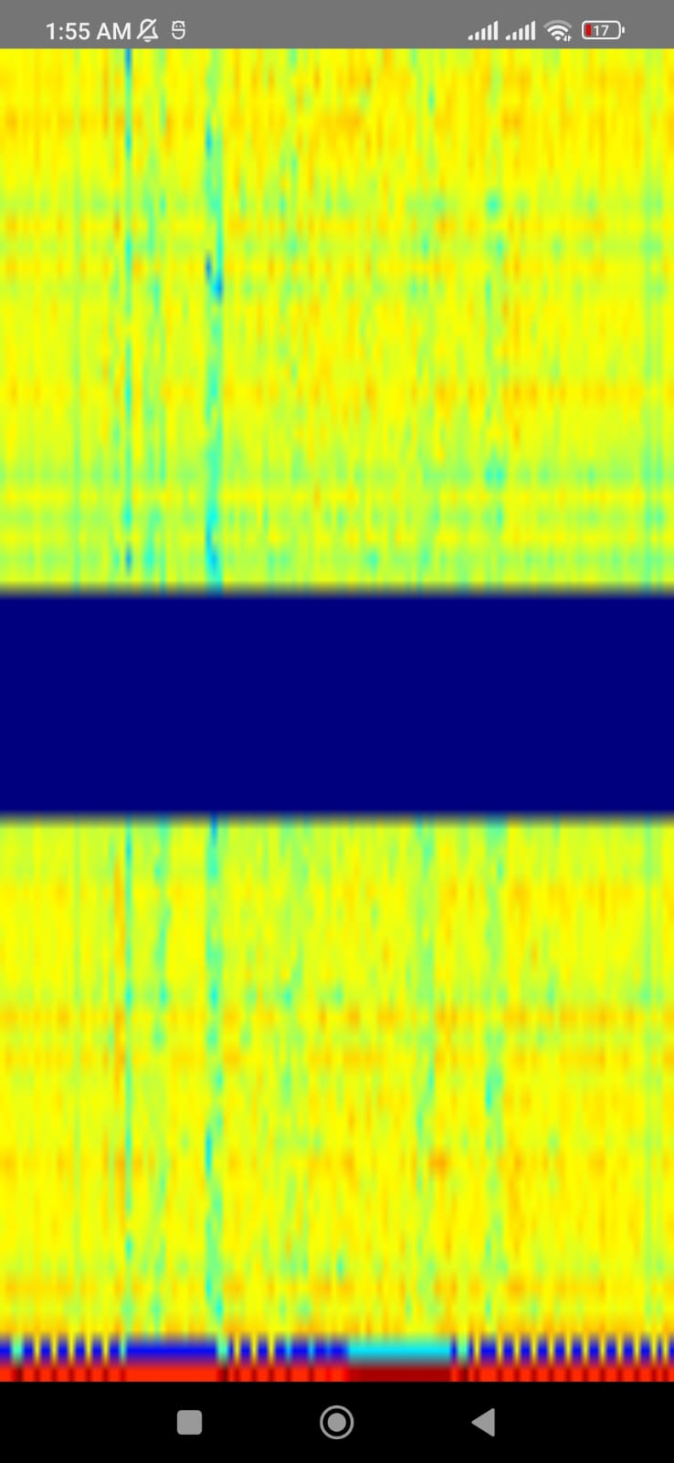
Live Spectrogram Visualization
Initial CSI Spectrogram
(Blue palette — quiet state)
Current Spectrogram
(Active CSI with warm signal)
Debug View
(High-energy signal detected)

Slide 14
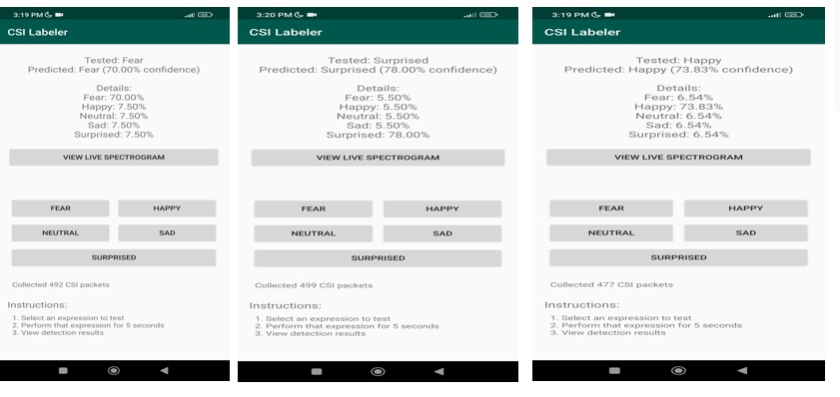
Real-Time Emotion Inference
Three test runs: Fear 70% | Surprised 78% | Happy 73.83%
⚠️ Note: '334.98% confidence' is a known softmax display bug — raw logits are being used directly. Fix in progress (apply softmax before percentage display).
Detailed output with raw logits

Slide 15
Expected Impact & Use Cases
🏥
🏠
👴
Healthcare
Smart Homes
Elderly Care
Mental wellness monitoring, stress & anxiety detection in clinical settings
Emotion-aware environments that adapt lighting, music, and ambiance
Non-intrusive continuous monitoring without cameras or wearables
💻
🔒
🌐
HCI
Security
IoT
Emotion-adaptive interfaces for gaming, education, and productivity apps
Works in darkness, through obstacles, with zero privacy footprint
Embedded into existing Wi-Fi infrastructure — no new hardware needed

Slide 16
EmotiFi
Privacy-Preserving · Contactless · Real-Time · On-Device
Wi-Fi Sensing
Edge AI
Real-Time
Custom Dataset
Embedded AI
No cameras needed
On-device inference
Low latency pipeline
Original CSI data
PyTorch Mobile Lite
The Full Pipeline
Wi-Fi CSI → Amplitude Extraction → Filtering & Normalization → Spectrogram Encoding → CNN Feature Learning → Emotion Classification → Mobile Real-Time Inference
Sabir Jan | BS Computer Engineering | COMSATS University Islamabad | Final Year Project
github.com/Saber7Jan/EmotiFi

