Slide 1
Generalized linear models of neural activity
Bi23: Methods in Neural Data Analysis
2/1/2019

Slide 2
Neural encoding
Stimulus feature
Recorded spikes
time →
time →
Brightness of a screen
Concentration of an odor
Proximity of a predator
Movement of a limb

Slide 3
Neural encoding
Stimulus feature (x)
Recorded spikes (y)
Encoding model
P ( y | x )
time →
time →
Given that the animal saw stimulus “x”, what pattern of spiking “y” do we expect to observe in its brain?

Slide 4
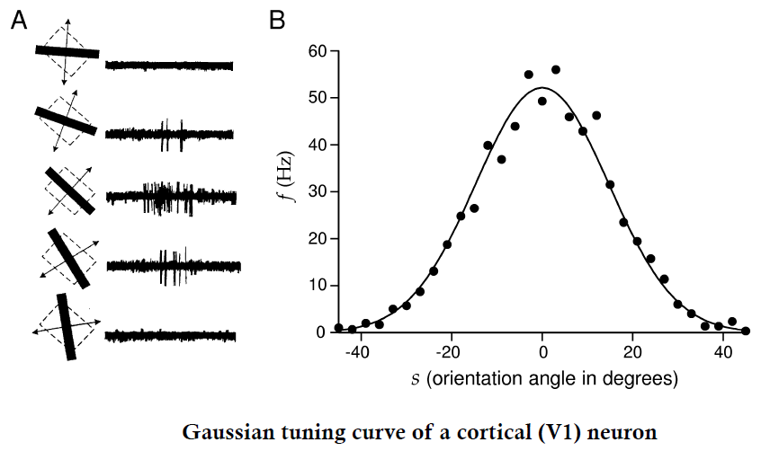
Tuning curves as one example of an encoding model

Slide 5





Tuning curves as one example of an encoding model
$$\hat{x}=35$$
$$x_{obs}=38$$
P( firing rate | s = -12 )
$$x_{obs}=6$$
0
60
Firing rate (Hz)
$$x_{obs}=6$$
P( firing rate | s = -28 )
$$x_{obs}=38$$
0
60
Firing rate (Hz)

Slide 6


An example “Gaussian” neuron model
Underlying
spike rate
Predicted spike
distribution
$$μ=θx$$
$$y\sim N(μ,σ^{2})$$
stimulus
unknown
parameter

Slide 7




An example “Gaussian” neuron model
$$y\sim N(θx,σ^{2})$$
Predicted spike
distribution
$$y\sim N(μ,σ^{2})$$
(each point is one trial)
number
of spikes
observed
(y)
Underlying
Spike rate
$$μ=θx$$
stimulus
unknown
parameter
stimulus intensity ($x$)

Slide 8



An example “Gaussian” neuron model
$θ_{est}$ = 0.5
Predicted spike
distribution
$$y\sim N(μ,σ^{2})$$
number
of spikes
observed
(y)
$$y\sim N(θx,σ^{2})$$
Underlying
Spike rate
$$μ=θx$$
stimulus
unknown
parameter
stimulus intensity ($x$)

Slide 9


An example “Gaussian” neuron model
$θ_{est}$ = 1
Predicted spike
distribution
$$y\sim N(θx,σ^{2})$$
$$y\sim N(μ,σ^{2})$$
number
of spikes
observed
(y)
Underlying
Spike rate
$$μ=θx$$
stimulus
unknown
parameter
stimulus intensity ($x$)

Slide 10


An example “Gaussian” neuron model
$θ_{est}$ = 1.5
Predicted spike
distribution
$$y\sim N(θx,σ^{2})$$
$$y\sim N(μ,σ^{2})$$
number
of spikes
observed
(y)
Underlying
Spike rate
$$μ=θx$$
stimulus
unknown
parameter
stimulus intensity ($x$)

Slide 11


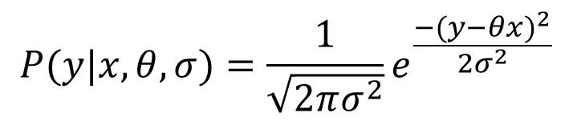
Fitting the Gaussian model
Predicted spike
distribution
$$P(y|x,θ,σ)=\frac{1}{\sqrt{2πσ^{2}}}e^{\frac{−{(y−θx)}^{2}}{2σ^{2}}}$$
$$y\sim N(μ,σ^{2})$$
Underlying
Spike rate
$$μ=θx$$
Now, find the “most likely” $θ$ given observed y and x!
stimulus
unknown
parameter

Slide 12
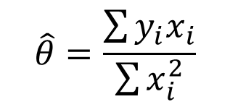
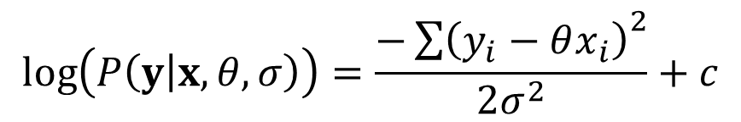

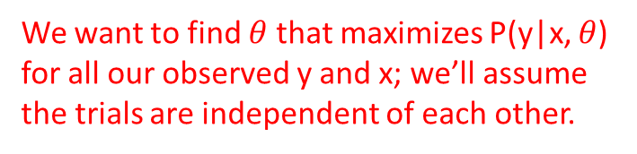
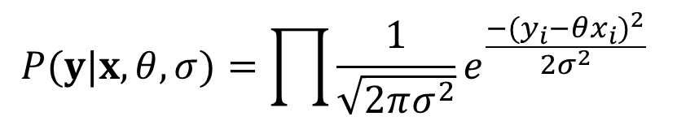

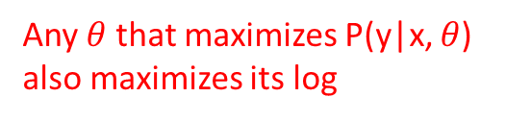
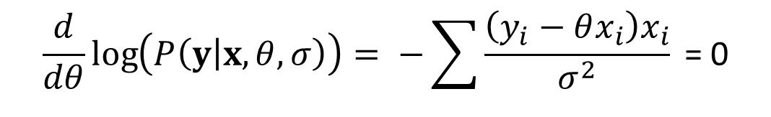
Maximum likelihood (ML) estimation of $θ$:
$$P(y|x,θ,σ)=\prod{\frac{1}{\sqrt{2πσ^{2}}}e^{\frac{−{(y_{i}−θx_{i})}^{2}}{2σ^{2}}} }$$
We want to find $θ$ that maximizes P(y|x, $θ$) for all our observed y and x; we’ll assume the trials are independent of each other.
$$\log\left(P\left(y | x,θ,σ\right)\right)=\frac{−{\sum{\left(y_{i}−θx_{i}\right)}}^{2}}{2σ^{2}}+c$$
Any $θ$ that maximizes P(y|x, $θ$) also maximizes its log
$$\frac{d}{dθ}\log\left(P\left(y | x,θ,σ\right)\right)= −\sum{\frac{\left(y_{i}−θx_{i}\right)x_{i}}{σ^{2}} \text{= 0}}$$
The maximum of log(P(y|x,$θ$) occurs where its derivative is zero.
$$\hat{θ}=\frac{\sum{y_{i}x_{i}}}{\sum{x_{i}^{2}}}$$
This is our maximum likelihood estimate of $θ$!

Slide 13
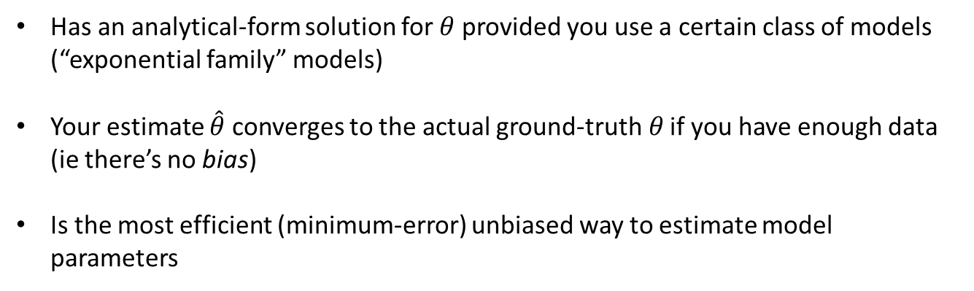
Maximum likelihood estimation
Has an analytical-form solution for $θ$ provided you use a certain class of models (“exponential family” models)
Your estimate $\hat{θ}$ converges to the actual ground-truth$θ$ if you have enough data (ie there’s no bias)
Is the most efficient (minimum-error) unbiased way to estimate model parameters

Slide 14

We don’t have to assume a Gaussian model
P( firing rate | s = -12 )
0
60
Firing rate (Hz)
Different widths ($σ^{2}$) !!
P( firing rate | s = -28 )
0
60
Firing rate (Hz)

Slide 15

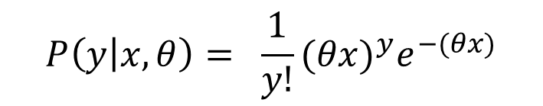




Another model class that works well for neural data: Poisson models
Predicted spike
distribution
$$y\sim Poiss(λ)$$
number
of spikes
observed
(y)
Underlying
spike rate
$$λ=θx$$
stimulus intensity ($x$)
Encoding
model
$$P\left(y | x,θ\right)= \frac{1}{y!}{(θx)}^{y}e^{−(θx)}$$
$$mean\left(y\right)=λ=θx$$
$$var\left(y\right)=λ=θx$$

Slide 16
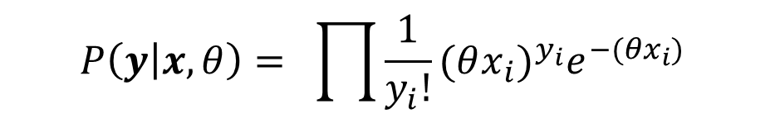

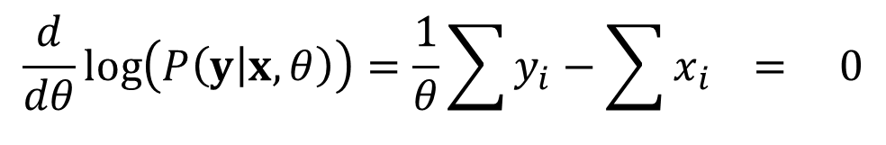
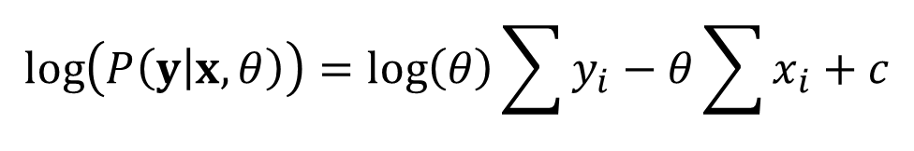
We can solve for the ML estimate of $θ$ for the Poisson model, too
Encoding
model
$$P\left(y | x,θ\right)= \prod{\frac{1}{y_{i}!}{(θx_{i})}^{y_{i}}e^{−(θx_{i})} }$$
$$\log\left(P\left(y | x,θ\right)\right)=\log\left(θ\right)\sum{y_{i}}−θ\sum{x_{i}}+c$$
$$\frac{d}{dθ}\log\left(P\left(y | x,θ\right)\right)=\frac{1}{θ}\sum{y_{i}}−\sum{x_{i}} = 0$$
$$\hat{θ}=\frac{\sum{y_{i}}}{\sum{x_{i}}}$$

Slide 17
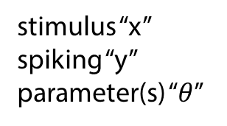

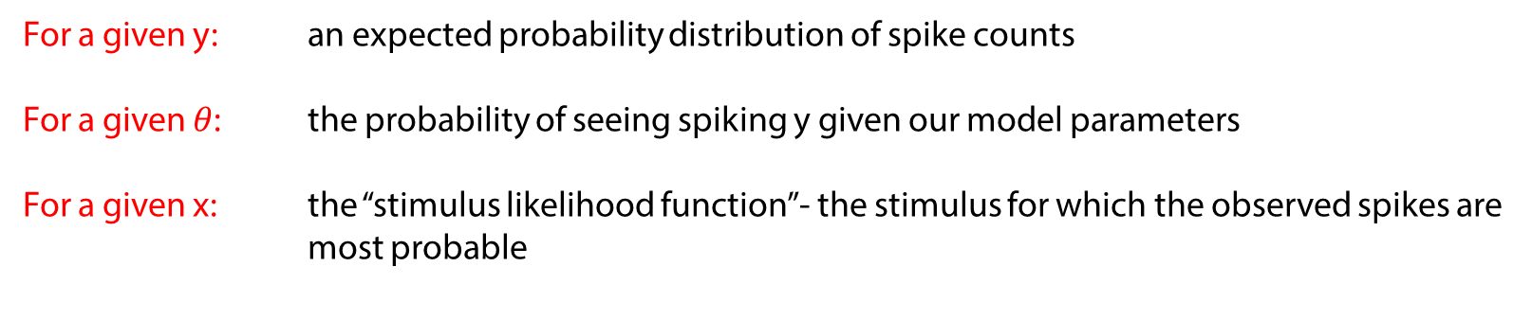
Taking a step back
stimulus “x”
spiking “y”
parameter(s) “$θ$”
Encoding
model
$$P\left(y | x,θ\right)$$
For a given y: an expected probability distribution of spike counts
For a given $θ$: the probability of seeing spiking y given our model parameters
For a given x: the “stimulus likelihood function”- the stimulus for which the observed spikes are most probable

Slide 18



Now: Generalized Linear Models
Poisson encoding
model
$$P\left(y | λ\right)= \frac{1}{y!}λ^{y}e^{−λ}$$
Underlying
spike rate
$$λ=θx$$
What goes into our spike rate $λ$?
Short answer: whatever we want

Slide 19
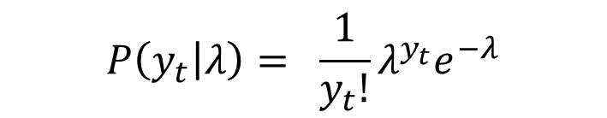

Now: Generalized Linear Models
Stimulus feature (x)
Recorded spikes (y)
Encoding model
time →
$$P\left(y_{t} | λ\right)= \frac{1}{y_{t}!}λ^{y_{t}}e^{−λ}$$
time →
Underlying
spike rate
$$λ=f(x_{1:t},y_{1:t−1})$$

Slide 20
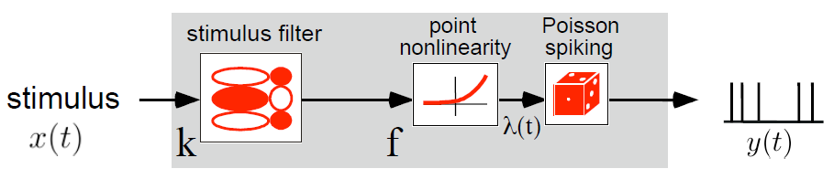
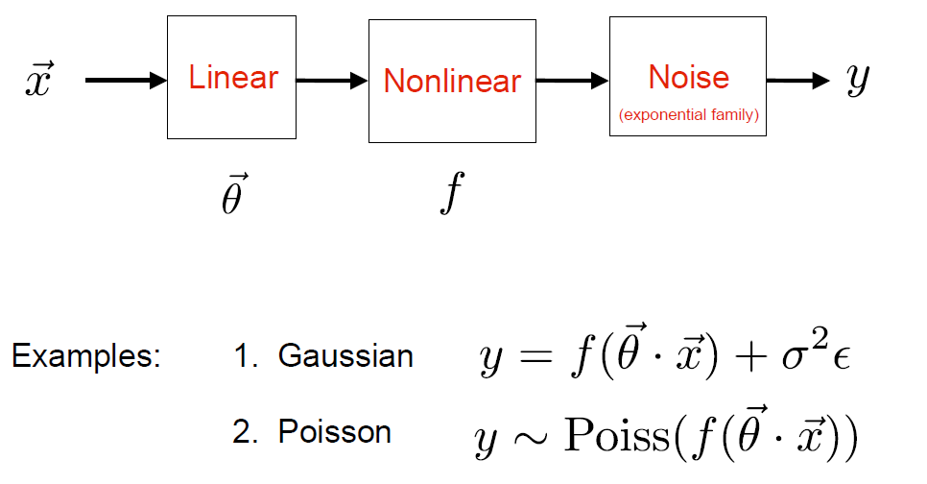
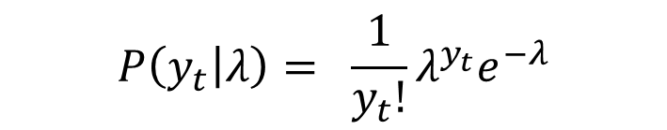

Now: Generalized Linear Models
Stimulus encoding model
$$P\left(y_{t} | λ\right)= \frac{1}{y_{t}!}λ^{y_{t}}e^{−λ}$$
$$λ=f(x_{1:t},y_{1:t−1},…)$$

Slide 21
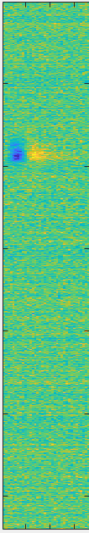
How does this compare to the STAs we computed last week?
Generalized Linear Model
Linear “STA” Model

Slide 22
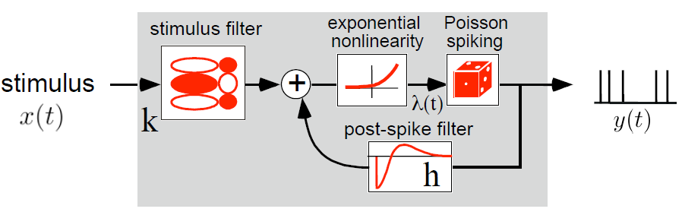
Adding spike-history effects

Slide 23
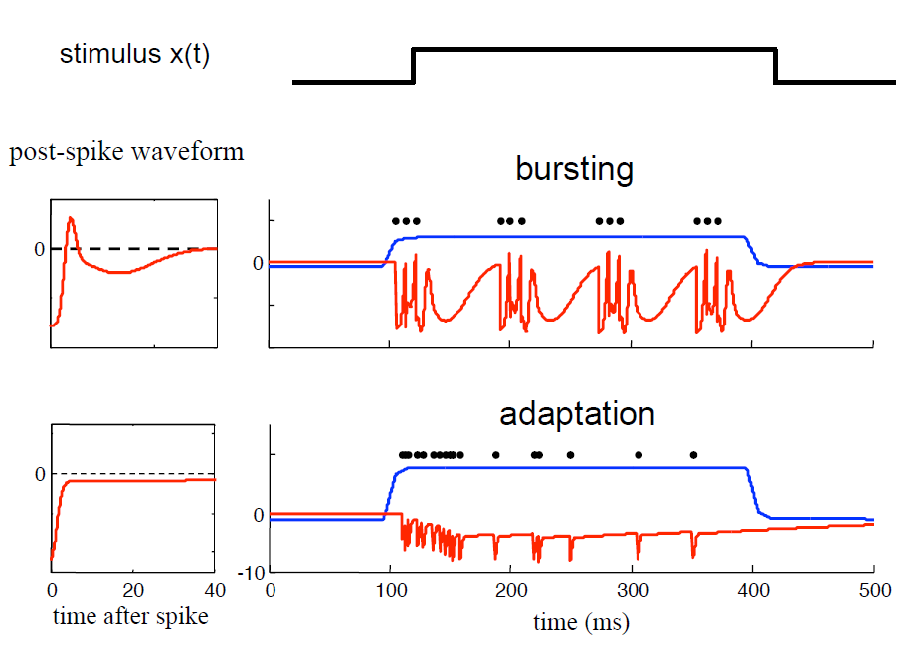
Adding spike-history effects

Slide 24
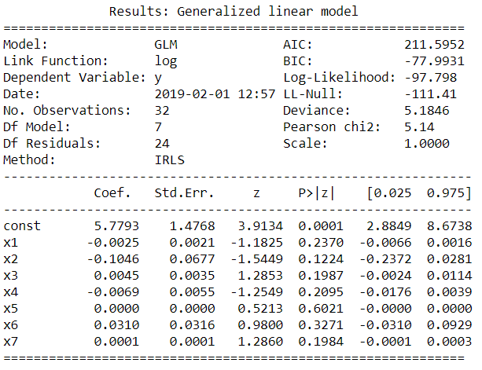
Evaluating your model

Slide 25
Encoding models- recap from last module
Linear regression models as an example
Point processes
Neural spiking as an inhomogeneous Poisson process
Why this is helpful for model-fitting
How models are fit
Evaluating goodness of fit
Types of linking functions
Adding spike-history term

