Slide 1
Questions and discussion

Slide 2
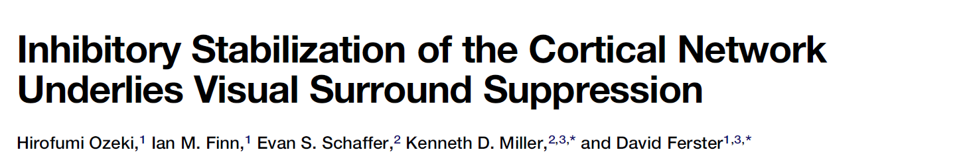
What are these simplified neural models actually good for?
A motivating example: Ozeki et al 2009

Slide 3
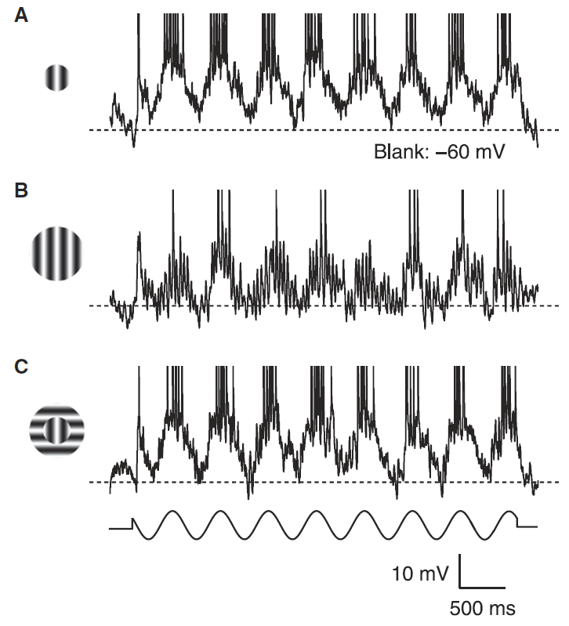
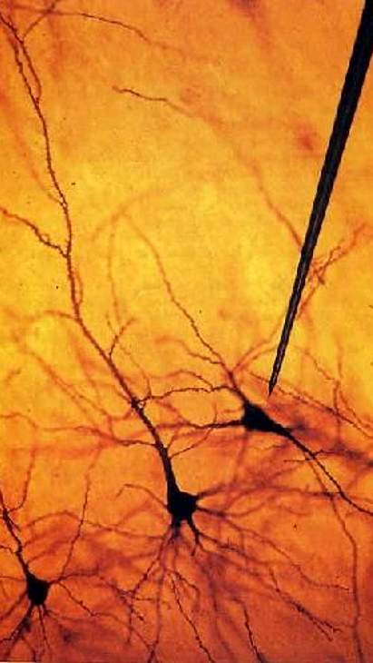
Neurons in primary visual cortex show “surround suppression” of their spiking activity
stimulus in center of receptive field
center + surround
center + orthogonal surround

Slide 4
What could cause surround suppression?
Hypothesis 1: lateral inhibition
Stimulus extent:
A
B
neighboring population
recorded cell
Prediction: neurons receive more inhibitory input when the surround is present.

Slide 5
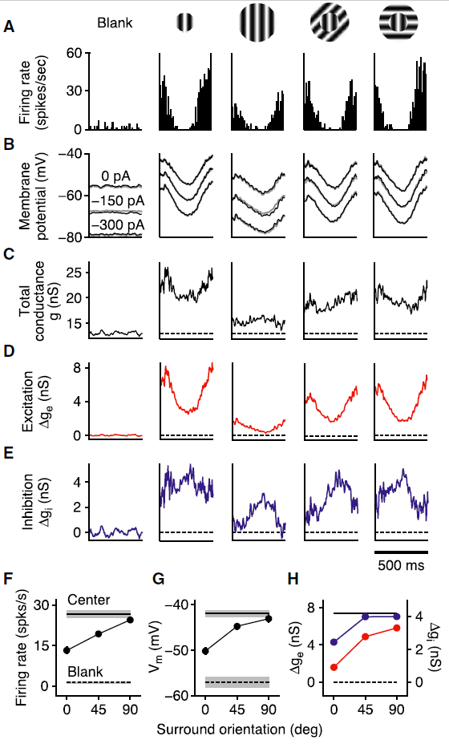
Experiment: measure excitatory and inhibitory currents into a neuron
Lateral inhibition hypothesis: NOPE
Clamp membrane at inhibitory reversal potential
Clamp membrane at excitatory reversal potential

Slide 6
What could cause surround suppression?
Hypothesis 2: it’s inherited from earlier brain regions.
Input cell in lateral geniculate nucleus (LGN)
recorded cell in V1
Prediction: we should also see surround suppression in those earlier regions.

Slide 7
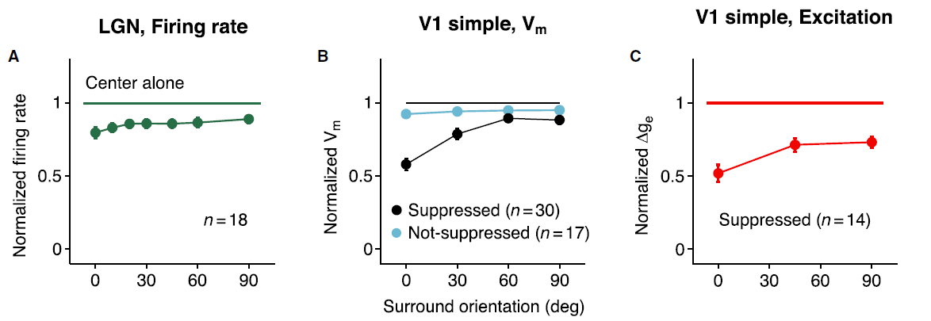
Experiment: characterize surround suppression in thalamic input to visual cortex
Inheritance hypothesis: NOPE

Slide 8
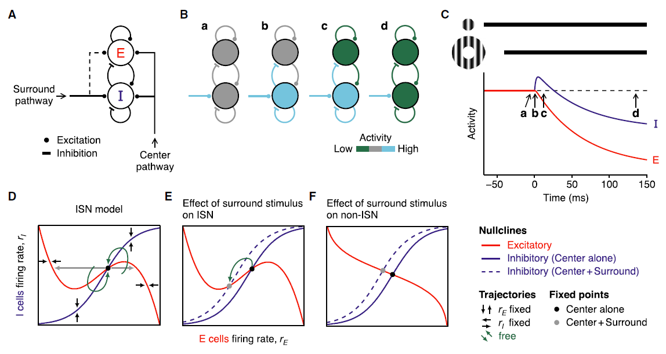
What could cause surround suppression?
Hypothesis 3: inhibition stabilization

Slide 9
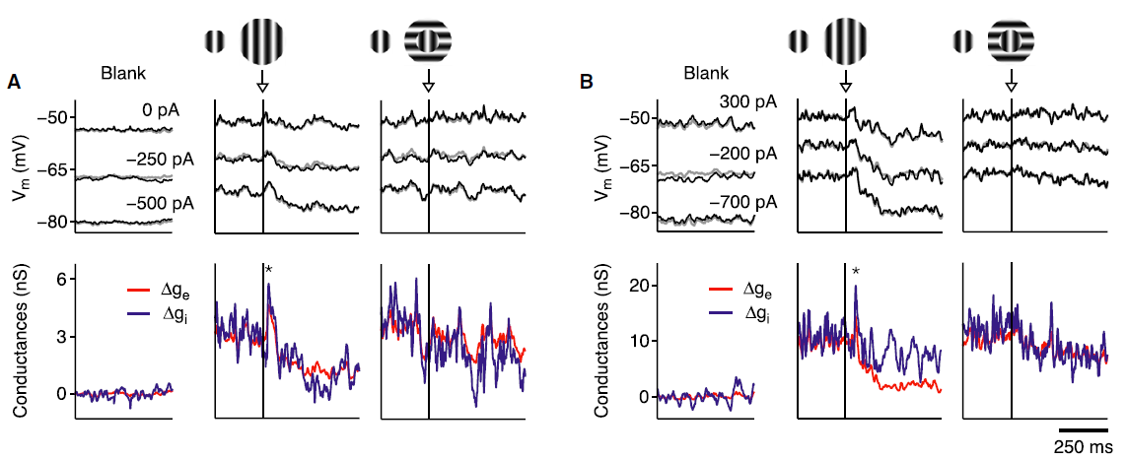
Experiment: look for transient increases in inhibitory cell firing rates

