Slide 1
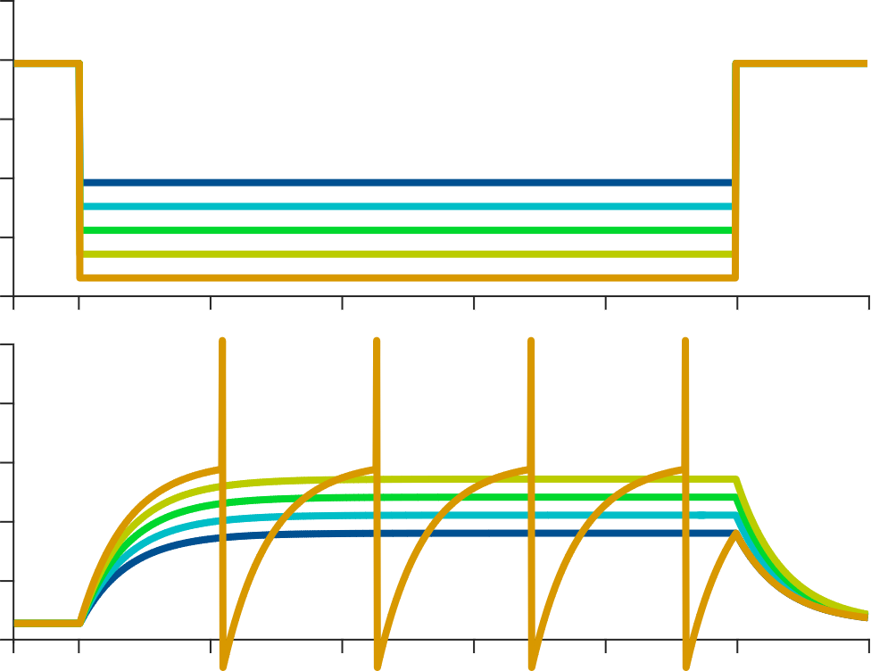
A quick follow-up:
what if I want to model more than one neuron?
τ dV/dt = – V + I_{external}
if (V > V_threshold):
emit a spike
V = V_reset
0
external current
I_{ext}
membrane
potential
E_{ion}
time

Slide 2
A quick follow-up:
τ dV/dt = – V + J s + I_{external}
if (V > V_threshold):
emit a spike
V = V_reset
s_{i} = s_{i} + 1
0
external current
I_{ext}
τ_{synapse} ds/dt = – s
membrane
potential
E_{ion}
time

Slide 3
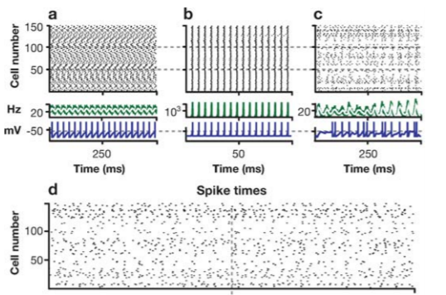
Spiking (and rate) network models can operate in different dynamical regimes
Asynchronous regular
Synchronous regular
Synchronous irregular
Asynchronous irregular

