Slide 1
Dynamical systems and time series data in neuroscience
Caltech DataSAI
Ann Kennedy
July 6, 2022

Slide 2
WAINT
Why am I not talking?

Slide 3
Neuroscience data is time series data
Stimulus feature
Recorded spikes
time ->
time ->

Slide 4
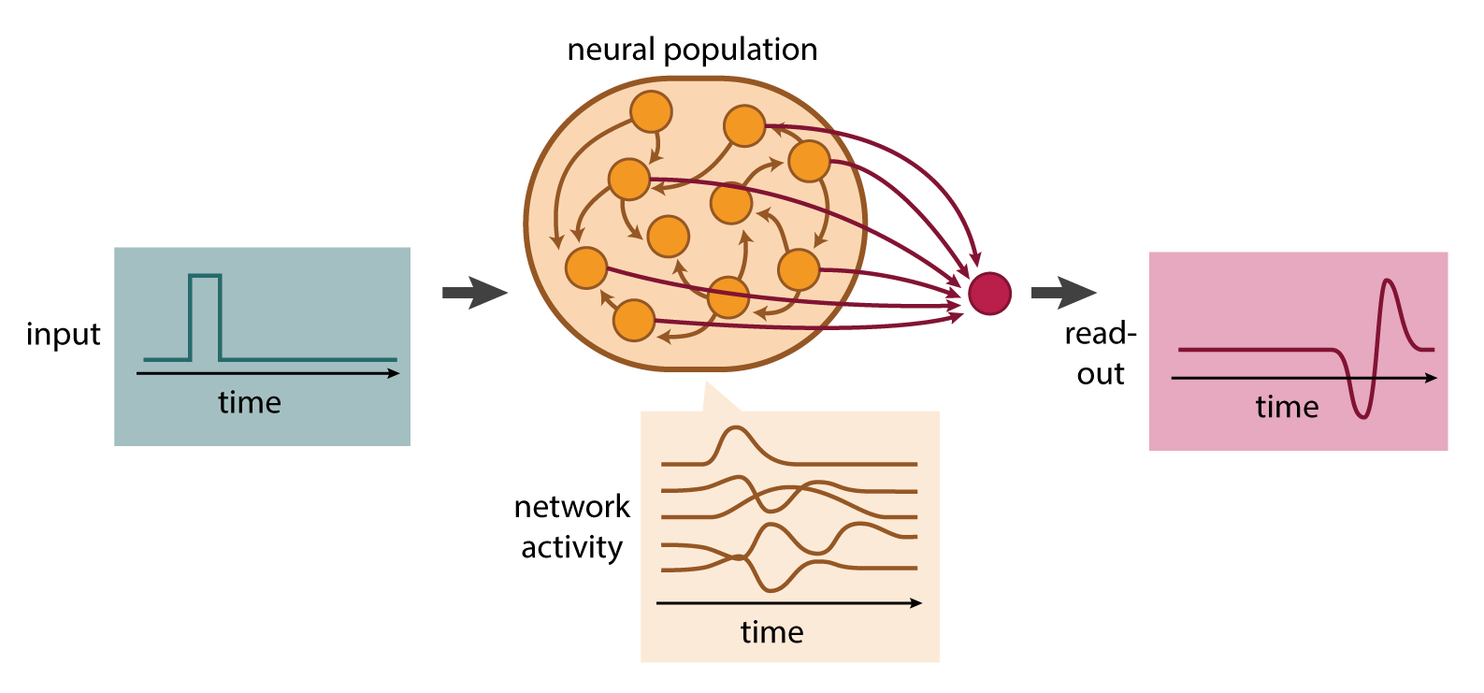
Neuroscience data is time series data

Slide 5
We use two families of tools to deal with time series data
Statistical models and signal processing
Dynamical systems
Model behavior of neural populations from first principles, at different levels of abstraction
Analyze models for interesting structure: attractors, limit cycles, etc
Fit descriptive models of observed neural activity
Understand how a neuron filters and transforms its input
This morning
This afternoon

Slide 6

Ohm’s Law
V = I R
capacitor dynamics
C dV/dt = I

Slide 7

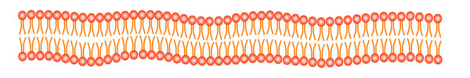
Neurons store energy in the form of charge + concentration gradients across their membrane
outside
ion channel
+
+
+
+
+
+
resistor
lipid bilayer
=
capacitor
–
–
power source
–
–
–
–
concentration difference
charge difference
+
Nernst potential
Combined effect of concentration and charge “forces” on ions
inside

Slide 8
outside
Ohm’s law
capacitor dynamics
V = I R
C dV/dt = I
resistor
I = (1/R) V
I = g (E_{ion} – V)
C dV/dt = g (E_{ion} – V)
capacitor
power source
R C dV/dt = E_{ion} – V
inside
Note: g = conductance = 1/resistance

Slide 9
Neurons store energy in the form of charge + concentration gradients across their membrane
R C dV/dt = E_{ion} – V
outside
0 = E_{ion} – V
V_{ss} = E_{ion}
resistor
=
The membrane potential V approaches a “steady state” (ss) value of E_{ion}
V approaches its steady state value at a rate proportional to 1/(RC)
It approaches it exponentially:
capacitor
power source
inside
K dx/dt = – x
x(t) = e ^{– t/K}

Slide 10
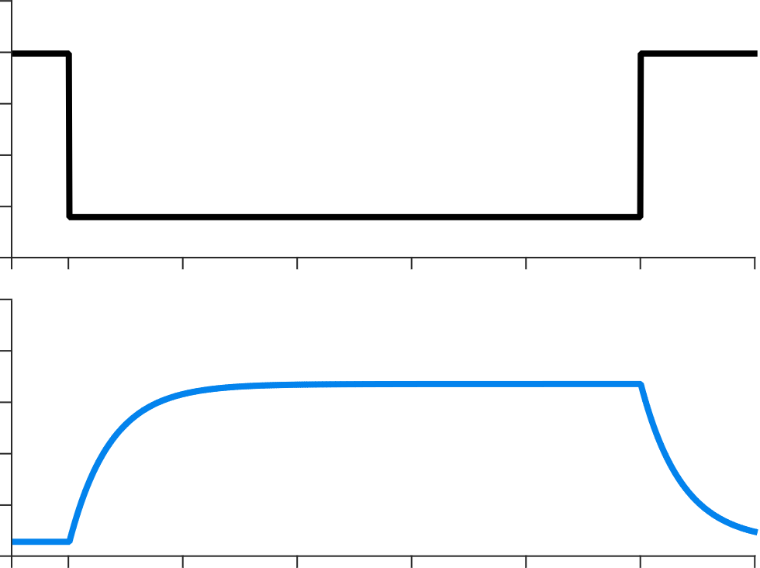
Neurons store energy in the form of charge + concentration gradients across their membrane
C dV/dt = R (E_{ion} – V) + I_{external}
outside
0
external current
resistor
=
I_{ext}
capacitor
I_{ext}
power source
membrane
potential
E_{ion} +
R
τ = R · C
E_{ion}
inside
time

Slide 11
Voltage-gated ion channels let neurons generate action potentials
outside
voltage-gated
ion channel
+
+
variable
+
+
+
+
resistor
lipid bilayer
=
capacitor
–
+
power source
–
–
–
–
–
+
inside

Slide 12
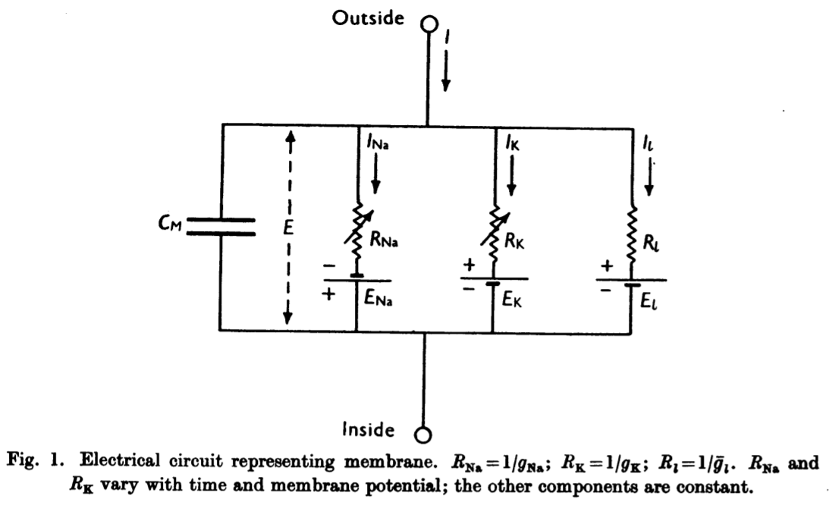
“leak”
(everything else)
sodium
potassium
Hodgkin and Huxley (1952) J Physiol.

Slide 13
outside
Membrane potential dynamics in the Hodgkin-Huxley model
Ohm’s law
capacitor dynamics
variable
V = I R
C dV/dt = I
resistor
I = (1/R) V
C dV/dt = I_{Na} + I_{K} + I_{L} + I_{ext}
capacitor
power source
I = g (E_{ion} – V)
inside
C dV/dt = g_{Na}(V) (V – E_{Na}) + g_{K}(V) (V – E_{K}) + g_{L} (V – E_{L}) + I_{external}
function of voltage and time
function of voltage and time
Note: g = conductance = 1/resistance

Slide 14
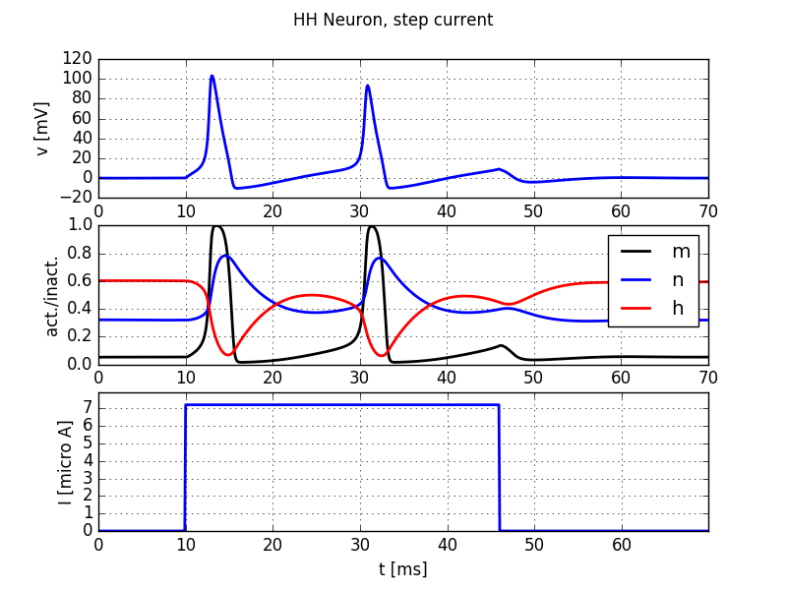
Membrane potential dynamics in the Hodgkin-Huxley model
action potentials
Hidden parameters describing ion channel opening/closing kinetics

Slide 15
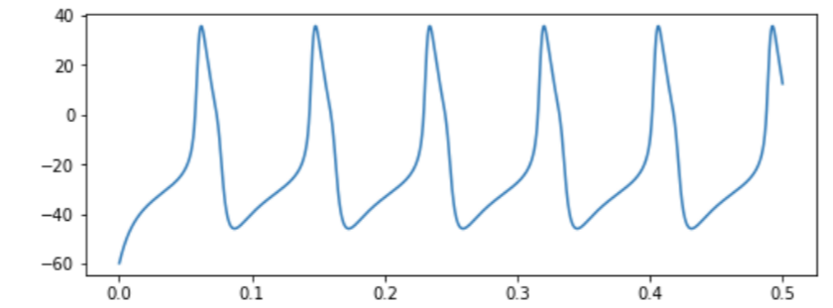
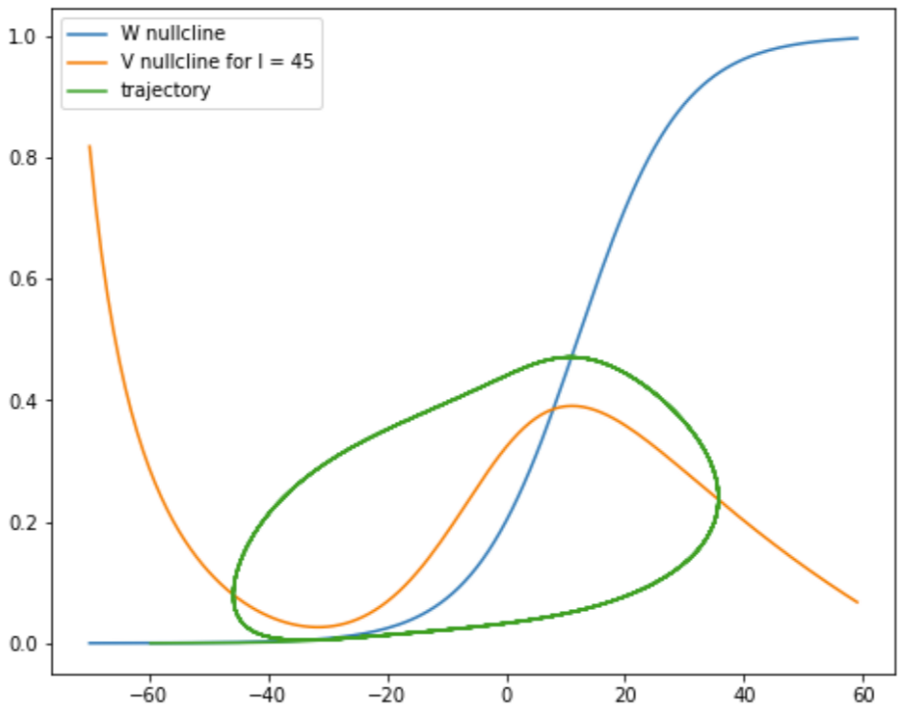
What is my neuron doing and why?
membrane potential
We won’t get into this today (unless you insist), but there are some excellent methods in dynamical systems for visualizing these models and understanding their behavior.
If you’re interested, check out the bonus notebook “neural_model_simulation” on the Morris-Lecar model!
time (seconds)
potassium channel activation
membrane potential

Slide 16
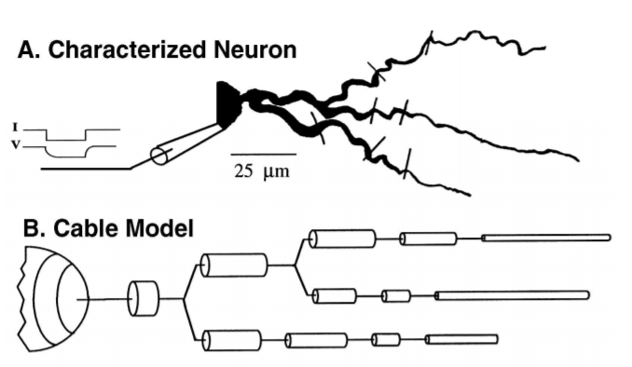
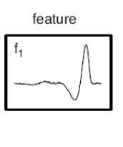
How much detail do we need to describe neural activity?
More complex
Less complex
Biophysical, multicompartmental model
Linear neural
filter
“all models are wrong, but some are useful”

Slide 17
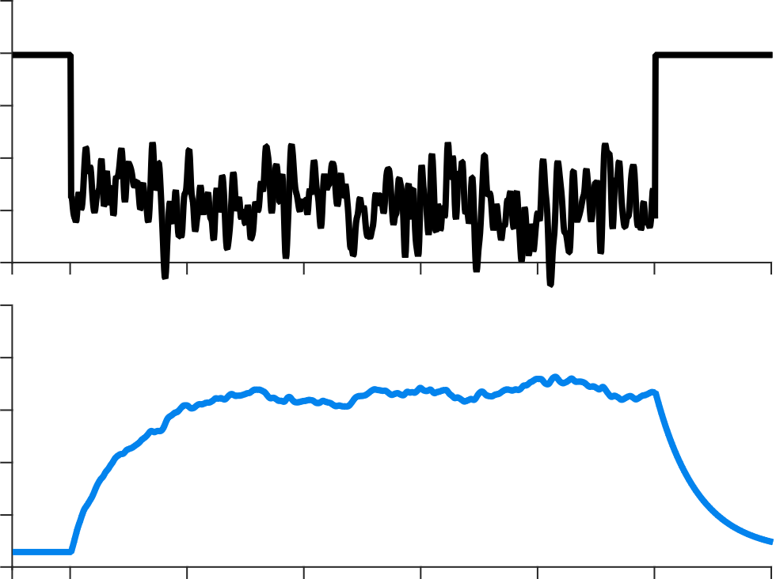
One important feature of our neuron model: input filtering
C · dV/dt = R · (E_{ion} – V) + I_{external}
outside
0
external current
resistor
=
I_{ext}
capacitor
power source
membrane
potential
E_{ion}
inside
time

Slide 18
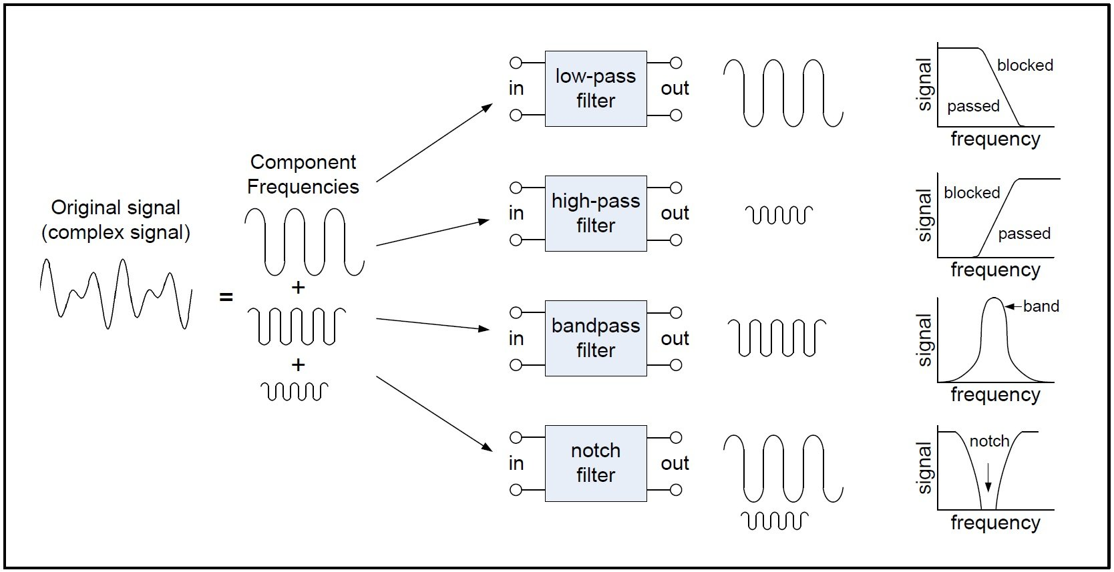
(what do we mean by filtering?)

Slide 19
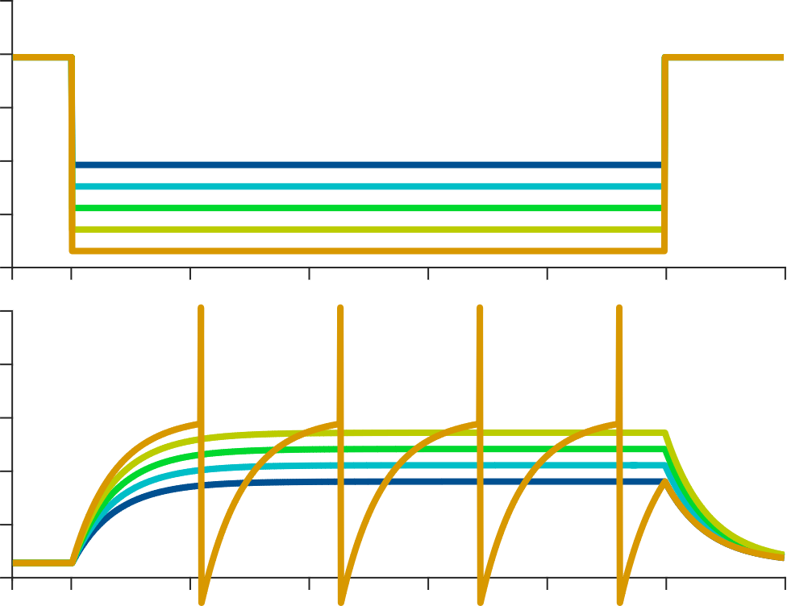
Another important feature of our neuron model: spike threshold nonlinearity
0
external current
cell activity
(spikes/second)
I_{ext}
0
input current magnitude (Amps)
membrane
potential
spiking threshold
E_{ion}
time

Slide 20
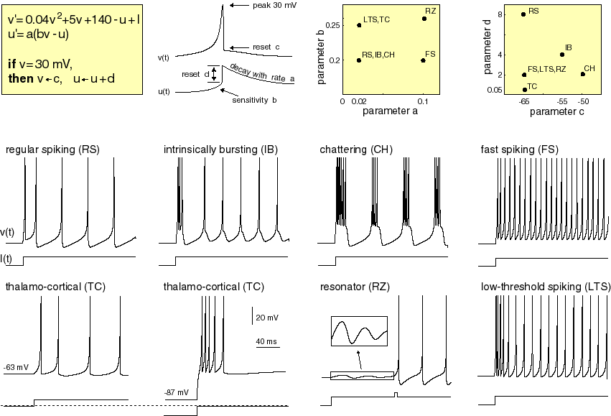
Another (important?) feature of our/other neuron models: diverse spike-history effects
https://www.izhikevich.org/publications/spikes.htm

Slide 21
Keep the filter and the spiking, but throw out all those ion channel parameters:
=> leaky integrate-and-fire neurons
0
τ dV/dt = – V + I_{external}
external current
I_{ext}
if (V > V_threshold):
emit a spike
V = V_reset
membrane
potential
E_{ion}
time

Slide 22
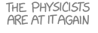
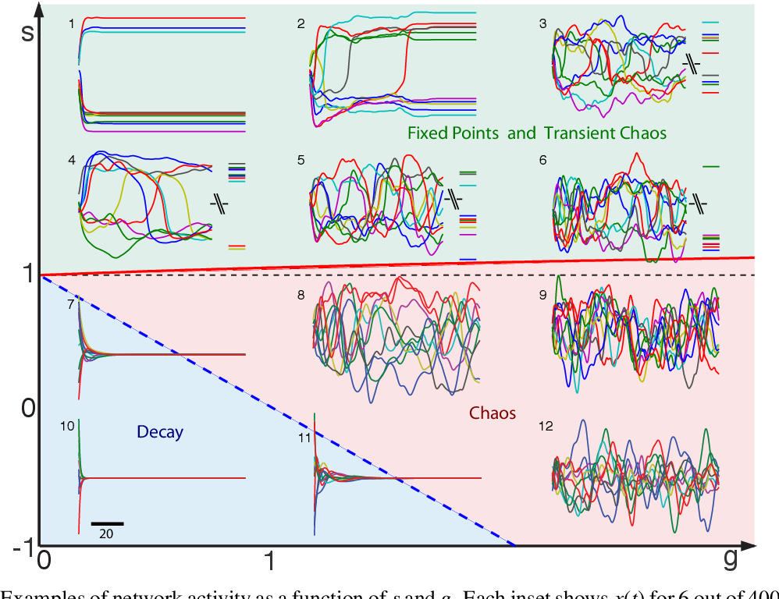
Actually, just keep the filtering, and give me an approximate spike rate
=> rate models
τ dV/dt = – V + I_{external}
r(t) = φ(V(t))
1
where φ(x) =
1 + e^{-x}
tanh(x)
Stern, Sompolinsky, and Abbott (2014) PRE

Slide 23
So, how much detail do we need to describe neural activity?
???
C dV/dt = g_{Na}(V) (V – E_{Na}) + g_{K}(V) (V – E_{K}) + g_{L} (V – E_{L}) + I_{external}
A last important feature of neurons in the brain: there are lots of them

Slide 24
How does the firing of a neuron encode information?
Many, many layers of neurons
Stimulus feature s
Recorded spikes r
time ->
time ->
Brightness of a screen
Concentration of an odor
Proximity of a predator
Movement of a limb
How does the neuron’s activity reflect the stimulus?
Which properties of the stimulus are captured?
What information could other neurons be reading out from this one?
Notes:
The language of stimulus encoding models is formed around thinking about continuous signals, like sensory inputs or muscle contractions

Slide 25
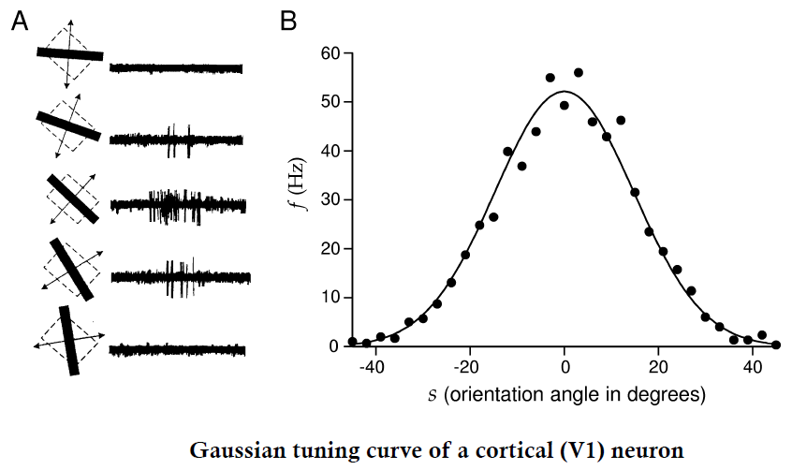


Tuning curves are an example of a neural encoding model
s_{pref}
$$spikes \sim e^{−{\left({(s −s_{pref})}/{\text{σ}}\right)}^{2}}$$
r
$$\text{σ}$$
Hubel & Wiesel, 1968

Slide 26
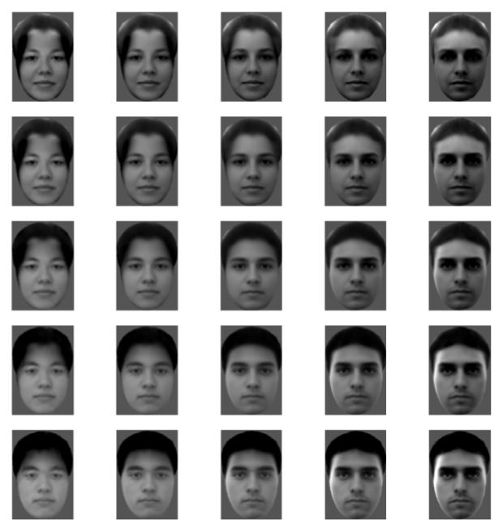
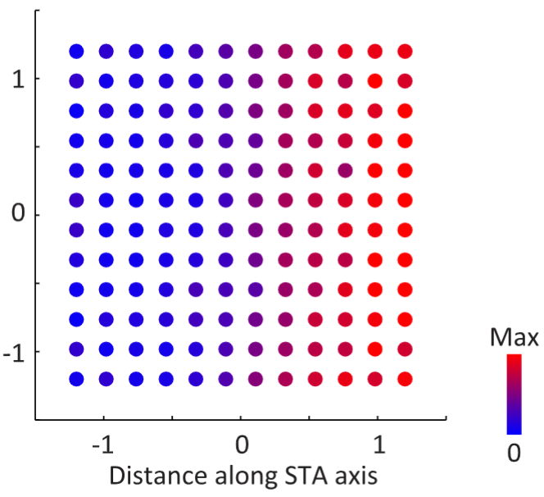

A 2D neural encoding surface for facial features
Stimulus features
Recorded spikes
Facial feature 2
(forehead luminence?)
$$spikes \sim w_{1}s_{1}+w_{2}s_{2}$$
Facial feature 2 (s2)
Number of
spikes
Facial feature 1 (eye depth)
Facial feature 1 (s1)
Chang and Tsao 2017

Slide 27
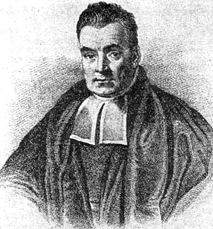
Coming up after lunch…
Encoding model
P ( r | s )
Stimulus feature (s)
Recorded spikes (r)
Decoding model
P ( s | r )
time →
time →
soon

