Slide 1
Fitting generalized linear models to neural data
Caltech DataSAI
Ann Kennedy
July 6, 2022

Slide 2
Neural encoding
Stimulus feature
Recorded spikes
time →
time →
Brightness of a screen
Concentration of an odor
Proximity of a predator
Movement of a limb

Slide 3
Neural encoding
Stimulus feature (x)
Recorded spikes (y)
Encoding model
P ( y | x )
time →
time →
Given that the animal saw stimulus “x”, what pattern of spiking “y” do we expect to observe in its brain?

Slide 4
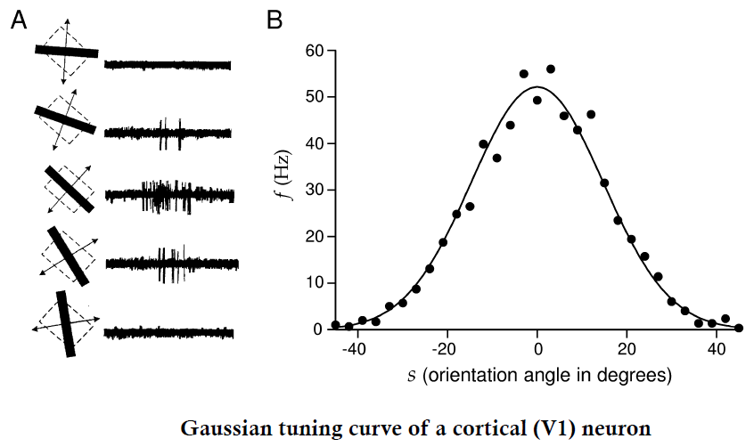
Tuning curves as one example of an encoding model

Slide 5





Tuning curves as one example of an encoding model
$$\hat{x}=35$$
$$x_{obs}=38$$
P( firing rate | s = -12 )
$$x_{obs}=6$$
0
60
Firing rate (Hz)
$$x_{obs}=6$$
P( firing rate | s = -28 )
$$x_{obs}=38$$
0
60
Firing rate (Hz)

Slide 6
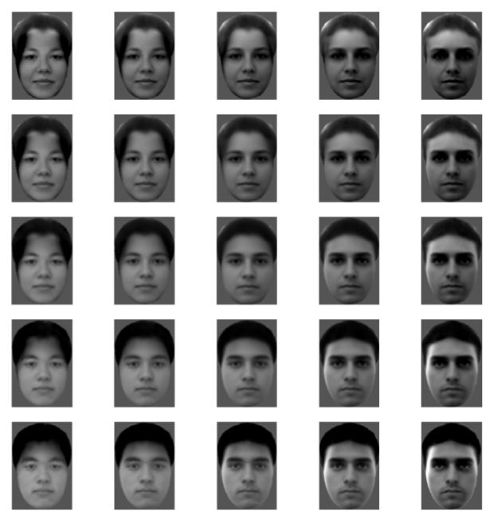
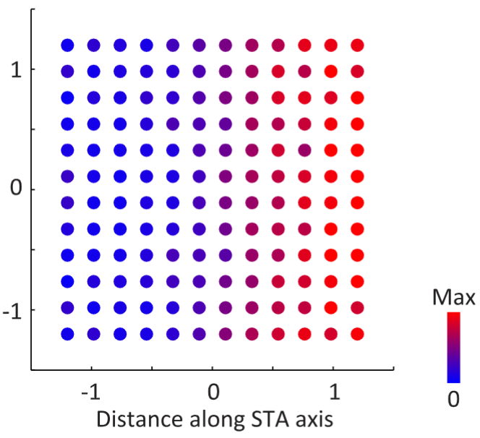

A 2D neural encoding surface for facial features
Stimulus features
Recorded spikes
Facial feature 2
(forehead luminence)
$$spikes \sim w_{1}s_{1}+w_{2}s_{2}$$
Facial feature 2 (s2)
Number of
spikes
Facial feature 1 (eye depth)
Facial feature 1 (s1)
Chang and Tsao 2017

Slide 7

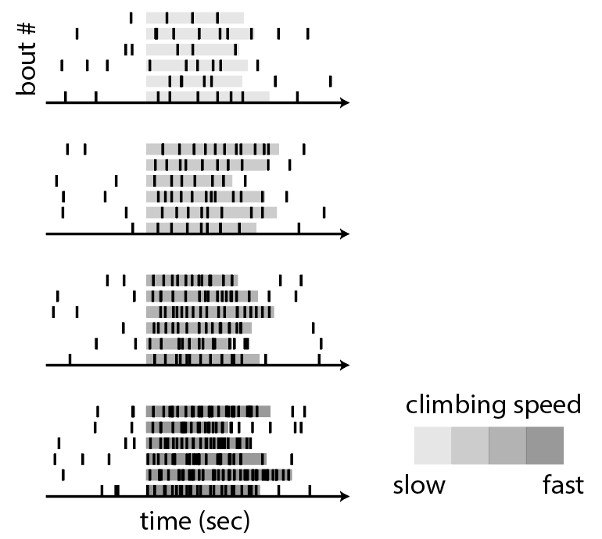
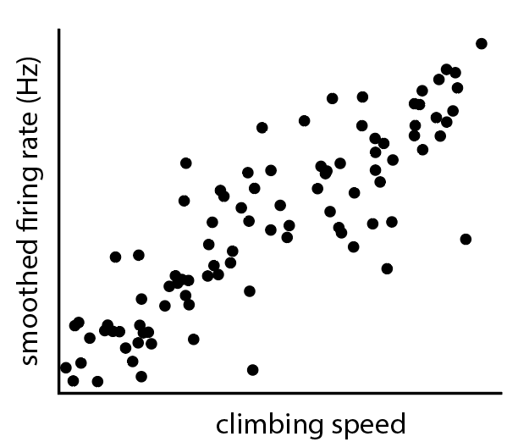
Let’s build an example encoding model
spikes
climbing speed
We want to capture:
The relationship between climbing speed and firing rate
The amount of trial-to-trial variability in the firing rate

Slide 8

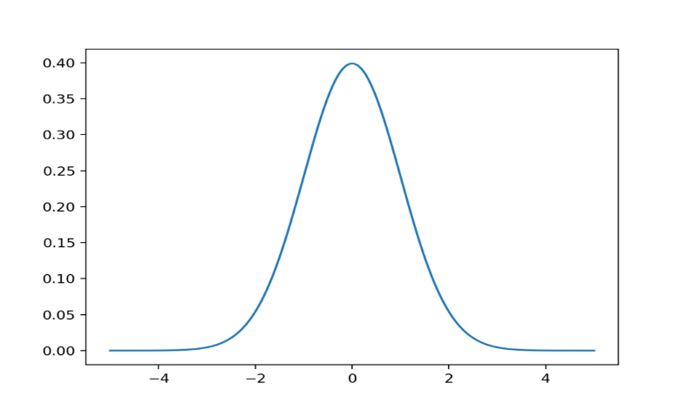

An example model
^
Gaussian
Conditional probability of r given s
Underlying
spike rate
Predicted spike
distribution
$$μ=ws$$
$$r\sim N(μ,σ^{2})$$
P (r|s)
stimulus
(climbing speed)
unknown
parameter
smoothed firing rate (r)

Slide 9

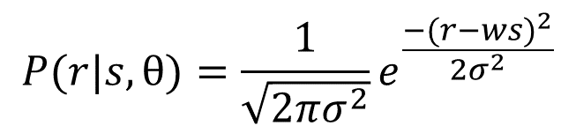
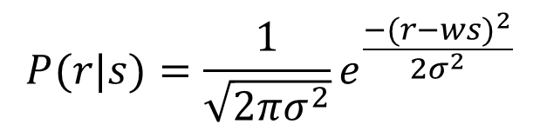


What is the relationship between these two equations?
Predicted spike
distribution
$$P(r|s,θ)=\frac{1}{\sqrt{2πσ^{2}}}e^{\frac{−{(r−ws)}^{2}}{2σ^{2}}}$$
$$P(r|s)=\frac{1}{\sqrt{2πσ^{2}}}e^{\frac{−{(r−ws)}^{2}}{2σ^{2}}}$$
$$r\sim N(μ,σ^{2})$$
Underlying
Spike rate
$$μ=ws$$
Conditional probability of r given s
climbing
speed
unknown
parameter
P (r|s,$θ$)
smoothed firing rate (r)
Notes:
Depending on context, you will see P(r|s,theta) called several things:
If we are talking about r, it’s often called the encoding distribution
If we are talking about theta, it’s often called the likelihood function (eg, “find theta to maximize the likelihood given the data”)
If we are talking about s, it’s often called the stimulus likelihood function (eg in Bayesian decoding, “the posterior is the likelihood times the prior” (next section!))

Slide 10


Solving for $w$
$w_{est}$ = 0.5
Predicted spike
distribution
Conditional probability of r given s
$$r\sim N(μ,σ^{2})$$
Underlying
Spike rate
$$μ=ws$$
P (r|s,$θ$)
climbing
speed
smoothed firing rate (r)
unknown
parameter
What we want is a model that maximizes the likelihood (the total conditional probability) of all observed datapoints given the model.

Slide 11
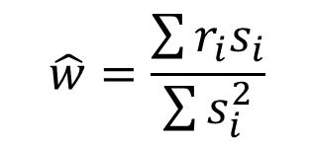
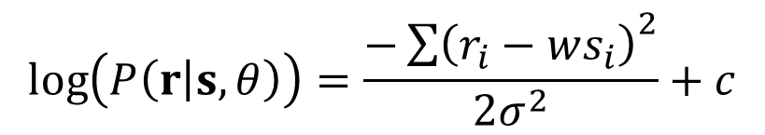

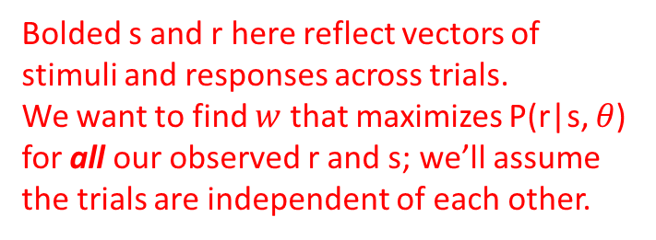
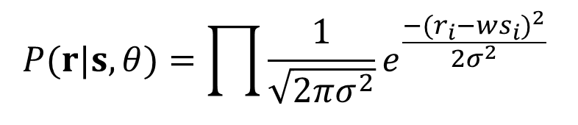

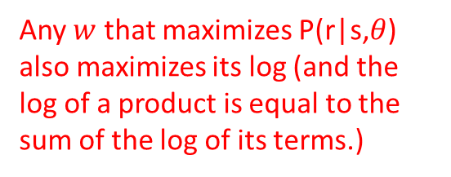
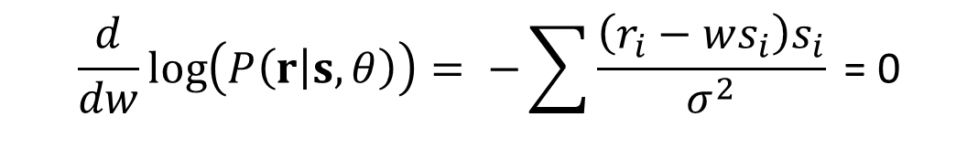
Bonus math slide: how do we actually do maximum likelihood (ML) estimation of $θ$?
Bolded s and r here reflect vectors of stimuli and responses across trials.
We want to find $w$ that maximizes P(r|s, $θ$) for all our observed r and s; we’ll assume the trials are independent of each other.
$$P(r|s,θ)=\prod{\frac{1}{\sqrt{2πσ^{2}}}e^{\frac{−{(r_{i}−ws_{i})}^{2}}{2σ^{2}}} }$$
$$\log\left(P\left(r | s,θ\right)\right)=\frac{−{\sum{\left(r_{i}−ws_{i}\right)}}^{2}}{2σ^{2}}+c$$
Any $w$ that maximizes P(r|s,$θ$) also maximizes its log (and the log of a product is equal to the sum of the log of its terms.)
$$\frac{d}{dw}\log\left(P\left(r | s,θ\right)\right)= −\sum{\frac{\left(r_{i}−ws_{i}\right)s_{i}}{σ^{2}} \text{= 0}}$$
The maximum of log(P(r|s,$θ$) occurs where its derivative is zero.
$$\hat{w}=\frac{\sum{r_{i}s_{i}}}{\sum{s_{i}^{2}}}$$
This is our maximum likelihood estimate of $w$!

Slide 12
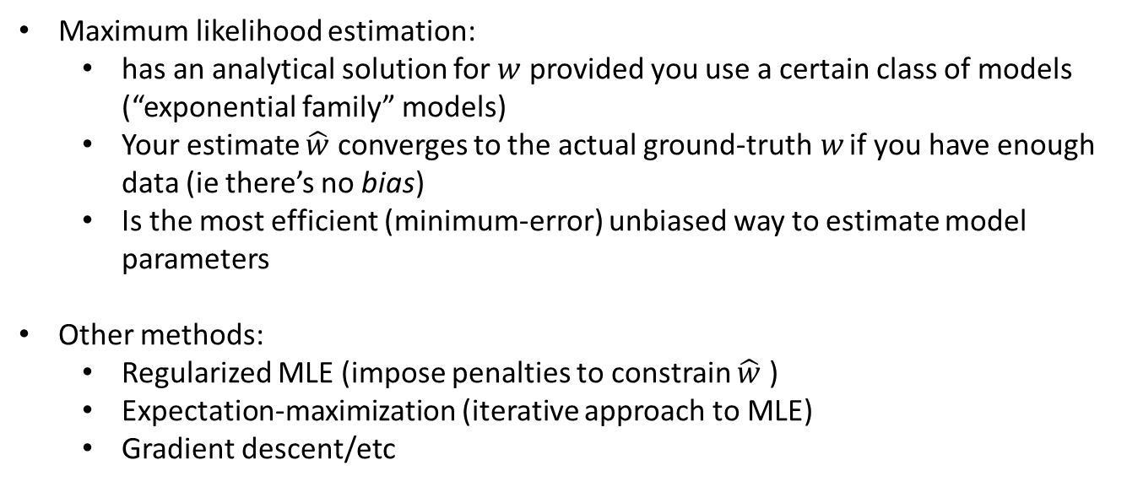
Model fitting, in general
Maximum likelihood estimation:
has an analytical solution for $w$ provided you use a certain class of models (“exponential family” models)
Your estimate $\hat{w}$ converges to the actual ground-truth$w$ if you have enough data (ie there’s no bias)
Is the most efficient (minimum-error) unbiased way to estimate model parameters
Other methods:
Regularized MLE (impose penalties to constrain $\hat{w}$ )
Expectation-maximization (iterative approach to MLE)
Gradient descent/etc

Slide 13

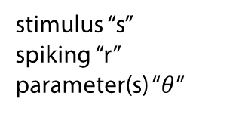

Neural encoding vs neural decoding
stimulus “s”
spiking “r”
parameter(s) “$θ$”
Encoding distribution
$$P\left(r | s,θ\right)$$
“How likely it is the neuron fires k spikes given the climbing speed s.”
Decoding
distribution
$$P\left(s | r,θ\right)$$
“How likely it is the animal was climbing at speed s given the observed neuron’s spiking.”
Encoding model
P ( r | s )
Stimulus feature (s)
Recorded spikes (r)
Decoding model
P ( s | r )
time →
time →

Slide 14
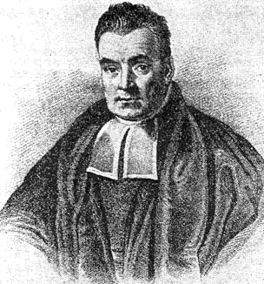
probability
Neural encoding vs neural decoding
stimulus “s”
spiking “r”
parameter(s) “$θ$”
Encoding distribution
$$P\left(r | s,θ\right)$$
“How likely it is the neuron fires k spikes given the climbing speed s.”
# spikes observed
Decoding
distribution
$$P\left(s | r,θ\right)$$
“How likely it is the animal was climbing at speed s given the observed neuron’s spiking.”
How do relate these two distributions to each other?
probability
Thomas Bayes
climbing speed

Slide 15







Bonus math slide 2: derivation of Bayes’ theorem
$$P\left(s | r\right)= \frac{P(s, r)}{P(r)}$$
$$P\left(r | s\right)= \frac{P(r, s)}{P(s)}$$
By definition
$$P\left(s | r\right)P(r)=P(s, r)$$
$$P\left(r | s\right)P(s)=P(r, s)$$
Multiply by denominator
$$P(r, s)=P(s, r)$$
P(A and B) = P(B and A)
$$P\left(s | r\right)P(r)=P\left(r | s\right)P(s)$$
Substituting line 2
$$P\left(s | r\right)=\frac{P\left(r | s\right)P(s) }{P(r)}$$
Divide by P(r)

Slide 16
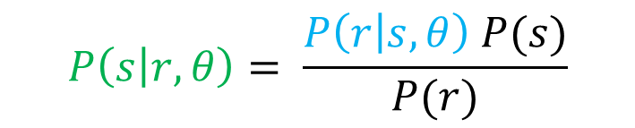
Bayes’ theorem and neural data
stimulus “s”
spiking “r”
parameter(s) “$θ$”
Encoding distribution
$$P\left(r | s,θ\right)$$
“How likely it is the neuron fires k spikes given the climbing speed s.”
Prior over stimuli
Bayes’ theorem
Decoding
distribution
$$P\left(s | r,θ\right)= \frac{P\left(r | s,θ\right) P(s)}{P(r)}$$
$$P\left(s | r,θ\right)$$
“How likely it is the animal was climbing at speed s given the observed neuron’s spiking.”
“Evidence”
(often ignored)

Slide 17

We don’t have to assume a Gaussian model
P( firing rate | s = -12 )
0
60
Firing rate (Hz)
Different widths ($σ^{2}$)
P( firing rate | s = -28 )
0
60
Firing rate (Hz)

Slide 18

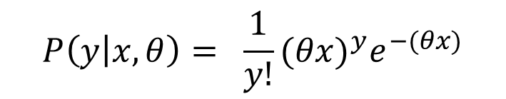




Another model class that works well for neural data: Poisson models
Predicted spike
distribution
$$y\sim Poiss(λ)$$
number
of spikes
observed
(y)
Underlying
spike rate
$$λ=θx$$
stimulus intensity ($x$)
Encoding
model
$$P\left(y | x,θ\right)= \frac{1}{y!}{(θx)}^{y}e^{−(θx)}$$
$$mean\left(y\right)=λ=θx$$
$$var\left(y\right)=λ=θx$$

Slide 19
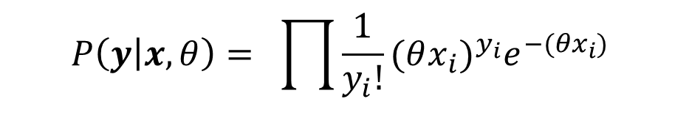

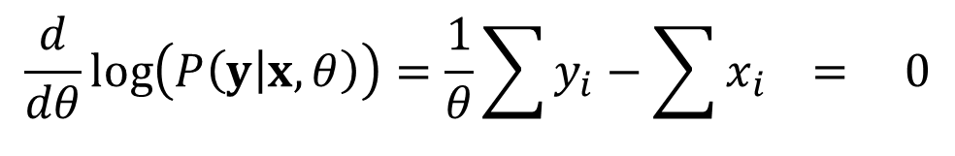
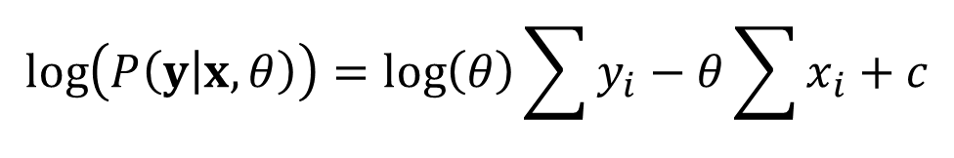
We can solve for the ML estimate of $θ$ for the Poisson model, too
Encoding
model
$$P\left(y | x,θ\right)= \prod{\frac{1}{y_{i}!}{(θx_{i})}^{y_{i}}e^{−(θx_{i})} }$$
$$\log\left(P\left(y | x,θ\right)\right)=\log\left(θ\right)\sum{y_{i}}−θ\sum{x_{i}}+c$$
$$\frac{d}{dθ}\log\left(P\left(y | x,θ\right)\right)=\frac{1}{θ}\sum{y_{i}}−\sum{x_{i}} = 0$$
$$\hat{θ}=\frac{\sum{y_{i}}}{\sum{x_{i}}}$$

Slide 20
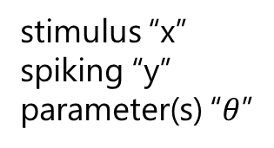

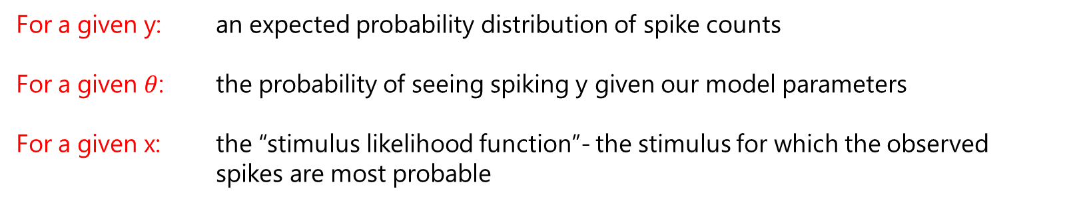
Taking a step back
stimulus “x”
spiking “y”
parameter(s) “$θ$”
Encoding
model
$$P\left(y | x,θ\right)$$
For a given y: an expected probability distribution of spike counts
For a given $θ$: the probability of seeing spiking y given our model parameters
For a given x: the “stimulus likelihood function”- the stimulus for which the observed spikes are most probable

Slide 21



Now: Generalized Linear Models
Poisson encoding
model
$$P\left(y | λ\right)= \frac{1}{y!}λ^{y}e^{−λ}$$
Underlying
spike rate
$$λ=θx$$
What goes into our spike rate $λ$?
whatever we want

Slide 22
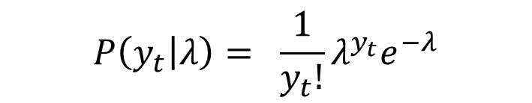

Now: Generalized Linear Models
Stimulus feature (x)
Recorded spikes (y)
Encoding model
time →
$$P\left(y_{t} | λ\right)= \frac{1}{y_{t}!}λ^{y_{t}}e^{−λ}$$
time →
Underlying
spike rate
$$λ=f(x_{1:t},y_{1:t−1})$$

Slide 23
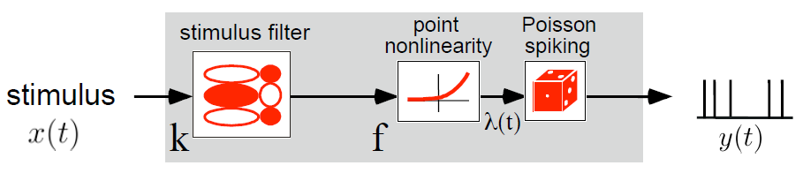
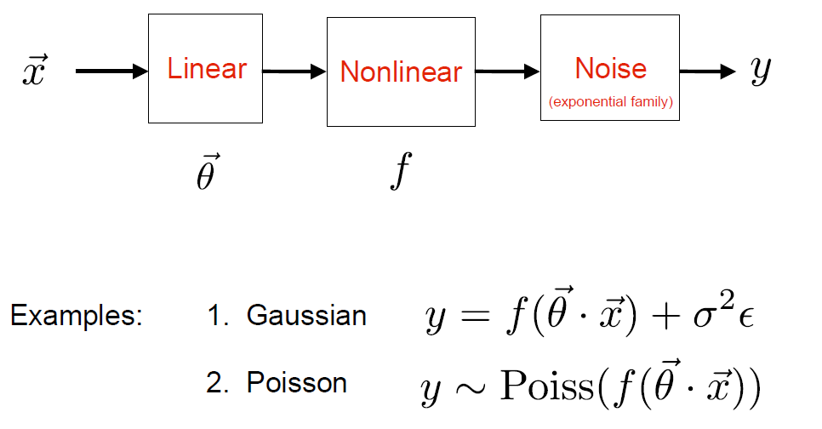
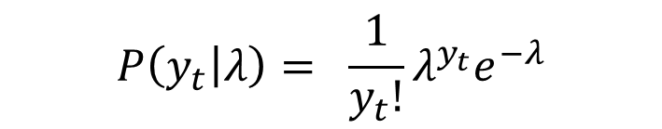

Now: Generalized Linear Models
Stimulus encoding model
$$P\left(y_{t} | λ\right)= \frac{1}{y_{t}!}λ^{y_{t}}e^{−λ}$$
$$λ=f(x_{1:t},y_{1:t−1},…)$$

Slide 24
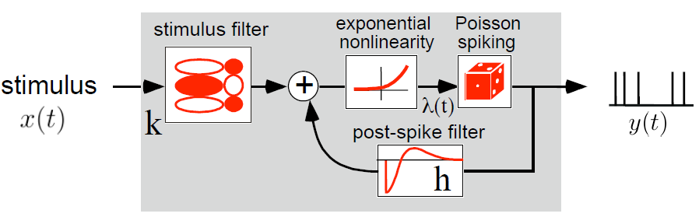
Adding spike-history effects

Slide 25
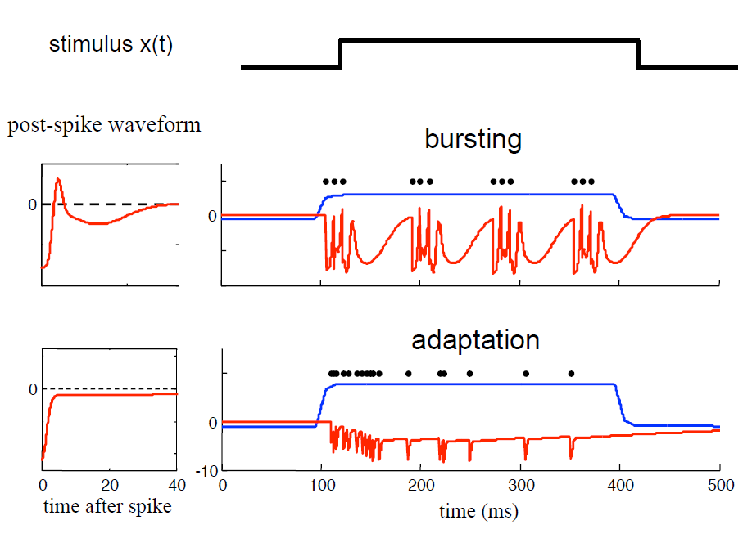
Adding spike-history effects

Slide 26
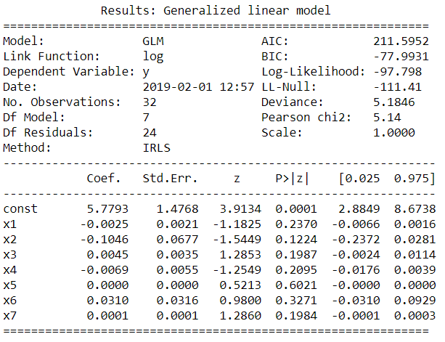
Evaluating your model

