Slide 1

Data
Analysis

Slide 2
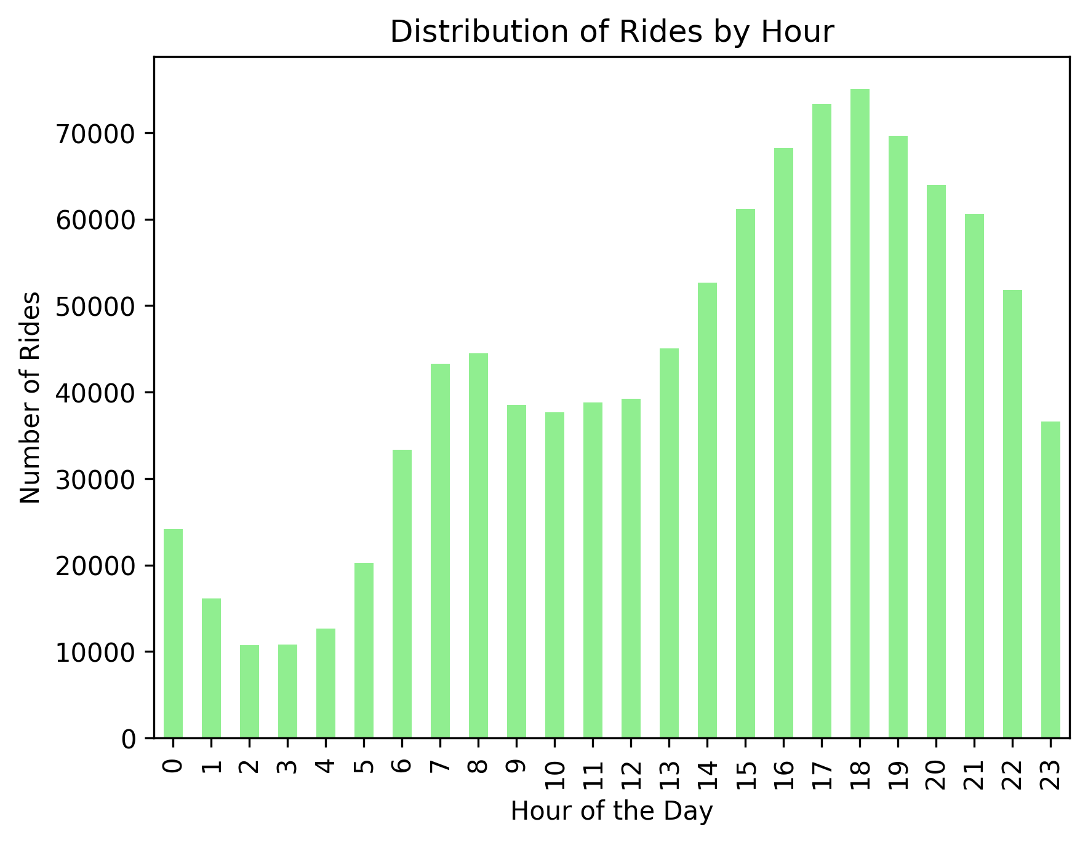
Distribution of rides by hour
From the graph, the number of rides generally increases from the early morning hours, peaks between 5 PM and 9 PM, and then decreases towards the late-night hours. The busiest hour for rides is 7 PM, followed by 8 PM and 6 PM. The least busy hours are 1 AM, 2 AM, and 3 AM.
Overall, the graph suggests that most people take rides during the evening hours, likely for commuting to and from work or for leisure activities.

Slide 3
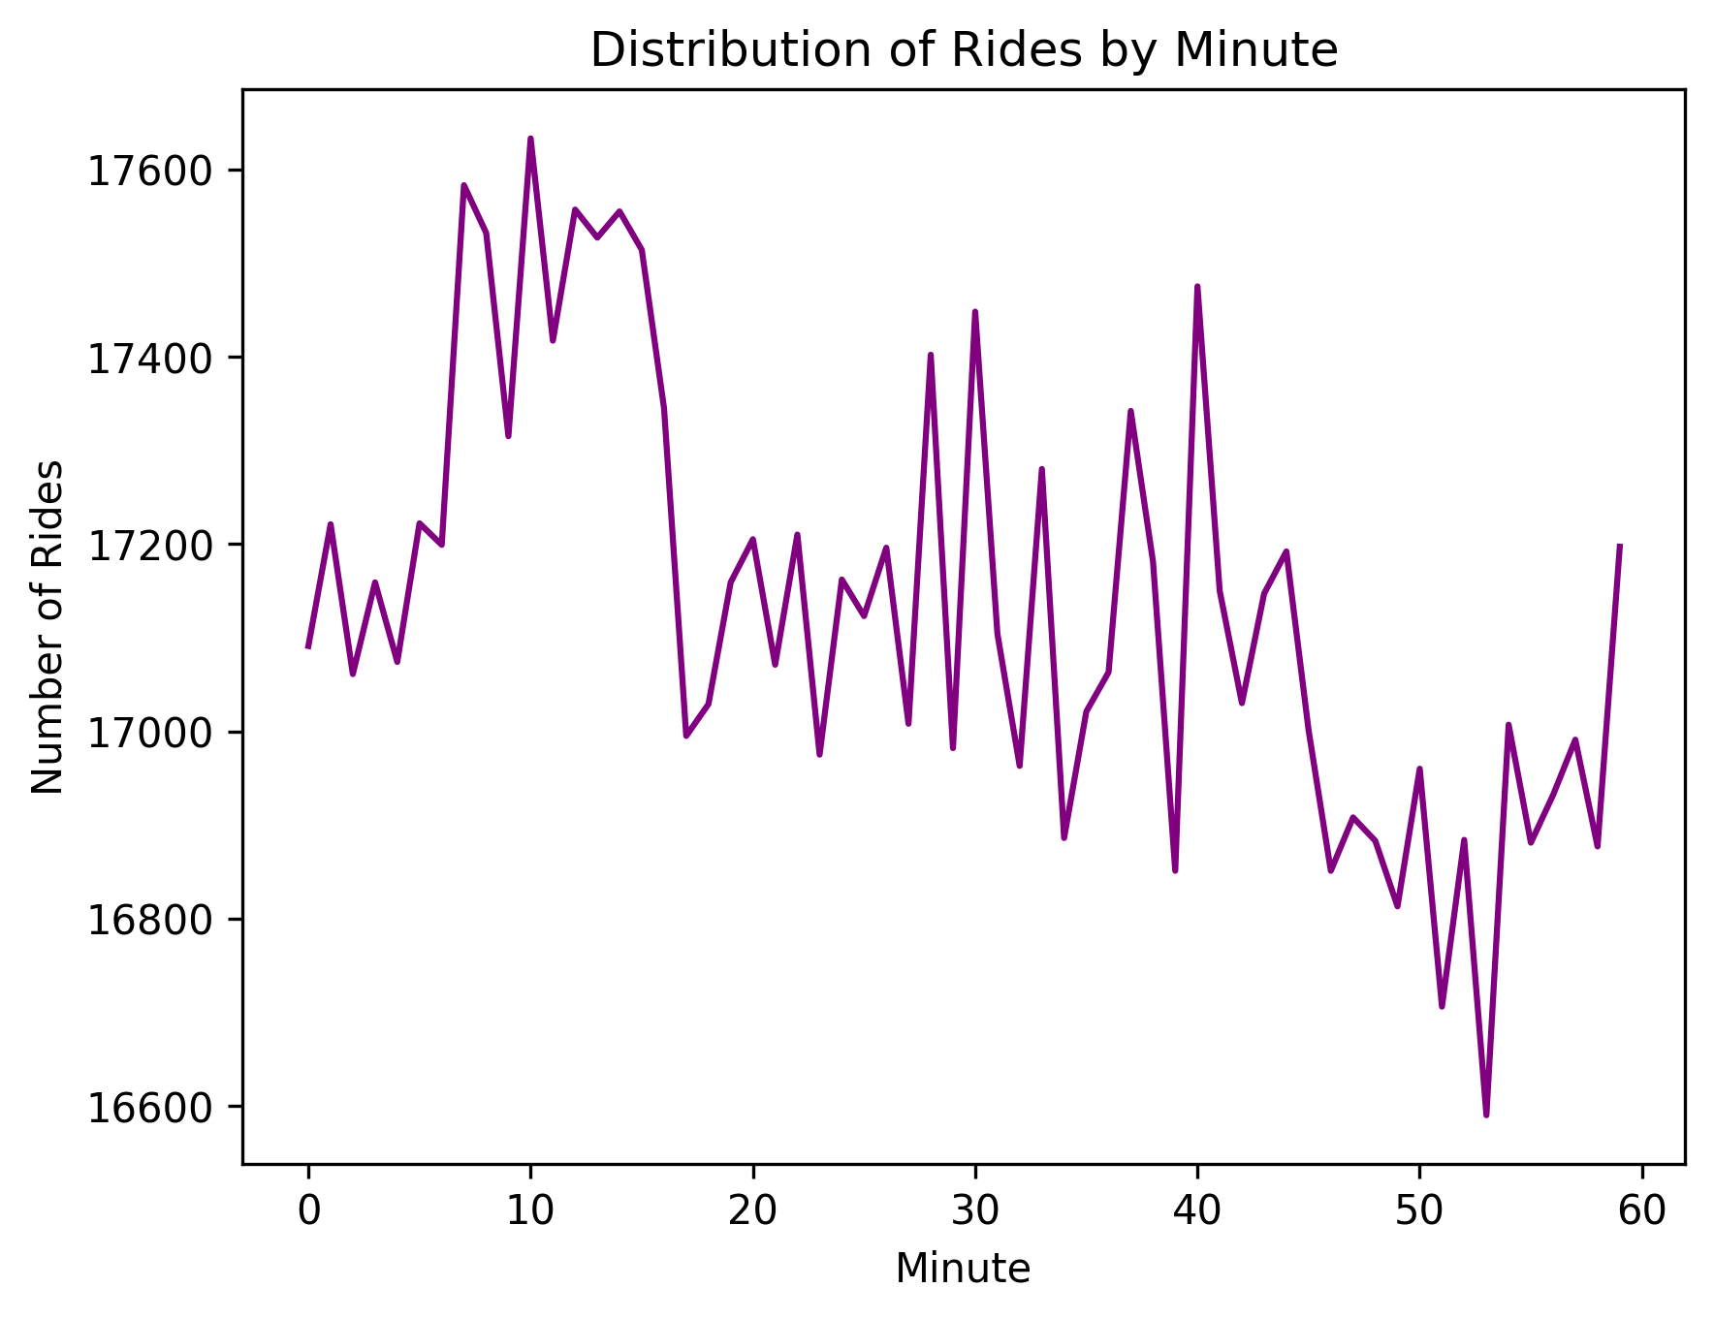
Distribution of rides by Minute
From the graph, the number of rides fluctuates throughout the hour. There are peaks and valleys in the number of rides, indicating that there are periods of higher and lower demand for Uber rides. The highest number of rides occurs around the 10th minute of the hour, while the lowest number of rides occurs around the 50th minute of the hour.
Overall, the graph suggests that the demand for Uber rides is not constant throughout the hour. There are periods of high demand, likely due to factors such as rush hour or popular events, and periods of low demand, likely due to factors such as off-peak hours or less popular events.

Slide 4
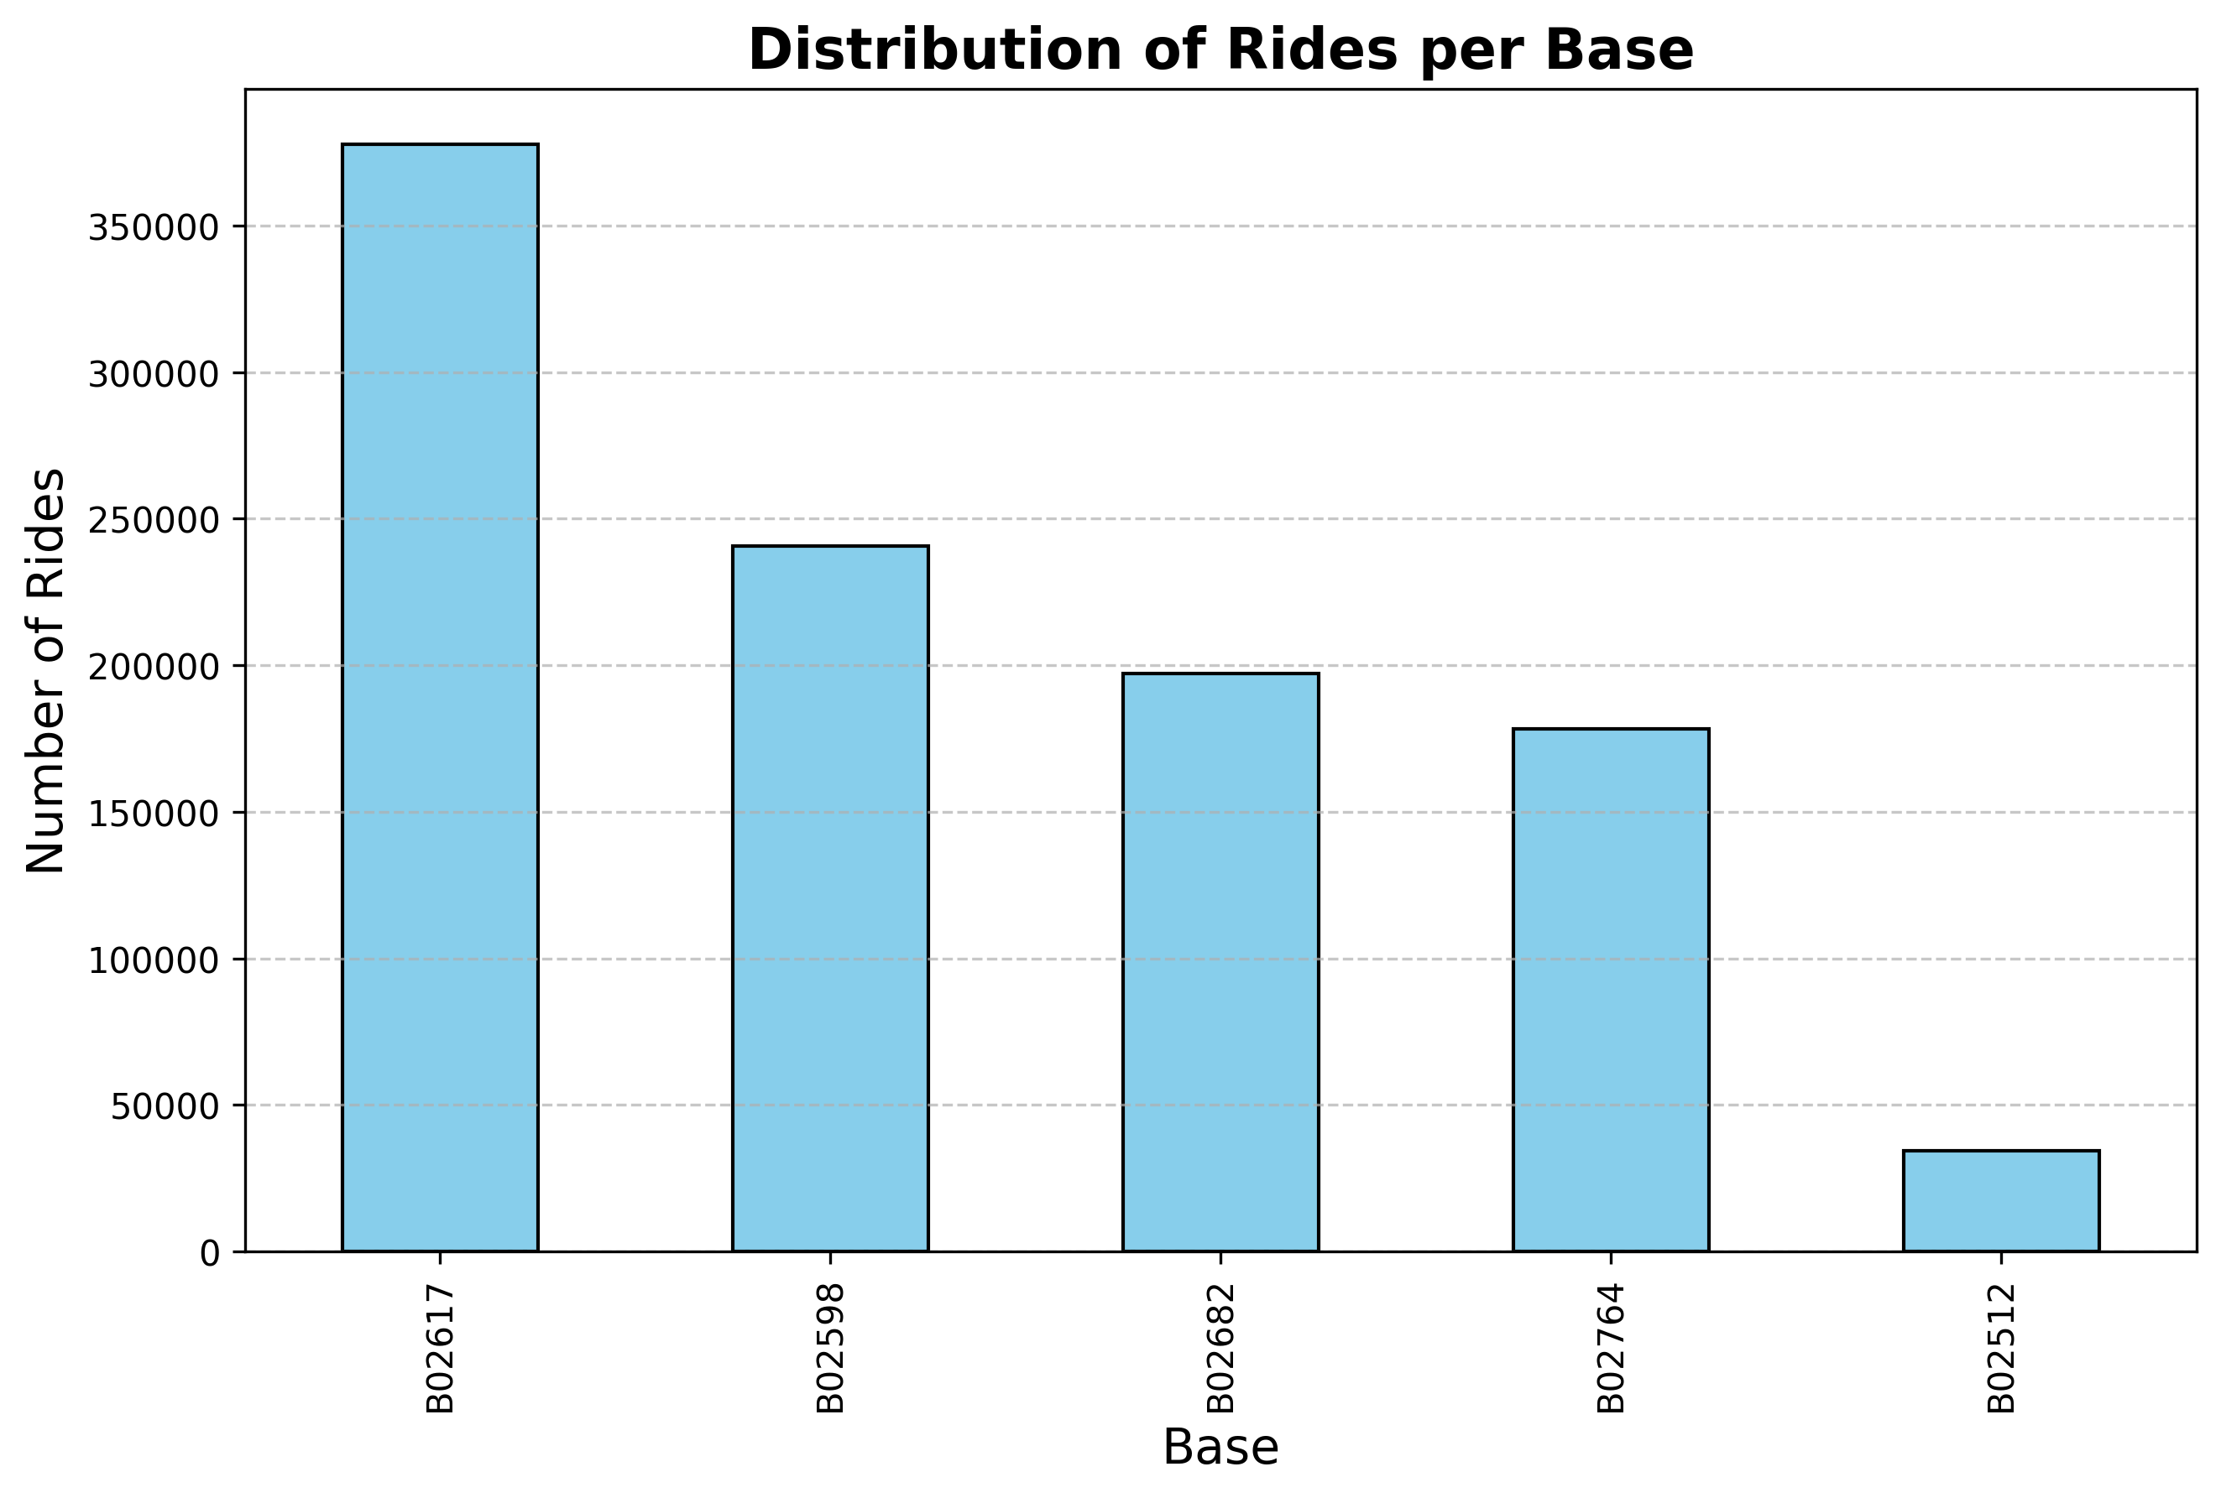
Distribution of rides per base
From the graph, the number of rides varies significantly between different bases. Base B02617 has the highest number of rides, followed by B02598 and B02682. Base B02512 has the lowest number of rides.
Overall, the graph suggests that there is a significant disparity in the number of rides between different Uber bases. This could be due to a variety of factors, such as the location of the base, the availability of drivers, and the demand for rides in the area.

Slide 5
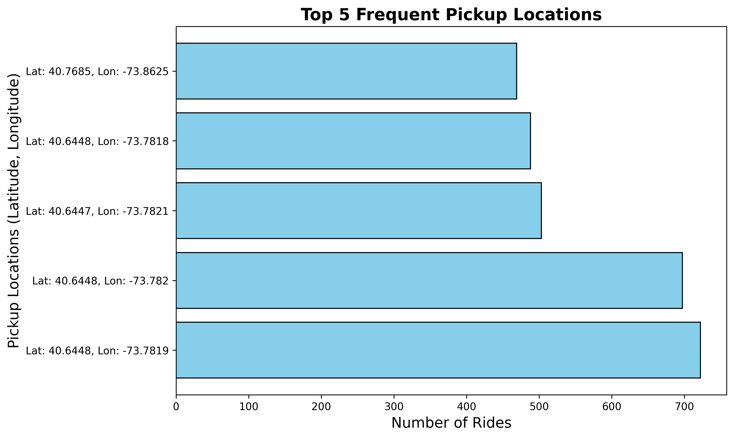
Top 5 frequent locations
From the graph, the pickup location with the highest number of rides is (40.6448, -73.782), followed by (40.6448, -73.7819), (40.6447, -73.7821), (40.6448, -73.7818), and (40.7685, -73.8625).
Overall, the graph suggests that there are certain areas in the city that are more popular for Uber pickups. This could be due to a variety of factors, such as the location of popular attractions, business districts, or residential areas.

Slide 6
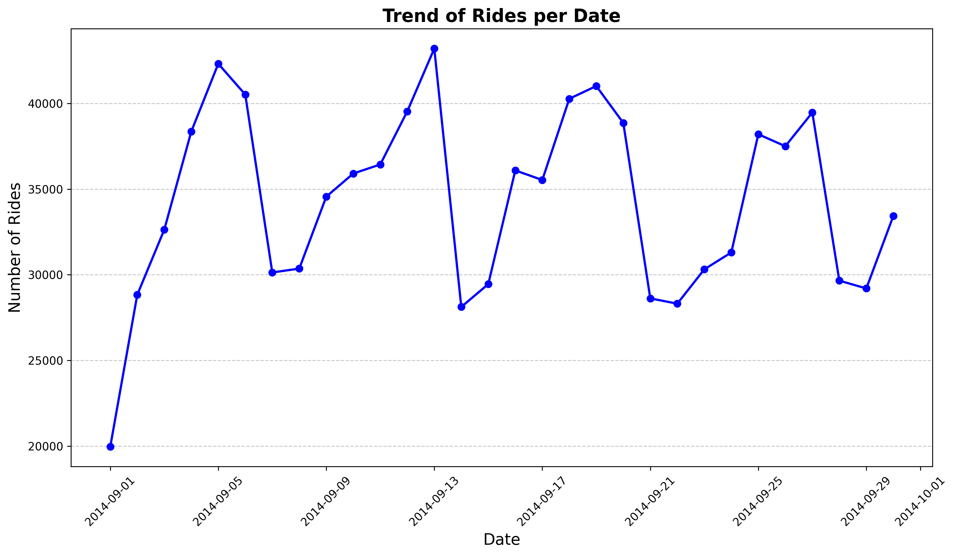
Trend of Rides per Date
From the graph, we can see that the number of rides fluctuates throughout the month. There are periods of high demand, likely due to factors such as weekends, holidays, or special events, and periods of low demand, likely due to factors such as weekdays or less popular events. The highest number of rides occurs around September 13, 2014, while the lowest number of rides occurs around September 29, 2014.
Overall, the graph suggests that the demand for Uber rides is not constant throughout the month. There are periods of high demand, likely due to factors such as rush hour or popular events, and periods of low demand, likely due to factors such as off-peak hours or less popular events.

Slide 7
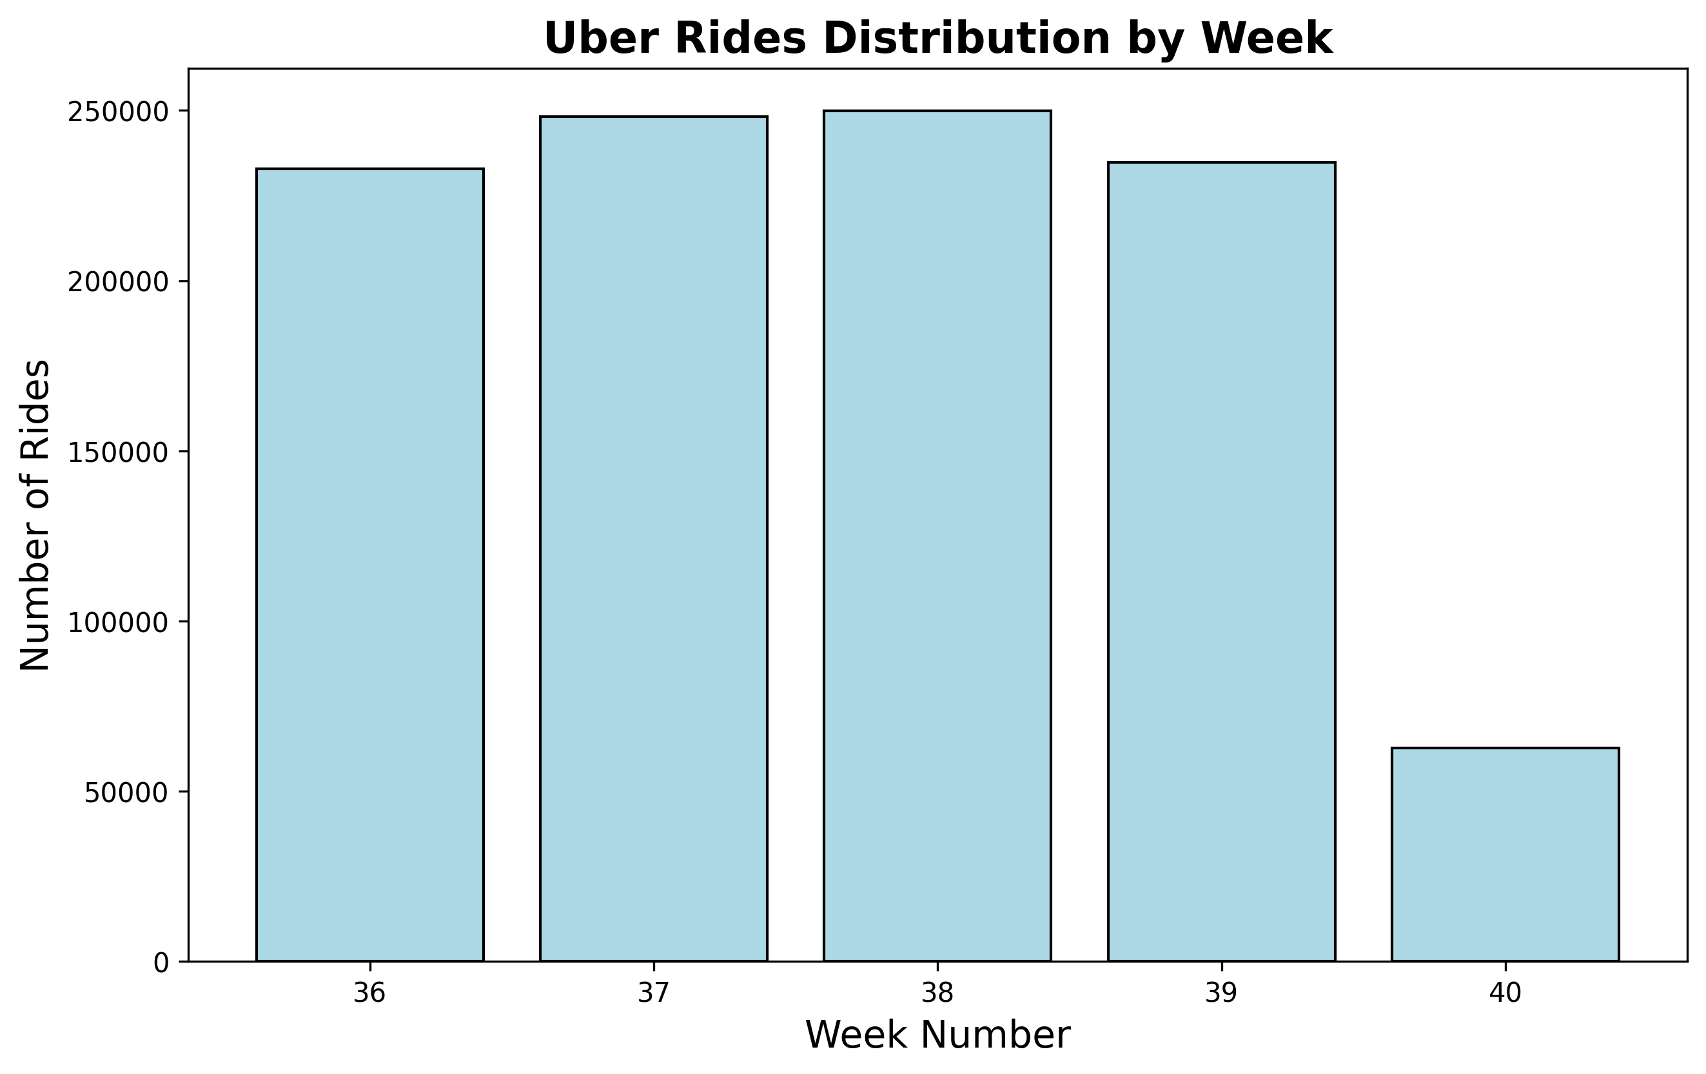
Uber Rides Distribution by week
From the graph, the number of rides varies significantly between different weeks. Week 38 has the highest number of rides, followed by Week 37 and Week 36. Week 40 has the lowest number of rides.
Overall, the graph suggests that there is a significant disparity in the number of rides between different weeks. This could be due to a variety of factors, such as holidays, special events, or seasonal changes.

Slide 8
Thank you

