Slide 1

CLOUD COMPUTING
Cloud Storage and Enablers for Storage Virtualization
Dr. Prafullata Kiran Auradkar
Department of Computer Science and Engineering
Acknowledgements:
Significant information in the slide deck presented through the Unit 3 of the course have been created by Dr. H.L. Phalachandra and would like to acknowledge and thank him for the same. There have been some information which I might have leveraged from the content of Dr. K.V. Subramaniam’s lecture contents too. I may have supplemented the same with contents from books and other sources from Internet and would like to sincerely thank, acknowledge and reiterate that the credit/rights for the same remain with the original authors/publishers only. These are intended for classroom presentation only.

Slide 2
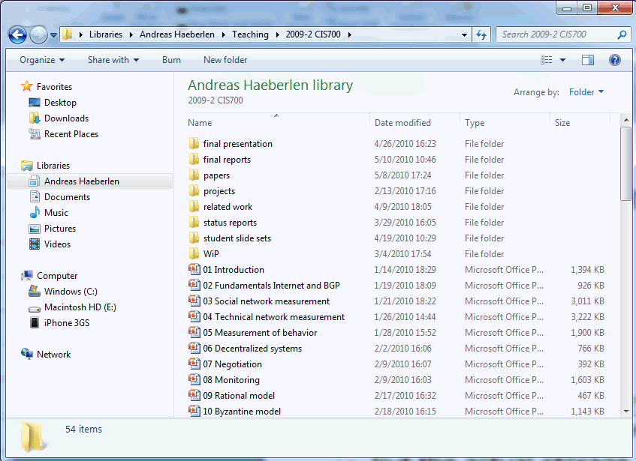
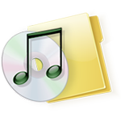


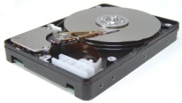
CLOUD COMPUTING
What is Cloud Storage : Complex service, simple storage
Consider the following files which you see regularly
Variable-size files - read, write, append - move, rename - lock, unlock - ...
Operating system
Fixed-size blocks - read - write
PC users see a rich, powerful interface
Hierarchical namespace (directories); can move, rename, append to, truncate, (de)compress, view, delete files, ...
But the actual storage device is very simple
HDD only knows how to read and write fixed-size data blocks
Translation done by the operating system

Slide 3
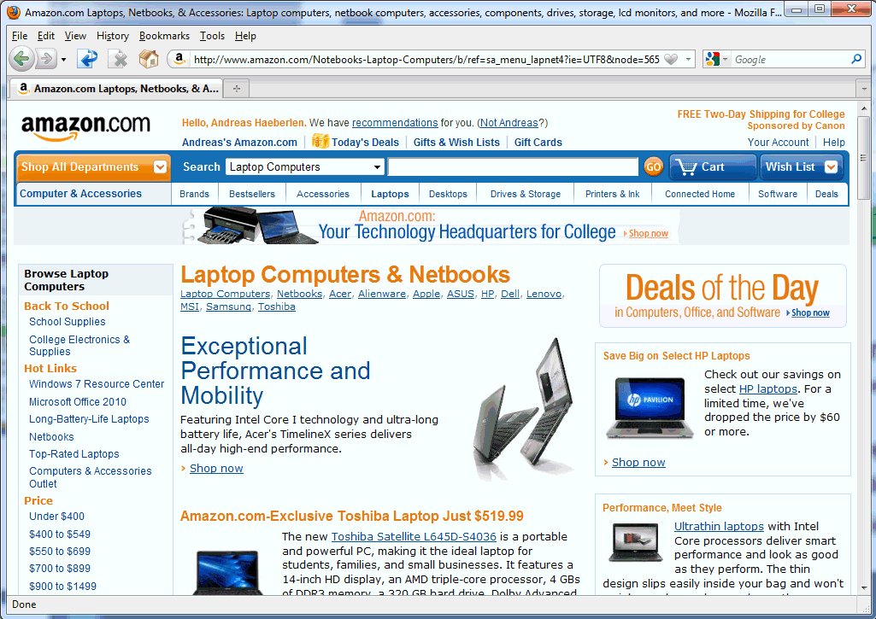


CLOUD COMPUTING
What is Cloud Storage : Analogy to cloud storage
Shopping carts Friend lists User accounts Profiles ...
Web service
Key/value store - read, write - delete
Many cloud services have a similar structure
Users see a rich interface (shopping carts, product categories, searchable index, recommendations, ...)
But the actual storage service is very simple
Read/write 'blocks', similar to a giant hard disk
Translation done by the web service

Slide 4
CLOUD COMPUTING
Cloud Storage
We have seen the Applications can be thrown into the cloud, and we don’t care what server the application lands on. This application needs to store/write or read data, there needs to be an ability for the application to access this seamlessly. This data should also be accessible in case the VM migrates too.
Cloud Storage provides an ability to an application running some-where, to save data and files in an off-site location, and access the same either through the public internet or a dedicated private network connection from where-ever.
Storage Virtualization helps supporting access, utilization, availability and other features which are needed by the applications.
Terminologies like Private cloud, Public cloud, Hybrid Cloud, Internal cloud, external cloud can be applied to the storage based on the where the storage is located, but finally its just the storage systems having the capability of virtual storage pool and multi-tenancy.
Cloud Storage infrastructure includes the hardware and software cloud components. Object based storage is the prominent approach and access to the infrastructure is via web services API

Slide 5
CLOUD COMPUTING
What is Cloud Storage : Cloud Storage
Cloud storage is a data storage service model in which data is maintained, managed, and backed up remotely and made available to users over a network (typically the internet)
These cloud storage providers are responsible for keeping the data available and accessible, and the physical environment, protected and running.
People and organizations buy or lease storage capacity from the providers to store user, organization, or application data.
Cloud Storage or cloud enabled storage can also be visualized as virtual storage pool
Object storage services like Amazon S3 and Microsoft Azure Storage, object storage software like Openstack Swift, object storage systems like EMC Atmos, EMC ECS and Hitachi Content Platform, and distributed storage research projects like OceanStore and VISION Cloud are all examples of storage that can be hosted and deployed with cloud storage characteristics.
Notes:
Object storage services like Amazon S3 and Microsoft Azure Storage, object storage software like Openstack Swift, object storage systems like EMC Atmos, EMC ECS and Hitachi Content Platform, and distributed storage research projects like OceanStore and VISION Cloud are all examples of storage that can be hosted and deployed with cloud storage characteristics.

Slide 6
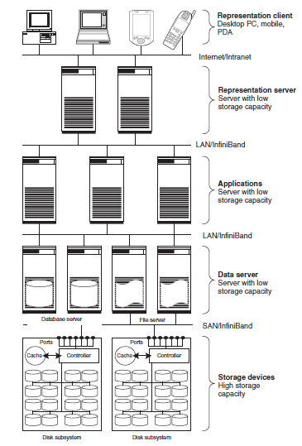


CLOUD COMPUTING
Storage in the Cloud – Cloud Storage Service
Cloud Storage Provider
Web Browser
Storage server
http Server (Could be load balanced)
Web server
Organization of Data
Client

Slide 7
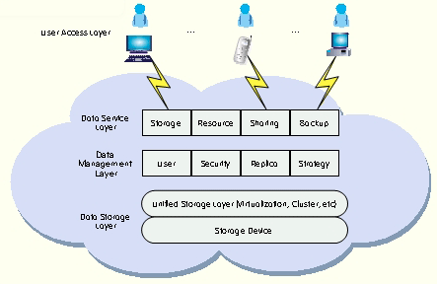


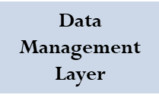




CLOUD COMPUTING
E.g. Architecture of a cloud storage platform
User access layer: an authorized user can log into the cloud storage platform from any location via a standard public application interface and access cloud storage
Data service layer: deals directly with users and depending on user demands, different application interfaces can be developed to provide services such as data storage, space leasing, public resource, multi-user data sharing, or data backup
Data management: provides the upper layer with a unified public management interface for different services. With functions such as user management, security management, replica management, and strategy management
Data storage: data stored in the system forms a massive pool and needs to be organized
User Access Layer

Slide 8
CLOUD COMPUTING
Cloud storage : Cloud Storage Service
Cloud Storage Provider
Storage server
Web server
Pros:
Lower cost
Easier management
Enables sharing and access from anywhere
Cons:
Loss of control
No guarantees of data availability
Provider failures
Client

Slide 9
CLOUD COMPUTING
What Constitutes Cloud Storage
Dramatic reduction in TCO
Cuts storage cost by more than 10 times compared to block or file storage
Unlimited scalability
Since built using distributed technologies, has unlimited scalability
Seamlessly add or remove storage systems from the pool
Elasticity
Storage virtualization decouples and abstracts the storage pool from its physical implementation. So we can get an virtual elastic (grow and shrink as required) and unified storage pool
On-Demand
Uses a pay-as-you-go model, where you pay only for the data stored and the data accessed. For a private cloud, there is a minimal cluster to start with, beyond which it is on-demand.
This can result in huge cost savings for the storage user.

Slide 10
CLOUD COMPUTING
What Constitutes Cloud Storage
Universal Access
Traditional storage has limitations like for block storage, the server needing to be on the same SAN , but Cloud storage offers flexibility on the number of users and from where to access the same.
Multitenancy
Cloud Storage is typically multi-tenant and supports centralized management, higher storage utilization and lower costs
Data durability and availability
Runs on commodity hardware but still highly available even with partial failures of the storage system supported by software layer providing the availability
Usability
Disaster Recovery

Slide 11
CLOUD COMPUTING
Cloud Storage Enablers
Storage like Compute resources is enabled for the cloud by Virtualization
Storage virtualization could be implemented in hardware or software.
Storage virtualization could also be implemented in the Server, in the storage device and in the network carrying the data
Techniques and components like File Systems, Volume Manager, Logical Volume Managers enable Storage virtualization in the Server
Techniques like RAID and Logical Volume Management is also used with Storage virtualization in the storage device
We will discuss a few of these enablers now and discuss the Storage Virtualization itself in the next session.

Slide 12
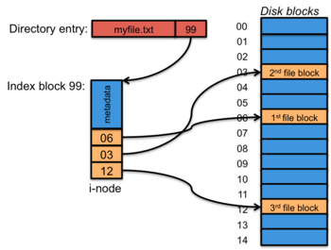
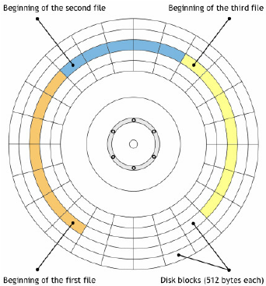
CLOUD COMPUTING
Enablers for Storage Virtualization – File Systems
Data is separated and grouped into pieces and given a name called a file
The structure and logic rules used to manage the groups of information (files) and their names is what forms a file system
File system is used to control how data is stored and retrieved. Without a file system, information placed in a storage medium would be one large body of data with no way to tell where one piece of information stops and the next begins.
Block is a basic unit of storage for IO (Read/Write) operations

Slide 13
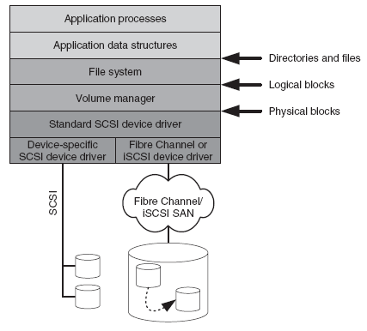
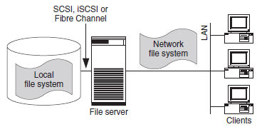
CLOUD COMPUTING
Enablers for Storage Virtualization – File Systems
Local file systems could be seen in this fashion
File systems
Can be used on numerous different types of storage devices that uses different kinds of media
There are also many different kinds of file systems.
Some filesystems are used on local data storage devices and others provide file access via a network interface and is responsible for arranging storage space;
Network file systems make local files and directories available over the LAN. Several end users can thus work on common files
Network File Systems supports applications to share and access files remotely from various computers
NFS functionality (in a typical server dedicated to host files and directories and making them available to be accessed across the network), has a daemon process called nfsd. Server administrator exports the directories and advertises the same in a configuration file.
NFS client requests to the exported directories with the mount command
Once mounted, its transparent on where the data is being accessed and can be controlled by permissions
(End users)

Slide 14
CLOUD COMPUTING
Enablers for Storage Virtualization– Logical Volume Manager (LVM)
Independent layer between the File System and the disk drives
You could create partitions on the physical disk and create physical volumes.
These physical volumes could be grouped into a volume group
This volume group could be broken up into logical volumes
File system can be created on these Logical volumes and mounted
LVM
https://opensource.com/business/16/9/linux-users-guide-lvm

Slide 15
CLOUD COMPUTING
Enablers for Storage Virtualization
Thin Provisioning or Virtual Provisioning
Capacity-on-demand from a shared storage pool
Logical units presented to hosts have more capacity than physically allocated (The physical resources are thinly or virtually provisioned)
Physical storage is allocated only when the host requires it
Provisioning decisions not bound by currently available storage
Shared
Storage Pool
Host
Reported
Capacity
Allocated
Allocated
Allocated
Storage perceived by the application is larger than physically allocated storage

Slide 16
THANK YOU
Prafullata Kiran Auradkar
Department of Computer Science and Engineering
prafullatak@pes.edu

