Slide 1

CLOUD COMPUTING
Multi Leader Replication
Dr. Prafullata Kiran Auradkar
Department of Computer Science and Engineering
Acknowledgements:
Significant information in the slide deck presented through the Unit 3 of the course have been created by Dr. H.L. Phalachandra and would like to acknowledge and thank him for the same. There have been some information which I might have leveraged from the content of Dr. K.V. Subramaniam’s lecture contents too. I may have supplemented the same with contents from books and other sources from Internet and would like to sincerely thank, acknowledge and reiterate that the credit/rights for the same remain with the original authors/publishers only. These are intended for classroom presentation only.

Slide 2
CLOUD COMPUTING
Multi-Leader Replication
Recap: Replication is a means keeping a copy of the same data on multiple machines that are connected via a network. We discussed that there were three popular algorithms for replicating changes between nodes: single-leader, multi-leader, and leaderless replication.
We discussed Leader Based Replication earlier.
Leader-based replication has a single bottleneck in the leader
All writes must go through it. If there is a network interruption between the user and the leader, then no writes are allowed.
An alternate approach to consider is , what if we have more than one leader through whom you can do the writes.

Slide 3
CLOUD COMPUTING
Multi-Leader Replication
So with this natural extension of the leader-based replication model of allowing more than one node to accept writes will lead to
Each node that processes a write must forward that data change to all the other nodes
This approach is also known as master/master or active/active replication
Each leader simultaneously acts as a follower to the other leaders.
This would have different Use cases like
Multi-Datacenter operation can have a leader in each datacenter. Each datacenter has a regular leader– follower replication and between datacenters, each datacenter’s leader replicates its changes to the leaders in other datacenters.
Clients with offline operation
Every device has a local database that
acts as a leader
Collaborative editing

Slide 4
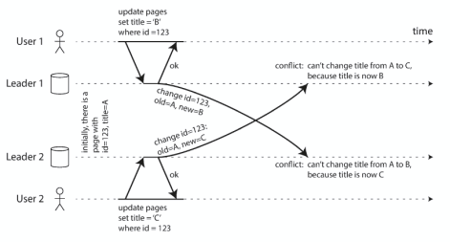
CLOUD COMPUTING
Multi-Leader Replication Challenges
A problem with multi-leader replication is that it can lead to write conflicts
Conflict avoidance - ensure that all writes for a particular record go through the same leader
Converging toward a consistent state - Give each write a unique ID (e.g., a timestamp, a long random number, a UUID, or a hash of the key and value), pick the write with the highest ID as the winner and throw away the other writes.
Custom conflict resolution logic - Write conflict resolution logic in application code. That code may be executed on write or on read

Slide 5
CLOUD COMPUTING
Single-Leader vs. Multi-Leader Replication
Performance
In a single-leader configuration, every write must go over the internet to the datacenter with the leader. This can add significant latency to writes and might contravene the purpose of having multiple datacenters in the first place.
In a multi-leader configuration, every write can be processed in the local datacenter and is replicated asynchronously to the other datacenters. Thus, the inter-datacenter network delay is hidden from users, which means the perceived performance may be better.
Tolerance of datacenter outages
In a single-leader configuration, if the datacenter with the leader fails, failover can promote a follower in another datacenter to be leader.
In a multi-leader configuration, each datacenter can continue operating independently of the others, and replication catches up when the failed datacenter comes back online.

Slide 6
CLOUD COMPUTING
Single-Leader vs. Multi-Leader Replication
Tolerance of network problems
Traffic between datacenters usually goes over the public internet, which may be less reliable than the local network within a datacenter.
A single-leader configuration is very sensitive to problems in this inter-datacenter link, because writes are made synchronously over this link.
A multi-leader configuration with asynchronous replication can usually tolerate network problems better: a temporary network interruption does not prevent writes being processed.

Slide 7
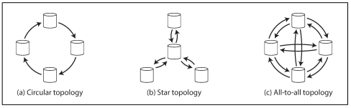
CLOUD COMPUTING
Multi-Leader Replication Topologies
A replication topology describes the communication paths along which writes are propagated from one node to another.
Circular topology - each node receives writes from one node and forwards those writes (plus any writes of its own) to one other node
Star topology - one designated root node forwards writes to all of the other nodes.
All-to-all topology - allows messages to travel along different paths, avoiding a single point of failure.

Slide 8
THANK YOU
Prafullata Kiran Auradkar
Department of Computer Science and Engineering
prafullatak@pes.edu

