Slide 1

CLOUD COMPUTING
Distributed Transactions
Dr. Prafullata Kiran Auradkar
Department of Computer Science and Engineering
Acknowledgements:
Significant information in the slide deck presented through the Unit 3 of the course have been created by Dr. H.L. Phalachandra and would like to acknowledge and thank him for the same. There have been some information which I might have leveraged from the content of Dr. K.V. Subramaniam’s lecture contents too. I may have supplemented the same with contents from books and other sources from Internet and would like to sincerely thank, acknowledge and reiterate that the credit/rights for the same remain with the original authors/publishers only. These are intended for classroom presentation only.
Notes:
https://developers.redhat.com/articles/2021/09/21/distributed-transaction-patterns-microservices-compared#
https://developer.ibm.com/articles/use-saga-to-solve-distributed-transaction-management-problems-in-a-microservices-architecture/#:~:text=A%20transaction%20is%20distributed%20to,to%20span%20across%20different%20databases.
https://hazelcast.com/glossary/distributed-transaction/
https://www.slideshare.net/sriprasanna/transactions-distributed-computing
http://www.cs.cornell.edu/courses/cs614/2002sp/Transactions.pdf
https://www.geeksforgeeks.org/flat-nested-distributed-transactions/

Slide 2
CLOUD COMPUTING
Transactions
Transaction is an operation composed of a number of discrete steps
All the steps must be completed for the transaction to be committed. The results are made permanent else the transaction is aborted and the state of the system reverts to what it was before the transaction started E.g. Buying a house
Basic Operations
Transaction primitives:
Begin transaction: mark the start of a transaction
End transaction: mark the end of a transaction; try to commit
Abort transaction: kill the transaction, restore old values
Read/write data from files (or object stores): data will have to be restored if the transaction is aborted.

Slide 3
CLOUD COMPUTING
Transactions : Properties of Transactions (ACID)
ACID :
Atomic
The transaction happens as a single indivisible action. Others do not see intermediate results. All or nothing.
Consistent
If the system has invariants, they must hold after the transaction. E.g., total amount of money in all accounts must be the same before and after a “transfer funds” transaction.
Isolated (Serializable)
If transactions run at the same time, the final result must be the same as if they executed in some serial order.
Durable
Once a transaction commits, the results are made permanent. No failures after a commit will cause the results to revert.

Slide 4
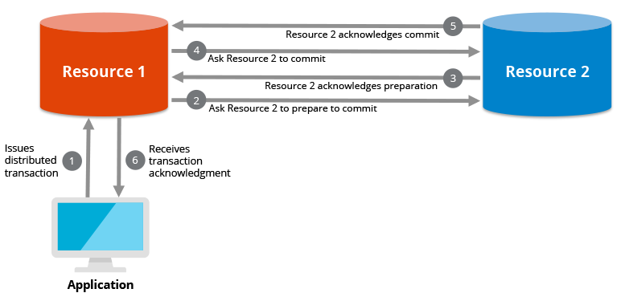
CLOUD COMPUTING
Transactions and different types of transactions :
Nested Transactions
Nested Transaction is a top-level transaction which may create sub-transactions
Problem:
Sub-transactions may commit (results are durable) but the parent transaction may abort.
One solution : private workspace
Each sub-transaction is given a private copy of every object it manipulates. On commit, the private copy displaces the parent’s copy (which may also be a private copy of the parent’s parent)
Distributed Transactions
A distributed transaction is a set of operations on data that is performed across two or more data repositories or resources across different systems
Challenge: handle machine, software, & network failures while preserving transaction integrity.
There are two possible outcomes all operations successfully complete, or none of the operations are performed at all due to a failure somewhere in the system
In the second outcome if some work was completed prior to the failure, that work will be reversed to ensure no net work was done. This type of operation is in compliance with the “ACID” principles to ensure data integrity

Slide 5
CLOUD COMPUTING
Distributed Transaction System Architecture
A system architecture supporting distributed transactions, has multiple data repositories hosted on different nodes connected by a network.
Transaction may access data at several nodes/sites.
Each site has a
local transaction manager responsible for:
Maintaining a log for recovery purposes
Participating in coordinating the concurrent execution of the transactions executing at that site.
Responsible for sub-transactions on that system
Performs prepare, commit and abort calls for sub-transactions
Each sub-transaction must agree to commit changes before the transaction can complete
Transaction coordinator coordinating activities across the data repositories
Periodically a local transaction manager is nominated as a local coordinator
Starting the execution of transactions that originate at the site.
Distributing sub transactions at appropriate sites for execution.
Coordinating the termination of each transaction that originates at the site, which may result in the transaction being committed at all sites or aborted at all sites.
Application
TR Co-ordinator
R
TR Manager
TR
TR Manager
TR Manager
TR
TR
Node
Node
Node

Slide 6
CLOUD COMPUTING
Concurrency Control
All concurrency mechanisms must preserve data consistency and complete each atomic action in finite time
Important capabilities are
Be resilient to site and communication link failures.
Allow parallelism to enhance performance requirements.
Incur optimal cost and optimize communication delays
Place constraints on atomic action.

Slide 7
CLOUD COMPUTING
Commit Protocols
Commit protocols are used to ensure atomicity across sites
A transaction which executes at multiple sites must either be committed at all the sites, or aborted at all the sites.
Not acceptable to have a transaction committed at one site and aborted at another.
The two-phase commit (2 PC) protocol is widely used.
Notes:
Two-phase commit protocol: Phase 1 Get distributed agreement: the coordinator asked each cohort if it will commit or abort and received replies from each coordinator Coordinator Cohort <ul><li>Write prepare to commit to log </li></ul><ul><li>Send prepare to commit message </li></ul><ul><li>Work on transaction </li></ul><ul><li>Wait for message from coordinator </li></ul><ul><li>Wait for reply from each cohort </li></ul><ul><li>Receive prepare message. </li></ul><ul><li>When ready, write agree to commit or abort to the log </li></ul><ul><li>Send agree or abort reply </li></ul>
14. Two-phase commit protocol: Phase 2 <ul><li>Ask all cohorts to commit or abort and get everyone’s response that they’re done. </li></ul>Coordinator Cohort <ul><li>Write commit to log </li></ul><ul><li>Wait for commit message </li></ul><ul><li>Send commit or abort </li></ul><ul><li>Receive commit or abort </li></ul><ul><li>Wait for all cohorts to respond </li></ul><ul><li>If a commit was received, write “ commit ” to the log, release all locks, update databases. </li></ul><ul><li>If an abort was received, undo all changes </li></ul><ul><li>Send done message </li></ul><ul><li>Clean up all state. Done!

Slide 8
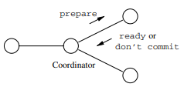
CLOUD COMPUTING
Two Phase Commit Protocol - Phase 1
Lets consider a transaction is named as “T”
The coordinator places a log record prepare T on the log at its site.
The coordinator sends to each component’s site the message prepare T.
Each site receiving the message prepare its component of the transaction “T”.
If a site wants to commit its component, it must enter a state called pre-committed with a Ready T message. Once in the pre-committed state, the site cannot abort its component of T without a directive to do so from the coordinator
So, after prepare T is received, Perform whatever steps necessary to be sure the local component of T will not have to abort
If everything is fine and it ready to commit, then place the record Ready T on the local log and flush the log to disk and send Ready T message to the coordinator
If the site wants to abort its component of T, then it logs the record Don’t Commit T and sends the message Don’t commit T to the coordinator
Two Phase Commit : Phase 1
Co-Ordinator | Related Nodes (Sites)
Write prepare to commit T to log at its site Send prepare to commit message | Receive prepare message Work on the components towards T If ready to commit get into pre-committed state for T and place Ready T in the local log and send Ready T message to the coordinator (holds locks..) If not ready to commit place Don’t commit T to the local log and send Don’t commit T message to the coordinator Wait for message from coordinator
Wait for reply from each related node

Slide 9
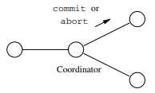
CLOUD COMPUTING
Two Phase Commit Protocol - Phase 2
If the coordinator has received ready T from all components of T, then it decides to commit T. The coordinator logs Commit T at its site and then sends message commit T to all sites involved in T
If the coordinator has received don’t commit T from one or more sites, it logs Abort T at its site and then sends abort T messages to all sites involved in T
If a site receives a commit T message, it commits the component of T at that site, releases the locks ..,logging Commit T as it does.
If a site receives the message abort T, it aborts T, releases locks and writes the log record Abort T
Two Phase Commit : Phase 2
Co-Ordinator | Related Nodes (Sites)
If Ready T has been received from all nodes, then write commit T to the local log and Send commit T message If Don’t commit T is received from any of the related nodes, then write Abort T to the local log and send Abort T is sent to all related nodes (sites) Wait for Done message and clear up all states | (If in the Pre-Committed State, continue to hold the locks) Receive Commit T or Abort T message If Commit T is received, commit the component of T at the site, release locks .. and place Commit T to local log and send Done message to the co-ordinator If Abort T is received, roll back all changes, release locks .. and place Abort T to the local log and send Done message to the Co-ordinator

Slide 10
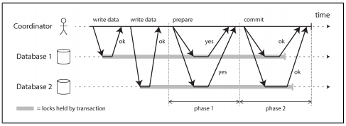
CLOUD COMPUTING
Two Phase Commit Protocol
A successful execution of two-phase commit

Slide 11
THANK YOU
Prafullata Kiran Auradkar
Department of Computer Science and Engineering
prafullatak@pes.edu

