Slide 1
Title
LunaBot: Autonomous Navigation of Robot for Lunar Habitats

Slide 2
Abstract
Autonomous robot for lunar habitat navigation using AI, sensors and obstacle avoidance.

Slide 3
Introduction
LunaBot supports astronauts by performing navigation, inspection and transport tasks.

Slide 4
Need for Project
The Moon has harsh terrain and communication delays. Autonomous robots improve efficiency and safety.

Slide 5
Objectives
Autonomous movement, obstacle avoidance, path planning, mapping and monitoring.

Slide 6
Literature Survey
Existing lunar rovers use sensors, SLAM, computer vision and AI-based navigation.

Slide 7
System Architecture
Sensors → Processing Unit → Navigation Module → Motor Controller → Robot.

Slide 8
Hardware Components
Raspberry Pi, Camera, LiDAR/Ultrasonic Sensor, Motors, Battery.

Slide 9
Software Components
Python, OpenCV, NumPy, ROS, Machine Learning algorithms.

Slide 10
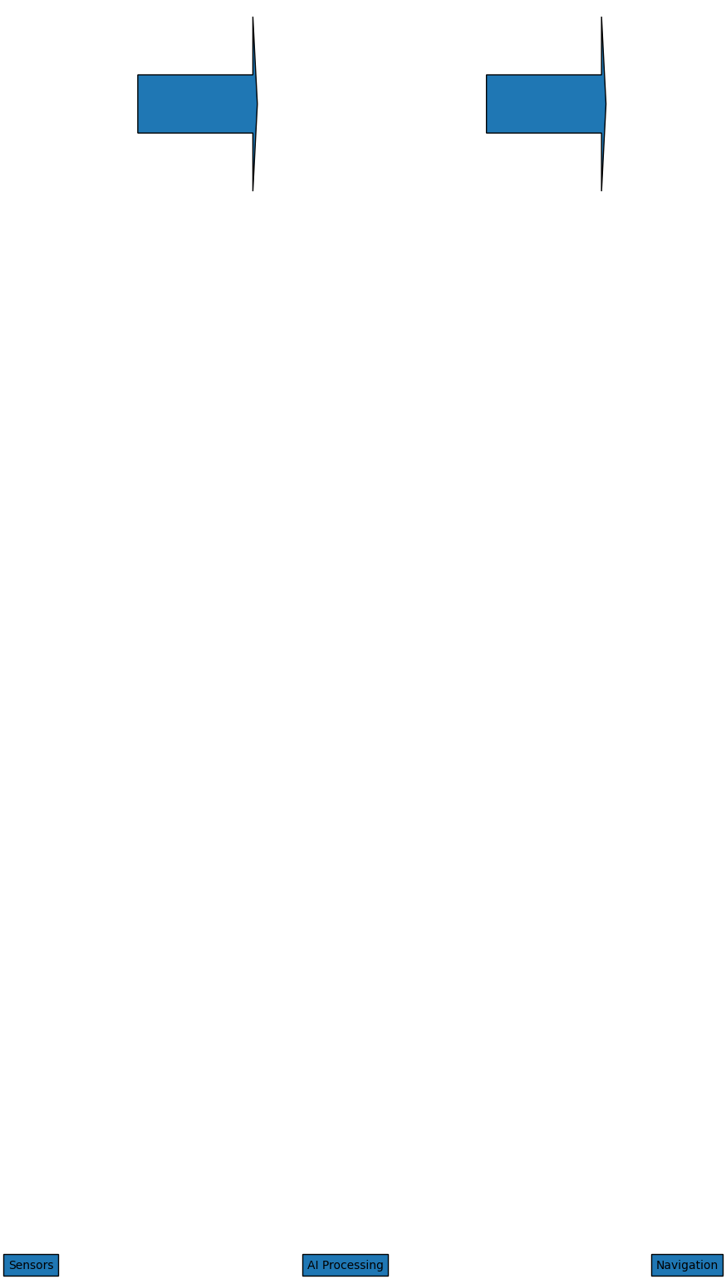
Flowchart
System flowchart shown below.

Slide 11
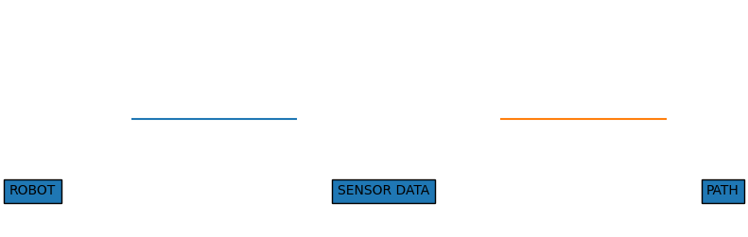
ER Diagram
Entity relationship diagram shown below.

Slide 12
Algorithm
1. Read sensor data
2. Detect obstacles
3. Plan route
4. Move robot
5. Repeat.

Slide 13
Python Program
import cv2
obstacle_detected = False
if obstacle_detected:
print('Stop Robot')
else:
print('Move Forward')

Slide 14
Applications
Lunar exploration, habitat maintenance, logistics and scientific missions.

Slide 15
Advantages
Reduced human risk, continuous operation, efficient navigation.

Slide 16
Future Scope
Swarm robots, advanced AI mapping, deep-space missions.

Slide 17
Conclusion
LunaBot demonstrates intelligent navigation for future lunar habitats.

