Slide 1
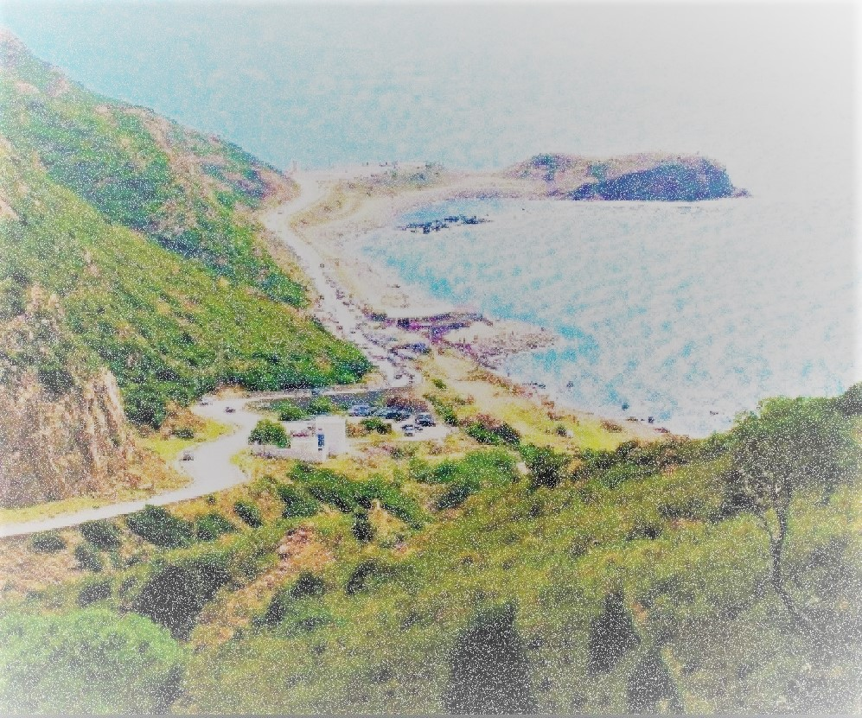
General comments:
Comment 1: joe willock from england (august 2016)
Being in Oued Abid was like a dream..i really felt like I’m in paradise, the atmosphere was amazing and the view was unbelievable.
Comment2: Lukas Ginter from germany ( November 2018)
“I went to break stereotypes of Arab culture, I went to takelsa and indeed I discovered a world of warm love and respect.”
Comment 3: Reyansh from india (july 2015)
Lying on a sloping hill it is possible to climb to the "back" of the place and up on the rooftops for fantastic views and panoramic pictures...the nature there is indescribable
Comment4: Jose Barros from brazil (august 2018)
I visited the palace of wassila during my trip and I can say it’s the most beautiful building I have ever seen..just being there in an old and beautiful structure made my day.
Comment 5: Diop from Burkina Faso (july 2013)
I was spirited by swimming in takelsa beach and being in the health centre in korbos with that hot water slips from among the stones..What a magical trip it was.

