Slide 1
Metadata
Title: Random Forests
Purpose: Introduce random forests and provide some tips for implementation
Date created: 04/06/2021
Created by: Sabhya Gupta
Last edited on: 04/06/2021
Last edited by: Sabhya Gupta
Notes/guidelines: This PPT is accompanied by an exercise
J- PAL | Random Forests

Slide 2


Random Forests
Introduction and implementation

Slide 3

Machine Learning Overview
Random Forests
Exercise

Slide 4
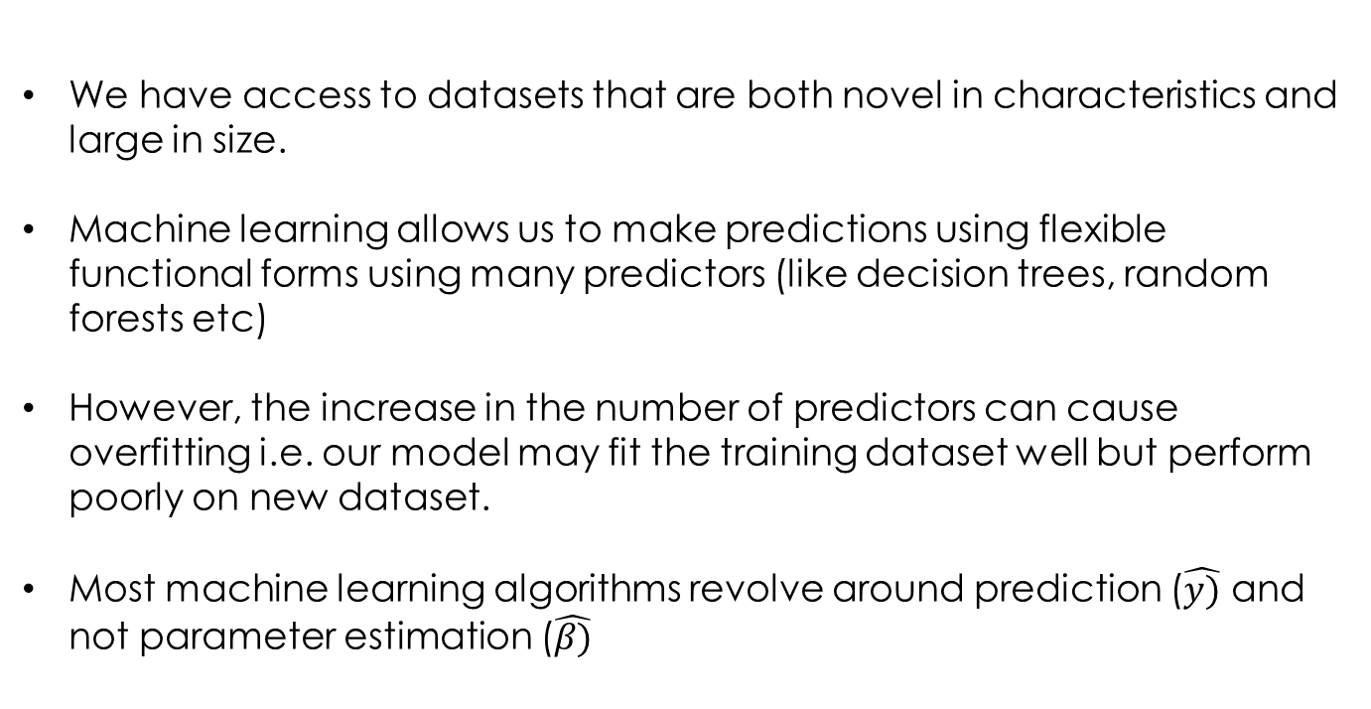
Why use Machine Learning?
We have access to datasets that are both novel in characteristics and large in size.
Machine learning allows us to make predictions using flexible functional forms using many predictors (like decision trees, random forests etc)
However, the increase in the number of predictors can cause overfitting i.e. our model may fit the training dataset well but perform poorly on new dataset.
Most machine learning algorithms revolve around prediction ($\hat{y)}$ and not parameter estimation ($\hat{β)}$
J- PAL | Random Forests
3
Notes:
Machine learning is similar to regression in the sense that it is uses predictors to fit values of a dependent variable. However, it is not good for parameter estimation

Slide 5
Machine Learning Overview
Random Forests
Exercise

Slide 6
Random Forests
We can use the random forests for regression and classification (binomial or multi-class)
The random forest algorithm aggregates the predictions from multiple decision trees on sub-samples from the training dataset
Randomly split the original dataset into a training and validation datasets
Repeatedly sub-sample the training dataset (bootstrapping)
One decision tree is made per bootstrapped sample
The results from the many decision trees are then aggregated for predictions on a new sample
J- PAL | Random Forests
5

Slide 7
1. Training and Validation Dataset
We first divide our original dataset into a training and validation dataset.
Training dataset is used to “estimate” the random forest. The next steps of the algorithm are performed on the training dataset.
The random forest is then used to predict the dependent variable in the validation dataset. Since we know the actual values, we can estimate the error rate on data outside the training dataset.
Original dataset
Age | Income | Sex | Married
Age | Income | Sex | Married
Training dataset (randomly select 60 percent)
Married (actual)
Married (predicted)
Age | Income | Sex
Validation dataset (randomly select 40 percent)
J- PAL | Random Forests
6

Slide 8
Example Training Dataset
Age | Income | Sex | Married
35 | 46000 | F | N
50 | 90000 | M | N
22 | 70000 | M | N
28 | 50000 | F | N
41 | 90000 | F | Y
32 | 60000 | F | Y
71 | 120000 | M | N
60 | 70000 | F | Y
J- PAL | Random Forests
7

Slide 9
2. Bootstrapping
Age | Income | Sex | Married
50 | 90000 | M | N
41 | 90000 | F | Y
71 | 120000 | M | N
28 | 50000 | F | N
60 | 70000 | F | Y
Age | Income | Sex | Married
35 | 46000 | F | N
50 | 90000 | M | N
22 | 70000 | M | N
28 | 50000 | F | N
41 | 90000 | F | Y
32 | 60000 | F | Y
71 | 120000 | M | N
60 | 70000 | F | Y
Bootstrapped sample
Age | Income | Sex | Married
35 | 46000 | F | N
32 | 60000 | F | Y
22 | 70000 | M | N
Not in the bootstrapped sample (out of the bag sample)
The algorithm repeatedly randomly samples the training set with replacement, each of which is called the “bootstrapped” sample.
The rest of the training set is called the “out of the bag” sample
J- PAL | Random Forests
8

Slide 10
3. Decision Trees
On each bootstrapped sample, the algorithm tries to fit a decision tree
Age | Income | Sex | Married
50 | 90000 | M | N
41 | 90000 | F | Y
71 | 120000 | M | N
28 | 50000 | F | N
60 | 70000 | F | Y
Age >40
Yes
No
2 married
2 not married
0 married
1 not married
We use a variable (“age”) and a threshold value (“40”) at each node and split the data into two
J- PAL | Random Forests
9
Notes:
If this was a regression tree, the final results would be the value of the dependent variable

Slide 11
3. Decision Trees
On each bootstrapped sample, the algorithm tries to fit a decision tree
Age | Income | Sex | Married
50 | 90000 | M | N
41 | 90000 | F | Y
71 | 120000 | M | N
28 | 50000 | F | N
60 | 70000 | F | Y
Age >40
Yes
No
Sex = F
0 married
1 not married
Yes
No
2 married
0 not married
0 married
2 not married
We use another variable at the next node and divide the data into 2
J- PAL | Random Forests
9
Notes:
Make this easier

Slide 12
3. Decision Trees
On each bootstrapped sample, the algorithm tries to fit a decision tree
Age | Income | Sex | Married
50 | 90000 | M | N
41 | 90000 | F | Y
71 | 120000 | M | N
28 | 50000 | F | N
60 | 70000 | F | Y
Age >40
Yes
No
m = 2
Sex = F
Predicts not married
Yes
No
Predicts married
Predicts not married
The variable and threshold that provides the best split is used to do a binary split at each node.
Each decision tree uses some “m” variables. In random forests, m is less than the total number of predictor variables.
J- PAL | Random Forests
9
Notes:
If this was a regression tree, the final results would be the value of the dependent variable. Trees can vary in complexity with many variables and logical operations at each node. Other features are the depth of the tree. Decision trees can be more complicated with more logical statements at each node. Usually binary division (ie yes and no). Can have more “impure” divisions i.e. after a division, there are some people who are married and some who are not. The decision tree chooses the majority share.

Slide 13
4. Prediction by aggregating
The random forest algorithm creates a decision tree for each bootstrapped sample. When a new sample is presented to the random forest, it aggregates the results of the individual decision trees in the forest to make a prediction
Classification: Takes the majority of the predictions from each tree
Regression: The average of the prediction from each tree
J- PAL | Random Forests
10

Slide 14
Age >40
Age | Income | Sex
35 | 20000 | M
Yes
No
Sex = F
Not married
Yes
Sex = F
Married
Income < 30000
Yes
No
No
Yes
Income > 40000
Age < 40
Age > 30
Not married
Yes
No
Yes
No
Married
Not married
Married
Not married
Yes
No
Married
Not married
J- PAL | Random Forests
11
9
9
Notes:
Say our model bootstrapped 3 subsamples from the training set and made a tree on each. These are example trees. Now we will use the trees to predict the marital status of the new person

Slide 15
Age >40
Age | Income | Sex
35 | 20000 | M
Yes
No
Sex = F
Not married
Yes
Sex = F
Married
Income < 30000
Yes
No
Yes
No
Income > 40000
Age < 40
Age > 30
Not married
Yes
No
Yes
No
Married
Not married
Married
Not married
Yes
No
Married
Not married
J- PAL | Random Forests
12
9
9
Notes:
So the model will conclude that the person is married

Slide 16
Recap
Randomly split the original dataset into a training and validation datasets
Repeatedly sub-sample the training dataset
One decision tree is made per bootstrapped sample using some variables. We can specify the number of variables tried for each tree and the number of trees
The results from the many decision trees are then aggregated for predictions on a new sample
J- PAL | Random Forests
13

Slide 17
Advantages and Disadvantages
Advantages:
We can use several variables without worrying about overfitting since each decision tree is made with only a few variables. However, each variable ends up being used in at least one decision tree, reducing bias
Disadvantages:
A regression random forest cannot predict values beyond the values of the dependent variable in the training set.
They cannot run with missing data but we can use random forests for imputations
Results can be sensitive to random sampling especially in small datasets
J- PAL | Random Forests
14
Notes:
This is because the predictions are averaged across decision trees. Since the predictions from each decision tree will lie in the training set, the average will also lie within the training set. Some data suggests that they are good for prediction but should be vary of using them for continuous variable.

Slide 18
Random Forests in Economics
Human Decision Making:
Dobbie and Yang (forthcoming) and Kleinberg et.al (2018) use random forests to predict the probability of future misconduct for bail defendants. This is used to make jail-or-release decisions
New kinds of Data :
Combes et al (2020) use random forests to identify land use on old, imperfect maps circa 1860 to study urban growth
J- PAL | Random Forests
15

Slide 19
Measuring Performance
Classification:
Out-of-the-Bag error: The decision tree trained on each bootstrapped sample is tested on the corresponding out-of-the-bag sample. The percentage of incorrectly predicted rows is computed for each. This error is averaged across out-of-the bag samples
Validation error: The percentage of incorrected predicted rows in the validation dataset
Other measures include the area under the ROC which is also used for linear classifiers (logistic regression, linear probability model etc)
J- PAL | Random Forests
16

Slide 20
Measuring Performance
Regression:
Performance measures used for linear regression like root mean square error (RMSE), Mean Square error (MSE) and pseudo R squared on the training and the validation dataset can be used to measure performance.
J- PAL | Random Forests
17

Slide 21
Choosing Variables
We can use two measures to rank the variables of the model:
Mean Decrease Accuracy: This measures the decrease in the performance from omitting that variable from the model. A higher value indicates that the variable is uniquely important for predicting the model. The value can be interpreted as the accuracy provided by including that variable
J- PAL | Random Forests
18
Notes:
It is helpful to note that accuracy does not mean that if you were to remove that variable, the model would become X percent better. The accuracy Mean Decrease Accuracy depends on the correlation between the variables. The actual value of accuracy is less important and the measure is primarily used for ranking. It is calculated by permuting the variable and subtracting the OOB from the overall OOB

Slide 22
Mean Decrease Gini: Gini is a measure of “impurity” of a node. For instance: Say we are classifying whether someone prefers tea or coffee
Age <= 18
Sex = F
Yes
No
Yes
No
5 percent prefer coffee
95 percent prefer tea
90 percent prefer coffee
10 percent prefer tea
60 percent prefer coffee
40 percent prefer tea
70 percent prefer coffee
30 percent prefer tea
Age splits the data into more homogenous groups than sex. Hence, age has a lower Gini value than gender. “Mean Decrease Gini” measures how much the Gini decreases when we include a variable. A high value means that the variable leads to more homogenous splits and is more important for prediction
J- PAL | Random Forests
19
Notes:
If both nodes are hundred percent pure/homogenous, the Gini is 0.

Slide 23
Tuning the model (Hyperparameter tuning/Regularization
We can adjust the following parameters of the model:
Number of trees: A higher number of trees are better to learn about the data however a lot of trees can slow down the training process.
Number of variables to try when making a tree: A higher number may lead to more accurate prediction per tree but can cause overfitting.
Depth of the tree: Depth of the tree represents the number of splits or nodes in the tree. A higher depth means that it captures more information about the data
J- PAL | Random Forests
20

Slide 24
Machine Learning Overview
Random Forests
Exercise

Slide 25
Random forests in STATA/R
R:
A very basic introduction to Random Forests using R
Random Forest in R
RandomForest and RandomForestExplainer packages
Example based on Titanic data
STATA:
CRTrees: an implementation of CART and Random Forests in STATA, Ricardo Mora (2019)
J- PAL | Random Forests
22

Slide 26
References and Resources
Machine Learning: An Applied Econometric Approach, Mullainathan, Sendhil and Jann Spiess (2017), Journal of Economic Perspectives, Vol 31(2), pp 87-106
Handing missing data
Random forest for regression: why it fails and potential solutions
J- PAL | Random Forests
23

Slide 27
Appendix 1: Decision Tree (Regression)
Age | Sex | Married | Income
50 | M | N | 90000
41 | F | Y | 90000
71 | M | N | 120000
28 | F | N | 50000
60 | F | Y | 70000
Married = Y
Yes
No
Age > 50
Age > 50
Yes
No
Yes
No
Income = 90000
Income = 90000
Income = 70000
Income = 70000
J- PAL | Random Forests
20

Slide 28
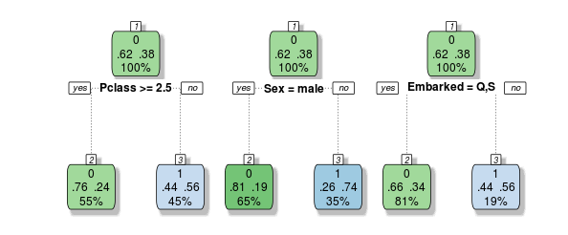
Appendix 2: More Decisions Trees
0 and 1 outcome variable indicate the outcome for a passenger on the Titanic. 1 = Die, 0 = survive
These are three decision trees with m=1 each.

