Slide 1
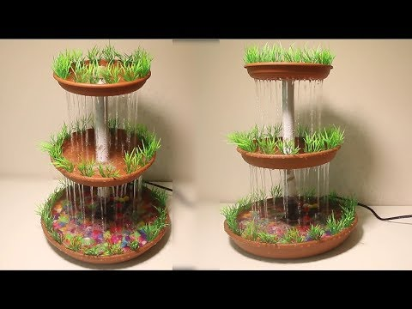
SMART WATER FOUNTAIN
BY….,
Sabitha N

Slide 2
PROBLEM STATEMENT :
When the water flow does not have any restrict , there is lose of water in household as well as environment .
The lack of fountains in a community can have a number of negative consequences for people, the environment, and the local economy.

Slide 3
Project statement
HARDWARE
First we start by using the Wio Node and a relay ,also going to a screen for feedback and text.Using the relay we can control the power supply.
SOFTWARE
The hardware is all connected ,its time to setup the software . We will use the Wio app by seeed.

Slide 4
design
STEP 1: Install Android/iOS App
STEP 2: Create your Account
STEP 3: Connect Wio Node to Internet
STEP 4: Virtually interconnect modules with Wio Node and update firmware
Here is where we add the 2 components
Relay
OLED

Slide 5
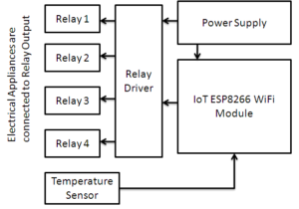
Block diagram

Slide 6
Code for the proposed projet:
def activate_fountains(fountains):
n = len(fountains)
min_fountains = float('inf’)
for i in range(1, 2**n):
activated = []
for j in range(n):
if (i >> j) & 1:
activated.append(j)
if is_covered(activated, fountains): min_fountains = min(min_fountains,len(activated))
return min_fountains

Slide 7
def is_covered(activated, fountains):
n = len(fountains)
coverage = [0] * n
for i in activated:
left = max(0, i - fountains[i])
right = min(n - 1, i + fountains[i])
for j in range(left, right + 1):
coverage[j] = 1
return all(coverage)
a1 = [1, 2, 1]
a2 = [2, 1, 1, 2, 1]
print(activate_fountains(a1)) print(activate_fountains(a2))

Slide 8
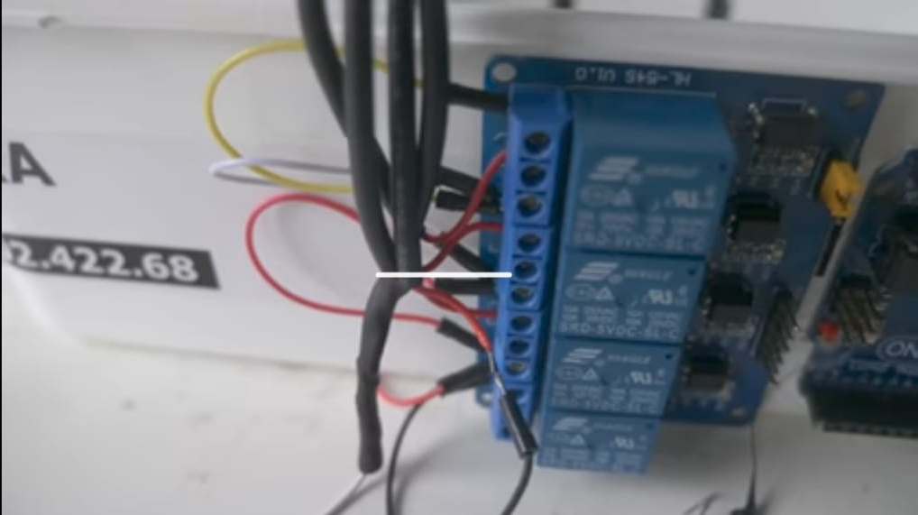
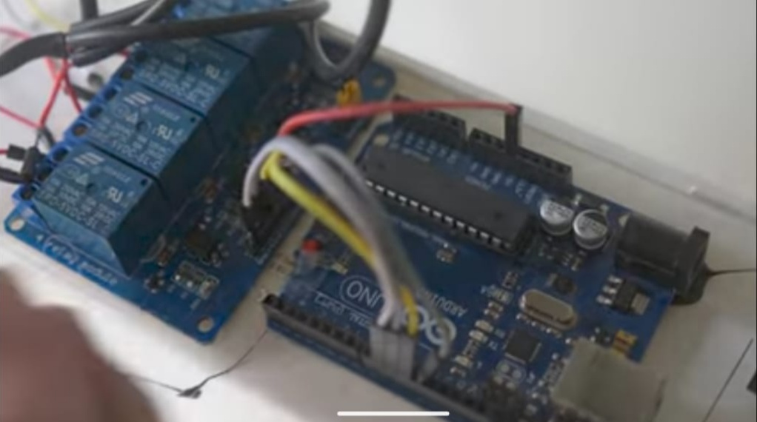
Simulation input

Slide 9
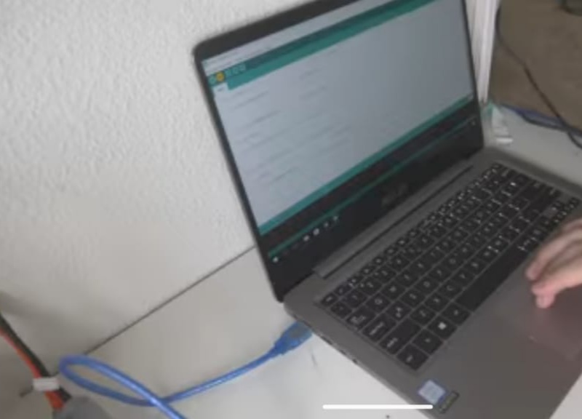
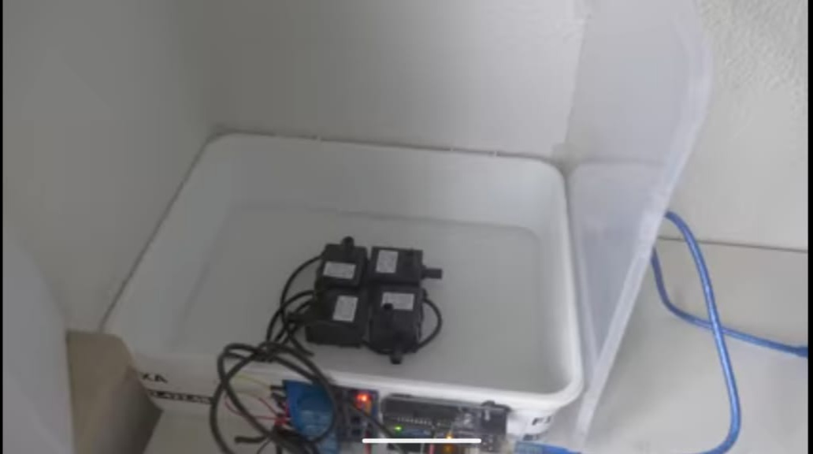
Simulation process

Slide 10
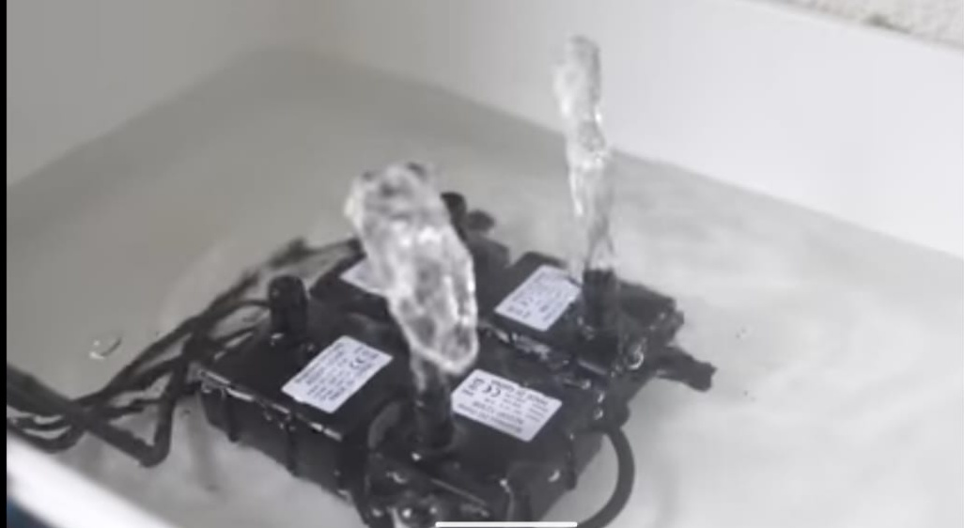
Simulation output

Slide 11
SIMULATION INPUT: The input connection are made from relay to arudino as per the software simulation arrangements.
SIMULATION PROCESS: The inputs get performed based on the simulation program.
SIMULATION OUTPUT: When the program runs the water from the waterpumper comes out at particularly time duration.

Slide 12


