Slide 1

11 Player Selection Model

Slide 2
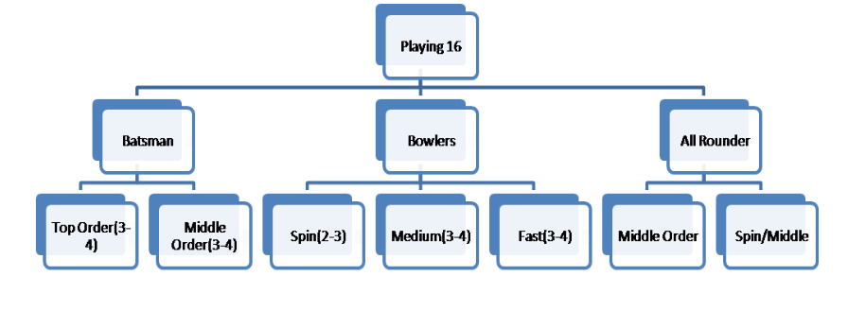
Category or Subcategory of Player
>Injury:
- normal – 1
- strain – 2
- a little serious – 5
- serious – out from game
Pressure
Normal matches: 1
Quarter Finals: 3
Semi Finals: 4
Finals: 5

Slide 3
Factor's To Include in this Statistical Model
Overall stats
Year wise stats
Last 5 or 3 match performance
Opposition stats
Location wise stats
Injury
Pressure
pitch

Slide 4
Weightaige for every Factor's(acc. to paper)
5% - Oposition stats
5 % - Location wise stats
15% - year wise stats
25% - overall stats
50% - Last 5 or 3 match stats

Slide 5
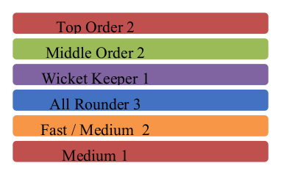
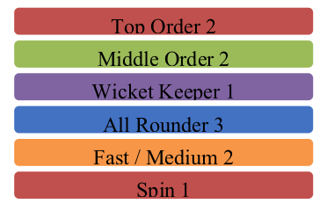
Ground(or pitch) affect on Player Selection
Batting + Pace Batting + Spin

Slide 6
statistic for calculation of bating score
A= Innings_batted/Total_Matches
B= Bat_Avg/Max_Avg
C=(20 * Num_Centuries + 5*Num_Fities)
Innings_batted
D= C/Max(C)
E= 0.4*D + 0.6*B
E->Batting_Score(Overall_stats)
P->Batting_Score(Year_Wise)
Q->Batting_Score(Oppostion_Wise)
R->Batting_Score(Location_Wise)
L= Mean of Last 5/ Max (Mean)
Batting_Score= A*((0.25*E) + (0.15*P) + (0.1*
(Q+R))+(0.5*L))

Slide 7
statistic for calculation of bowlingscore
V=Innings_bowled/Total_Matches
F= ((20*Num_5W)+(5*Num_3W))/Innings_bowled
/ G= F/Max(F)
H= Bowl_Avg/Max_avg
I= 0.4*G + 0.6 *H
I ->Bowling_Score(Overall_stats)
S->Bowling _Score (Year_Wise)
T->Bowling_Score(Oppostion_Wise)
U->Bowling_Score(Location_Wise)
L1= Mean of Last 5/ Max (Mean)
Bowling_Score=V*((0.25*I) +(0.15*S) + (0.1 *
(T+U) )+(0.5*L1))

Slide 8
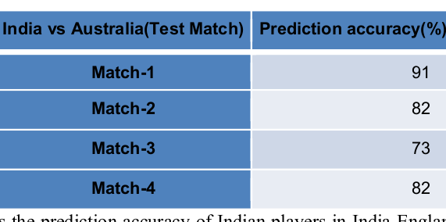
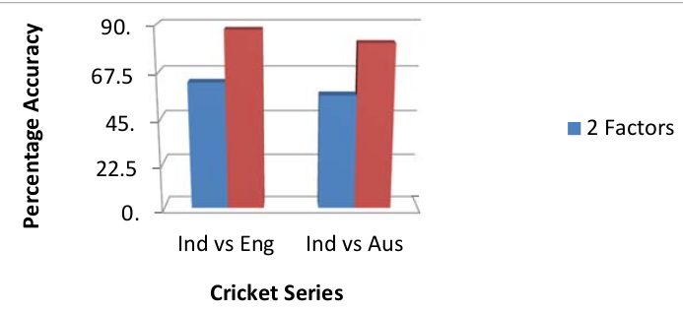
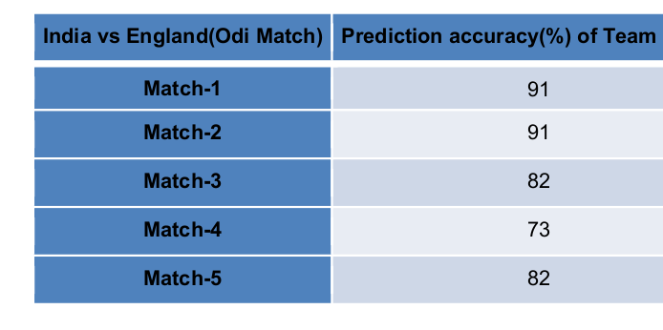
Result or conclusion
algorithm, 14 out of 16 team members were predicted correctly( i.e 88% accuracy) for India vs England and 13
out of 16 team members were predicted correctly( i.e 81% accuracy) for Australia vs India. These results show
that prediction accuracy of our approach is considerable for prediction team of 16 players. Wrong prediction of
the remaining 2-3 players are because of the assumptions that were made earlier i.e. all players are fit for
remaining 1-2 players wrongly predicted is because of the situation based decisions made by the team.

