Slide 1
Cancer Prediction Using Clustering Algorithm
By
Sabick Puliyali

Slide 2
Table of contents
Rational statement
Justify the number of clusters required to optimize K-means model - Elbow Method
Justify the number of clusters required to optimize K-means model - Silhouette Method
Cluster visualization
Cluster visualization Five Cluster Insights
Conclusion

Slide 3
Rational Statement
Proposed algorithm is K-means algorithm, in which the number of clusters is estimated using the Elbow method and the Silhouette method in predicting leukemia remission dataset.

Slide 4
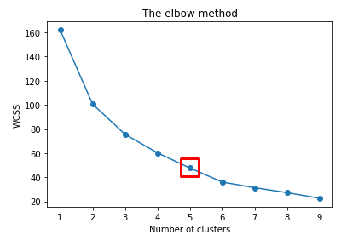
Justify the number of clusters required to optimize K-means model Elbow Method
By doing the analysis, the optimal number of cluster that fix the model is 5.
Within cluster sum of the square(WCSS) is high for when k=5. As k value increases, WCSS value is decreasing linearly.
Can choose any number of clusters, adding another cluster does not improve the total wcss which shows the stability of model.

Slide 5
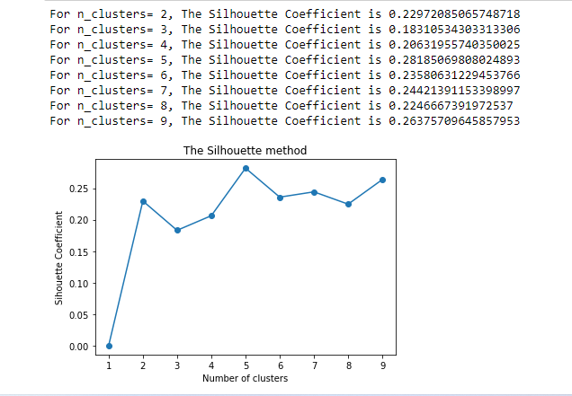
Justify the number of Clusters required to optimize K-means model Silhouette Method
By doing the analysis, the optimal number of cluster that fix the model is k=5 with coefficient value=0.2816, having high Silhouette coefficient value among other clusters.
It assess the quality of clustering, means it determines how well each object lies within its cluster.
Computes Silhouette coefficients of each point which indicate how similar a point is to its own cluster in comparison to other clusters.
The coefficient value is less than 0.5 which indicates the clusters are overlapping.

Slide 6
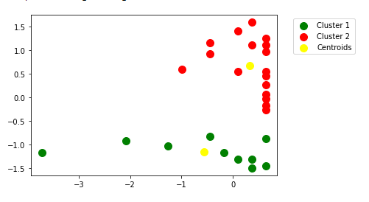
Cluster visualization Two Cluster
Showing the visualization of two cluster.
Clusters 1 is green color and datapoints are not overlapped inside the cluster. Can see that some datapoints are far from centroid (Yellow color).
Cluster 2 is red color and can be seen that datapoints are overlapped inside the cluster.
Majority of data points lies in cluster2.
Since the datasets is small it is difficult to analyze two cluster visualization.
Cluster 1 has few datapoints far from centroid and cluster 1 has datapoints overlapped, so we couldn’t optimize the plot accurately.

Slide 7
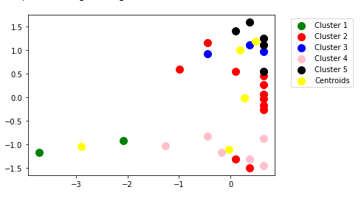
Cluster visualization Five Cluster Insights
Showing the visualization of Five cluster
Majority of the datapoints lies in cluster 2 and cluster 1 has minimum datapoints.
Clusters are overlapping each other.
Cluster 1 and cluster 2 are nicely separated.

Slide 8
Conclusion
To conclude
K –Means algorithm is easy to implement.
It adapts the new examples very frequently.
It can handle large data set and faster to large datasets.
By looking and considering all aspects we can easily cluster the Leukemia remission dataset.

Slide 9
Thank You!!!!!!

