Slide 1
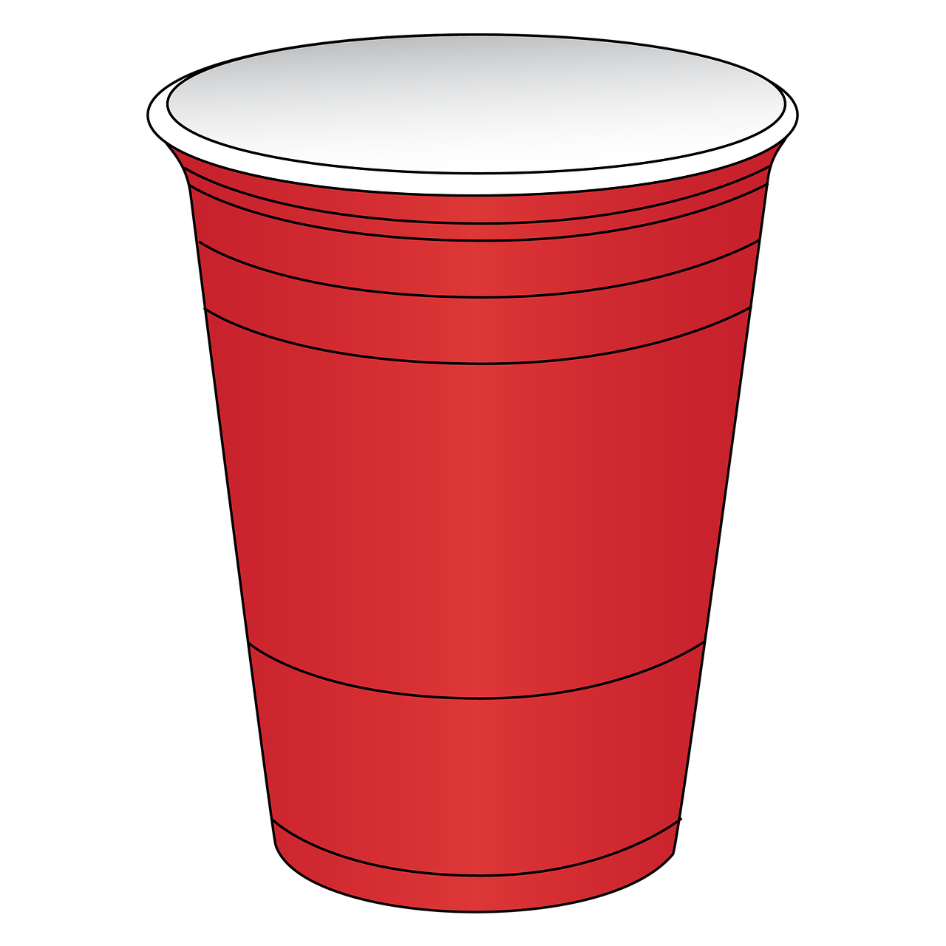


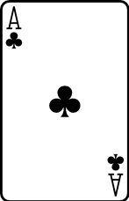

Ring
of
Fire

Slide 2
RoF

Slide 3


