Slide 1





Datathon Miniproject: Linking XML Corpora to Dictionaries
Tutors:
Maxim Ionov, Christian Chiarcos (Goethe Universität)
Participants:
Yifat Ben-Moshe (K Dictionaries), Helena Bermúdez-Sabel (POSTDATA), Mariana Curado Malta (POSTDATA), Frances Gillis-Webber (University of Cape Town), Sabine Tittel (Heidelberger Akademie)

Slide 2
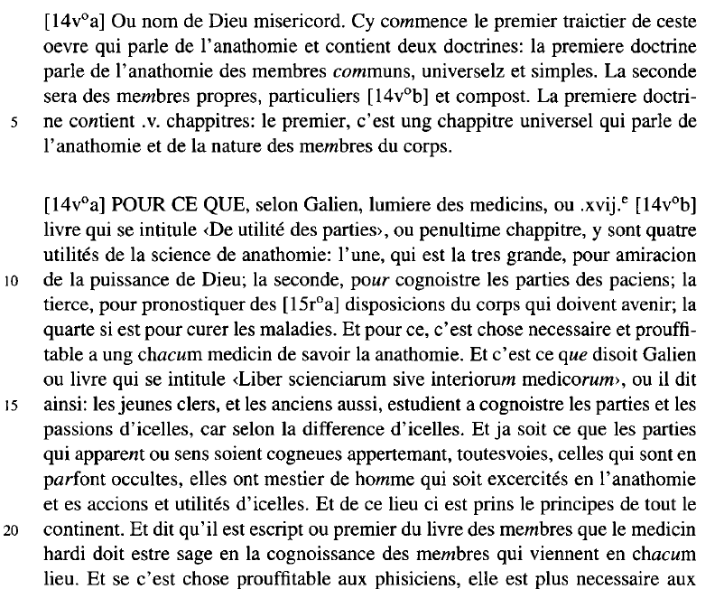
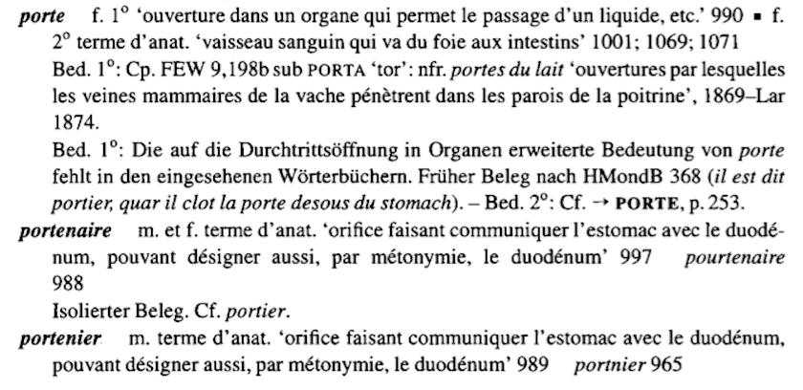
MOTIVATION
Replace the glossary of a text edition with inline links to a dictionary

Slide 3
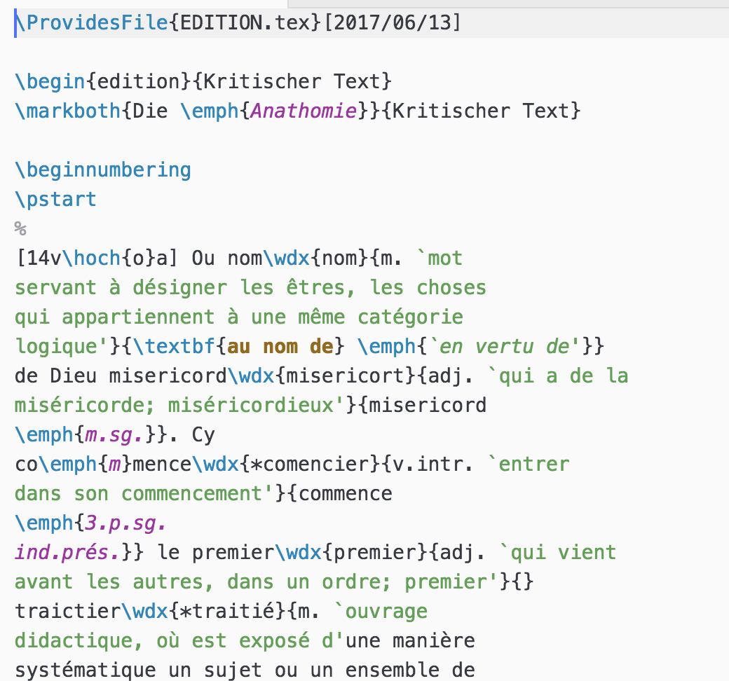
STARTING POINT - 1
The text edition – in LaTeX:

Slide 4
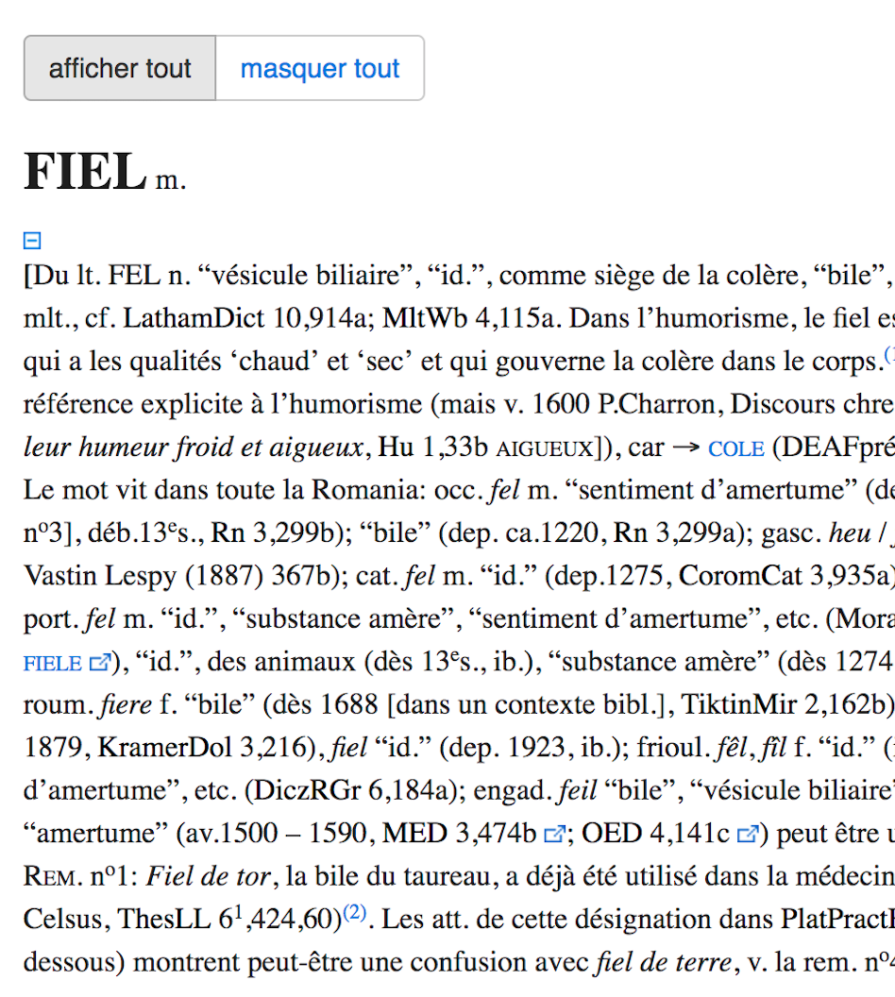
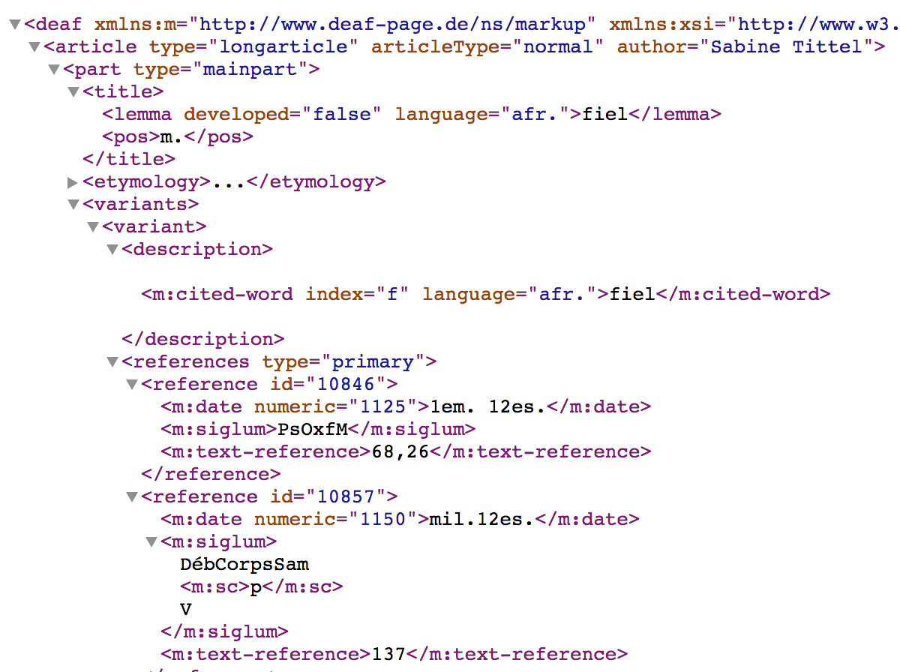
STARTING POINT - 2
The dictionary articles – in XML:

Slide 5
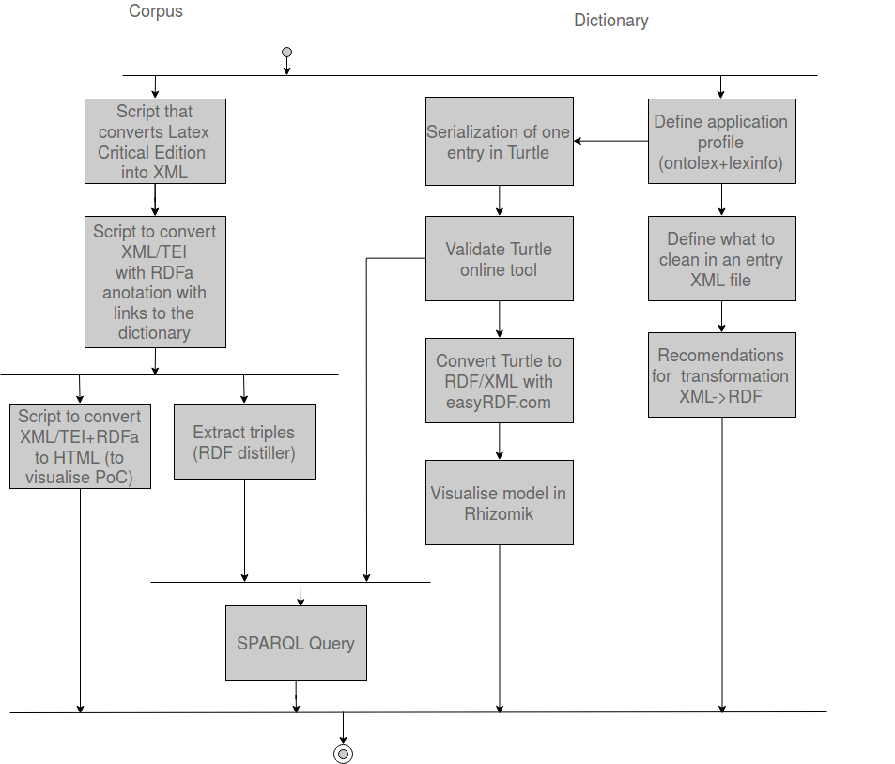
WORKFLOW

Slide 6
STEPS
Define a word entry as the Proof of Concept (PoC)
Define the application profile for the dictionary
Identify the terms
Serialise the PoC using Turtle & validate
Validate the model visually
Define a process to convert the other articles to Turtle
Clean the PoC dictionary article XML
Define rules for transformation
Text transformation and HTML presentation of the corpus
Convert the LaTeX to XML-TEI & annotate with RDFa
Convert the XML-TEI+RDFa script to HTML
Extract the triples

Slide 7
STEP 1: DEFINE THE PROOF OF CONCEPT - 1
We used the word entry: fiel (n)
In this entry, there are 6 variants, and 3 main senses, with 13 sub-senses
The variants are:
fel, feel, fele, feil, fieil, fius
The main senses are:
“bile”
“gallbladder”
“bitterness”

Slide 8
STEP 2: IDENTIFYING THE TERMS - 1
From the 3 main senses and 13 sub-senses for the entry fiel, we identified:
A Lexical Entry of type Word
Also, sub-entries of type MultiwordExpression
Classes chosen:
Ontolex-Lemon: LexicalEntry, Word, Form, LexicalSense, LexicalConcept
Other ontologies: dbpedia:…, lexinfo:noun
Properties chosen:
Ontolex-Lemon properties: canonicalForm, otherForm, evokes, sense, writtenRep, reference, definition, lexicalizedSense, usage
Other ontologies: lexinfo:partOfSpeech, dct:subject, olia:hasRegister, rdfs:comment, decomp:subterm
New class: deaf:techreg = olia:TechnicalRegister

Slide 9
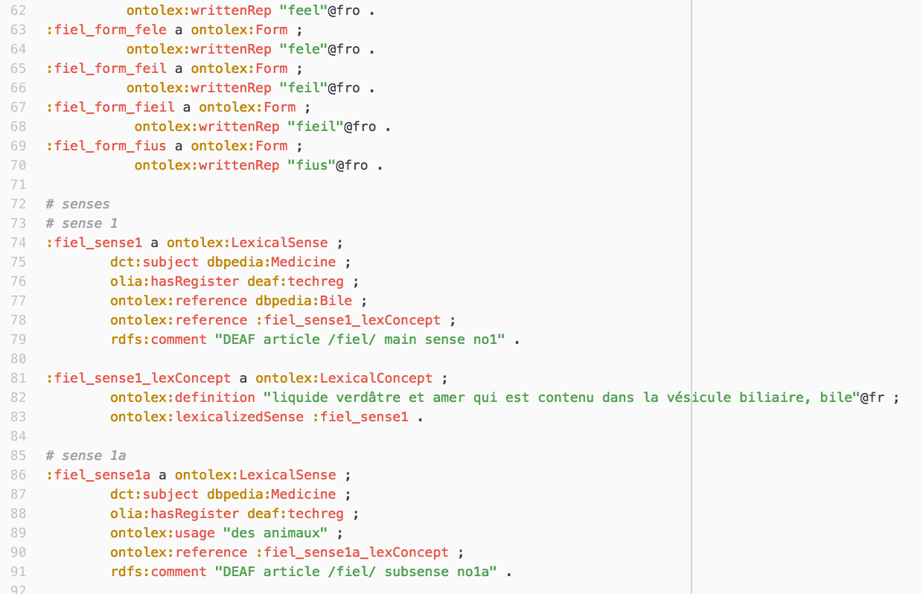
STEP 2: SERIALISE THE POC – 2
We expressed the PoC in the Ontolex-Lemon model, using Turtle as the serialisation
The Turtle code was validated using http://ttl.summerofcode.be/

Slide 10
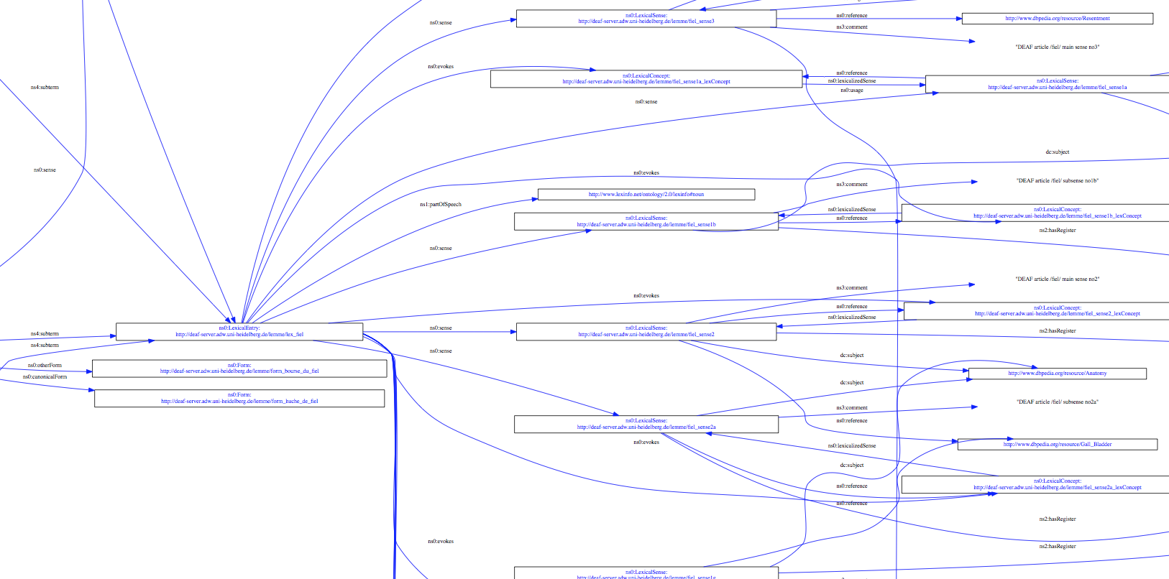
STEP 2: VALIDATE THE MODEL VISUALLY – 3
We then converted the Turtle code to RDF/XML using www.easyRDF.com
We then visualised the model in Rhizomik http://rhizomik.net/html/redefer/rdf2svg-form/

Slide 11
STEP 2: ISSUES WE IDENTIFIED
We identified the issue that our sub-senses are not always narrower / broader, so skos:narrower / broader is insufficient.
This needs to be explored further, with a possible recommendation for the Ontolex-Lemon model.

Slide 12
STEP 3: CLEAN THE POC DICTIONARY ARTICLE XML - 1
For our PoC, we did a manual clean-up, identifying the rules, for example:
Delete <etymology>…</etymology>
Delete <variants><variant><references>…</references></variant></variants>
Delete <variants><variant><description><m:date>…</m:date></description></variant></variants>
Delete <senses><sense><datings>…</datings></sense></senses>
Delete <senses><sense><references>…</references></sense></senses>
Remove all non-breaking spaces: &#x2060;
Add an attribute to the first <variant>: type=“standard”

Slide 13
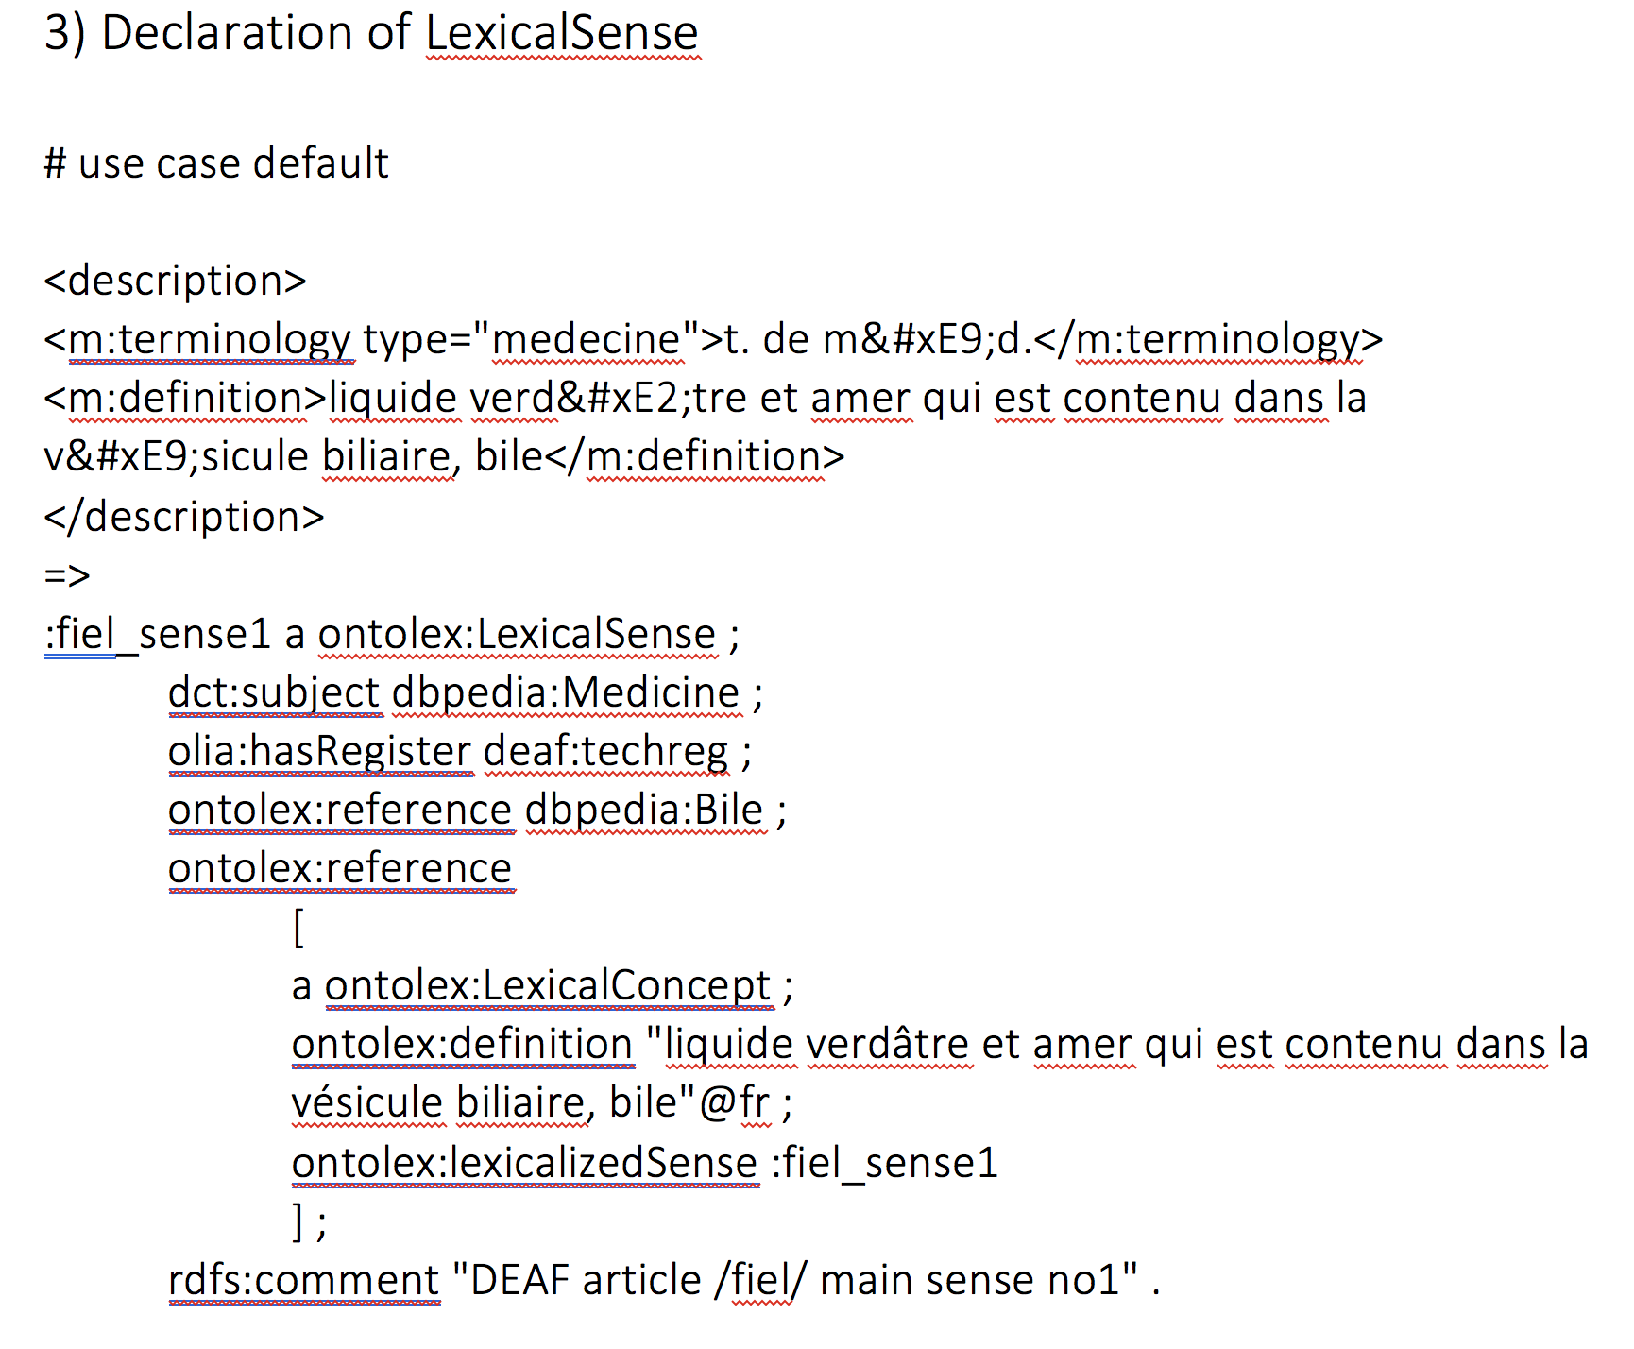
STEP 3: DEFINE THE RULES FOR TRANSFORMATION - 2
We determined recommendations for transformation from XML -> RDF for all the entries

Slide 14
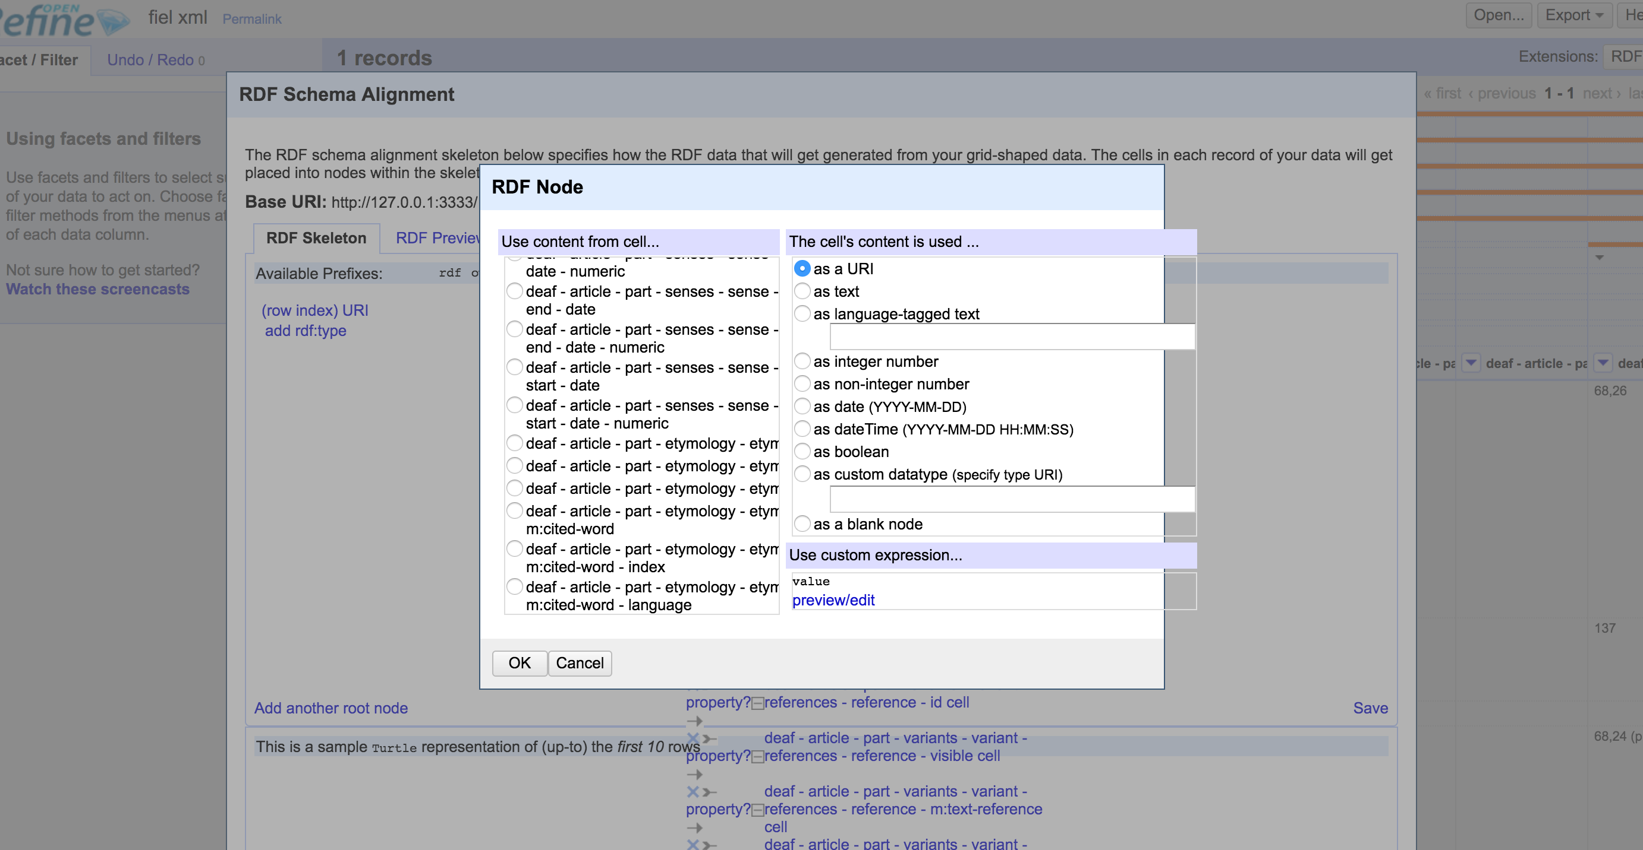
STEP 3: CHALLENGES
We tried to import the original XML file for the PoC into OpenRefine, but identifying the fields to map within the RDF Skeleton was too complex
We then cleaned up the XML file (using the rules previously defined), but RDF mappings still proved problematic
We then opted to write a script to map from XML -> RDF for the other entries

Slide 15
WORKFLOW

Slide 16
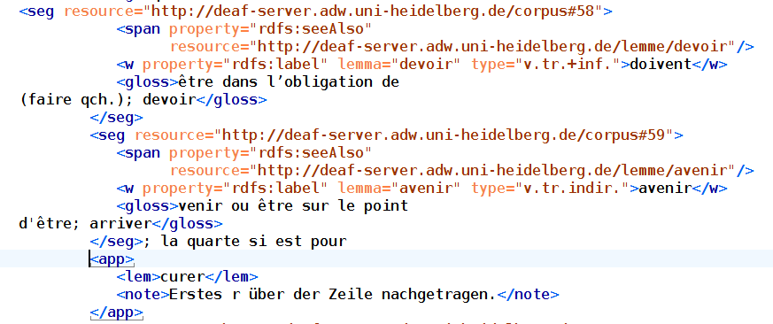
STEP 4: CONVERT THE LATEX TO XML-TEI - 1
This required the following steps:
Conversion of the LaTeX critical edition to XML using a Perl script
Then we made this XML file TEI-compliant using XSLT
Result: XML-TEI with RDFa included

Slide 17
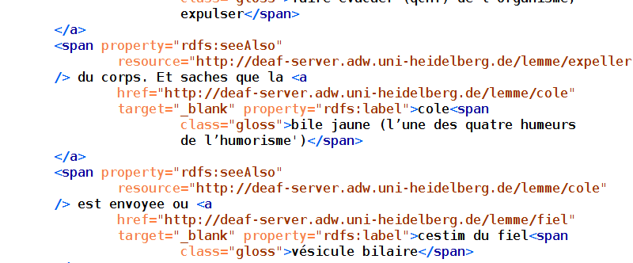
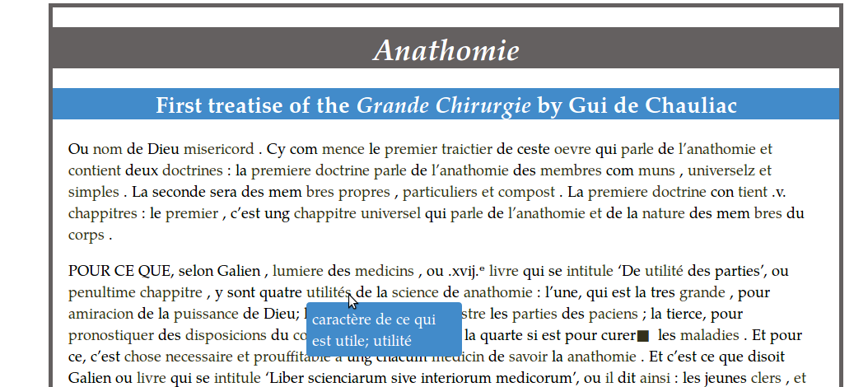
STEP 4: CONVERT THE XML-TEI+RDFa to HTML - 2
Notes:
Demo this using the browser.

Slide 18
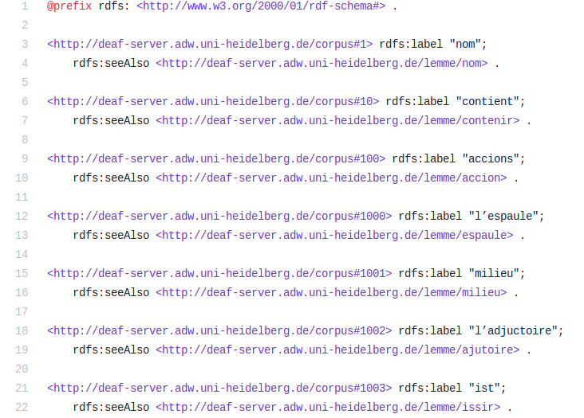
STEP 4: EXTRACT THE TRIPLES - 3

Slide 19
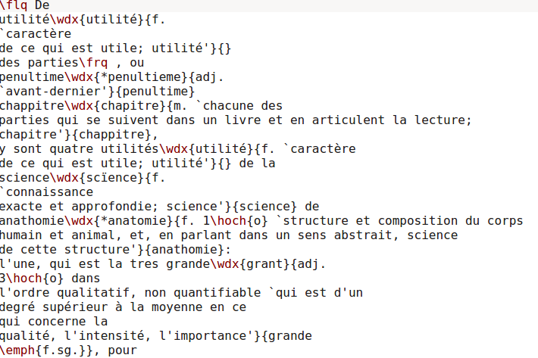
STEP 4: CHALLENGES
The source file had markup created for book publishing. This is for layout, not semantics.

Slide 20
FUTURE WORK
Create a script to automate the process of transformation of dictionary articles from XML to RDF/ontolex:lemon
Use-case dictionary: 80 000+ xml files
Linking of corpus and dictionary: from word-level to sense-level
Extend the workflow to other dictionaries

Slide 21
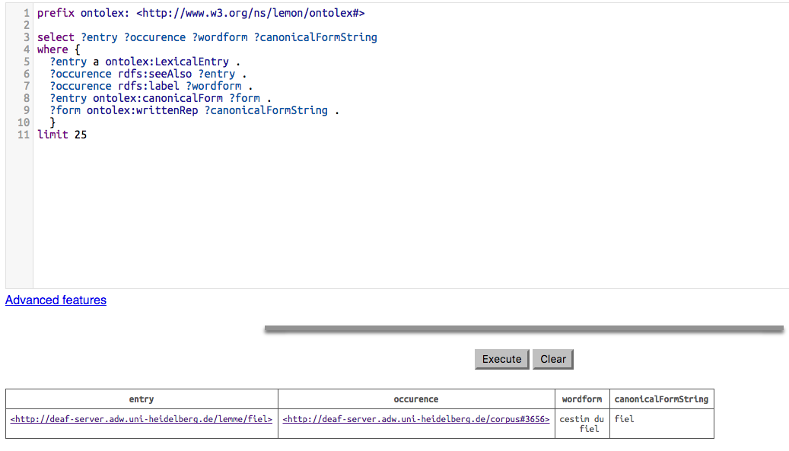
FINALLY: QUERYING THE DATA

