Slide 1
CSE465 Project Presentation on “Calculating the Concrete Strength” Faculty: Dr. Mohammad Ashrafuzzaman Khan (Azk)
Presented by
CSE465 Section-02 Spring-2021
A. S. M. Sabiqul Hassan
NSU ID – 1812442042

Slide 2
The Task
We are given a dataset collected on a construction project and we applied our DL knowledge to prepare a model which can be used in future to predict the strength of our building concrete (Strong or Not Strong).
It can be used to predict the quality of our building concrete on different stages and reduce the rate of accidents.

Slide 3
Solution Part - 1
Source Link:
https://www.kaggle.com/prathamtripathi/regression-with-neural-networking
dataset contains about 1k+ instances
There are 9 columns (8 features and 1 label)
used that dataset for both training and testing purpose
TRAIN Data (80%)
TEST Data (20%)
transformed target column (continuous value) into 2 classes
Strong if ‘Strength’ > 50
Not Strong if ‘Strength’ < 50

Slide 4
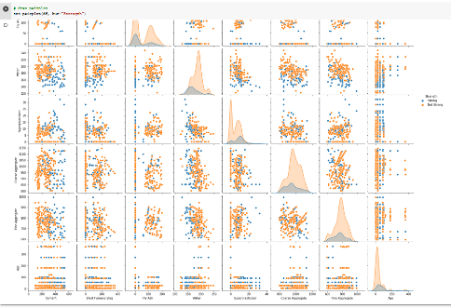
Pairplot [target]

Slide 5
Solution Part -2
Used PyTorch library to convert np array to tensors
Created our models with
(input_features=8, hidden1=20, hidden2=20, output_features=2)
Defined our loss function (cross entropy) and
optimizer (adam optimizer, learning rate = 0.01)
Took 500 epochs to train our model

Slide 6
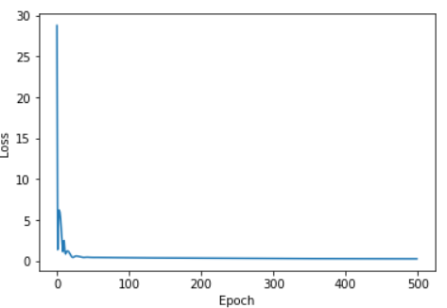
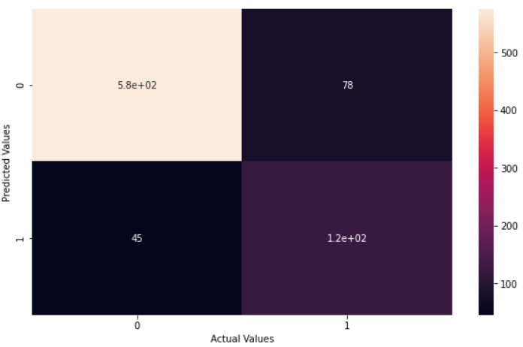
Result (Train Dataset)

Slide 7
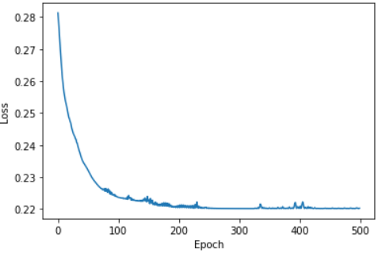
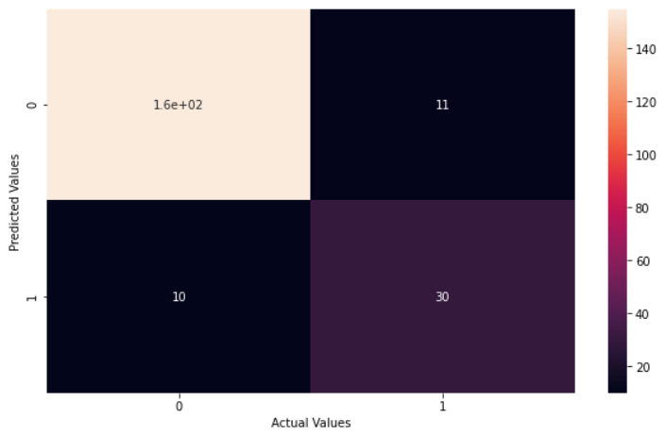
Result (Test Dataset - Dev)

Slide 8
Conclusion
Main challenge of our project is small dataset (only about 1k+ instances).
For that reason we only divided our dataset into 2 parts only train and test set and there was no dev set.
Training dataset : accuracy of 85.07% and loss 5.16%
Test (dev) dataset : accuracy of 89.81% and loss 3.52%
If we can collect more data it would perform better.

