Slide 1
CSE445 Presentation on “Banking Loan Prediction Problem” Faculty: Syed Athar Bin Amir (SAA3)
Presented by
CSE445 Section-02 Group-02 Fall-2020
A. S. M. Sabiqul Hassan (NSU ID – 1812442042)
Sazzad Hossain Sabbir (NSU ID – 1612229042)
Aiaj Uddin Bhuiyan (NSU ID – 1621696042)

Slide 2
Intro Page - 01
We worked on an application based problem ‘bank loan prediction problem’.
Where a bank created a digital team to analyze the collected data to predict the future customers (marketing lead) based on the previous loan request.
Source Link: https://www.kaggle.com/arashnic/banking-loan-prediction

Slide 3
Problem Type Page - 02
Human Supervision –> Supervised Learning
Dataset increment –> Batch Learning
Predictive Model Building –> Model-based Learning
Predict loan approval -> Binary Classification (discrete value, only 2 result)
[label was only -> yes (1) or no (0)]

Slide 4
Get the data Page - 02
Our main challenge -> data collection
Used Kaggle dataset
train.csv -> containing about 70 k instances
test.csv -> containing about 30 k instances
As there was noise in our dataset, we used train.csv file for both training and testing purpose.
We will see the observation later during feature selection part.

Slide 5
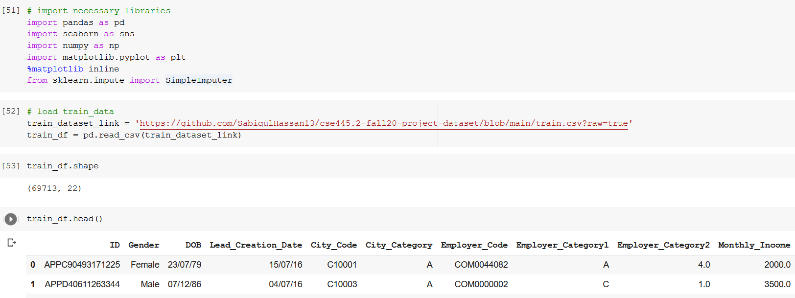
Data Visualization Page - 02

Slide 6
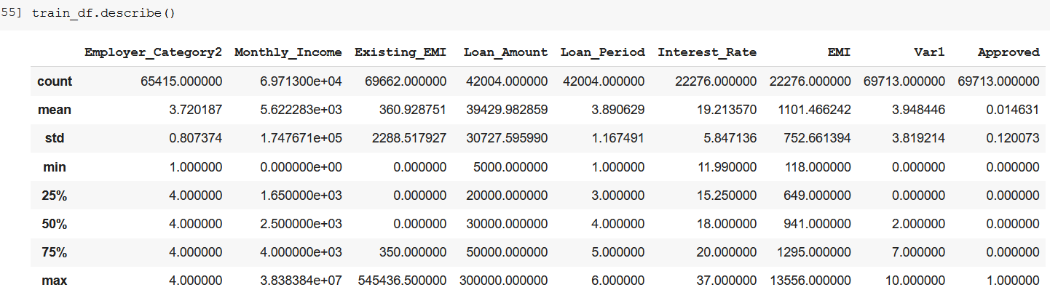
Data Visualization Page - 02

Slide 7
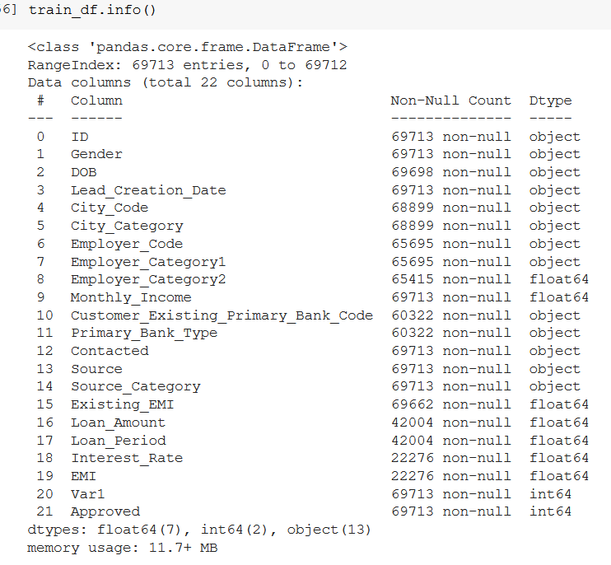
Data Visualization Page - 02

Slide 8
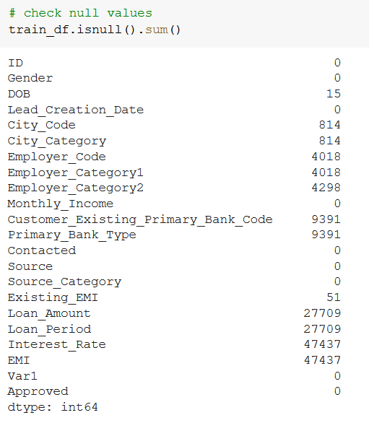
Data Visualization Page - 02

Slide 9
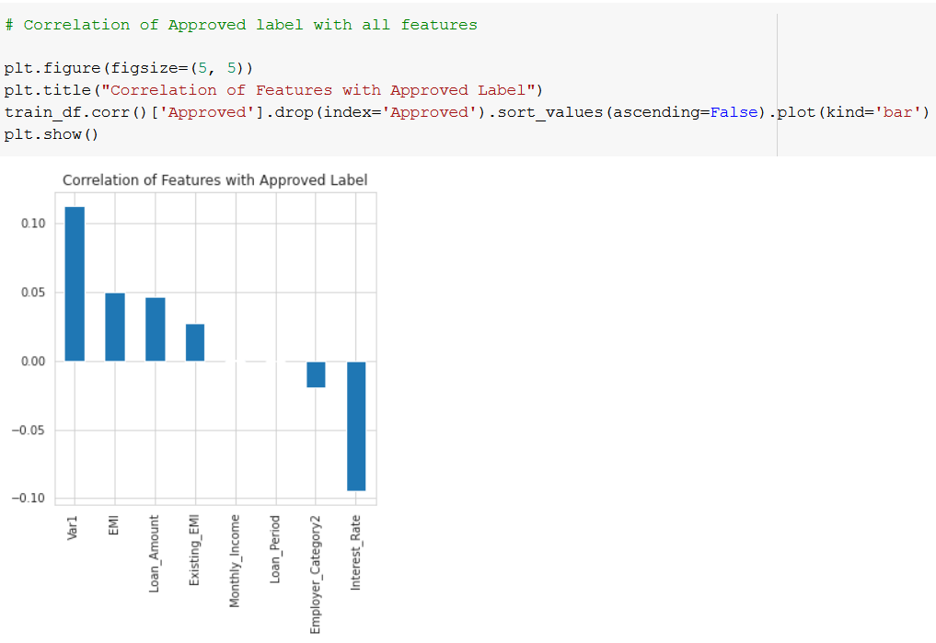
Data Visualization Page - 02
Due to noise (missing value mainly) in dataset, there was not that much correlation

Slide 10
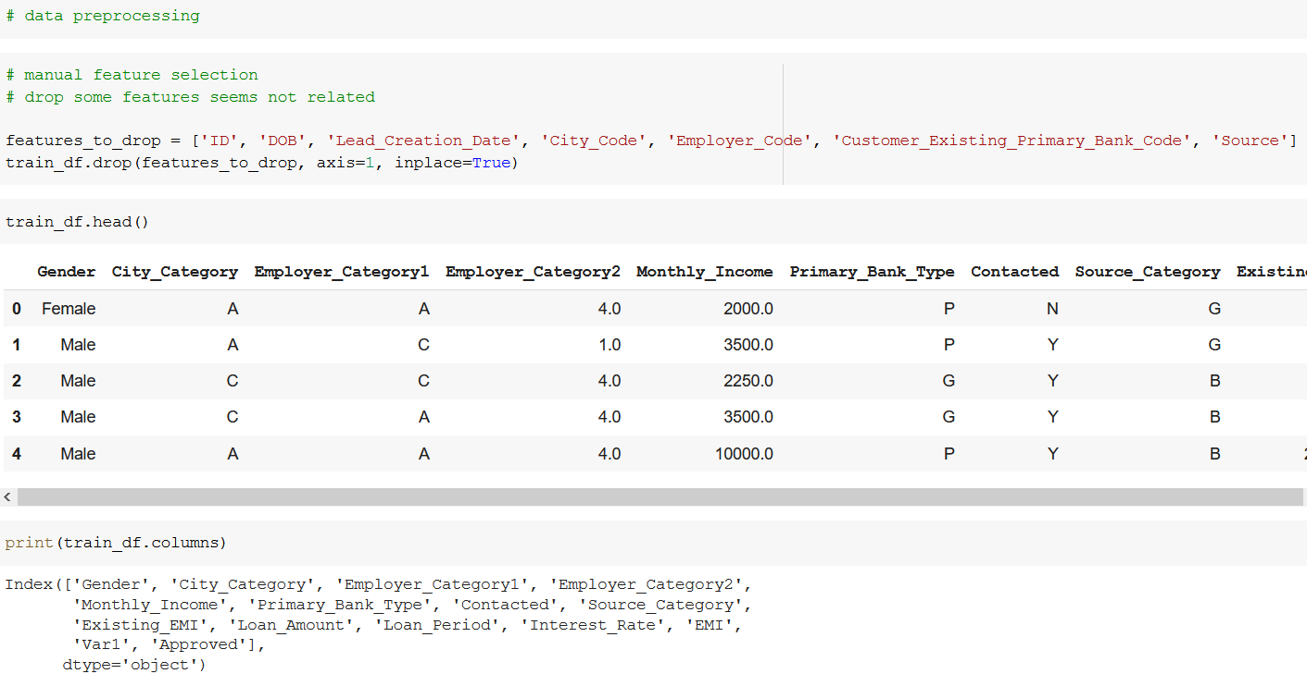
Data Preprocessing Page - 02
Features selection part

Slide 11
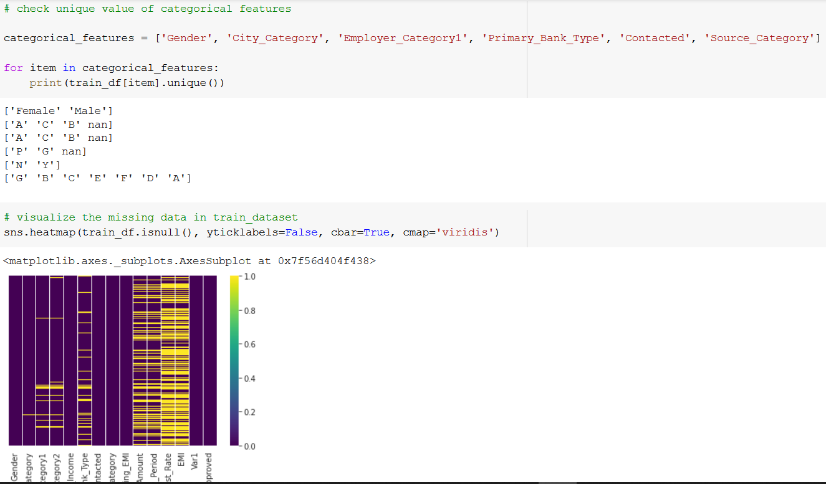
Data Preprocessing Page - 02
Checked unique value of categorical features for processing

Slide 12
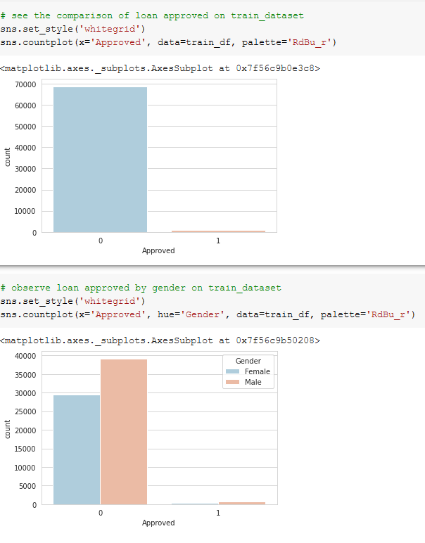
Data Preprocessing Page - 02
see the comparison of loan approved on dataset against 2 condition

Slide 13
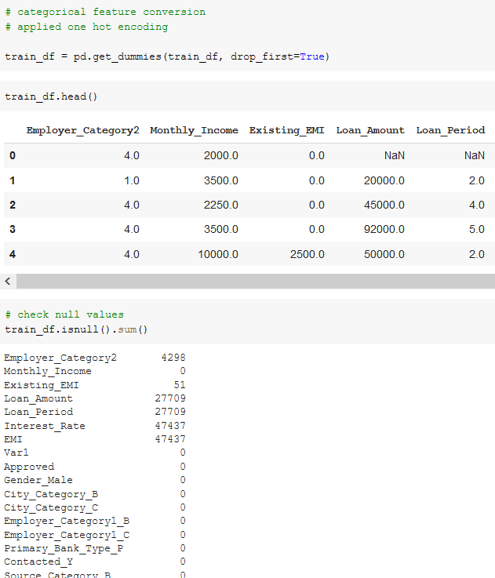
Data Preprocessing Page - 02
Process categorical features with one hot encoding

Slide 14
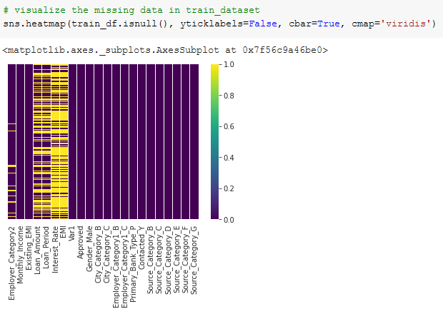
Data Preprocessing Page - 02
Process categorical features with one hot encoding

Slide 15
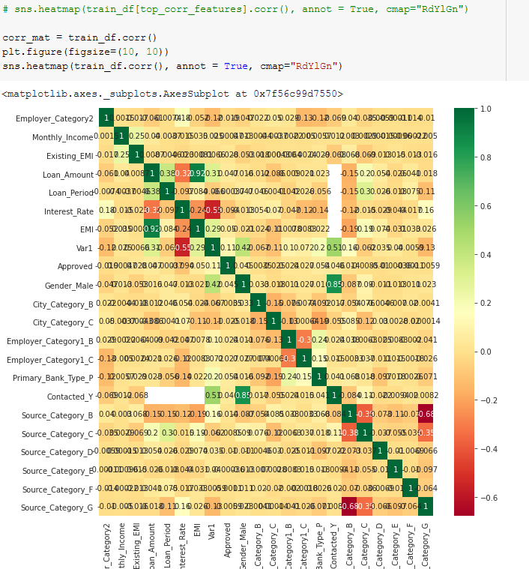
Data Preprocessing Page - 02
|Correlation coefficients| are < 0.35 -> low or weak correlations

Slide 16
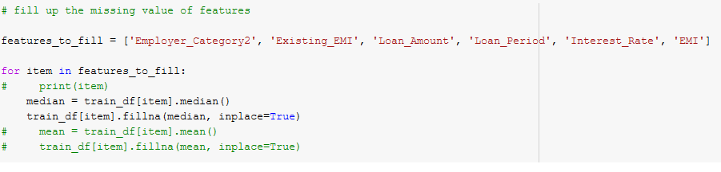
Data Preprocessing Page - 02
Replace the missing continuous values with median value of each column
Because some features like loan amount, existing emi etc. would effect the prediction
Notes:
E

Slide 17
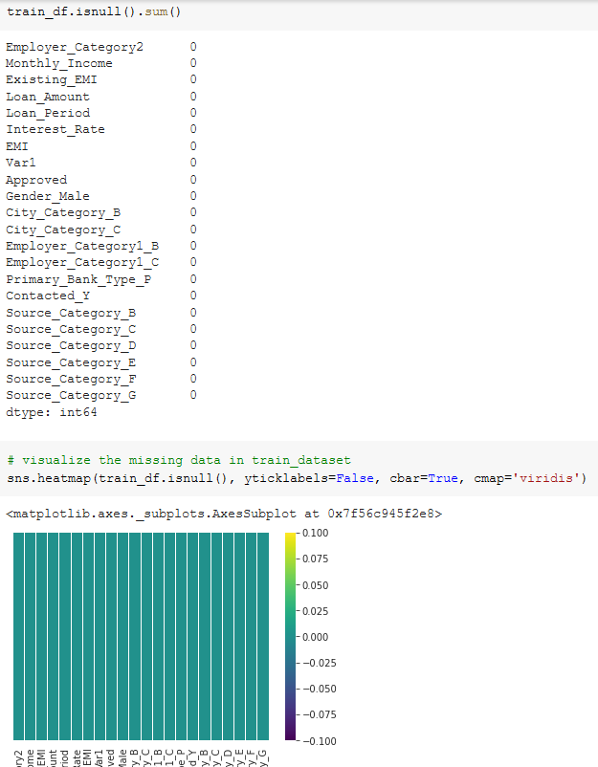
Data Preprocessing Page - 02
Now there is no missing value in our dataset
Notes:
E

Slide 18
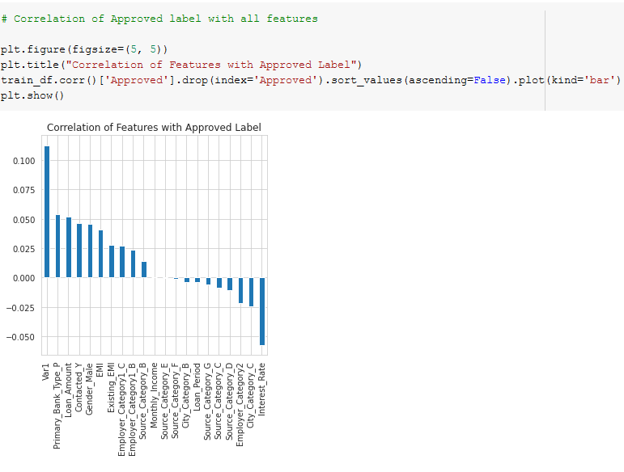
Data Preprocessing Page - 02
There is not drastic change in our correlation matrix, It means our feature extraction would not effect our prediction result
Notes:
E

Slide 19
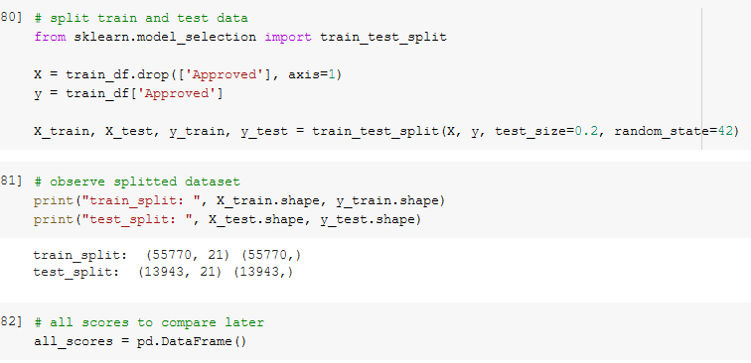
Data Preprocessing Page - 02
Split our dataset into 2 parts
-> train dataset (80%) -> test dataset (20%)
We kept a way to store model prediction result for comparison later.
Notes:
E

Slide 20
Data Preprocessing Page - 02
We applied 5 machine learning algorithms on our dataset
-> logistic regression
-> decision tree
-> random forest
-> XGBoosts
-> Support Vector Machine – SVM (didn’t get compiled)
Notes:
E

Slide 21
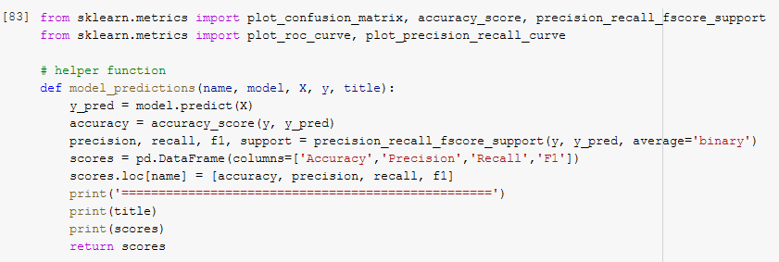
Data Preprocessing Page - 02
A helper function to reduce result processing after train the dataset with a particular ML model
Notes:
E

Slide 22
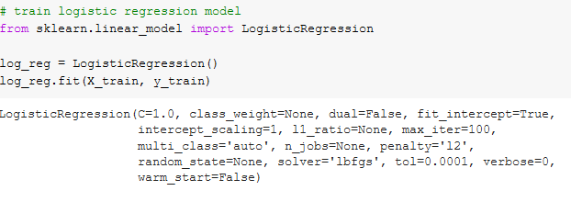
Apply ML Model Page - 02
Train with logistic regression
Notes:
E

Slide 23
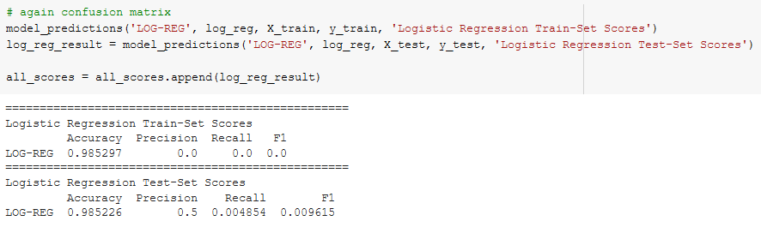
Apply ML Model Page - 02
Result with logistic regression
No over fitting and under fitting, as accuracy are almost same on both cases
Notes:
E

Slide 24
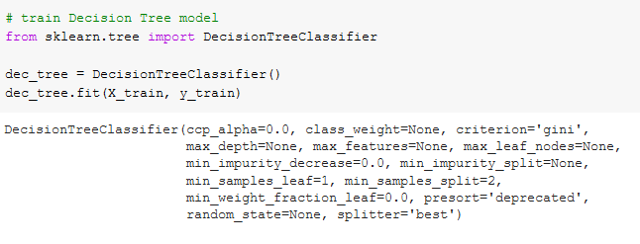
Apply ML Model Page - 02
Train with decision tree
Notes:
E

Slide 25
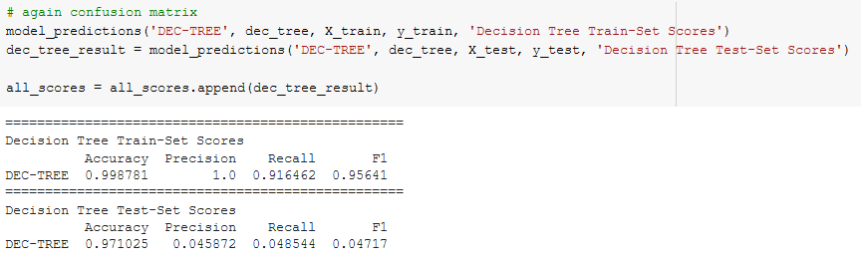
Apply ML Model Page - 02
Result with decision tree
No over fitting and under fitting, as accuracy are almost same on both cases
Accuracy difference 2 %
Notes:
E

Slide 26
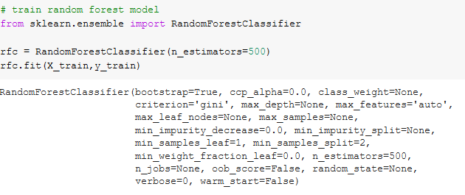
Apply ML Model Page - 02
Train with random forest
Notes:
E

Slide 27
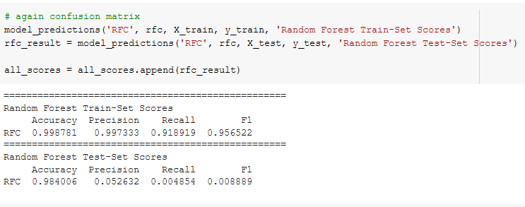
Apply ML Model Page - 02
Result with random forest
No over fitting and under fitting, as accuracy are almost same on both cases
Accuracy difference 1 %
Notes:
E

Slide 28
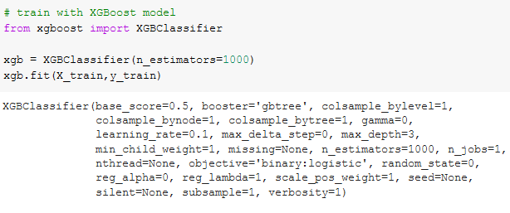
Apply ML Model Page - 02
Train with XGBoosts
Notes:
E

Slide 29
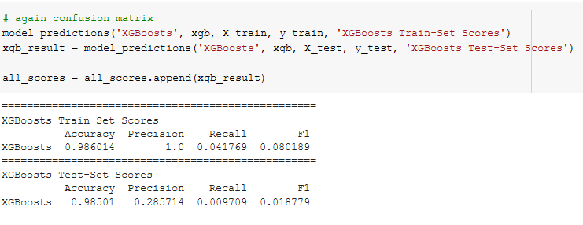
Apply ML Model Page - 02
Result with XGBoosts
No over fitting and under fitting, as accuracy are almost same on both cases
Notes:
E

Slide 30
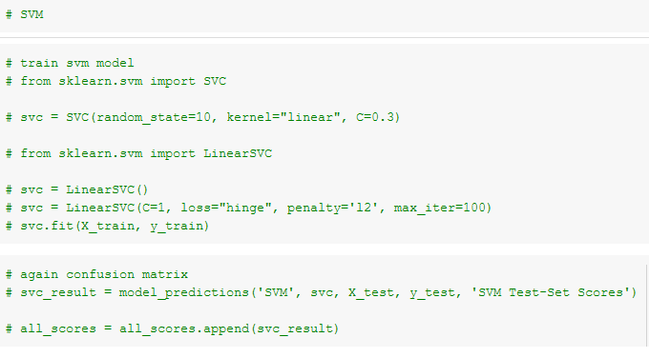
Apply ML Model Page - 30
Train and Result with SVM (didn’t get compiled)
Notes:
E

Slide 31
Apply ML Model Page – 31
Could not implement some things
-> cross-validation
-> stratified sampling
-> feature scaling (normalize, standardize)
-> hyper parameters tuning
Notes:
E

Slide 32
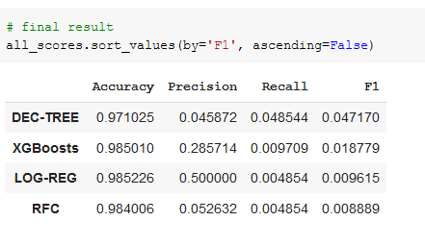
Apply ML Model Page - 32
Result comparison and final decision
All these models have almost same accuracy.
The dataset can perform well each ML models we applied here.
Notes:
E

Slide 33


