Slide 1
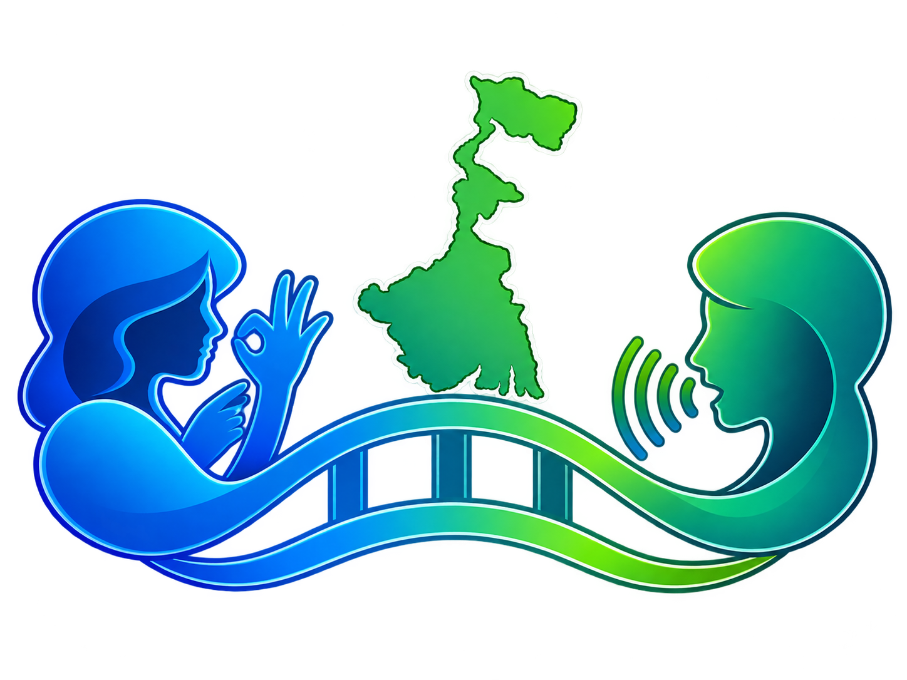
WBSL Bridge
Intent-Aware Bidirectional Sign Language Communication for the Deaf Community of West Bengal
TEAM
Sabir Ali Mondal
Roll: 34900123032 · 7th Sem
Koushaki Singha
Roll: 34900124074 · 7th Sem
Monirul Halder
Roll: 34900123021 · 7th Sem
Firdos Shaikh
Roll: 34900123011 · 7th Sem
Mentor: Prof. Prabir Kr. Naskar
Department of Computer Science & Engineering, Cooch Behar Government Engineering College

Slide 2
Sign Language Landscape & Linguistic Research
HIGH-RESOURCE
ZERO-RESOURCE
ASL
American Sign Language
BdSL
Bangladesh Sign Language
ISL
Standard Indian Sign Language
WBSL
West Bengal Sign Language
High-resource
Medium-resource
Pan-India focus
Zero-resource
Google DeepMind’s SL2T (2026) proved real-time translation using 100,000+ hours of data.
Backed by large datasets (BdSLW401, BdSLW60).
Crucial note: all existing “Bengali” tech projects target BdSL, a linguistically separate language.
Supported by the iSign benchmark (ACL 2024) and ISLTranslate datasets.
Linguistically proven distinct from both Delhi ISL and BdSL (Johnson & Johnson, 2016).
iSign (2024) confirms high regional variation in the East.
0 AI projects · 170 static signs

Slide 3
The Core Problem: A Verified Technological Void
0
0
170
AI/ML/DL projects specifically for WBSL
Continuous video datasets
Video/action documented, not dataset.(Wikisigns)
Linguistic Distinction
The Flaw in Current Systems
WBSL ≠ Delhi ISL ≠ BdSL
Existing tech translates word-by-word and ignores facial expressions (Non-Manual Markers), which completely changes the meaning.
West Bengal Sign Language is scientifically proven to be distinct from Delhi ISL and Bangladesh BdSL.
Statement vs. Question

Slide 4
Our Solution: WBSL Bridge
1
2
3
Intent-Aware Translation
Bidirectional Communication
Privacy & Accessibility
Captures Hand Signs + Non-Manual Markers (Grammar) + Emotion (Tone) to translate the true intention, not just words.
Forward: Sign → Bengali Text & Speech
Reverse: Bengali Text/Voice → Sign Video
Runs entirely on CPU (no cloud dependency) and complies with the DPDP Act 2023 by processing only geometric landmarks.

Slide 5
System Architecture: The Pipeline
Vision Input
Intent Extraction
Translation Brain
Output
MediaPipe Holistic
540 landmarks @ 30 FPS
Grammar
Geometry-based NMM detection (<5 ms latency)
Tone
ViT-ONNX emotion classifier, robust to glasses
Constrained LLM
gemma-4-E4B
Guided by a 50-criteria semantic prompt
Natural Bengali Text
Dual-engine TTS
edge-tts with BanglaTTS fallback

Slide 6
Current Implementation Status
MediaPipe Stream
540 landmarks extracted at stable 30 FPS.
✓
Emotion & NMM
ViT-ONNX (glasses-robust) and 5 geometric NMM markers live.
✓
Static Recognition
126-dim MLP achieving 99.9% validation accuracy.
✓
Bengali NLG & TTS
6 models benchmarked; gemma-4-E4B selected and stress-tested.
✓
Continuous Action Recognition
Pipeline designed; LSTM video training is half-done.
…

Slide 7
Roadmap & Active Progress Highlights
1
Continuous Action Recognition
Finalizing LSTM training on continuous video sequences for dynamic signs (currently half-done).
2
WBSL Data Creation
ACTIVE PROGRESS
A dedicated WBSL data collector tool is being prepared to build the first continuous WBSL dataset.
3
Field Survey
ACTIVE PROGRESS
50+ WBSL field verification questions prepared and structured for real-world community data collection.
4
Unknown Sign Handling
Fully implementing the “Honesty Layer” to detect unknown signs and prevent AI hallucination.
5
Real-Time Workable UI
Conversation documenting, Sign-to-Voice and Voice-to-Sign on a single, high-speed interface.

Slide 8
Key Innovations
Open-Set “Honesty Layer”
Unknown Sign Handling
Privacy-Preserving Community Growth
Continuous dataset growth
Detects vocabulary mismatch before the LLM processes it
Prevents “confident hallucination”
Outputs tentative meanings with a “সম্ভবত” (probably) marker
Users submit only landmark data (no raw video)
Automated checks provide evidence; human reviewers make the final decision
Enables dataset growth without compromising privacy

Slide 9
Conclusion & Impact
Bridging the Gap
The first dedicated AI framework for the West Bengal Deaf community.
Beyond Words
Moving from literal translation to true, intent-aware communication.
Thank You!
Scalable & Ethical
Designed for low-resource environments, budget devices, and strict data privacy.
Questions & Discussion

