Slide 1
PHP OOP
By Sabir Mohammedi Taieb

Slide 2
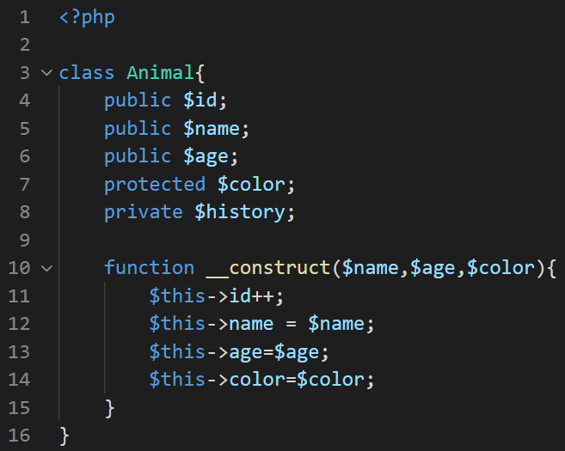
PHP Class

Slide 3
PHP Class

Slide 4
PHP Class

Slide 5
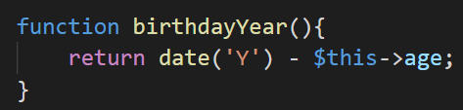

PHP Class Functions
Output

Slide 6
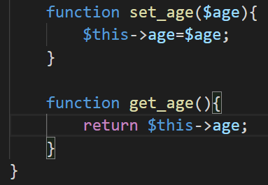
Getters & Setters

Slide 7
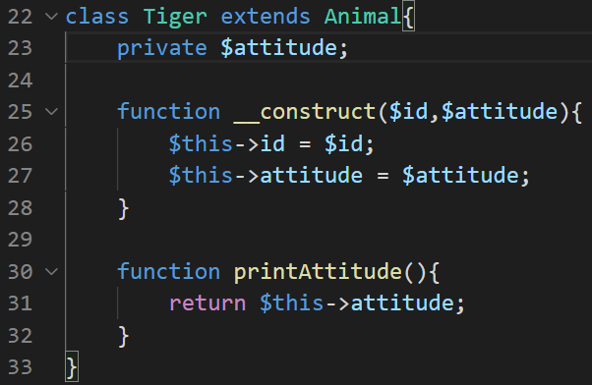
Inheritance

Slide 8
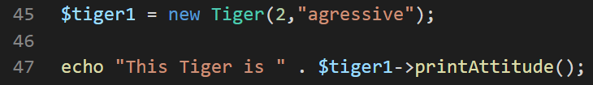
Inheritance
Output

Slide 9
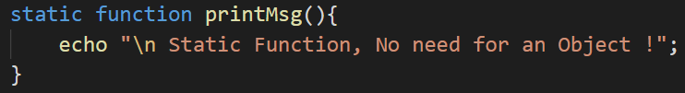

Static Keyword
Output

Slide 10
Thanks for watching

