Slide 1
Comparer<T> & EqualityComparer<T>
Quliyev Sabir
PYP

Slide 2
What is Comparer<T> ?
Provides a base class for implementations of the IComparer<T> generic interface.
Comparer<T> is an object-to-object comparer that allows us to compare objects recursively member by member.
var comparer = new Comparer <Person>();
comparer.Compare(person1, person2);

Slide 3
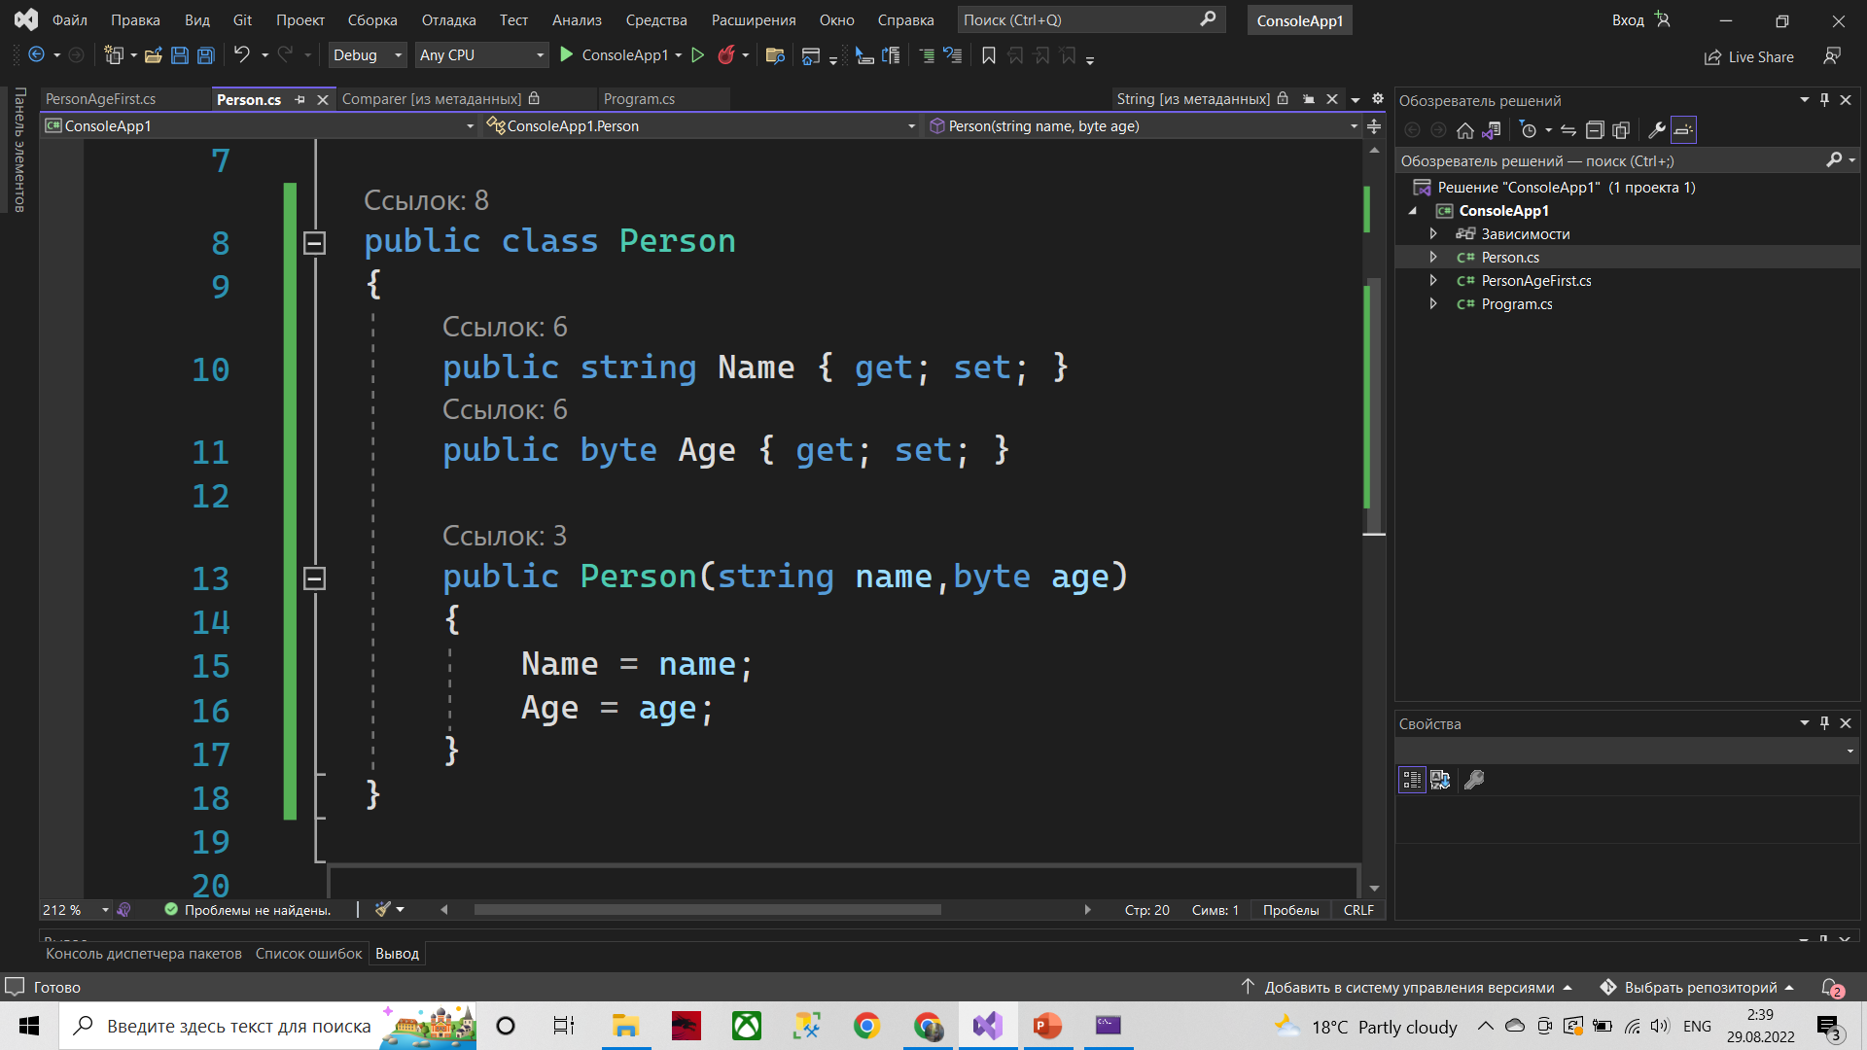
1: Create class

Slide 4
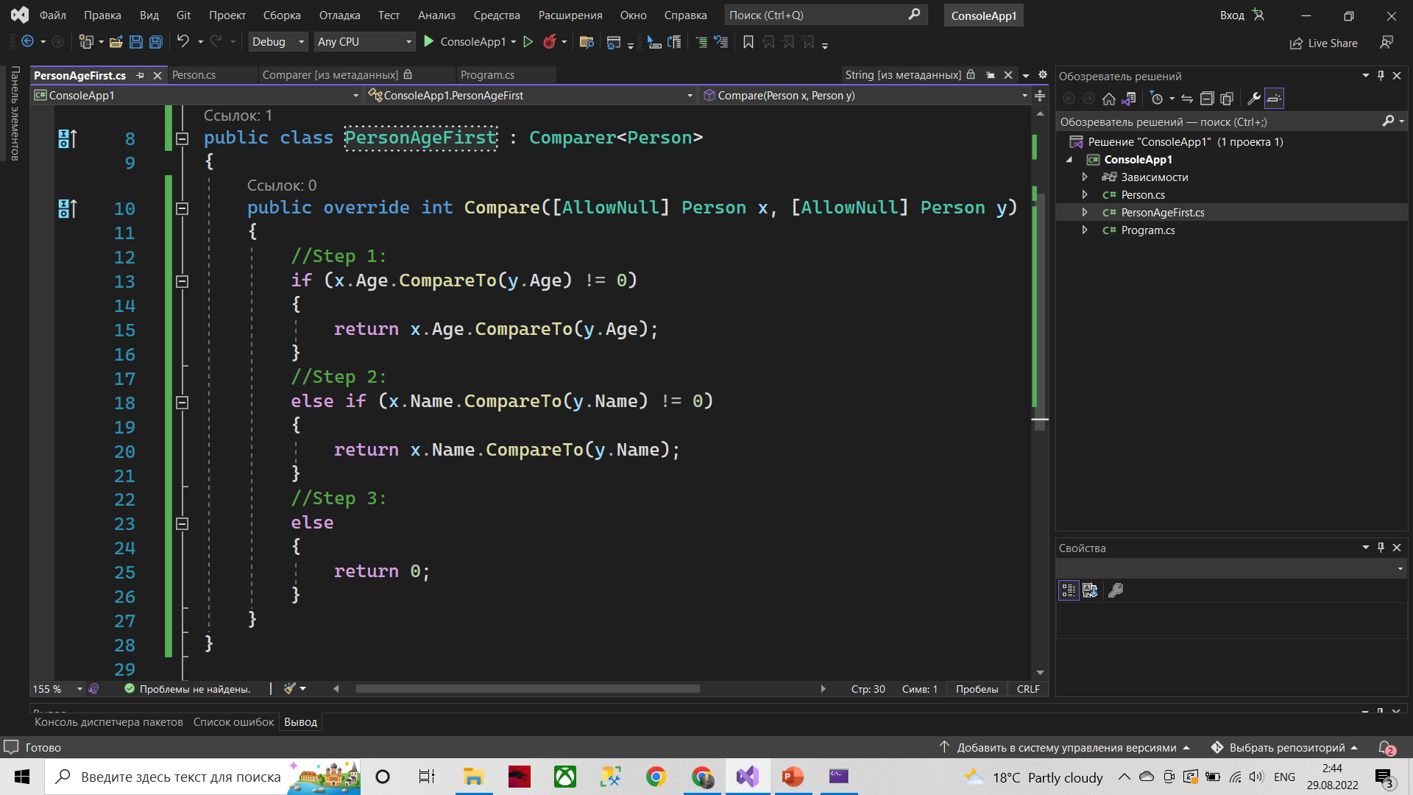
2: Create Custom Comparer<T>

Slide 5
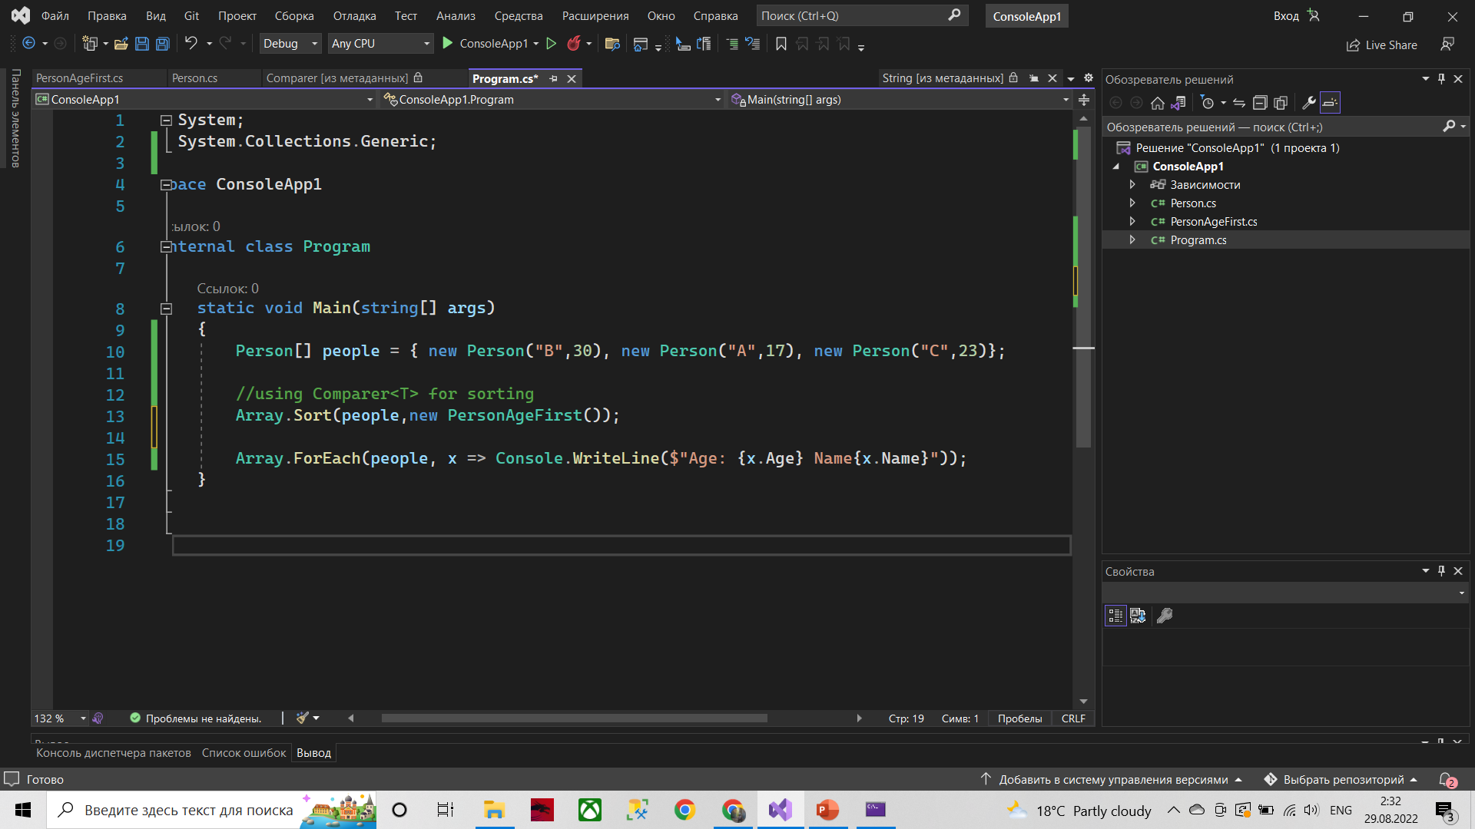
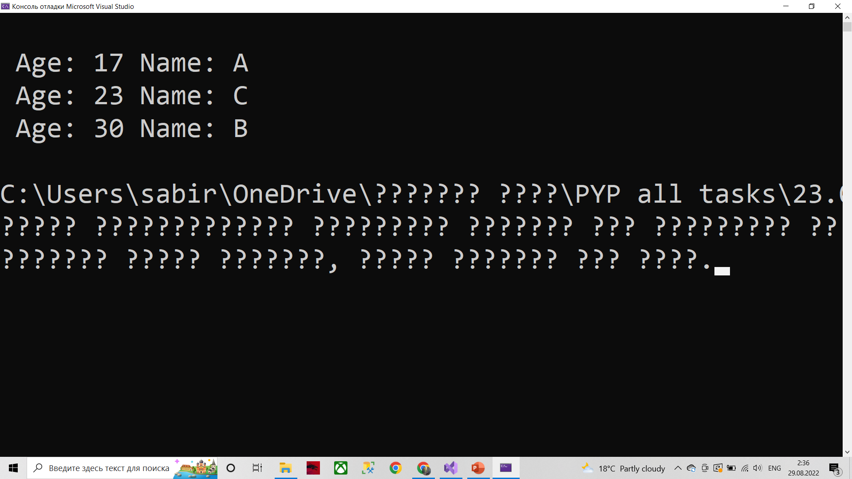
3: Sort by Comparer<T>

Slide 6
What is EqualityComparer<T>?
Provides a base class for implementations of the IEqualityComparer<T> generic interface.
Implements methods to support the comparison of objects for equality.
var equality = new Equality<Person>();
equality.Equals(person1, person2);

Slide 7
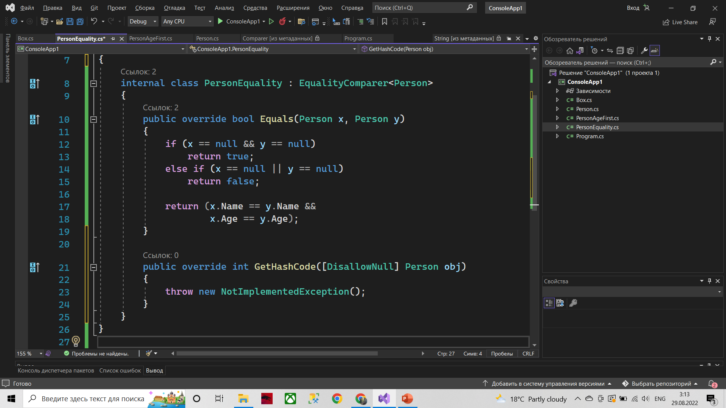
1: Create Custom EqualityComparer<T>

Slide 8
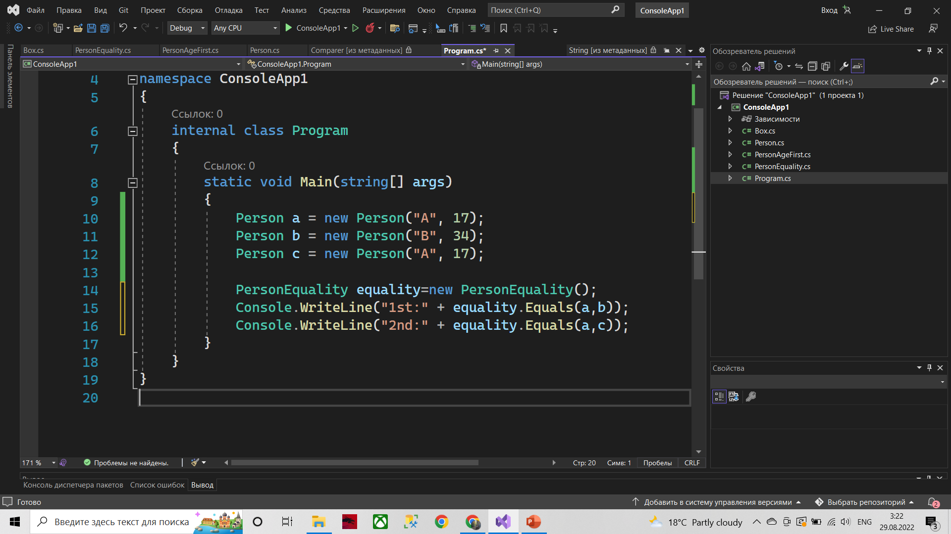
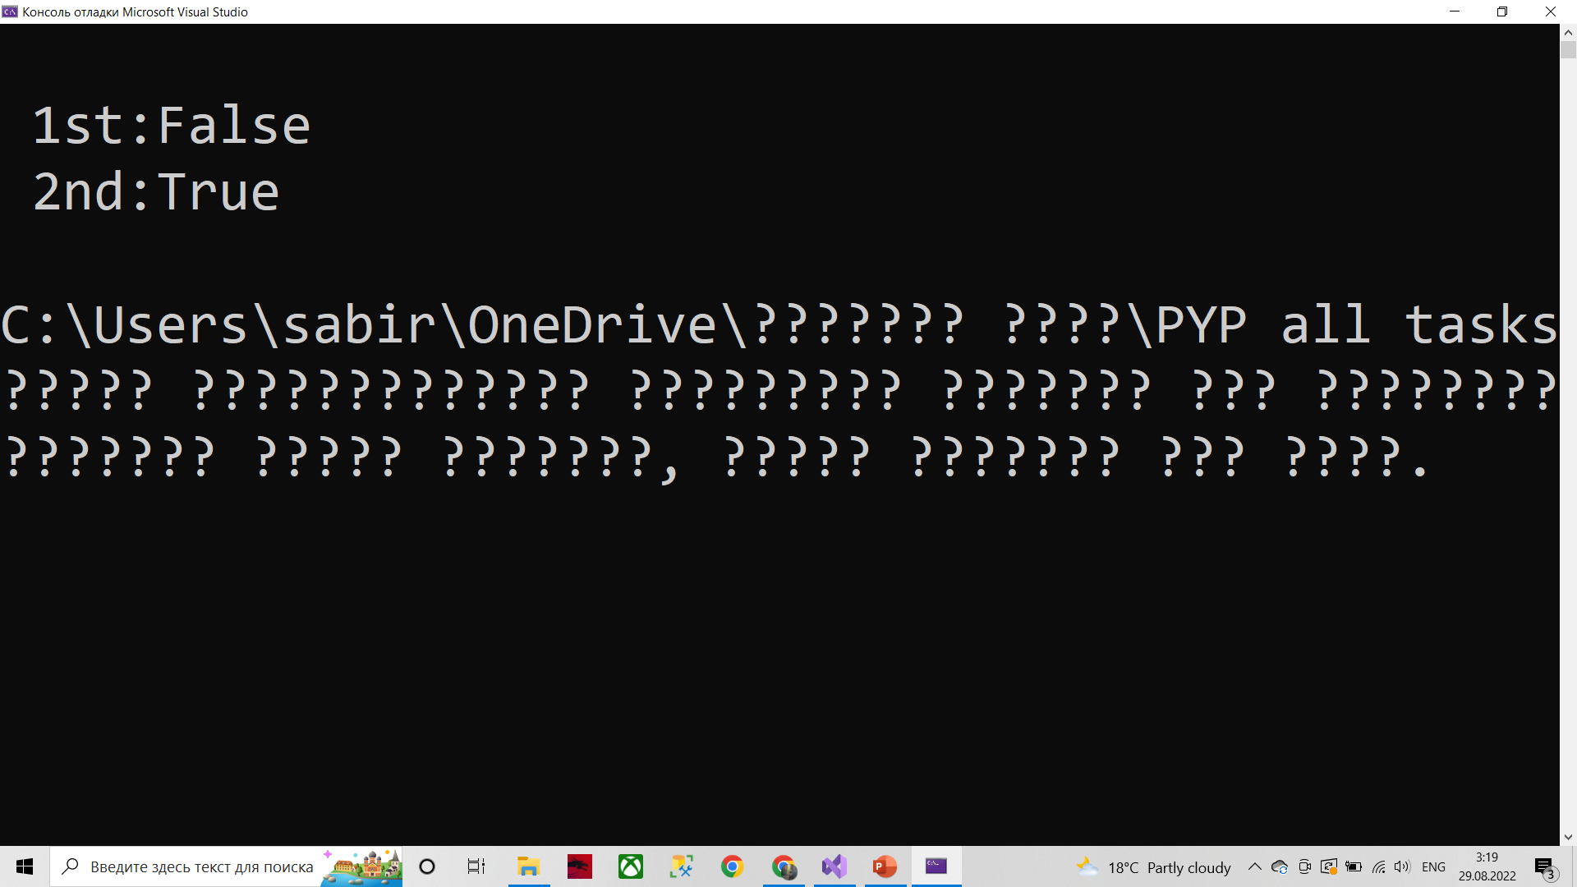
2: Check by EqualityComparer<T>

Slide 9
Thanks for Your Attention

