Slide 1
Sentiment Analysis Based on Hybrid Neural Network Techniques Using Binary Coordinate Ascent Algorithm
Authors: MOHAMMED HUSSEIN ABDALLA, JAFAR MAJIDPOUR, RAHELA AZIZ RASUL, ABDULRAHMAN A. ALSEWARI

Slide 2
Motivation
Understanding Sentiment Analysis:
Crucial for various applications such as product reviews, social media monitoring, and customer feedback.
Helps businesses and researchers extract meaningful insights from large volumes of text data, driving decisions and strategies.
Aim:
Improve sentiment analysis performance using advanced neural network techniques.
Develop a more accurate and efficient method to better understand and classify sentiments.

Slide 3
Problem Statement
Difficulty in Understanding Subtle Emotions:
Traditional models often miss subtle emotional cues, leading to oversimplified sentiment classifications.
Current Challenges:
Current methods often fail to accurately interpret complex sentiments due to the nuances and variations in language.
Sentiment nuances, sarcasm, and context are difficult for traditional models to interpret correctly.
Limitations in Handling Language Variability:
Diverse language usage, including slang and regional expressions, poses challenges for traditional models, impacting their performance.
Need for a robust, efficient, and accurate sentiment analysis method.

Slide 4
Objectives
Primary Goals:
Develop a hybrid neural network model.
Combine the strengths of different neural network architectures to enhance sentiment analysis.
Specific Objectives:
Improve sentiment prediction accuracy.
Achieve better accuracy by leveraging advanced techniques and integrating Binary Coordinate Ascent Algorithm(BCAA) which improve the performance of models by selecting the most relevant features from the dataset.
Optimize model efficiency and reduce computational overhead:
Make the model faster and less resource-intensive without compromising performance.

Slide 5
Contributions
Enhanced Sentiment Classification:
Achieves significant improvement in accuracy over traditional models.
Understands subtle emotions, context, and sarcasm better.
Practical Applications:
Adaptable to various data sources like social media and customer feedback.
Provides more reliable insights for better decision-making and strategy development.
Enhanced Performance:
Achieved higher accuracy and efficiency compared to traditional methods.
Demonstrated significant improvements in both prediction accuracy and processing speed.

Slide 6
Results
Experimental Setup:
Evaluated three deep learning architectures: RNN, CNN, and Hybrid CNN-RNN.
Applied fivefold cross-validation (CV) to standard sentiment analysis datasets.
Key Findings:
Accuracy Improvement:
Hybrid CNN-RNN with Binary Coordinate Ascent (BCA) achieved the highest accuracy of 97.91%.
Accuracy for the Hybrid CNN-RNN model on the Amazon Fine Food Reviews dataset improved from 74.28% to 97.91% after applying BCA.
Accuracy for CNN and RNN models using BCA was 96.24% and 96.21%, respectively.

Slide 7
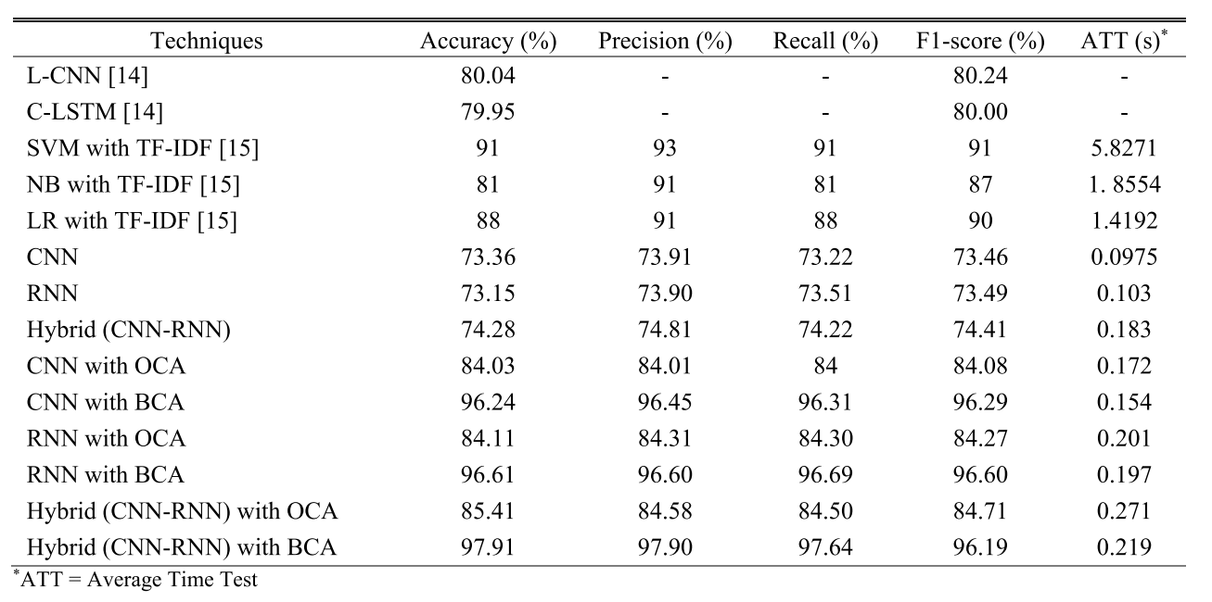
The performance of the proposed system in comparison with state-of-the-art techniques

Slide 8
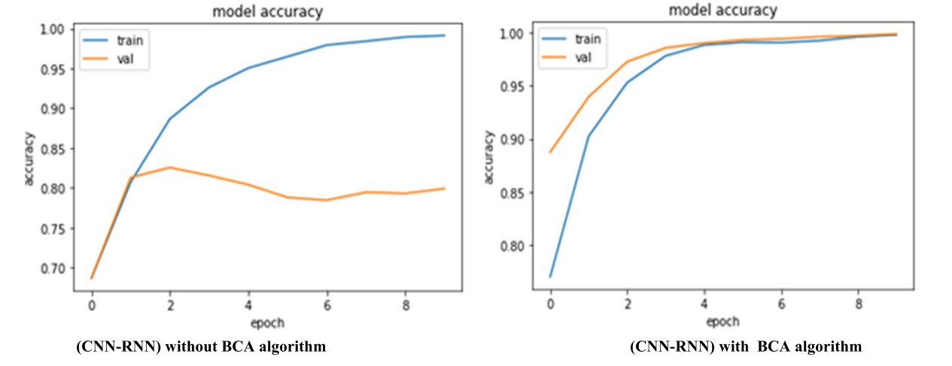
The accuracy of the models before and after the BCA, used the Amazon Fine Food Reviews dataset.

Slide 9
Critical Analysis
Strengths:
High Accuracy: Hybrid CNN-RNN with Binary Coordinate Ascent (BCA) achieved 97.91% accuracy.
Effective Feature Selection: Significant accuracy improvement with BCA and OCA methods.
Robust Evaluation: Comprehensive testing with RNN, CNN, and Hybrid CNN-RNN models and fivefold cross-validation.
Weaknesses:
Complexity: Hybrid model may be complex and resource-intensive.
Feature Dependency: Performance heavily relies on feature selection methods.
Dataset Limitation: Evaluation based on limited datasets may not represent all scenarios.
Future Work:
Model Simplification: Reduce complexity while maintaining accuracy.
Generalization: Test across diverse datasets and applications.
Advanced Features: Explore new feature selection methods for better performance.

Slide 10
References
S. Khanna, B. Tiwari, P. Das, and A. K. Das, ‘‘A comparative study on various text classification methods,’’ in Proc. Comput. Intell. Pattern Recognit. (CIPR). Singapore: Springer, 2020, pp. 539–549, doi: 10.1007/978-981- 15-2449-3_46.
Krizhevsky, I. Sutskever, and G. E. Hinton, ‘‘ImageNet classification with deep convolutional neural networks,’’ Commun. ACM, vol. 60, no. 6, pp. 84–90, May 2017.
A. Graves, A.-R. Mohamed, and G. Hinton, ‘‘Speech recognition with deep recurrent neural networks,’’ in Proc. IEEE Int. Conf. Acoust., Speech Signal Process., May 2013, pp. 6645–6649, doi: 10.1109/ICASSP.2013.6638947.
M. Wazery, H. S. Mohammed, and E. H. Houssein, ‘‘Twitter sentiment analysis using deep neural network,’’ in Proc. 14th Int. Comput. Eng. Conf. (ICENCO), Dec. 2018, pp. 177–182, doi: 10.1109/ICENCO.2018.8636119.

