Slide 1
EET 226: INFORMATION TECHNOLOGY IN ENGINEERING
-
DATABASE MANAGEMENT SYSTEM DESIGN WITH MICROSOFT ACCESS
By
Engr. OLANIYI O. M. (PhD)
DEPARTMENT OF COMPUTER ENGINEERING
FEDERAL UNIVERSITY OF TECHNOLOGY, MINNA, NIGER STATE, NIGERIA
June 2017
1

Slide 2
Introduction
Microsoft Access is a relational database management system (RDBMS)
Relational database design eliminates unnecessary data duplications. RDMS is easier to maintain
Other PC-based RDMBS include:
MS FoxPro
Borland dBase
“Industrial-strength” RDBMS include:
Oracle
MS SQL Server
IBM DB2
Informix

Slide 3
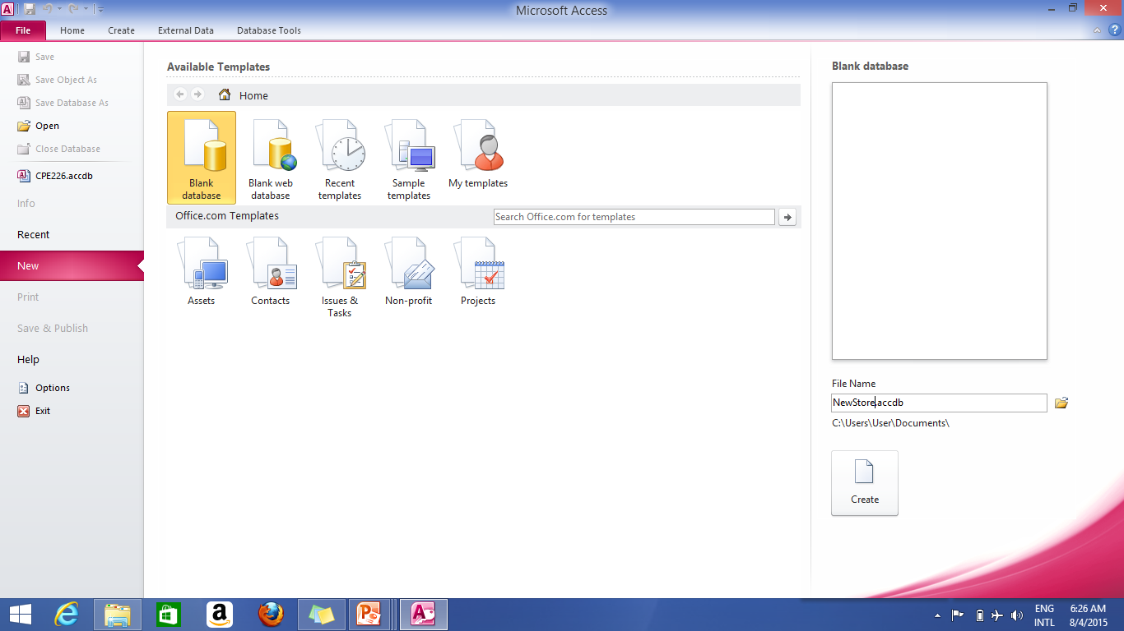
Getting Started
Open MS Access (Microsoft Office 2007/2010 heading)
Open a New Database
My_eStore

Slide 4
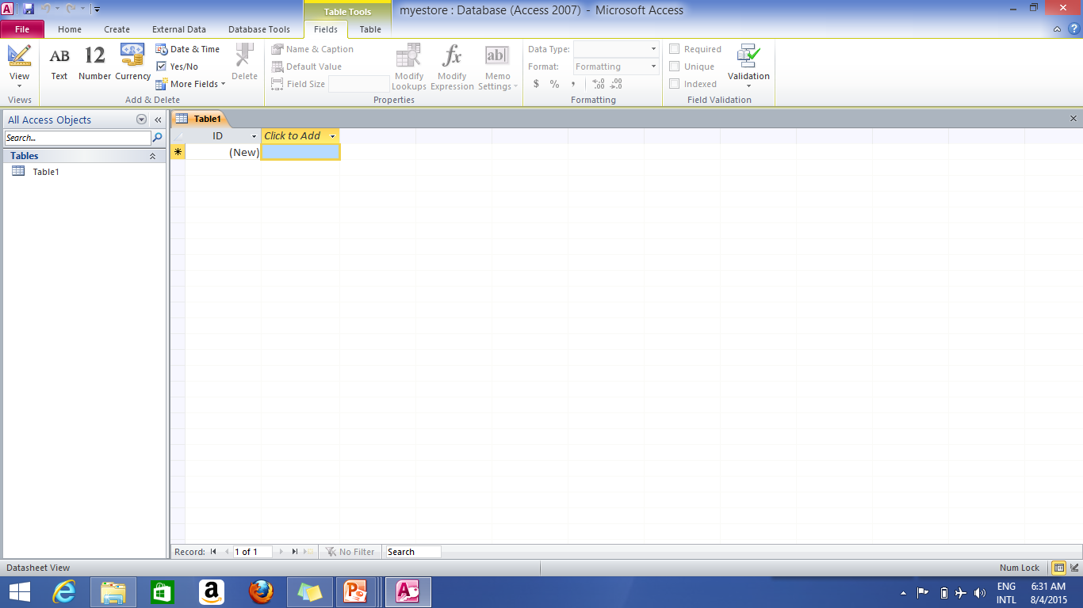
“Mye_store” Database
Blank table
Figure 2: Blank Table1 for mye_store Database

Slide 5
MS Access Functionality
Microsoft Access contains:
Tables
Store data
Forms
Make data entry into the table and display from table easier
Reports
Provides information from database to users in easy-to-understand format
Queries
Manipulate data in the tables (in the database)

Slide 6
Recall that…
Database contains :
Tables
Representation of how entities are arranged in a database
Each row is a record and each column a field.
Fields
Individual pieces of information
Record
Collection of related fields within one entity

Slide 7
Recall that…
Database Design involves:
Requirements Analysis
Gathering requirements for the problem.
Data Structure
Clarification of data types of the tables in the database
Creation of Tables
Creation of Tables and entering of tables
Updating of Records in the Tables
Creating Database Reports
Generation of reports of data available in the database

Slide 8
“Mye_shop” Business Example
Problem:
Supposing NUESA president has appointed the class representative as the business manager of his cabinet student-décor shop.
The décor-shop is expected to sell items such as: NUESA branded pen, Lecture Notes, Rulers, Plane sheets, Files, Pencil, Drawing board, Drinks, and Snacks. The president wishes to track items in the décor_shop inventory, sales and student information.
Develop a simple MS Access database that will track the appropriate information

Slide 9
Solution:
Requirement Analysis (RA):
Identification of possible tables of the proposed student-décor shop:
a) Product Table
b) Sale Table
c) Student Table
Creation of Tables:
The following tables are to be created for RA process:
a) Product Table contains the:
Product number, product name, product description, product price, and product at hand.
b) Sale Table contains the:
Sale number, sale date, the product sold and the buyer.
c) Student Table contains the:
Student number, student last name, Student first name,
phone number, address and notes about student preferences (notify if a new products are available in NUESA student- décor shop, etc.)

Slide 10
Solution…
Data Structure: Clarification of data structure in identified tables:
Product Table:
S/N | Field Name | Data Type | Description
1 | ProductNumber | Text | Uniquely identifies each product in the inventory
2 | ProductName | Text | Name of each product
3 | ProductDescription | Memo | Description of each product
4 | ProductPrice | Number | The unit price of each price
5 | ProductatHand | Number | The totalnumber of Unit remaining in the inventory

Slide 11
Solution…
Sales Table
Student Table
S/N | Field Name | Data Type | Description
1 | Sales_ID | Text | Unique code that identifies a specific sale
2 | Sales_Date | Date | Date of a specific sale
3 | Sold_Product | Text | Product sold
4 | Sales_Price | Number | Sales price
5 | Sales_Subject | Text | The student
S/N | Field Name | Data Type | Description
1 | Student_Num | Number | Unique number that identifies a specific student
2 | Student_lastname | Text | LastName of the student
3 | Student_FirstName | Text | FirstName of the student
4 | Student_PhoneNumber | Number | PhoneNumber of The student
5 | Student_Address | Text | Address of the student
6 | Student Preference | Memo | Preference of the student

Slide 12
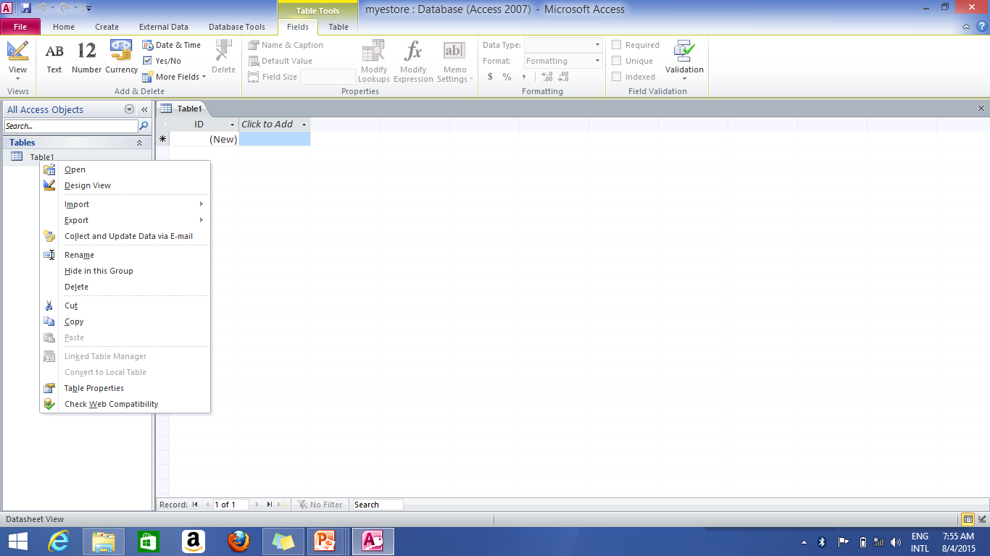
Creating Tables in MS Access ’07
Change Figure 2 to Design as follows:
Figure 3: Blank Table1 for mye_store Database in design view

Slide 13
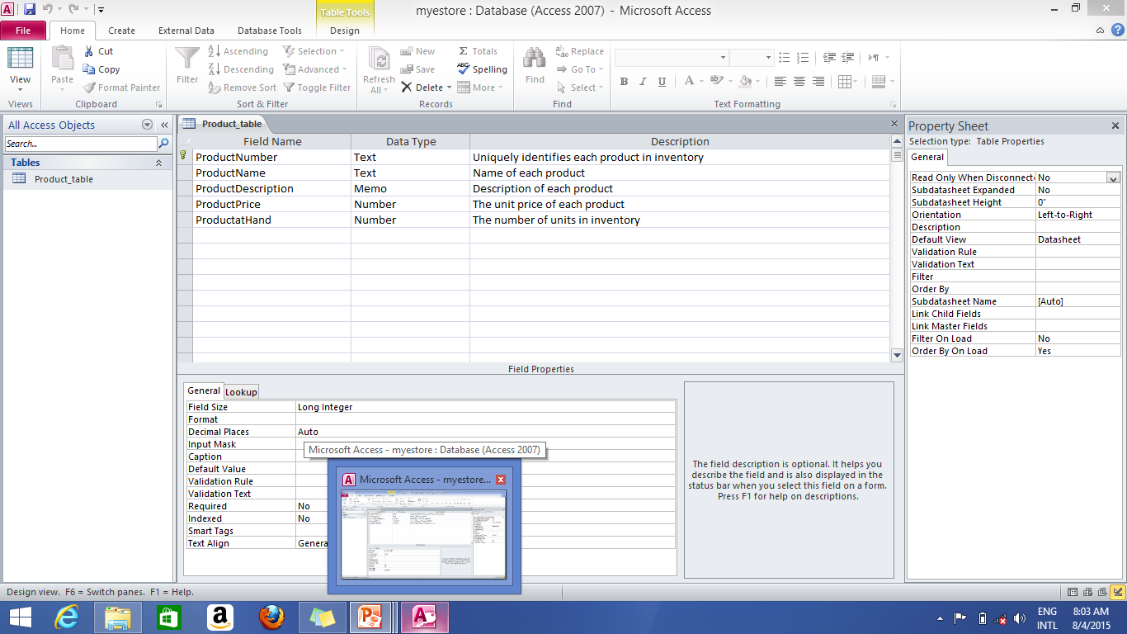
Product Table Creation…
Create Product table in MSaccess as Shown:
Fields in Product Table
Figure 4: Sales Table for mye_store Database in design view

Slide 14
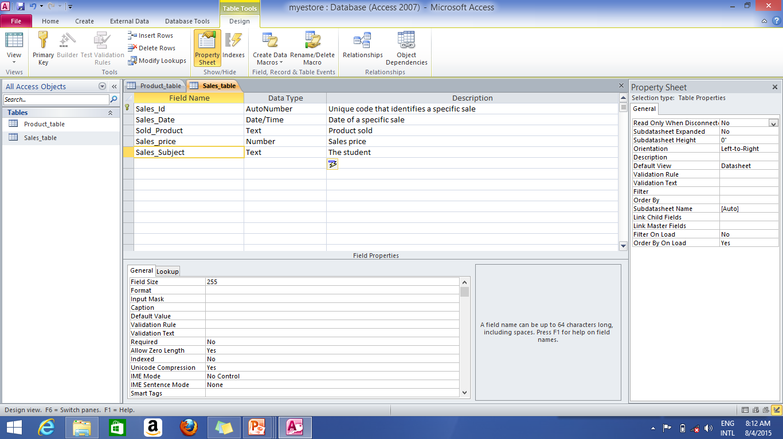
Sales Table Creation…
Create Sales table in MSaccess as Shown:
Fields in Sales Table
Figure 5: Product Table for mye_store Database in design view

Slide 15
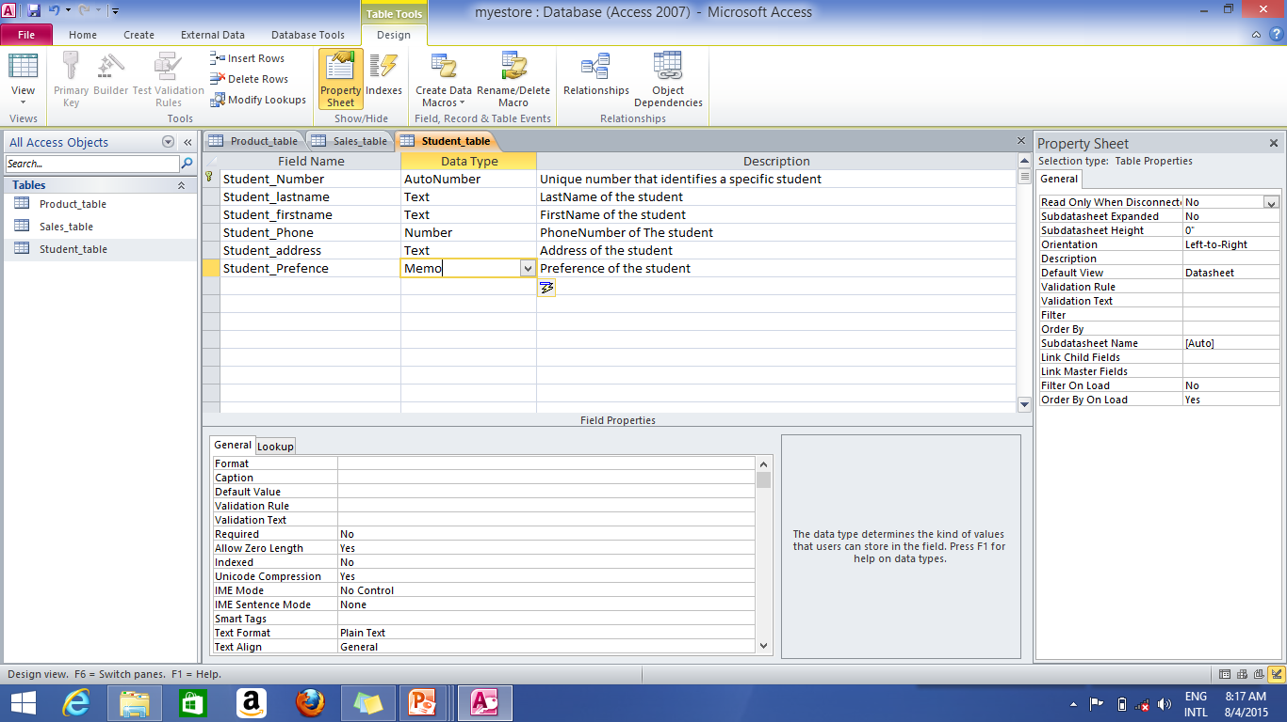
Student Table Creation…
Create the Student table in MSaccess as Shown
Fields in in Student Table
Figure 6: Student Table for mye_store Database in design view

Slide 16
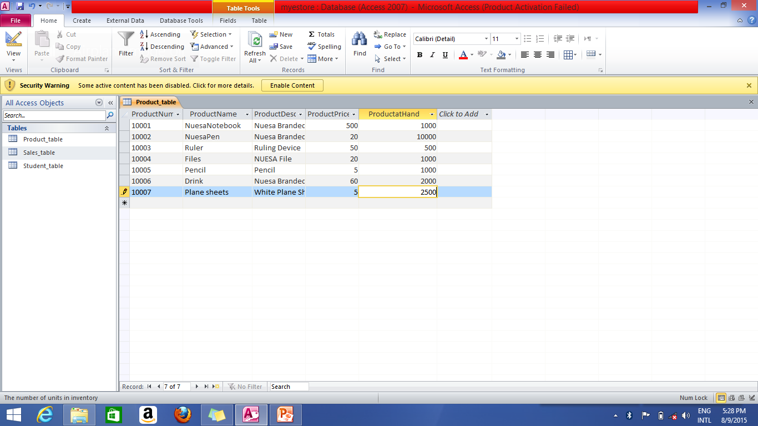
Data Entry into Tables…
Enter the following data into product table as shown:
Records in Product Table

Slide 17
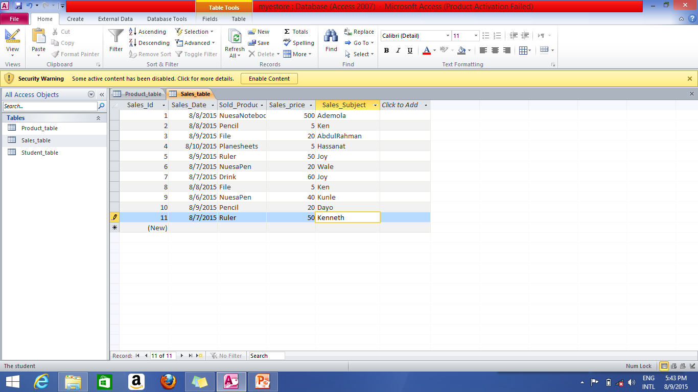
Data Entry into Tables…
Enter the following data into Sales table as shown:
Records in Sales Table

Slide 18
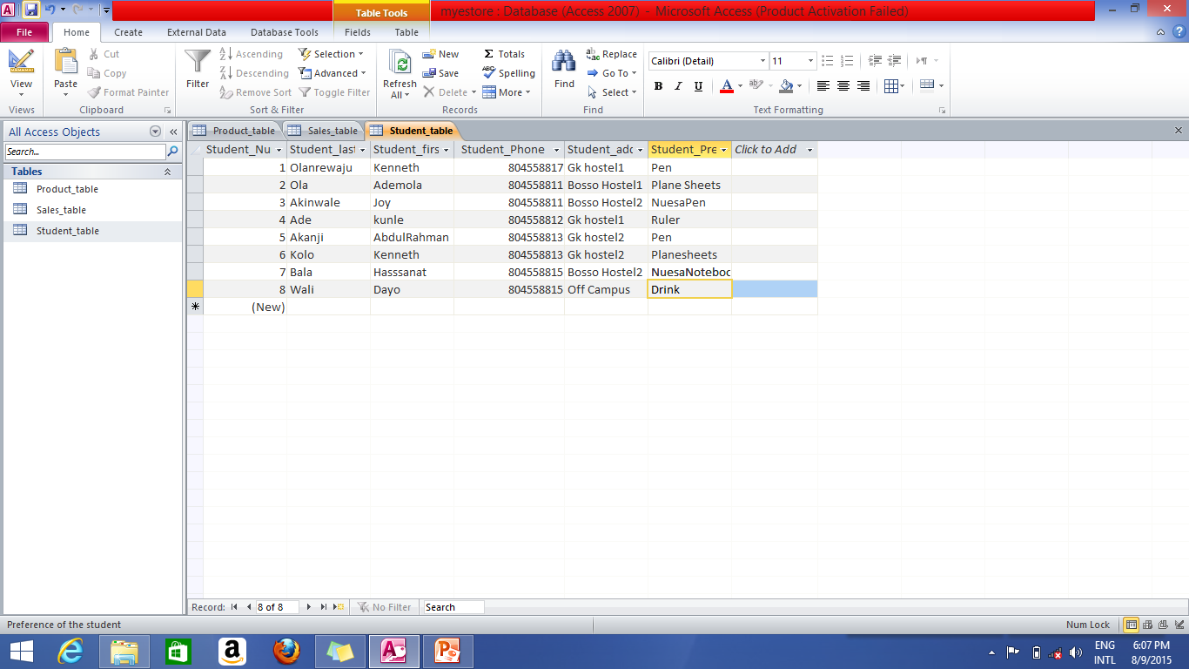
Data Entry into Tables…
Enter the following data into Student’s table as shown:
Records in Student Table

Slide 19
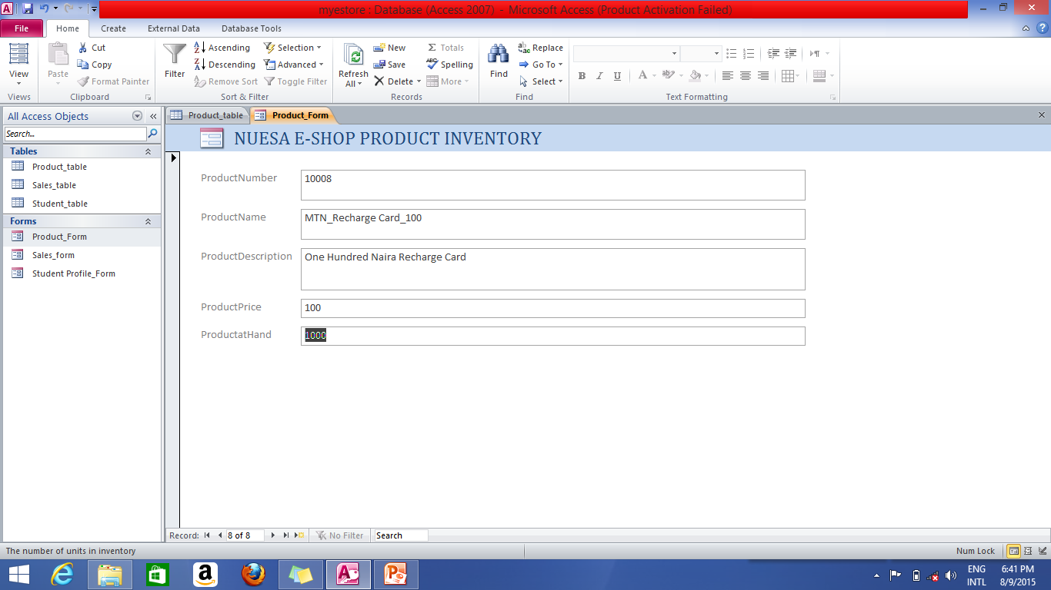
Updating of Records
Update data in the Product table using form as shown :
Updating data in Product Inventory

Slide 20
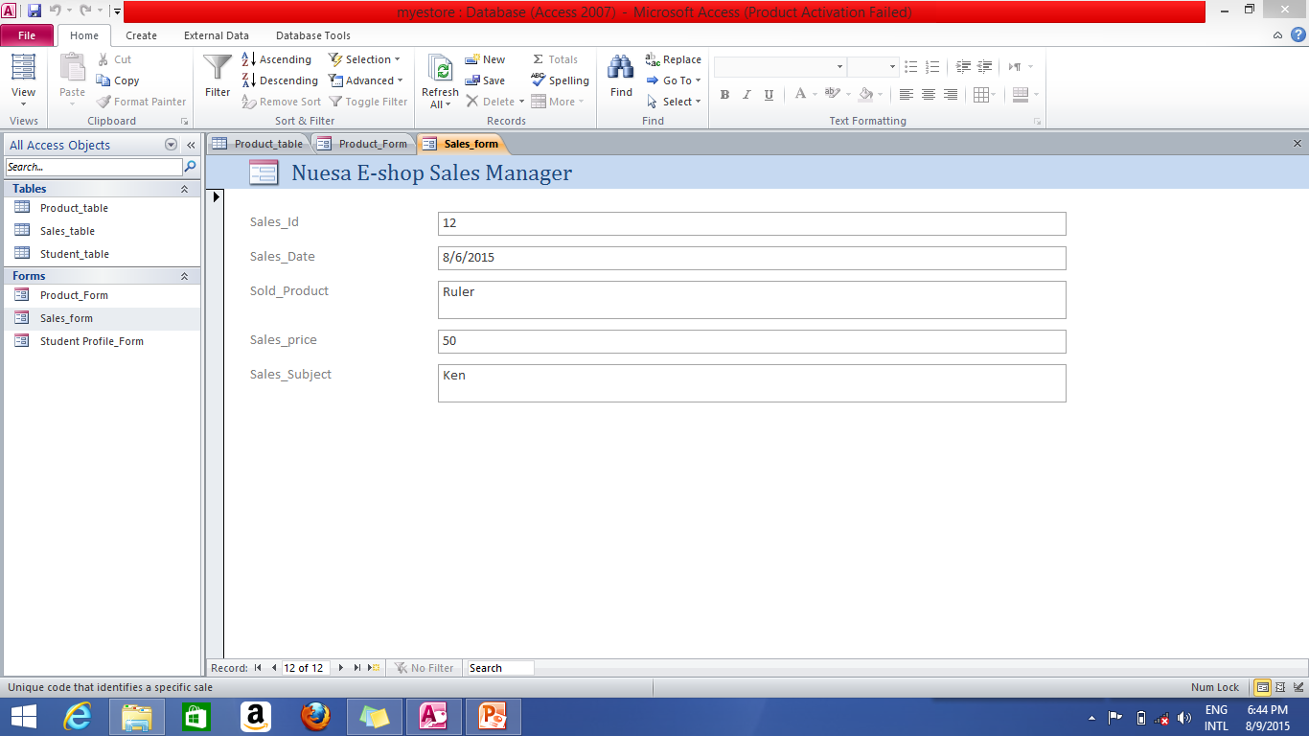
Updating of Records…
Update data in the Sales table using form as shown :
Updating data in Sales Inventory

Slide 21
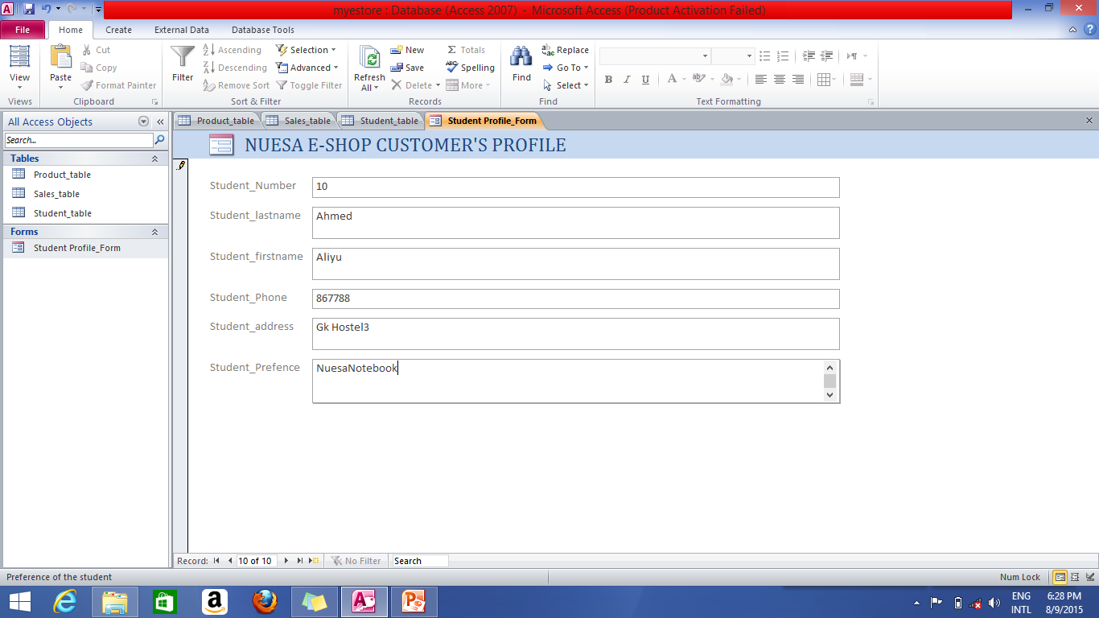
Updating of Records…
Update data in the Student table using form as shown :
Updating data in Student table

Slide 22
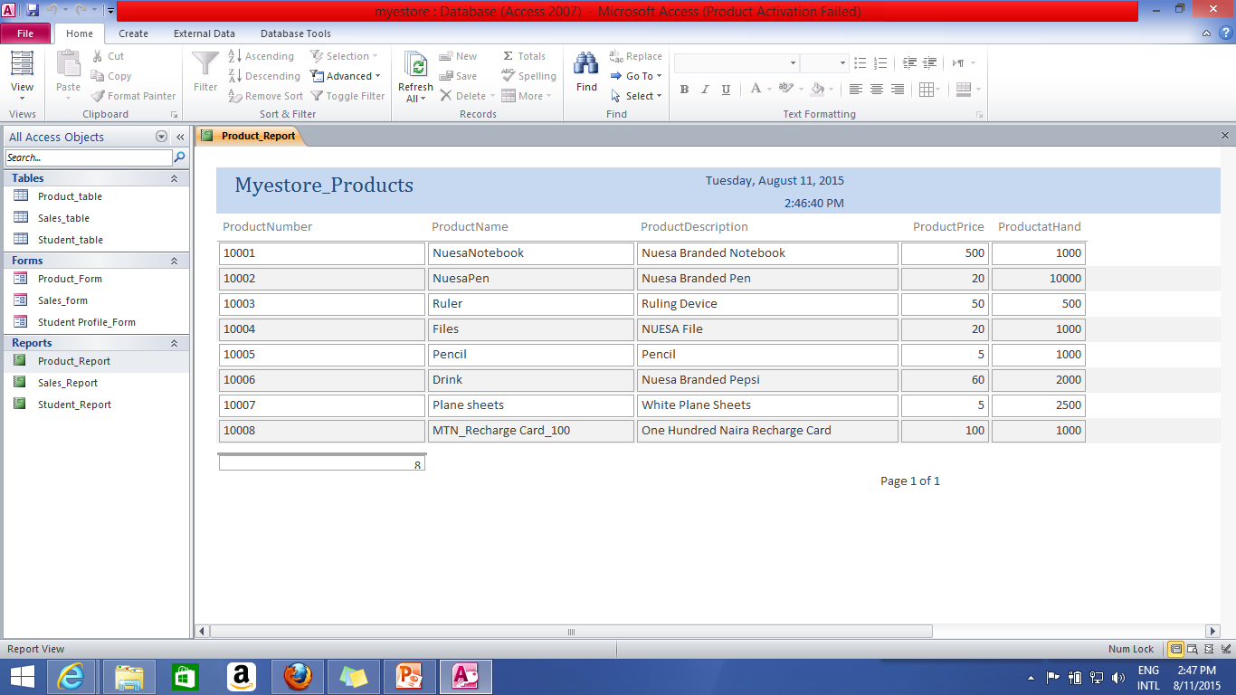
Reports Generation…
Generate Report for Products from Product Table as:
Generating Reports in Product Table

Slide 23
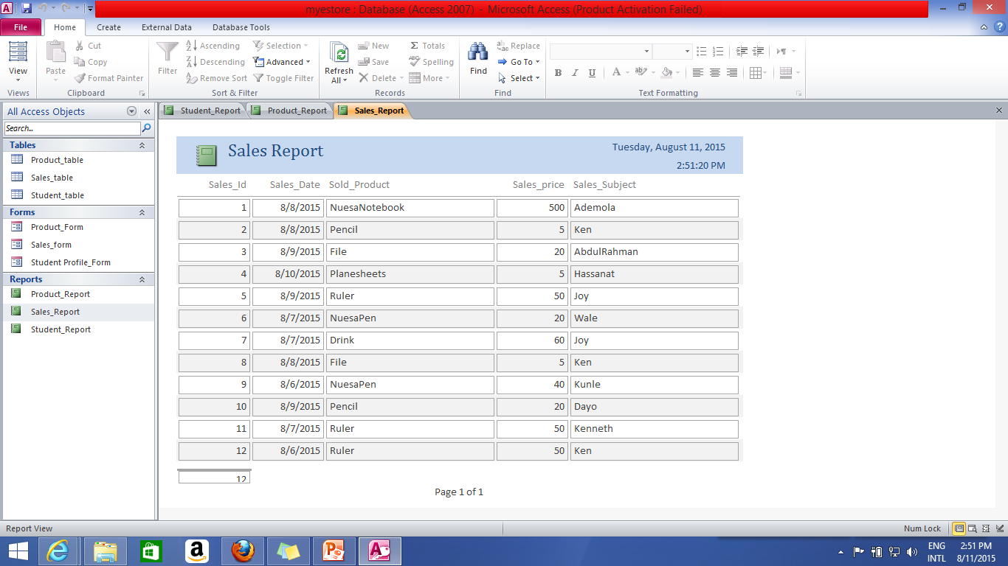
Reports Generation…
Generate Report for Sales from Sales table as:
Generating Reports in Product Table

Slide 24
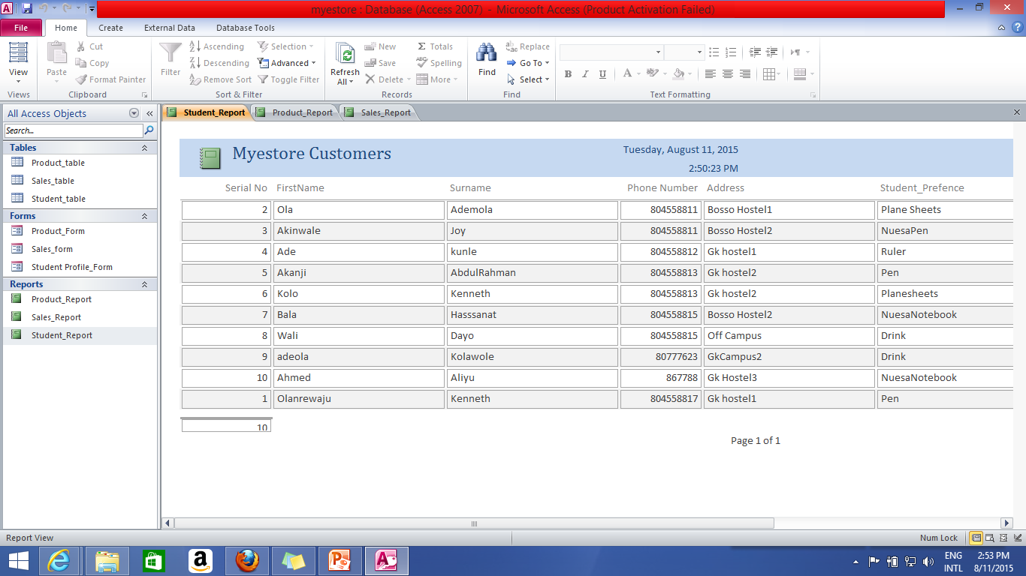
Reports Generation…
Generate Report for Customers from Student table as:
Generating Reports in Product Table

Slide 25
What Next?
“This is not the end. It is not even the beginning of the end.
But it is, perhaps, the end of the beginning”
-Sir Winston Churchill (1874-1965),
former British Prime Minister

Slide 26
