Slide 1

Heap Sort: An Efficient Sorting Algorithm
Heap sort is a powerful sorting algorithm that utilizes the heap data structure to efficiently sort a collection of elements. By building a max heap and repeatedly extracting the maximum element, the algorithm can sort the input in place, making it a popular choice for large datasets.
Notes:
1

Slide 2
Understanding the Heap Data Structure
Complete Binary Tree
Efficient Operations
Array Representation
A heap is a specialized tree-based data structure that satisfies the heap property: the value of each node is greater than or equal to (or less than or equal to) the values of its children.
Heaps support efficient implementation of the priority queue ADT and provide fast operations like insert, extract-min (or extract-max), and heapify.
Heaps can be conveniently represented using an array, with the root at index 0 and the children of a node at indices 2i+1 and 2i+2.
Notes:
2

Slide 3
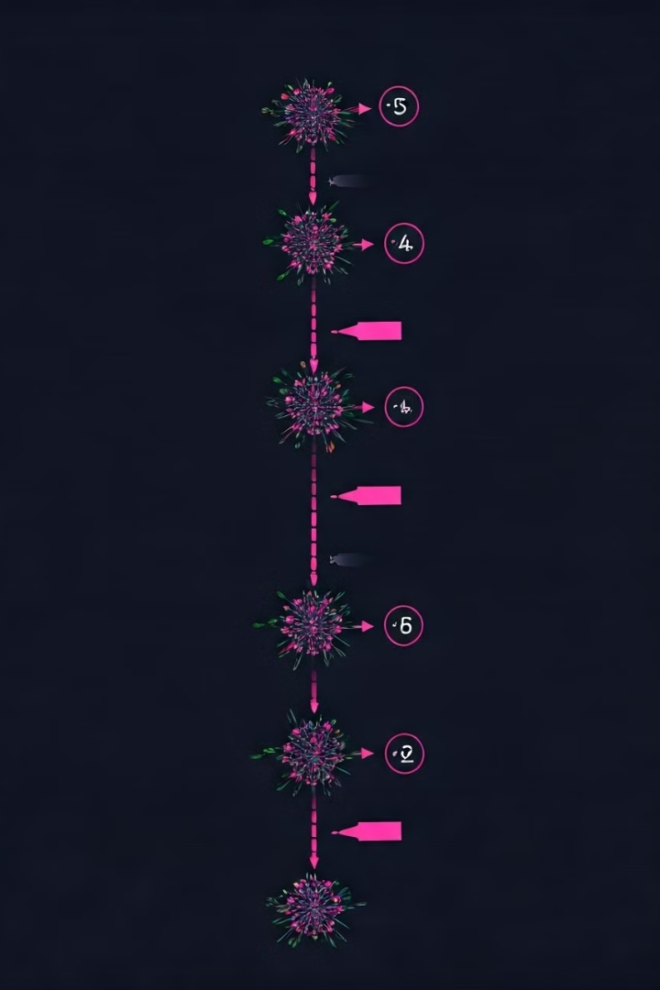
Building the Max Heap
1
Heapify
The heapify operation is used to build a max heap from an unordered array. It rearranges the elements to satisfy the heap property.
2
Sift-up
The sift-up operation is used to maintain the heap property when inserting a new element. It moves the element up the heap until the heap property is satisfied.
3
Sift-down
The sift-down operation is used to maintain the heap property when extracting the maximum element. It moves the root element down the heap until the heap property is satisfied.
Notes:
3

Slide 4





The Heap Sort Algorithm
Build Max Heap
Extract Max
Repeat
Construct a max heap from the input array using the heapify operation.
Repeatedly extract the maximum element from the heap and append it to the sorted array.
Continue extracting elements until the heap is empty, resulting in a sorted array.
Notes:
4

Slide 5

Time Complexity and Applications of Heap Sort
1
Time Complexity
2
In-place Sorting
3
Applications
Heap sort has a time complexity of O(n log n), making it an efficient sorting algorithm for large datasets.
Heap sort can be implemented as an in-place algorithm, requiring only a constant amount of additional space.
Heap sort is widely used in various domains, such as task scheduling, priority queues, and external sorting of large datasets.
Notes:
5

